Slide 1

COCHISE LINUX USER GROUP

Slide 2
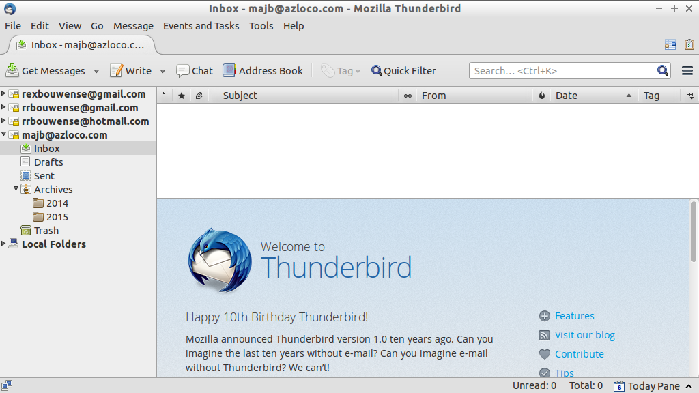
THUNDERBIRD MAIL

Slide 3
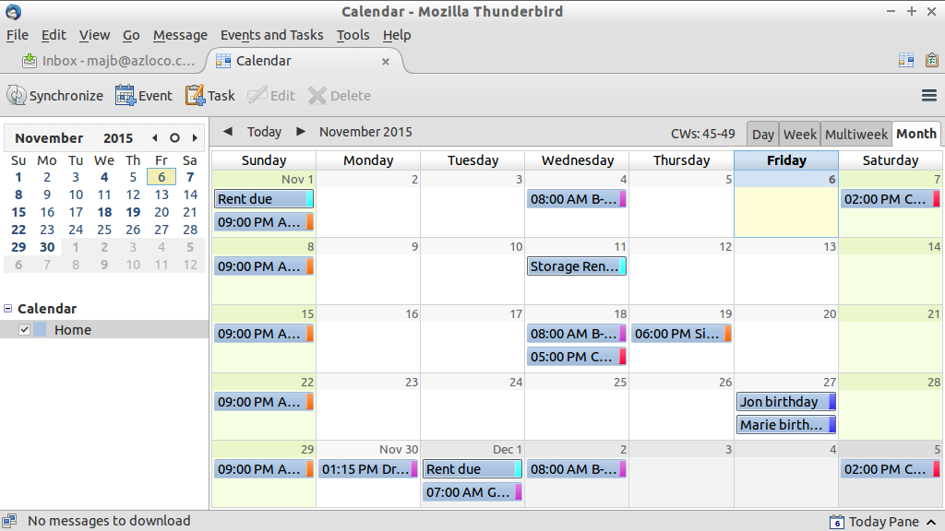
THUNDERBIRD CALENDAR

Slide 4
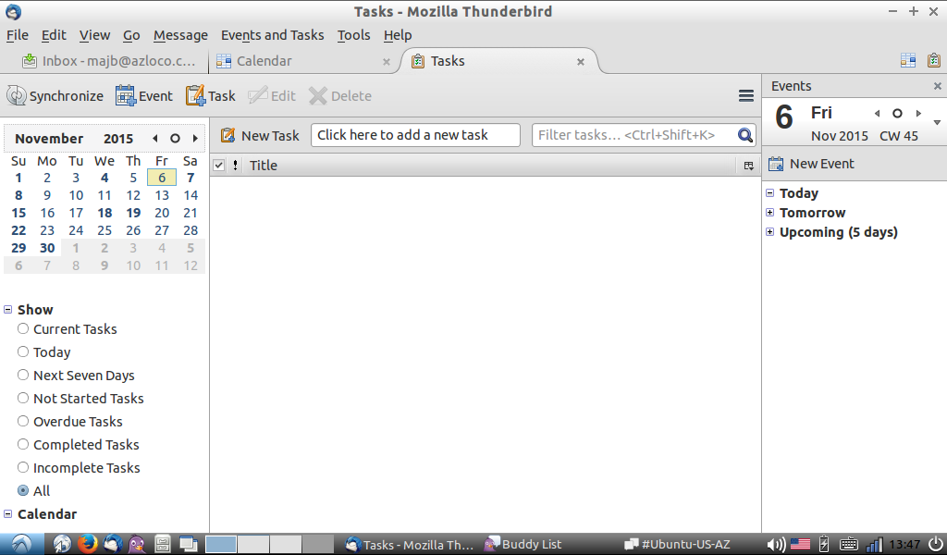
THUNDERBIRD TASKS

Slide 5
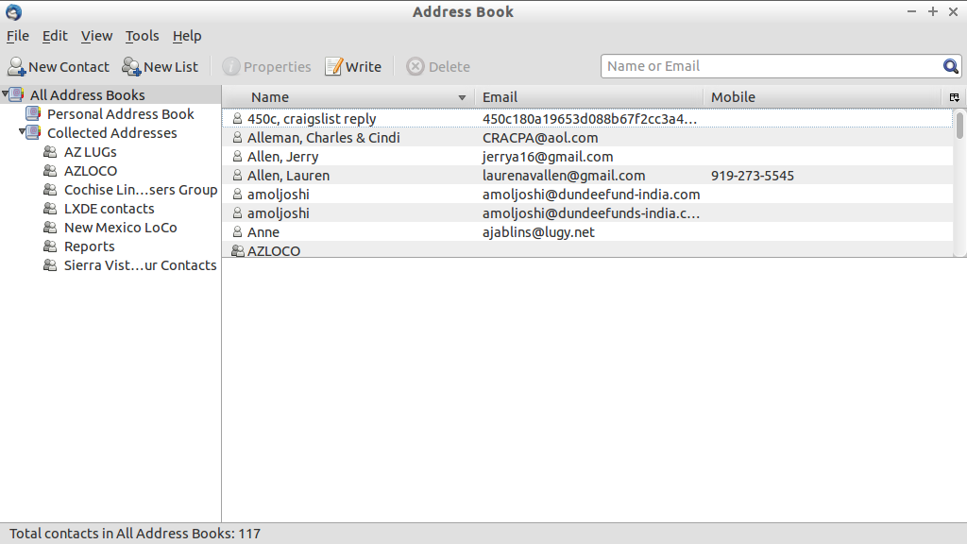
THUNDERBIRD ADDRESS BOOK

Slide 6
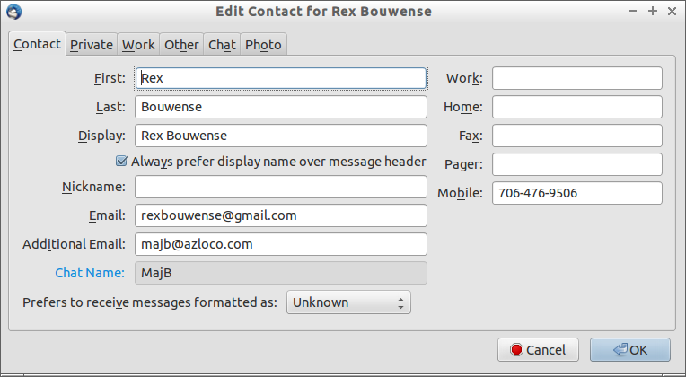
THUNDERBIRD CONTACT CARD

