Slide 1

Cochise Linux User group

Slide 2

Ubuntu

Slide 3
Ubuntu
Initial Release April 2004
Founder Mark Shuttleworth
Release Cycle
Only 64 bit versions
LTS versions supported for 5 years

Slide 4
Ubuntu Install Requirements
2GHz dual core processor
2 GB RAM (4 GB RAM recommended)
25 GB hard drive

Slide 5
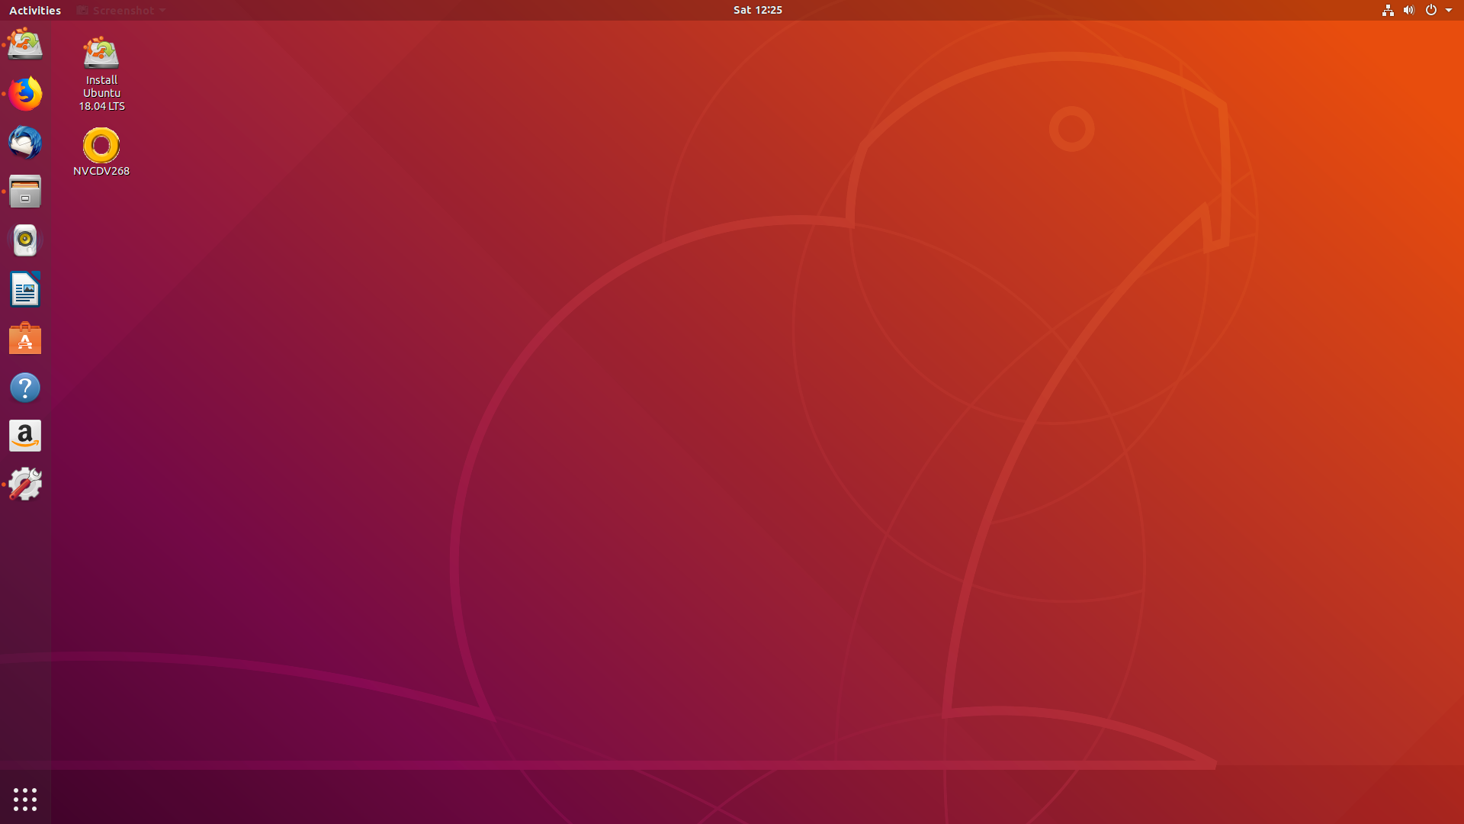
Ubuntu Desktop

Slide 6
Ubuntu Default Applications
File Manager – Nautilus
Window Manager – Mutter
Web Browser – FireFox
Email Client – Thunderbird
Text Editor – Gedit
Video Player – Totem
Music Player – Rhythmbox
Terminal – Gnome Terminal
Office Suite - LibreOffice

Slide 7
Ubuntu Flavors
Kubuntu
Xubuntu
Lubuntu
Ubuntu Mate
Ubuntu Budgie

Slide 8

Kubuntu

Slide 9
Kubuntu
Ubuntu with KDE
First released 8 April 2005
Release Schedule same as Ubuntu
32 and 64 bit releases
LTS versions supported for 3 years

Slide 10
Kubuntu Install Requirements
1 GHz processor
512 MB RAM (2 GB RAM recommended)
5 GB hard drive (10 GB recommended)

Slide 11
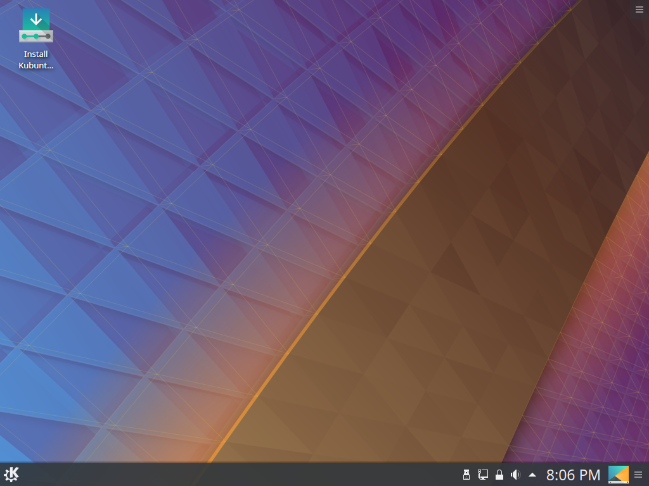
Kubuntu Desktop

Slide 12
Kubuntu Default Applications
File Manager – Dolphin
Window Manager – Kwin
Web Browser – FireFox
Email Client – Kmail
Text Editor – Kate
Video Player – VLC
Music Player – Cantata
Terminal – Konsole
Office Suite – LibreOffice

Slide 13

Xubuntu

Slide 14
Xubuntu
Ubuntu with xfce
First Released 01 June 2006
Release Schedule same as Ubuntu
32 and 64 bit releases
LTS versions supported for 3 years

Slide 15
Xubuntu Install Requirements
700 MHz processor
(dual core processor recommended)
512 MB RAM (1-2+ GB RAM recommended)
5 GB hard drive (8-16+ GB recommended)

Slide 16
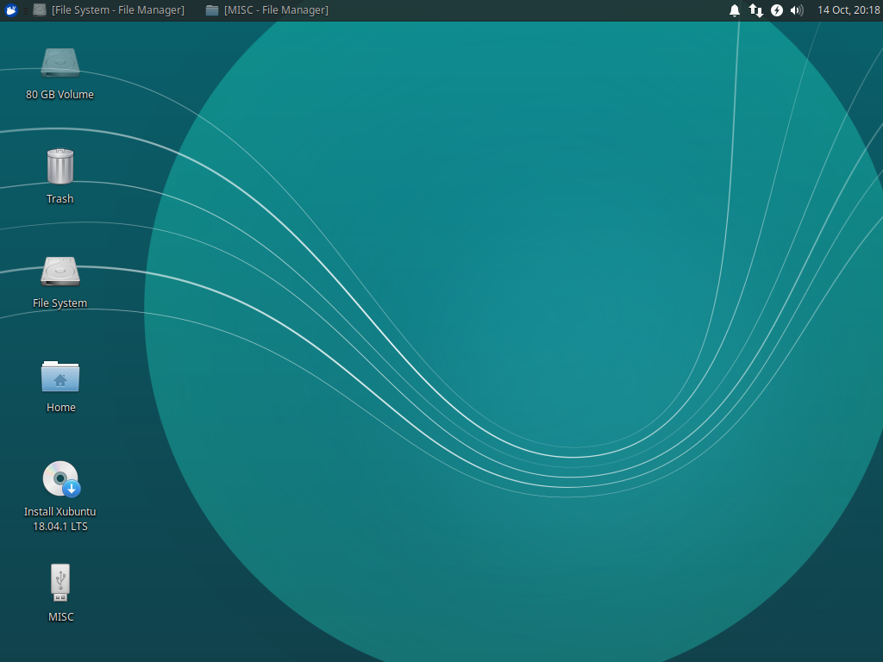
Xubuntu Desktop

Slide 17
Xubuntu Default Applications
File Manager – Thunar
Window Manager – xfwm4
Web Browser – FireFox
Email Client – Thunderbird
Text Editor – Mousepad
Video Player – Parole Media Player
Music Player -
Terminal – xfce4 Terminal
Office Suite - LibreOffice

Slide 18

Lubuntu

Slide 19
Lubuntu
Ubuntu with LXDE
First released 2 May 2010 (not official until 11.10)
Release schedule same as Ubuntu
32 and 64 bit versions
LTS versions supported for 3 years

Slide 20
Lubuntu Install Requirements
Pentium II
128 MB RAM

Slide 21
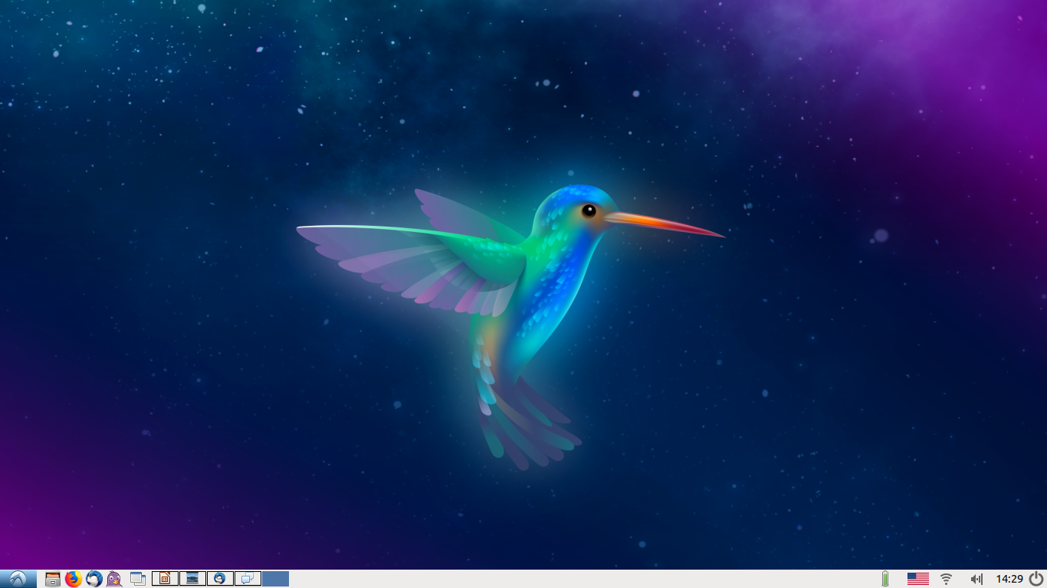
Lubuntu Desktop

Slide 22
Lubuntu Default Applications
File manager – PCManFM
Window manager – Openbox
Web Browser – FireFox
Email Client – Sulpheed
Text Editor – Leafpad
Video Player – Gnome MPV
Music Player – Audacious
Terminal – LX Terminal
Office Suite – Abiword & Gnumeric

Slide 23

Ubuntu Mate

Slide 24
Ubuntu Mate
Ubuntu with MATE desktop
First released 23 October 2014
Release schedule the same as Ubuntu
32 and 64 bit versions until 18.10
LTS versions supported for 3 years

Slide 25
Ubuntu Mate Install Requirements
Pentium III 75 MHz processor
(dual core 1.6 GHz recommended)
512 RAM (2 GB RAM recommended)
8 GB hard drive (16 GB recommended)

Slide 26
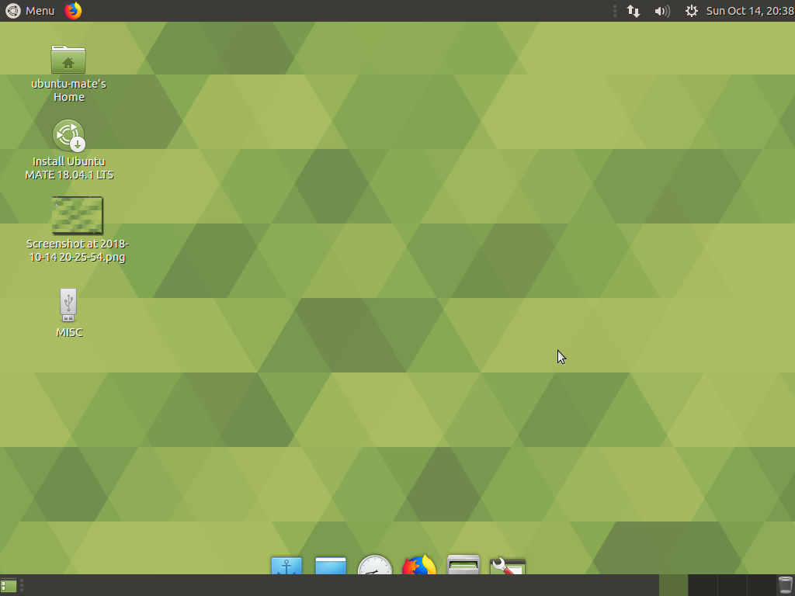
Ubuntu Mate Desktop

Slide 27
Ubuntu Mate Default Applications
File Manager – Caja
Window Manager – Marco
Web Browser – FireFox
Email Client – Thunderbird
Text Editor – Pluma
Video Player – VLC
Music Player – Rhythmbox
Terminal – MATE Terminal
OfficeSuite - LibreOffice

Slide 28

Ubuntu Budgie

Slide 29
Ubuntu Budgie
Ubuntu with Budgie desktop
First released 25 April 2016
Release schedule the same as Ubuntu
32 and 64 bit versions until 18.10
LTS versions supported for 3 years

Slide 30
Ubuntu Budgie Install Requirements
1.5 GHz processor
2 GB RAM
60 GB hard drive

Slide 31
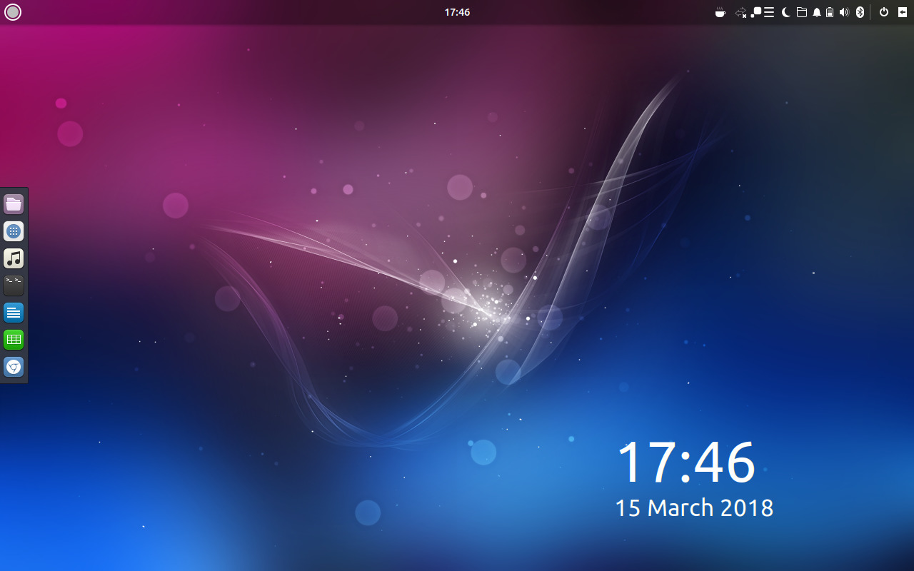
Ubuntu Budgie Desktop

Slide 32
Ubuntu Budgie Default Applications
File Manager – Nautilus
Window Manager – Budgie WM
Web Browser – Chromium
Email Client – Geary Email
Text Editor – Gedit
Video Player – Gnome MPV
Music Player – Rhythmbox
Terminal – Tilix
Office Suite – LibreOffice

Slide 33
Cochise Linux User group

