Slide 1

CLUG Trusted PPAs

Slide 2
What is A PPA
PPA stands for Personal Package Archive.
The PPA allows application developers and Linux users to create their own repositories to distribute software.
With PPA, you can easily get newer software version or software that are not available via the official Ubuntu repositories.

Slide 3
Why is PPA used
Ubuntu controls what software and more importantly which version of a software you get on your system.
But imagine if a software developer releases a new version of the software.
Suppose someone develops a software and wants Ubuntu to include that software in the official repositories.
If a deb package is used there is no guarantee that it will be updated when you update your system. It’s because the apt upgrade procedure relies on the sources.list. If there is no entry for a software, it doesn’t get the update via the standard software updater.

Slide 4
PPA’s
Ubuntu provides a platform called Launchpad that enables software developers to create their own repositories.
An end user i.e. you can add the PPA repository to your sources.list and when you update your system, your system would know about the availability of this new software and you can install it using the standard sudo apt install command

Slide 5
CLUG Trusted PPAs
GRUB Customizer
Boot-Repair Tool
UNetbootin

Slide 6
Grub Customizer
Many aspects of GRUB can be changed
Boot order, time out, hide selected operating systems, hide the Grub screen entirely, change the background, change the theme

Slide 7
Grub Customizer
This is done by changing the config files at /etc/default/grub and /boot/grub2 in the command line
Or you can use a GUI tool like Grub Customizer

Slide 8
Grub Customizer
These days, Grub Customizer is available in the official repositories of many mainstream Linux distributions.
This means that you can easily install it from the software center for the respective Linux distribution
Alternatively, you can use your distribution’s package manager for installing it.

Slide 9
Grub Customizer
On Debian and Ubuntu-based distributions:
sudo apt install grub-customizer
On Fedora:
sudo dnf install grub-customizer
On Arch and Manjaro:
sudo pacman -Sy grub-customizer

Slide 10
Grub Customizer
If your distribution does not have Grub Customizer in its repository or you happen to be using Ubuntu 18.04 or Mint 19, then use the PPA
Do you need it?

Slide 11
Grub Customizer
If you have only one OS on your hard drive. No
If you are happy with the background. No
If you are happy with the theme. No

Slide 12
Grub Customizer
For information on changing boot order, boot time out, hiding GRUB, changing background or theme see:
https://itsfoss.com/customize-grub-linux/
A copy of these slides can be found on our web page at:
https://github.com/CochiseLinuxUsersGroup/Presentations

Slide 13
Boot-Repair Tool
Boot repair was covered in our presentation “What to do If Ubuntu Won’t Boot” as one of the steps to take. It can be found on our web site under presentations:
https://github.com/CochiseLinuxUsersGroup/Presentations

Slide 14
#3 Repair the GRUB Bootloader to Boot Ubuntu
If GRUB is not loading, then Ubuntu won’t boot. Fortunately, you can repair GRUB using the Ubuntu installation media. Restart the computer with the disc inserted and wait for it to load up.
Again, you may need to change the boot order, Make a note of the boot order before you change it!

Slide 15
Repair the GRUB Bootloader to Boot Ubuntu - 2
With the installation disc booted into the Live environment, confirm you have a network connection and then open a Terminal. Enter:
sudo apt-add-repository ppa:yannubuntu/boot-repair
sudo apt update
sudo apt install -y boot-repair
boot-repair

Slide 16
Repair the GRUB Bootloader to Boot Ubuntu - 3
This will install the boot-repair tool and run it after the final instruction. Wait for the system to be scanned, then select Recommended Repair. (There is also an Advanced options view, where you can select a default OS, default disk or partition, and more.)

Slide 17
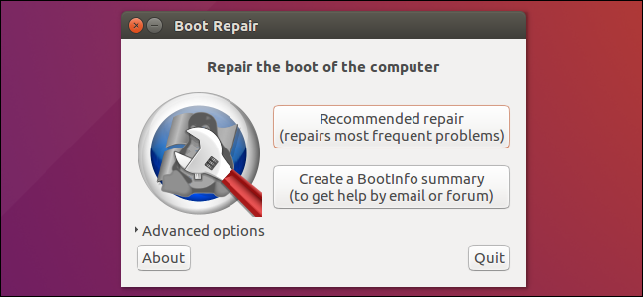
Repair the GRUB Bootloader to Boot Ubuntu - 4

Slide 18
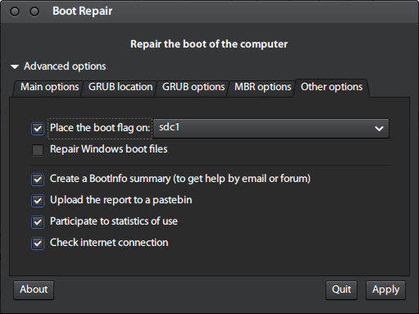
Repair the GRUB Bootloader to Boot Ubuntu - 5

Slide 19
Repair the GRUB Bootloader to Boot Ubuntu - 6
Click Apply when done. You should now be able to restart your PC and boot into Ubuntu. Alternatively, it will be listed an option in the GRUB bootloader menu.
When repair is finished, copy the URL (paste.ubuntu.com/XXXXX) that appeared (on a piece of paper) then reboot and check if you recovered access to your OSs.
If the repair did not succeed, send the URL to people who can help you by email or forum. For Ubuntu the forum is https://ubuntuforums.org/ If you are using a different distribution send it to that distribution’s forum.

Slide 20
UNetbootin
Unetbootin was covered in our presentation “How To Make A Bootable Flash Drive”. The slides can be found on our website. https://github.com/CochiseLinuxUsersGroup/Presentations

Slide 21
UNetbootin
UNetbootin (Universal Netboot Installer)
Creates bootable USB flash drives
Is a live USB creator
Supports mainstream Linux distributions such as Ubuntu, Fedora, openSUSE, CentOS, Gentoo, Linux Mint, Arch Linux, Mandriva, MEPIS, Slackware

Slide 22
UNetbootin
Install UNetbootin
sudo apt-add-repository ppa:gezakovacs/ppa
sudo apt update
sudo apt install unetbootin

Slide 23
UNetbootin
Launch UNetbootin from your main menu

Slide 24
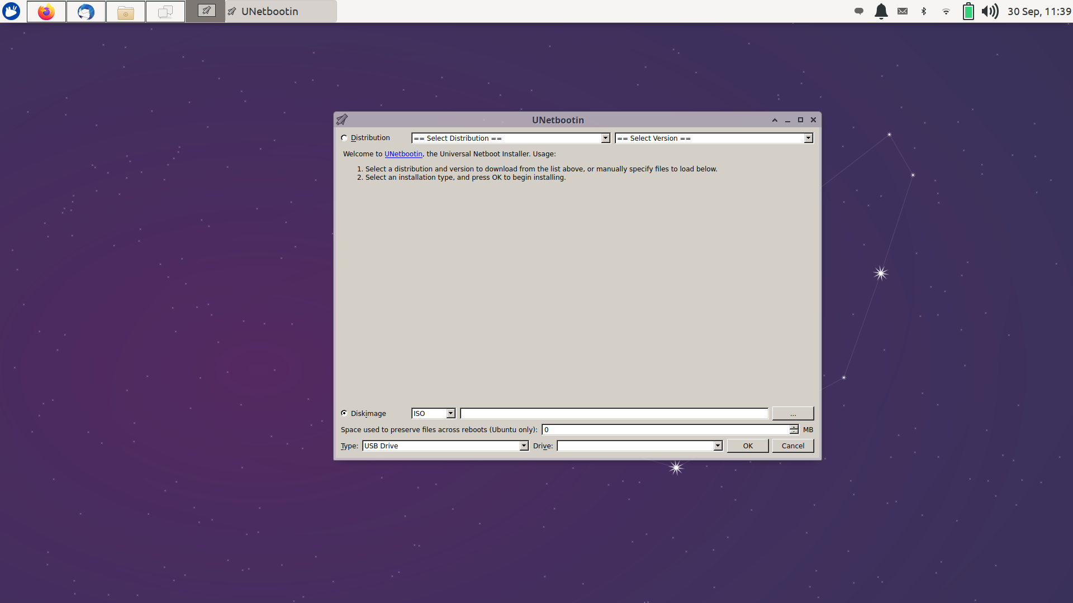
UNetbootin

Slide 25
UNetbootin
There are two ways to create the bootable flash drive: Distribution and Disk Image

Slide 26
UNetbootin
Distribution:
Select a distribution from the drop down menu and then the desired version.
Select an installation type (USB Drive) and then OK to begin installing.
The ISO will then be downloaded and installed to the USB flash drive.

Slide 27
UNetbootin
Disk Image:
Select the ISO which you have already downloaded to your computer
Select the type (USB Drive) and then OK to begin installing

Slide 28
UNetbootin
Do you need Unetbootin? No. There are other applications that do the same thing. It was just introduced as an option for CLUG members.
Recently I discovered Ventoy which is a multiboot application that allows you to store other items on the same flash drive and you do not have to install the operating system to the flash drive, merely copy it.

Slide 29

Cochise Linux User Group

