Slide 1

Cochise Linux User Group

Slide 2
There are three common errors that may prevent your Linux system from booting. You will get three different prompts when these errors occur. They are
  (initramfs)
  grub>
  grub rescue>

Slide 3
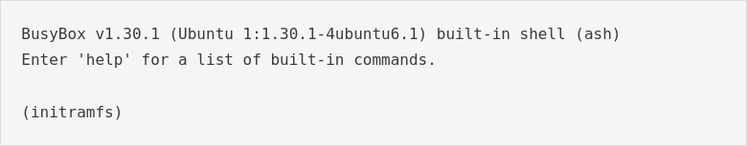
Initramfs error

Slide 4
Initramfs error
What is initramfs?
Initial RAM file system
It is a CICO (copy in copy out) archive of the file system that gets loaded into memory during the Linux start-up process.
It is used as the first root file system that your machine has access to.

Slide 5
BusyBox
What is BusyBox?
BusyBox is software that provides several stripped-down UNIX tools in a single executable file.
It provides replacements for most of the utilities you usually find in GNU fileutils, shellutils, etc.

Slide 6
Initramfs error
You get the BusyBox initramfs error when your initial RAM file system partition has some errors.
The output should tell you which partition is corrupted.

Slide 7
Initramfs Error
What do you do?
If you type exit at the initramfs prompt it should tell you which partition has the corrupted file system.
However, this is not always the case.
If you don’t know the name of the partition, it can be found by typing the command lsblk. (It is your boot partition.)

Slide 8
Initramfs Error
To correct the initramfs error you need to repair the file system on the corrupted partition using the fsck command

Slide 9
Initramfs Error
(initramfs) fsck /dev/sda1 -y
Replace /dev/sda1 with your partition name. It could be /dev/sdb1, /dev/sdc1, etc.
Use the -y switch or you will be typing y to fix each error.

Slide 10
Initramfs Error
The fsck command will automatically start to fix all of the bad blocks in the file system.
After it finishes, type reboot and click enter. (If it fails to reboot, type exit and click enter.)
Your computer should reboot normally after the repair.

Slide 11
References
For Debian and Ubuntu based systemshttps://ostechnix.com/how-to-fix-busybox-initramfs-error-on-ubuntu/
For Fedora https://ostechnix.com/solve-initramfs-fedora/

Slide 12
Cochise Linux User Group

