Slide 1

COCHISE LINUX USER GROUP

Slide 2
UPCOMING CLUG EVENTS
(May be conducted on Big Blue Button depending upon the Covid-19 Situation.)
09 July, Ubuntu Hour, 1800-1900, Schlotzsky’s Cafe, 3900 E. Fry Blvd., SV
25 July, CLUG Mtg, 1300-1545, Location TBA

Slide 3
Future Presentations
Hands on installation with group members acting as clients
(Rex Bouwense – 25 July)
Different ways to install a program on a Linux OS
(Greg Christ – TBD)
The contents of some Linux Directories (Rex Bouwense – TBD)
How to build a computer (Ted Janecki – TBD)
Robo Linux (Tim Kirk – TBD)

Slide 4
Discussion Topics
Put and take bin for spare computer parts at CLUG events (RAM, wifi chips, switches, AC adapters, power cords, cables, power supplies, keyboards, mice)
Location for September Installfest
Location for 25 July CLUG meeting
Re-introduction of the 5-10 minute mini presentations
CLUG hamburger cook out

Slide 5
How To Install Ubuntu Defining the Partitions Yourself

Slide 6
How To Install Ubuntu Defining the Partitions Yourself
Why would you want to do this.
Desire for a separate “/home” partition
Dual Boot with Windows 10 or another Linux OS.

Slide 7
How To Install Ubuntu Defining the Partitions Yourself -2
Pros
A fresh-install will not erase your data if you have a separate home partition. (although you best back it up because Murphy may be present)
Installation of a new version will not erase your data. (SAS above)
It also makes resizing/migrating to a larger home partition easier, if you ever need more space.
It isn't going to affect the speed of file access much, UNLESS you tend to have lots and lots of small files in your home directory.
A separate /home can also make data retrieval easier in the case of a crash.
In any event, BACK UP YOUR DATA!!!

Slide 8
How To Install Ubuntu Defining the Partitions Yourself -3
Cons:
/home also contains config files. If you have more than one OS or DE installed, there may be issues associated conflicting configurations between the OS’s or the DE’s.
A Windows update has broken the system in the past. Be aware of this.

Slide 9
How to Install Ubuntu With a Separate /Home

Slide 10
How to Install Ubuntu With a Separate /Home
During the installation process you will be asked how you want to install Ubuntu
Choose “Something else”
Gparted will open in a new window

Slide 11
How to Install Ubuntu With a Separate /Home -2
Create two partitions. One for installation of the operating system and one for all of your data
Set the mount point for the first partition as / (This will contain the root file system)
Set the mount point for the second partition as
/home (This will contain your data files)
Proceed with the installation

Slide 12
How To Add A Separate Home To Your Ubuntu Installation

Slide 13
How To Add A Separate Home To Your Ubuntu Installation
Create a new partition
Copy Home files to the new partition
Locate the new partition’s UUID
Modify the fstab File
Move the Home Directory & restart
Clean up

Slide 14
Create A New Partition
Install Gparted
Create a new ext4 partition after resizing

Slide 15
Copy Home Files To The New Partition
Ubuntu makes it easy to mount the new partition. Just click it under Devices in the file manager
After you do, click the Go menu and select Location to view its mount point.
Launch a terminal and run the following command to create a copy of your current /home directory on the new partition, where /mount/location is the location of your mounted partition:
sudo cp -Rp /home/* /mount/location
You should check the new home directory to verify it contains your files. However, we won’t be deleting the old home directory just yet.

Slide 16
Copy Home Files To The New Partition -2
You should check the new home directory to verify it contains your files. However, we won’t be deleting the old home directory just yet.
You should confirm all files and directories copied over successfully. One way to do this (for an unencrypted file system) is by using the diff command:
sudo diff -r /home /media/home -x ".gvfs/*"
You can also expect to see some errors about files not found. These are due to symbolic links that point to places that don't presently exist (but will do after you have rebooted). You can ignore these - but check out anything else.

Slide 17
Locate The New Partition’s UUID
You can locate the partition’s UUID by running the following command in a terminal:
sudo blkid
The long, random-looking string of numbers and letters is actually the partition’s UUID, and we’ll need it to add the partition to our fstab file, which tells Linux where to mount partitions when it boots.

Slide 18
Modify The fstab File
Before modifying our fstab file, we should create a backup copy that we can restore, just in case:
sudo cp /etc/fstab /etc/fstab.backup

Slide 19
Modify The fstab File -2
Next, run the following command to open the fstab file in gedit. You can also use another text editor, if you prefer.
gksu gedit /etc/fstab
Add the following text to the fstab file on a new line, replacing the _____ portion with the full UUID of your new home partition from the sudo blkid command above:
UUID=_____ /home ext4 nodev,nosuid 0 2
Save the file after adding the line.

Slide 20
Move Home Directory & Restart
From a terminal, run the following command to leave your home directory, move your current home directory to a placeholder location, and create a new, empty home directory which your new partition will be mounted at:
cd / && sudo mv /home /home_old && sudo mkdir /home
Reboot your computer after running this command. You can restart with the following command:
sudo shutdown -r now

Slide 21
Clean Up
After restarting your computer, you should be able to log in normally. Ubuntu is now using the separate home partition.
After making sure that everything went okay and you still have all your files in your /home directory – just in case –
you can you can remove your /home_old directory to free up space:
sudo rm -rf /home_old

Slide 22
How To Install Ubuntu In A Dual Boot With Windows 10

Slide 23
How To Install Ubuntu In A Dual Boot With Windows 10
When Windows is turned off, it does not completely shut down. This is why Windows 10 starts so quickly. To install a Linux OS as a dual boot, “fast boot” must be disabled.
To do this you must enter BIOS/UEFI which can be accomplished by pressing F2, F10, or ESC during boot.
This differs from manufacturer to manufacturer so check the manufacturer’s website to find out which one is applicable.

Slide 24
How To Install Ubuntu In A Dual Boot With Windows 10
In some cases “secure boot” must also be disabled.
This is also done in BIOS/UEFI

Slide 25
How To Install Ubuntu In A Dual Boot With Windows 10
The next thing you need to take care of is to create free space on the computer hard disk in case the system is installed on a single partition.
Log in to your Windows machine with an administrative account and right click on the Start Menu → Command Prompt (Admin) in order to enter Windows Command-Line

Slide 26
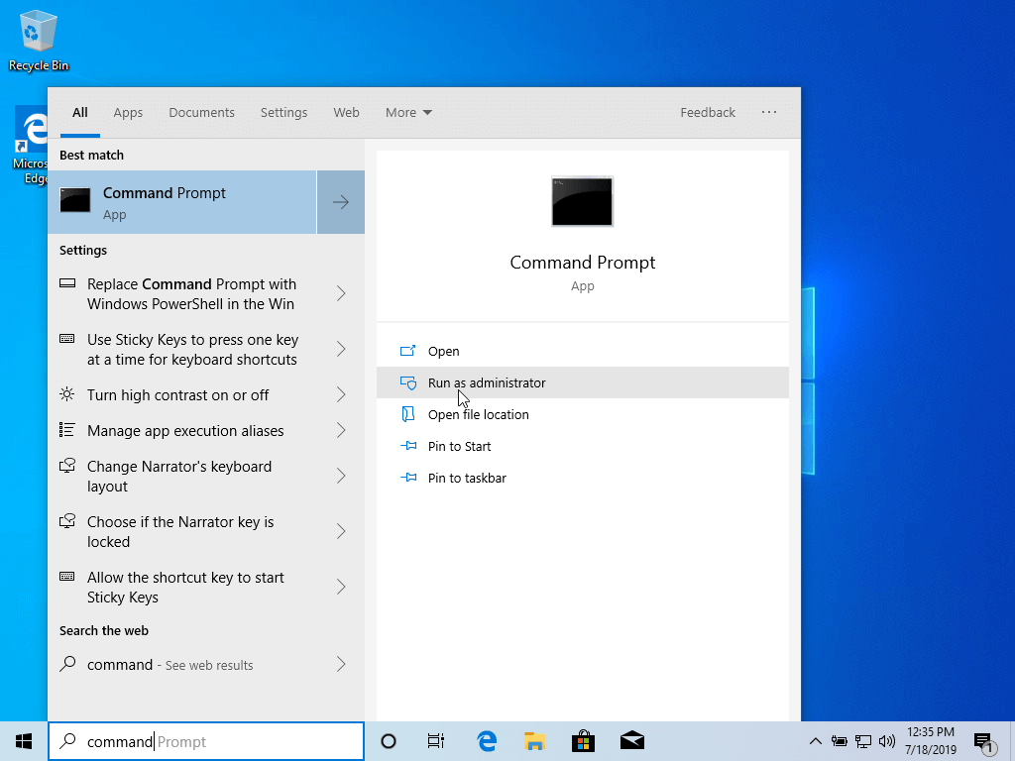
How To Install Ubuntu In A Dual Boot With Windows 10

Slide 27
How To Install Ubuntu In A Dual Boot With Windows 10
Once in the CLI/CMD, type: diskmgmt.msc on the prompt.
The Disk Management Utility should open.
Alternatively you can simultaneously press the Windows key + x and that will also open the Disk Management Utility.

Slide 28
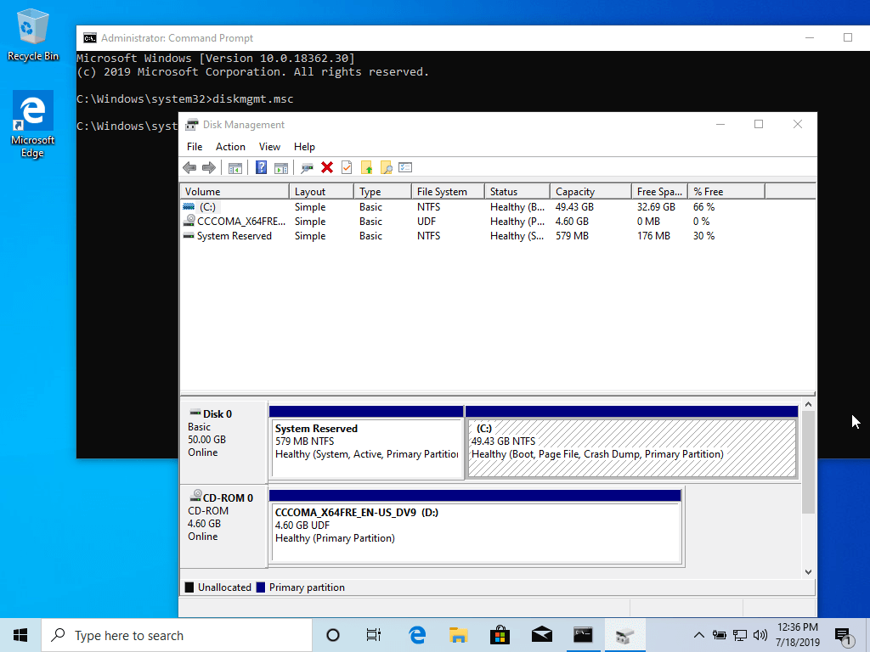
How To Install Ubuntu In A Dual Boot With Windows 10

Slide 29
How To Install Ubuntu In A Dual Boot With Windows 10
From here, right click on C: partition.
Select Shrink Volume in order to resize the partition.
On Shrink C: enter a value to shrink in MBs and hit shrink to start partition resize.

Slide 30
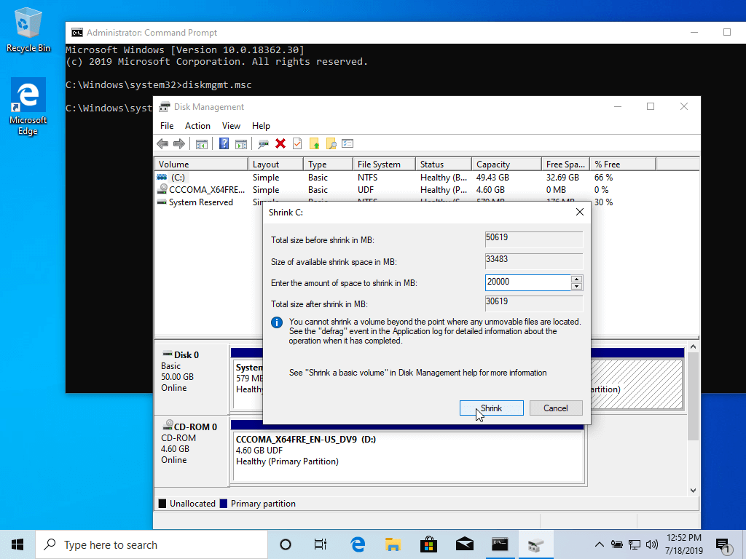
How To Install Ubuntu In A Dual Boot With Windows 10

Slide 31
How To Install Ubuntu In A Dual Boot With Windows 10
Once space has been resized you will see a new unallocated space on the hard drive.
Leave it as default and reboot the computer in order to proceed with the Ubuntu installation.

Slide 32

How To Install Ubuntu In A Dual Boot With Windows 10

Slide 33
How To Install Ubuntu In A Dual Boot With Windows 10
Alternatively, the Ubuntu installer will give you the option of installing next to Windows.
This has occasionally not worked in the past but you can try it if you want to do so. However, Use Windows tools in Windows and Linux tools in Linux for best results.

Slide 34
How To Install Ubuntu In A Dual Boot With Windows 10
Proceed with the Ubuntu installation

Slide 35
COCHISE LINUX USER GROUP

