Slide 1
Aliases

Slide 2
What is the alias command in Linux?
The alias command allows you to create "custom commands" from existing Linux commands. It is primarily used for creating a short form of a long Linux command combination. So instead of typing find / -type f -name *.txt, you create an alias like ftext and just use this smaller 'command'.
This is particularly helpful when you have to regularly use some command combinations. Instead of manually typing them from memory and knowledge or copying it from your script collection, you can create an alias and quickly use them.

Slide 3
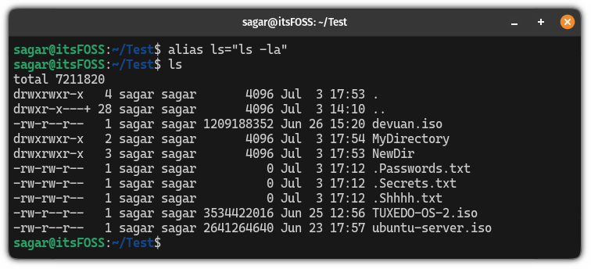
How to create an alias in Linux?
alias short_name="your custom command here"
Ex: alias ls="ls -la"

Slide 4
Make alias permanent
So first, open the .bashrc file for editing:
nano ~/.bashrc
Go to the end of the file in nano text editor using Alt + / and add the lines as shown:
alias short_command='custom command here'
For example, here, I created an alias for ls -la which will be executed when I use ls:
alias ls='ls -la'
Once done, save changes and exit from the nano text editor.

Slide 5
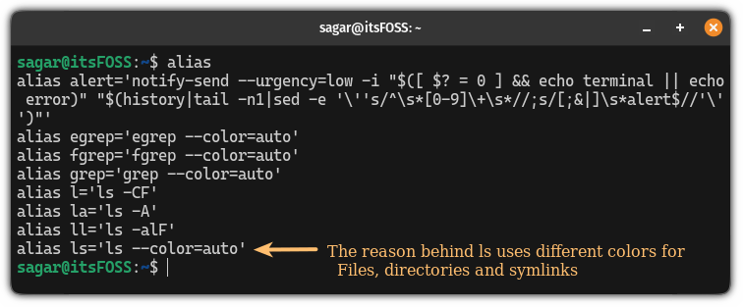
How to list all the aliases?
To list existing alias, you can simply execute the following command
alias
As you can see, there's already one alias set for --color=auto which is the reason why the ls command uses different colors to indicate files, directories, and symlinks by default.

