Slide 1
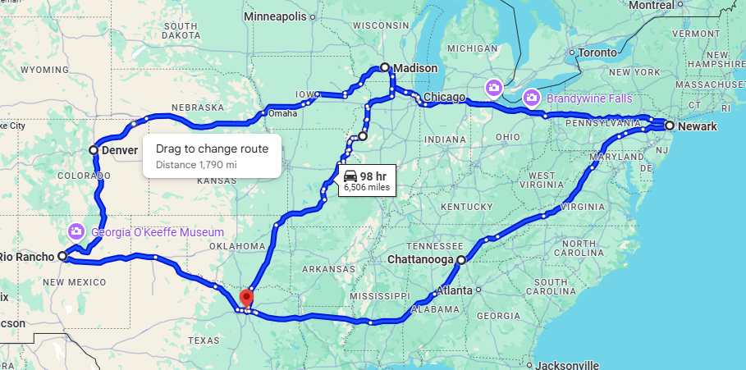

Acme Corp SuperComputing Grid

Slide 2
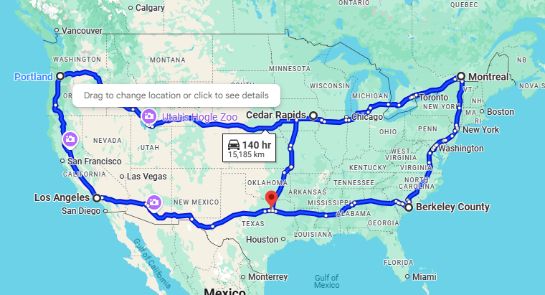


Modeled Network - Public
Amazon
CTS/USC
Google

