Slide 1
SUSTAINED RELEASE DRUG DELIVERY SYSTEM
Presented by :
Manisha pare. Under the guidance of :
M . Pharmacy (1st year). Vijay Bhaskar Desai
Dep. Of Pharmaceutical. M . Pharma (PhD)
Technology
H.k.e,COP ,GLB

Slide 2
Contents:
Introduction
Definition
Objectives of sustained release system
Ideal characteristics of drugs suitable for SRDDS
Drugs unsuitable for SRDDS
Principle of SRDDS
Physicochemical factors influencing SRDDS
Biological factors influencing SRDDS

Slide 3
Contents :
Physicochemical approaches for SRDDS
Biological approaches for SRDDS
Applications of SRDDS
Advantages and disadvantages of SRDDS
Comparative analysis of different release patterns in various delivery systems
Conventional RDDS Vs. Sustained RDDS Vs. Controlled RDDS.

Slide 4
Previous year question asked on SRDDS
Discuss the rationale and concepts behind the development of controlled and sustained drug delivery systems.
Explain the physicochemical and biological factors that influence the design and performance of sustained/controlled release formulations.
Describe in detail the various mechanisms of drug release from SR/CR systems such as Diffusion, Dissolution, Osmosis, and Erosion.

Slide 5
Introduction
Conventional dosage forms release drug immediately after administration.
This leads to fluctuations in plasma drug concentration.
Sustained release systems are designed to maintain drug levels within the therapeutic window for prolonged periods.
Sustained release drug delivery system is an important approach to improve efficiency, safety and patient compliance.

Slide 6
Definition
Sustained release drug delivery system is defined as :
“ A dosage form that release the drug at a predetermined rate , maintaining constant drug concentration in the systemic circulation for a specific period of time.”
Sustained drug release is slower than immediate release
And also extends duration of action.

Slide 7
Objectives of sustained release system
To maintain therapeutic plasma concentration.
To reduce dosing frequency.
To minimise peak trough fluctuations.
To reduce dose related side effects.
To improve patient compliance.
To enhance overall therapeutic effectiveness.

Slide 8
Ideal characteristics of drugs suitable for SRDDS
Short biological half-life (2-6 hours).
High therapeutic index.(It is ratio of toxic dose to the effective dose , which is measures the safety margin )
Good absorption through out GIT.
Stable in GI environment
Low dose requirement.
Linear pharmacokinetics.
Some examples are : Metformin, Theophylline, propranolol.

Slide 9
Drug unsuitable for SRDDS
Very short or long half- life drugs.
Narrow therapeutic index.
Poor GI absorption.
Drug requiring rapid onset of action.
Drug undergoing extensive first pass metabolism.
Significant “First-Pass” Effect or Site-Specific absorption.
High dosage forms become too large/bulky to swallow

Slide 10

Principle for SRDDS
The principle of sustained release formulation can be divided in to two considerations i.e. release rate & dose consideration
Release rate consideration : In conventional dosage form Kr > ka in this the release of drug from dosage form is not rate limiting step.

Slide 11
The above criteria i.e. (Kr>Ka) is in case of immediate release where as in non immediate (Kr<Ka) i.e. release is rate limiting step.
Absorption phase becomes insignificant compared to drug release phase.
Thus effort of developing S.R.F must be directed primarily altering the release rate. The rate should be independent of drug remaining in the dosage form over constant time.
The release should follow zero order kinetics

Slide 12
Kr=Rate in =Rate out =KeVd.Cd
Where Ke =overall elimination (first order kinetics). Vd= Total volume of distribution. Cd= Desired drug concentration.
B)Dose consideration :-
To achieve the therapeutic level & sustain for a given period of time for the dosage form generally consist of 2 part :
Initial dose
Maintenances dose

Slide 13
Initial Dose (Di)- It is immediately released to provide a therapeutic blood level. The time required for the drug to accumulate to a steady state plasma level is mainly dependent on its half-life, Maintenance dose(Dm) – is released after Di, has produced a blood level equal to the therapeutic drug level. It is released over a period of time and is equal to the product duration of action. Therefore the total dose ‘W’ can be.
W=Di+Dm

Slide 14
In a system, the therapeutic dose release follows zero order process for specified time period then,
W=Di+ K°r . Td
K° r =Zero order release rate
Td = time desired for sustained release from one dose.
If maintenance dose begins to release the drug during dosing t= 0 then,
W=Di+K°r Td-K°r . Tp
Tp = time of peak drug level.

Slide 15
However a constant drug release can be obtained by suitable combination of Di & Dm that release the drug by first order process, then
W=Di+(Ke Cd/Kr)Vd.
Terminology Used in Modified Release Systems :
Sustained release , Sustained release, Sustained action, Prolonged action ,Controlled release ,Extended action, Time-release dosage forms.

Slide 16
Designed to achieve prolonged therapeutic effect.
By continuous drug release after a single dose.
In case of injectable dosage form, this period may vary from days to month, in case of orally administrated forms, however, this period is measured in hours & critically depends on the residence time of the dosage form in GI tract.

Slide 17
In some case, control of drug therapy can be achieved’ taking advantage of beneficial drug interaction that affect disposition and elimination. E.g.:- the action of probenicid, which inhibit the excretion of penicillin, thus prolonging it’s blood level.
Mixture of drug might be utilized to attend, synergize, or antagonize given drug action.
Sustained release dosage form design embodies this approach to the control of action i.e. through a process of either drug modification, the absorption process, and subsequently drug action can be controlled.

Slide 18
Physicochemical factors influencing SRDDS
Factor | Preferred Property for SR | Impact on Formulation
Aqueous solubility | > 0.1mg/mL (pH 1-7.8) | Too low causes poor bioavailability; too high makes release hard to control.
Partition coefficient | High (Lipophilic) | Higher lipid solubility aids diffusion across membrane barriers.
Molecular size | < 1000 Daltons | Smaller molecules diffuse faster through polymer matrices.
pKa and Ionisation | Unionized at Gl PH | Un-ionized forms pass through biological membranes more easily.
Drug solubility | Stable in Gl fluids | Unstable drugs (e.g., degraded by enzymes) are poor candidates.

Slide 19
Biological factors influencing SRDDS
Factors | Impact on Sustained Release
Biological Half-Life | Optimal: 2-8 hrs; too short causes dosing issues; too long is unnecessary.
Absorption Rate | Must be fast enough to avoid limitations in drug absorption.
Metabolism | Extensive metabolism limits effectiveness and reduces bioavailability.
Elimination | Rate must be balanced with release rate to maintain plasma levels.
GI Residence Time | Longer transit improves absorption of controlled-release products.
Disease State | Alters absorption/metabolism; can impact therapeutic outcomes.

Slide 20
Physicochemical approaches for SRDDS
A) Dissolution controlled release system :
These system are most commonly employed in the production of enteric dosage forms. Drug present in the system having high aqueous solubility and dissolution rate
It is further divided into matrix and reservoir type dissolution controlled release system.
Matrix system :
Matrix system are also called as monolithic since the drug is homogeneously dispersed throughout a rate-controlling medium.

Slide 21
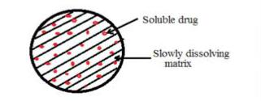
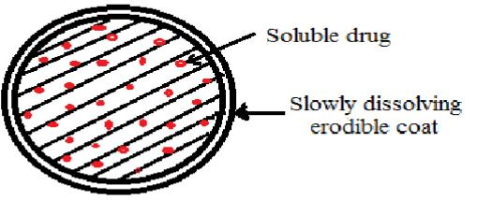
e.g. Bees wax, Carnauba wax, Hydrogenated Castor oil .
Reservoir system :
These system are hallow containing an inner core of drug surrounded in a water insoluble polymer membrane.

Slide 22
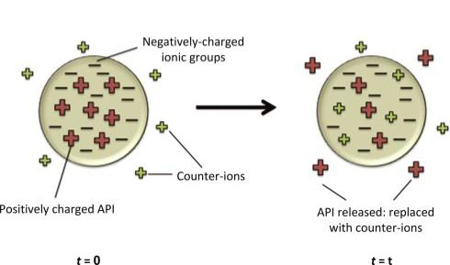
B) Ions exchange based SR formulations :
Ion-exchange systems generally use resins composed of water-insoluble cross-linked polymers. These polymers contain salt-forming functional groups in repeating positions on the polymer chain.
The drug is bound to the resin and released by exchanging with appropriately charged ions in contact with the ion-exchange groups.

Slide 23
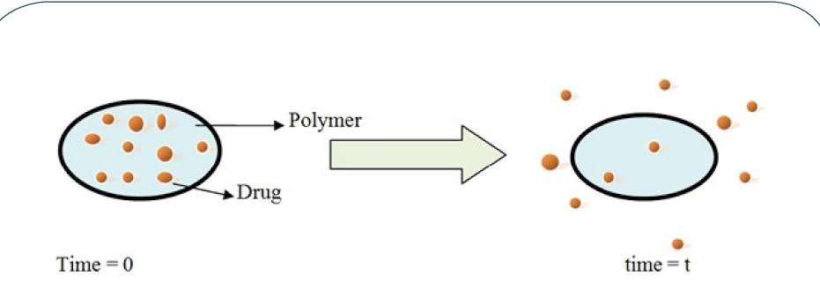
C) Diffusion controlled release system :
Movement of drug molecules from a region of a higher concentration to one of lower concentration.
Matrix system :
The drug is dispersed in an insoluble
matrix of rigid nonswellable hydrophobic
materials or swellable hydrophilic
Substances.

Slide 24
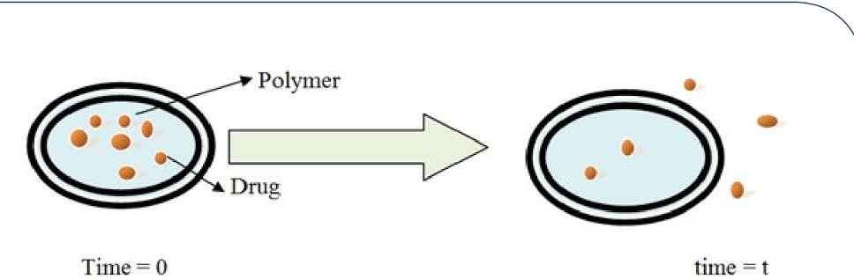
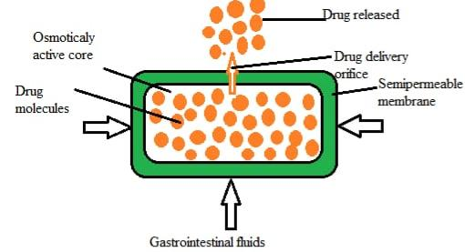
Reservoir system :
These systems are hollow containing
an inner core of drug surrounded in a water insoluble polymer membrane .
D) Osmotic pressure based SR formulations :
In this system, the flow of liquid into the release unit driven by a difference in Osmotic pressure between the inside and outside of the release unit is used as the release- controlling process.

Slide 25
E) pH Independent Based SR Formulations:
These system are designed to eliminate the influence of GI pH on dissolution and absorption of drugs by formulating then with sufficient amount of buffering agents i.e salts of phosphoric, citric, or tartaric acids.
These helps to adjust the pH to desired value as the dosage form passes along the GIT and permit drug dissolution and release at a constant rate independent of GI ph.

Slide 26
F) Altered Density Based SR Formulations:
It is reasonable to expect that unless a delivery system remains in the vicinity of the absorption site until most, if not all of drug contents is released, it would have limited utility.
To this end, several approaches have been developed to prolong the residence time of DDS in the GI tract.
High-density approach
Low-density approach

Slide 27
Biological Approaches For SRDDS:
A) Bio- Polymers Based SR/CR Formulations:
Nanoparticles in submicron size range (50-1000nm) made from biological/physiological lipids which are biodegradable are used as colloidal drug carriers for I.V application. At room temperature the particles are in the solid state. Therefore, the mobility of incorporated drugs is reduced, which is a prerequisite for controlled drug release.

Slide 28
B) Pulse Based (Pulsatile) SR/CR Formulations:
Those drug delivery system deliver the drug at specific time aa per patient or pathophysiological need of the diseases, resulting unimproved patient therapeutic efficacy and compliance.
The drug release is controlled by the stimuli like the biological pH or enzyme present in body or drug delivery system.

Slide 29
C) Gastro retention based SR/CR Formulations:
Gastro Retentive dosage forms (GRDFs) are a drug delivery formulation that are designed to be retained in the stomach for a prolonged time a. release there their active materials and thereby enable sustained and prolonged input of the drug to the upper part of the gastrointestinal (GI) tract.

Slide 30
Application of SRDDS
Application of SRDDS in following drug delivery system
Oral controlled drug delivery system
Gastro retentive drug delivery system ( GRDDS)
Ocular drug delivery system .
Transdermal drug delivery system (TDDDS).
Intestinal drug delivery system.
Colonic drug delivery system.

Slide 31
Advantages & Disadvantages of SRDDS
Advantages | Disadvantages
Prolonged therapeutic effect & uniform plasma drug concentration. | Delayed onset of action; not for drugs requiring rapid effect.
Improved compliance due to reduced dosing frequency. | Difficult to adjust dose once the medication is administered.
Reduced peak-trough fluctuations, side effects, and toxicity. | Risk of "dose dumping" (premature release of entire dose).
Better drug utilization and reduced total drug dose. | Absorption can be affected by gastric pH or GI motility.
Efficient long-term delivery systems. | Higher formulation costs and complex manufacturing processes.
Controlled, steady-state release. | Possibility of incomplete drug release from the carrier.

Slide 32
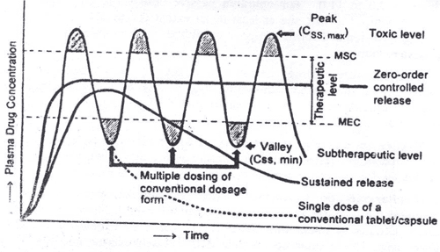
Comparative Analysis of Different release patterns in various delivery systems

Slide 33
Conventional RDDS Vs Sustained RDDS Vs controlled RDDS
Feature | Conventional (immediate) | Sustained release (SR) | Controlled release (CR)
Primary goal | Fast onset of action | Extended therapeutic effect (8-12 hrs). | Constant blood levels for days/months.
Release kinetics | First-order (Concentration dependent). | Primarily First-order. | Zero-order (Pre-designed/Constant rate).
Dosing frequency | High (e.g., TDS/QID). | Reduced (e.g., BD). | Minimal (e.g., OD or weekly).
Complexity | Low (Standard formulation). | Moderate (Matrix/Coated beads). | High (Osmotic pumps/OROS).
Example | Aspirin Tablet. | Aspirin SR. | Adalat CR (Nifedipine).

Slide 34
Summary
Sustained release, controlled release, extended release, and time-release dosage forms are designed to provide prolonged therapeutic effect. These systems continuously release the drug over an extended period after a single dose. They help in maintaining therapeutic drug levels and reducing dosing frequency.

Slide 35
THANK YOU

