Slide 1
What is scientific realism?
What does science try to describe?
“the world”, of course
Is there a “real world” out there that science can come to know about?
Does nature have joints, and can science carve those nature joints?
Affirmative answers are known as “scientific realism”

Slide 2
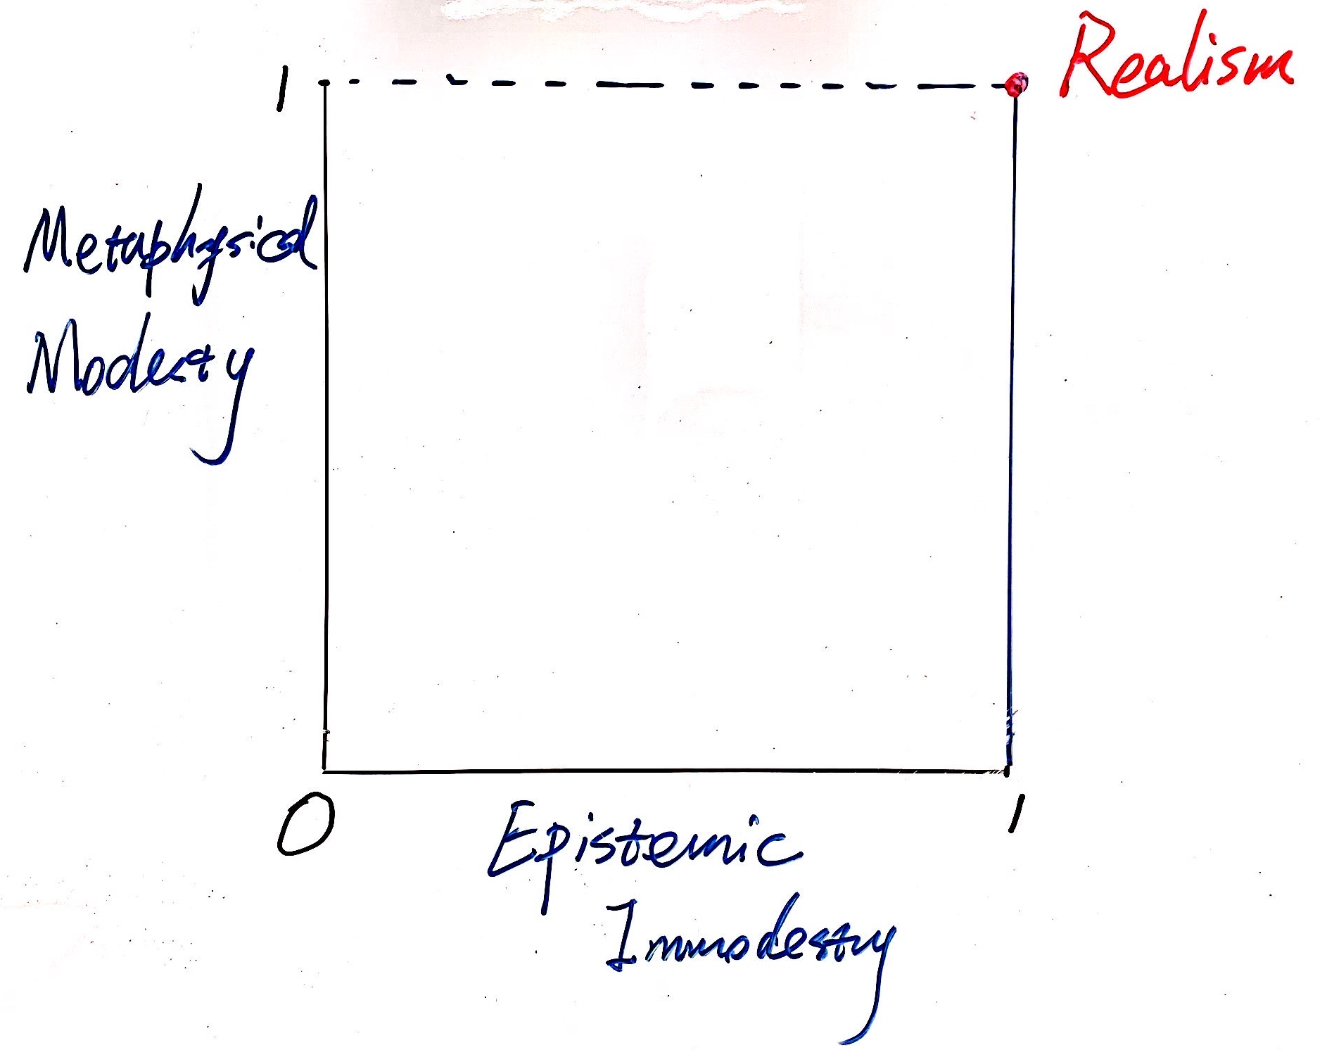
What is scientific realism?
Metaphysical Modesty:
  The world exists independent of our thoughts about it.
Epistemic Immodesty:
  We can come to know the world more or less accurately.
The more independent the world is of our thoughts, the more pessimistic we should be of our ability to know it.
A more detailed account of how theory and reality are connected.

Slide 3
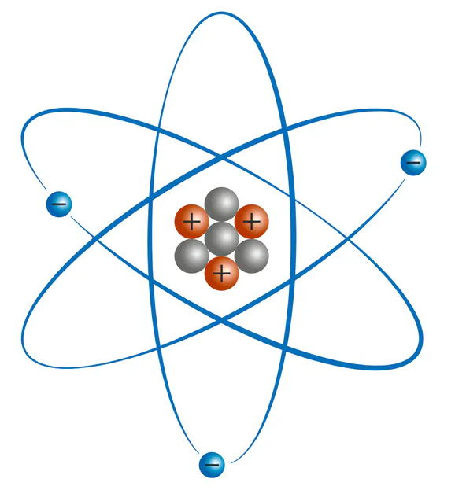
1 Strange Debates
Science describes the observable things in the world, but what about the unobservable things?
Was the world of one thousand years ago a world of electrons?
Yes, although nobody knew it back then.
  About epistemic immodesty
we must regard the existence of electrons as dependent on our conceptualization of the world.
  Rejecting metaphysical modesty

Slide 4
Rejecting Metaphysical Modesty [Kuhn]:
Logical empiricism: reject any talk of the real world beyond what we observe as meaningless. [Never go beyond evidence]
  Observable Vs. Theoretical entities
    Too small: electrons, quarks
    Invisible/insensible: radio waves, dark matter
    Scattered objects: species, solar systems
  Reduce talk of theoretical entities to talk of observable entities
  “the tower is broadcasting radio waves”: “if we turn on a radio in range we’ll hear the broadcast”
  Otherwise, an invitation to metaphysics

Slide 5
  About epistemic immodesty
‘Current realism’
Reality is more or less the way our current best scientific theories say it is.
  Have survived rigorous testing
  The details may change, but the core is mostly right
If our current theories turn out to be wrong, then so does realism
PGS: How do we decide the right level of confidence to have in current science?
The question of realism (metaphysical question)
The question of whether our current theories are correct (epistemic question)

Slide 6
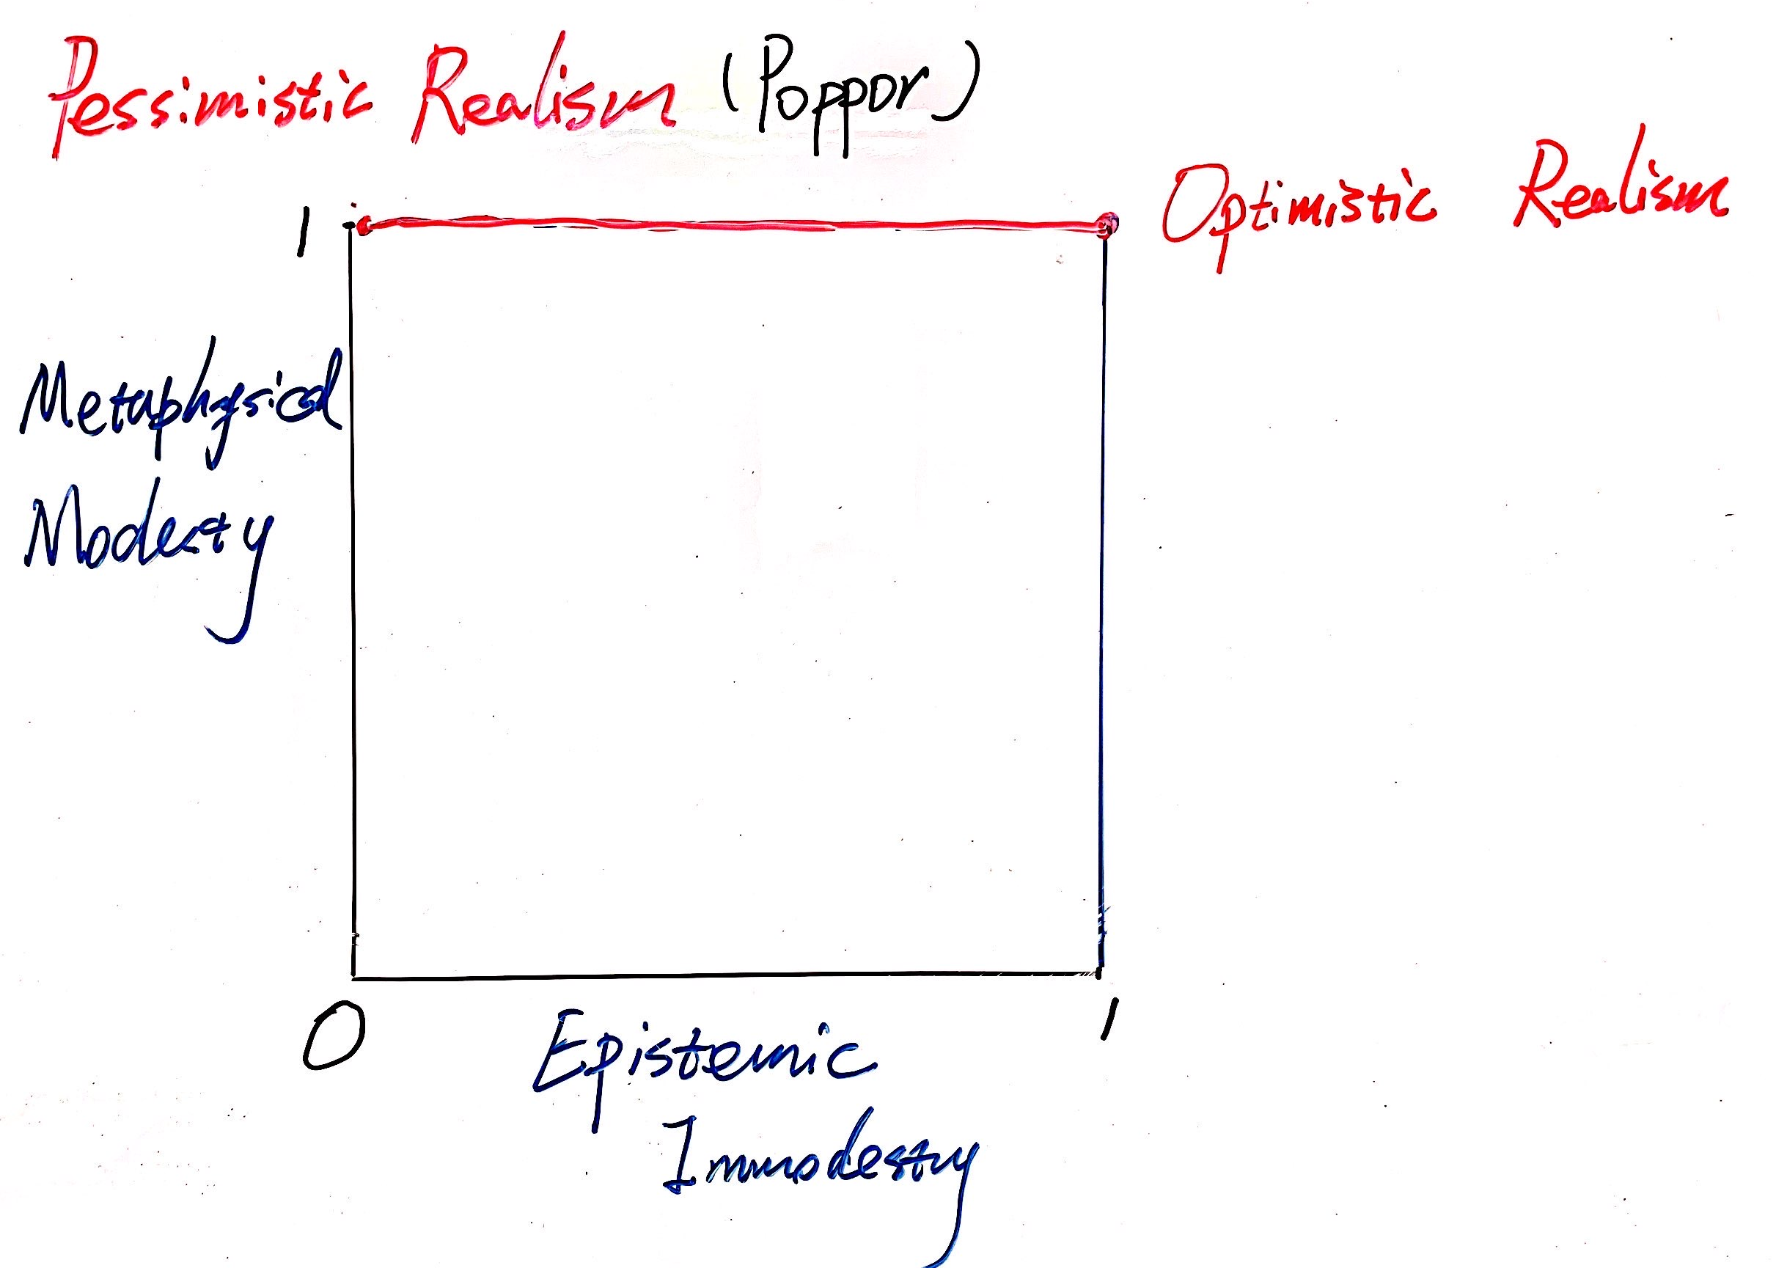
3 A Statement of Scientific Realism
capture the possibility of both optimistic and pessimistic versions
a limit to the pessimism that is compatible with realism
Skeptical Realism [Kuhn]? the world is just so complicated that our theories will always run into trouble in the end

Slide 7
Thank you!

