Slide 1

《Emergence of social punishment and cooperation through prior commitments》
The Anh Han
Reporter：Wan Zhijie

Slide 2
01 Introduction
Punishment has been suggested as one of the most important instruments or mechanisms for enforcing cooperation and compliance of social norms in various societies.
Social punishment, whereby cooperators punish defectors.
Antisocial punishment, whereby defectors punish cooperators.
Antisocial punishment outperforms social punishment, leading to the destruction of cooperation.
Antisocial punishment can be significantly restrained by relying on prior commitments

Slide 3
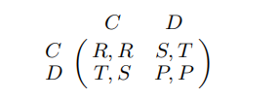
02 Models and Methods
Prisoner’s Dilemma (PD)
T>R>P>S

Slide 4
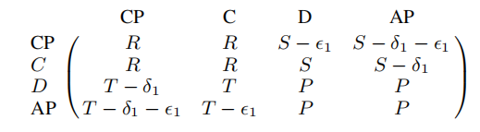

02 Models and Methods
PD with Punishment
After the PD has taken place, a player can choose to punish her opponent, which consists in paying a cost $∈_{1}$ to make the opponent incur a cost $δ_{1}$.
Assume that $∈_{1}<δ_{1}$.
CP cooperates in the PD, and punishes a co-player who defected in the game.
AP defects in the PD, and punishes a co-player who cooperated in the game.
pure cooperator (C) and pure defector (D) (i.e. they do not use the punishment option).
4 × 4 payoff matrix (for row player):

Slide 5
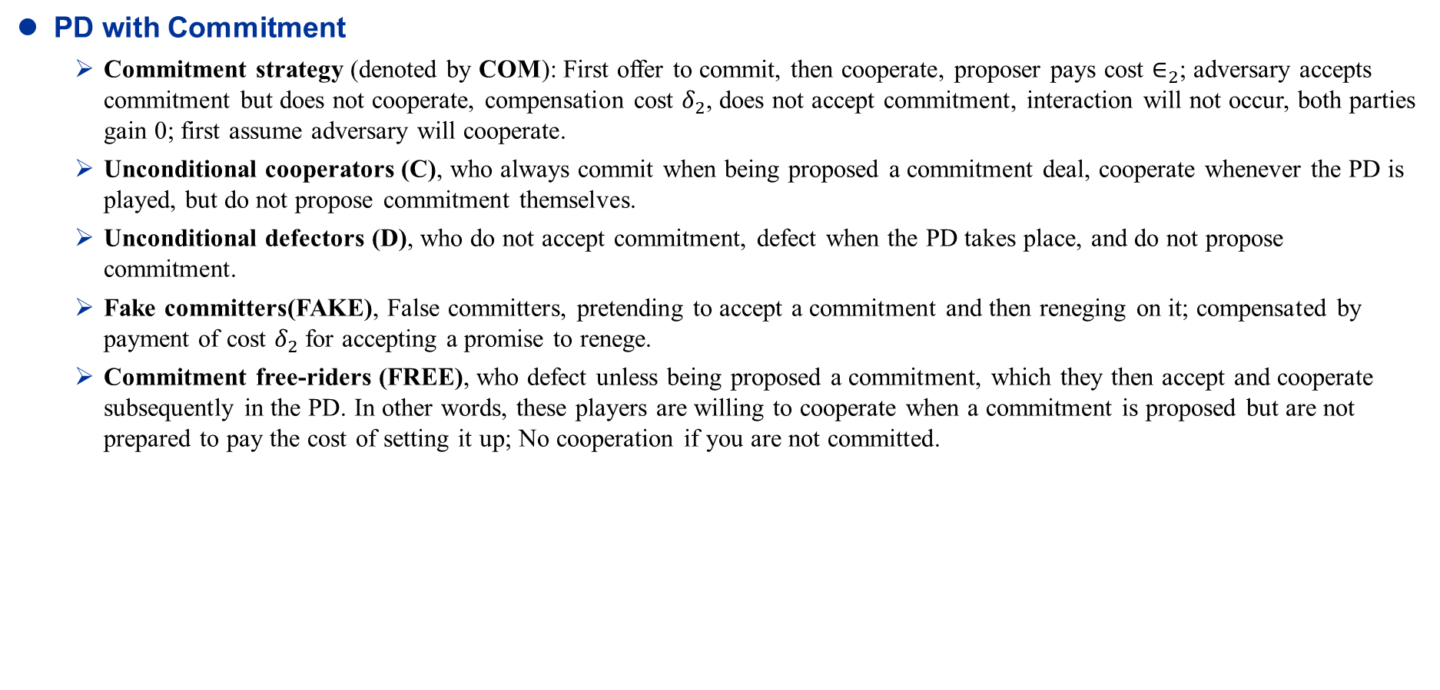
02 Models and Methods
PD with Commitment
Commitment strategy (denoted by COM): First offer to commit, then cooperate, proposer pays cost $∈_{2}$; adversary accepts commitment but does not cooperate, compensation cost $δ_{2}$, does not accept commitment, interaction will not occur, both parties gain 0; first assume adversary will cooperate.
Unconditional cooperators (C), who always commit when being proposed a commitment deal, cooperate whenever the PD is played, but do not propose commitment themselves.
Unconditional defectors (D), who do not accept commitment, defect when the PD takes place, and do not propose commitment.
Fake committers(FAKE), False committers, pretending to accept a commitment and then reneging on it; compensated by payment of cost $δ_{2}$ for accepting a promise to renege.
Commitment free-riders (FREE), who defect unless being proposed a commitment, which they then accept and cooperate subsequently in the PD. In other words, these players are willing to cooperate when a commitment is proposed but are not prepared to pay the cost of setting it up; No cooperation if you are not committed.

Slide 6
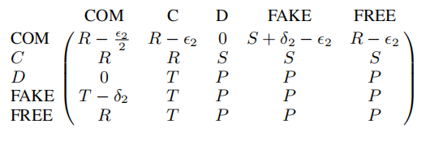
02 Models and Methods
PD with Commitment

Slide 7
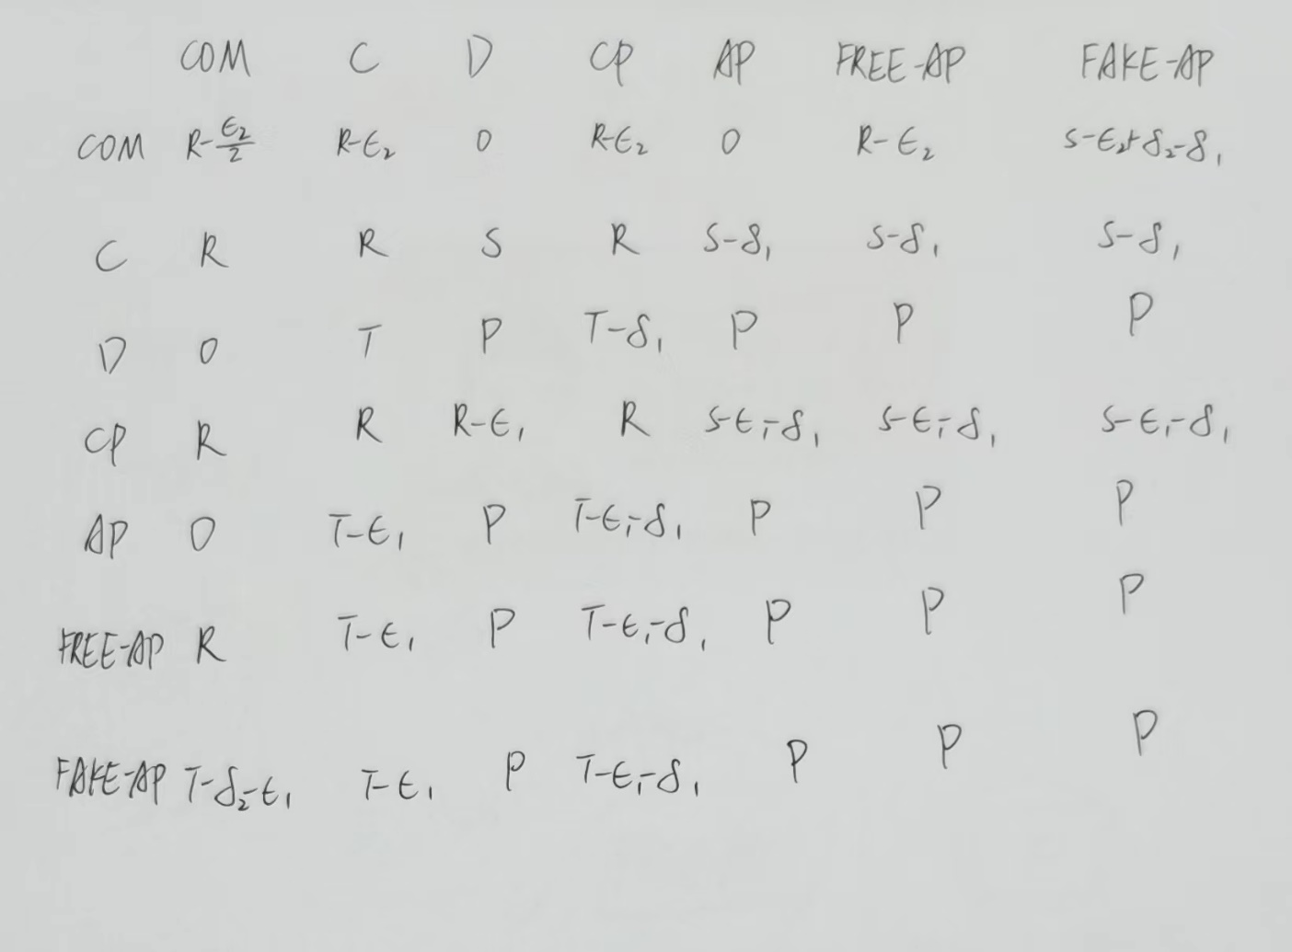
02 Models and Methods
PD with Punishment and Commitment

Slide 8

02 Models and Methods
Population Setup and Evolutionary Dynamics
A with fitness $f_{A}→$B with fitness $f_{B}$: $p_{A,B}={\left[1+e^{−β\left(f_{B}−f_{A}\right)}\right]}^{−1}$.
$β$ represents the ‘imitation strength’ or ‘intensity of selection’.
$β=0$: $p_{A,B}=\frac{1}{2}$, the imitation decision is random.
For large$β$, $p_{A,B}$ will be large, imitation becomes increasingly deterministi.

Slide 9
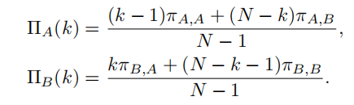

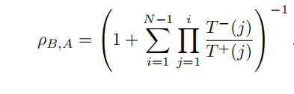


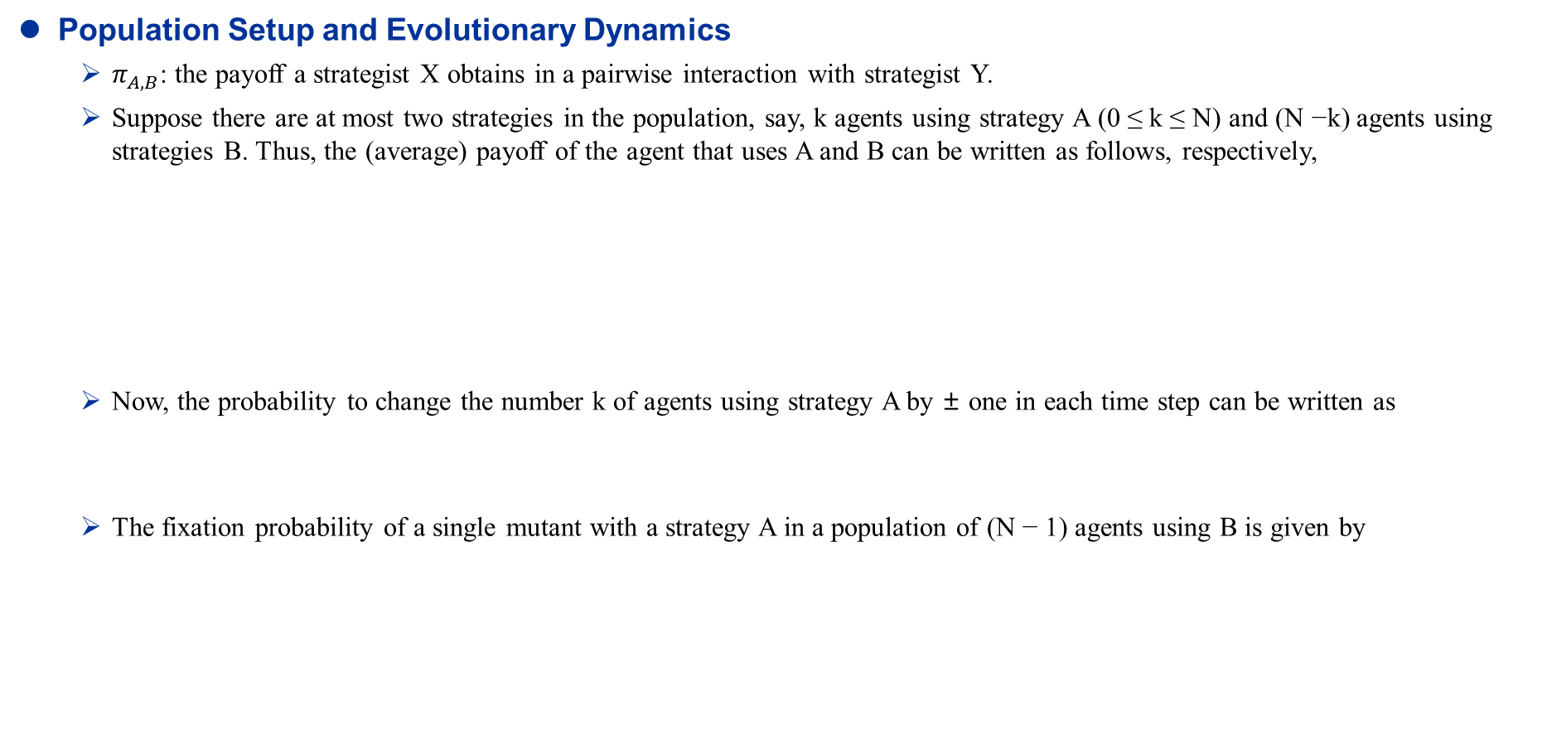

03 Models and Methods
Population Setup and Evolutionary Dynamics
$π_{A,B}$: the payoff a strategist X obtains in a pairwise interaction with strategist Y.
Suppose there are at most two strategies in the population, say, k agents using strategy A (0 ≤ k ≤ N) and (N −k) agents using strategies B. Thus, the (average) payoff of the agent that uses A and B can be written as follows, respectively,
Now, the probability to change the number k of agents using strategy A by ± one in each time step can be written as
The fixation probability of a single mutant with a strategy A in a population of (N − 1) agents using B is given by
$A→B$: $k+1$
$B→A$: $k−1$

Slide 10
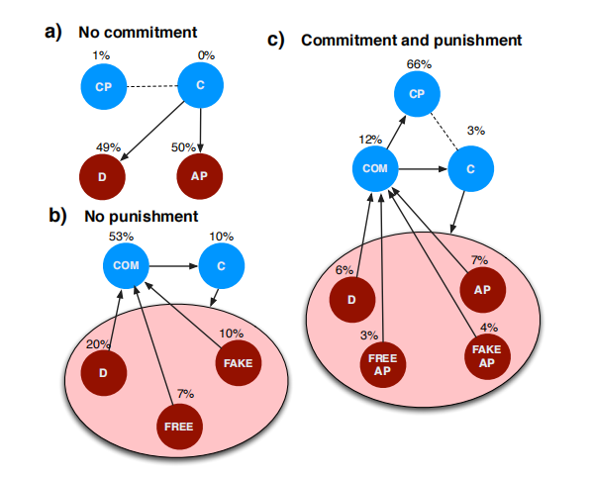
04 Results
Dashed lines stand for neutral transitions;
Blue circles represent cooperative;
red circles represent defective strategies.

Slide 11
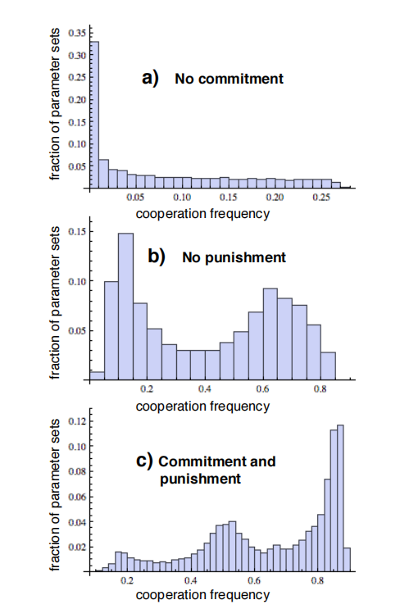
04 Results
When commitment is not an option (Figure a), the cooperation frequency is very low (8% on average), with no sample having more than 50% of cooperation.
When punishment is not available (Figure 2b), cooperation is more frequent (41% on average), but defection is also prevalent (59% on average). In 45% of the samples there is more than 50% of cooperation.
when both options are present (Figure 2c), a significantly higher level of cooperation is achieved (65% on average), with 75% of the samples having more than 50% of cooperation.

Slide 12
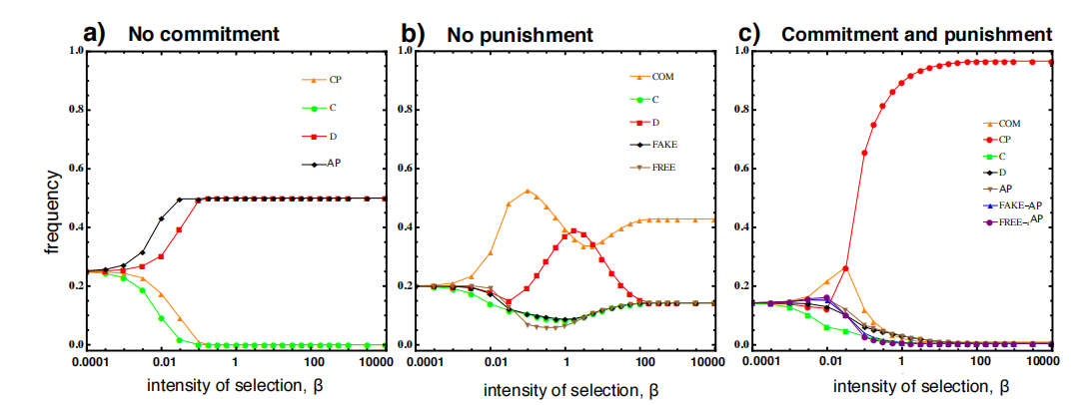
04 Results
Stationary distributions for varying intensity of selection
a) Antisocial punishment and defection are dominant when no commitment is present.
b) Although commitment performs best, all strategies are present in population.
c) Costly punishment and cooperation are prevalent for increasing intensity of selection when both strategic options are available.

