Slide 1
Do Equity Markets Care About Income Inequality?
Evidencefrom Pay Ratio Disclosure
YIHUI PAN, ELENA S. PIKULINA, STEPHAN SIEGEL, and TRACY YUE WANG* Journal of Corporate Finance, 2020.
李祎明 2022/11/10
1

Slide 2
Background
How U.S. financial markets and shareholders assess the dispersion in pay between a firm’s top executives and rank-and-file employees?
U.S. publicly traded companies to report the ratio between CEO pay and median worker pay for the first time in 2018.
Financial markets may respond negatively to high pay ratios throught a cash flow channel(Edmans (2011), Mohan et al. (2018), Green and Zhou (2019)).
Inquality-averse shareholders’ reluctance to invest firms with high pay ratios(Merton (1987)).
2

Slide 3
Motivation & Related Literature
The average pay ratio across 2,300 U.S. firms in 2018 is 145, median 65.
one σ increase in pay ratio decreases 7-day CAR by about 42 basis points
High CEO pay relative to median worker pay leads to a downward revision of firm value.
When controlling for disclosed CEO or worker pay in the same time:
significantly negative reaction
largely unchanged reaction
Financial markets react to pay ratio independently of pay levels.

Slide 4
Motivation & Related Literature
Two potential mechanisms of the negative market reaction:
1. Shareholders’ inequality aversion
2. Shareholders’ concerns about potential negative cash flow
How to determine inequality aversion?
1. Local social norms and preferences with respect to income inequality.
(for a similar location-based approach, see Hilary and Hui (2009), Kumar, Page,and Spalt (2011), and Di Giuli and Kostovetsky (2014)).
2. Individuals’ attitudes towards income inequality and redistribution, which are correlated with voting behavior and policy choices.
(for example, Alesina and Giuliano (2011), Luttmer and Singhal (2011), Bavetta et al. (2019)).
4

Slide 5
Research Design
1. To measure a firm’s exposure to potential negative cashflow:
Political leaning & Redistributive policies of the states
2. To measure the firm shareholders’ inequality aversion:
Political leaning & Redistributive policies of the the shareholders’ home states
3. To measure institutional investors’ social preferences:
(1) HQ states’s income inequality
(2) The value-weighted average KLD Social Score of their 2017 portfolio stock holdings.

Slide 6
Research Conclusion
1. Equity markets react negatively to high pay ratios.
2. Financial markets react to pay ratios independently of pay levels.
3. The shareholders’ inequality aversion is an important driver of the negative reaction to high pay ratios.
4. Firms with inequality-averse shareholders have significantly more negative market reactions to high pay ratio.
5. More inequality-averse institutional investors reduce their allocations to stocks with higher pay ratios.

Slide 7
Contribution
1. Proved the firms’ practices with respect to social responsibility affect firms’ equity valuation via investors’ preferences.
2. Different from other social responsibility studies that highlight profitability aspect.
(for example, Fernando, Sharfman, and Uysal (2017), Lins, Servaes, and Tamayo (2017),Albuquerque, Koskinen, and Zhang (2018))
3. The firm-specific change in investors’ portfolios in response to the newly available firms’ pay ratios.
7

Slide 8
Contribution
4. Previous researches:
(1) Inequality aversion is shared by many individuals and they are willing to make sacrifices to lower inequality (Fehr and Schmidt (1999), Dawes et al. (2007),Tricomi et al. (2010)).
(2)While survey-based evidence suggests that many Americans prefer less inequality in comparison to the existing levels in the U.S. society (Norton and Ariely (2011)).
(3) Wealthy Americans, who are more likely equity investors, have been found to be more accepting of inequality than the rest of the population (Cohn et al. (2019)).
Debate:
Does the financial market participants have negative attitude of ineqality?
This study is consistent with the hypotheses:
Sufficiently many U.S. investors are concerned about income inequality.
Their concerns affect equity prices.
Violations of social norms bring costly punishment.
7

Slide 9
Data of CEO-worker Pay Ratio
The pay ratio disclosure rule from 2017:
1. The median of the annual total compensation of all employees (exp CEO)
2. The annual total compensation of the CEO
3. The ratio between those two numbers.
To identify the median worker pay:
1. Include part-time, seasonal, and temporary employees(not annualizing wages).
2. Include non-U.S. employees (unless it’s less than 5%mployees in countries other than the country of the CEO’s residence.
3. Exclude workers get paid by third party.
8

Slide 10
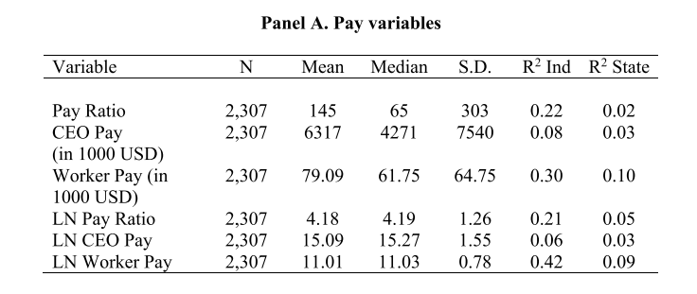
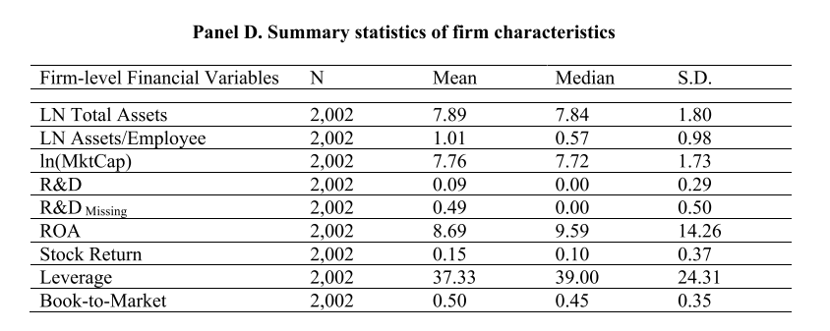
Data of CEO-worker Pay Ratio
8

Slide 11
Regressions: CAR to Pay Ratio
1. Identify 2,135 firms in our sample with non-missing daily returns over
[ 1 day before, pay ratio announcement day, 5 days after ]
2. Calculate abnormal returns for [-1,+5] , excluding dividends
(daily return - value-weighted CRSP market return)
3. Delete 128 firms with abnormal returns deviate by more than 3σ from the mean of all days of 2018.
4. Calculate cumulative abnormal returns, CAR[-1,+5]
5. Regression:
controlling for equity market capitalization, ln(MktCap) and Book-to-Market
9

Slide 12
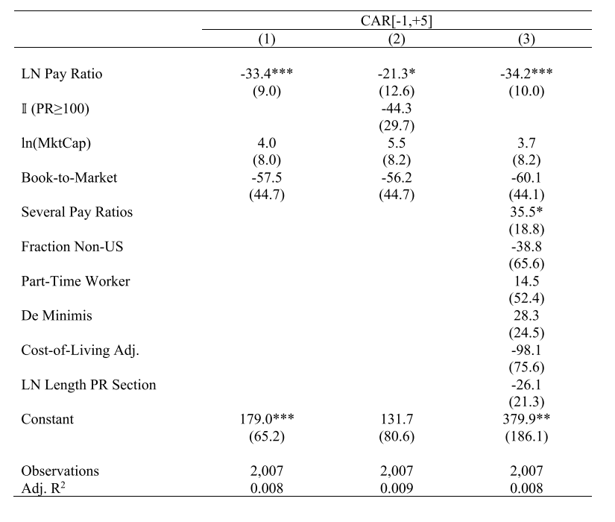
Regressions: CAR to Pay Ratio
9

Slide 13
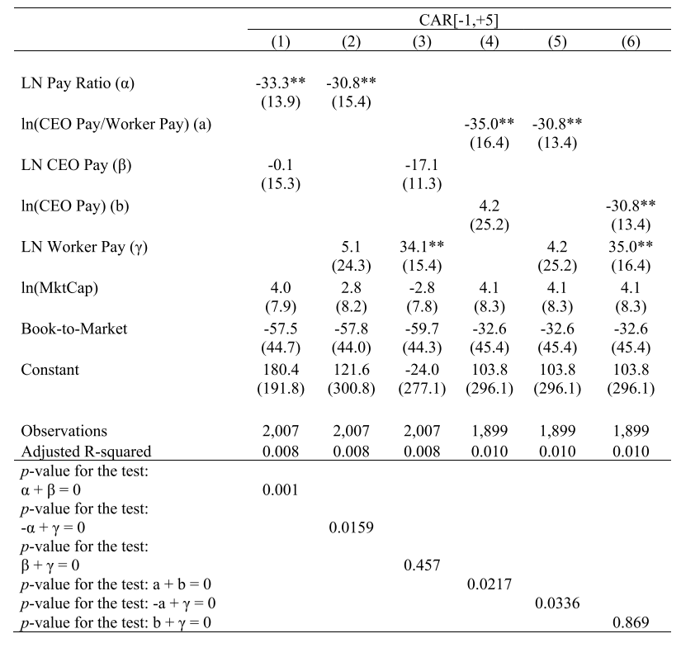
Pay Dispersion vs. Pay Levels
10

Slide 14
Equity market reaction to pay ratio
To measure firm & Investor inequality aversion:
1. Political views:
The support for Democratic candidate in the 2016 U.S. Presidential Elections in a state as a proxy for the revealed inequality aversion in the state.
2. State income taxes:
max individial income tax - min individual income tax
min wage = inequality aversion of local residents.
3. Firm investors’ :
weighted avg inequality aversion across the states of the investors
4. Individual investors:
Inequality aversion in the firm’s headquarters state
10

Slide 15
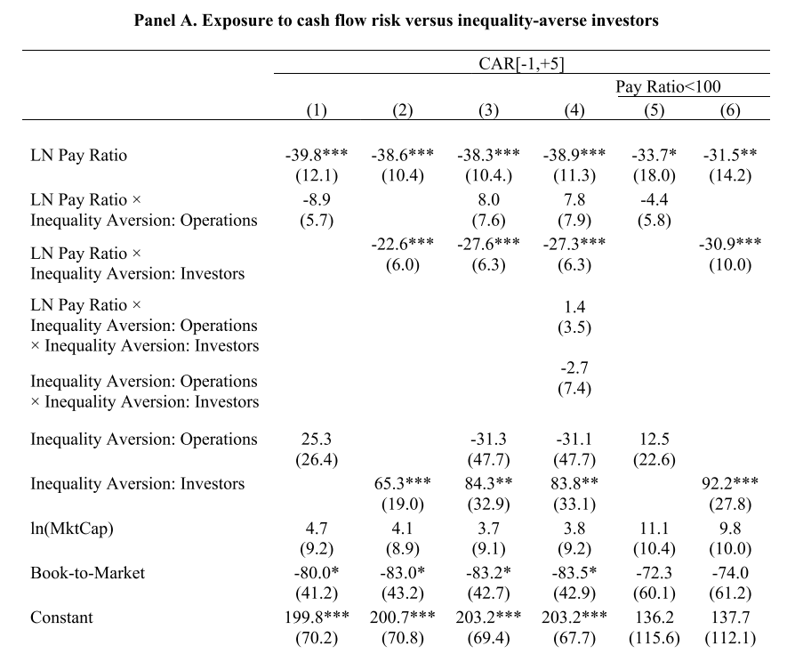
Equity market reaction to pay ratio
We estimate the following regression model to test Effect of entrepreneurs' facial trustworthiness on crowdfunding success:
•

Slide 16



Institutional Investors’ Portfolio Rebalancing
Target: U.S. institutional investors (>100M USD)
Data: 1,862 institutional investors’ holding database(end of 2017,2018)
Inequality aversion: HQ states’s income inequality
KLD Social net score
Investor’s portfolio rebalancing activity between 2017.12.31 -2018.12.31
is the stock prices of stock j by the end of 2017

Slide 17

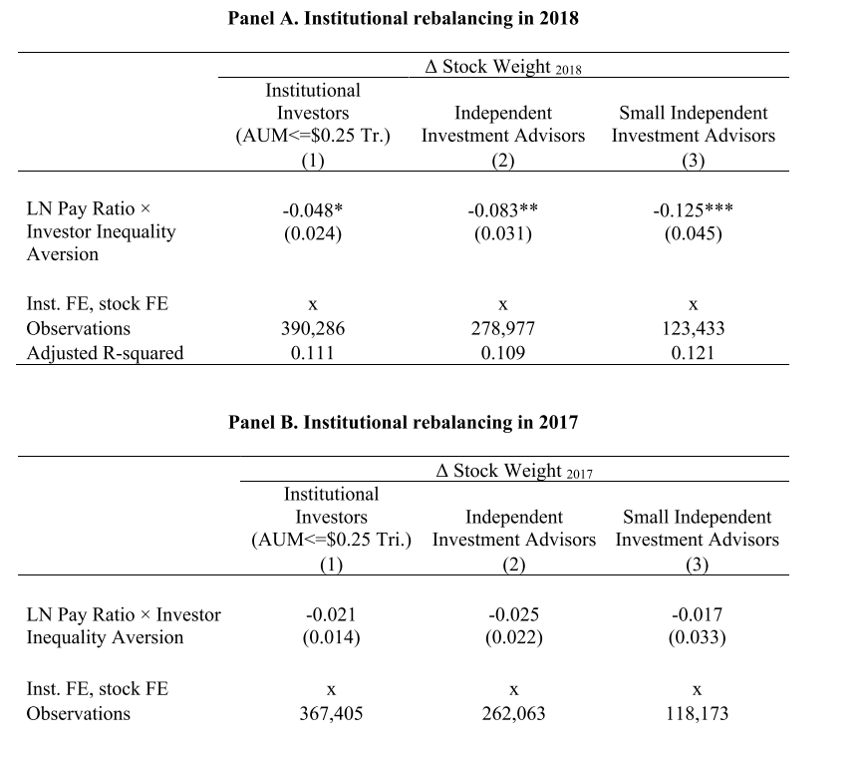
Institutional Investors’ Portfolio Rebalancing

Slide 18
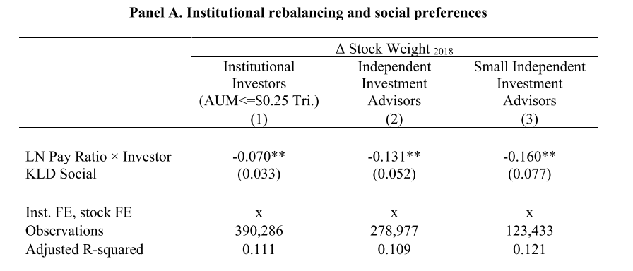
Institutional Investors’ Portfolio Rebalancing（ESG）
KLD means positive environmental, social and corporate governance (ESG) characteristics

Slide 19
Conclusion
1. Equity markets react negatively to high pay ratios.
2. Financial markets react to pay ratios independently of pay levels.
3. The shareholders’ inequality aversion is an important driver of the negative reaction to high pay ratios.
4. Firms with inequality-averse shareholders have significantly more negative market reactions to high pay ratio.
5. More inequality-averse institutional investors reduce their allocations to stocks with higher pay ratios.

