Slide 1
Debt Refinancing and Equity Returns
NILS FRIEWALD, FLORIAN NAGLER, and CHRISTIAN WAGNER*
Journal of Finance, 2022
李祎明
2023-01-05
liyiming 1

Slide 2
Content
1. Introduction
• Background & Motivation
• Question
• Research content
• Contribution
2. Variables
3. Empirical Analysis
4. Conclusion
liyiming 2

Slide 3
1. Introduction
Background & Motivation
• MM —fixing asset beta, expected equity returns should increase with leverage.
• Previous research shows that the empirical link between leverage and equity returns is not as clear and simple as proposed by MM.
• Previous research assumes that investors price all leverage-related risks equally.
• However, there are two key opposing economic forces behind the debt maturity effects.
liyiming 3

Slide 4
1. Introduction
Background & Motivation
• He and Xiong (2012): short-term debt exposes firms to rollover risk, whereas long_x0002_term debt mitigates the immediacy of debt refinancing needs.
• Equity holders, as residual claimants to firms’ cash flows, commit to cover potential shortfalls arising from the rollover of maturing debt, that is, they face potential losses due to debt rollover.
• Given level of leverage, shareholders’ expected rollover losses increase in a firm’s refinancing intensity,
• Equity risk increases in short-term leverage but decreases in long-term leverage.
liyiming 4

Slide 5
1. Introduction
Background & Motivation
• Dangl and Zechner (2021) , DeMarzo and He (2021):
short-term debt provides firms with more financial flexibility than long-term debt. Such flexibility is crucial to alleviate (agency) costs due to debt overhang.
• The key idea is that short-term debt is considered a device for equity holders to reduce leverage when cash flows deteriorate.
• Given level of leverage, higher debt refinancing intensity reflects more flexibility to adjust the firm’s capital structure and thus reduces equity risk.
• Equity risk decreases in short-term leverage but increases in long-term leverage.
liyiming 4

Slide 6
1. Introduction
Question
• Controlling for leverage, how are firms’ debt refinancing intensities related to equity returns?
• Do shareholders require the same premium for short-term leverage and for long-term leverage?
liyiming 5

Slide 7
1. Introduction
Research contents
Controlling the leverage
Cross-sectional regressions
&
Portfolio sorts
How firms’ debt maturities matter for equity returns
2 、 Use portfolio sorts to assess the premia for short-term and long-term leverage Then study their factor risk exposures.
liyiming 6

Slide 8
1.Introduction
Contribution
1) Concluded a debate :
• Equity returns increase in short-term leverage but not in long-term leverage.
• Because of higher rollover risk, investors require a premium for stocks with higher short-term leverage ratio（refinancing intensity)
• The premium differential (controlling for size effects) is about 3.2% per year.
liyiming 7

Slide 9
1.Introduction
Contribution
2) Method highlight
• Decompose leverage into shor-term leverage(within 3 years) and long-term leverage(over 3 years)
3) Corporate financial application
• Shareholders price debt refinancing risk, and that firms should take this into account when choosing their debt maturity structure.
• The more short term the leverage of a firm is, the more expensive is its equity capital.
liyiming 8

Slide 10


2. Variables
1) Data
• Listed nonfinancial U.S.firms: 10,202 in total, period 1976.01~2019.12
• CompuStat has data of company debt maturing 1,2,3,4,5, more years.
• Debt mature in 1 ,2 , 3 , or more years
Mature in 1 , 2 , 3 years: dd1 , dd2 , dd3
Mature in > 1year : dltt
2) Variables
LEV (leverage) = $\frac{total debt}{total debt + market value}$
RI (refinancing intencity) = $\frac{dd1 + dd2+dd3}{total debt}$
liyiming 9

Slide 11
2. Variables
3) Other variables:
beta (β),
market value of equity (ME),
investment-to-assets(I/A),
return on equity (ROE),
book-to-market (BM),
operating profitability (OP)
1. Using a constant accounting lag of six months for firms with fiscal years not ending in December
2. Or measuring the latest available accounting data as of
the end of December
liyiming 10

Slide 12
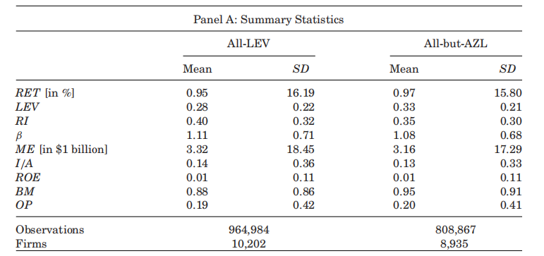
2. Variables
3) Summary statistics
AZL: leverage ratio below 5%
liyiming 11

Slide 13
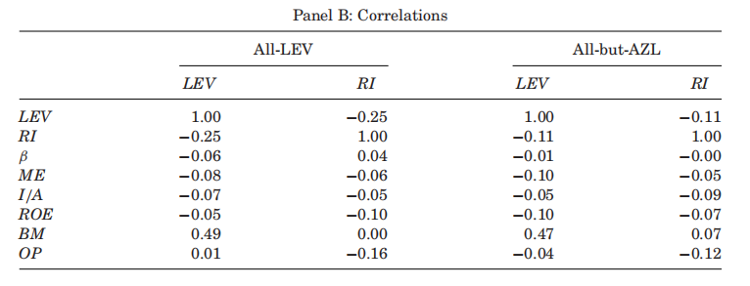
2. Variables
3) Summary statistics
AZL: leverage ratio below 5%
Firms with a high leverage ratio tend to have a lower debt refinancing intensity.
liyiming 11

Slide 14
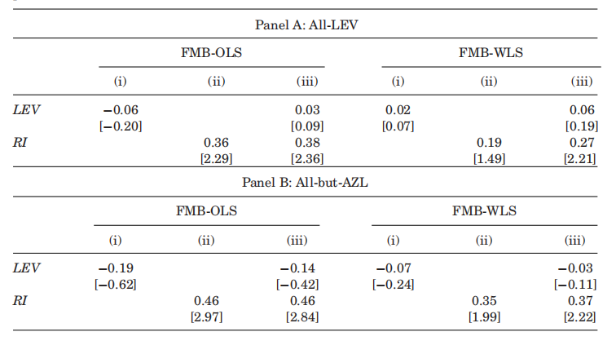
2. Variables
4）FamaMacbenth OLS & WLS
Finding that equity returns increase in the fraction of short debt/ total debt.
First evidence of debt rollover risk channel.
liyiming 12

Slide 15
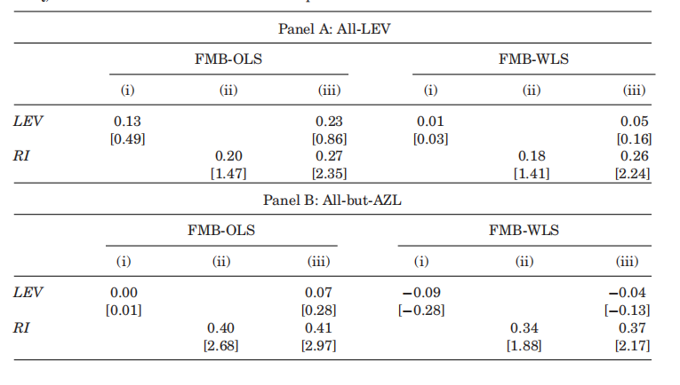
2. Variables
4）FamaMacbenth OLS & WLS
FMB regressions is sensitive to microcaps, we repeat the analysis for the subset of stocks with market equity greater than or equal to the 20th percentile of NYSE stocks.
liyiming 12

Slide 16
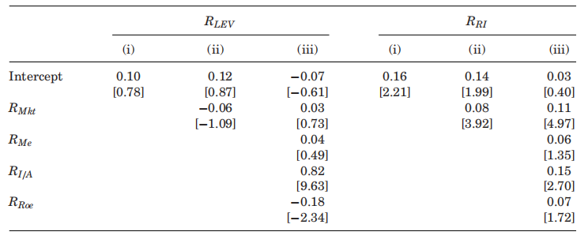
3. Empirical Analysis
1) HXZ (2015) the q-Factors
These results show that the cross-section of stock returns reflects a positive premium for debt refinancing risk.
A higher immediacy of debt refinancing is associated with higher equity returns due to increased exposure to systematic risk.
liyiming 13

Slide 17
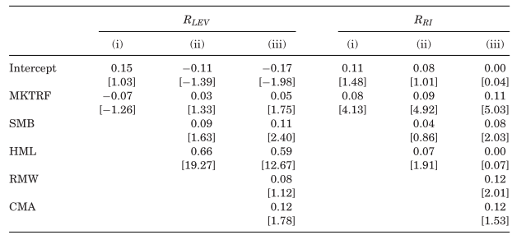
3. Empirical Analysis
2) Fama and French 3 & 5
RI premium is spanned by positive risk factor exposures.
liyiming 13

Slide 18
3. Empirical Analysis
3) Different Angle
Decompose LEV into Short & Long Angle
Short-term LEV = STLEV = RI·LEV
Long-term LEV = LTLEV = (1 − RI) · LEV
liyiming 13

Slide 19
3. Empirical Analysis
4) Different Angle
Decompose LEV into Short & Long Angle
Short-term LEV = STLEV = RI·LEV
Long-term LEV = LTLEV = (1 − RI) · LEV
liyiming 13

Slide 20
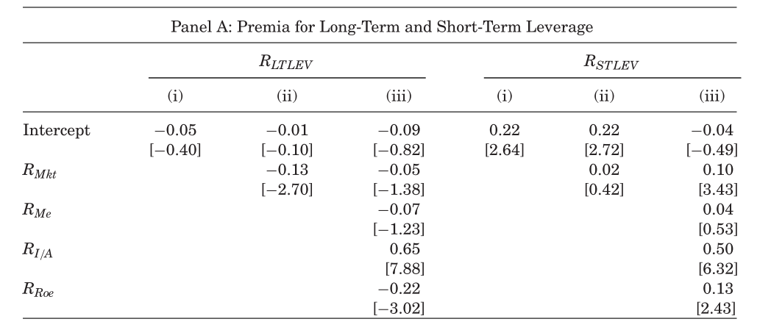
3. Empirical Analysis
4) HXZ (2015) the q-Factors
Short-term LEV starts to show significancy.
Long-term LEV does not.
liyiming 13

Slide 21
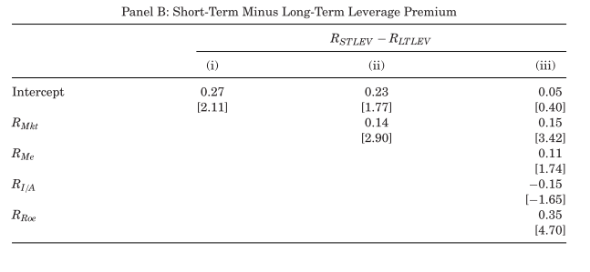
3. Empirical Analysis
4) HXZ (2015) the q-Factors
RSTLEV −RLTLEV show significancy.
liyiming 13

Slide 22
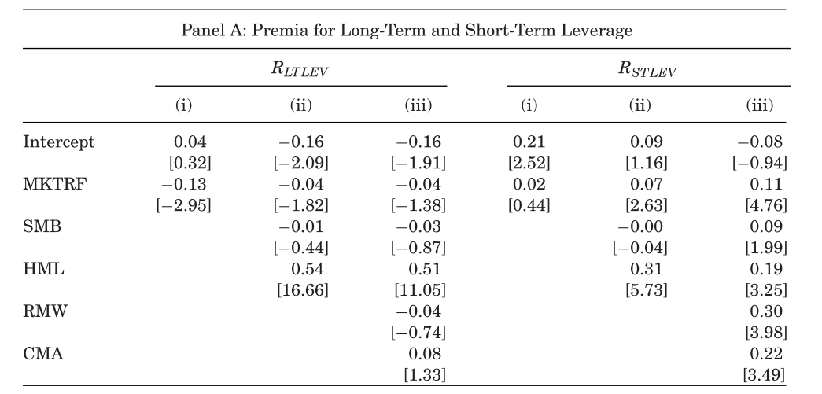
3. Empirical Analysis
4) Fama and French 3 & 5
Short-term LEV starts to show significancy.
Long-term LEV does not.
liyiming 13

Slide 23
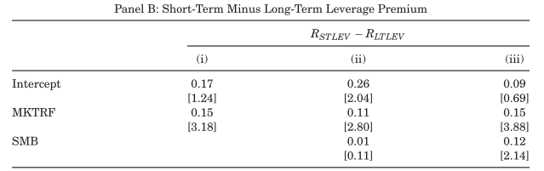


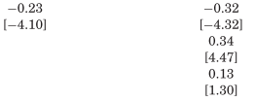
3. Empirical Analysis
4) Fama and French 3 & 5
Short-term LEV starts to show significancy.
Long-term LEV does not.
liyiming 13

Slide 24
3. Empirical Analysis
• Our empirical analysis shows that short-term leverage and long-term lever-age have fundamentally different implications for equity returns.
• Shareholders demand a premium for shortterm leverage over and above the compensation they require for long-term leverage.
• Since we also find that shareholders require a premium for a firm’s debt refinancing risk but not for the level of its leverage, our evidence suggests that the economic source of the premium for short-term leverage is debt rollover risk.
liyiming 22

Slide 25
4.Conclusion
Contribution
1) Concluded a debate :
• Equity returns increase in short-term leverage but not in long-term leverage.
• Because of higher rollover risk, investors require a premium for stocks with higher short-term leverage ratio（refinancing intensity)
• The premium differential (controlling for size effects) is about 3.2% per year.
liyiming 7

Slide 26
4.Conclusion
Contribution
2) Method highlight
• Decompose leverage into shor-term leverage(within 3 years) and long-term leverage(over 3 years)
3) Corporate financial application
• Shareholders price debt refinancing risk, and that firms should take this into account when choosing their debt maturity structure.
• The more short term the leverage of a firm is, the more expensive is its equity capital.
liyiming 8

