Slide 1
Do sophisticated investors follow fundamental analysis strategies?
Evidence from hedge funds and mutual funds
Feifei Wang · Xuemin Sterling Yan · Lingling Zheng
Review of Accounting Studies, 2023.

Slide 2
Background
Prior studies have documented considerable evidence that fundamental analysis works, and leads to profitable investment strategies (Richardson et al. 2010; Green et al. 2013)
Earnings, cash flows, accruals, F-score, G-score, and accounting ratios
Competing explanations for the profitability of fundamental strategies fall into two categories.
Market inefficiency and Compensations for bearing risk
If market inefficiency works, then one would expect sophisticated investors such as institutional investors to arbitrage against the mispricing

Slide 3
Background
Several studies have investigated the issue and find mixed results (Ke and Ramalingegowda, 2005; Ali et al., 2008)
Transient institutions exploit PEAD, mutual funds trade on the accruals
A number of finance papers examine whether institutional investors exploit market anomalies in general (Lewellen, 2011; Akbas et al., 2015; Edelen et al., 2016; Calluzzo et al., 2019; McLean et al., 2020)
Overall, institutional investors do not bet on anomalies, even act on the short leg
Hedge funds do, mutual funds do not, and focus on the post-publication period.

Slide 4
Motivation
Prior literature shows that many fundamental signals predict the cross-section of stock returns, then one would expect sophisticated investors to actively follow fundamental strategies.
Existing studies examine one or a small number of accounting anomalies and use the holdings data to infer institutional investors’ trading behavior
Stockholdings inform us about institutional investors’ trading behavior, such data have several limitations (no short positions, window dressing)
We use fund returns to gauge this issue with 54 fundamental strategies

Slide 5
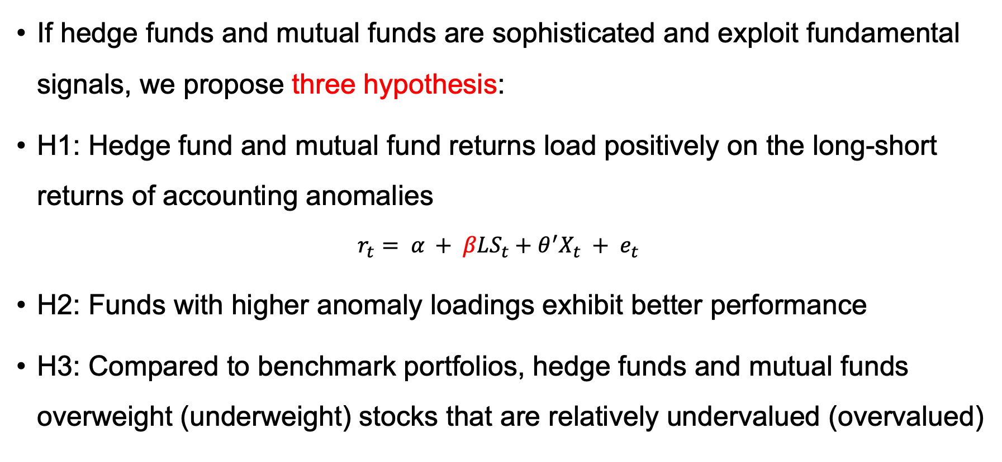
Research Design
If hedge funds and mutual funds are sophisticated and exploit fundamental signals, we propose three hypothesis:
H1: Hedge fund and mutual fund returns load positively on the long-short returns of accounting anomalies
$$r_{t}= α + βLS_{t}+{θ^{′}X}_{t} + e_{t}$$
H2: Funds with higher anomaly loadings exhibit better performance
H3: Compared to benchmark portfolios, hedge funds and mutual funds overweight (underweight) stocks that are relatively undervalued (overvalued)

Slide 6
Research Design
Loading on long-short returns
Positive loading:
bet on anomaly
H1: Whether exploit fundamental signals?
Negative loading: contrary to anomaly
Why negative:
Agency explanation
H2: Anomaly loadings and fund performance
A significant and positive relation
Aggregate holding
H3: Stockholding to benchmark portfolio
weighted against most accounting anomalies
Fund level holding
Time-series level

Slide 7
Research findings
We find that, on average, aggregate fund returns tend to load negatively on the long-short returns of accounting anomalies
Hedge fund: 42 of the 54, Mutual fund: 39 of the 54, 5 of the 7 categories
Agency explanation: concentrated in the short leg and contrarian-like anomalies
Hedge funds and mutual funds with higher average anomaly loadings significantly outperform funds with lower average loadings
We find no evidence that hedge funds and mutual funds tilt their portfolios towards profitable accounting anomaly factors

Slide 8
Contribution
Our main contribution is to provide a first comprehensive study of whether institutional investors follow fundamental analysis strategies (Lewellen, 2011; Akbas et al., 2015; Edelen et al., 2016; Calluzzo et al., 2019; McLean et al., 2020)
New perspective by using fund returns
54 comprehensive anomalies and examine the type of trade
Our paper also contributes to several streams of the accounting literature (Bartov et al. 2000; Collins et al. 2003; Green et al. 2011; Kokkonen and Suominen 2015).
Influence of institutional investors on the anomalies and Meta-analysis of anomalies

Slide 9
Data
Fundamental analysis strategies
We restrict sample to anomaly variables that can be constructed primarily using the Compustat data from Green et al. (2013), Hou et al. (2015), McLean and Pontiff (2016).
54 comprehensive anomalies exclude financial stocks and stocks price lower than $5
Category: Earnings Quality, Investment, Profitability, Profit Growth, External Financing, R&D, and Value
Hedge fund and mutual fund data
We obtain hedge fund data 1994–2020 from Lipper TASS (exclude less than 10 million)
Mutual fund data 1994–2020 from CRSP-SBFMFD (exclude less than 15 million)

Slide 10
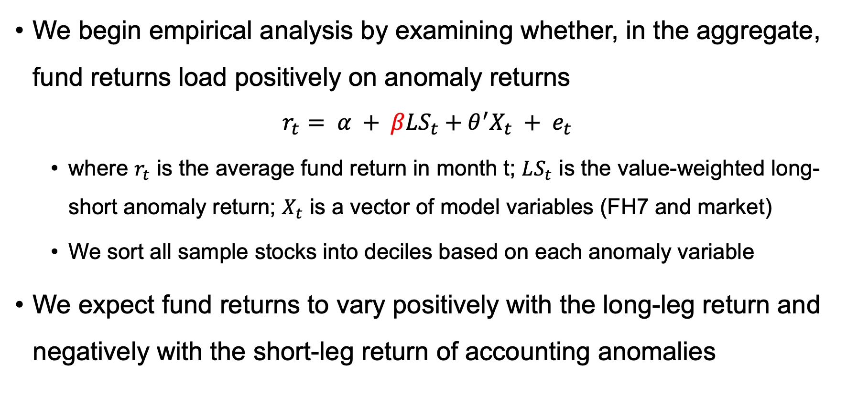
Empirical results for H1
We begin empirical analysis by examining whether, in the aggregate, fund returns load positively on anomaly returns
$$r_{t}= α + βLS_{t}+{θ^{′}X}_{t} + e_{t}$$
where $r_{t}$ is the average fund return in month t; $LS_{t}$ is the value-weighted long-short anomaly return; $X_{t}$ is a vector of model variables (FH7 and market)
We sort all sample stocks into deciles based on each anomaly variable
We expect fund returns to vary positively with the long-leg return and negatively with the short-leg return of accounting anomalies

Slide 11
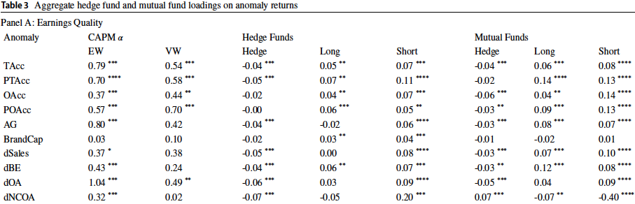
Empirical results for H1
Aggregate fund returns tend to load negatively on anomaly returns

Slide 12
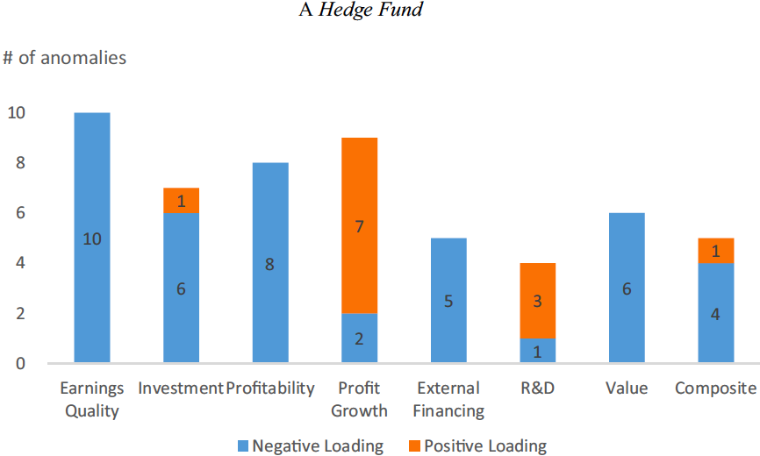
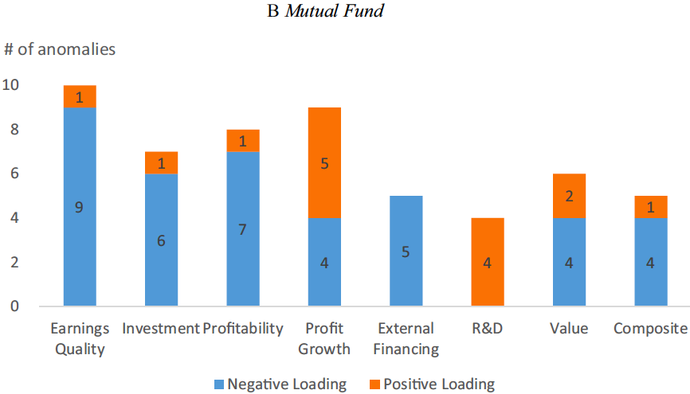
Empirical results for H1
Aggregate fund returns tend to load negatively on anomaly returns
Hedge fund: 42 of the 54, Mutual fund: 39 of the 54, 5 of the 7 categories

Slide 13
Empirical results: Agency explanation
The agency explanation makes two testable predictions
Negative loadings should be focused on the short leg of the anomalies because agency considerations incentivize fund managers to hold overpriced, glamour stocks
Negative loadings should be more pronounced among contrarian-like anomalies because contrarian-like anomalies are driven by market overreaction
To test this prediction, we classify the 54 accounting anomalies as either momentum-like and contrarian-like anomalies
If the formation period returns and the holding period (1 year) returns are in the same direction, we classify the anomaly as a momentum like anomaly.
Overall, 28 of our sample anomalies are classified as contrarian-like anomalies, while the remaining 26 are classified as momentum-like anomalies

Slide 14
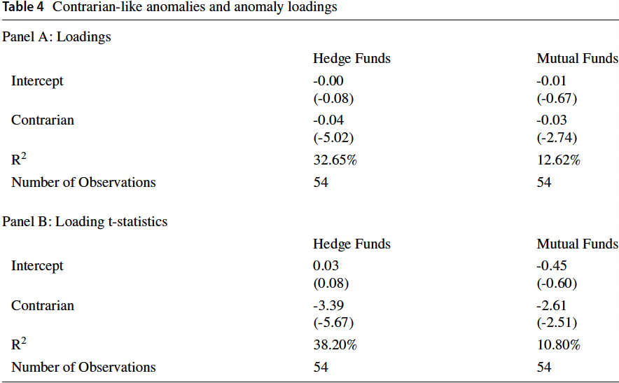
Empirical results: Agency explanation
Negative anomaly loadings documented earlier are significantly more pronounced for contrarian-like anomalies.

Slide 15
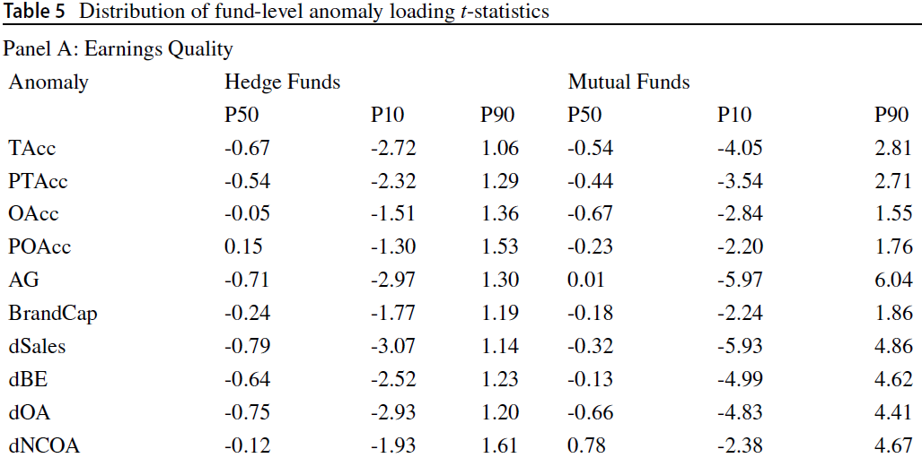
Empirical results for H2
Anomaly loadings and fund performance
We first estimate anomaly loadings at the individual fund level and find that fund-level anomaly loadings are disproportionately negative.

Slide 16
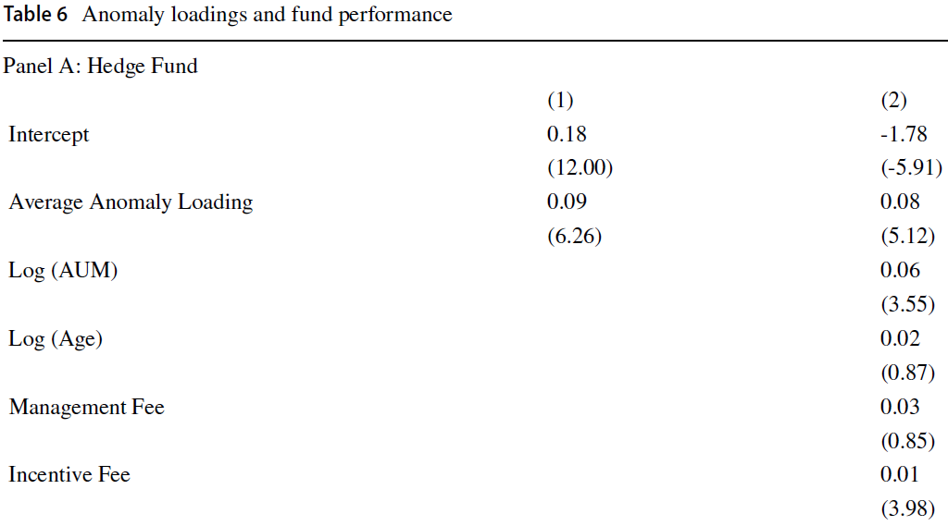
Empirical results for H2
Anomaly loadings and fund performance
We find a significant and positive relation between average anomaly loadings and fund performance.

Slide 17
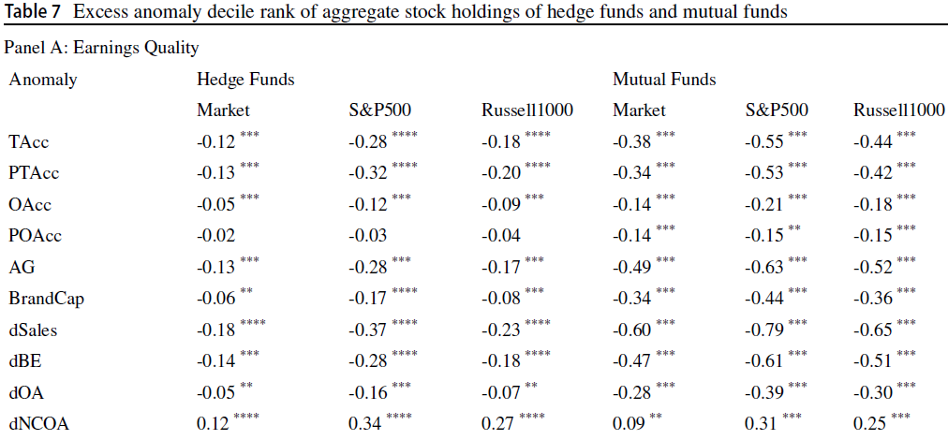
Empirical results for H3
To evaluate whether fund managers bet on accounting anomalies, we compute average anomaly decile ranks of fund stockholdings
Excess anomaly ranks tend to be negative for hedge funds and mutual funds.

Slide 18
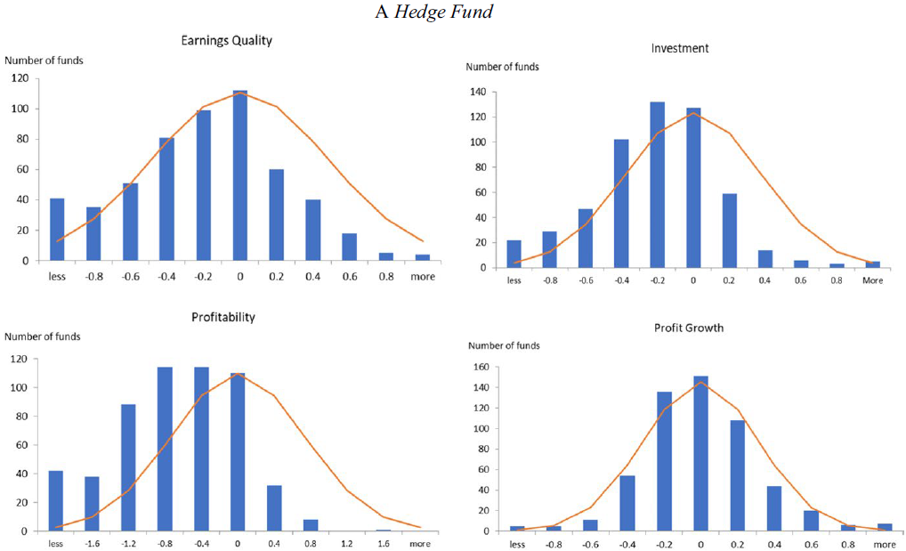
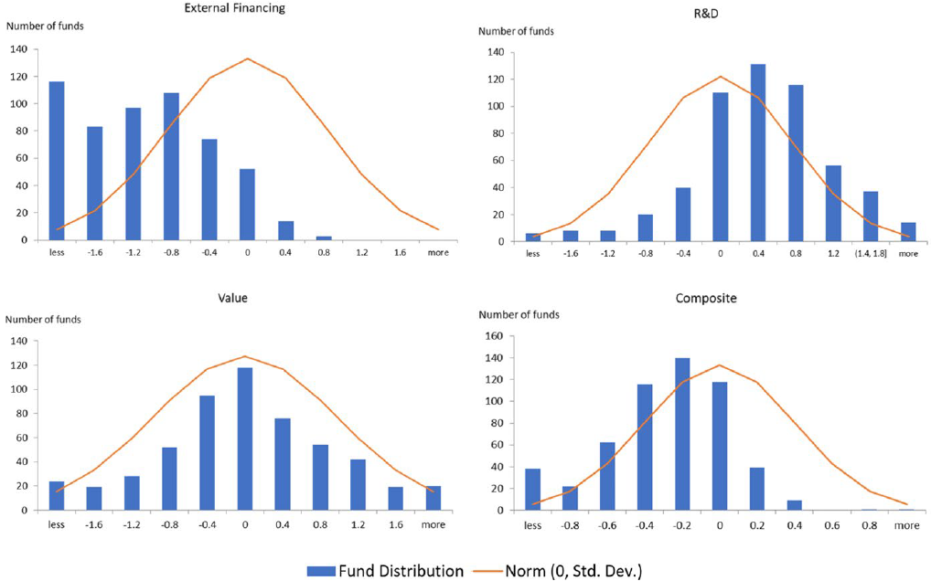
Empirical results for H3
We also calculate the average anomaly decile rank of stockholdings at the individual fund level.
Excess anomaly ranks tend to be negative for hedge funds and mutual funds.

Slide 19
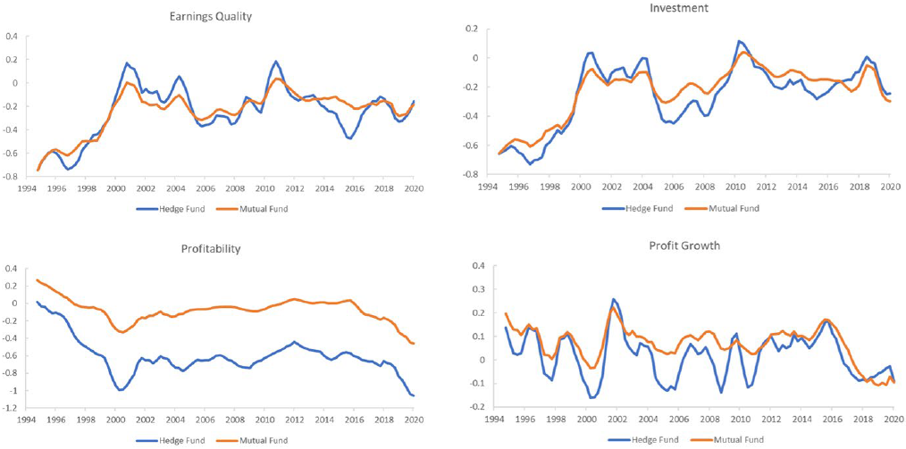
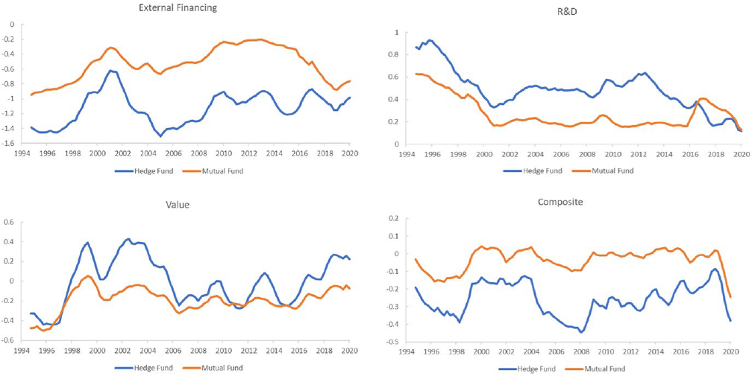
Empirical results for H3
We also explore the time-series variation of excess anomaly ranks.
The average excess anomaly ranks are persistently negative during our sample period

Slide 20
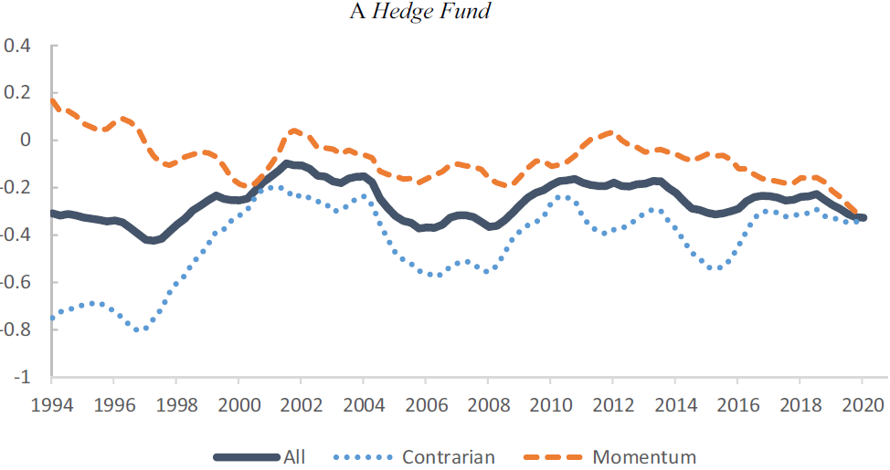
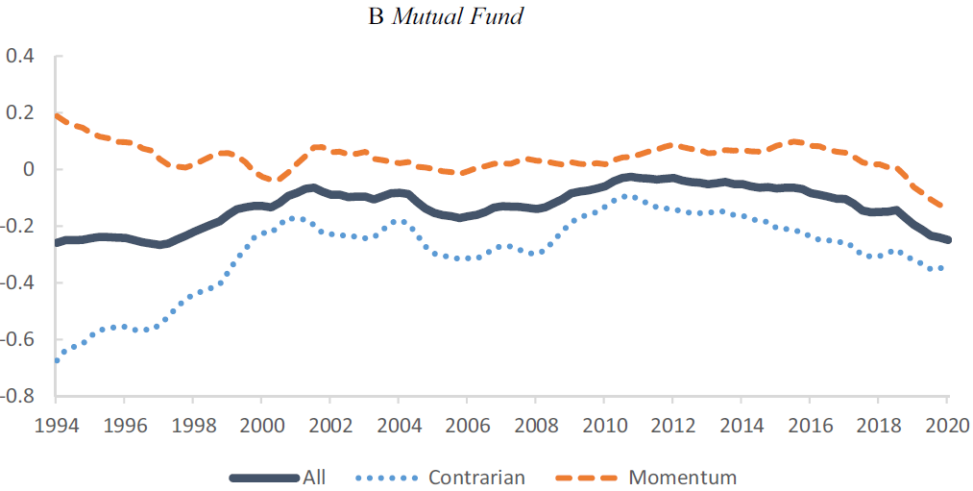
Empirical results for H3
We also plot the average excess anomaly ranks aggregated across all contrarian-like anomalies and momentum-like anomalies
These negative excess anomaly ranks are primarily driven by contrarian-like anomalies.
We find a co-movement in the excess anomaly ranks between hedge funds and mutual funds.

Slide 21
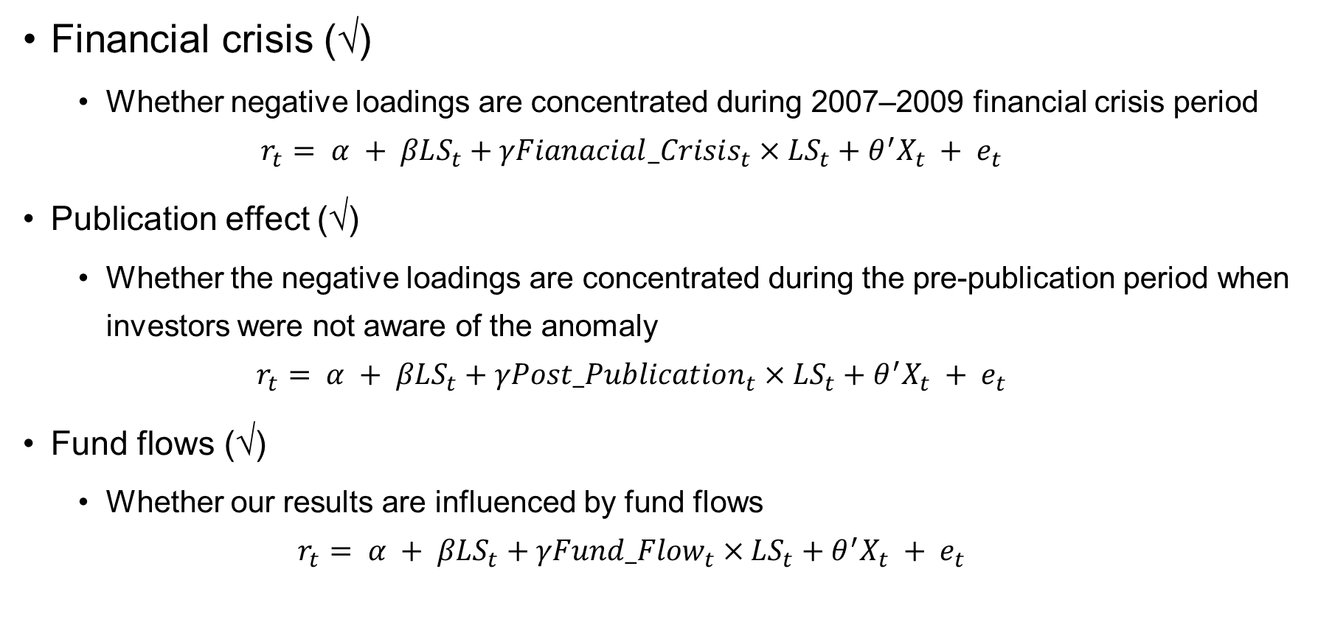
Additional analyses and discussions
Financial crisis (√)
Whether negative loadings are concentrated during 2007–2009 financial crisis period
$$r_{t}= α + βLS_{t}+γFianacial_Crisis_{t}×LS_{t}+{θ^{′}X}_{t} + e_{t}$$
Publication effect (√)
Whether the negative loadings are concentrated during the pre-publication period when investors were not aware of the anomaly
$$r_{t}= α + βLS_{t}+γPost_Publication_{t}×LS_{t}+{θ^{′}X}_{t} + e_{t}$$
Fund flows (√)
Whether our results are influenced by fund flows
$$r_{t}= α + βLS_{t}+γFund_Flow_{t}×LS_{t}+{θ^{′}X}_{t} + e_{t}$$

Slide 22
Conclusion
We use the returns and stockholdings of hedge funds and mutual fund to examine the whether sophisticated investors follow fundamental analysis strategies.
We find that the returns of hedge funds and mutual funds tend to load negatively on the long-short returns of 54 fundamental strategies.
We find that funds with higher anomaly loadings significantly outperform their peers.
We find similar results when examining the stockholdings of hedge funds and mutual funds

