Slide 1
Deep Learning in Asset Pricing
Luyang Chen, et.al, working paper, 2020.

Slide 2
Outline
Introduction
Research design
Empirical result
Robust Test
A brief introduction of “Autoencoder Asset Pricing Models”
Some views

Slide 3
Introduction: Background
The most fundamental question in asset pricing is to estimate a stochastic discount factor that can explain expected returns of all assets.
Recently, lots of new methods was applied to find a stochastic discount factor that can explain more asset’s returns, like IPCA(Kelly et al., 2019).
Deep learning method has shown its power in many field.

Slide 4
Introduction: Motivation
The SDF is hard to estimate by traditional method:
The SDF could by construction depend on all available information, which means the SDF is a function of a potentially very large set of variables.
The functional form of the SDF is unknown and likely complex.
Recent machine learning methods do not take the economic condition into consideration.

Slide 5
Introduction: Research Questions
Does the new method have a better performance than existing methods?
Which variable is important to the SDF from the new method.
What’s the structure of the SDF in this paper.

Slide 6
Introduction: Related Researches
Using existing machine/deep learning methods:
Gu et al. (2019) conduct a comparison of machine learning methods for predicting the panel of individual US stock returns.
Messmer (2017) and Feng et al. (2018) follow a similar approach as Gu et al. (2019) to predict stock returns with neural networks.
Rossi (2018) uses Boosted Regression Trees to form conditional mean-variance efficient portfolios based on the market portfolio and the risk-free asset.

Slide 7
Introduction: Related Researches
Design new model structure:
Gu et al. (2019) extend the linear conditional factor model of Kelly et al. (2018) to a non-linear factor model using an autoencoder neural network.
Kelly et al. (2018) raised a new method named IPCA to find a better SDF.

Slide 8
Introduction: Research Contents
Form a new deep learning structure, which has a highest sharpe ratio (2.6) and best explanation power of individual stock returns.
Calculate the importance of input variables and find that trading frictions and past returns are the most relevant categories.
Study the structure of the SDF weights and betas as a function of the characteristics and find that individual characteristics have an almost linear effect on the pricing kernel and the risk loadings

Slide 9
Introduction: Innovation
Using the no-arbitrage condition as part of the neural network algorithm.

Slide 10
Introduction: Contribution
Draw a new method to estimate SDF, which combines new method and economic conditions.

Slide 11
Research Design:
Returns
Linear GAN(LS)
Elastic Net(EN)
feedforward Network(FFN)
GAN
Model
+
No-arbitrage
vs
Firm characteristics,
Macroeconomic variables
Variable importance
SDF structure

Slide 12
Research Design: Data
1967.01-2016.12 monthly data, all stocks on CRSP.
46 firm-specific characteristics listed either on Kenneth French Data Library or used by Freyberger et al. (2019)
Past returns(6): Short-term momentum, Momentum, Intermediate momentum, Long-term momentum, Short-term reversal Long-term, Long-term reversal
Investment(4): Investment, [Net operating assets, Change in property, plants, and equipment Net], Net share issue.
Profitability(11): Profitability, Net sales over lagged net operating assets Capital turnover, Fixed costs to sales Operating profitability, Profit margin, Return on net operating assets Return on assets, Return on equity, Selling, general and administrative expenses to sales Capital, sales Capital intensity

Slide 13
Research Design: Data
46 firm-specific characteristics listed either on Kenneth French Data Library or used by Freyberger et al. (2019)
Intangibles(4): Accrual, Operating accruals Operating leverage Price, Price to cost margin
Values(10): Assets to market cap, Book to Market Ratio, Ratio of cash and short-term investments to total assets, Free Cash Flow to Book Value, Cashflow to price, Dividend Yield, Earnings to price, Tobin’s Q, Sales to price, Leverage
Trading friction(11): Total Assets, CAPM Beta, Idiosyncratic volatility, Size, Turnover Market Beta, Closeness to past year high Residual Variance, Bid-ask spread, Standard unexplained volume, Variance

Slide 14
Research Design: Data
178 macroeconomic variables: 124 from FRED-MD database(McCracken and Ng, 2016) + the cross-sectional median of 46 firm characteristics + 8 macroeconomic predictors from Welch and Goyal (2007)
Data processing:
limit to the returns of stocks that have all firm characteristics information available in a certain month, which leaves around 10,000 stocks
1967-1986 for taining, 1987-1991 for validation, 1992-2016 for testing.

Slide 15
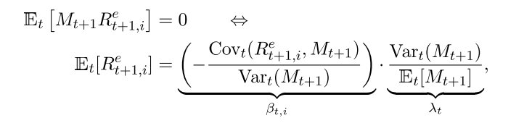

Research Design: Theoretical Derivation
No-Arbitrage Asset Pricing
The fundamental no-arbitrage assumption is equivalent to the existence of a stochastic discount factor (SDF)
Then assume:

Slide 16


Research Design: Theoretical Derivation
No-Arbitrage Asset Pricing: Adding more information
When adding firm characteristics and macroeconomic variables, the moment problem becomes:
Then the weight w of M become:

Slide 17
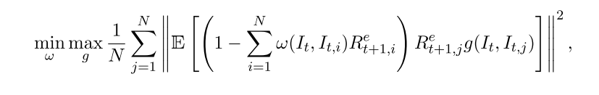
Research Design: Theoretical Derivation
No-Arbitrage Asset Pricing: combine with network.
When adding no-arbitrage condition, the loss function becomes:
This function means:
Find g which contains most useful information of firm and macroeconomic variables and find w which holds the no-arbitrage condition.

Slide 18
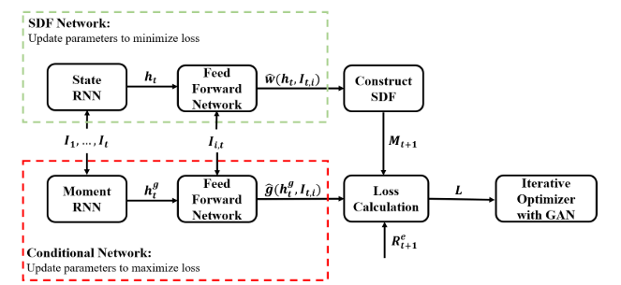
Research Design: Model structure

Slide 19

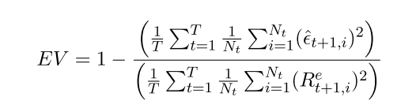
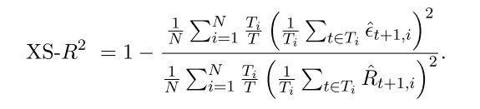
Research Design: Method
Model performance:
Sharpe ratio:
Explain variance:
Cross-sectional mean R square:

Slide 20
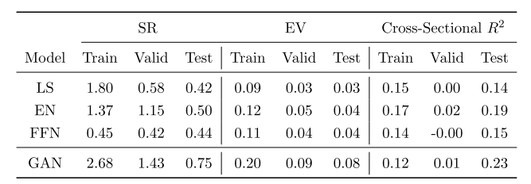
Empirical Result: Model Performance
GAN drawn by the authors has the highest out-of-sample Sharpe ratio, EV and R square.

Slide 21
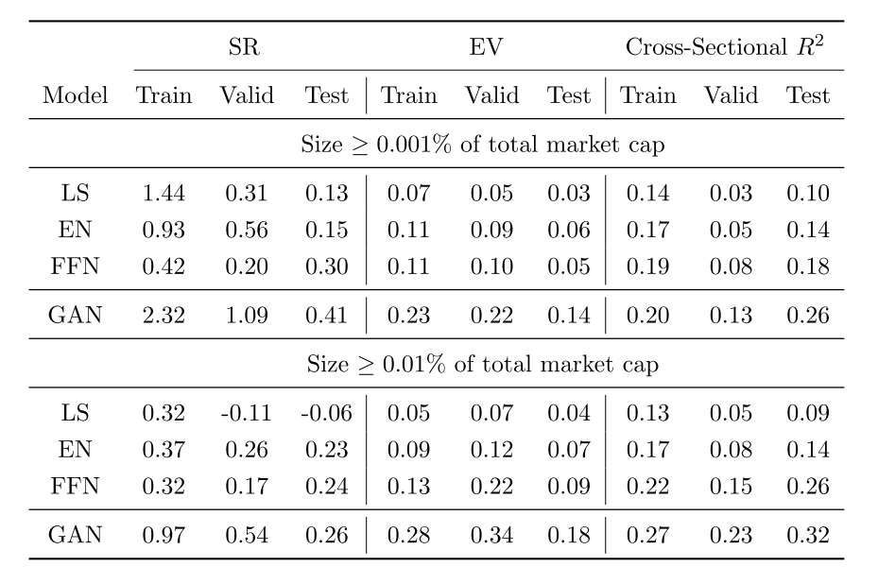
Robust Test: Only Large Stock Situation

Slide 22
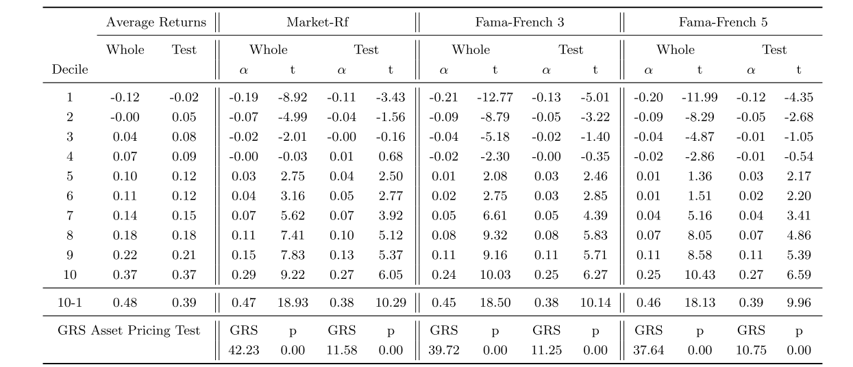
Empirical Result: Performance of SDF
The new SDF can gain more information which can not be explained by existing asset pricing models.

Slide 23
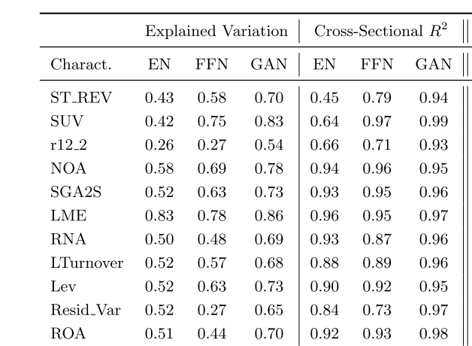
Empirical Result: Explanation Power of SDF
SDF from GAN has the best explanation power.

Slide 24
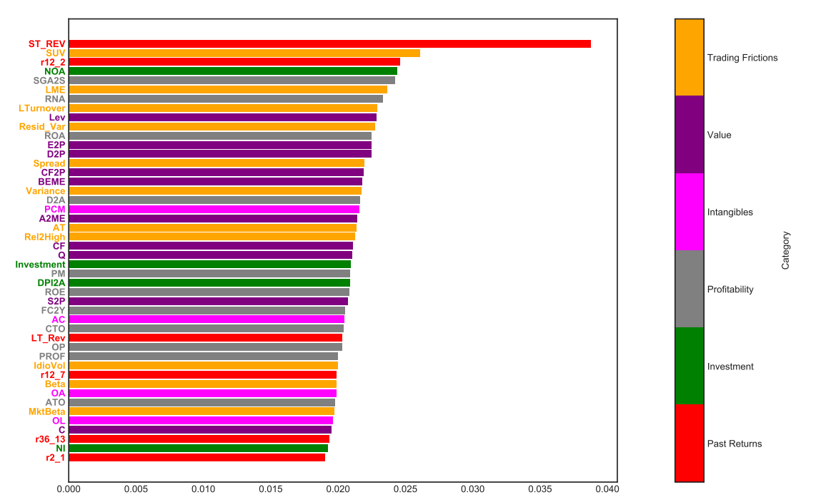
Empirical Result: Variable Importance
Trading frictions and past returns are the most relevant categories.

Slide 25
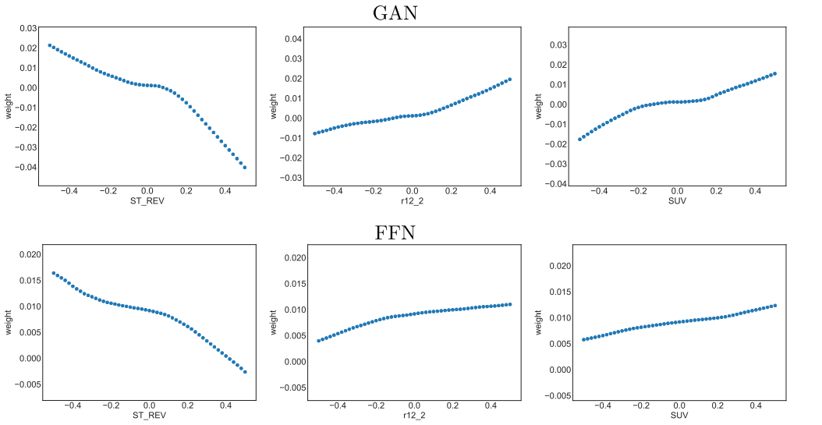
Empirical Result: SDF Structure
Take the most 3 important variables as example and observe change of weight.
Conclusion 1: Individual characteristics have an almost linear effect on the pricing kernel and the risk loadings

Slide 26
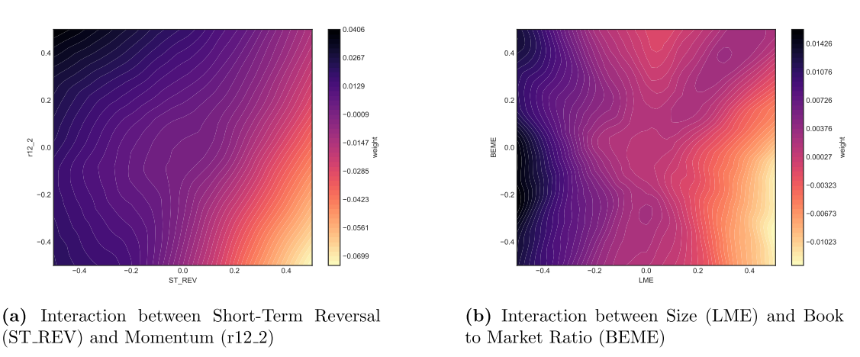
Empirical Result: SDF Structure
Take the interaction of Short-Term Reversal and Momentum as example.
Conclusion 2: the better performance of GAN is explained by non-linear interaction effects

Slide 27
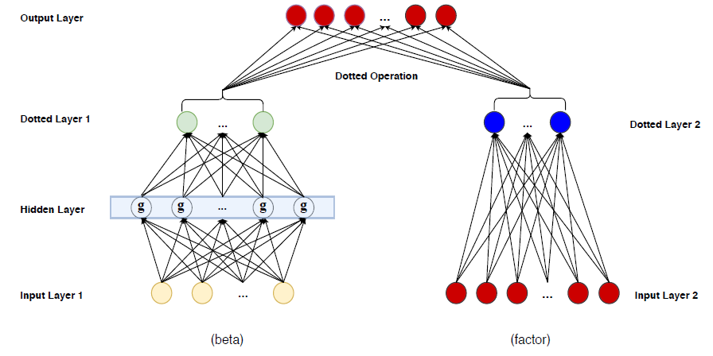
Autoencoder Asset Pricing Models(Gu et al., 2019)
Difference: Using autoencoder to raise a new factor model.
Input: Stock returns, lagged firm characteristics
Data: 1957.03-2016.12, monthly data, all stocks’ returns.
1957 – 1974 for training
1975-1986 for validation
1987-2016 for testing.

Slide 28
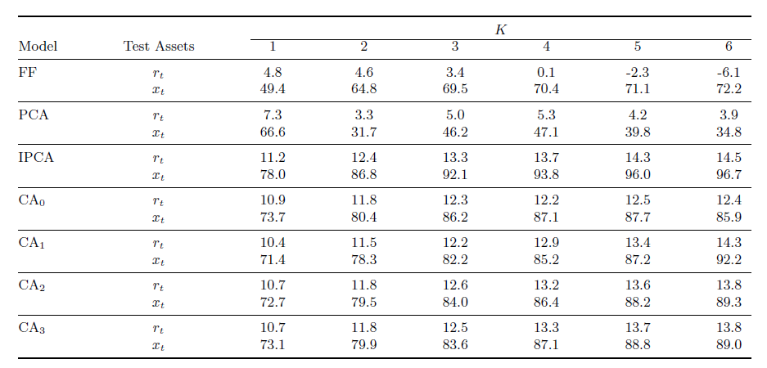
Autoencoder Asset Pricing Models(Gu et al., 2019)
Empirical results(out-of-sample R2):

Slide 29
Some views
flaw:
They should have to train and test a model with all stocks to check the behavior of SDF raised by GAN.
Inspiration:
When using new technology, we need to combine economic knowledges with it.

Slide 30
本周工作
因子检查：
96个因子已检查完成。

