Slide 1
Hedge Fund Performance: End of an Era?
NICOLAS P.B. BOLLEN, JUHA JOENVÄÄRÄ, MIKKO KAUPPILA
SSRN Working Paper, 2020.

Slide 2
A Cross-Sectional Machine Learning Approach for Hedge Fund Return Prediction and Selection
Wenbo Wu, Jiaqi Chen, Zhibin Yang, Michael L. Tindall
SSRN Working Paper, 2018.

Slide 3
Outline
Whether hedge fund performance declined?
2011 diverges
Warren Buffet’s successful bet with Protégé Partners
Whether prediction models is efficient?
Benefit of Allocation and decrease STD
What are the likely causes of decline?
Data bias and economic explanation
Different features input
Machine Learning
LASSO
RF
GB
DNN
Can we find more efficient model to forecast fund performance?
A. Linear model
B. Time series prediction

Slide 4
Outline
Introduction
Research design
Empirical result
Robust Test
Conclusion

Slide 5
Introduction: Research Questions
Has aggregate hedge fund performance generally declined over time, as claimed by the popular press?
Do any of the wide array of prediction models developed in the academic literature over the past several decades enable investors to pick a subset of funds that perform well out-of-sample?
What are the likely causes of decline in aggregate hedge fund performance, and what does this suggest for hedge fund investment going forward?

Slide 6
Research Design: Data
1994.01-2016.12 monthly data, consolidate six major commercial databases (BarclayHedge, EurekaHedge, eVestment, HFR, Lipper TASS and Morningstar)
Certain treatments for bias
Survivorship bias
Start using data from EurekaHedge and eVestment in 2003 and 2010 respectively, and use data from other databases starting in 1994.
Backﬁll bias
Remove the first 12 return observations of each fund.
Retain a fund’s history starting from the time its AUM first reaches 20 million USD
12,173 funds, 4,431 (36.4%) are still reporting and 7,742 (63.6%) have stopped reporting.
Notes:
increase the power of our tests, decrease the possibility that some documented results are driven by database-specific selection biases

Slide 7
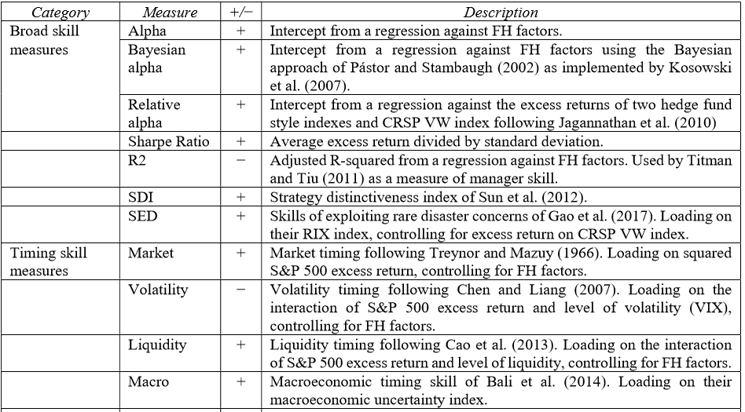
Research Design: Hedge Fund Performance Predictors
Notes:
proxy for the investor redemption risk,because Ω is sensitive to the investor’s utility function

Slide 8
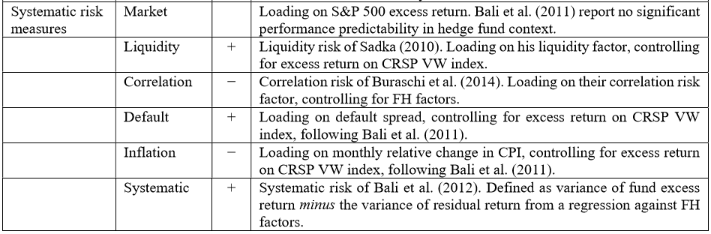
Research Design: Hedge Fund Performance Predictors
Notes:
proxy for the investor redemption risk,because Ω is sensitive to the investor’s utility function

Slide 9
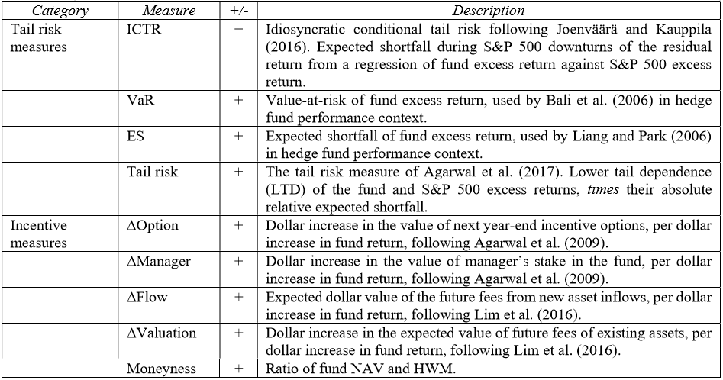
Research Design: Hedge Fund Performance Predictors
Notes:
proxy for the investor redemption risk,because Ω is sensitive to the investor’s utility function

Slide 10
Research Questions
Has aggregate hedge fund performance generally declined over time, as claimed by the popular press?
Do any of the wide array of prediction models developed in the academic literature over the past several decades enable investors to pick a subset of funds that perform well out-of-sample?
What are the likely causes of decline in aggregate hedge fund performance, and what does this suggest for hedge fund investment going forward?

Slide 11
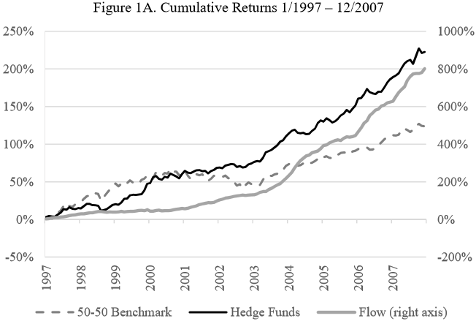
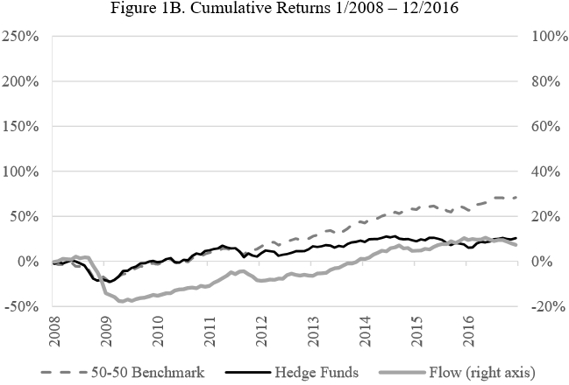
Empirical Result: Performance
Question 1: Whether overall hedge fund performance has declined substantially over time?
“stock/bond”:Equally weighted portfolio consisting of the S&P 500 and the Vanguard Total Bond Market Index fund (VBTIX)

Slide 12
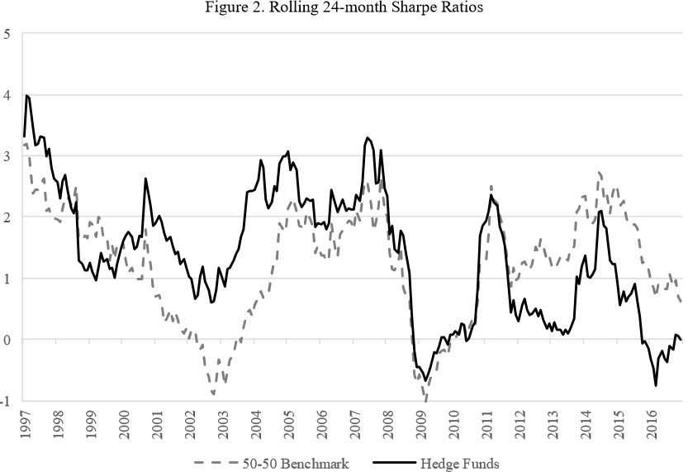
Empirical Result: Performance
Question 1: Whether overall hedge fund performance has declined substantially over time?

Slide 13
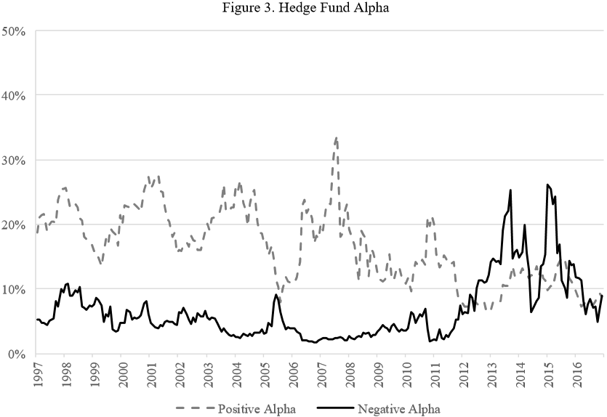
Empirical Result: Performance
Question 1: Whether overall hedge fund performance has declined substantially over time?

Slide 14
Research Questions
Has aggregate hedge fund performance generally declined over time, as claimed by the popular press?
Whether prediction models and predictor variables developed in prior literature enable investors can select subsets of individual funds that subsequently outperform?
What are the likely causes of decline in aggregate hedge fund performance, and what does this suggest for hedge fund investment going forward?

Slide 15
Benefit of Allocation
Investors should not hold hedge funds in isolation but rather as a source of diversification for positions in standard asset classes.
Compare the performance of the stock/bond portfolio to the performance of a portfolio in which the weights are 30% S&P 500, 50% the bond index fund VBTIX, and 20% hedge funds in a risk-averse investor’s portfolio.
Non-Hedge Fund Portfolio
Performance
Hedge Fund Portfolio
V.S

Slide 16
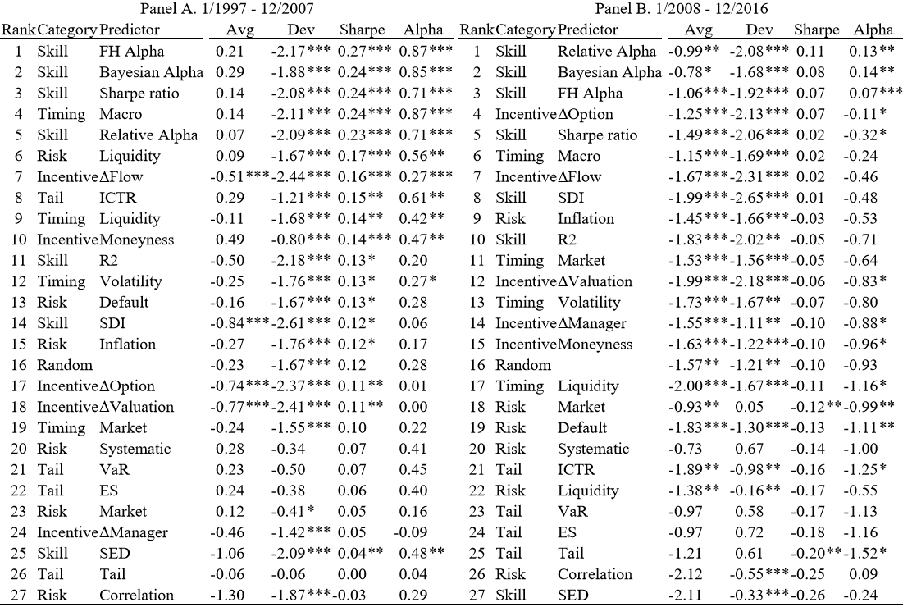
Whether predictor variables can select successful funds

Slide 17
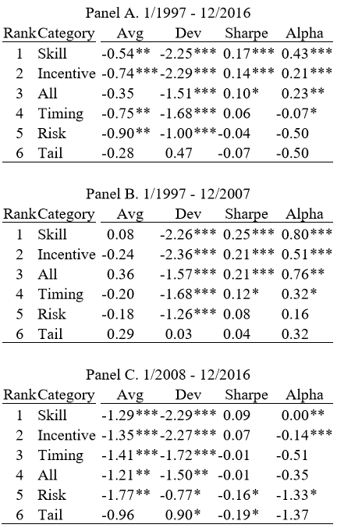
Whether predictor variables can select successful funds
In all cases the skill and incentive categories are ranked first and second.
The risk reduction provided by a hedge fund allocation is especially valuable to investors.

Slide 18
Benefit of Allocation
Two types of utility-based measures of performance.
MPPM (Goetzmann et al., 2007)
Minimum incremental return that a risk-averse investor would accept to exchange a risky investment.
“Delta” Method (Fleming et al, 2001)
The maximum fee a risk-averse investor would pay in order to switch from one risky asset to another
Table 5 lists differences between the performance statistics of portfolios with a 20% allocation to hedge funds to those with no hedge fund allocation.

Slide 19
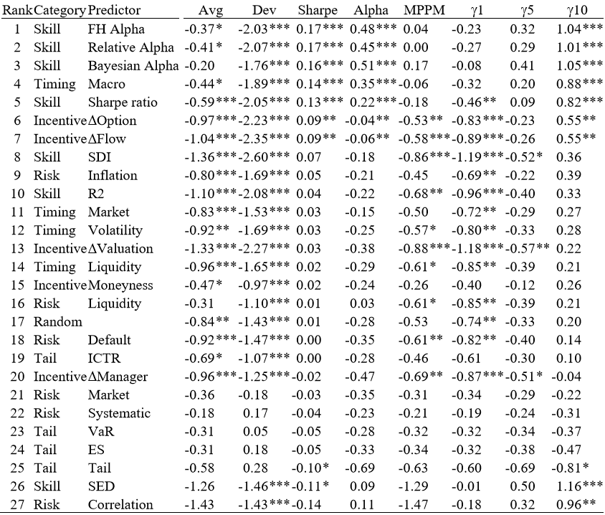

Slide 20
Performance of Prediction Model
We simulate random selection of 15 funds from the top quintile sorted on various predictor variables and repeat the process 1,000 times.
The “Raw” results are those of portfolios of all funds in the top quintile using returns as reported to the databases.
The “Treated” results are averages across the simulated portfolios of 15 funds using returns treated to reverse the impact of database biases
V.S
“Raw” Result
“Treated” Result

Slide 21
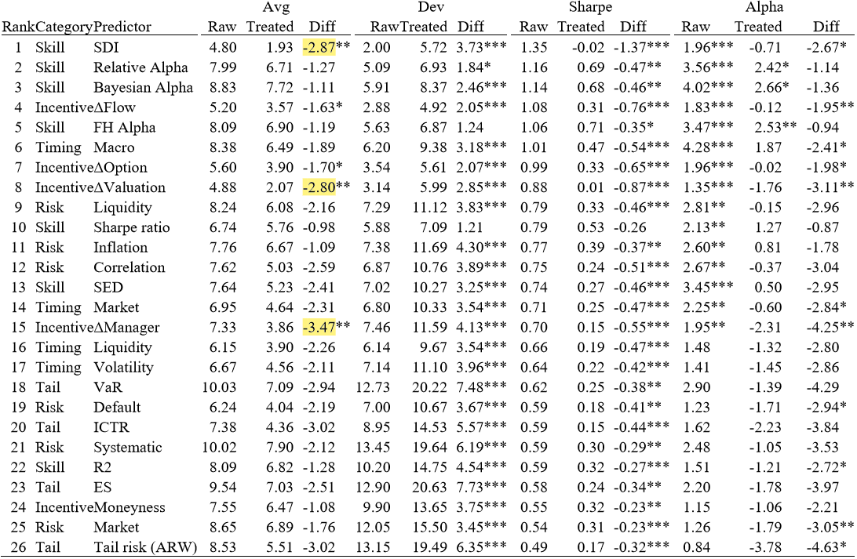
Empirical Result: Performance
Prediction of Top Quintile Performance
Question 2: Whether prediction models developed in prior literature enable investors to select subsets of individual funds that subsequently outperform?

Slide 22
Empirical Result: Performance
The hedge fund performance realized by investors is likely far inferior than typically reported.
The average return drops because the delisting adjustment adds a one-time –50% return to funds that have been deemed to fail during the holding period
The standard deviation rises also due to the inclusion of the extreme delisting return for funds that fail, as well as the use of de-smoothed returns and loss of diversification when holding 15 funds as opposed to all in the top quintile.
Investors should not hold hedge funds in isolation but rather as a source of diversification for positions in standard asset classes.

Slide 23
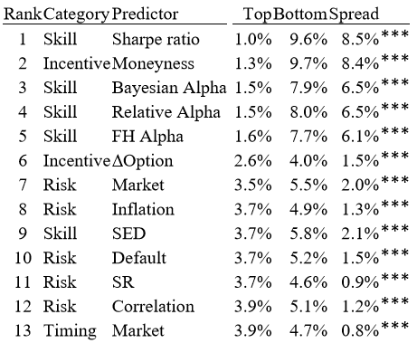
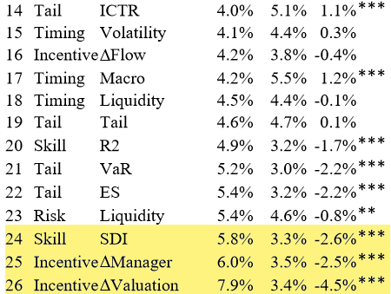
Empirical Result: Predicting Fund Failure
SDI, ∆Manager, and ∆Valuation sorts feature top quintile funds with the highest failure rates.

Slide 24
Robustness
Varying hedge fund allocations weights in the multi-asset class from 0% to 50%
Using expanding windows for means and rolling 36-month windows for variances and correlations
Combine the predictors with other fund characteristics that prior work shows correlate with performance. Whether the results above are robust to incorporating four of these organizational variables.

Slide 25
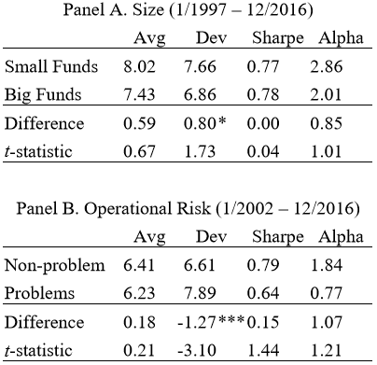
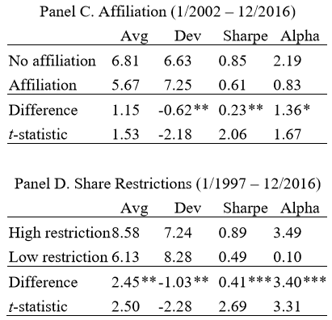
Robustness-C
Unaffiliated funds and high restriction portfolio outperform on each of the summary statistics.

Slide 26
Research Questions
Has aggregate hedge fund performance generally declined over time, as claimed by the popular press?
Do any of the wide array of prediction models developed in the academic literature over the past several decades enable investors to pick a subset of funds that perform well out-of-sample?
What are the likely causes of decline in aggregate hedge fund performance, and what does this suggest for hedge fund investment going forward?

Slide 27
Question 3:What might explain the pronounced decline of overall hedge fund performance?
Database-related Explanations
Backfill bias of the available self-reported hedge fund return data, managers tend only to import histories with good performance
Economic Explanation
Increased correlation and depressed levels of volatility in many asset markets
Regulators have increased scrutiny for financial crisis and managerial misconduct in the hedge fund industry
Increased competition among hedge fund managers could erode fund level performance.

Slide 28
Outline
Whether hedge fund performance declined?
2011 diverges
Warren Buffet’s successful bet with Protégé Partners
Whether prediction models is efficient?
Benefit of Allocation and decrease STD
What are the likely causes of decline?
Data bias and economic explanation
Different features input
Machine Learning
LASSO
RF
GB
DNN
Can we find more efficient model to forecast fund performance?
A. Linear model
B. Time series prediction

Slide 29
Introduction: Background
Various approaches have been studied for selecting a portfolio of hedge funds for investment.
Due diligence
Reviewing and monitoring primarily operational risk to sort out funds that are likely to fail or underperform (Brown et al., 2008, 2012).
Hedge fund return distributions(negative skewness and excess kurtosis)
Alternatives to the variance: VaR, drawdown at risk, expected shortfall, tail risk & their variants, and the performance measure of omega. (Agarwal and Naik,2004; Giomouridis and Vrontos, 2007; Bali et al., 2007; Liang and Park, 2007, 2010; Harris and Mazibas, 2013)
Notes:
lack of data,and lack of clear distinction of operational risk from market and credit risks

Slide 30
Introduction: Background
C. Prediction of future performance of the hedge fund
Time series prediction
Forecast built on regression on time series of systematic or macroeconomic factors is powerful for explaining the systematic part of hedge fund returns(Amenc et al.,2003; Hamza et al.,2006; Wegener et al.,2010; Avramov et al.,2011,2013)
Cross-sectional forecast
Hedge fund performance is linked to fund characteristics. It is eﬀective for explaining and predicting the idiosyncratic part of the return. (Fama and MacBeth,1973; Fama and French, 1992, 2015)
Notes:
,but it is rather “indirect” for explaining and predicting the idiosyncratic part of the return.

Slide 31
Introduction: Research Design
④
Fund-speciﬁc features
②
Equity Hedge
Event Driven
Relative Value
Macro
HFR Index
AR
SortR
Alpha
IR
LASSO
RF
GB
DNN
①
V.S
Macroeconomic
risk factors
③
2020/3/6
31

Slide 32
Introduction: Research Questions
Does ML forecast method outperform the respective HFR Index for each of the four hedge fund styles?
Does methodological advantage of ML forecast method outperform the forecast based on time series regression and linear regression?
Does macroeconomic risk factor improve the prediction performance?
How does the predictive power of the return-based feature set contributes?
Robustness

Slide 33
Introduction: Motivation
There is a growing stream of research on the idiosyncratic determinants and predictors of the hedge fund’s performance.
No one takes cross-sectional approach to prediction of future hedge fund returns and power the prediction with machine learning.

Slide 34
Introduction: Contribution
The paper is the ﬁrst to apply machine learning to hedge fund return prediction and selection.
In comparison with forecast methods based on time series regression, the approach oﬀers two methodological advantages.
We ﬁnd that kurtosis is the most important feature, regardless of whether or not we merge the two variable sets.

Slide 35
Research Design: Data
1994.01-2015.12 monthly data, individual hedge funds recorded in the HFR database.
Certain treatments for bias (Fung and Hsieh, 2000, 2004)
Survivorship bias
Use all available 7,327 live funds and 16,435 graveyard funds in the HFR database.
Backﬁll bias
Exclude the ﬁrst 24 months (i.e., from January, 1994 to December, 1995) of reported returns of each fund.

Slide 36
Research Design: Data
B. Certain treatments to obtain enough data (Aragon,2007)
Consider only the funds that report net-of-fee returns on a monthly basis and are denoted in US dollars
Filter out the funds-of-funds
Eliminate the funds that survived less than 3 years
Eliminate funds that never reached 5 million dollars of assets under management
The ﬁnal dataset contains 3,193 unique funds, among which 1,237 are live funds and 1,956 are graveyard funds.
Notes:
to experience at least one complete training-testing cycle

Slide 37

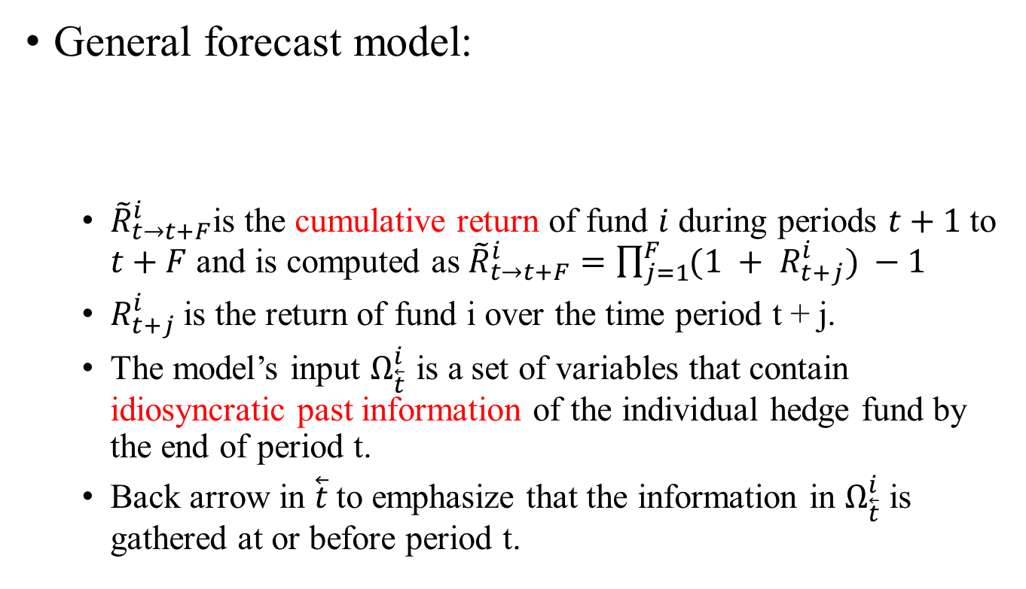
Research Design: Method
General forecast model:
${\tilde{R}}_{t→t+F}^{i}$is the cumulative return of fund $i$ during periods $t+1$to $t+F$and is computed as ${\tilde{R}}_{t→t+F}^{i}=\prod_{j=1}^{F}{(1 + R_{t+j}^{i})} −1$
$R_{t+j}^{i}$is the return of fund i over the time period t + j.
The model’s input $Ω_{\overset{⃖}{t}}^{i}$ is a set of variables that contain idiosyncratic past information of the individual hedge fund by the end of period t.
Back arrow in $\overset{⃖}{t}$to emphasize that the information in $Ω_{\overset{⃖}{t}}^{i}$is gathered at or before period t.

Slide 38
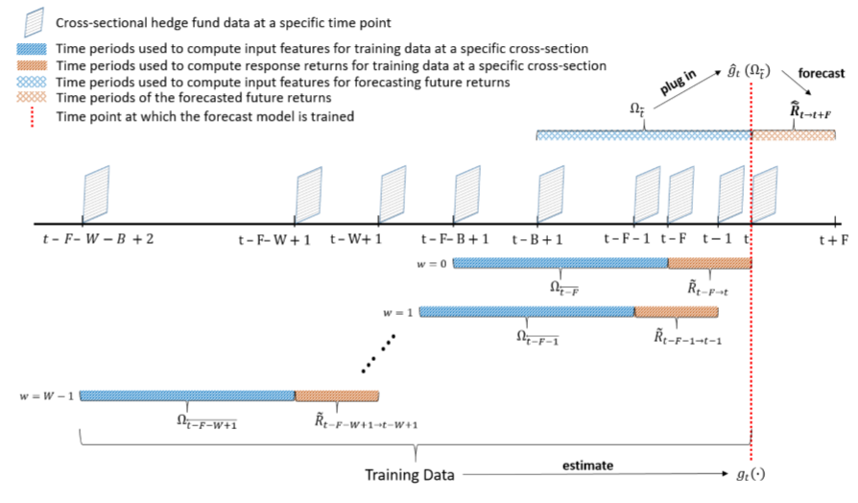


Research Design: Method
In this paper, we set F = 3 and W = 12

Slide 39
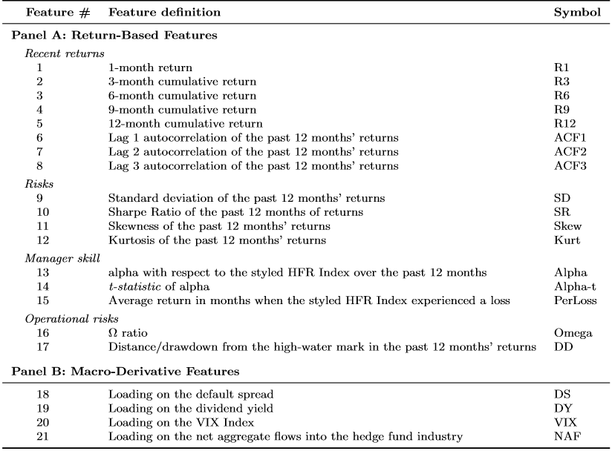
Research Design: Method
Notes:
proxy for the investor redemption risk,because Ω is sensitive to the investor’s utility function

Slide 40
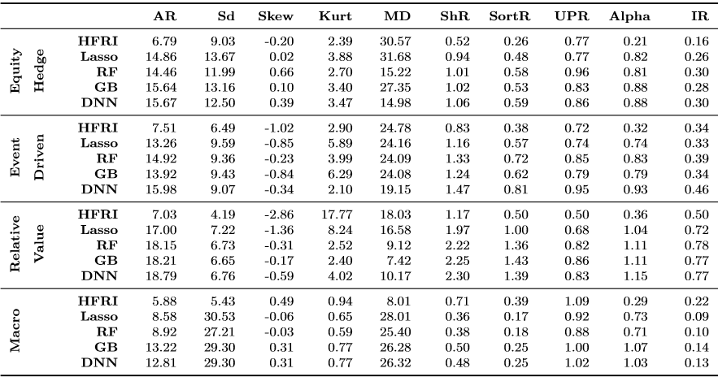
Empirical Result: Performance
AdvML methods outperform among the Equity Hedge, Event Driven, and Relative Value fund styles, but the Macro fund style

Slide 41
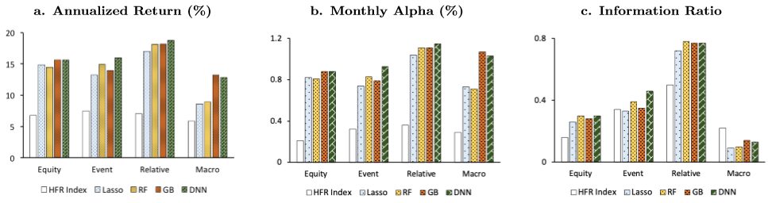
Empirical Result: Performance
For non-Macro funds, the AdvML methods consistently generate higher returns, alphas and IRs than that of the HFR Indices by a signiﬁcant margin.

Slide 42
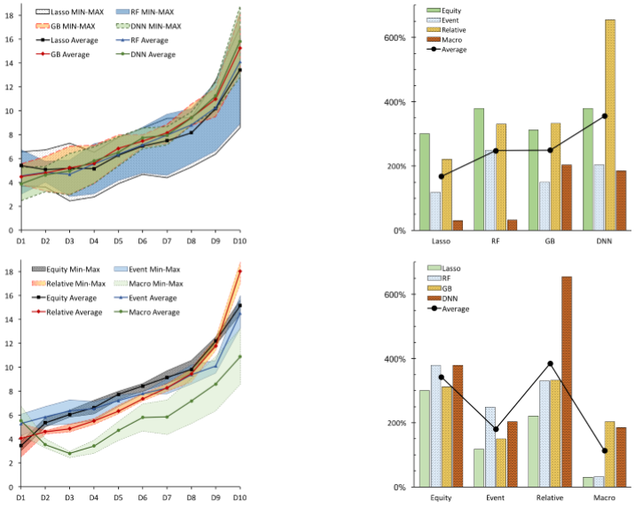
Empirical Result: Sorting Ability
Comparisons of different ML approaches.
Notes:
degree of diversiﬁcation over the sub-strategies

Slide 43
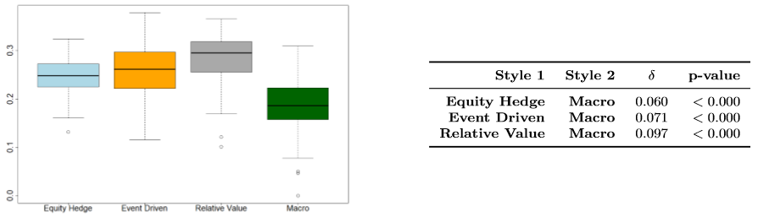
Empirical Result: Macro Fund
Comparisons of the Shannon Equitability Index of the D10 portfolios between fund styles.
Macro Funds that follow the same sub-strategy are relatively homogeneous in their investment processes, causing under-diversiﬁcation and concentration of risk.
Notes:
degree of diversiﬁcation over the sub-strategies

Slide 44
Empirical Result: Values of ML
We strive to feed all of these forecast methods with equivalent information.
Linear model (BLM)
Cross sectional forecast
Prediction of fund performance
Nonlinear model (AdvML)
Time series forecast(ABK,2013)
Macroeconomic
risk factors
Notes:
degree of diversiﬁcation over the sub-strategies

Slide 45
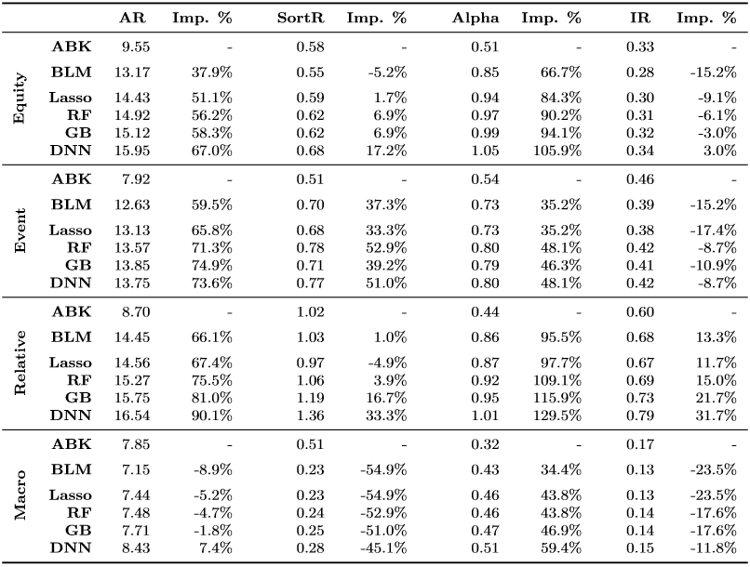
Empirical Result: Macro Fund
Notes:
degree of diversiﬁcation over the sub-strategies

Slide 46
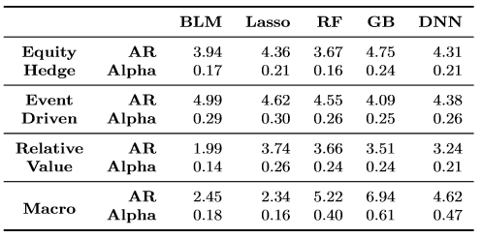
Empirical Result: Interaction between information and modeling capabilities
To assess how the value of return-based features depends on the AdvML methods’ advanced modeling capability, we compare the diﬀerence in this value when the AdvML methods are used and when BLM is used.
Return-based feature set

Slide 47
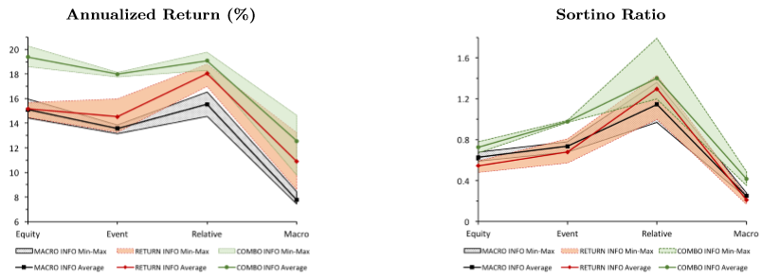
Empirical Result: Performance of the AdvML methods on diﬀerent feature sets
Using the pure return-based feature set leads to higher returns than using only the macro-derivative feature set
Having more information enhances the models’ predictive power.
Notes:
degree of diversiﬁcation over the sub-strategies

Slide 48
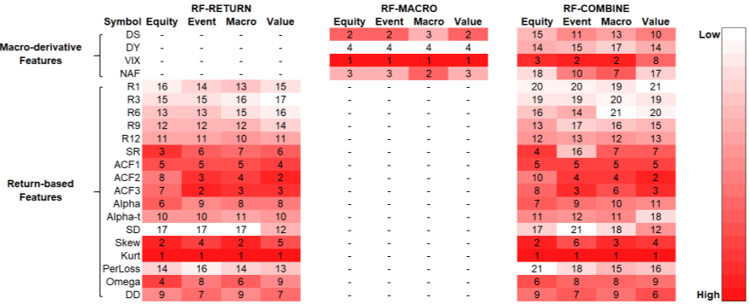
Empirical Result: Predictive Power of the Return-based Features
We conﬁrm that kurtosis is the most important feature.
VIX Index is the most important feature when using the macro-derivative.
feature set alone

Slide 49
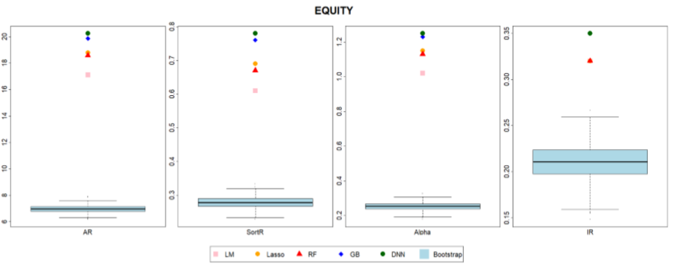

Robustness: Whether the superior performance is mainly due to pure luck
At each rebalancing time period t, we randomly select $N_{ml}$ hedge funds to form a portfolio. We repeat the process 1,000 times to obtain 1,000 randomly selected portfolios.

Slide 50
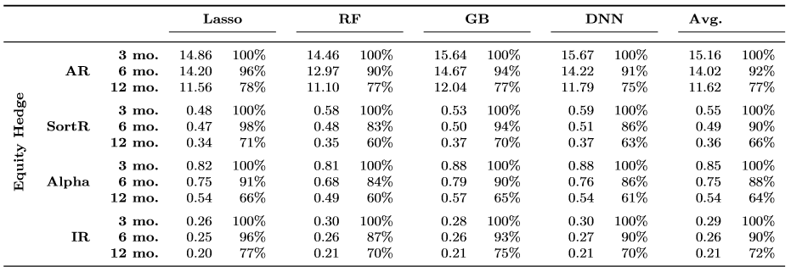
Robustness: Performance persistence
Extend the look-forward window F from 3 months to 6 months and then to 12 months.
Most performance tend to decline mildly as the look-forward window increases from 3 to 6 months and then drop more rapidly as the window stretches to 12 months

Slide 51
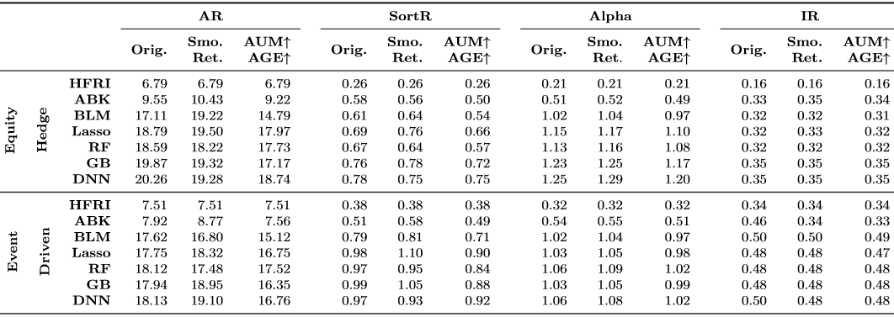
Robustness: Smaller pool of fund
Consider funds with at least 10 million dollars of assets under management, and funds aged at least 5-years old

Slide 52
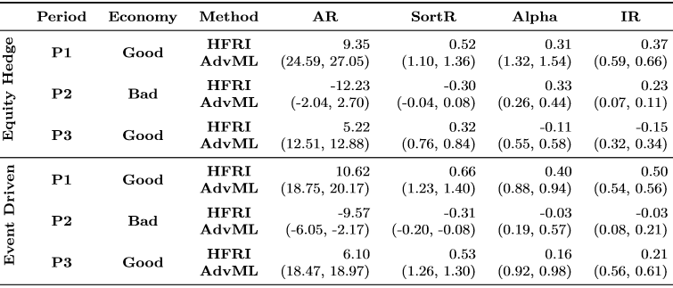
Robustness: Good vs. bad economy
Hedge fund managers may deliver relatively better performance in down markets given their ﬂexibility to control risk by hedging.
We split the data into three economic periods:
P1
P2
P3
2001.12.31
2007.12.31
2009.6.30
2015.12.31

Slide 53
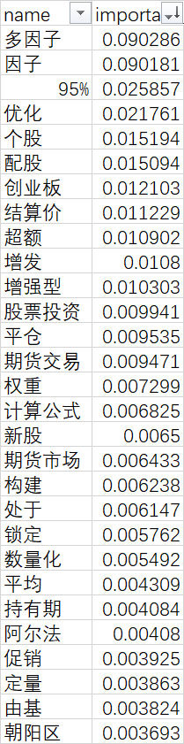
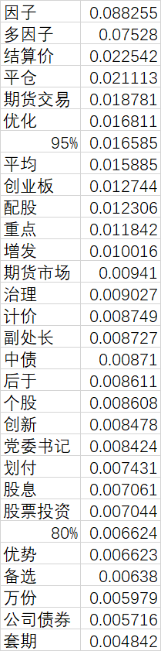
准确率: 0.941
召回率: 0.918
f1-score: 0.922

