Slide 1
Cross-Sectional Earnings Forecasts A Forecast Combination Approach
Xinyuan Stacie Tao and Chunchi Wu
January 16, 2018
讲解人：梅子萌

Slide 2
Outline
Introduction
Methodology
Data
Empirical Result
Conclusion

Slide 3
Introduction: Background
Expected return is an important variable in capital budgeting and security valuation.
Traditionally, realized returns are used to estimate expected returns.
Recent studies use the implied cost of capital (ICC) to estimate expected returns and analysts’ forecasts is commonly used as an input of ICC calculation proxy for expected cash flows
Analysts’ s forecasts are proved to be biased

Slide 4
Introduction: Background
New approaches are raised to improve earning prediction:
Hou, van Dijk and Zhang (2012) propose a cross-sectional approach to generate earnings forecast
There has been growing interest in using the cross-sectional model to predict earnings and estimate the ICC

Slide 5
Introduction: Background
Improvement of cross-sectional forecast :
Forecast combination of individual forecasters has been proved to improve the performance of a predictive model with multiple predictors
The noise in a large set of predictors may lead to poor out-of-sample performance.
Partial least squares (PLS) are raised to solve this problem

Slide 6
Introduction: Related Researches
ICC related researches:
Raised to estimate expected returns
(Gebhardt, Lee, and Swaminathan, 2001; Easton, 2004; Ohlson and Juettner-Nauroth, 2005)
Empirically proved to be a good proxy for time-varying expected returns
( Li et al., 2013; Lee, So and Wang, 2017)
Use analysts’ forecasts of earnings as a proxy for expected cash flows
(Gebhardt, Lee and Swaminathan, 2001; Easton, 2004; Easton and Monahan, 2005; Guay, Kothari and Shu, 2011 )

Slide 7
Introduction: Related Researches
Biased analyst’s forecast and new approach:
Analyst’s are biased
(McNichols and O’Brien, 1997; Easton and Sommer 2007; Kothari et al., 2016)
Hou, van Dijk and Zhang (2012) propose a cross-sectional approach
Other cross-sectional models
(Nekrasov and Ogneva, 2011; Hou et al., 2015; Penman and Zhu, 2016; Lee et al, 2017)

Slide 8
Introduction: Related Researches
Cross-sectional forecast related
Combination of multiple single forecasters
(Rapach, Strauss and Zhou, 2010; Kelly and Pruitt, 2013,2015; Lin, Wu and Zhou,2017)
Problems of multiple single forecasters
(Bates and Granger, 1969; Timmermann, 2006; Capistrán and Timmermann, 2009; Gerakos and Gramacy ,2013 )
PLS regression (Kelly and Pruitt 2013, 2015)

Slide 9
Introduction: Motivation
Motivated by Hou, van Dijk and Zhang (2012), trying to propose a new approach to estimate expected earning for a better ICC performance.
Inspired by the recent findings on Cross-sectional forecast, combining multiple forecasters and time series information.

Slide 10
HVZ model
𝐸𝑖,𝑡+1 denotes the earnings of firm i in year t+1
𝑇𝐴𝑖,𝑡 is the total assets
𝐷𝑖𝑣𝑖,𝑡 is the dividend payment
𝐷𝑖𝑣𝑖,𝑡𝑑 is a dummy variable that equals 1 with positive dividend payment and 0 otherwise
𝑛𝑒𝑔𝐸𝑖,𝑡 is a dummy variable that equals one with negative earnings and 0 otherwise
𝐴𝐶𝐶𝑖,𝑡 is accruals

Slide 11

Methodology: First Step
We run pooled cross-sectional regression for each predictor, predict 𝐸𝑖,𝑡+1
𝐹𝑖,𝑡𝑘 denotes k-th individual accounting variable of firm i in year t
𝑎̂𝑘 and b𝑘 are same for all firms in year t

Slide 12



Methodology: Second Step
We use the average combination to combine the individual forecasts for year t+1

Slide 13





Methodology: Third Step
For each firm i, we can run the time-series regressions of actual (realized) earnings
On the mean forecasts using all available information at time m for regression
the one-year ahead (m+1) earnings forecasts for firm i made at time m will be

Slide 14
Methodology
In the first and second step regression, pooled cross-sectional regression, we include all firms without imposing survivorship requirements.
In the second step time-series regression for each firm, at least ten historical records are required.

Slide 15
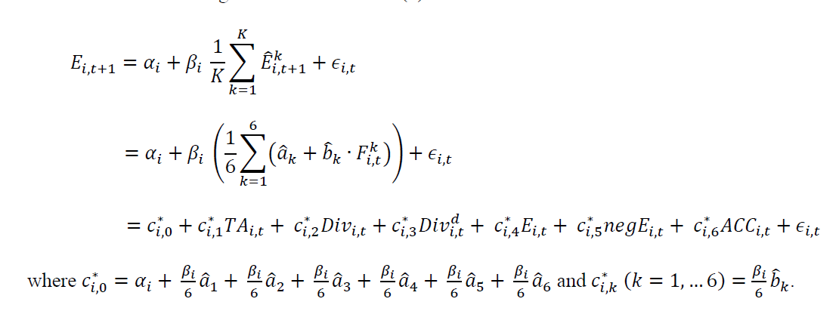
Methodology
This formulation is similar in spirit to the partial least squares approach, which is better than HVZ regression on coefficient

Slide 16
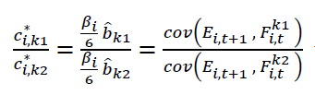

Methodology
Assume that each variable in the cross-sectional regression is standardized to have mean zero and variance equal to one.
Then taking the ratio of the two coefficient estimates in our model, we have:
reflects the correlation between future earnings and predictive variables.

Slide 17



Methodology: Combine analyst’s forecast
Find the optimal weight 𝜔 for:
where is the model forecast and is the consensus analyst forecast.

Slide 18
Data
Data base : Standard & Poor’s COMPUSTAT, CRSP (Center for Research in Security Prices), and Thomson Reuters I/B/E/S
Data : Our forecast period runs from 1970 to 2016, covering 105,393 firm-year observations and 9,188 firms
analyst forecast from 1982 to 2016 and covers 52,534 firm-year observations by 6,350 firms
Winsorize earnings and all other non-dummy variables each year at the 1st and 99th percentiles

Slide 19
Data：Select Model Forecasters
Four models of different variable input:
The first model consists of variables used in HVZ
The second model add the market value of stockholder’s equity as the 7th variable in HVZ
The third model add the most recently month-end market stock price as the 7th variable in HVZ
The last model consists of the variables in Fama –French(2006), including book-to-market ratio, market capitalization, asset growth, dividend payment, dividend dummy, last earnings, negative earnings dummy, positive and negative accruals

Slide 20
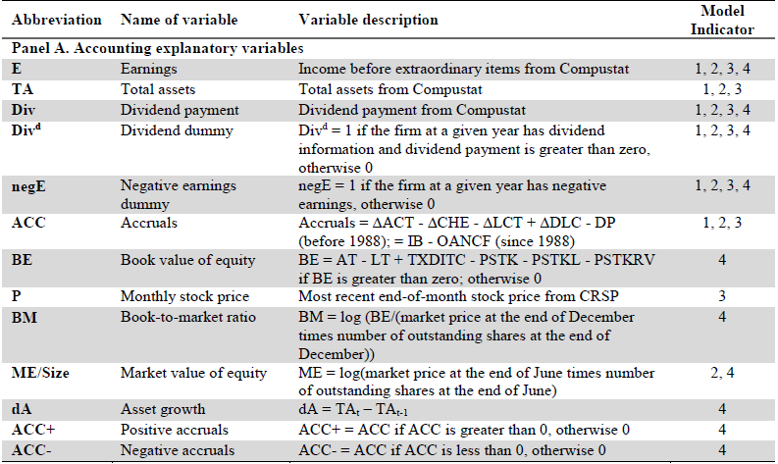
Data：Select Model Forecasters

Slide 21
Data: Divide by Characters
In the empirical test, we separate the sample into different groups duel to their firm or industry characters.
Firm characters: earnings volatility, firm age, book-to-market ratio, firm size, high vs. low dividend payment, dividend dummy, management forecast dummy, and institutional holdings
Industry characters: ten groups based on their first 2-digit standard industry classification (SIC) code
The following table show all the characters

Slide 22
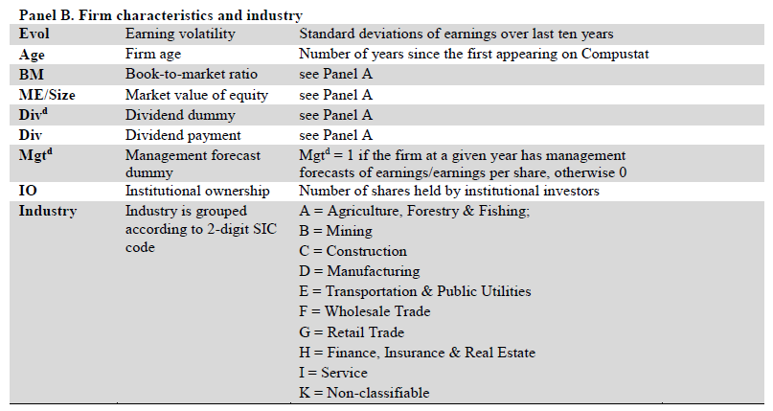
Data: Characters of Sample

Slide 23
Empirical Result
HVZ model is used as the benchmark
Three performance result
mean absolute errors (MAEs)
forecast bias
forecast accuracy
earnings response coefficients (ERCs)
announcement ERC
annual ERC
the implied cost of capital (ICC)

Slide 24
Empirical Result
For HVZ we use the data in the past ten years at t, to forecast the earnings at year t+1
For our models, we use the data in the past ten years at t, to estimate parameters in the first step. And then use all data available in year t to forecast the earnings of firm i at year t+1
Forecast period starts from 1970 to 2016

Slide 25
Empirical Result : MAEs
Forecast bias is the difference between actual and forecast earnings, scaled by the end-of-June market equity.
Forecast accuracy is the absolute value of forecast bias.
A negative bias indicates an optimistic estimation.
Smaller MAEs suggests a better forecast

Slide 26
Empirical Result : ERCs
Used to evaluate how closely an earnings forecast lines up with the market’s expectations, value is the slop of market reaction on unexpected earnings (the difference between actual and forecast earnings)
The larger the ERCs is, the better the model proxy for market expectations
In announcement ERC, the dependent variable is the sum of the quarterly earnings announcement returns over the next year
In annual ERC the dependent variable is the buy-and-hold return over the next year.

Slide 27
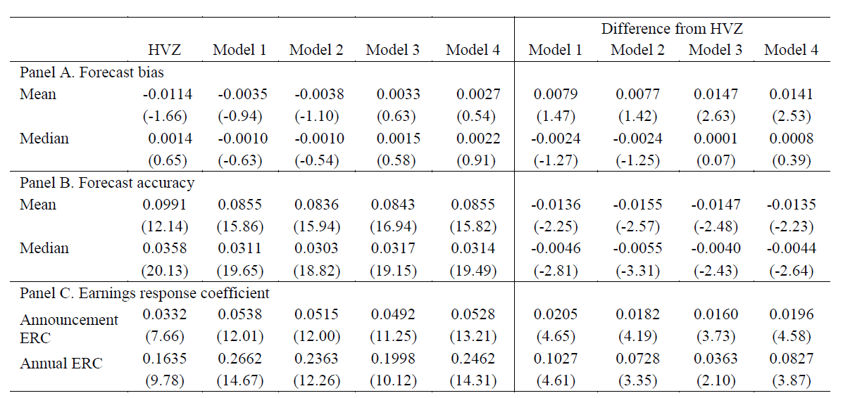
Empirical Result:

Slide 28
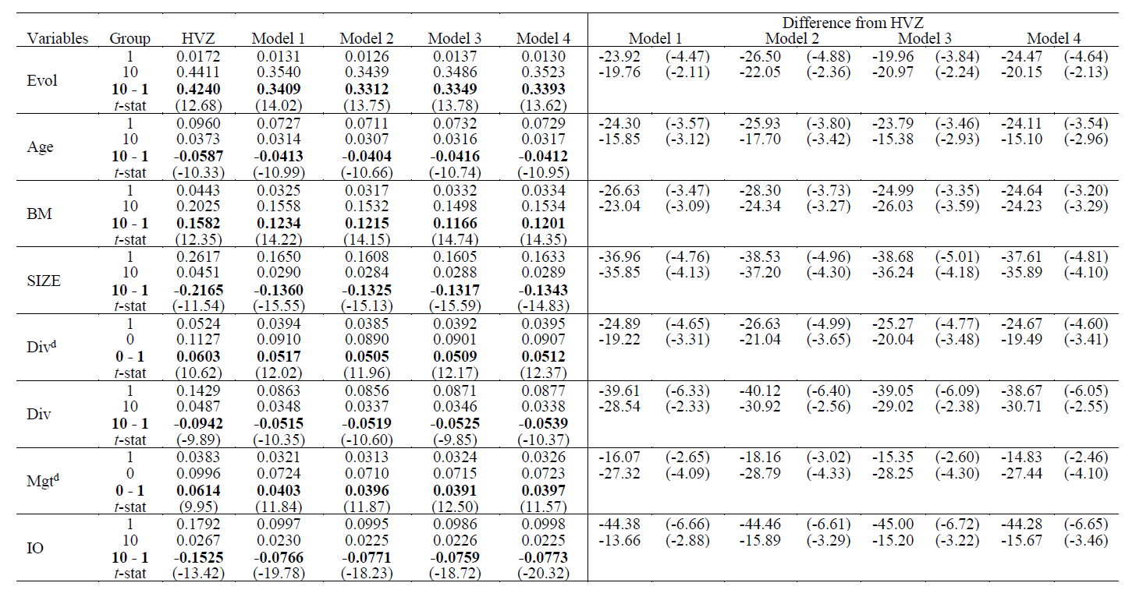
Empirical Result: Firm Characteristics(MEA)

Slide 29
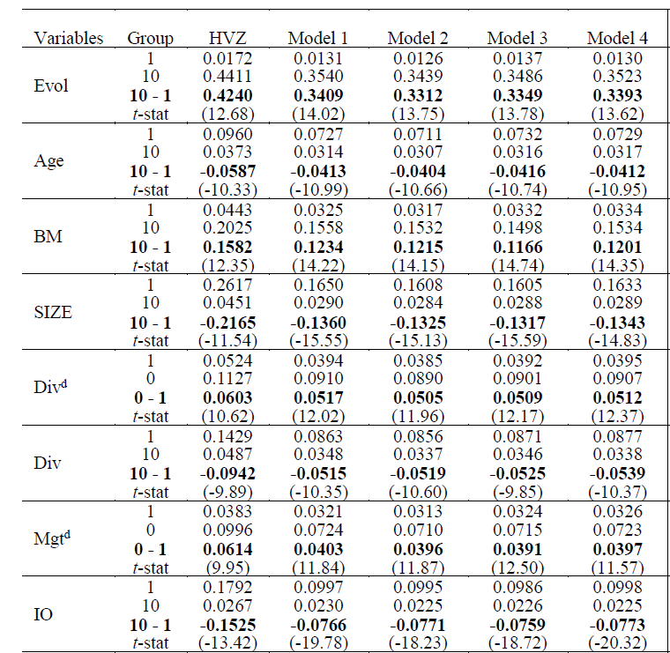

Slide 30

Empirical Result: Firm Characteristics(ERC)
𝑅𝑖𝑡 is the market reaction variable
𝑑𝑖𝑡 = 0 if firm group = 1, 𝑑𝑖𝑡= 1 otherwise
𝑥𝑖𝑡 is the firm’s unexpected earnings standardized with variance
The differences between groups is captured by 𝛽3. If differences of 𝛽3 is significant, it suggests that the ERC depends on firm characteristics.

Slide 31
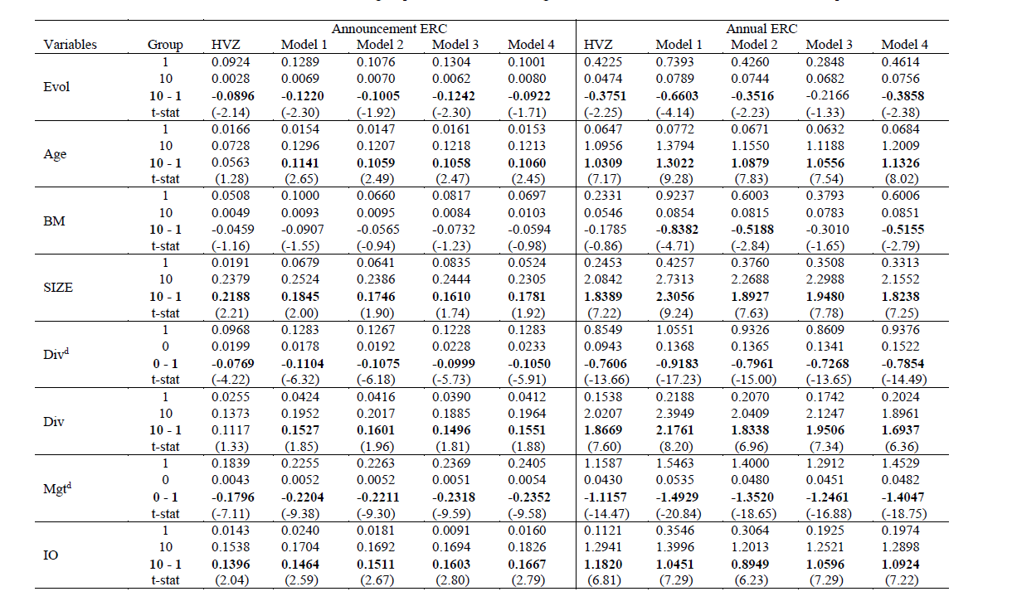

Slide 32
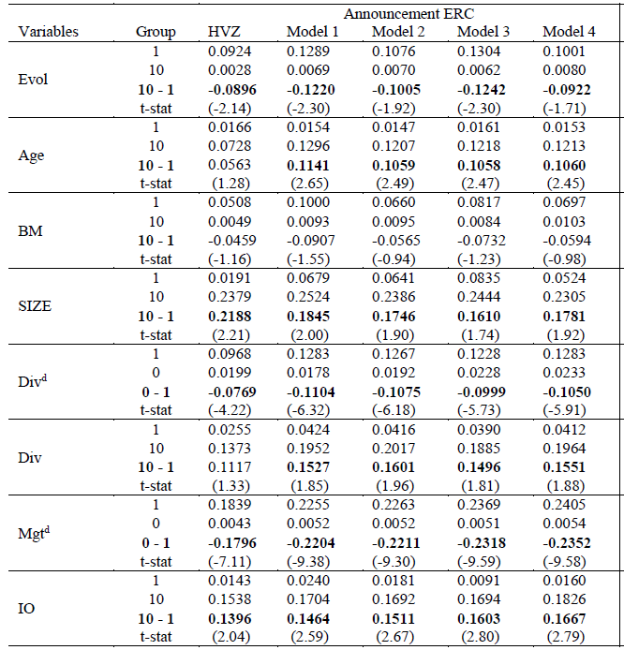

Slide 33
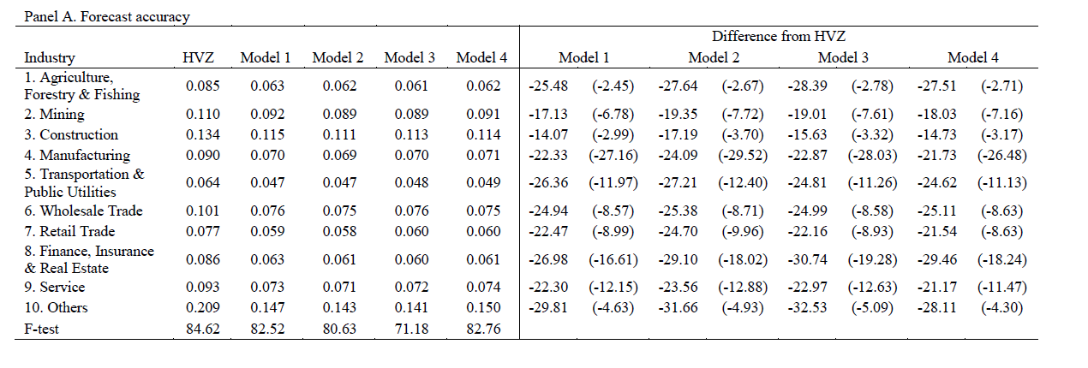
Empirical Result: Industry Characteristics

Slide 34
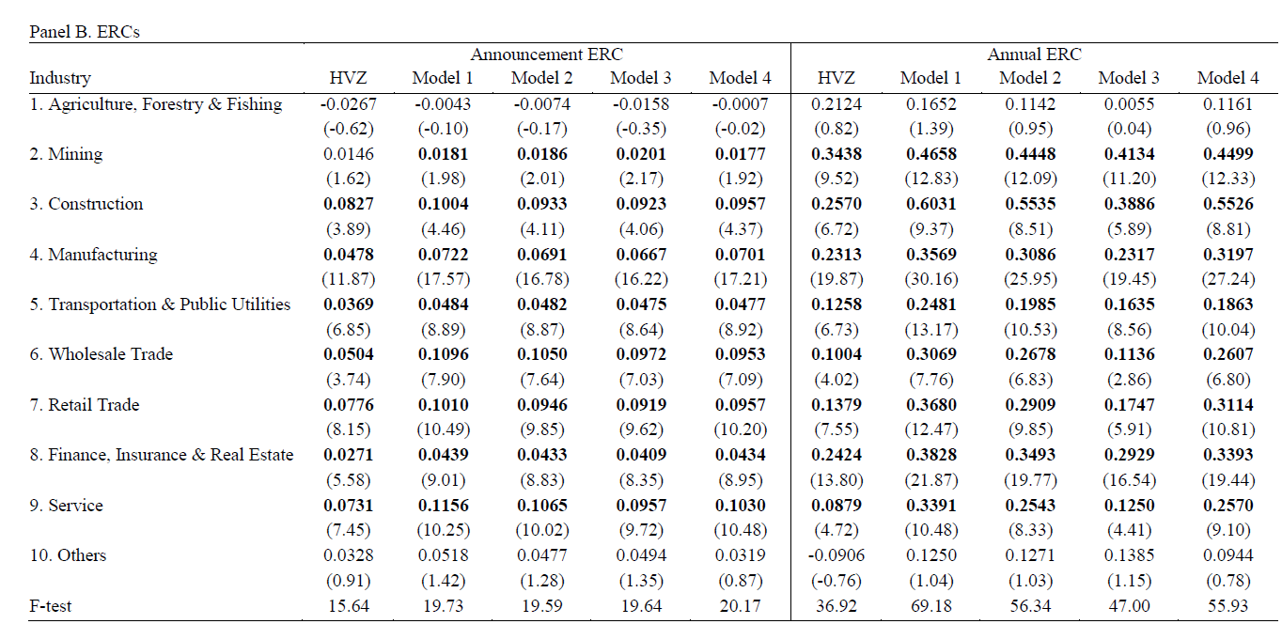

Slide 35


Empirical Result: ICC
To construct the ICC, we need to forecast earnings multiple periods ahead. Use information at time m to forecast earnings at m+τ:

Slide 36
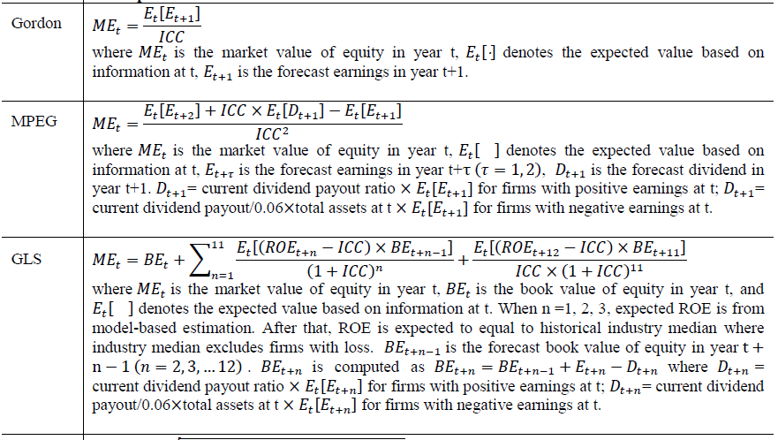
Empirical Result: ICC
We first construct the ICC measures from the four different models and then average them to come up with a composite ICC.

Slide 37
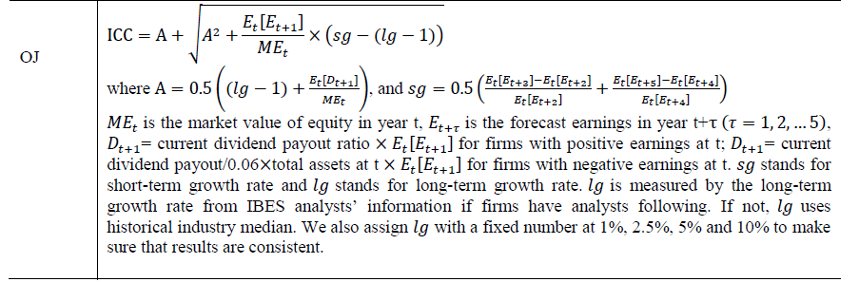

Slide 38
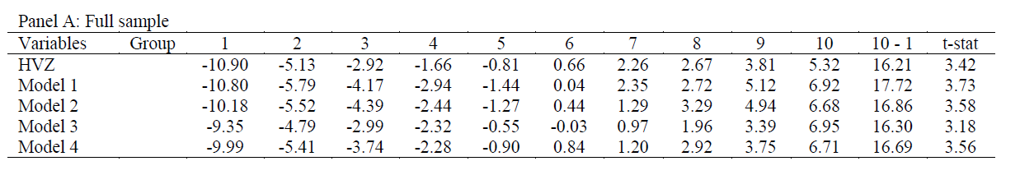
Empirical Result: Full Sample ICC
In principle, the ICCs constructed from the forecast earnings by our model should be positively related with the future realized return of stocks, that is, as ICC increases, future stock return increases.

Slide 39

Empirical Result: Firm characteristics (ICC)
To examine the role of firm characteristics, we regress:
𝑅𝑖𝑡 is the buy-and-hold return over the next year
𝑑𝑖𝑡 = 0 if firm group is 1, 𝑑𝑖𝑡 = 1, otherwise
𝐼𝐶𝐶𝑖𝑡 is the ICC calculated at time t
𝛽2 captures the coefficient difference between two firm groups, difference denoted as 𝛽5(0)−𝛽1 in the table

Slide 40
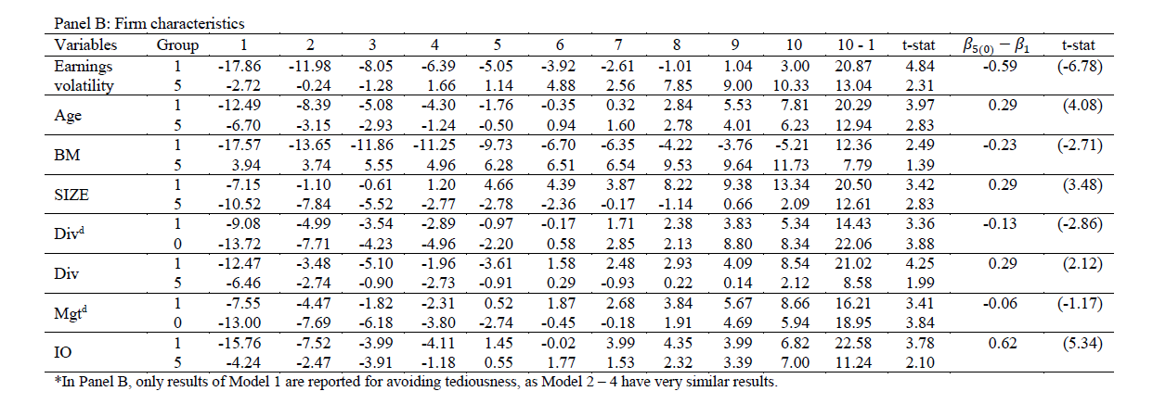
Empirical Result: Firm characteristics (ICC)

Slide 41
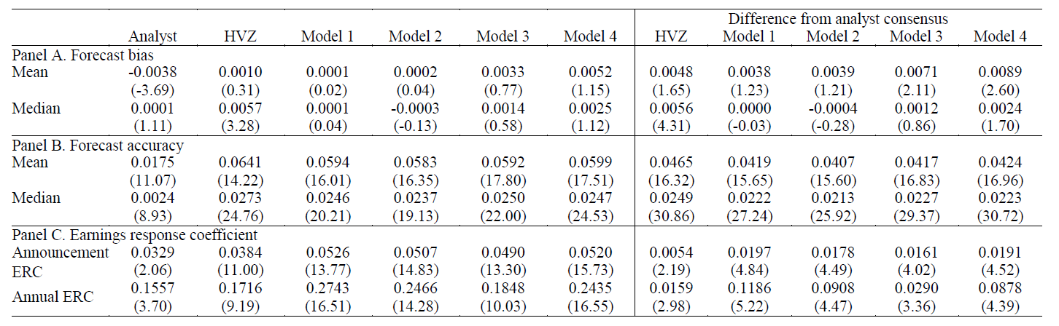
Empirical Result: Analysts’ forecast

Slide 42
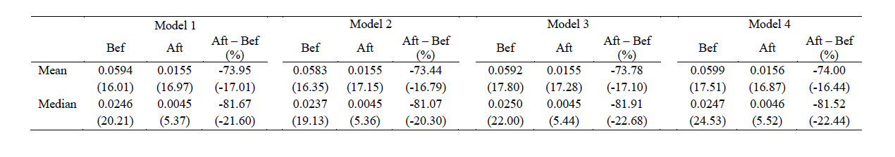
Empirical Result: Combine analysts’ forecast

Slide 43
Conclusion
Propose a novel approach to improve the performance of the cross-sectional forecast model and provide a better proxy for market expectations of future earnings
Find that combining analysts’ forecast further improves the forecast accuracy of the model

