Slide 1
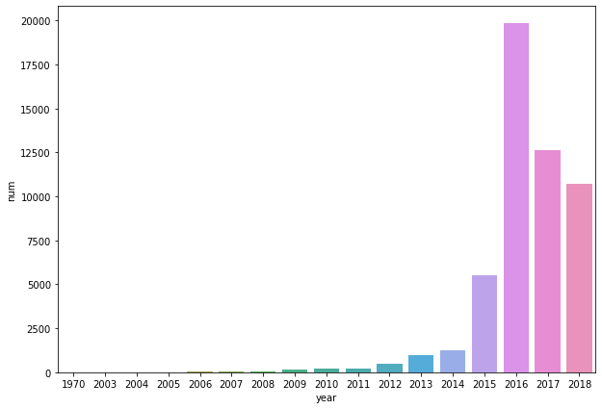
2015年出现明显的增长，2016年达到高峰
Number of the Private Fund

Slide 2
短期收益率波动较大，长期偏度趋于0，峰度下降明显
 | Mean | SD | Skew | Kurt | Min | 5% | 25% | Median | 75% | 95% | Max | n
NAV | 2.5036 | 75.6563 | 94.0601 | 9255.971 | 0.0237 | 0.7372 | 0.9737 | 1.0161 | 1.1285 | 1.8079 | 9075.485 | 186476.3
CNAV | 2.555 | 75.6559 | 94.0595 | 9255.96 | 0.0237 | 0.7518 | 0.9854 | 1.0363 | 1.1964 | 1.9768 | 9075.485 | 186476.3
ret_1m | 0.0039 | 0.0566 | 13.3986 | 855.7507 | -0.9017 | -0.0616 | -0.0093 | 0.0015 | 0.0158 | 0.0737 | 5.9714 | 173449.3
ret_3m | 0.0028 | 0.03 | 0.7687 | 62.6904 | -0.729 | -0.035 | -0.007 | 0.0017 | 0.0124 | 0.0445 | 0.8508 | 159781.3
ret_9m | 0.0022 | 0.0169 | -0.4606 | 32.7999 | -0.4068 | -0.0211 | -0.0042 | 0.0019 | 0.009 | 0.0265 | 0.2797 | 123226
ret_12m | 0.0017 | 0.0139 | -0.1605 | 30.435 | -0.2673 | -0.0175 | -0.0034 | 0.0016 | 0.0073 | 0.0211 | 0.1914 | 107036.8

Slide 3
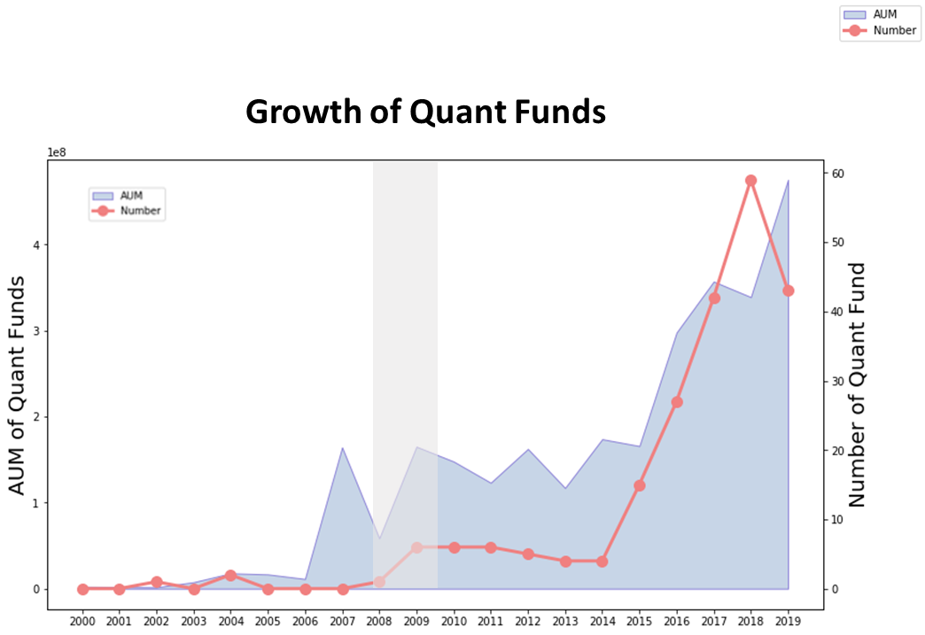
 | Age | TNA
 | (1) | (2)
Constant | -140.299*** | 0.00014***
 | (0.000) | (0.000)
Recessions | 5.315*** | 2300.979***
 | (0.000) | (0.000)
Quant | -18.431*** | -318.129***
 | (0.000) | (0.000)
Quant X Recessions | 12.463 | 6760.262***
 | (0.157) | (0.000)
Log(TNA) | 10.826***
 | (0.000)
ExpenseRatio | 22.244*** | 3333.216***
 | (0,000) | (0.000)
NetFlows | 0.005 | 11.385***
 | (0.835) | (0.000)
FlowVolatility | 1.665*** | 10.388***
 | (0.000) | (0.000)
Momentum | 0.2337*** | 12.506***
 | (0.000) | (0.000)
Size | -0.2247*** | -10.810***
 | (0.000) | (0.000)
Value | 0.1389*** | 11.173***
 | (0.000) | (0.000)
Log(Age) |  | 2127.820***
 |  | (0.000)
observations | 49411 | 49412

Slide 4
 | Picking | Timing | Picking | Timing
 | (1) | (2) | (1) | (2)
Constant | 0.2608 | 0.1352*** | 0.937*** | 0.0768***
 | (0.122) | (0.000) | (0.000) | (0.000)
Recessions | 0.0313 | -0.0382*** | 0.0284 | -0.0349***
 | (0.143) | (0.000) | (0.188) | (0.000)
Theta_TNA | 20.7009*** | -0.2907***
 | (0.000) | (0.000)
Theta_Hold |  |  | 4.0542*** | 0.7958***
 |  |  | (0.000) | (0.000)
Log(AGE) | -0.0175 | 0.0040*** | -0.0913*** | 0.0127***
 | (0.178) | (0.000) | (0.000) | (0.000)
Log(TNA) | -0.0327*** | 0.0012*** | -0.0393*** | 0.0017***
 | (0.000) | (0.000) | (0.000) | (0.000)
ExpenseRatio | 0.2155** | -0.0019 | 0.2107** | 0.0011
 | (0.022) | (0.796) | (0.026) | (0.875)
NetFlows | -0.0016*** | 0.008*** | -0.0021*** | -0.00005
 | (0.007) | (0.008) | (0.001) | (0.204)
FlowVolatility | 0.001 | 0.0010*** | -0.0104*** | 0.0011***
 | (0.484) | (0.000) | (0.000) | (0.000)
Momentum | 0.0122*** | -0.0010*** | -0.0104*** | -0.0009***
 | (0.000) | (0.000) | (0.000) | (0.000)
Size | -0.0103*** | 0.0003*** | 0.0133*** | 0.0002***
 | (0.000) | (0.000) | (0.000) | (0.000)
Value | -0.0038*** | -0.0001 | -0.0046*** | 0.000065***
 | (0.000) | (0.599) | (0.000) | (0.000)
Observations | 47989 | 47989 | 47989 | 47989

Slide 5
 | TimingRecession | PickingRecession | TimingExpansion
 | (1) | (2) | (3)
Constant | 0.3555 | -2.176 | 0.097
 | (0.138) | (0.006) | (0.000)
Quant | -0.0004** | 0.0077 | -0.0019
 | (0.038) | (0.000) | (0.665)
TopPickersExpansions | -0.0006 | -0.00006802
 | (0.364) | (0.975)
Quant X TopPickersExpansions | -0.0042 | -0.005
 | (0.364) | (0.975)
TopTimersRecessions |  |  | 0.0002***
 |  |  | (0.000)
Quant X TopTimersRecessions |  |  | 0.00001
 |  |  | (0.655)
Log(Age) | 0.0046 | -0.1112 | 0.0031***
 | (0.879) | (0.267) | (0.003)
Log(TNA) | -0.0136*** | 0.0545*** | 0.0016***
 | (0.000) | (0.000) | (0.000）
ExpenseRatio | 0.0223 | 0.7834** | 0.0051
 | (0.826) | (0.020) | (0.394)
NetFlows | 0.0022*** | -0.0097*** | -0.0005***
 | (0.000) | (0.000) | (0.000)
FlowVolatility | -0.0007 | 0.0192*** | 0.0014***
 | (0.330) | (0.000) | (0.000)
Momentum | -0.0045*** | -0.0143*** | -0.0009***
 | (0.000) | (0.000) | (0.000)
Size | -0.0009*** | -0.0047*** | 0.0003***
 | (0.001) | (0.000) | (0.000)
Value | 0.0006 | -0.0081*** | 0.000001
 | (0.108) | (0.000) | (0.447)
observations | 2810 | 2810 | 46538

Slide 6
Out-of-Sample Performance of Mutual Fund Predictors
Christopher S. Jones , Haitao M
The Review of Financial Studies, 2020.

Slide 7
Outline
Introduction
Research design
Empirical result
Robust Test
Conclusion

Slide 8
Outline
①
Whether the alpha predictors continue to perform outside of the original samples?
②
Data snooping
The alpha declines out-of-sample
Learning ability
Arbitrage activities
Market conditions
Market competitions
③
Applying Alpha Predictors for Corporate Bond Funds

Slide 9
Introduction: Research Questions
A modest number of variables that appear to do so have now been found. Whether these alpha predictors continue to perform out-of-sample.
Data snooping, arbitrage activities, fund competition and learning, which explains the OOS declines of the forecast performance.
Did these alpha predictors work in the corporate bond fund?

Slide 10
Find Mutual Fund Alpha Predictors
Construct a comprehensive sample of mutual fund predictors by examining journal articles published between 1960 and 2015 with the word “fund” in the title or “mutual fund” in the abstract.
Financial journals
(Journal of Finance, Review of Financial Studies, Journal of Financial Economics, Review of Finance, Journal of Financial and Quantitative Analysis, and Review of Asset Pricing Studies)
Economics journals
(American Economic Review, Econometrica, Journal of Political Economy, Review of Economics and Statistics, and Quarterly Journal of Economics).

Slide 11
Find Mutual Fund Alpha Predictors
Requirements:
The predictor must be constructible using standard data sets, which we deﬁne as CRSP, Compustat, IBES, Thompson-Reuters, and a collection of benchmarks from Standard and Poor’s, FTSE Russell, and Barclays.
We do require that signiﬁcance is established for actual fund returns, holdings, post fees and costs, which we use in our analysis.
We examine each paper in that list to ﬁnd if it contained statistically signiﬁcant evidence (at the 5% level) that some mutual fund predictor not considered in prior work

Slide 12
Mutual Fund Alpha Predictors
One-year return(Hendricks et al. 1993)
One-year Carhart alpha (Carhart 1997)
Five-year Carhart alpha (Carhart 1997)
Back-tested alpha(Mamaysky et al. 2007)
Active share(Cremers & Petsjisto 2009)
Active weight(Doshi et al. 2015)
R-squared(Amihud & Goyenko 2013)
Abnormal cash holdings(Simutin 2014)
Holdings-based alpha(Elton et al. 2011)
Return gap(Kacperczyk el al.2008)
Risk shifting(Huang et al. 2011)
Momentum(Grinblatt et al.1995)
Inverse of diversification(Pollet & Wilson 2008)
Industry concentration(Kacperczyk el al. 2005)
Intangibles(Gupta-Mukherjee 2014)
Public info(Kacperczyk & Seru 2007)
Fund size(Chen et al. 2004)
Growth style(Chan et al. 2002)
Fund flows(Zheng 1999)
Turnover(Elton et al. 1993)
Flow-induced trading(Lou 2012)
Expense ratio(Elton et al. 1993)
Direct-sold(Bergstresser et al. 2009
Notes:
proxy for the investor redemption risk,because Ω is sensitive to the investor’s utility function

Slide 13
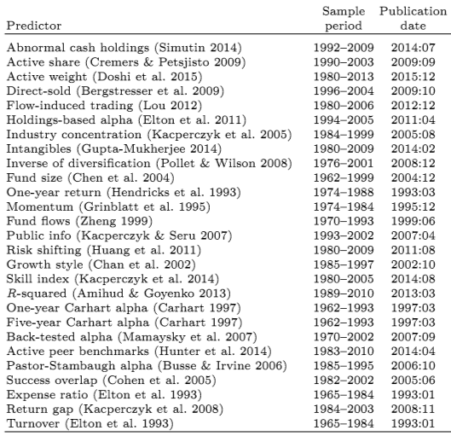
Mutual Fund Alpha Predictors
Notes:
proxy for the investor redemption risk,because Ω is sensitive to the investor’s utility function

Slide 14
Research Design: Data
(CRSP MF) database, from 1961.11 to 2015.01
Returns (monthly) and fund characteristics
Thomson Reuters, from 1980 to 2014
Quarterly fund equity holdings data
Exclude ﬁxed income, international, money market, sector, index, target-date, and balanced funds, focusing on active U.S. equity funds.
Exclude the fund with TNA below $15 million
Require a fund to hold at least ten stocks
The ﬁnal sample ranges from November 1961 to January 2015, comprises 3,069 unique funds.
Notes:
increase the power of our tests, decrease the possibility that some documented results are driven by database-specific selection biases

Slide 15
Introduction: Research Questions
A modest number of variables that appear to do so have now been found. Whether these alpha predictors continue to perform out-of-sample.
Data snooping, arbitrage activities, fund competition and learning, which explains the OOS declines of the forecast performance.
Did these alpha predictors work in the corporate bond fund?

Slide 16
Computing alpha spreads
For each fund at each date, we use the previous 36 months to estimate the betas on the FF3 and FFC factors, then use those betas to risk-adjust the current month’s excess return.
Measure alpha spreads by sorting.
“Q5-Q1”: Computing the diﬀerence between the equal weighted average alphas in the top and bottom quintiles.
Measure alpha spreads by cross sectional regression.
CSR spread is computed by running univariate cross-sectional regressions on these indicators.
Notes:
increase the power of our tests, decrease the possibility that some documented results are driven by database-specific selection biases

Slide 17
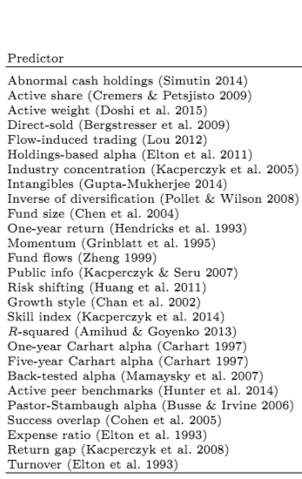
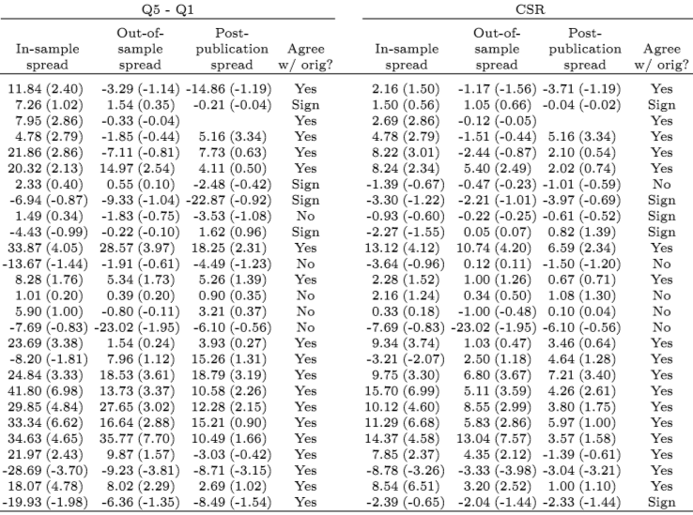
Re-evaluate predictors within consistent framework
18 of the 27 predictors have t-statistics above 1.5

Slide 18
Introduction: Research Questions
A modest number of variables that appear to do so have now been found. Whether these alpha predictors continue to perform out-of-sample.
Data snooping, arbitrage activities, fund competition and learning, which explains the OOS declines of the forecast performance.
Did these alpha predictors work in the corporate bond fund?

Slide 19
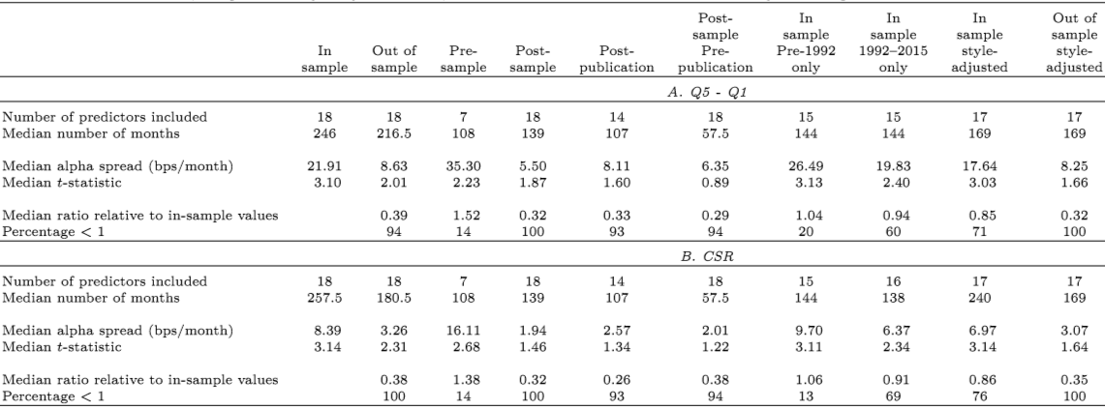
Alpha spread in different samples
Pre-sample
In-sample
Publication
1992
Post-sample

Slide 20


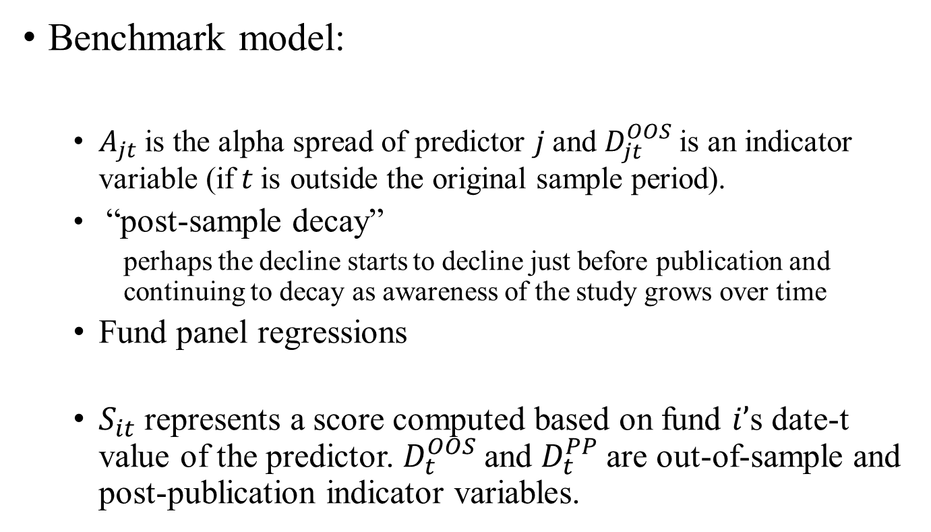
Panel regression model
Benchmark model:
$A_{jt}$is the alpha spread of predictor $j$and $D_{jt}^{OOS}$is an indicator variable (if$t$is outside the original sample period).
“post-sample decay”
perhaps the decline starts to decline just before publication and continuing to decay as awareness of the study grows over time
Fund panel regressions
$S_{it}$ represents a score computed based on fund $i’$s date-t value of the predictor. $D_{t}^{OOS}$and $D_{t}^{PP}$are out-of-sample and post-publication indicator variables.

Slide 21
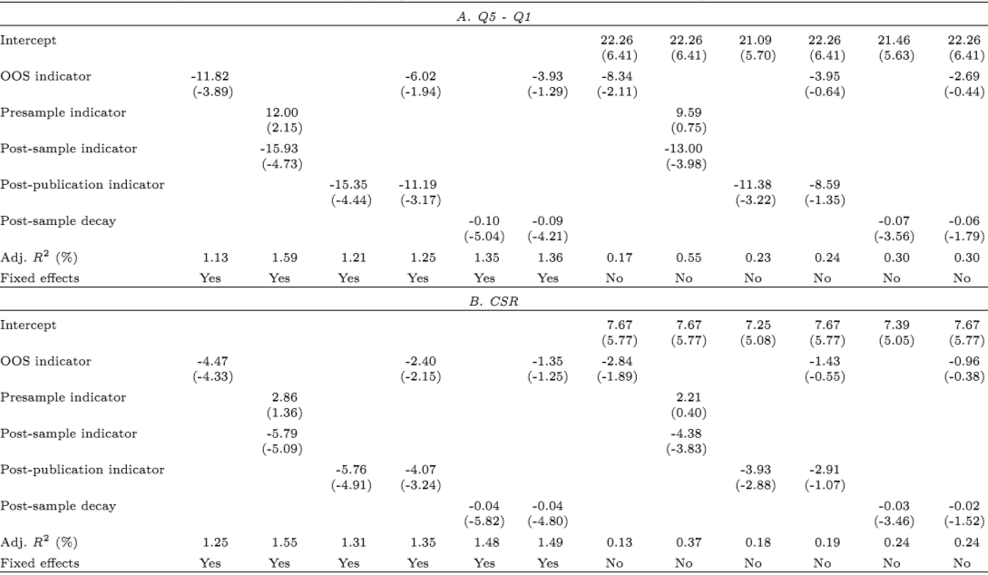
$$A_{jt}=a_{j}+bD_{jt}^{OOS}+cD_{jt}^{Pre}+dD_{jt}^{Post}+eD_{jt}^{PP}+emax⁡\{t−τ_{j},0\}$$
Question 1: Whether overall hedge fund performance has declined substantially over time?

Slide 22
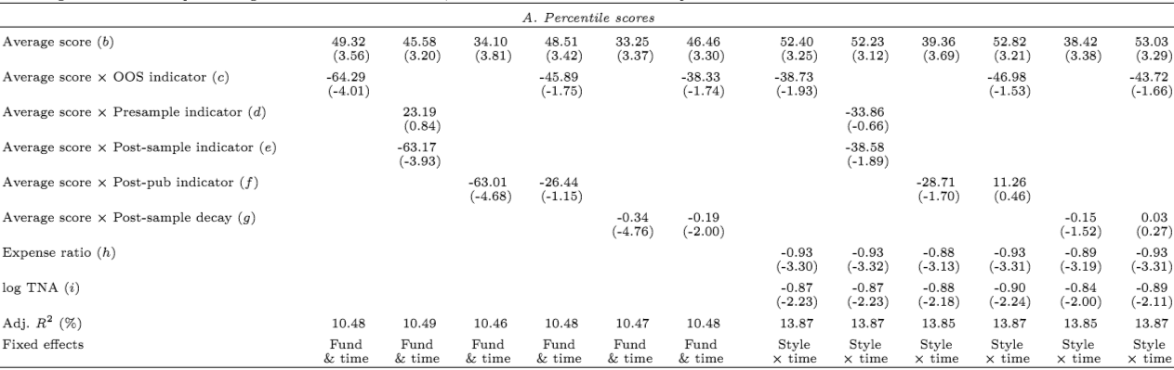
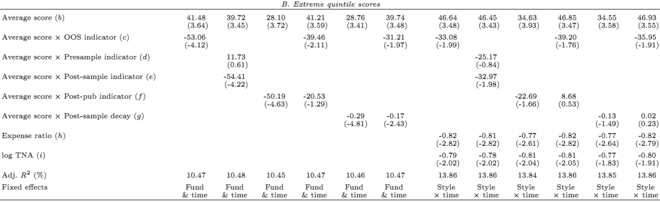

Slide 23
Time-Varying Arbitrage Activity and Fund Competition
Consider three diﬀerent proxies of market-level arbitrage activity (Chordia, Subrahmanyam, and Tong, 2014)
– Aggregate short interest
– Aggregate share turnover
– Aggregate hedge fund asset size
Consider four diﬀerent measures of competition
– Aggregate industry size
– Sector size
– NPeers (number of peers)
– TSIM (total similarity)

Slide 24
Research Design: Data
Stock short interest data is from Compustat, January 1973 to December 2014.
Aggregate short interest of U.S. common equities is the value-weighted monthly short interest scaled by the previous month’s outstanding shares.
Aggregate share turnover are obtained from CRSP, January 1961 to December 2014.
Aggregate share turnover is the monthly value-weighted share turnover using the market capitalization at the end of the previous year as the weight
Aggregate hedge fund asset size, are from Jylh¨a and Suominen (2011), March 1977 to December 2010.
Notes:
increase the power of our tests, decrease the possibility that some documented results are driven by database-specific selection biases

Slide 25

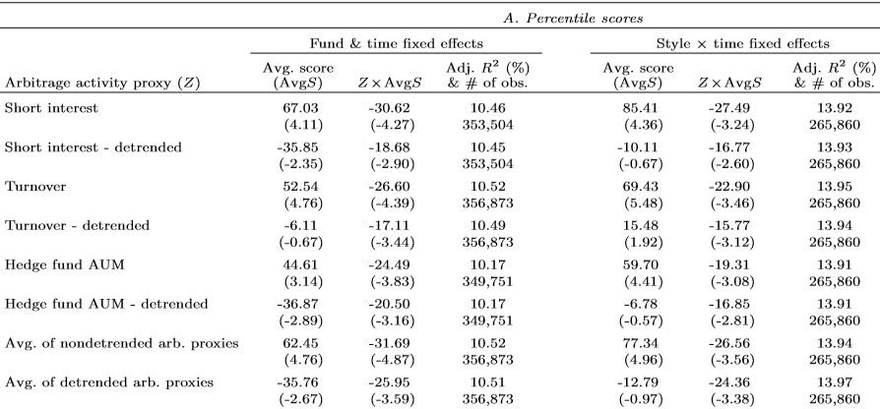
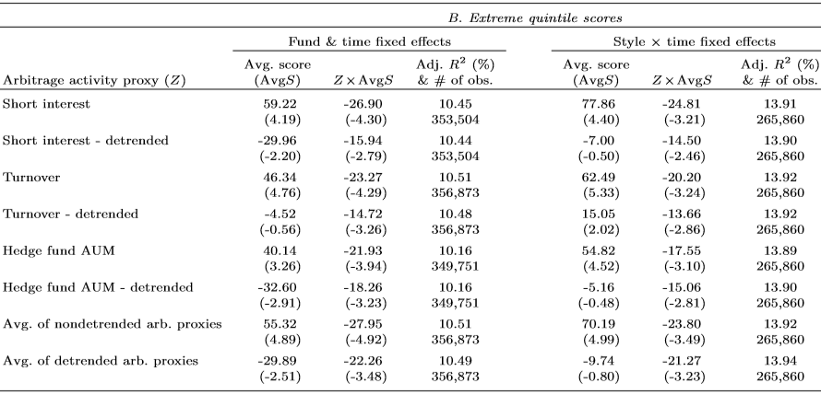

Slide 26
Time-Varying Arbitrage Activity and Fund Competition
Consider three diﬀerent proxies of market-level arbitrage activity (Chordia, Subrahmanyam, and Tong, 2014)
– Aggregate short interest
– Aggregate share turnover
– Aggregate hedge fund asset size
Consider four diﬀerent measures of competition
– Aggregate industry size
– Sector size
– NPeers (number of peers)
– TSIM (total similarity)

Slide 27
Research Design: Data
The sample period starts in 1980:1 and ends in 2015:1
Aggregate industry size (P´astor, Stambaugh, and Taylor, 2015)
Total AUM of all actively managed U.S. equity mutual funds divided by the total market capitalization of all CRSP common stocks.
Sector size
Computed similarly with Aggregate industry size, but separately for each style.
NPeers (number of peers) (Hoberg, Kumar, and Prabhala, 2018).
The number of peers with holdings of similar size/ value/ momentum
TSIM (total similarity) (Hoberg, Kumar, and Prabhala, 2018).
The degree of similarity with holdings of similar size/ value/ momentum
Notes:
increase the power of our tests, decrease the possibility that some documented results are driven by database-specific selection biases

Slide 28
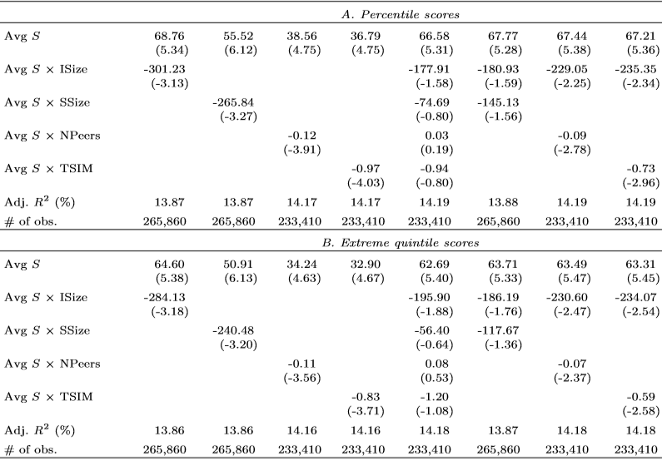

Slide 29
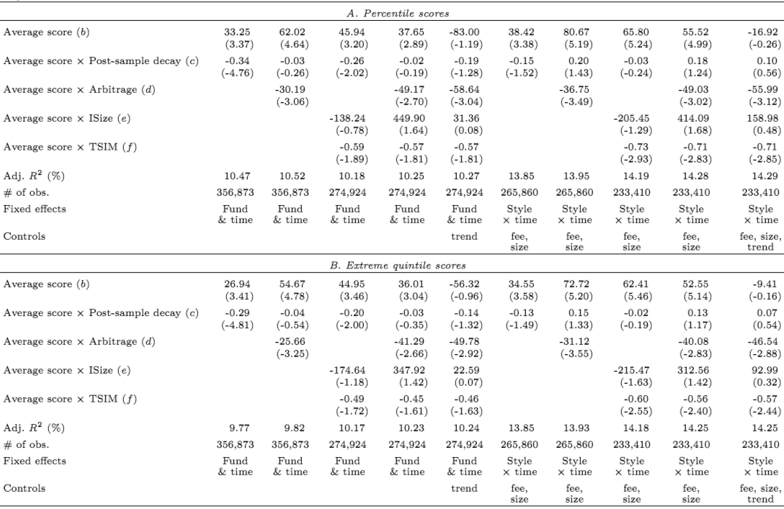

Slide 30
Introduction: Research Questions
A modest number of variables that appear to do so have now been found. Whether these alpha predictors continue to perform out-of-sample.
Data snooping, arbitrage activities, fund competition and learning, which explains the OOS declines of the forecast performance.
Did these alpha predictors work in the corporate bond fund?

Slide 31
Corporate bond fund performance
The vast majority of the mutual fund predictors we consider in this paper were originally studied in the context of U.S. equity funds.
Why we study the performance of Corporate bond?
The asset class that they represent is extremely large.
The corporate bonds are conceptually somewhat close to equities.
It is therefore conceivable that the skills required to generate alpha in one market could be valuable in the other.

Slide 32
Corporate bond fund: Data
Corporate bond fund sample is from the CRSP Mutual Fund database (if the CRSP style code begins with “IC.” )
Our corporate bond fund data begin in January 1991, the ﬁrst realized alphas are observed in January 1994. The sample ends in January 2015.
Limitations
Holdings of corporate bond funds are only available starting in September of 2003.
Reporting to the TRACE system became mandatory from 2005 for all ﬁxed income trades.
As a result, our bond fund analysis considers only 13 predictors, 6 of which are measures of past performance.

Slide 33
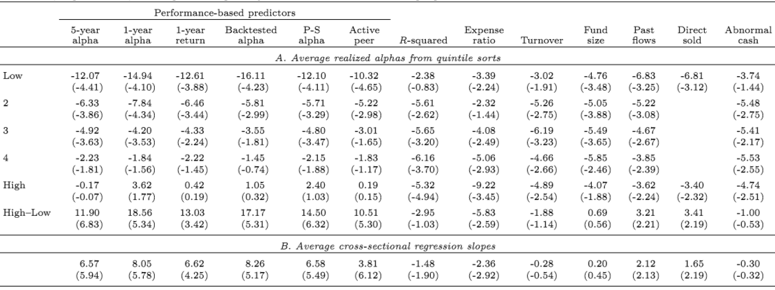
Corporate bond fund performance
All factors are excess returns on Barclays bond indexes (include indexes for U.S. Treasuries, investment-grade corporates, high-yield corporates, and mortgage-backed securities)

Slide 34
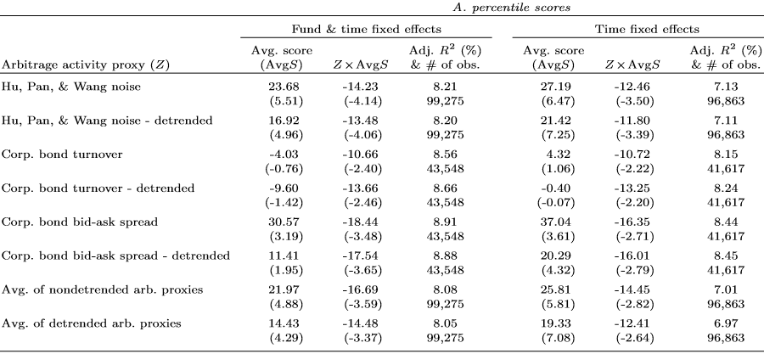
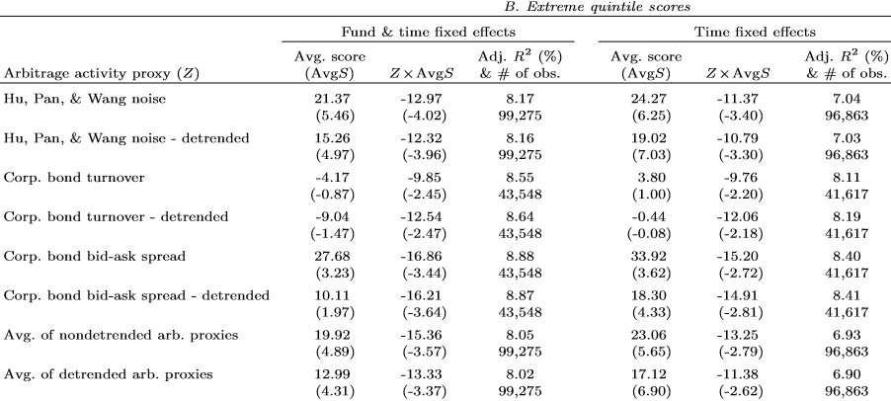
This is a measure of the degree of non-smoothness in the U.S. Treasury yield curve.

