Slide 1
私募基金预测-portfolio sort1
 |  | 1 | 2 | 3 | 4 | 5 | 6 | 7 | 8 | 9 | 10 | 10-1
1-month return | Average | 0.0003 | -0.0004 | 0.0015 | 0.0014 | 0.0029 | 0.0023 | 0.0016 | 0 | 0.0004 | -0.0021 | -0.0024
 | t-statistic | (0.0426) | (-0.0868) | (0.3556) | (0.4098) | (0.9189) | (0.9836) | (0.468) | (-0.0066) | (0.0719) | (-0.3016) | (-0.5264)
3m cumulative return | Average | -0.0039 | 0.0014 | 0.0004 | -0.0005 | 0.0001 | 0.0016 | 0.0034 | 0.0032 | 0.0039 | 0.0009 | 0.0048
 | t-statistic | (-0.6073) | (0.2391) | (0.0701) | (-0.1129) | (0.0427) | (0.5321) | (1.0858) | (0.9578) | (0.7954) | (0.1465) | (1.2309)
6m cumulative return | Average | -0.0036 | -0.0007 | 0.0006 | -0.0001 | -0.0005 | 0.0014 | 0.0024 | 0.0023 | 0.0041 | 0.0032 | 0.0068
 | t-statistic | (-0.511) | (-0.1169) | (0.1184) | (-0.0274) | (-0.1549) | (0.5298) | (0.9316) | (0.5899) | (0.8562) | (0.5071) | (1.4879)
9m cumulative return | Average | -0.0062 | 0.0003 | 0.0008 | -0.0003 | 0.0008 | 0.0017 | 0.0021 | 0.0025 | 0.0045 | 0.0038 | 0.01
 | t-statistic | (-0.9659) | (0.0484) | (0.182) | (-0.1094) | (0.26) | (0.5468) | (0.6268) | (0.5986) | (0.7818) | (0.5328) | (2.1292)
12m cumulative return | Average | -0.0056 | 0.0026 | 0.0013 | 0.0013 | 0.0002 | 0.0011 | 0.0008 | 0.0028 | 0.0018 | 0.0029 | 0.0085
 | t-statistic | (-0.794) | (0.4449) | (0.3538) | (0.4645) | (0.0834) | (0.3754) | (0.2103) | (0.5717) | (0.3427) | (0.4327) | (2.1124)
ACF1 of past 12 months’ ret | Average | 0.0022 | 0.0011 | 0.0007 | 0.0005 | -0.001 | 0.0014 | 0.0007 | 0.0015 | 0.0007 | 0.0007 | -0.0018
 | t-statistic | (0.4246) | (0.2131) | (0.1405) | (0.1277) | (-0.2433) | (0.3214) | (0.1378) | (0.3461) | (0.1692) | (0.1437) | (-0.6052)
ACF2 of past 12 months’ ret | Average | 0.0002 | 0.0001 | 0.003 | 0.0026 | 0 | 0.0008 | 0.0009 | 0.0001 | 0.001 | 0.0022 | 0.002
 | t-statistic | (0.0482) | (0.0238) | (0.6609) | (0.6526) | (-0.0009) | (0.1553) | (0.201) | (0.0288) | (0.1937) | (0.3667) | (0.5664)
ACF3 of past 12 months’ ret | Average | 0.0033 | 0.0022 | 0.0021 | 0.0017 | 0.0008 | 0.0004 | -0.002 | -0.0007 | -0.0006 | 0.0015 | -0.0019
 | t-statistic | (0.6151) | (0.4312) | (0.4348) | (0.436) | (0.1894) | (0.0993) | (-0.4218) | (-0.1498) | (-0.1252) | (0.3809) | (-0.6523)

Slide 2
私募基金预测-portfolio sort2
 |  | 1 | 2 | 3 | 4 | 5 | 6 | 7 | 8 | 9 | 10 | 10-1
Standard deviatio | Average | -0.0008 | 0.0007 | 0.0031 | 0.001 | 0.0011 | 0.0035 | 0.003 | 0.0018 | 0.0002 | -0.0033 | -0.0025
 | t-statistic | (-1.5113) | (0.9803) | (1.4723) | (0.3179) | (0.2181) | (0.5723) | (0.4274) | (0.2952) | (0.0254) | (-0.4691) | (-0.3758)
Skewness | Average | 0.0006 | 0.0011 | 0.0011 | 0.0015 | 0.0015 | 0.0014 | 0.0017 | 0.0009 | 0.0004 | 0 | -0.0006
 | t-statistic | (0.3896) | (0.2612) | (0.2068) | (0.2973) | (0.2772) | (0.2845) | (0.3199) | (0.1748) | (0.0853) | (-0.0048) | (-0.1975)
Kurtosis | Average | 0.0026 | 0.0011 | 0.0027 | 0.0009 | 0.0003 | 0.0012 | 0.001 | -0.0003 | 0.0004 | -0.0004 | -0.003
 | t-statistic | (0.5186) | (0.2031) | (0.518) | (0.1859) | (0.0673) | (0.2527) | (0.2356) | (-0.07) | (0.0921) | (-0.1714) | (-1.0037)
Sharpe Ratio | Average | -0.0019 | -0.0006 | 0.0015 | 0.0002 | -0.0012 | 0 | 0.001 | 0.0027 | 0.0028 | 0.0048 | 0.0066
 | t-statistic | (-0.5126) | (-0.1134) | (0.3116) | (0.0508) | (-0.265) | (0.0041) | (0.1857) | (0.529) | (0.4982) | (1.1992) | (1.9369)
Alpha w.r.t styled index | Average | -0.0058 | -0.0012 | 0.002 | -0.0011 | -0.0002 | 0.0019 | 0.003 | 0.0044 | 0.0038 | 0.0035 | 0.0092
 | t-statistic | (-1.0361) | (-0.2423) | (0.4861) | (-0.4001) | (-0.0888) | (0.6226) | (0.7382) | (0.8755) | (0.5912) | (0.4737) | (2.7322)
t-statistic of alpha | Average | -0.004 | -0.0018 | 0.0004 | -0.0012 | -0.0013 | 0.0007 | 0.0027 | 0.0039 | 0.0041 | 0.0045 | 0.0085
 | t-statistic | (-1.2808) | (-0.4323) | (0.0989) | (-0.2985) | (-0.3223) | (0.1673) | (0.4811) | (0.7099) | (0.6815) | (1.0827) | (4.2283)
Drawdown | Average | -0.0064 | 0.001 | 0.0027 | 0.0045 | 0.0018 | 0.0009 | 0.0015 | 0.0023 | 0.0023 | 0.0016 | 0.0079
 | t-statistic | (-0.8884) | (0.1657) | (0.4321) | (0.7196) | (0.3255) | (0.1899) | (0.3776) | (0.8492) | (1.3261) | (2.2984) | (1.1898)

Slide 3
公募基金——主动管理
基金持仓数据来自wind，从1998年3月开始
基金月度净值数据和月度收益率数据来自色诺芬数据库，从2001年9月开始（可以扩展）
股票市值数据来自wind
样本筛选
成立时间1年以上（刘京军等，2018）
净值数据2年以上（刘京军等，2018）
Incubation bias:删除成立之后一年的数据（申宇等，2013）
只选取有连续一年持仓数据的基金（Doshi,2015)
主动管理型基金筛选
选取股票/偏股型基金(国内大部分研究）
选取股票偏股型/混合型基金，要求持股比例80%以上

Slide 4
公募基金——主动管理
基金研究时间的筛选
肖峻和石劲（2011）指出，我国基金在2005年存在样本量较少，代表性不足，且净值波动较大，因此在统计上可能存在较大的偏误，建议选取2005年之后的数据来研究
罗荣华等（2011）选取2005年作为起点：
1.2005年我国进行了股权分置改革，
2.文中的参考指数沪深300发布时为间2005年
3.2005年之前的基金数量和规模都相对较小
刘莎莎等（2013）利用2003年1月至2011年9月前两年的数据计算基金的风险头寸，检验期为2005年1月至2011年9月
刘京军等（2013）采用样本期间从2005年至2015年
2005年之前成立的指数有上证50/上证180/深证成指/沪深300

Slide 5
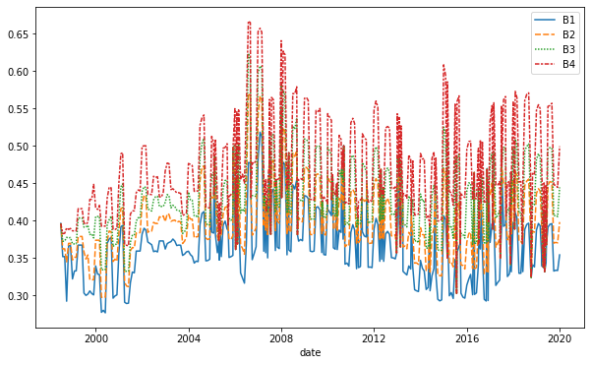
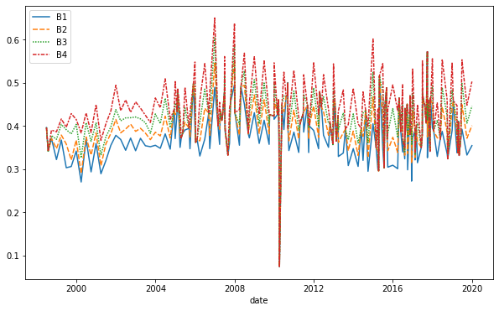
Active weight五分位线（1998.9-2019.12）

Slide 6
1185只基金，月度收益率数据（2002.9-2019.12）
 | 1 | 2 | 3 | 4 | 5 | 5-1
FFC Alpha | 0.409 | 0.758 | 0.566 | 0.732 | 0.668 | 0.259
tvalues | (0.869) | (1.551) | (1.157) | (1.472) | (1.386) | (1.724)
Excess return | 0.482 | 0.797 | 0.552 | 0.772 | 0.746 | 0.265
tvalues | (0.913) | (1.415) | (0.969) | (1.336) | (1.311) | (1.756)
1185只基金，月度收益率数据（2005.1-2019.12）
 | 1 | 2 | 3 | 4 | 5 | 5-1
FFC Alpha | 0.409 | 0.758 | 0.566 | 0.732 | 0.668 | 0.259
tvalues | (0.869) | (1.551) | (1.157) | (1.472) | (1.386) | (1.725)
Excess Return | 0.482 | 0.797 | 0.552 | 0.772 | 0.746 | 0.265
tvalues | (-0.913) | (-1.415) | (-0.969) | (1.336) | (1.311) | (1.756)

Slide 7
How Active Is Your Fund Manager? A New Measure That Predicts Performance
K. J. Martijn Cremers, Antti Petajisto
The Review of Financial Studies, 2009.

Slide 8
Managerial Activeness and Mutual Fund Performance
Hitesh Doshi, Redouane Elkamhi, Mikhail Simutin
Review of Asset Pricing Studies, 2015.

Slide 9
Motivation
An important long-standing question in financial economics is whether active mutual fund managers possess skills to beat their benchmarks.
Among the existing measure of managerial activeness, all of them have their own advantage and disadvantage.
It is important to propose new measures as a complement to the old and to test the existing hypothesis.

Slide 10
Outline—Comparison
Compare the advantage of the different factors in the view of construction.
Compare the data they used.
Compare the similar test for old topics: the active managerial with size, expenses, turnover.
Compare the return performance of the both active managerial factors.
Compare the two new factors with the other active managerial factors.

Slide 11





Introduction: Active Managerial
Tracking error
(Grinold and Kahn 1999)
Industry concentration ratio (Kacperczyk, Sialm, and Zheng 2005)
Active share
(Cremers and Petajisto 2009)
R-squared
(Amihud and Goyenko 2013)
Active weight
(Doshi Elkamhi and Simutin 2015)

Slide 12
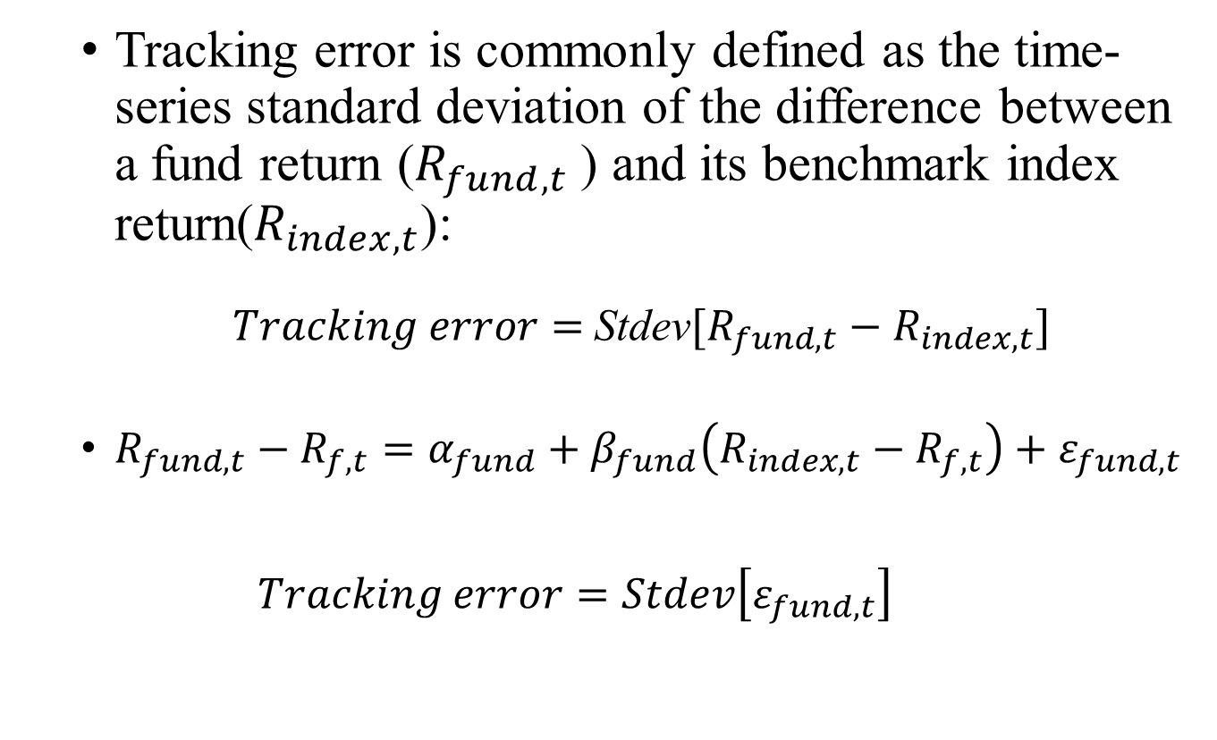

Tracking Error
Tracking error is commonly defined as the time-series standard deviation of the difference between a fund return ($R_{fund,t}$) and its benchmark index return($R_{index,t}$):
$Tracking error=$Stdev$[R_{fund,t}−R_{index,t}]$
$R_{fund,t}−R_{f,t}=α_{fund}+β_{fund}\left(R_{index,t}−R_{f,t}\right)+ε_{fund,t}$
$$Tracking error=Stdev\left[ε_{fund,t}\right]$$
$$β_{fund}=1$$
Factor Timing

Slide 13
Introduction: Active Managerial
Tracking error
(Grinold and Kahn 1999)
Industry concentration ratio (Kacperczyk, Sialm, and Zheng 2005)
Active share
(Cremers and Petajisto 2009)
R-squared
(Amihud and Goyenko 2013)
Active weight
(Doshi Elkamhi and Simutin 2015)

Slide 14
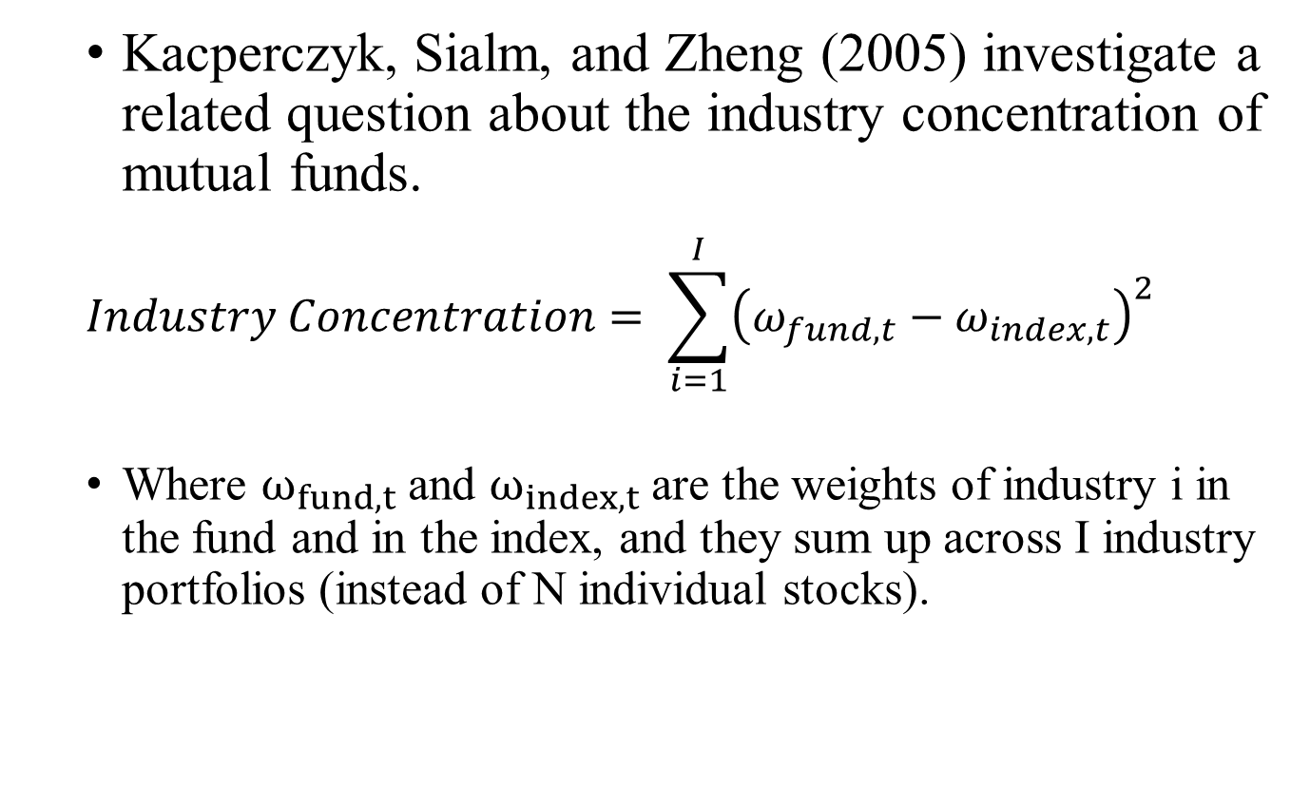
Industry concentration ratio
Kacperczyk, Sialm, and Zheng (2005) investigate a related question about the industry concentration of mutual funds.
$$Industry Concentration= \sum_{i=1}^{I}{{\left(ω_{fund,t}−ω_{index,t}\right)}^{2} }$$
Where $ω_{fund,t}$ and $ω_{index,t}$ are the weights of industry i in the fund and in the index, and they sum up across I industry portfolios (instead of N individual stocks).

Slide 15
Introduction: Active Managerial
Tracking error
(Grinold and Kahn 1999)
Industry concentration ratio (Kacperczyk, Sialm, and Zheng 2005)
Active share
(Cremers and Petajisto 2009)
R-squared
(Amihud and Goyenko 2013)
Active weight
(Doshi Elkamhi and Simutin 2015)

Slide 16
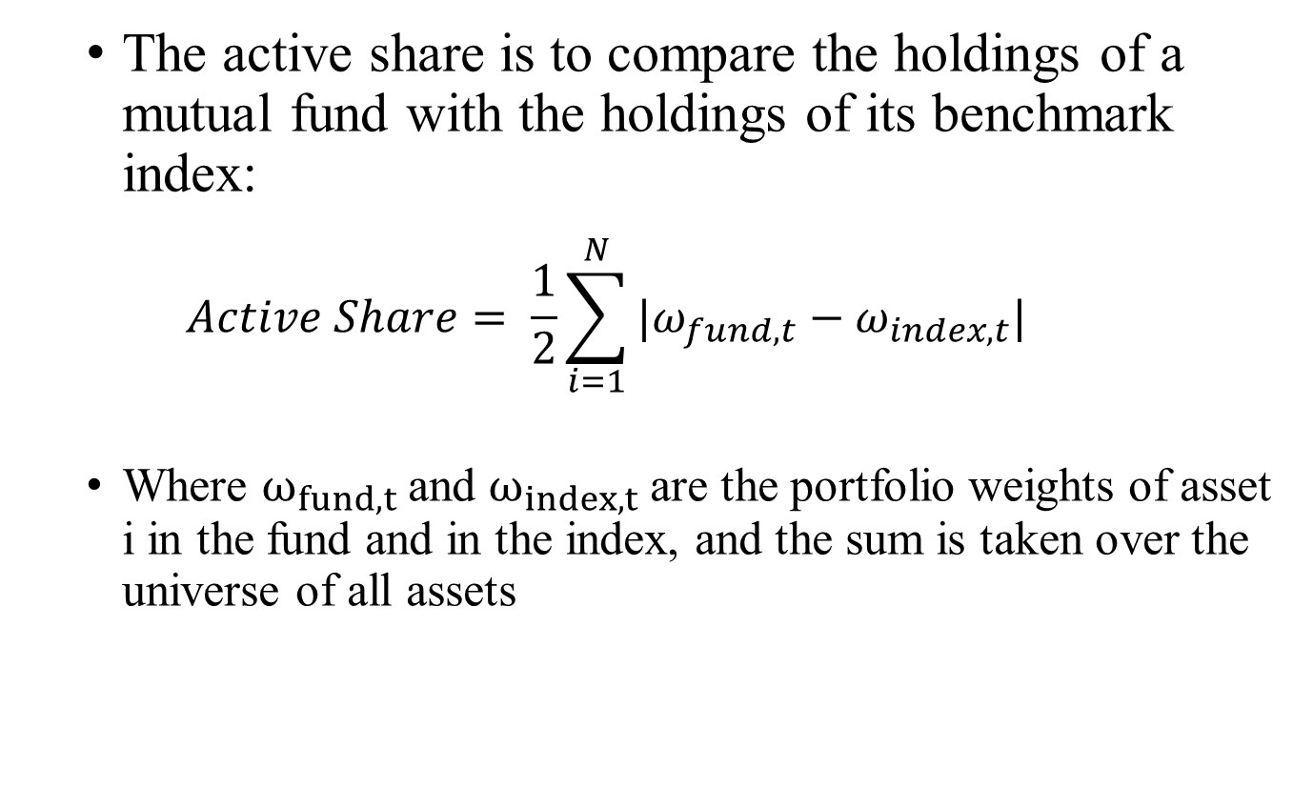
Active Share
The active share is to compare the holdings of a mutual fund with the holdings of its benchmark index:
$$Active Share= \frac{1}{2}\sum_{i=1}^{N}{|ω_{fund,t}−ω_{index,t}| }$$
Where $ω_{fund,t}$and $ω_{index,t}$are the portfolio weights of asset i in the fund and in the index, and the sum is taken over the universe of all assets
Stock Picking

Slide 17
Introduction: Active Managerial
Tracking error
(Grinold and Kahn 1999)
Industry concentration ratio (Kacperczyk, Sialm, and Zheng 2005)
Active share
(Cremers and Petajisto 2009)
R-squared
(Amihud and Goyenko 2013)
Active weight
(Doshi Elkamhi and Simutin 2015)

Slide 18
R-Square
Use the fund’s R2 (from a regression on common factor) as a proxy measure of selectivity.
The lower R2 the greater selectivity, the better the subsequent performance, after controlling for fund characteristics and past performance
R2 also predicts performance for mutual funds that hold corporate bonds

Slide 19
Introduction: Active Managerial
Tracking error
(Grinold and Kahn 1999)
Industry concentration ratio (Kacperczyk, Sialm, and Zheng 2005)
Active share
(Cremers and Petajisto 2009)
R-squared
(Amihud and Goyenko 2013)
Active weight
(Doshi Elkamhi and Simutin 2015)

Slide 20
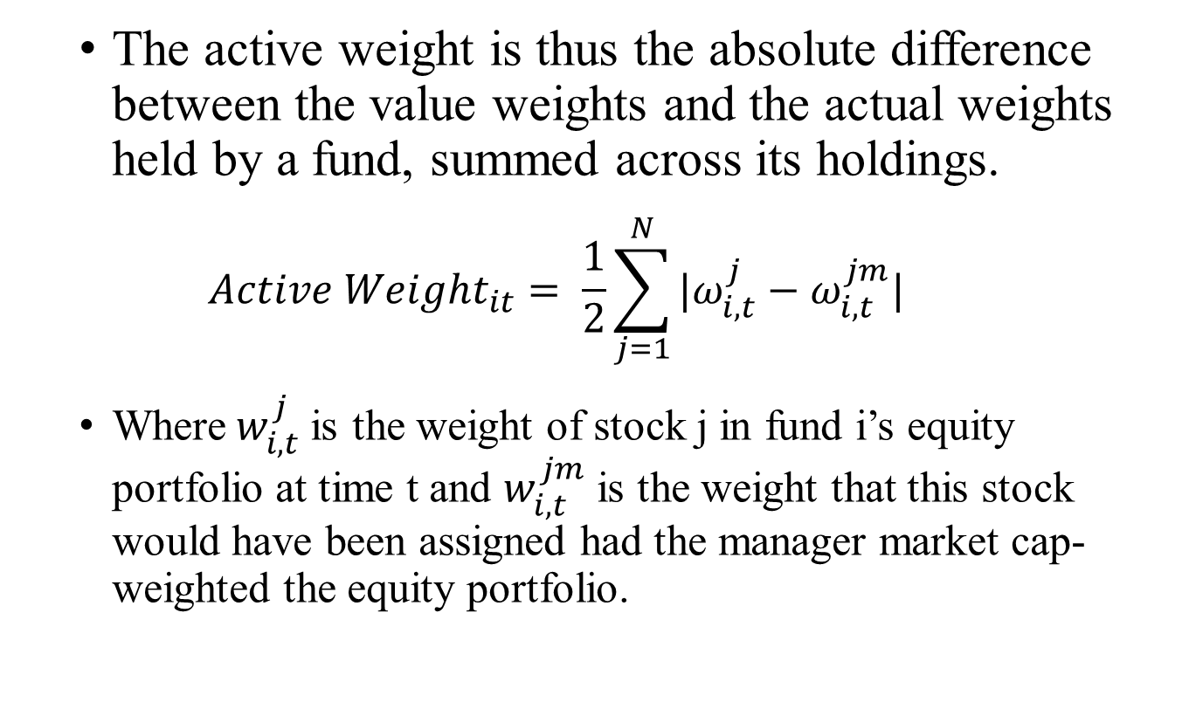
Active Weight
The active weight is thus the absolute difference between the value weights and the actual weights held by a fund, summed across its holdings.
$$Active {Weight}_{it}= \frac{1}{2}\sum_{j=1}^{N}{|ω_{i,t}^{j}−ω_{i,t}^{jm}| }$$
Where$w_{i,t}^{j}$is the weight of stock j in fund i’s equity portfolio at time t and $w_{i,t}^{jm}$ is the weight that this stock would have been assigned had the manager market cap-weighted the equity portfolio.
Weight Allocation

Slide 21

Active Share & Active Weight
Active management:
Selecting assets from the universe of suitable investments given a fund’s investment objective and benchmark.
Assigning weights to each selected asset.
Active Weight
Active Share

Slide 22
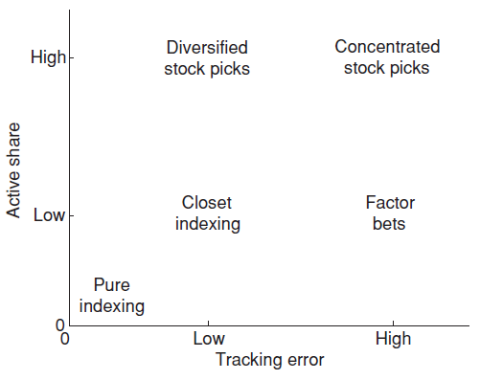
Tracking Error & Active Share
Active Share represents the fraction of portfolio holdings that differ from the benchmark index, thus emphasizing stock selection. Tracking error is the volatility of fund return in excess of the benchmark, so it emphasizes bets on systematic risk.

Slide 23
Active share: Data
Portfolio composition of mutual funds
The stock holdings of mutual funds are from the CDA/ Spectrum mutual fund holdings database maintained by Thomson Financial.(Start in 1980, quarterly)
19 benchmark index: Assign the index with the lowest Active Share as that fund’s benchmark
S&P/Barra
S&P 500, S&P 500/ Barra Growth, S&P500/ Barra Value, S&P Mid Cap 400, and S&P Small Cap 600.
Russell
Russell 1000, Russell 2000, Russell 3000, Russell Midcap, the value and growth components of the four Russell indexes
Wilshire
Wilshire 5000 and Wilshire 4500

Slide 24
Active share: Data
Return Data
Monthly returns for mutual funds are from the CRSP mutual fund database.
Monthly returns for benchmark indexes are from S&P, Russell, and Ibbotson Associates
Daily returns for mutual funds are from Standard & Poor’s, but it does not contain dead funds.
CRSP mutual fund database, which contains daily returns for live and dead funds starting in January 2001 and Wall Street Web (Goetzmann, Ivkovic, and Rouwenhorst 2001) from January 1968 to January 2001

Slide 25
Active share: Data
Sample Selection—Focus on all-equity funds
Look at investment objective codes from Wiesenberg, ICDI, and Spectrum.
aggressive growth, growth, growth and income, equity income, growth with current income, income, long-term growth, maximum capital gains, small capitalization growth, unclassified, or missing.
Look at the percentage of stocks in the portfolio as reported by CRSP.
At least 80% or missing
Value of the stock holdings from Spectrum and their share of the total net assets of the fund.
67% of reported total net assets

Slide 26
Active share: Data
Factor calculation
To compute tracking error, we require at least a hundred trading days of daily return data for each fund in the six months immediately preceding its holdings report date.
Incubation bias
Eliminating observations before the starting year reported by CRSP as well as the observations with a missing fund name in CRSP
Only include funds with equity holdings greater than $10 million.
Our final sample consists of 2,647 funds in the period 1980–2003, the observation is 48,354.

Slide 27
Active weight: Data
Fund characteristics and returns (same)
(CRSP) Survivor Bias-Free Mutual Fund Database.
Fund holdings (same)
Thomson Financial Mutual Fund Holdings.
Sample Selection
Diversified domestic actively managed equity mutual funds.
crsp_obj_cd when including funds with AGG, GMC, GRI, GRO, ING, and SCG Strategic Insight codes, EIEI,G,LCCE, LCGE, LCVE, MCCE, MCGE, MCVE, MLCE, MLGE, MLVE, SCCE, SCGE, and SCVE Lipper codes, and G, G-I, AGG,GCI, GRI, GRO, LTG, MCG, and SCG Wiesenberger codes.
Exclude funds with TNA of less than $15 million

Slide 28
Active weight: Data
Incubation bias (Evans 2010)
Remove the first eighteen months of returns on each fund.
Exclude funds that during their life hold on average less than 80% of net assets in equity. (Kacperczyk, Sialm, and Zheng 2008)
Delete funds with missing names in CRSP.(Cremers and Petajisto 2009; Amihud and Goyenko 2013)
Our final sample extends from 1980 to 2013 and contains 343,964 fund-month observations covering 2,790 distinct funds.

Slide 29
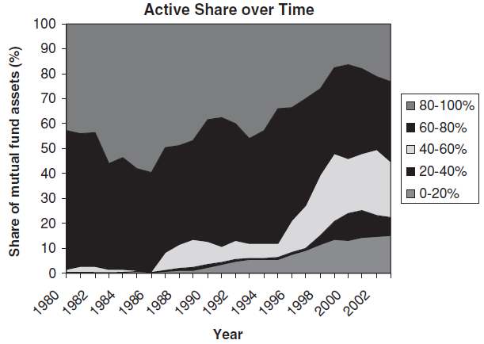
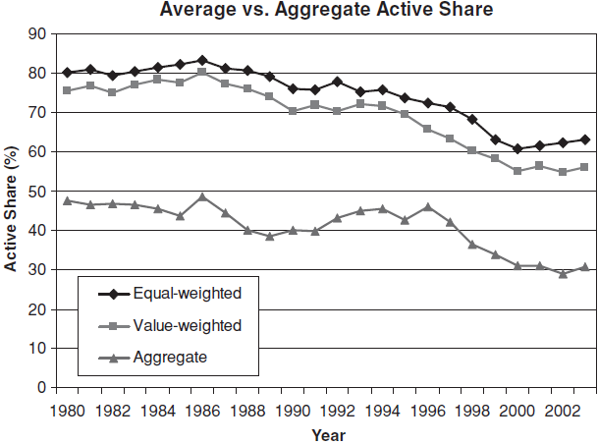
Active share over time

Slide 30
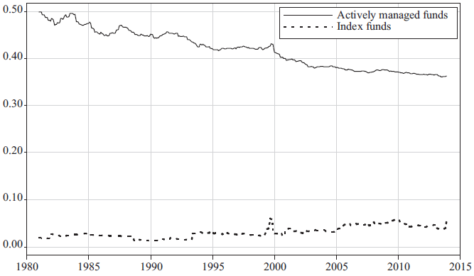
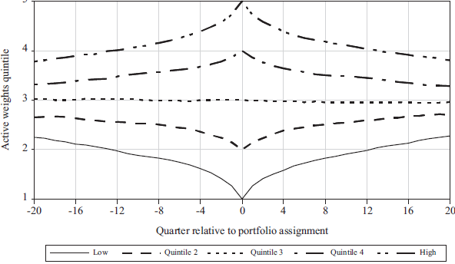
Active weight over time

Slide 31
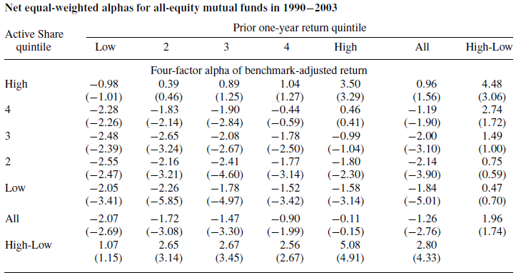
Active Share and performance persistence
Notes:
proxy for the investor redemption risk,because Ω is sensitive to the investor’s utility function

Slide 32
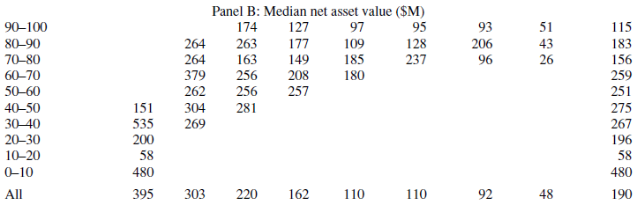
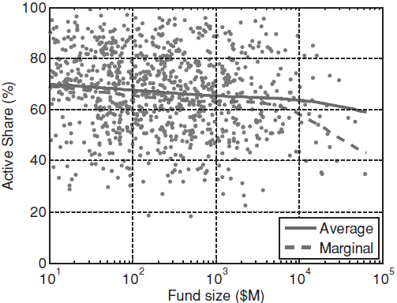
Are smaller funds more active?
Active share

Slide 33
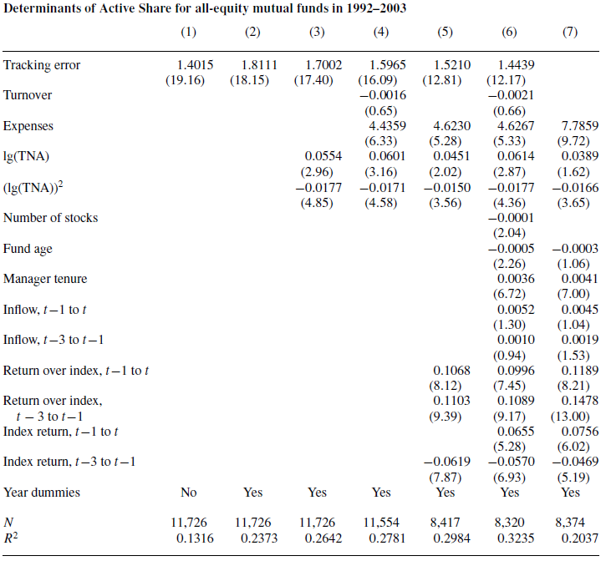
Active share

Slide 34
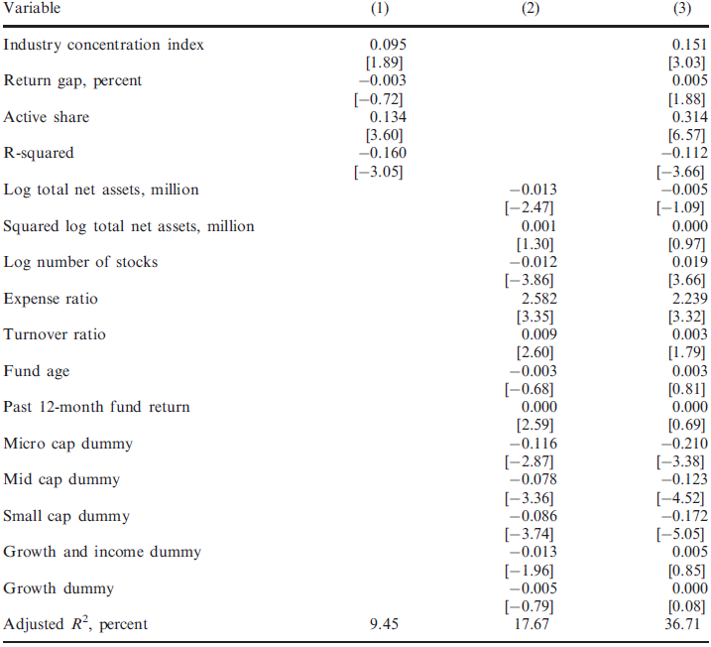
Active weight

Slide 35
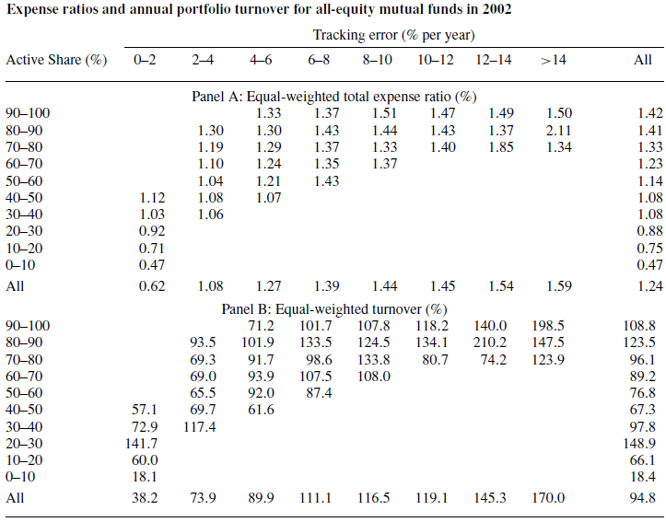
Fees and Portfolio Turnover

Slide 36
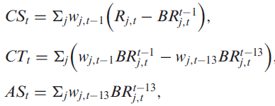
Active managerial with performance
Active share
Each month we sort funds first into Active Share quintiles and then further into tracking error quintiles
Then compute the equal-weighted benchmark-adjusted return within each of the twenty-five fund
Active weight
Adding the characteristic selectivity, characteristic timing, and average style measures for every decile portfolio.
Return on stock j
(Daniel.et al 1997)
Return in period t on size, value, and momentum characteristics (125 group)

Slide 37
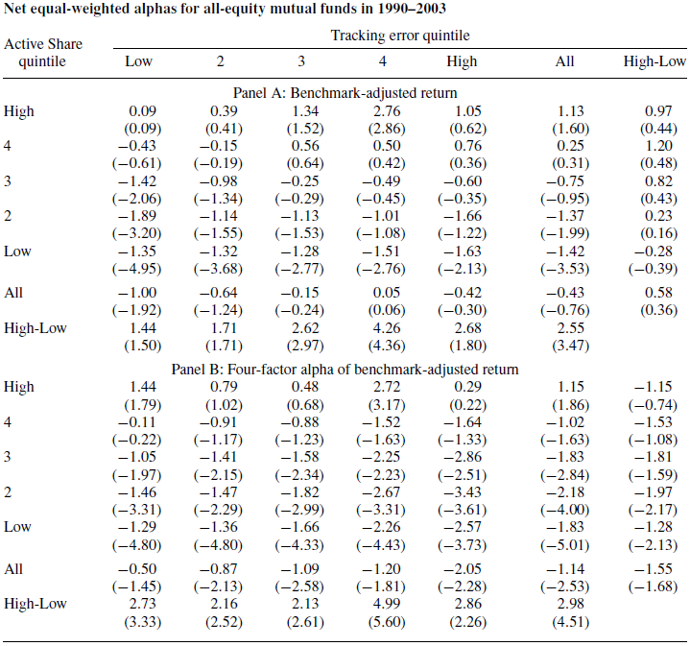
Active share

Slide 38
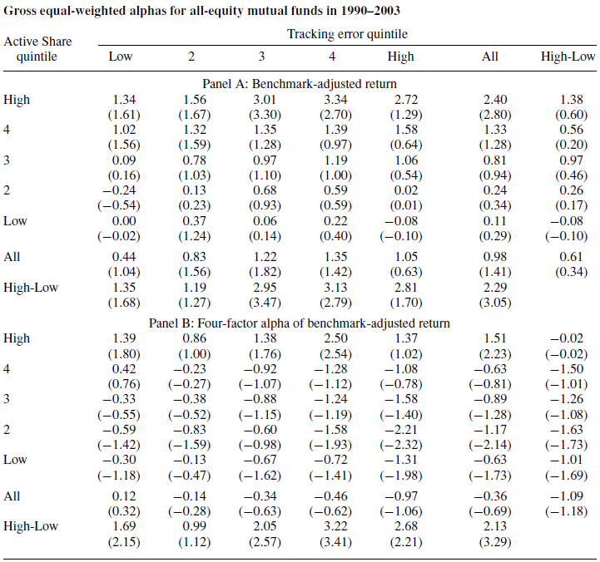
Active share

Slide 39
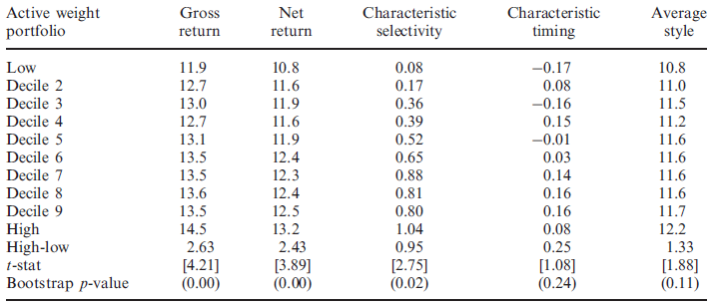
Active weight

Slide 40
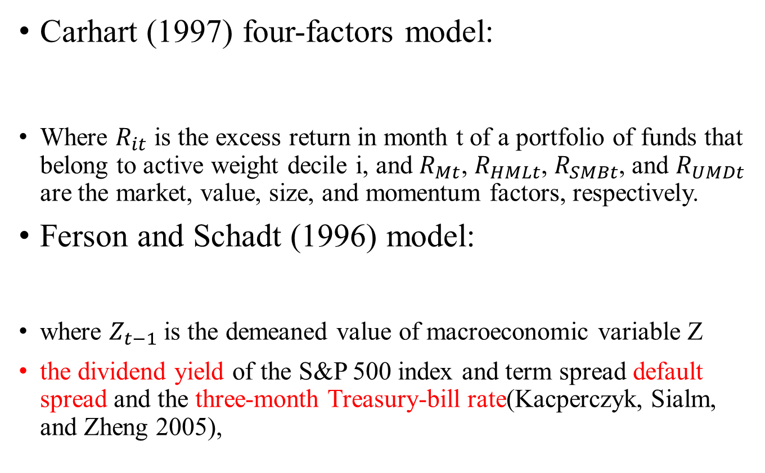
Factor-Adjusted Returns
Carhart (1997) four-factors model:
Where $R_{it}$ is the excess return in month t of a portfolio of funds that belong to active weight decile i, and $R_{Mt}$, $R_{HMLt}$, $R_{SMBt}$, and $R_{UMDt}$ are the market, value, size, and momentum factors, respectively.
Ferson and Schadt (1996) model:
where $Z_{t−1}$is the demeaned value of macroeconomic variable Z
the dividend yield of the S&P 500 index and term spread default spread and the three-month Treasury-bill rate(Kacperczyk, Sialm, and Zheng 2005),
Notes:
(the difference between the rates on a ten-year Treasury note and a three-month Treasury bill), (the difference between the rates on AAA and BAA bonds),

Slide 41
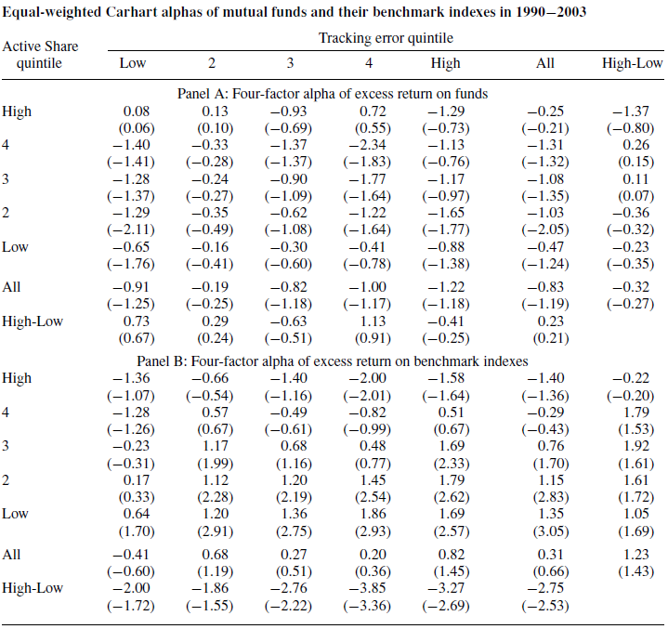
Benchmark performance and Active Share
Notes:
proxy for the investor redemption risk,because Ω is sensitive to the investor’s utility function

Slide 42
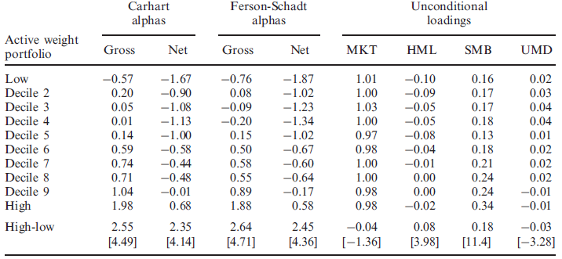
Factor-Adjusted Returns
Notes:
(the difference between the rates on a ten-year Treasury note and a three-month Treasury bill), (the difference between the rates on AAA and BAA bonds),

Slide 43
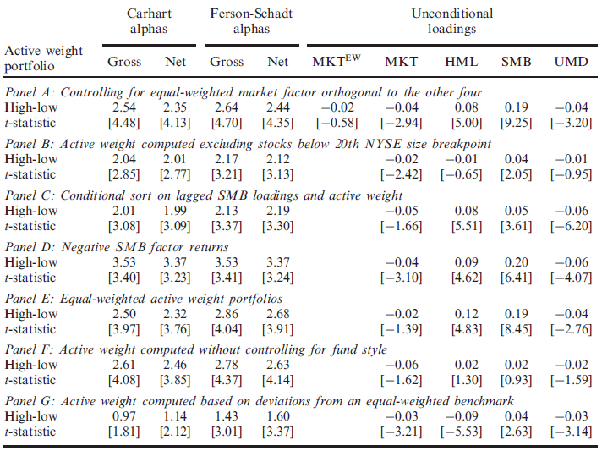
Control size—Factor AdjReturn
Notes:
(the difference between the rates on a ten-year Treasury note and a three-month Treasury bill), (the difference between the rates on AAA and BAA bonds),

Slide 44
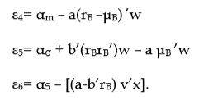
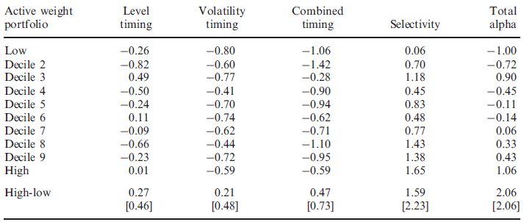
Ferson-Mo Decomposition
The superior performance of high-active weight managers appears to be in large part attributable to their better selectivity skills.
Notes:
proxy for the investor redemption risk,because Ω is sensitive to the investor’s utility function

Slide 45



Ferson-Mo Decomposition
Notes:
proxy for the investor redemption risk,because Ω is sensitive to the investor’s utility function

Slide 46
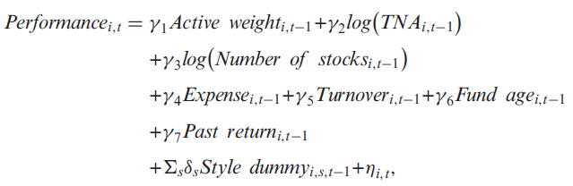
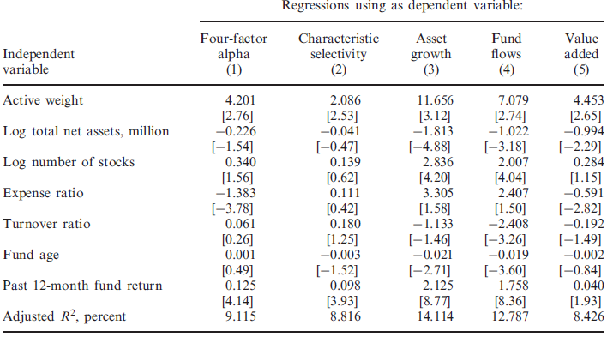
Panel Regression
Notes:
proxy for the investor redemption risk,because Ω is sensitive to the investor’s utility function

Slide 47
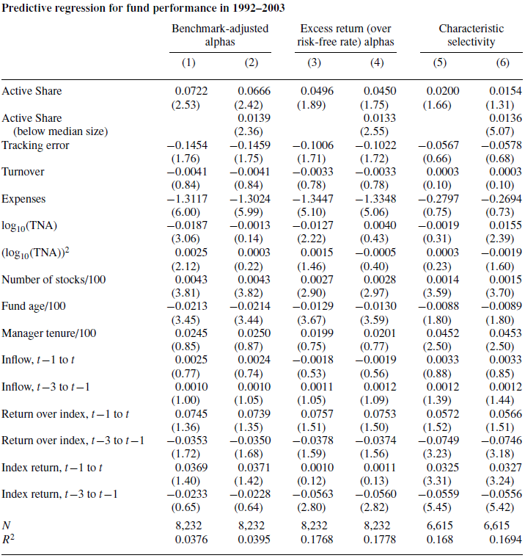
Active share
Notes:
proxy for the investor redemption risk,because Ω is sensitive to the investor’s utility function

Slide 48
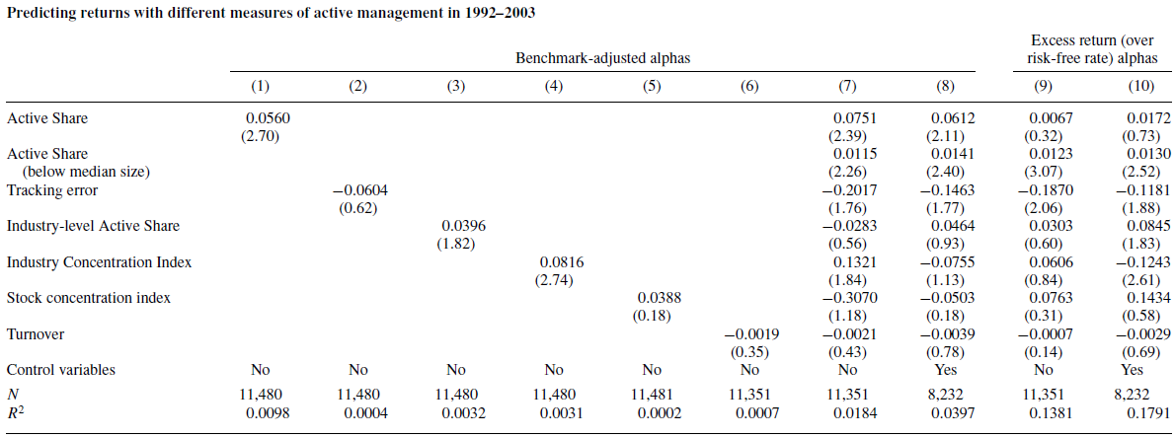
Different Measures
Active share—Panel regression
Notes:
proxy for the investor redemption risk,because Ω is sensitive to the investor’s utility function

Slide 49
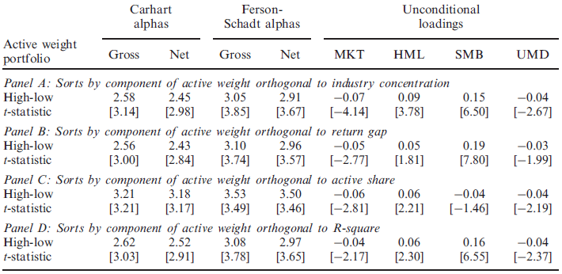
Different Measures
Active weight—Portfolio sort
Notes:
proxy for the investor redemption risk,because Ω is sensitive to the investor’s utility function

Slide 50
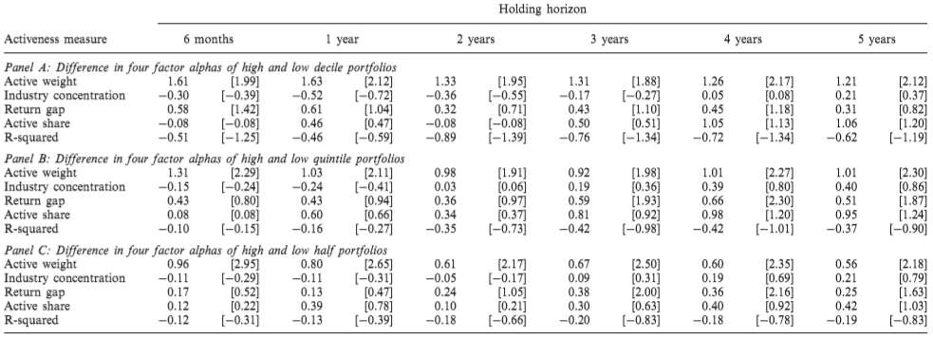
Different Measures
Active weight—Portfolio sort
Notes:
proxy for the investor redemption risk,because Ω is sensitive to the investor’s utility function

