Slide 1
Out-of-sample equity premium predictability and sample split–invariant inference Journal of Banking and Finance, 2017 Gueorgui I. Kolev, Rasa Karapandza

Slide 2
Outline
Introduction
Research design
Empirical results
Conclusions

Slide 3
1.Introduction
Background
An important concern is whether in-sample or instead out-of-sample econometric methods should be used to assess the predictability of returns.
Some sample splits yield results indicating that returns are not predictable whereas other splits lead to the opposite conclusion.

Slide 4
1.Introduction
Motivation
For any given predictor and any given data set, the derived predictability of returns is sensitive to where the sample is split between the estimation and forecast evaluation subsamples.

Slide 5
1.Introduction
Research questions
Is equity premium predictable under the tests proposed by this article?
Is the bootstrap-based inference valid?

Slide 6
1.Introduction
Related research
Hubrich and West (2010) and Clark and McCracken (2012) propose taking the maxima of various statistics for simultaneously judging whether a small set of alternative models that nest a benchmark model improve upon the benchmark model’s MSPE.
Rossi and Inoue (2012) derive the theoretical distribution of (general) sample split–invariant mean and maximum tests.

Slide 7
1.Introduction
Research content
Bias corrected in-sample predictability.
Out-of-sample (split sample–invariant) predictability and its graphical form.
Validity of the bootstrap procedure.

Slide 8
1.Introduction
Contribution
Document that conclusions about stock market predictability when using out-of-sample methods are strongly dependent on the choice of a sample split date.
This paper shows how to construct out-of-sample predictability tests that are sample split invariant.

Slide 9
2.Research Design
In-sample predictability
Out-of-sample predictability
Bootstrap
Validity of bootstrap

Slide 10

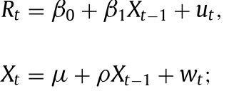


2.Research design
Predictive framework
In-sample predictability: auxiliary regression (Amihud and Hurvich, 2004)

Slide 11







2.Research design
Bootstrap under the null of no predictability
Use the original data to estimate Eqs. (2) and (3) by ordinary least squares and then store the residuals for resampling.
Imposing the null hypothesis of no predictability (β1 = 0).
Initiate the recursion in Eq. (3) :
T draws over dates t = 1 , . . . , T,
9999 bootstrap samples.

Slide 12

2.Research design
sample split–invariant inference:
validity of the bootstrap procedure: Monte Carlo experiments

Slide 13
2.Research design-data
Periods
January 1926 to December 2010
sample split date τ falls within the interval [ int (. 05 T ) , T − int (. 05 T )]
Variables
15 from Welch and Goyal (2008)
6 behavioral predictors from Jeffrey Wurgler’s Web page

Slide 14
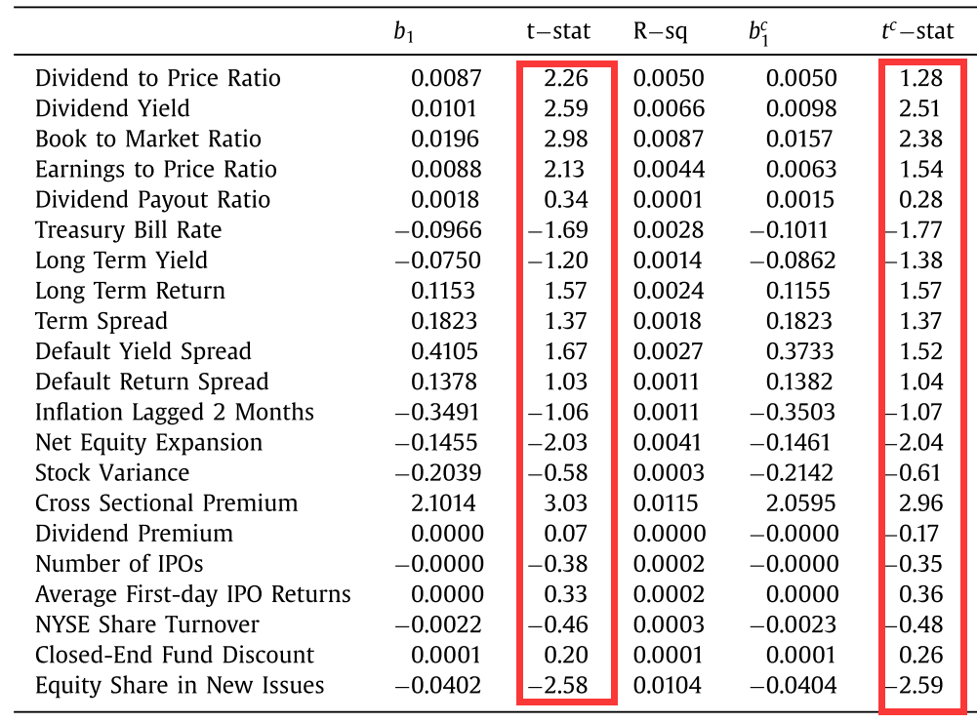
3.Empirical results: In-sample predictability

Slide 15
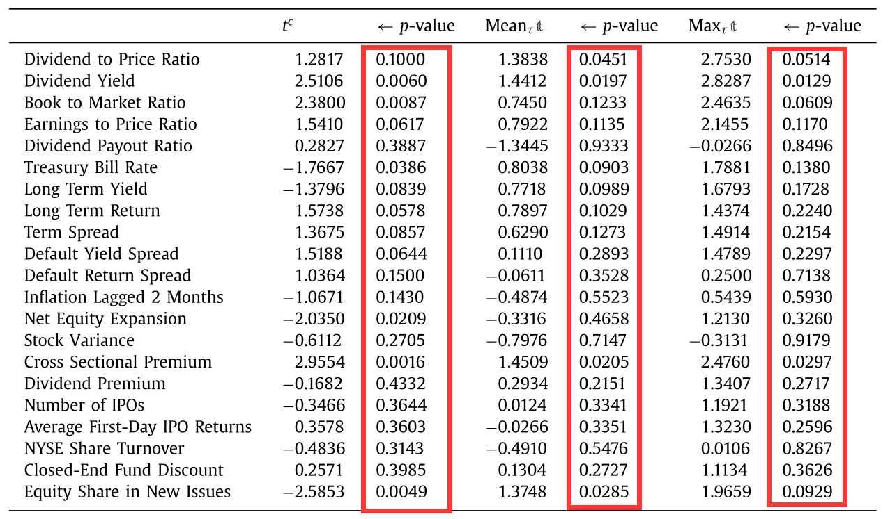
3. sample split invariant inference

Slide 16
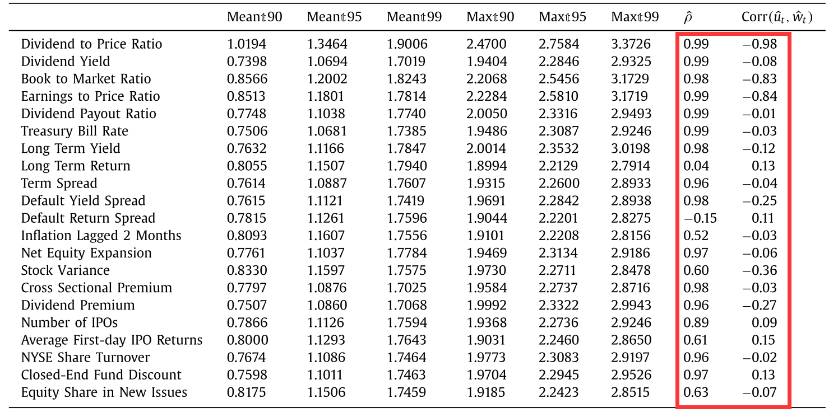
3. Bootstrap null distribution

Slide 17
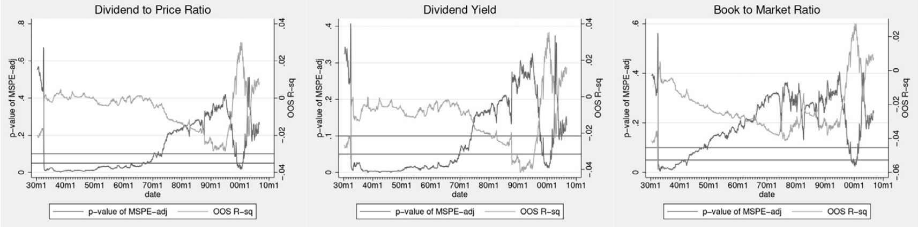
3. Summarizing out-of-sample predictability in graphical form

Slide 18
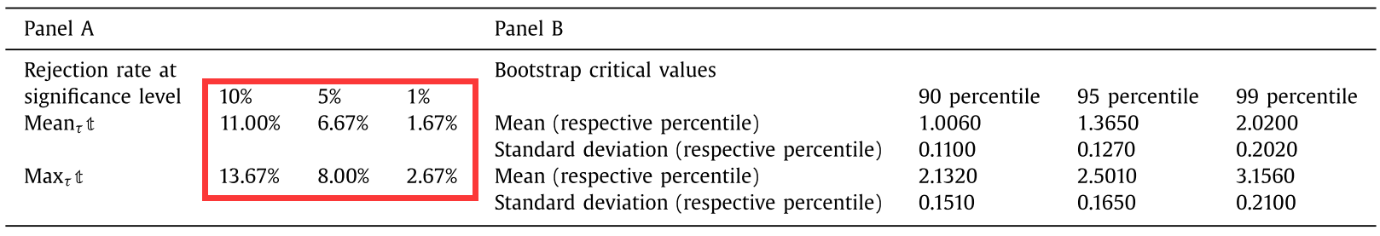
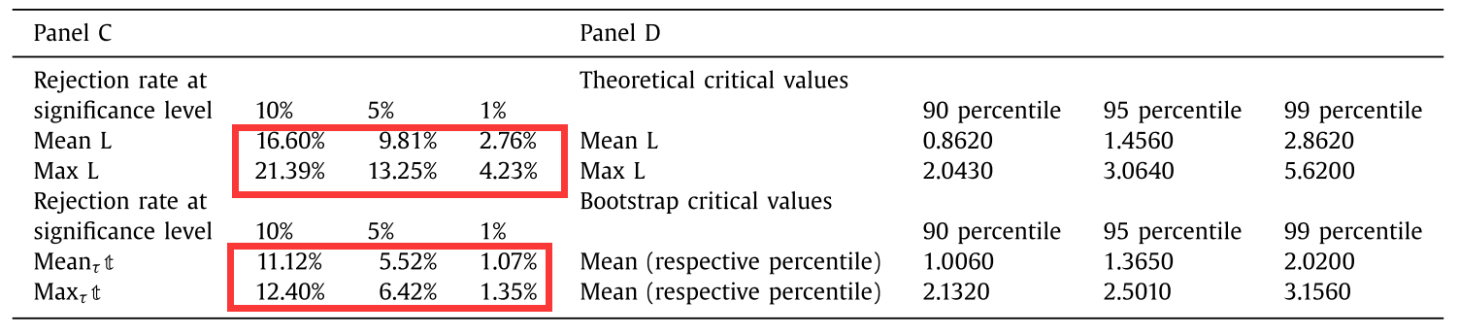
3. Monte Carlo experiments: validity of the bootstrap procedure

Slide 19
4.Conclusions
There are widely varying results reported for out-of-sample predictability tests that differ only in the chosen sample split date.
There are but minor disagreements between in-sample predictability test results and results from our proposed (mean and maximum) sample split–invariant out-of-sample predictability tests.

