Slide 1
Dissecting Characteristics Nonparametrically
Joachim Freyberger、Andreas Neuhierl、Michael Weber
The Review of Financial Studies / v 33 n 5 2020
Yue Yang

Slide 2
Contents
1.Introdution
Backgrounds
Literatures
Motivations
Contributions
2.Data
3.Method
4.Results
5.Conclusions

Slide 3
1.Backgrounds
Cochrane (2011): the cross-section of the expected return “is once again descending into chaos.”
Harvey et al. (2016) identify “hundreds of papers and factors” that have predictive power for the cross-section of expected returns.
Many economic models predict that only a small number of state variables suffice to summarize cross-sectional variation in expected returns.
Notes:
关于截面预测，再次陷入了混乱。
提出数百种因子。
一些论文证实，只有其中一些是有效的。

Slide 4
1. Literatures
Harvey, Liu, and Zhu (2016): list over 300 published papers that study the cross-section of expected returns, and get approximately 150 characteristics as useful predictors.
Lewellen (2015) jointly studies the predictive power of 15 characteristics and finds that only few are significant predictors for the cross-section of expected returns.
Notes:
300个因子只有150有用；
15个因子只有一些有用

Slide 5
1. Literatures
Horowitz (2016) gives a general overview of model selection in high-dimensional models
Huang, Horowitz, and Wei (2010) discuss variable selection in a nonparametric additive model
Rapach, Strauss, and Zhou (2013): use LASSO to investigate the leadlag relationship between US and international stock returns
Huang and Shi(2016): use an adaptive group LASSO in a linear framework and construct macro factors to test for determinants of bond risk premiums

Slide 6
1. Literatures
Chinco, Clark-Joseph, and Ye (2019): use a linear model for high-frequency return predictability using past returns of related stocks, and find their method increases predictability relative to OLS
Huang, Horowitz, and Wei (2010): group LASSO (least absolute shrinkage and selection operator) procedure for model selection and nonparametric estimation.

Slide 7
1.Motivations
Portfolio sorts are subject to the curse of dimensionality when the number of characteristics is large, and linear regressions make strong functional form assumptions and are sensitive to outliers.
Most of the variation in characteristic are in the extremes of the characteristic distribution and the association between characteristics and returns appears nonlinear (Fama and French 2008).

Slide 8
1.Motivations
(1)Which characteristics have incremental forecasting power for expected returns?
(2) Does the predictive power of characteristics vary over time?
(3) How does the nonparametric model compare to a linear model out of sample?

Slide 9

3.Method
current methods
① portfolio sorts(For a single characteristic)
C1,it−1,...,CS,it−1are S firm characteristics
② linear panel regression
Notes:
对于单变量，使用分组——10组，每组取均值，进行观察。
缺点：①不能应对高维，我们基本上只对一个因子排序，再分组。多了就很麻烦。
②不能区分不同的因子——不管什么因子都是这么分组；
③假设每个小组内收益不变。但其实肯定是变化的。
回归的好处是可以同时估计多个变量的预测能力，但问题是，没有人保证一定是线性模型。

Slide 10




3.Method
Nonparametric estimation
portfolio sorts regressions
single characteristic C1,it−1 → L portfolio
portfolio returns regression coefficients in a regression of returns on L indicator functions, where indicator function l is equal to 1 if stock i is in portfolio l for l=1,...,L
: the rank transformation of
Notes:
改进：使用加性模型。优点：
①收敛速度和特征个数无关；
②没有FM回归的可加性和线性那么严格；（因为没有规定mts的具体形式）
为了避免极端值带来的影响，首先对数据做一个变化：将截面内某因子值改为她的排序值。这样做的原因是我们不关心因子的大小（1960s的市值很大的股票放到现在市值就不是很大）
m是未知的。

Slide 11
3.Method
Adaptive group LASSO
Group LASSO(least absolute shrinkage and selection operator)
Model selection: which characteristics have incremental predictive power for expected returns, given the other characteristics.
Nonparametric estimation: estimating the effect of important characteristics on expected returns without imposing a strong functional form.
estimate the functions nonparametrically, while setting functions for a given characteristic to 0 if the characteristic does not help predict returns.

Slide 12


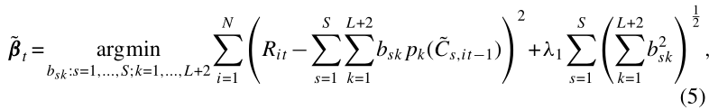
3.Method
Adaptive group LASSO
Step1:
Step2:
introduces characteristic-specific weights in the LASSO group penalty function as a function of first-step estimates to delete characters which can’t predict the return.
Notes:
按照因子把股票分成L个区间。最后因子估计出来的收益如右上式形式。
P是已知的函数形式（二次项）quadratic splines

Slide 13
2.Data
1965.7-2014.6
62 characteristics
Return: CRSP(NYSE, Amex, or Nasdaq)
Balance sheet data: Standard and Poor’s Compustat database

Slide 14
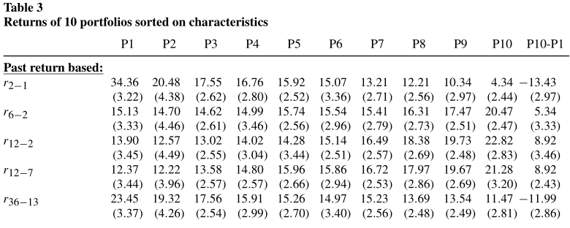
Annualized Return>5%: 31个
Notes:
收益超过10%的有13个。

Slide 15
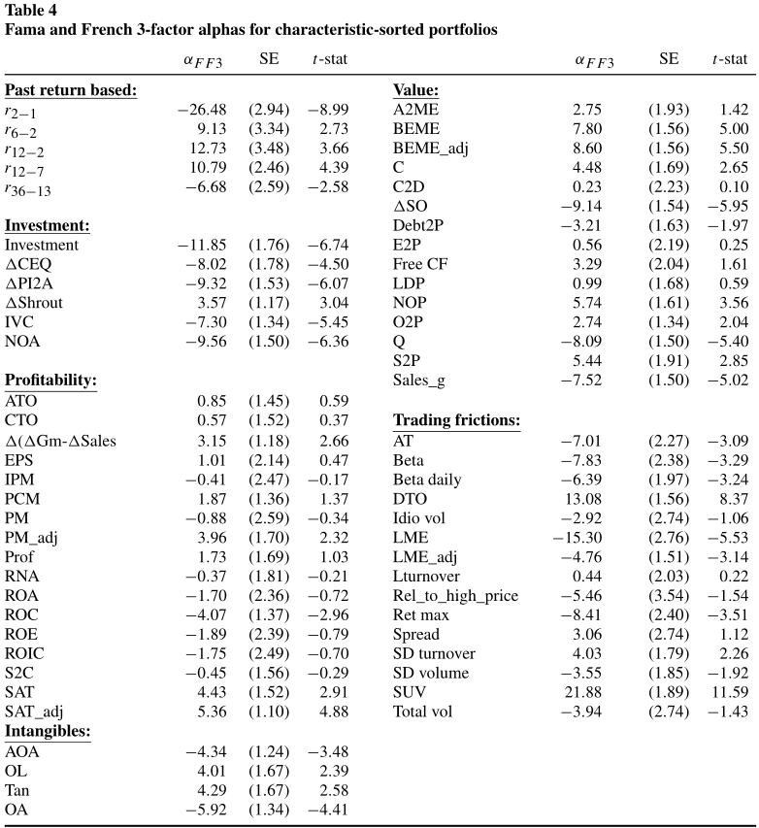
t>2: 36个

Slide 16
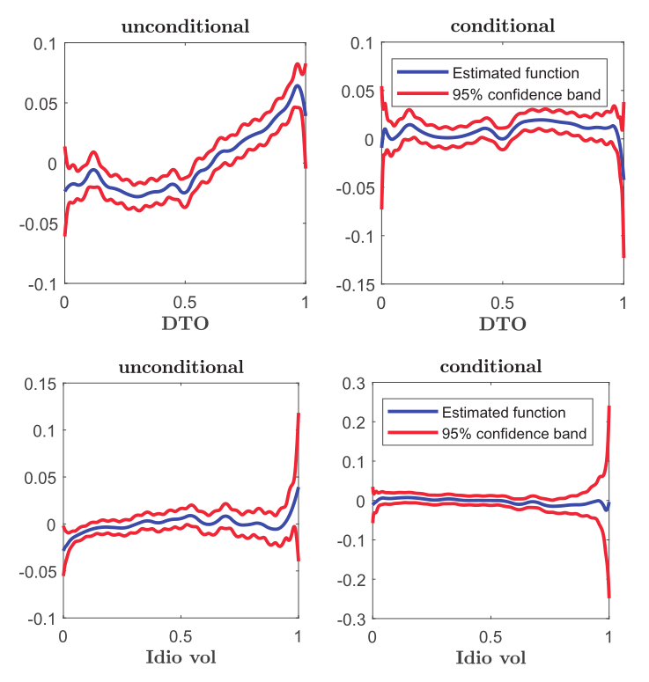
13%
3%
Notes:
DTO和Idio越大，收益越高；
但当以其他所有因子作为条件时，DTO和Idio的收益预测能力就消失了（和0没区别）

Slide 17
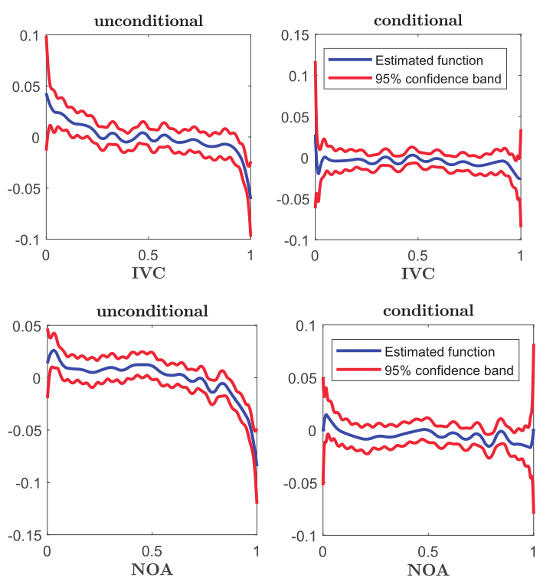

Slide 18
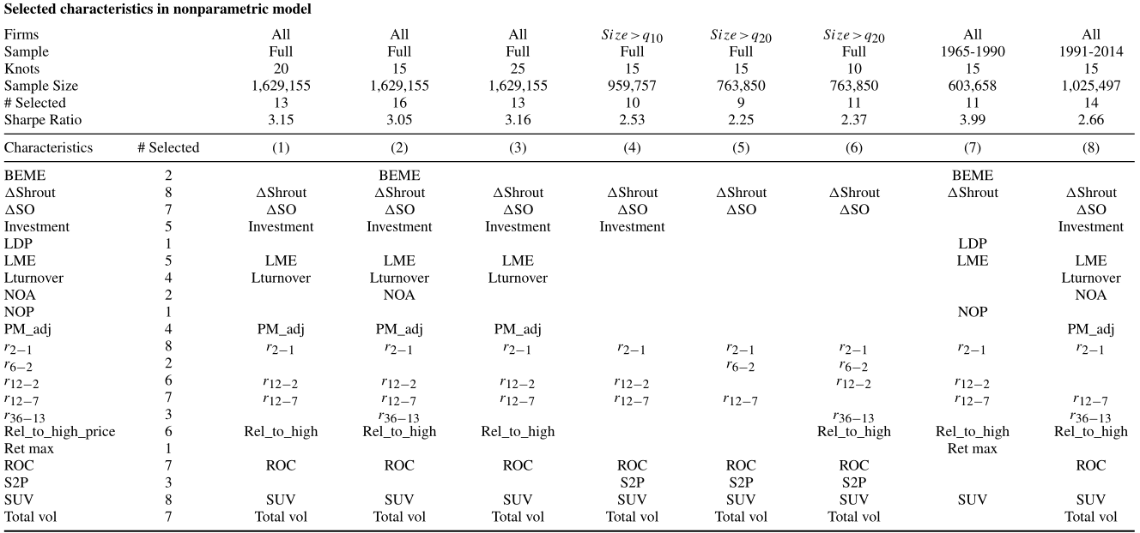
Notes:
节点不一样（10个节点就对应11个组合）
股票剔除小市值
时间段不一样
并集：只选出来21个（也就是说，62个里面有41个从未被选过）
共选出来7个最稳定的有预测能力的因子（最右侧）

Slide 19
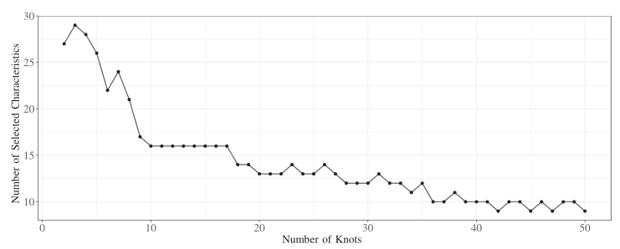
the method we propose is not sensitive to the choice of tuning parameters

Slide 20
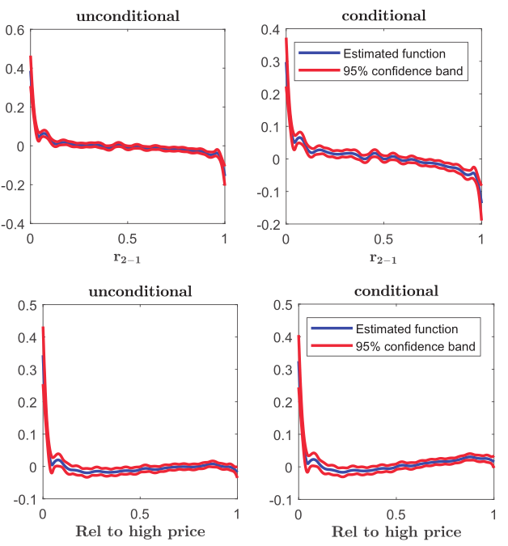
Notes:
short-term reversal
closeness to the 52-week high

Slide 21
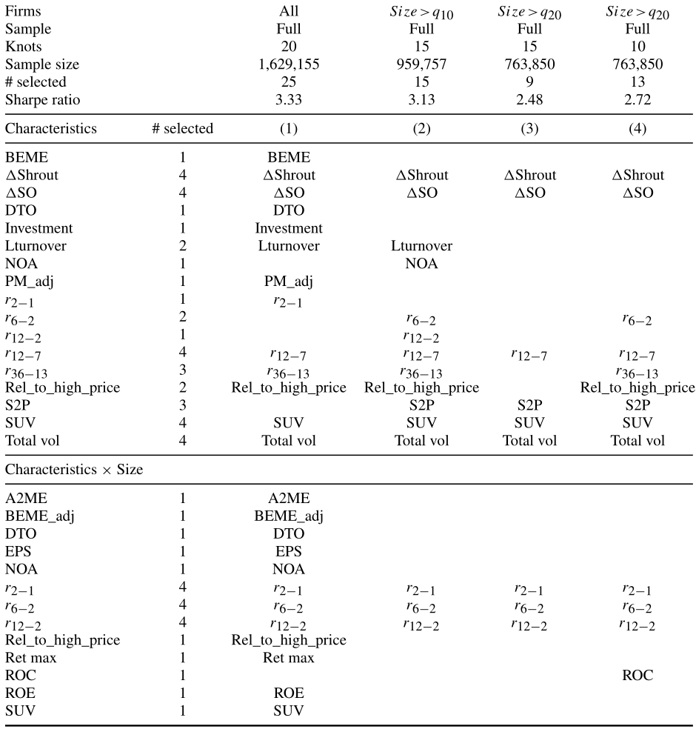
Notes:
之前的加性模型其实是一种简化，他认为因子之间没有关系。但是这是不太可能的，尤其在市值不同的股票里，因子呈现出不同的预测能力。所以我们把每个因子和市值的交互项也当做新的银子加入回归中。
和此前未使用交互项的筛选结果不同的是，之前只选择了13个，而现在选择了25个，且将近一半是交互项。（此前预测能力很稳定的ROC现在没有被选择）
但是，结果表明，和size的交互项只在小市值股票里有作用，当股票剔除小市值后，交互项有效的大大减少。

Slide 22
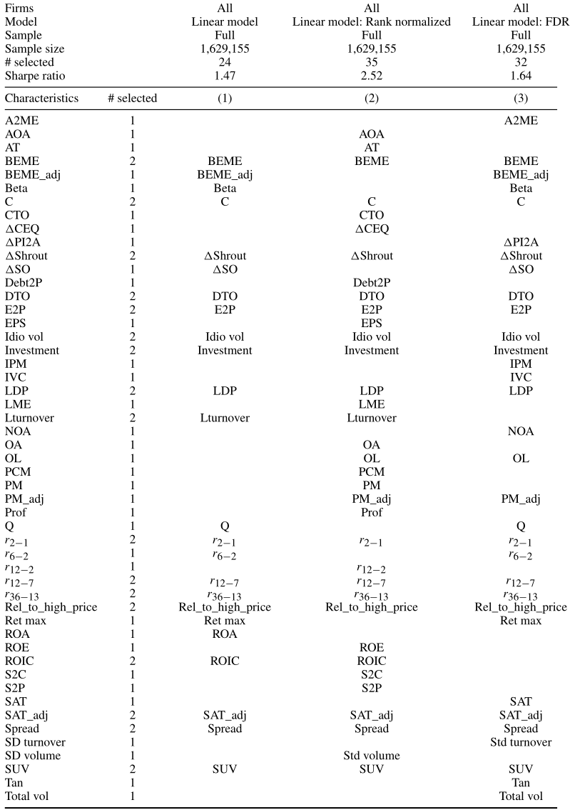
Notes:
第一列：在运用线性的时候，使用的是因子本身。结果发现线性模型选的因子更多了。我们担心这是因为我们没有像非参那样，使用排序值导致的。
第二列将因子改成排序值，在做线性模型。结果选的因子更多了。
第三列使用FDRp值，结果依然是选择了超过非参模型的因子个数。
因此，从数据降维的角度，非线性是非常值得考虑的部分。

Slide 23
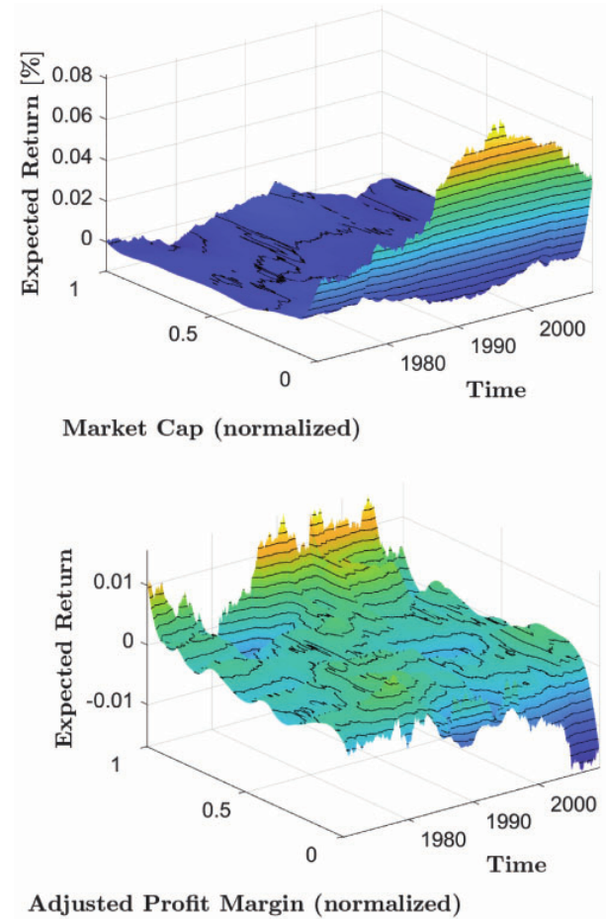
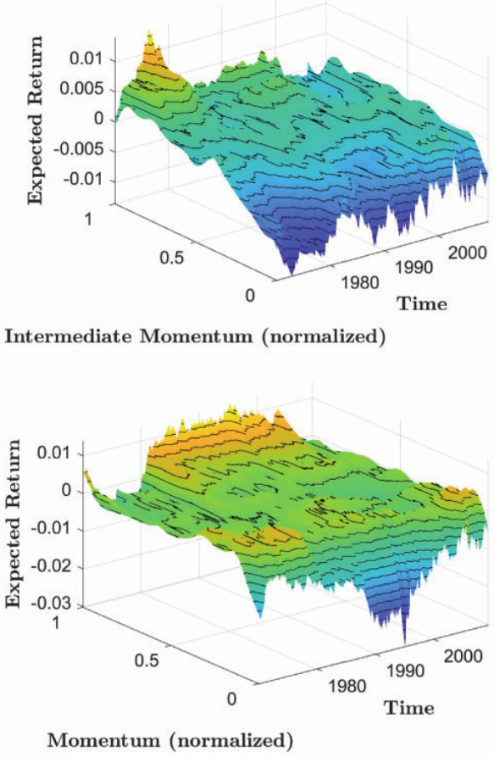
Notes:
这个三维图展示了一个因子的预测力（基于其他的因子）随着时间的变化，我们可以看到随着时间的变化，因子预测能力是有变化的。这佐证了之前我们说的在不同的时间，所选择出来的因子个数不同。

Slide 24
4.Results
Out-of-sample performance and model comparison
Model selection: 1995~1990
use return data from 1981.1 until 1990.12 and characteristics data from 1981.1 until 1990.11 to get estimates of β.
take the estimated coefficients and characteristics data of 1990.12 to predict returns for 1991.1 and form two portfolios for each method.

Slide 25
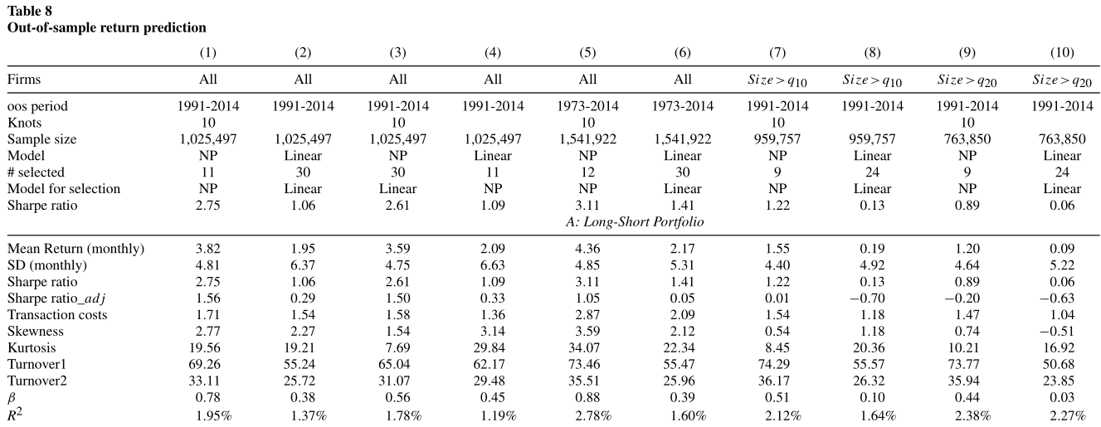
NP get better results.
Notes:
β：真实收益对预测收益回归。我们希望系数为1，并且R2要大一些。
列3：用线性模型选择因子，用非参模型做预测。
LASSO的结果是更高的收益，更低的风险，从而有更高的夏普。
结果发现，有可能是因为线性模型有样本内过拟合的原因，选择了很多并没有预测能力的因子，从而预测结果不好。
也印证了非线性很重要。因为1列和2列都用的是非参选择的因子，但考虑了非线性的非参方法可以得到更高的夏普比率。

Slide 26

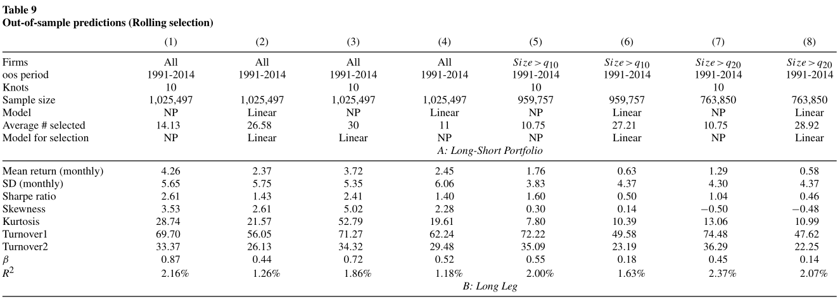
Training period: 1965.1~1990.12(for example)
First month to predict: 1991.1
Notes:
滚动模型，首先选择有效因子。辨别有效因子的基本窗口是不变的26年。第一个训练期是1965.1~1990.12.第一个预测月是1991.1

Slide 27
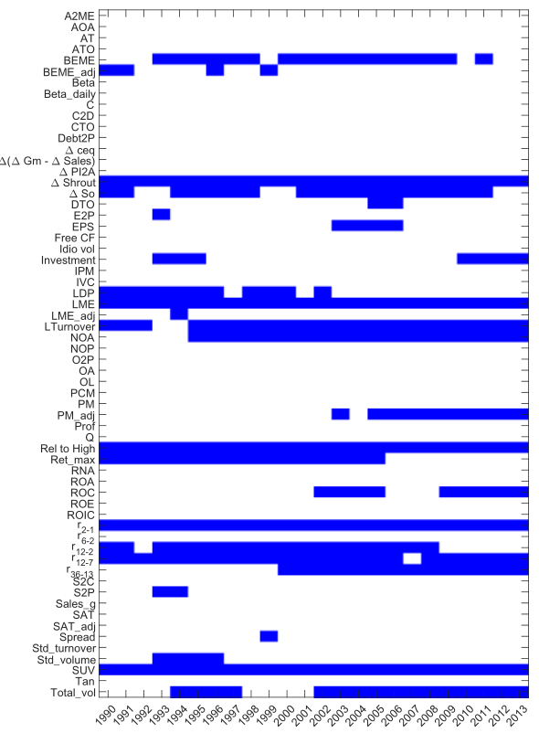
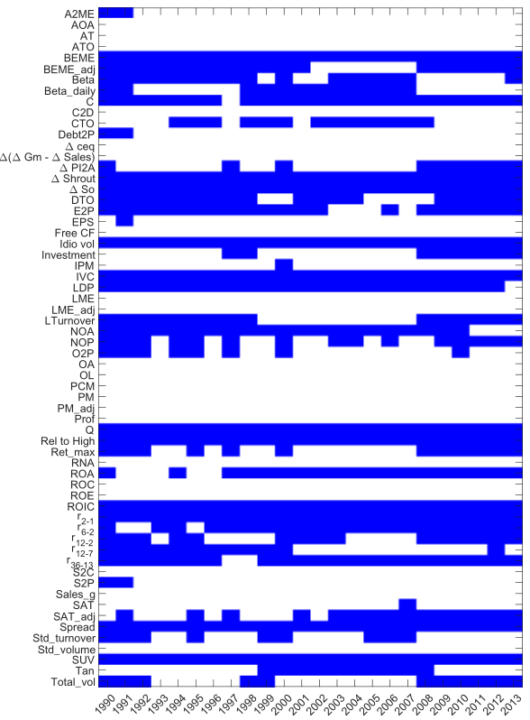
Nonlinear model
Linear model
Notes:
我们绘制了不同年份的两个模型选择的因子。
非参选择的个数较少，且选择对象很稳定。表明的确有一些因子是真的可以实现预测效果的。

Slide 28
4.Results
Simulation——Robustness tests
Whether tuning parameters matters?
Conventional t-statistic cutoff of 2
t-statistic cutoff of 3 to account for multiple testing
The FDR p-value adjustment
Linear single-step LASSO
Linear adaptive LASSO
Nonlinear group LASSO
Nonlinear adaptive group LASSO
penalty parameter:
Akaike information criterion (AIC)
Bayesian information criterion (BIC)
BIC as in Yuan and Lin (2006):for the case of grouped variables
Tenfold cross-validation.

Slide 29


4.Results
Simulation steps:
1. Take the full data set of 62 characteristics, Cit from Section 2
2. Focus on a sample from 1965 to 2012
3. Assume the 13 characteristics of Column 1 of Table 5 are the “true” predictors
4. Transform all characteristics to be standard normal distributed
5. Fit a fifth-order polynomial on the true characteristics to estimate gs(Cs,it−1) for each characteristic pooled over the entire sample
6. Generate returns according to:
7. resampled with replacement from the empirical residuals
preserving industry structure (details below)
8. Estimate nonparametric model on rank-transformed data with 20 knots
9. Estimate linear model on data from step 4
10. Redo steps 6 to 9 500 times

Slide 30
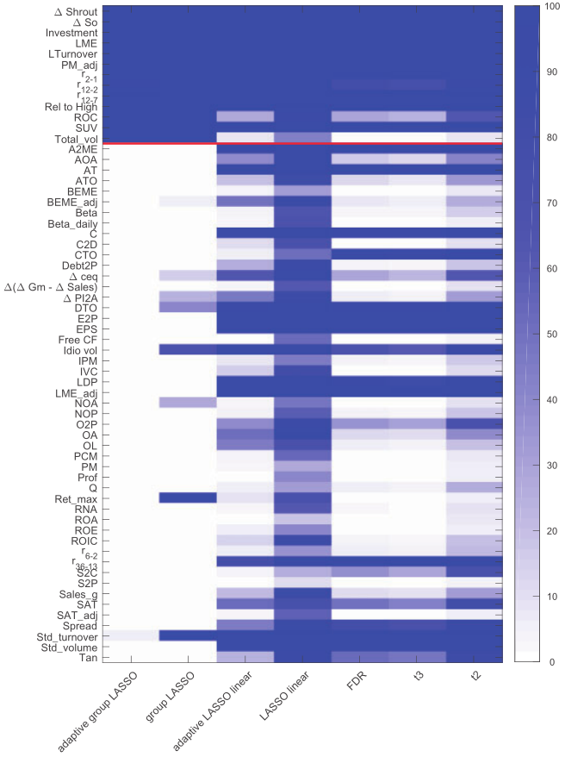
The darker the color, the more frequently a given selection method selects a given characteristic.
The 13 characteristics above the line indicate true return predictors, whereas the 49 other characteristics below the line do not predict returns.
The adaptive group LASSO does best in the dimensionality reduction, and select 13 characteristics at average, as we mentioned before.

Slide 31
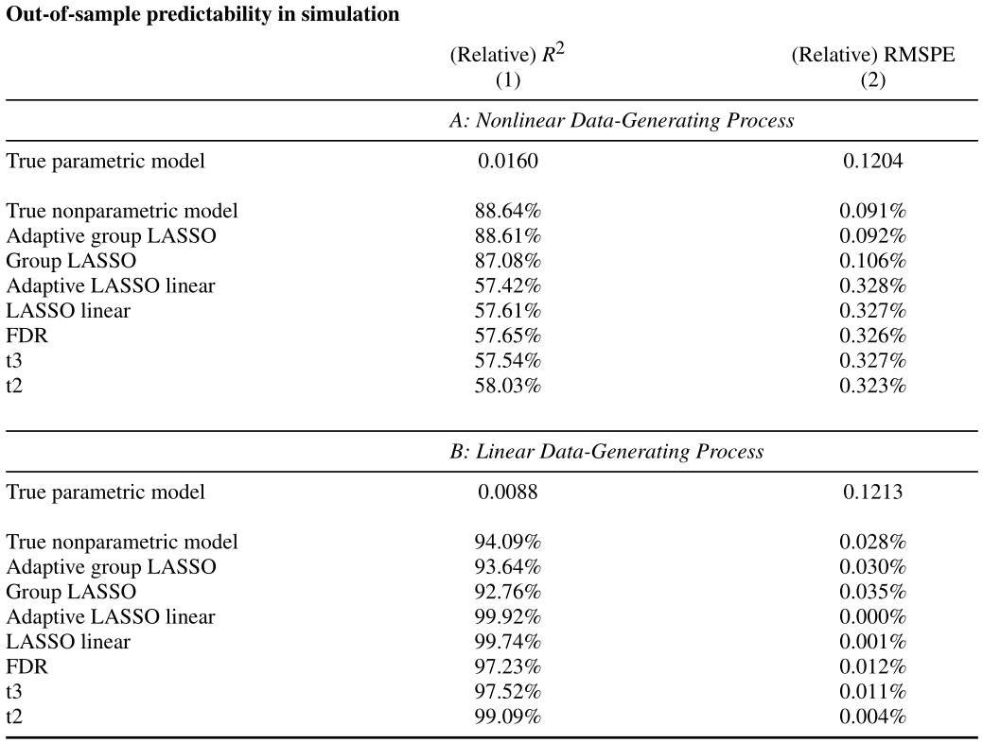
真实收益对预测收益的样本外回归
回归误差
1.6%
相对结果
相对结果
Adaptive group LASSO 在众多方法中相对表现更好

Slide 32
5.Conclusions
Only a small number of the characteristics are valid.
The nonparametric model has better out-of-sample performance than the linear model.
The predictive power of characteristics for expected returns varies over time.

