Slide 1
Understanding Systematic Risk: A High-Frequency Approach
Pelger Markus, Journal of Finance, forthcoming.

Slide 2
Outline
Introduction
Research design
Empirical result
Some views

Slide 3
Introduction: Background
Find the “right” systematic factors has become the central question of asset pricing.
There are essentially three common approaches to identify the factors that describe the systematic risk.
Factor selection is based on theory and economic intuition, like CAPM
Factors are based on firm characteristics, like FF-3 model
Factor selection is statistical, like APT.

Slide 4
Introduction: Motivation
High frequency data allows researchers analyze very short time horizons independently.
Traditional method is hard to detect the common co-movement in a large cross-section of stock returns.
PCA can extract the common factors from cross-section stock returns with time-variation loadings.

Slide 5
Introduction: Research Questions
What are the factors that explain the systematic co-movement in individual stocks?
How does the systematic factor structure for stocks change over time?
What are the asset pricing implications of the systematic factors?

Slide 6
Introduction: Related Researches
Searching Factor Model:
Lettau and Pelger (2020) show that characteristic-sorted portfolios are well described by a constant factor model.
Nagel(2013) pointed that the results of characteristic-sorted approach depend on the choice of conditioning variables to generate the portfolios
Lettau and Pelger (2020) show that a constant loading model is not appropriate to model individual stock returns over longer time horizons.

Slide 7
Introduction: Related Researches
Using PCA methods:
Lettau and Pelger (2020) generalize PCA by including a penalty on the pricing error in expected returns.
Kozak, Nagel, and Santosh(2020) apply mean-variance optimization with an elastic net to PCA-based factors.
Kelly, Pruitt, and Su (2017) and Fan, Liao, and Wang (2016b) apply a version of PCA to projected portfolio data.

Slide 8
Introduction: Research Contents
Using PCA method find 3 or 4 factors can explain high frequency stock returns.
Detecting the factor structure, find the factors are formed by oil, finance, and electricity stocks
Check sharpe ratio of factors’ tangency portfolio and find it better than FF models.

Slide 9
Research Design:
5 minutes stock returns
PCA
model
vs
FF models
Select number of factors
Portfolio sharpe ratio
Factor structure

Slide 10
Research Design: Data
2004.01-2016.12 daily data, intraday data, overnight data from WRDS TAQ millisecond trades database.
555 to 667 firms form the unbalanced panel, the intersection 332 firms form the balanced panel.
Size, book-to-market, and momentum characteristics in those three conditions.

Slide 11

Research Design: Theoretical Derivation
The log prices are modeled as Ito-semimartingales (Ait-Sahalia and Jacod, 2014)
Daily return is formed by intraday return and overnight returns, which means the formula can be rewrite as follow.
Continue
Jump
Intraday continue and jump
Overnight

Slide 12


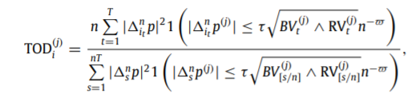
Research Design: Theoretical Derivation
How to distinguish continue and jump
Using TOD estimator of Bollerslev, Li, and Todorov (2013) to separate the continuous from the jump movements
Step 1: calculate realized variation and Bipower variation
Step 2: calculate TOD as follow. The threshold is

Slide 13
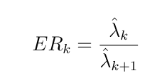

Research Design: Confirm the Number of Factors
Traditional method leads to that small eigenvalues cannot be bounded from below
Using perturbed eigenvalue ratio as criterion to pick the number of factors.
1. Calculate the ER value
2. Pick k factors which satisfy the condition.

Slide 14
Research Design: Performance
Generalized/canonical correlation(Bai and Ng, 2006)
Closer to 1 means the factors are more similar.
Sharpe ratio of mean-variance portfolios.

Slide 15
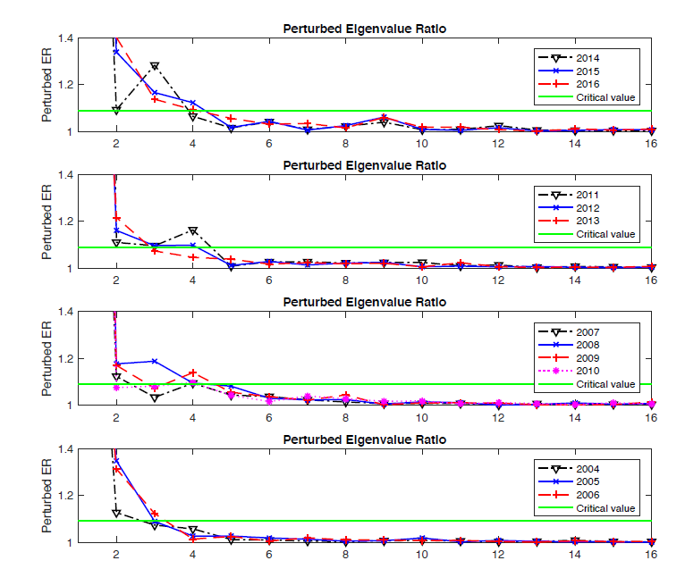
Empirical Result: Number of factors
After observing the perturbed ratio, the author chose 3 factor in 2004-2007, 4 factors in 2011-2016

Slide 16
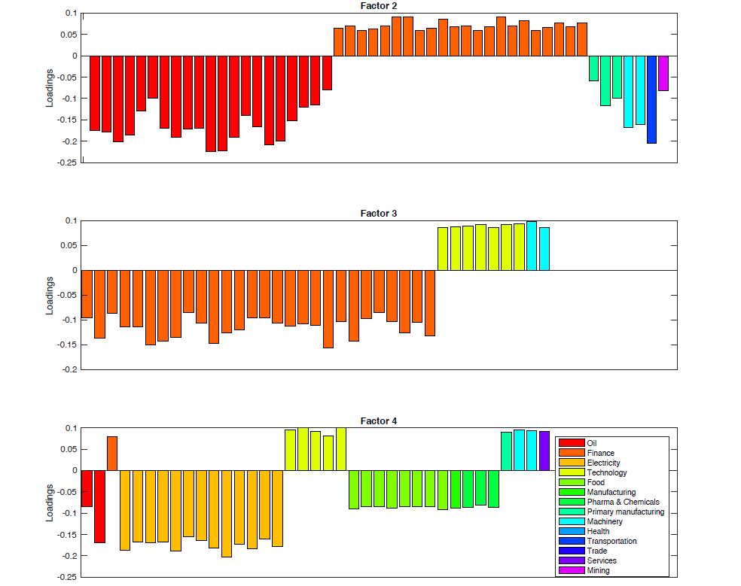
Empirical Result: Factor Structure
Oil, Finance, Electricity and Technology becomes important part in PCA factors.

Slide 17
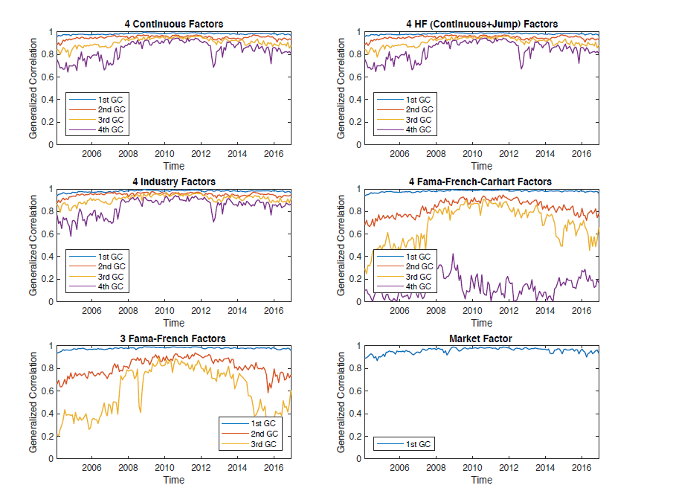
Empirical Result: Factor Structure-Time variation
The structure is more stable than FF model with time.

Slide 18
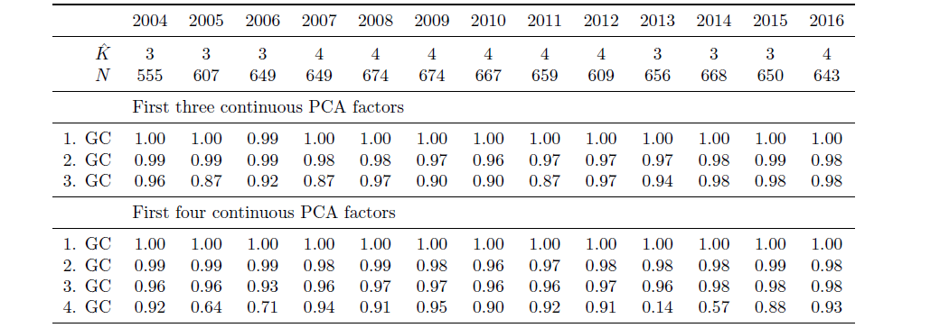
Empirical Result: Factor Performance-with Whole Data
The PCA factors are all using useful information of whole dataset.

Slide 19
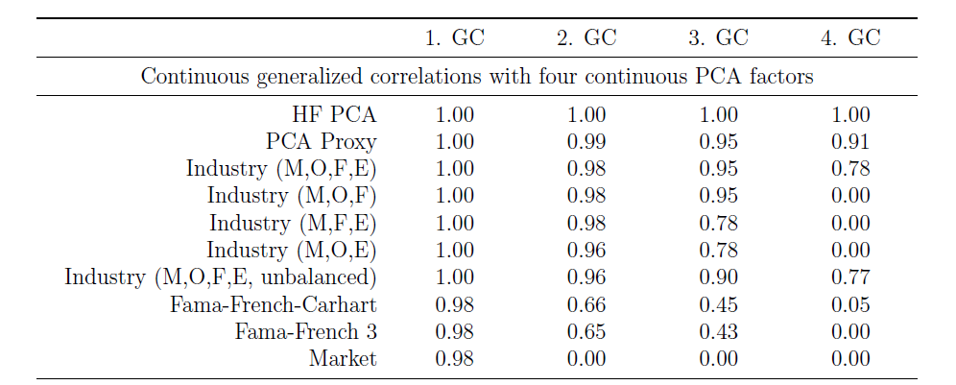
Empirical Result: Factor Performance-with Other Factors
The PCA factors gain extra information than FF model

Slide 20
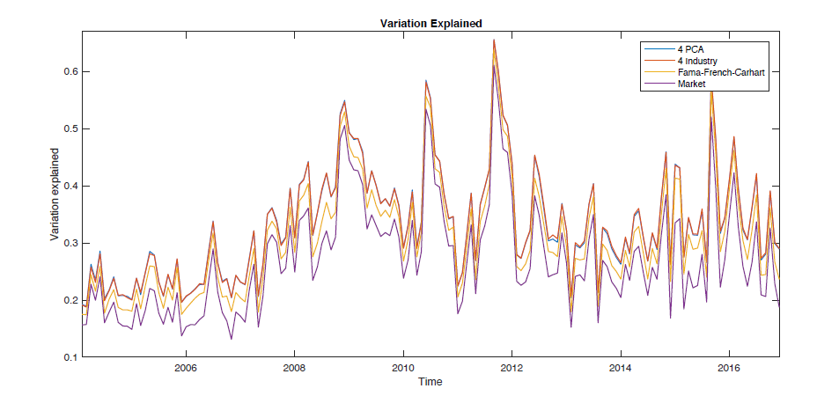
Empirical Result: Factor Performance-Explanation Ratio
The PCA factors are all using useful information of whole dataset.

Slide 21
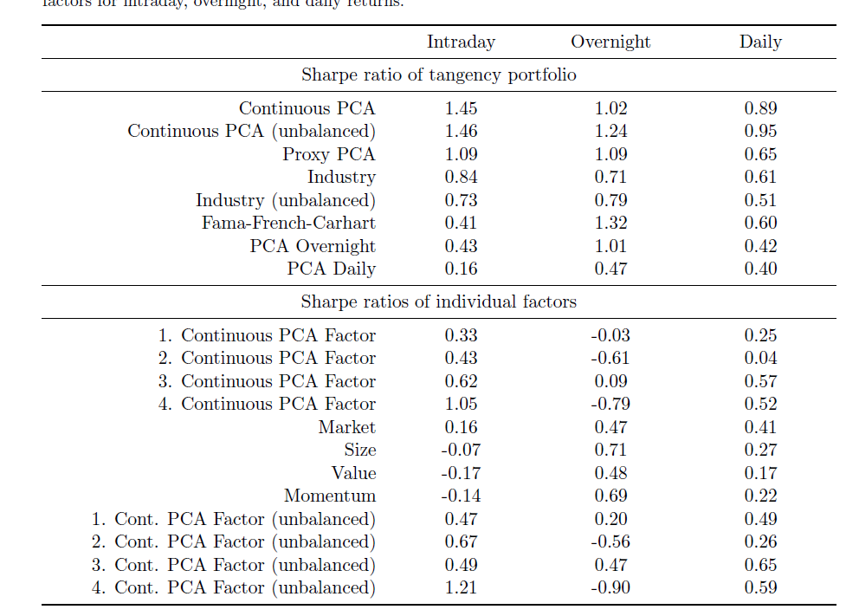
Empirical Result: Factor Performance-Sharpe Ratio
Portfolio formed by PCA factors has the best result.

Slide 22
Some Views
Flaw: They do not use traditional method to check whether the new factors can be explained by FF factors.
We can use the perturbed ratio to select the number of factor. It may lead to some interesting results.

