Slide 1
Tail Risk and the Cross-Section of Mutual Fund Expected Returns
Karagiannis. N and Tolikas. K
Journal of Financial and Quantitative Analysis, 2019.

Slide 2
Outline
Introduction
Research design
Empirical result
Robust Test
Conclusion

Slide 3
Motivation
Recent asset pricing studies demonstrate that a tail risk premium exists in the cross-section of asset returns, which is not simply a reward for commonly used risk factors.
Agarwal, Ruenzi, and Weigert (2017), Ang et al. (2006), Bali, Demirtas, and Levy (2009), Bollerslev and Todorov (2011), Chang, Christoffersen, and Jacobs (2013), Farago and T´edongap (2018), Kelly and Jiang (2014), Lettau, Maggiori, and Weber (2014), and Weigert (2016).
Increasing importance of the mutual fund industry
Indeed, the mutual fund market is one of the largest and fastest growing financial markets.
Households also increasingly rely on mutual funds to meet their long-term financial objectives of total wealth.
Mutual funds have also become increasingly important in setting stock prices.

Slide 4
Contribution
First, we contribute to the growing literature on the impact of tail risk on asset prices by providing evidence related to mutual funds.
Second, we provide evidence for the presence of a tail risk premium in the cross-section of equity mutual fund returns.
Third, we show that the tail risk premium is statistically and economically significant, even after controlling for commonly used risk factors, and that our results are robust to a number of important fund characteristics.
Fourth, we provide evidence that certain characteristics are related to mutual funds’ susceptibility to tail risk.

Slide 5
Research questions
Our study addresses the following questions:
Does tail risk help to explain the cross-sectional variation in fund returns?
Do certain fund characteristics help to explain their susceptibility to tail risk?

Slide 6
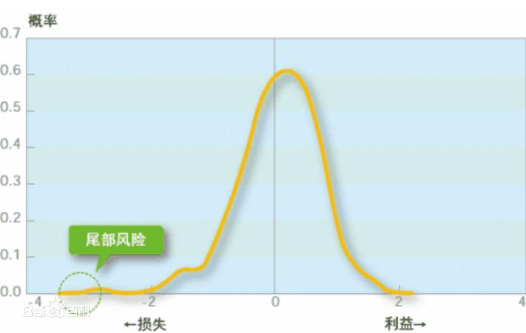
Outline

Slide 7
Introduction: Literature
Majority of equity mutual funds follow momentum trading strategies, which have a dark side because they also come with occasional large crashes.
(see, e.g., Badrinath and Wahal (2002), Barroso and Santa-Clara (2015), Daniel, Jagannathan, and Kim (2017), Daniel and Moskowitz (2016), De Long, Shleifer, Summers, and Waldmann (1990), and Grinblatt, Titman, and Wermers (1995)).
Further, the tendency of mutual funds to herd can also destabilize prices and lead to significant crash risk.
(see, e.g., Brown,Wei, andWermers (2014), Dass, Massa, and Patgiri (2008), Lakonishok, Shleifer, and Vishny (1992), Nofsinger and Sias (1999), Sias (2004), andWermers (1999)).
Mutual funds that experience extreme flows might be forced to engage in fire sales of stocks that lead to large swings in prices.
(see, e.g., Adam and Klipper (2017), Coval and Stafford (2007), Edelen (1999), and Rakowski (2010)).

Slide 8
Research Design: Data
Our sample consists of all U.S. equity diversified open-end mutual funds and is provided by Morningstar and includes all defunct funds.
Exclude sector funds, international funds, and balanced funds
Drop funds which there are less than 60 consecutive monthly returns available.
For the funds with multiple share classes, we use only the oldest share class as the representative one
The final sample comprises 1,750 actively managed mutual funds, 27,104 fund-years a total of 3,190 daily returns for Jan. 1985 to Sept. 2015.

Slide 9
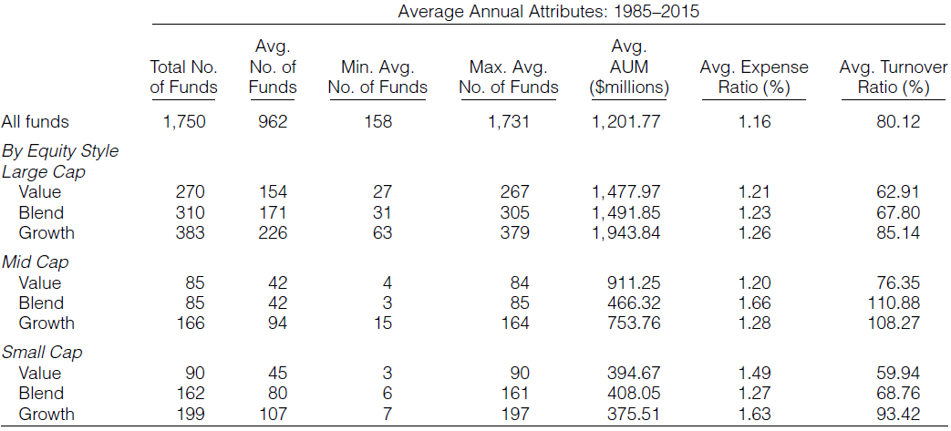
Summary Statistics
Morningstar’s equity style classification is a 3*3 grid that categorizes funds by market capitalization and growth and value factors.

Slide 10
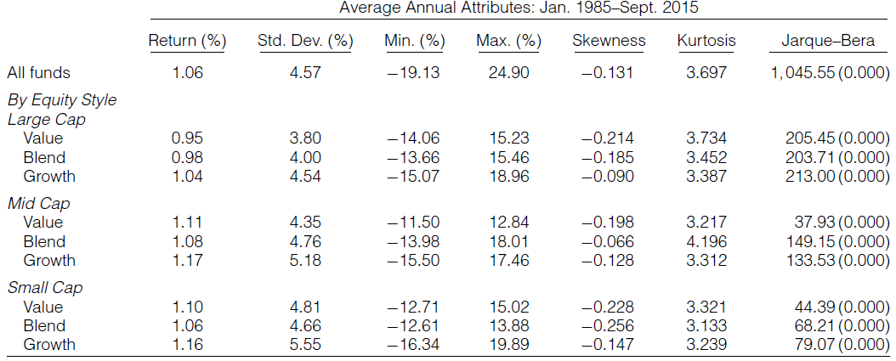
Summary Statistics
The average values of skewness and kurtosis for most of the funds’ returns indicate that the returns are not normally distributed

Slide 11


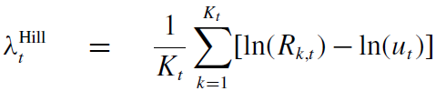

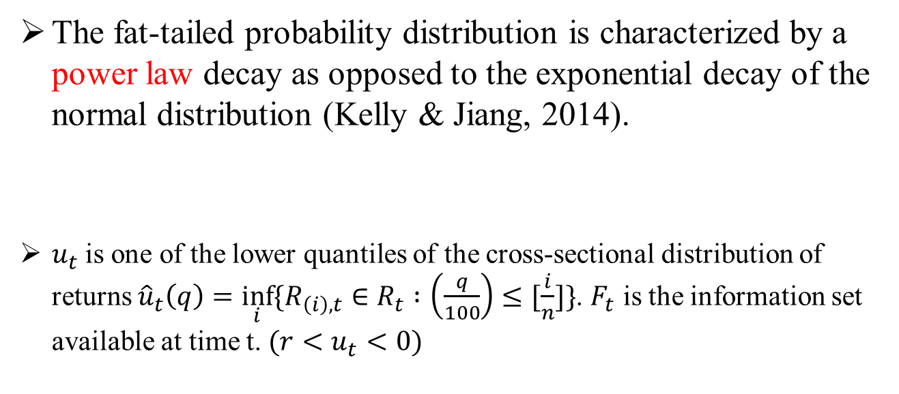
Measuring Tail Risk
The fat-tailed probability distribution is characterized by a power law decay as opposed to the exponential decay of the normal distribution (Kelly & Jiang, 2014).
$u_{t}$is one of the lower quantiles of the cross-sectional distribution of returns ${\hat{u}}_{t}\left(q\right)=\inf_{i}{\{R_{\left(i\right),t}}∈R_{t} :\left(\frac{q}{100}\right)≤[\frac{i}{n}]\}$. $F_{t}$ is the information set available at time t. $(r<u_{t}<0)$
Hill (1975)

Slide 12
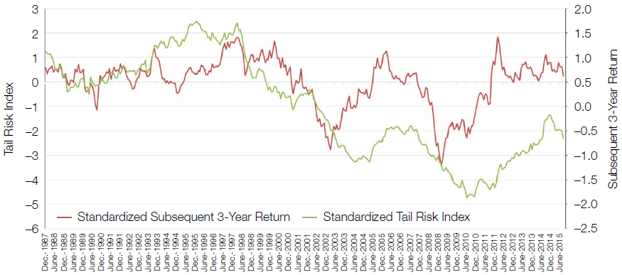
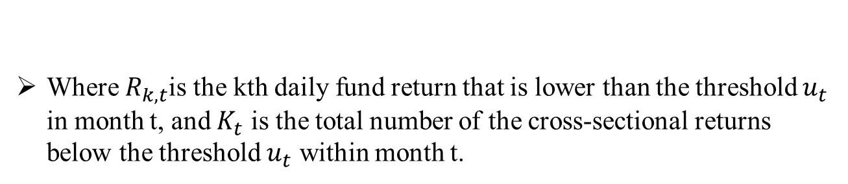
Measuring Tail Risk
Where $R_{k,t}$is the kth daily fund return that is lower than the threshold $u_{t}$ in month t, and $K_{t}$ is the total number of the cross-sectional returns below the threshold $u_{t}$ within month t.

Slide 13
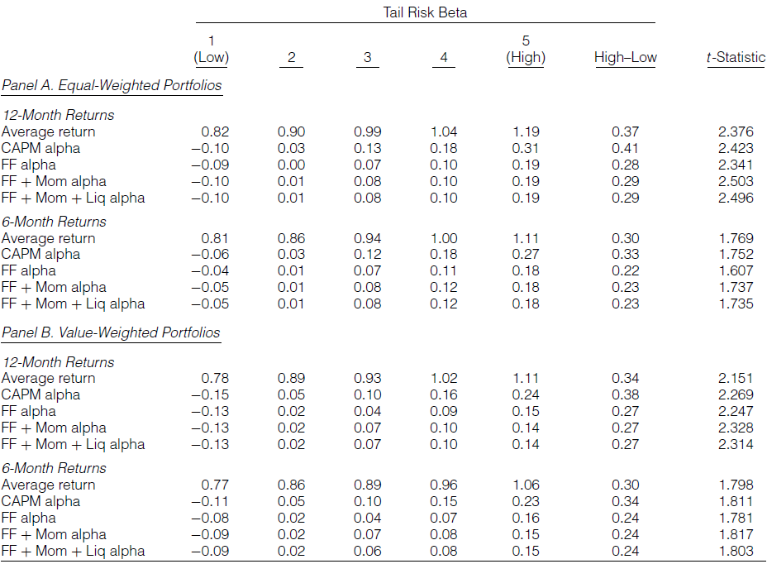
Tail Risk and Returns

Slide 14
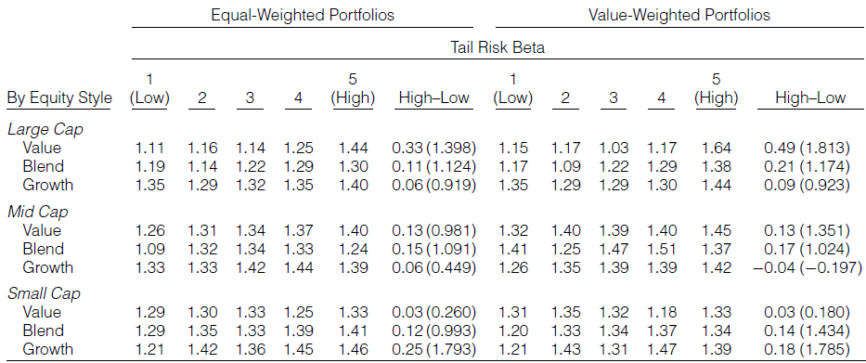
Tail Risk and Returns
We observe that the alphas for the high–low portfolios remain large and statistically significant in almost all cases. Overall, the empirical results indicate a substantial premium for the funds with high tail risk loadings.

Slide 15
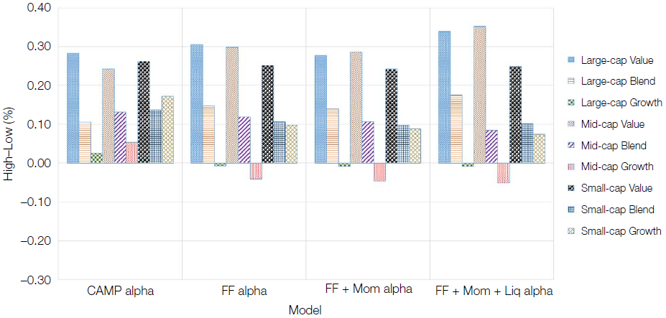
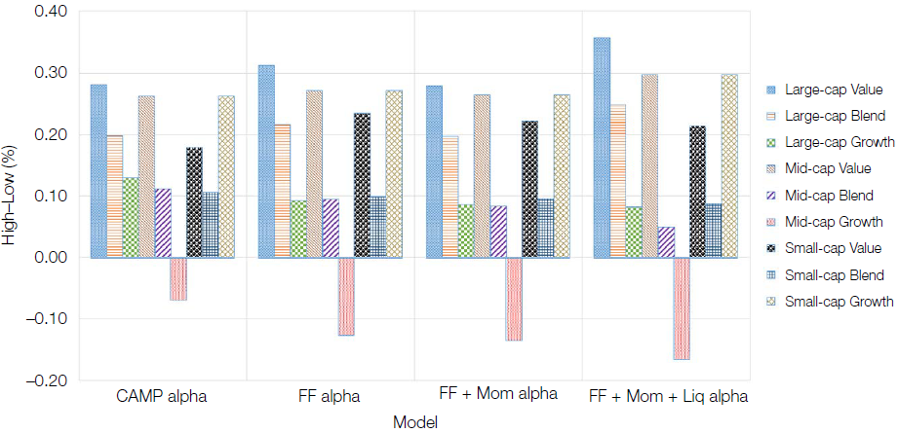
High-Low Formed on Equity Style

Slide 16
Robustness
We also examine whether our results are robust to several important mutual fund characteristics by independently double-sorting funds on tail risk loadings and each of these characteristics.
These characteristics comprise
Benchmark alpha (BNCH ALPHA),
Fund size (SIZE),
Expense ratio (EXP RATIO)
Turnover ratio (TURN OVER)
Tracking error (TR ERROR)
Management fee (MNG FEE)
Managerial ownership (MNG OWN).

Slide 17
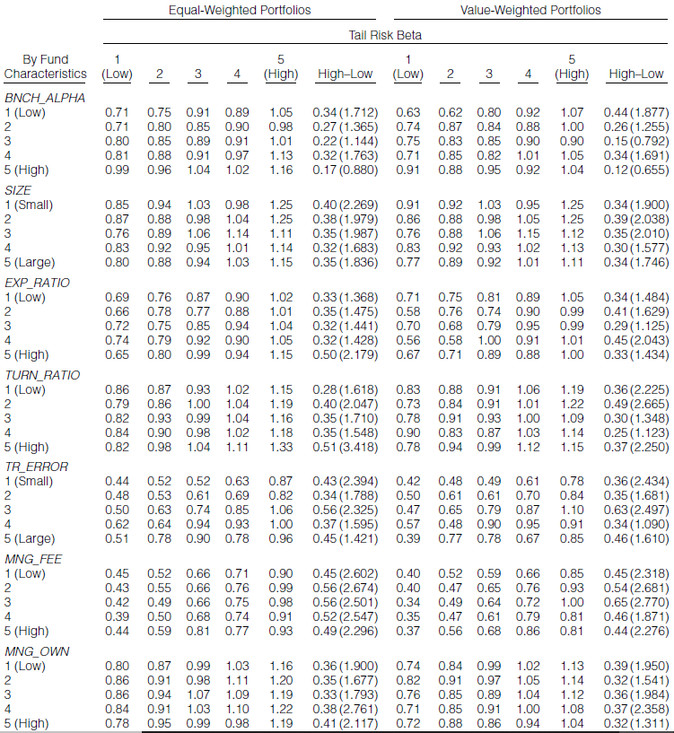
Double portfolio sort excess return

Slide 18
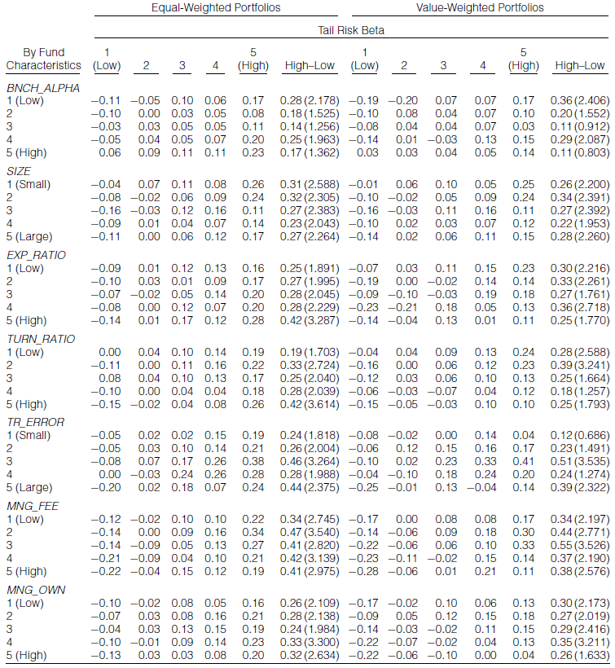
Double portfolio sort alpha

Slide 19

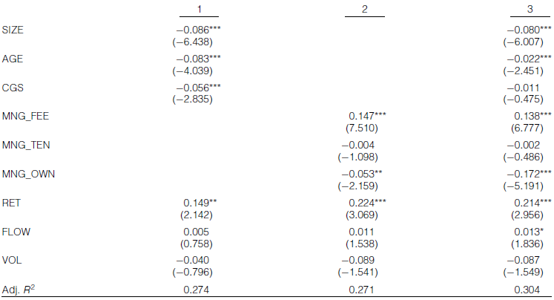
The Relation between Tail Risk and Mutual Fund Characteristics
Tail risk

Slide 20
Conclusion
We find that the estimates of the tail risk premium are statistically and economically significant. The tail risk premium persists even when we control for commonly used risk factors.
We also find that funds susceptible to tail risk tend to be small, young, have high management fees, and have managers who do not risk their own capital.

