Slide 1
The Cross-Section of Risk and Returns
Kent Daniel、Lira Mota、Simon Rottke、Tano Santos
The Review of Financial Studies / v 33 n 5 2020
岳阳 2020.5.23

Slide 2
Contents
1.Introduction
1.1Backgrounds
1.2Literatures
1.3Motivations
1.4Contributions
2.Data
3.Methods
4.Results
5.Conclusions

Slide 3
1.Backgrounds
A common practice in the academic finance literature has been to create characteristic portfolios (CPs) by sorting on characteristics positively associated with expected returns.
Fama and French argue that FF5 model does well in explaining the cross-section of average excess returns for a variety of test portfolios
Roll (1977) worried that the lack of consideration of the asset covariance structure will lead to inaccurate results.

Slide 4
1.Literatures
Fama and French (1993, 2015): prominent examples of constructing CPs
Markowitz (1952) and Roll (1977): if characteristics are a good proxy for expected returns, then forming CPs by sorting on characteristics alone will generally not explain the cross-section of return, because they do not take into account the asset covariance structure .
Ledoit and Wolf (2003, 2004a, 2004b, 2012, 2017) propose alternative covariance matrix estimators for CEP’s calculation.
Daniel and Titman (1997): proposed the construction of the optimal hedge portfolios

Slide 5
1.Motivations
Are the traditional CPs good proxies for mean variance efficient(MVE) portfolio?
How to improve CPs?

Slide 6
1.Contributions
We prove that the standard procedure employed for constructing characteristic portfolios (CPs) does not guarantee that the set of portfolios will span the mean variance efficient frontier.
We show how to construct hedge portfolios that capture the unpriced risk in these portfolios and that can be combined with the CPs to form characteristic-efficient portfolios (CEPs) free of exposure to these unpriced sources of common variation.

Slide 7
2.Data
July 1963 to December 2019
NYSE, Amex, and NASDAQ stocks
Construct portfolios every June

Slide 8




3.Methods
Consider a single period economy with N assets. Realized excess returns are determined by a two-factor structure, so for asset i:
λ: characteristic premium
f, g, ε are mutually orthogonal for all i≠j
Let r denote the (N×1) column vector of individual excess returns:

Slide 9




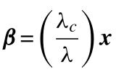
3.Methods
Taking expectations of Equation (2):
β is the (N×1) column vector of individual assets’ exposures to f
Assume that expected excess returns are perfectly described by a linear function of one single characteristic:
λc is the characteristic premium

Slide 10

3.Methods
the characteristic(x) is a perfect proxy for the exposure(β) to the priced factor, thus, sorting on the characteristic will pick up variation in β
Notes:
W代表多空投资组合中股票的权重。正数为买入，负数为卖出。

Slide 11
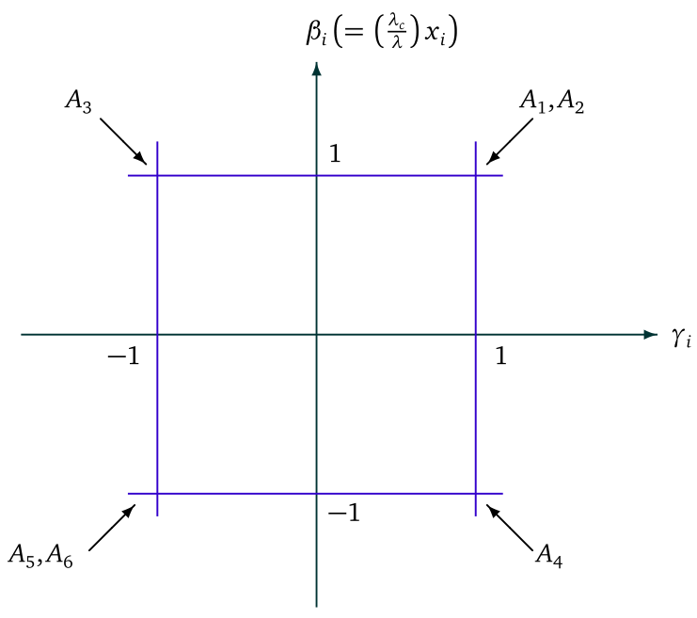
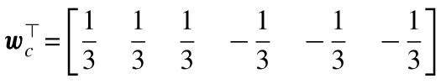
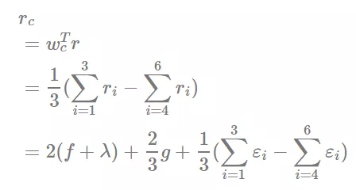
3.Methods
Suppose that there are only six stocks (N = 6) with equal market capitalizations.
CPc:

Slide 12


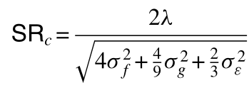
3.Methods
Expected excess return and variance:
Sharpe ratio:
CP is not MVE because it is exposed to both priced and unpriced risk.
improve on the CP——Hedge:
use the portfolio h to improve on the CP by reducing its variance without changing its expected excess returns

Slide 13

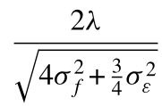
3.Methods
portfolio h:
form a portfolio for which for every dollar invested long in portfolio c we also invest $1/3(short) in the hedge portfolio h. SR:

Slide 14

3.Methods
Combining the hedge portfolio with the characteristic portfolio in order to maximize the Sharpe ratio
①construct the hedge portfolios;
②find the optimal hedge ratios.

Slide 15
3.Methods
Can FF5’s factors’ performance be improved?
HML/RMW/CMA: BEME/OP/INV & ME: 3*3
size
the stocks’ forecast future loading on the HML CP
Frazzini and Pedersen (2014)
SL |  | BL
SH |  | BH
H
L
hedge portfolio will indeed have large loading with
respect to the corresponding FF CP
BM
hedge portfolio for HML: long an equally weighted combination of all high loading portfolios and short an equally weighted combination of all low loading portfolios

Slide 16
3.Methods
SMB/MktRF: BEME/OP/INV and ME/MktRF
hedge portfolio for SMB/MktRF: an equally weighted portfolio of the three different SMB hedge portfolios

Slide 17
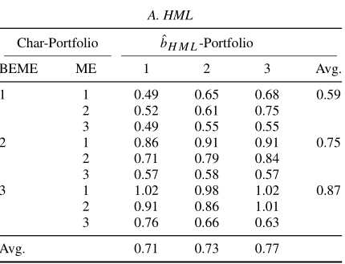
4.Results
value-weighted monthly excess returns
Avg=0.74

Slide 18
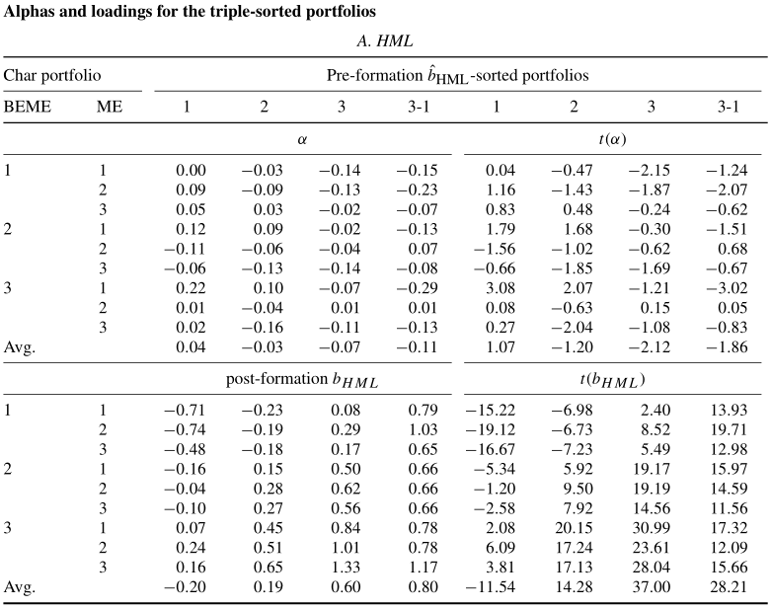
alphas and loadings from time-series regressions of monthly excess returns of the loading-sorted portfolios on the five FF characteristic portfolios
see large differences between the postformation loadings of the high- forecast loading (“3”) and low-forecast loading (“1”) portfolios.

Slide 19
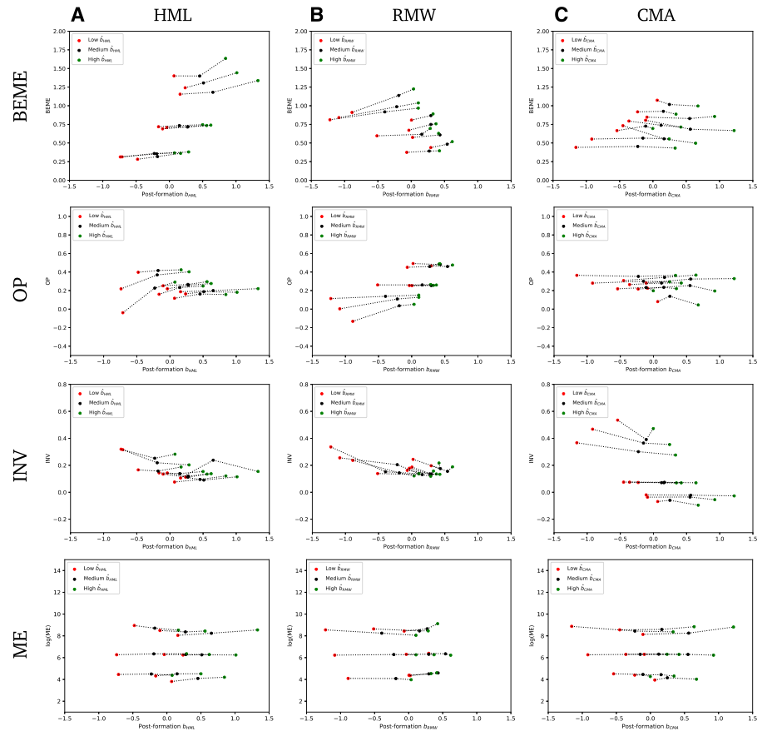
the average characteristics of the sorted portfolios. Each dot in these plots represents one of the 27 portfolios from the 3×3×3

Slide 20
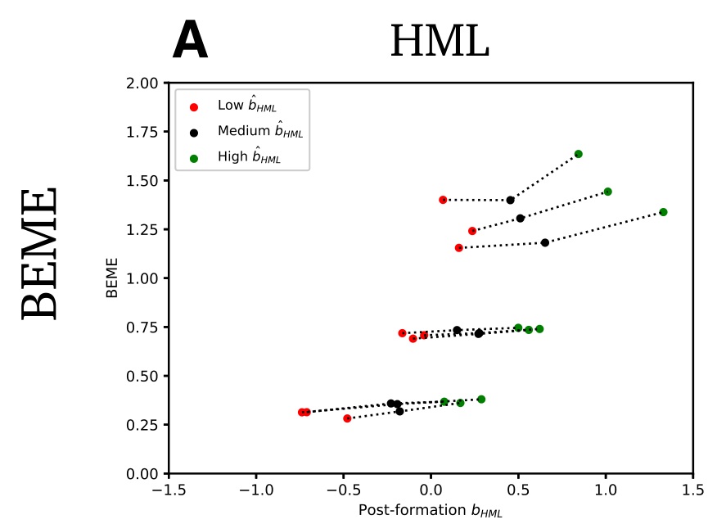
vertical distance between red and green dots: “unintended characteristic spread.
the vertical distance across the dotted lines for the cases in which the characteristic on the y-axis corresponds to the one used to form the CP: “intended spread”
the unintended spreads are relatively small, compared to the intended spreads

Slide 21

4.Results
We can reject the FF five-factor model using the hedge portfolios as test assets.
run a single time series regression of the monthly excess returns of the hedge portfolios m∈

Slide 22
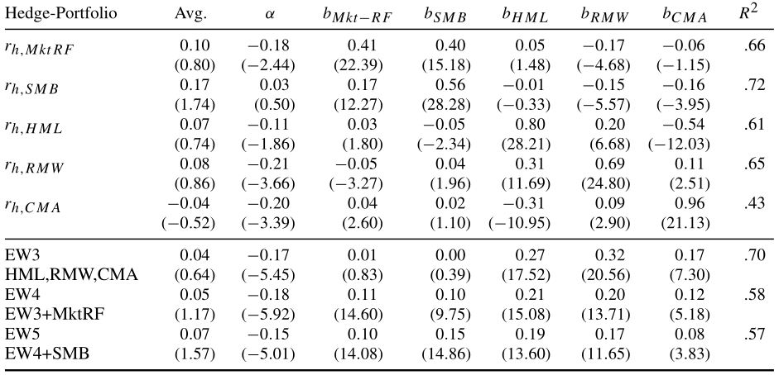
hedge portfolios must have zero expected excess returns
Significant exposure to classic CP combinations

Slide 23
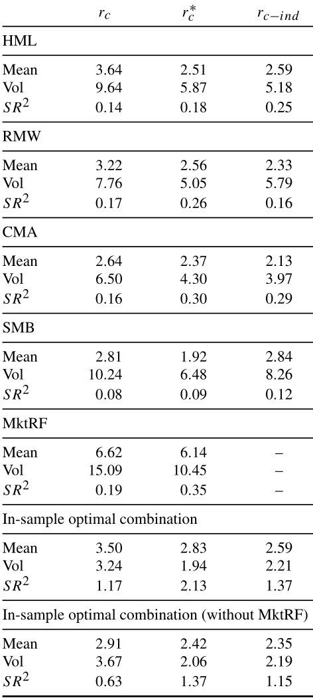
4.Results
the mean return of all characteristic portfolios decreases, but that the volatility decreases substantiall more. This leads to an increase in the Sharpe ratio for each of the individual Fama and French CPs
① the industry factors can be decomposed into a priced and an unpriced part. By creating industry-neutral portfolios, we indistinguishably hedge out both components, thereby causing a strong decrease in the mean of the factor-portfolio returns.
②there can be other sources of common variation that are not related to industries and do not command a premium.

Slide 24
5.Conclusions
The standard procedure employed for constructing characteristic portfolios (CPs) does not guarantee that the set of portfolios will span the mean variance efficient frontier.
The method of “constructing hedge portfolios” can capture the unpriced risk in these portfolios and can be combined with the CPs to form characteristic-efficient portfolios (CEPs), finally, it improves Sharpe ratio.

