Slide 1
Factor Timing
Valentin Haddad, Serhiy Kozak, Shrihari Santosh
The Review of Financial Studies
January, 2020
王念硕

Slide 2
Outline
Introduction
Research design
Empirical result
Conclusion

Slide 3
1. Introduction
因子择时介绍：
因子择时（factor timing），是指在多因子投资的框架下，通过识别影响因子表现的因素，建模预测未来因子收益，动态优化因子权重，使得最终结果优于普通预测。
因子择时是否可行面临大量争议，目前并没有一个广泛的结论。
对value spread用于因子择时是否有效的讨论，目前主要分为两个阵营：以AQR Asness为代表的悲观派和以Research Affiliate Arnott为代表的乐观派。

Slide 4
1. Introduction
因子择时介绍：
学术界一般用value spread衡量因子的估值水平，具体计算过程如下：
在每月末，按因子从小到大分成N组（以10组为例），第10组为多头组，第1组空头组；
计算多头组和空头组平均BM，作为两个组合的估值指标；
多头组合BM — 空头组合BM ，即为value spread。
当value spread变宽时，因子估值降低，未来收益可能增加；当value spread收窄时，因子估值变高，未来收益可能减少。

Slide 5
1. Introduction
Background
Aggregate stock returns are predictable over time (e.g., Shiller 1981; Fama and French 1988), creating the scope for investors to engage in market timing.
Factors beyond the aggregate market are sources of risk premiums in the cross-section of assets (e.g., Fama and French 1993), creating the basis for factor investing.
With the more frequent transformation of market style, the importance of factor timing research is also increasing.

Slide 6
1. Introduction
Motivation
It seems controversial to explain the importance of factor timing in theory and empirically determining the value of factor timing appears difficult, because doing so requires measuring the predictability of many returns and opens the door for spurious findings.

Slide 7
1. Introduction
Research question
How valuable is it to construct an optimal factor timing portfolio that unifies cross-sectional and time-series predictability of returns?

Slide 8
1. Introduction
Related researches
Freyberger, Neuhierl, and Weber (2018) use an adaptive group lasso method to test which characteristics provide independent information for the cross-section of expected returns on individual stocks
Light, Maslov, and Rytchkov (2017), Kelly, Pruitt, and Su (2019), and Giglio and Xiu (2018) employ latent factor analysis
Campbell, Polk, and Vuolteenaho (2009) and Lochstoer and Tetlock (2020), who use panel VAR techniques to forecast firm-level expected returns, then aggregate the estimates into portfolios

Slide 9
1. Introduction
Research Contents
Firstly, based on the theory of stochastic discount factors, this paper deduces that factor timing is expected to bring higher strategic returns and performance.
Secondly, this paper establishes a complete method of factor timing. From the information ratio, expected utility and other indicators, factor timing brings greater benefits than market timing and factor investment, which further explains the value of factor timing.

Slide 10
1. Introduction
Contribution
This paper not only explains the advantages of factor timing theoretically, but also improves the traditional method of factor timing, which is helpful for investors to construct better strategy of factor timing.

Slide 11
2. Research design
Theoretical analysis
Pricing factors
SDF, factor investing, and factor timing
Dominant components
Forecasts
Empirical analysis
Dynamic configuration weight
Construction factor timing strategy

Slide 12
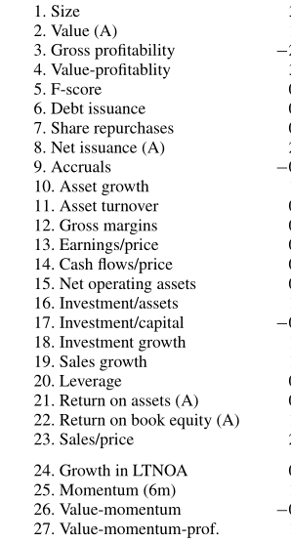
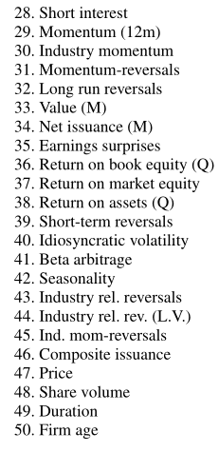
2. Research design : Variable
50 anomaly portfolios

Slide 13
2. Research design : Data
Company financial data： CRSP、 Compustat
Period：1974 - 2017 month data.
Sample: our sample consists of all New York Stock Exchange (NYSE), American Stock Exchange (Amex), and Nasdaq.

Slide 14
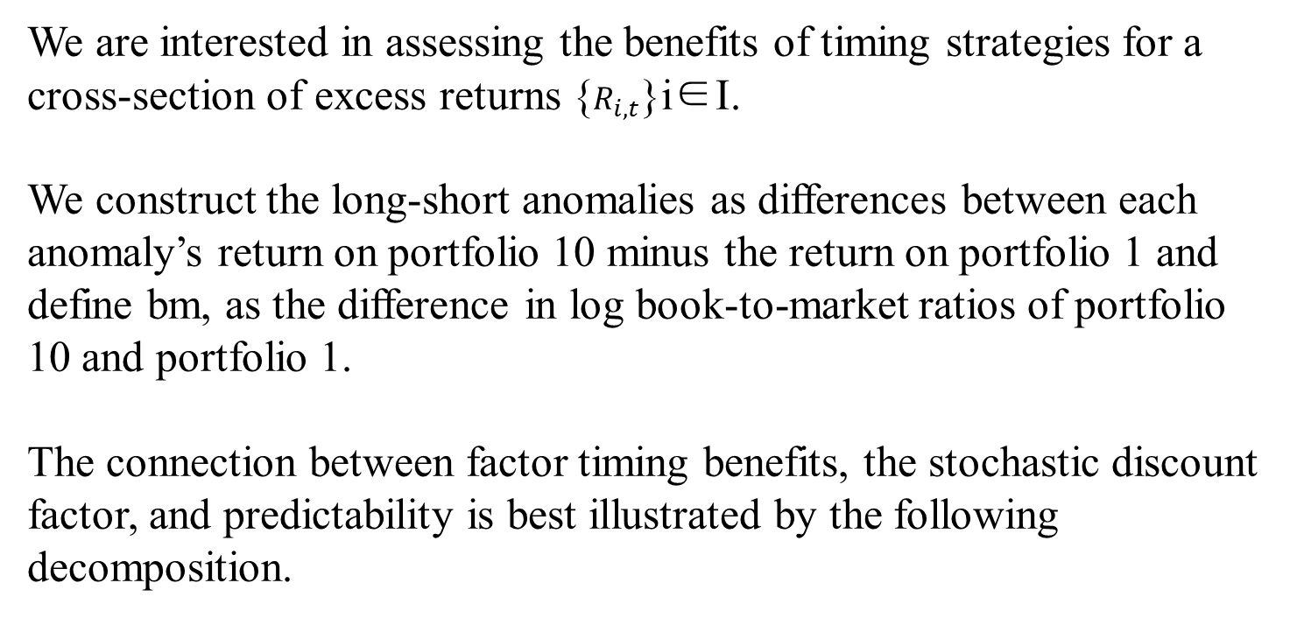
2. Research design : method
We are interested in assessing the benefits of timing strategies for a cross-section of excess returns {$R_{i,t}$}i∈I.
We construct the long-short anomalies as differences between each anomaly’s return on portfolio 10 minus the return on portfolio 1 and define bm, as the difference in log book-to-market ratios of portfolio 10 and portfolio 1.
The connection between factor timing benefits, the stochastic discount factor, and predictability is best illustrated by the following decomposition.

Slide 15

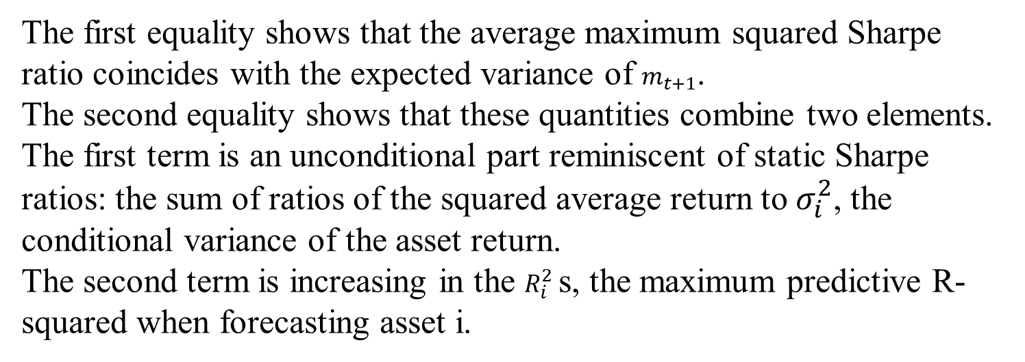
2. Research design : method
If asset returns are uncorrelated, the average maximum conditional Sharpe ratio can be expressed as：
The first equality shows that the average maximum squared Sharpe ratio coincides with the expected variance of $m_{t+1}$.
The second equality shows that these quantities combine two elements. The first term is an unconditional part reminiscent of static Sharpe ratios: the sum of ratios of the squared average return to $σ_{i}^{2}$, the conditional variance of the asset return.
The second term is increasing in the $R_{i}^{2}$ s, the maximum predictive R-squared when forecasting asset i.

Slide 16
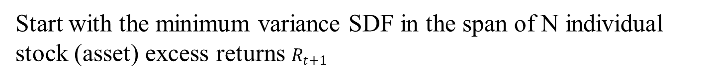
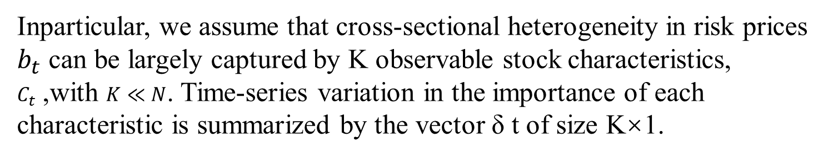
2. Research design : method
Start with the minimum variance SDF in the span of N individual stock (asset) excess returns $R_{t+1}$
which satisfies the fundamental relation $E_{t}\left[m_{t+1}R_{t+1}\right]=0$
Inparticular, we assume that cross-sectional heterogeneity in risk prices $b_{t}$ can be largely captured by K observable stock characteristics, $C_{t}$ ,with $K≪N$. Time-series variation in the importance of each characteristic is summarized by the vector δ t of size K×1.

Slide 17



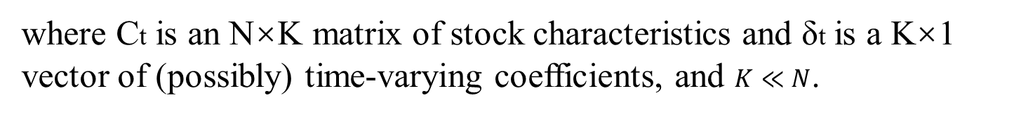
2. Research design : method
Assumption 1. Stock-level SDF loadings can be represented as
where Ct is an N×K matrix of stock characteristics and δt is a K×1 vector of (possibly) time-varying coefficients, and $K≪N$.
are “characteristics-managed” factor portfolios

Slide 18
2. Research design : method
Assumption 2. (Absence of near-arbitrage) There are usually no near-arbitrage opportunities: average conditional squared Sharpe ratios are bounded above by a constant.

Slide 19

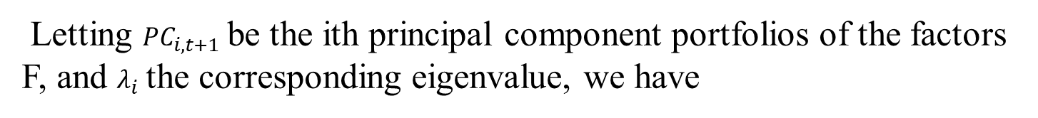
2. Research design : method
Letting ${PC}_{i,t+1}$ be the ith principal component portfolios of the factors F, and $λ_{i}$ the corresponding eigenvalue, we have
The first term represents the benefits of static factor investing. It is the squared Sharpe ratio of an optimal static factor portfolio.
The second term is our focus in this paper and captures the amount of predictability for each principal component.

Slide 20
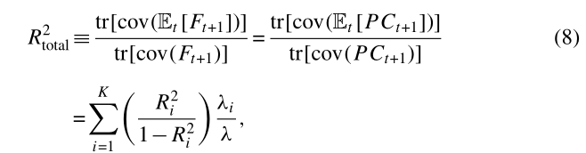

2. Research design : method
Second, we can ask how much each PC portfolio contributes to the total predictability of returns. As a measure of the total amount of predictability we define the total R2 as

Slide 21

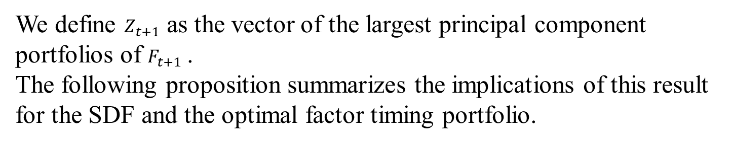
2. Research design : method
We define $Z_{t+1}$ as the vector of the largest principal component portfolios of $F_{t+1}$ .
The following proposition summarizes the implications of this result for the SDF and the optimal factor timing portfolio.
Proposition 1. Under Assumption 1 and Assumption 2, the SDF can be approximated by a combination of the dominant factors:

Slide 22

2. Research design : method
Equivalently, the maximum Sharpe ratio factor timing portfolio can be approximated by:

Slide 23
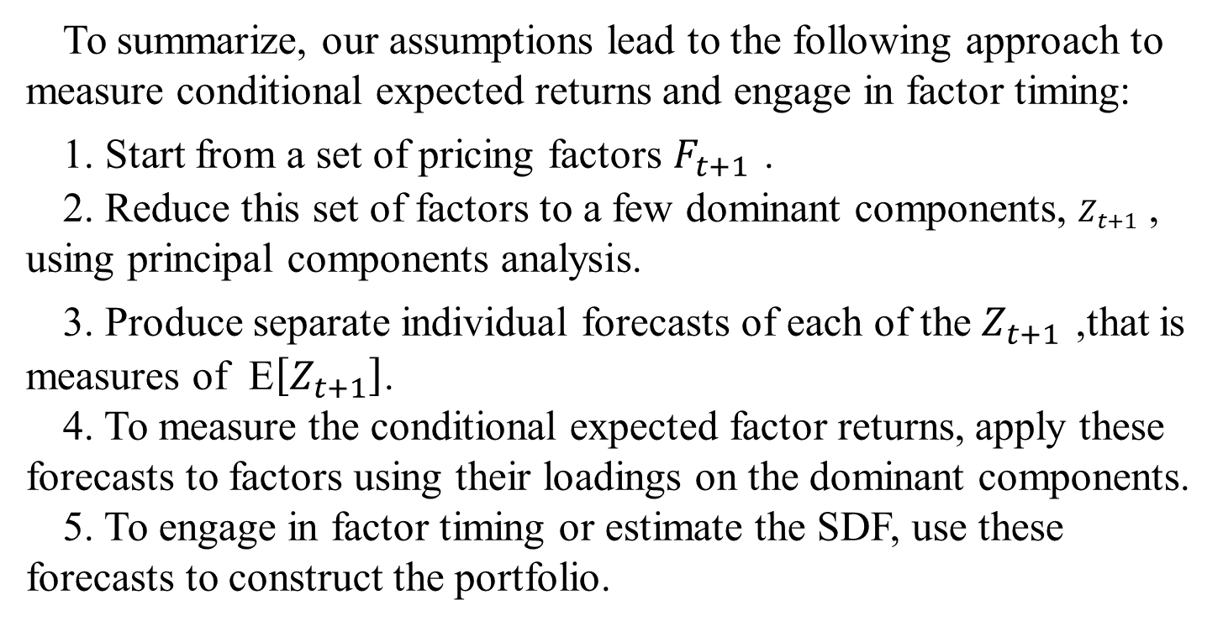
2. Research design
To summarize, our assumptions lead to the following approach to measure conditional expected returns and engage in factor timing:
1. Start from a set of pricing factors $F_{t+1}$ .
2. Reduce this set of factors to a few dominant components, $Z_{t+1}$ , using principal components analysis.
3. Produce separate individual forecasts of each of the $Z_{t+1}$ ,that is measures of E$\left[Z_{t+1}\right]$.
4. To measure the conditional expected factor returns, apply these forecasts to factors using their loadings on the dominant components.
5. To engage in factor timing or estimate the SDF, use these forecasts to construct the portfolio.

Slide 24
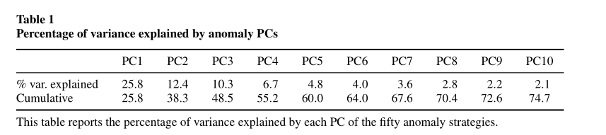
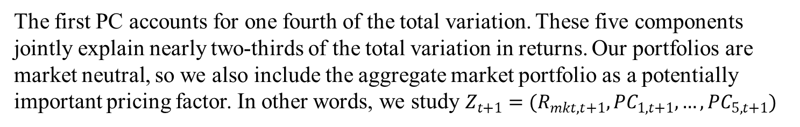
3. Empirical result: Dominant components of the factors
The first PC accounts for one fourth of the total variation. These five components jointly explain nearly two-thirds of the total variation in returns. Our portfolios are market neutral, so we also include the aggregate market portfolio as a potentially important pricing factor. In other words, we study $Z_{t+1}=(R_{mkt,t+1},{PC}_{1,t+1},…,{PC}_{5,t+1})$

Slide 25
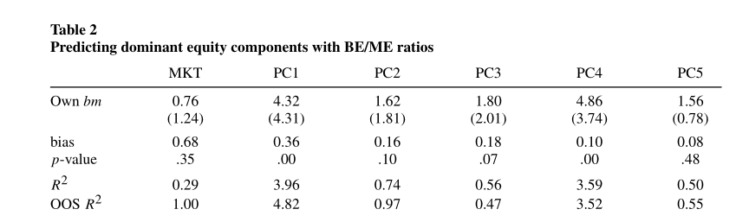
3. Empirical result: Predictability results
We obtain these forecasts using standard predictive regressions on valuation ratios.
Consistent with previous studies, the estimate is not statistically significant for the market. PCs1 and 4 are unambiguously predictable by their own bm ratio. The estimated coefficients are large and significant, with t-statistics around 4 and bootstrapped p-values close to 0. Both the in-sample and OOS R2s are large: around 4% for PC1 and around 3.5% for PC4.

Slide 26
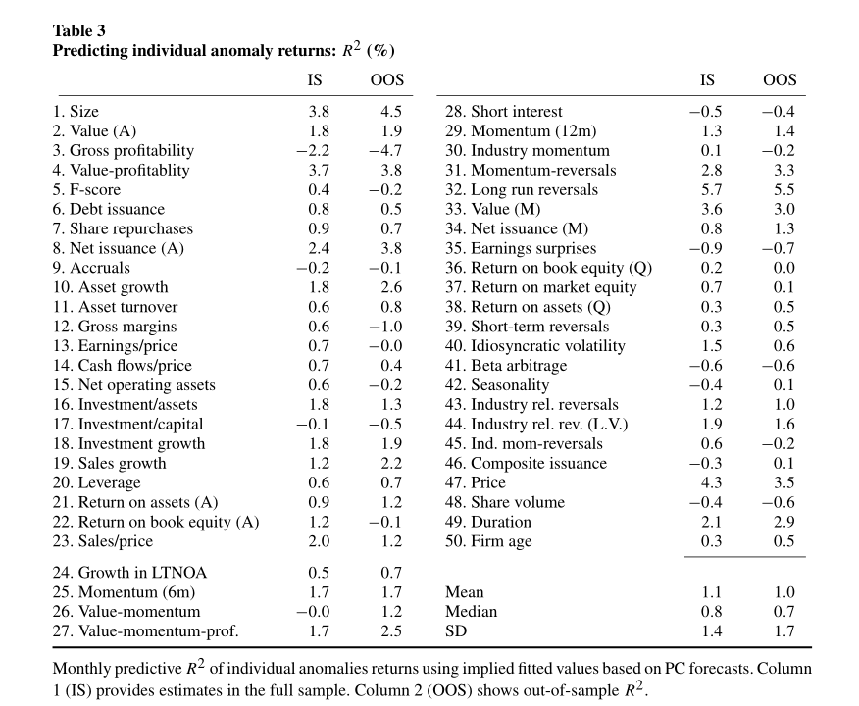
3. Empirical result: Predicting individual factors
Table 3 shows the in- and out-of-sample R2 for each anomaly return using our method. Many of the anomalies are highly predictable; roughly half have OOS R2 greater than 1%. The total R2 is 1.03% in-sample and 0.93% OOS. Our approach allows us to uncover these patterns in a robust way.

Slide 27
3. Empirical result: Predicting individual factors
Table 3 shows the in- and out-of-sample R2 for each anomaly return using our method. Many of the anomalies are highly predictable; roughly half have OOS R2 greater than 1%. The total R2 is 1.03% in-sample and 0.93% OOS. Our approach allows us to uncover these patterns in a robust way.

Slide 28
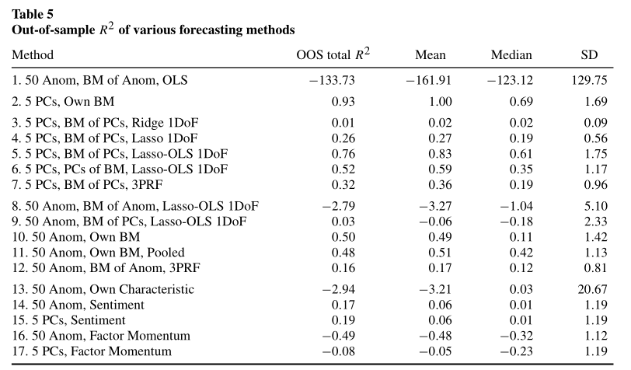
3. Empirical result: Comparison to alternative approaches
The first row shows results from a completely unregularized estimation in which each anomaly return is forecast using all fifty anomaly bm ratios.
The second row reports results from our method.
Row 3 shows that ridge regression, even with five predictors, does not deliver robust predictability. Row 4 shows that Lasso does somewhat better, but still substantially worse than using only each portfolio’s own bm.

Slide 29
3. Empirical result: Comparison to alternative approaches
Rows 8 to 12 consider various methods for reducing the dimensionality of the predictors but without any left-hand side (LHS) dimensionality reduction. However, row 5 shows that with the same information set and same estimation technique, restricting to PCs of returns produces a large OOS total R2, highlighting the importance of reducing the dimension of the LHS

Slide 30
3. Empirical result: Comparison to alternative approaches
In rows 13–17, we consider predictors besides bm ratios

Slide 31

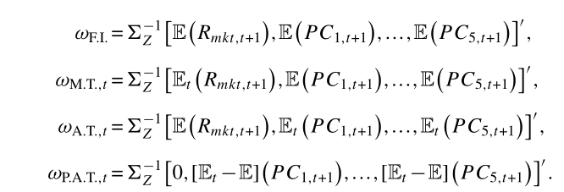
3. Empirical result: Optimal Factor Timing Portfolio
“Factor timing” (F.T.) is the portfolio described above.
“Factor investing” (F.I.) sets all return forecasts to their unconditional mean
“Market timing” (M.T.) does the same except for the market return.
“Anomaly timing” (A.T.) does the opposite: the market is forecast by its unconditional mean, while anomalies receive dynamic forecasts.
The “pure anomaly timing” (P.A.T.) portfolio sets the weight on the market to zero and invests in anomalies proportional to the deviation of their forecast to its unconditional average.

Slide 32
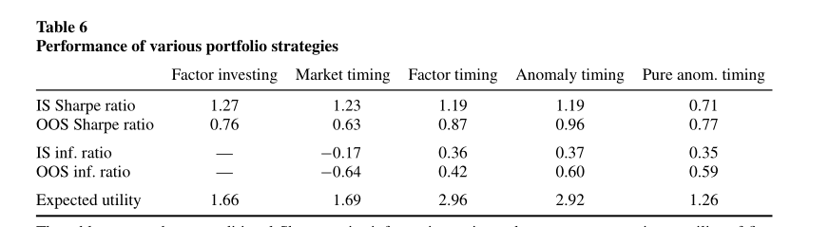
3. Empirical result: Optimal Factor Timing Portfolio
The first performance metric we consider is the unconditional Sharpe ratio: the ratio of the sample mean and the standard deviation of returns.
One might be tempted to conclude from these numbers that factor timing does not improve performance relative to static factor investing.

Slide 33
3. Empirical result: Optimal Factor Timing Portfolio
A second way to evaluate the value of factor timing is to assess whether the timing portfolios expand the unconditional investment opportunity set captured by the static factor investing portfolio.

Slide 34
3. Empirical result: Optimal Factor Timing Portfolio
A third take on the value of factor timing is to ask, given our completely estimated model, what utility would a mean-variance investor expect to obtain on average

Slide 35
4. Conclusion
Based on the theory of stochastic discount factor, this paper provides a new perspective and method to solve the problem of factor timing value.
In this paper, a complete method of factor timing is established
We find that factor timing is very valuable, generating superior performance relative to market timing and factor investing alone.

