Slide 1
Gross profitability and mutual fund performance
Kenchington. D., Wan. C. and Yüksel. Z.H.
Journal of Banking and Finance, 2019.

Slide 2
Outline
Introduction
Research design
Empirical result
Robust Test
Conclusion

Slide 3
Motivation
Focusing on the gross profitability anomaly provides a powerful setting to examine whether mutual fund managers profit from market anomalies for several reasons.
First, anecdotal evidence suggests professional investment managers are aware of this strategy.
Second, relative to other anomalies, a strategy based on gross profitability is profitable when trading solely on the long-leg ( Stambaugh et al., 2012; Edelen et al., 2016 ).
Finally, the return predictability of the gross profitability anomaly is robust.

Slide 4
Contribution
First, we provide strong evidence that a meaningful subset of mutual fund managers profit from an important market anomaly.
Second, our results suggest that fund managers’ exploiting the gross profitability strategy have investment ability.
Finally, our research extends the literatures that profitability-related anomalies have significant predictive power for the cross section of stock returns.

Slide 5
Outline
(1) a profitability-related risk premium
①
②
Whether mutual fund managers exploit the gross profitability anomaly?
What is the potential explanation for this relation?
(2) byproduct of investment anomalies/strategies
(3) managerial ability
③
(1) Fama and French (2015) five- factor model and Hou et al. (2015) q-factor model
(2) Group funds into nine style boxes based on size and value/growth dimensions.
(3) Funds with higher expenses, higher portfolio turnover, and superior past risk-adjusted performance are more likely due to managerial skill.

Slide 6
Research questions
Our study addresses the following questions:
Whether mutual fund managers exploit the gross profitability anomaly?
What is the potential explanation for this relation?

Slide 7
Research Design: Data
(CRSP MF) database, from 1984 to 2014
Returns (monthly) and fund characteristics such as total net assets, expense ratio and turnover.
Thomson Reuters, from 1984 to 2014
Quarterly or semiannual fund equity holdings data.
Focus on actively managed domestic equity mutual funds, we eliminate balanced, bond, money market, international, index funds.
Exclude funds managing less than $15 million and reported holdings are under 80% or over 120%.
For funds with multiple share classes, we compute weighted fund-level variables using class-level total net assets as the weight.

Slide 8

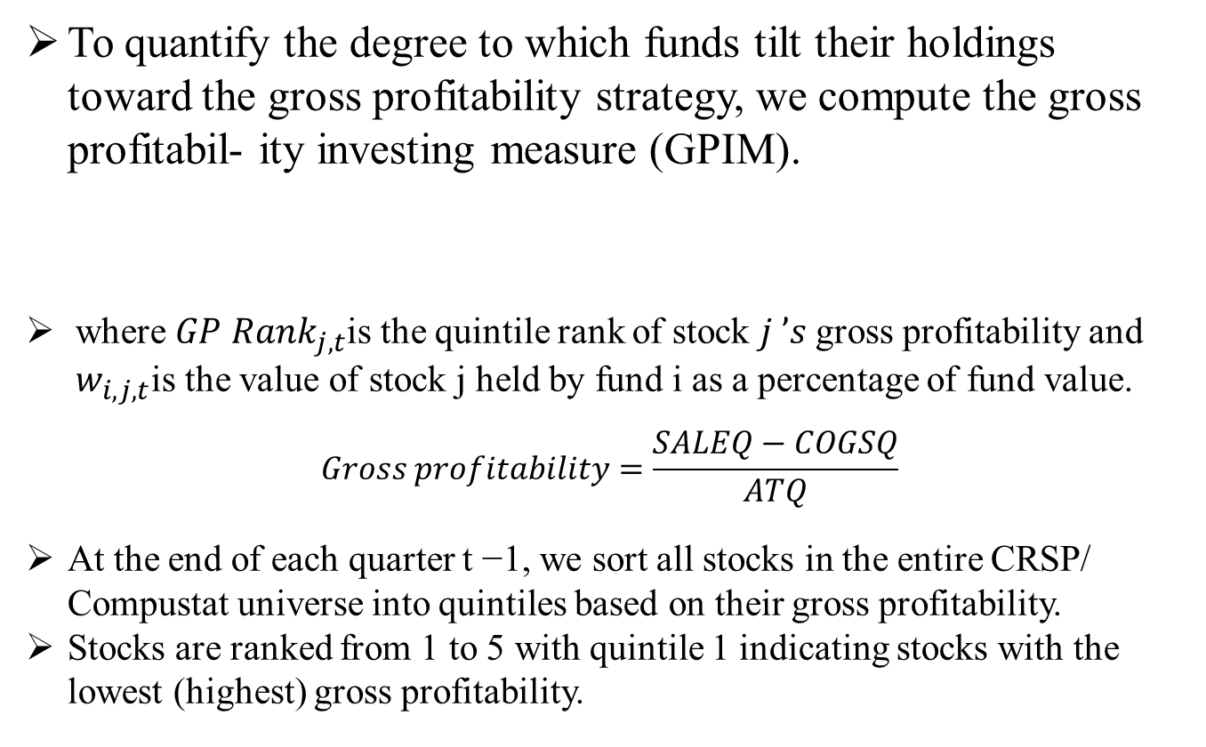
Gross profit investing measure (GPIM)
To quantify the degree to which funds tilt their holdings toward the gross profitability strategy, we compute the gross profitabil- ity investing measure (GPIM).
where $GP Rank_{j, t}$is the quintile rank of stock $j ’s$gross profitability and $w_{i, j, t}$is the value of stock j held by fund i as a percentage of fund value.
$$Gross profitability=\frac{SALEQ−COGSQ}{ATQ}$$
At the end of each quarter t −1, we sort all stocks in the entire CRSP/ Compustat universe into quintiles based on their gross profitability.
Stocks are ranked from 1 to 5 with quintile 1 indicating stocks with the lowest (highest) gross profitability.

Slide 9
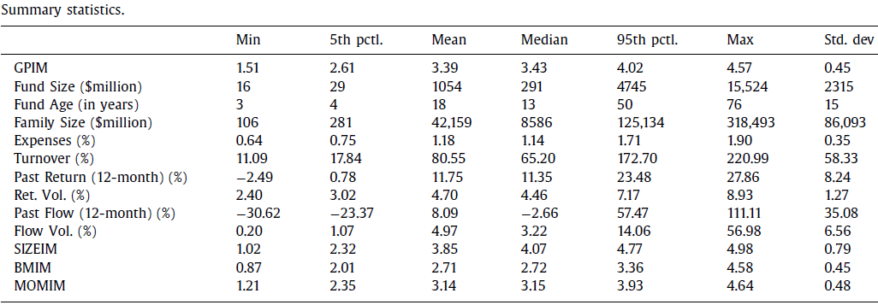
Summary Statistics
Our sample includes 2889 distinct funds and 310,992 fund-month observations.

Slide 10
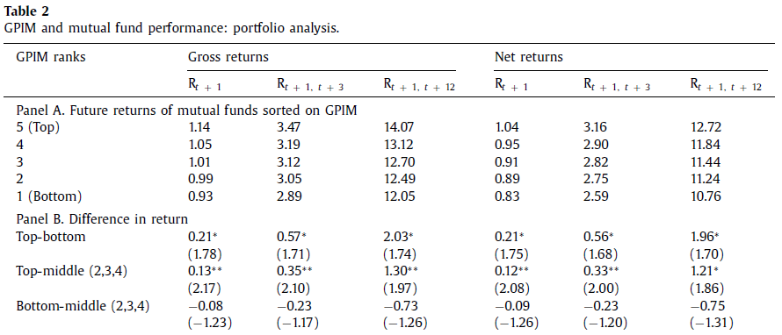
Portfolio analysis
We report the performance differences between the extreme portfolios and the middle portfolio, where the middle portfolio is created out of GPIM quintiles 2–4.
5-3
1-3

Slide 11

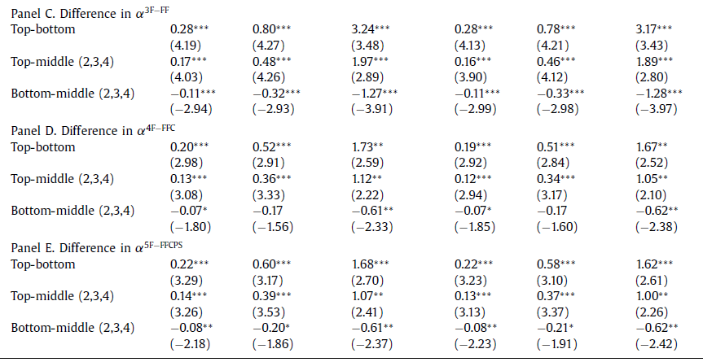
Portfolio analysis

Slide 12
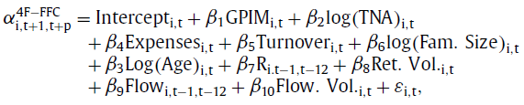
Regression analysis
In this section, we examine the performance of the gross profitability strategy using a multivariate regression framework.
Following previous literature (e.g., Chen et al., 2004; Pollet and Wilson, 2008; Jordan and Riley, 2015; Cici et al., 2018), we control for a comprehensive set of fund performance determinants.

Slide 13
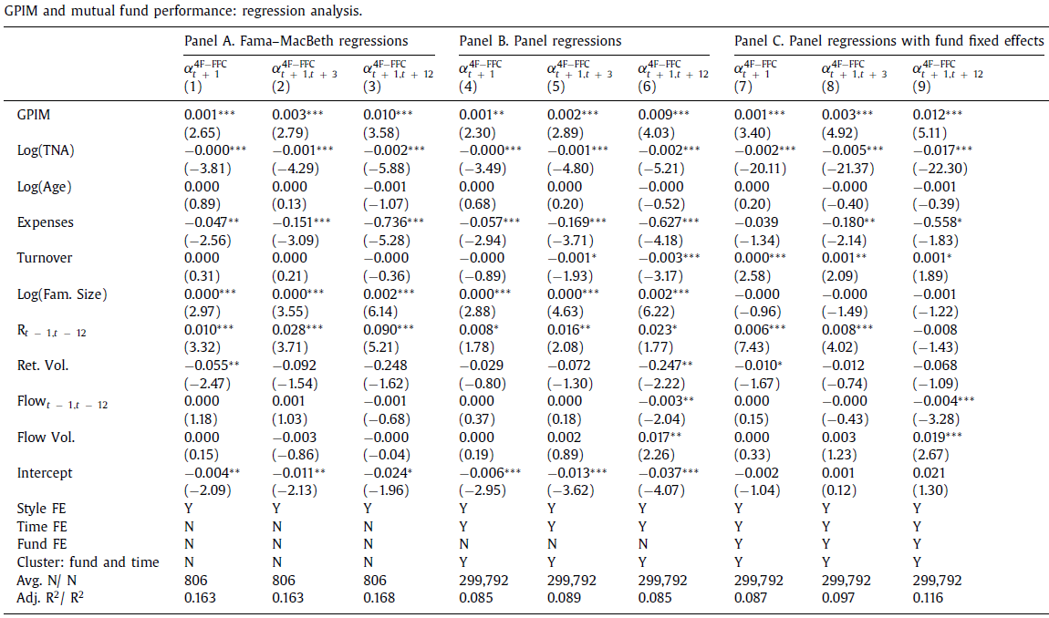
Regression analysis

Slide 14
Potential explanations for the relation between GPIM and future fund performance
In this section we examine explanations for the relation between GPIM and future fund performance.
Specifically, we explore whether the relation is due to:
A profitability-related risk premium
An uncontrolled byproducts for correlation with investments in other well-known strategies
Managerial ability
.

Slide 15

Profitability-related risk premium
Our first explanation for the positive relation between GPIM and future fund performance is that mutual funds with high GPIM are earning a profitability-related risk premium.
Fama and French (2015) develop an asset pricing model that explicitly includes a new factor to account for exposure to the profitability premium.
Hou et al. (2015) build a q-factor model that includes market, size, investment, and profitability factors.

Slide 16
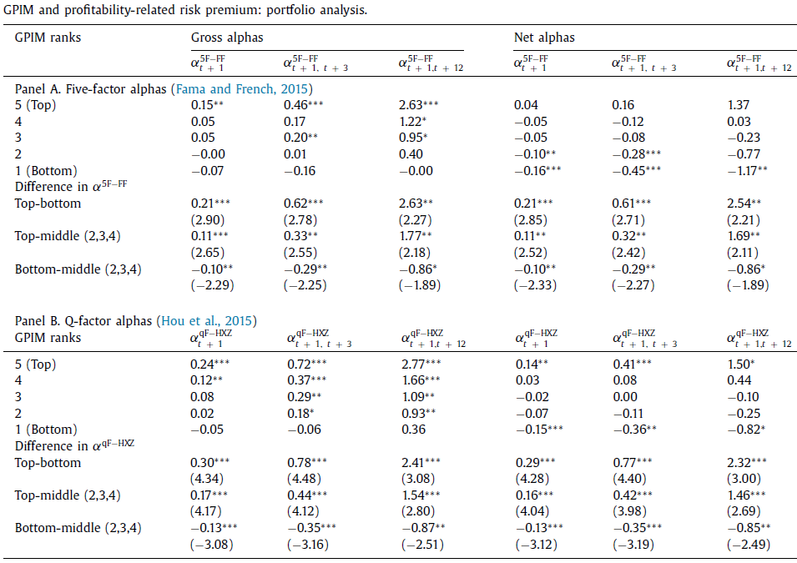

Slide 17
Correlation with other investment styles
We next investigate whether our results could be an unintended byproduct of mutual fund manager’s investing in other anomalies.
We focus our investigation on the size/value anomalies because many mutual funds are set up to exploit them.
In addition to size and value styles, previous research finds that momentum strategies are widespread among fund managers (Grinblatt and Titman, 1989, 1993; Grinblatt et al., 1995; Barroso and Santa-Clara, 2015).
Thus, we further group funds into high and low momentum subsamples based on the median level of UMD loading.
3 X 3 X 2

Slide 18
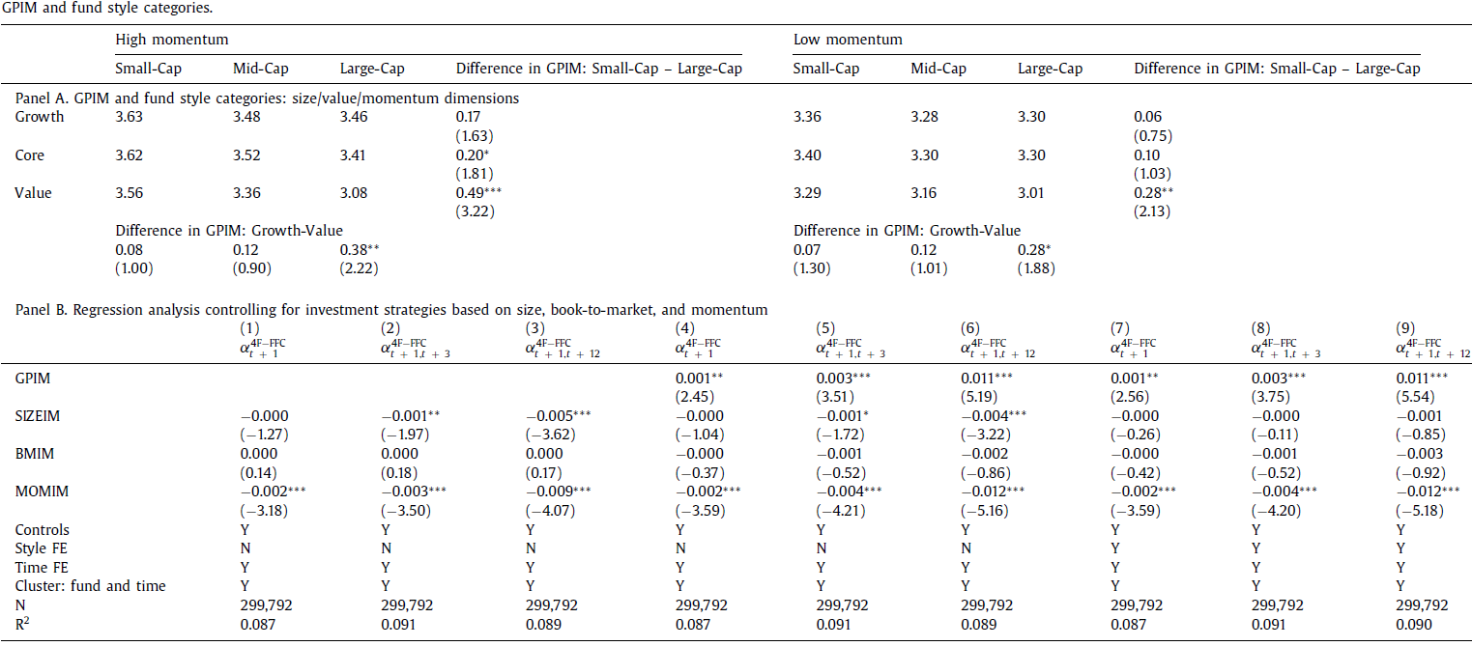
GPIM and fund style categories

Slide 19
Investment skill
In this section, we investigate whether successfully implementing the gross profitability strategy is related to managerial skill.
Previous studies show that smaller funds are more likely to exploit profit opportunities because of decreasing returns to scale associated with the liquidity costs of trading. (Berk and Green, 2004; Chen et al., 2004; Pastor et al., 2017).
And the managers of high GPIM funds expected to earn higher fees (Berk and Green, 2004).

Slide 20
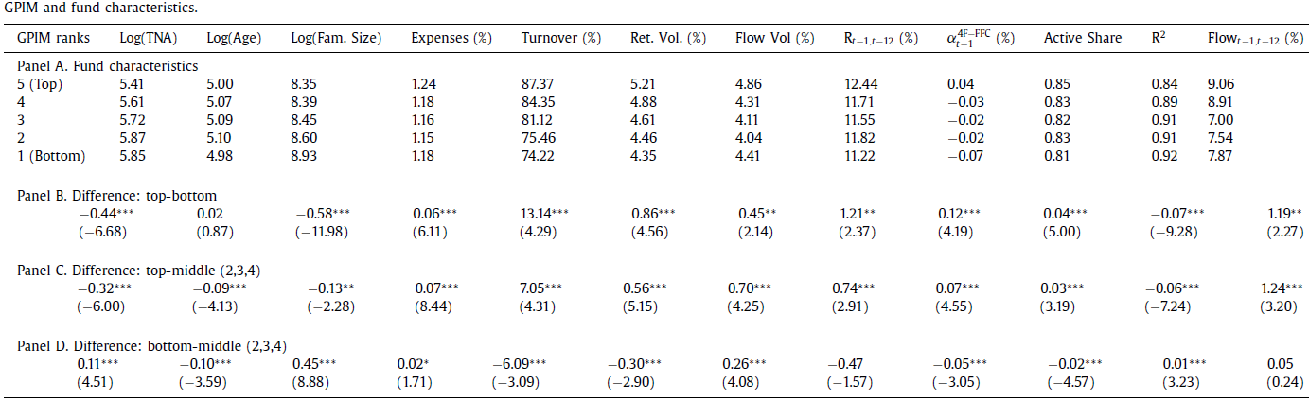
Investment skill
Compared with funds in the bottom and middle GPIM quintiles, funds in the top quintile are younger, smaller in size, and have a higher expense ratio, suggesting managers of these funds could have investment skill.

Slide 21
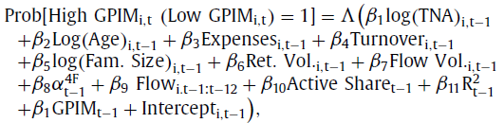
Investment skill
We next examine how GPIM is related to fund characteristics using the following multivariate logit regression

Slide 22
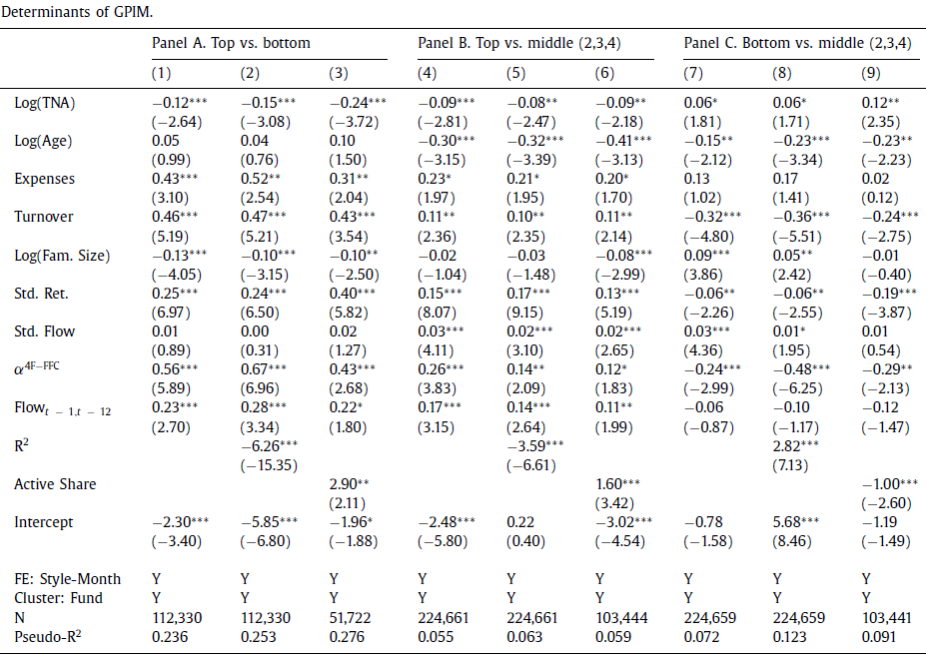
Investment skill

Slide 23
Investment skill
Prior research argues that managerial skill can also be measured by examining whether managers are able to select better performing stocks and attract new capital/investors (i.e., flows).
In this section, we consider several additional measures including
Characteristic Selectivity from Daniel et al. (1997)
The growth of assets under management
Future fund flows
The value added measure from Berk and van Binsbergen (2016) .

Slide 24
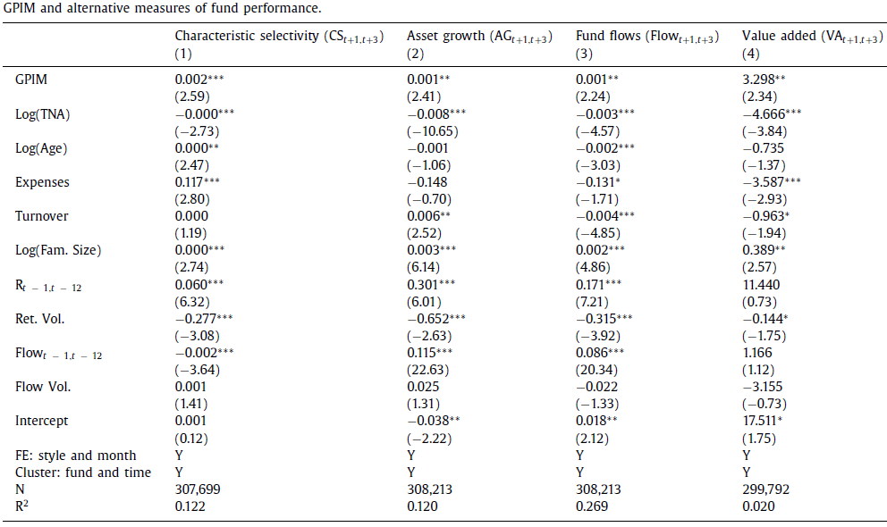
Investment skill

Slide 25
Further analysis: Why does it require skill to exploit the gross profitability anomaly?
Our results suggest that a subset of skilled fund managers profitably trade on the gross profitability anomaly. This raises a natural question: Why are high gross profitability stocks hard to exploit?
We argue that limits to engaging in arbitrage may be the answer.
The limit-to-arbitrage literature contends that risk-averse traders avoid or are otherwise impeded from trading on stocks with high limits to arbitrage, mispricing opportunities are often not fully exploited (Pontiff, 1996, 2006; Shleifer and Vishny, 1997).
Previous studies show that the investment ability of fund managers is more evident in stocks with high idiosyncratic volatility (or arbitrage risk) ( Duan et al., 2009; Puckett and Yan, 2011; Jiang and Verardo, 2018 ).

Slide 26
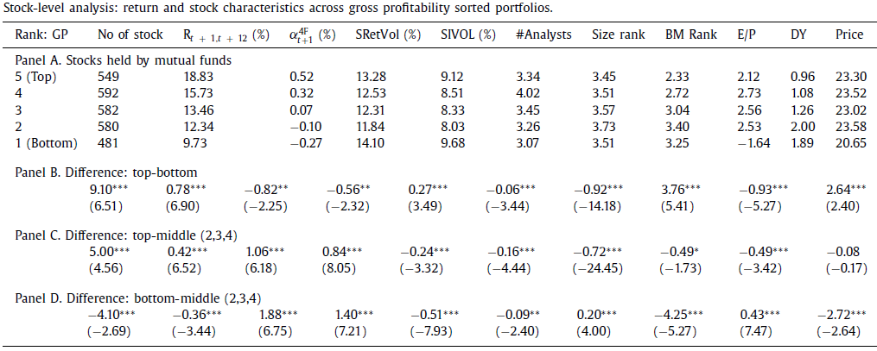
Arbitrage limitation
Two proxies for arbitrage risk: stock return volatility and idiosyncratic return volatility.

Slide 27
Robustness checks
In this section we perform additional analyses to ensure the robustness of our main findings.
First, we examine whether past fund flows drive the positive relation between GPIM and fund performance.
Previous studies show that mutual funds tend to expand their existing holdings in response to investor inflows (Edelen, 1999; Wermers, 2003; Coval and Stafford, 20 07; Frazzini and Lamont, 20 08; Khan et al., 2012; Lou, 2012).
Second, we control for alternative measures of firm profitability (trend in GPIM and operating profitability).
Ball et al. (2015) show that operating profitability has a similar return predictability to gross profitability
Third, we control for active portfolio management measures.
Active fund managers who deviate from benchmark indexes are more likely to implement the gross profitability strategy.

Slide 28
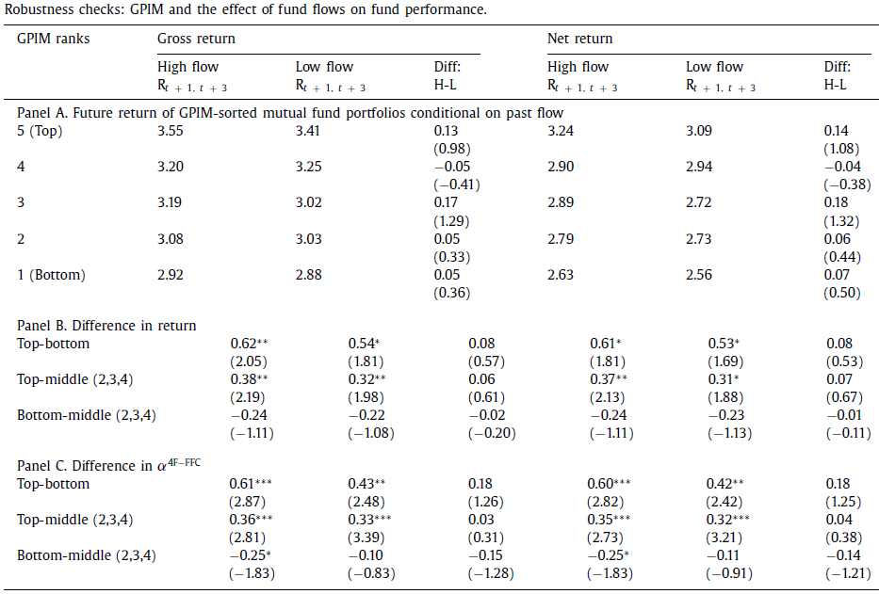
Robustness checks
Robustness checks A

Slide 29
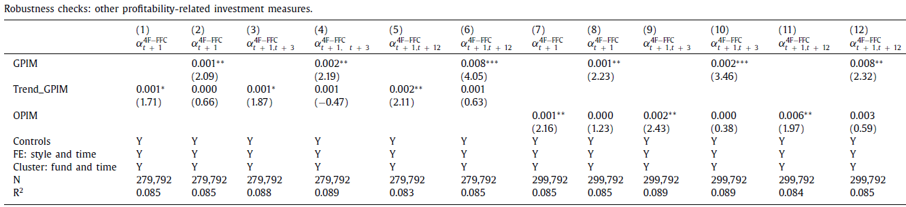
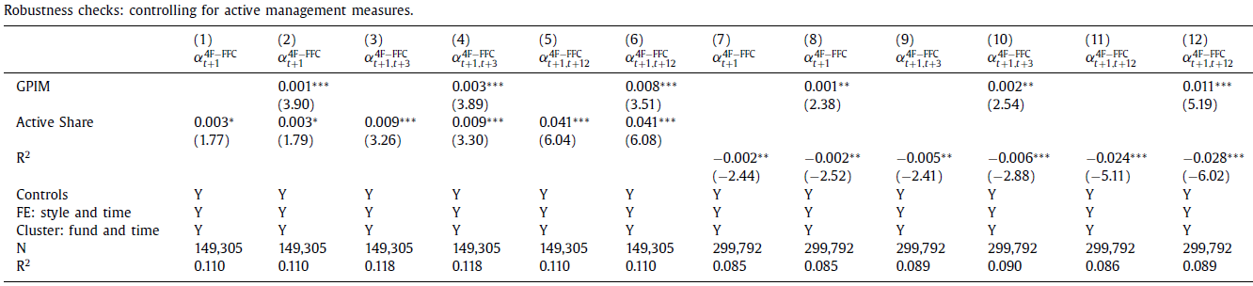
Robustness checks
Robustness checks B
Robustness checks C

Slide 30
Conclusion
In this paper, we examine whether mutual fund managers trade on and profit from the gross profitability anomaly.
We explore potential explanations and fail to find evidence that it is driven by a profitability-related risk premium or that it is a byproduct of investment style or investment strategies.
Instead, we show skilled fund managers are more likely to trade profitably on the gross profitability anomaly.
In addition, managers of high-GPIM funds exhibit better stock-picking ability and create value by attracting future fund inflows and growing fund assets under management.
Finally, the gross profitability anomaly is concentrated in stocks with high arbitrage risk and lower analyst coverage, suggesting it may require skill to take advantage of this anomaly.

