Slide 1
A trend factor: Any economic gains from using information over investment horizons?
Yufeng Han, Guofu Zhou, Yingzi Zhu
Journal of Financial Economics 122 (2016) 352–375
岳阳 2020.06.06

Slide 2
Contents
1.Introduction
1.1Background
1.2Literatures
1.3Motivation
1.4Contribution
2.Data
3.Method
4.Results
5.Conclusion

Slide 3
1. Background
Schwert (2003) , in his comprehensive study of anomalies, finds that the momentum anomaly is one of the most robust and persistent anomalies. It also survives the high hurdle proposed by Harvey, Liu, and Zhu (2016) to detect false discoveries.
There are three major stock price patterns that are difficult to explain by typical factor models.
The three patterns are investment horizon dependent: the short-term reversals (at daily, weekly, and monthly levels) documented by Lehmann (1990) , Lo and MacKinlay (1990b), and Jegadeesh (1990) , the momentum effects (6–12 month price continuation) documented by Jegadeesh and Titman (1993) , and the long-term reversal effects (3–5 year reversals) documented by DeBondt and Thaler (1985) .

Slide 4
1. Literatures
Schwert (2003) finds unlike most anomalies, the momentum is alive and well after its publication.
Cespa and Vives (2012) show that the presence of liquidity traders and asset payoff uncertainty will generate rational price trends in the market.
Barberis, Shleifer, and Vishny (1998) argue that prices can trend slowly when investors underweight new information in making decisions.
Notes:
Brunnermeier（2001）回顾了许多证明理性均衡中趋势有预测能力的模型。
Cespa和Vives（2012）表明，流动性交易者的存在和资产收益的不确定性将在市场上产生合理的价格趋势。
Barberis、Shleifer和Vishny（1998）认为，当投资者在决策时低估了新的信息时，价格会缓慢的吸收信息，这也为我们找寻更多种趋势水平提供了佐证。

Slide 5
1. Literatures
Treynor and Ferguson(1985) , Brown and Jennings (1989) , Cespa and Vives (2012) , Hong and Stein (1999) , and Edmans, Goldstein, and Jiang (2012) show that past stock prices can predict future prices which implies that the MAs have predictive power.
Any theory that explains momentum can be potentially useful for explaining the trend factor as well since the momentum is a particular trend.

Slide 6
1.Motivation
Are there any economic gains by combining all the price information across the three investment horizons?

Slide 7
1.Contribution
The paper is the first that unifies in a single framework the three major price patterns: the short-term reversal effects, the momentum effects, and the long-term reversal effects.

Slide 8
2.Data
1930.06~2014.12
NYSE, Amex, and NASDAQ stocks
portfolios are equal-weighted and rebalanced every month

Slide 9



3.Method
The MA on the last trading day of month t of lag L:
is the closing price for stock j on the last trading day d of month t
normalize the moving average prices by the closing price on the last trading day of the month:
L: 3,5,10,20,50,100,200,400,600,800,1000

Slide 10



3.Method
① Run in each month t a cross-section regression of stock returns on observed normalized MA signals to obtain the time-series of the coefficients on the signals
n is the number of stocks
② Estimate the expected return for month t+1

Slide 11
Why do the moving averages (MAs) of past prices have predictive power on stock returns?
Differences in the timing of receiving information or differences in the response to information by heterogeneous investors or be-havior biases or feedback trading;
Due to liquidity and uncertainty, the market is likely to trend in taking its time to react fully to big information;
Related studies show that MAs have forecasting power on the stock market matching or exceeding that of macroeconomic variables.

Slide 12
3.Method
Construct the trend factor:
sort all stocks into five portfolios by their expected returns. The portfolios are equal-weighted and rebalanced every month
High minus low

Slide 13
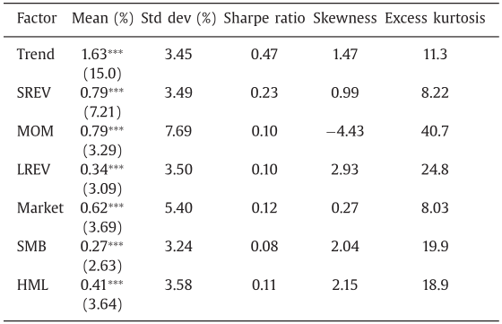
4.Results
short-term reversal factor (SREV)
long-term reversal factor (LREV)
The average monthly return of the trend factor is more than doubling the average return of any of the other factors
The trend factor has a large positive skewness (1.47) and large kurtosis (11.3), indicating a fat right tail, and great chances for large positive returns.

Slide 14
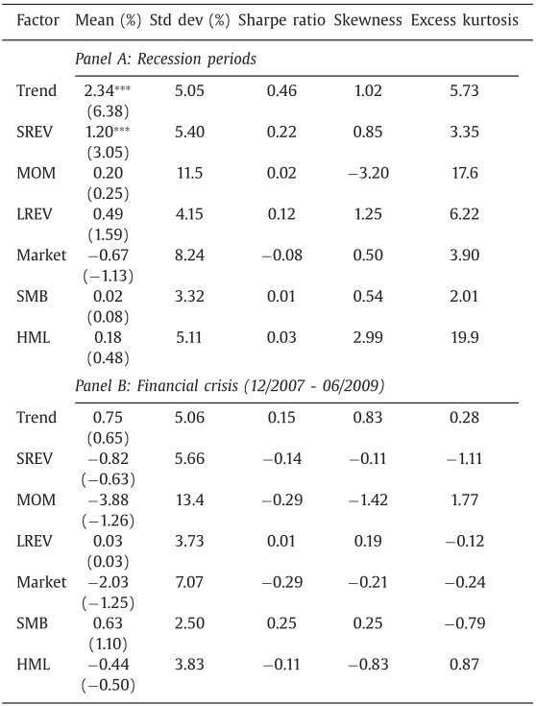
The trend factor and other factors: Recession periods.
The average return and volatility of the trend factor are both higher in recession periods than in the whole sample period.
The momentum factor and Fama-French factors experience much lower returns and much higher volatilities, and hence much lower Sharpe ratios.

Slide 15
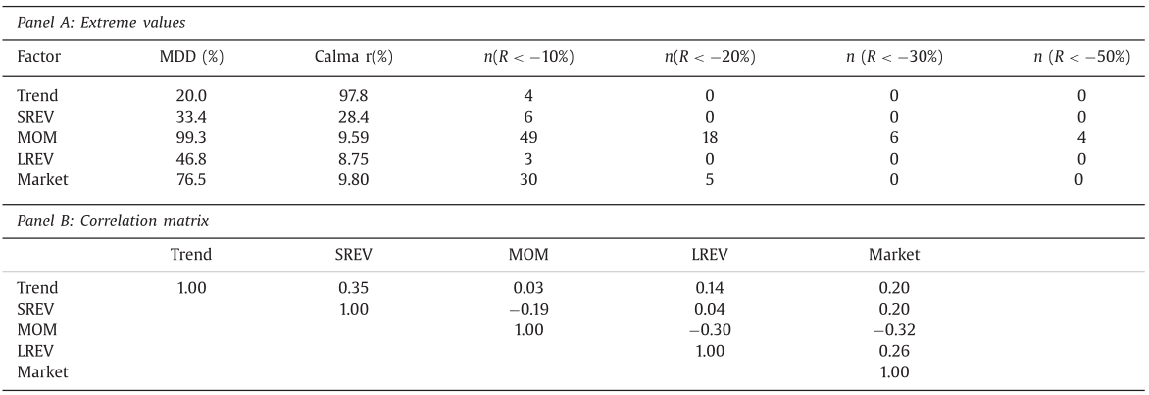
Calma r: the annualized rate of return divided by the MDD, which measures return versus downside risk.
The trend factor: the smallest MDD & the highest Calma r, and experienced fewer huge losses.
the trend factor have virtually zero correlation with the momentum factor

Slide 16
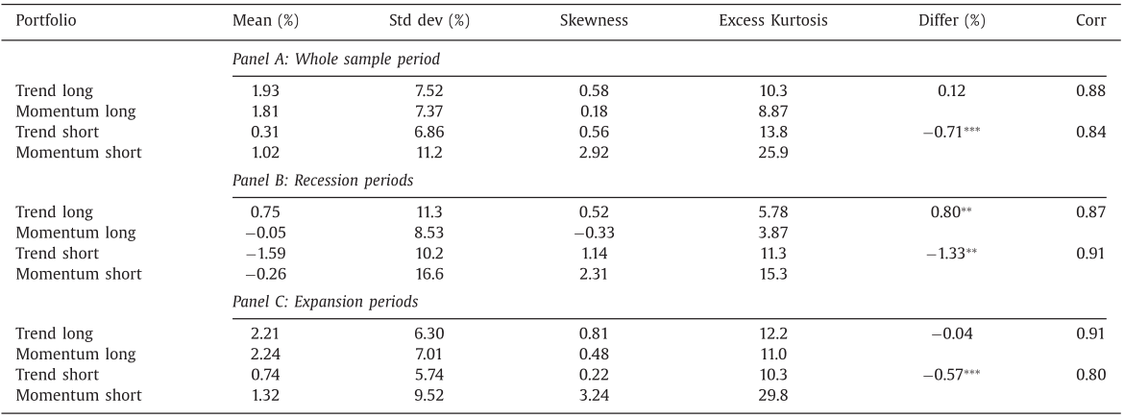
Why does the trend factor have virtually zero correlation with the momentum factor?
Returns are positively correlated:
one can set a pair of random variables A and C to be highly correlated and another pair B and D to be highly correlated, so that A–B and C–D are not correlated.

Slide 17
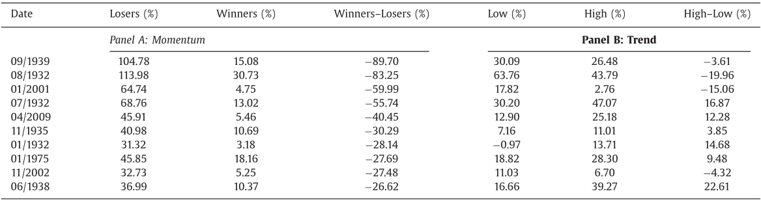
Some researches show that the momentum strategy suffers a great loss during some special periods.
Mom experienced a greater loss. In most of the losing months for the momentum strategy, the trend factor earns large and positive returns.
The trend factor outperforms the momentum factor not only in terms of average returns, but also in terms of downside risks.

Slide 18
Mean-variance spanning tests:
Whether a portfolio of the three factors can mimic the performance of the trend factor?
Can the trend factor outperform an equal- weighted portfolio of the three factors?
The spanning hy- pothesis is equivalent to the following parametric restrictions on the model:

Slide 19
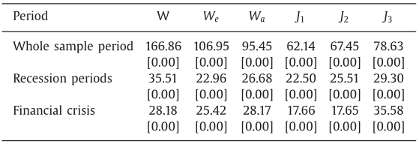
Wald test under conditional homoskedasticity, Wald test under independent and identically distributed (IID) elliptical distribution, Wald test under conditional heteroskedasticity, Bekerart-Urias spanning test with errors-in-variables (EIV) adjustment, Bekerart-Urias spanning test without the EIV adjustment and DeSantis spanning test.
The hypothesis is strongly rejected that the trend factor is inside the mean-variance frontier of the short-term reversal, momentum, and long-term reversal factors for all three periods.
Notes:
条件同质性下的Wald检验，独立同分布（IID）椭圆分布下的Wald检验，条件异质性下的Wald检验，变量误差（EIV）调整下的Bekerart-Urias跨越检验，无EIV调整和DeSantis跨距试验的Bekerart-Uras跨距试验。

Slide 20
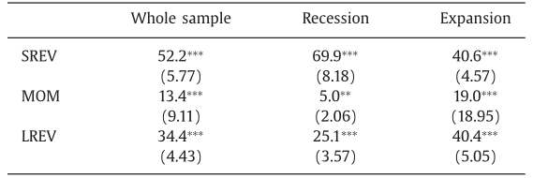
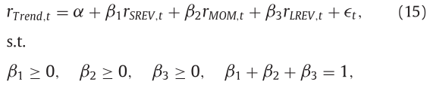
How the performance of the trend factor is related to the three factors
For the whole sample period, the short-term reversal factor accounts for about 52.2% of the movements of the trend factor, the momentum 13.4%, and long-term reversal 34.4%. Hence, the short-term information plays the greatest role in the performance of the trend factor.

Slide 21
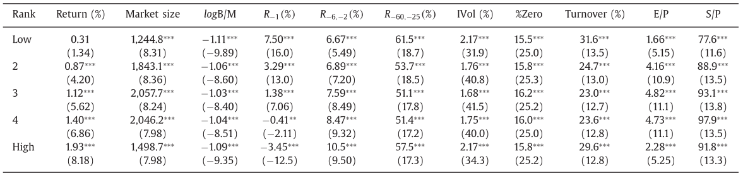
The average returns increase monotonically from the quintile with the lowest forecasted expected returns (Low) to the quintile with the highest forecasted expected returns (High).

Slide 22
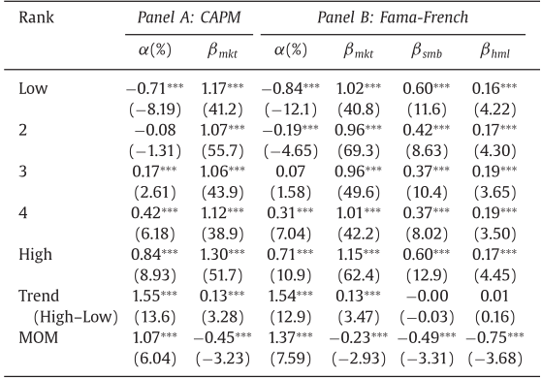
Can common risk factors explain the return on the trend factor?
The quintile alphas increase monotonically from the lowest quintile to the highest quintile.
The trend factor has a small loading on the market and insignificant SMB and HML betas in the Fama-French three factor model.
The trend factor appears more reliable statistically than the momentum factor.
Existing factor models cannot explain the return on the trend factor.

Slide 23
5.Conclusions
The trend factor has superior performance: more than quadruple those of the size and book-to-market factors, and more than twice that of the short-term reversal, momentum, and long-term reversal factors.
The trend factor’s performance is robust to various firm and market characteristics, such as size, book-to-market ratio, past returns, trading turnover rate, and business cycles.

