Slide 1
Anomalies across the globe: Once public, no longer existent?
H. Jacobs and S. Müller, Journal of Financial Economics, 2020.

Slide 2
Outline
Introduction
Research design
Empirical result
Robust Test
Some views

Slide 3
Introduction: Background
Based on World Bank data, non-US countries account on average for about 58% of the world market capitalization and for almost 73% of global gross domestic product
Existing asset pricing tests tend to focus on the US stock market, part of which to conclude that “there is a large and persistent US (home) bias in academic research in Finance.
Long-short returns in U.S. stock market shrink significantly post-publication.

Slide 4
Introduction: Motivation
International stock markets are economically important.
McLean and Pontiff (2016) study 97 return predictors in the US stock market and find that long-short returns shrink significantly post-publication.

Slide 5
Introduction: Research Questions
Does long-short returns in international stock market shrink post-publication?
If international market does not shrink, why?
Where does these anomaly returns come from?

Slide 6
Introduction: Related Researches
McLean and Pontiff (2016) study 97 return predictors in the US stock market and find that long-short returns shrink significantly post-publication
Karolyi(2016) concluded that “there is a large and persistent US (home) bias in academic research in Finance.”

Slide 7
Introduction: Related Researches
Chordia et al. (2017) , Harvey (2017) , Hou et al. (2019) , highlight the danger of widespread p-hacking in US return predictability.
Other studies including Bartram and Grinblatt (2018a) , Engelberg et al. (2018) argue that anomalies are, at least to a large extent, real.
Israel and Moskowitz (2013) find little evidence that size, value, and momentum returns are significantly affected by changes in trading costs or institutional and hedge fund ownership over time.

Slide 8
Introduction: Research Contents
Study US and international stock market anomalies’ long-short returns and find only US market shrinks.
Using size as proxy of arbitrage cost, and find portfolio returns formed by large stocks shrink less. And this is a evidence which proves returns of anomalies are from arbitrage cost.

Slide 9
Research Design:
US stock market
International stock market
Long-short return.
Dummy Regression
Check the publication effect

Slide 10
Research Design: Data
1980.01-2015.12 , 80 anomalies from McLean and Pontiff (2016) .
Daily data for US from CRSP, accounting data from Compustat.
International data from Worldscope.
Analyst earnings forecasts and recommendations for all markets from Institutional Brokers’ Estimate System (I/B/E/S).

Slide 11
Research Design: Data
In-sample returns are defined as the returns during max(first month of the original anomaly sample period, January 1980) and the end of the original sample period.
Post-sample returns are defined as the returns following the last month of the original sample period and preceding the month of the publication in a peer-reviewed journal.
Post-publication returns start in the publication month.

Slide 12

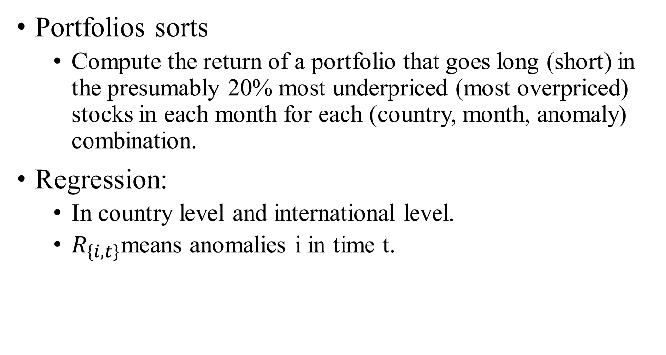
Research Design: Portfolio Sort and Regression method
Portfolios sorts
Compute the return of a portfolio that goes long (short) in the presumably 20% most underpriced (most overpriced) stocks in each month for each (country, month, anomaly) combination.
Regression:
In country level and international level.
$R_{\left\{i, t\right\}}$means anomalies i in time t.

Slide 13
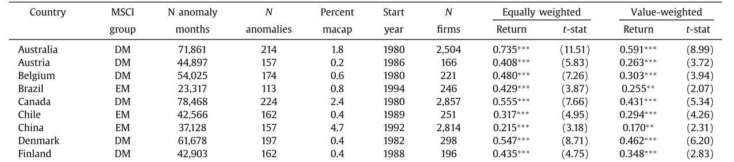
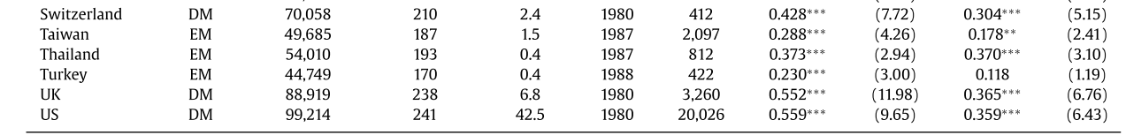
Empirical Result: Different Countries-Portfolio Returns
Anomalies in all countries are significant.
Equally weighted portfolios are larger than for value-weighted portfolios, which means both mis- pricing and limits to arbitrage tend to be stronger for smaller stocks.

Slide 14
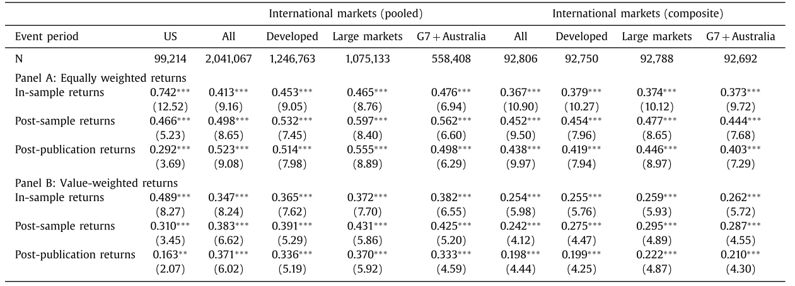
Empirical Result: Aggregate market-Portfolio Returns
US publication effects are pronounced.
In international markets, no clear difference emerges between in-sample, post-sample, and post- publication periods.

Slide 15
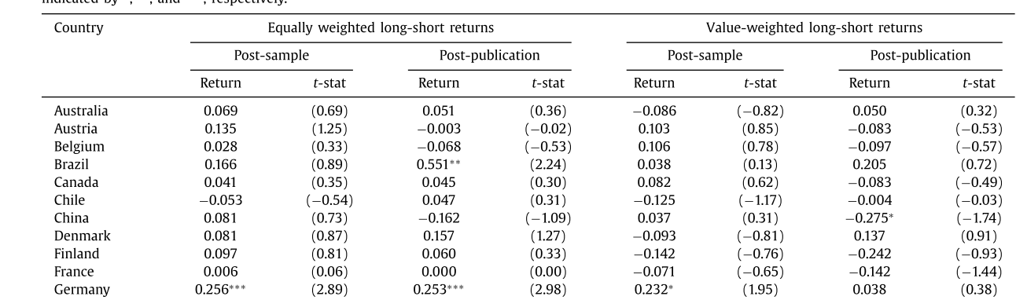
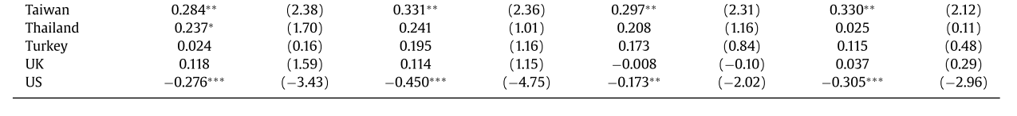
Empirical Result: Different Countries-Dummy Regression
Only US market has a 1% level significant negative coefficient.

Slide 16
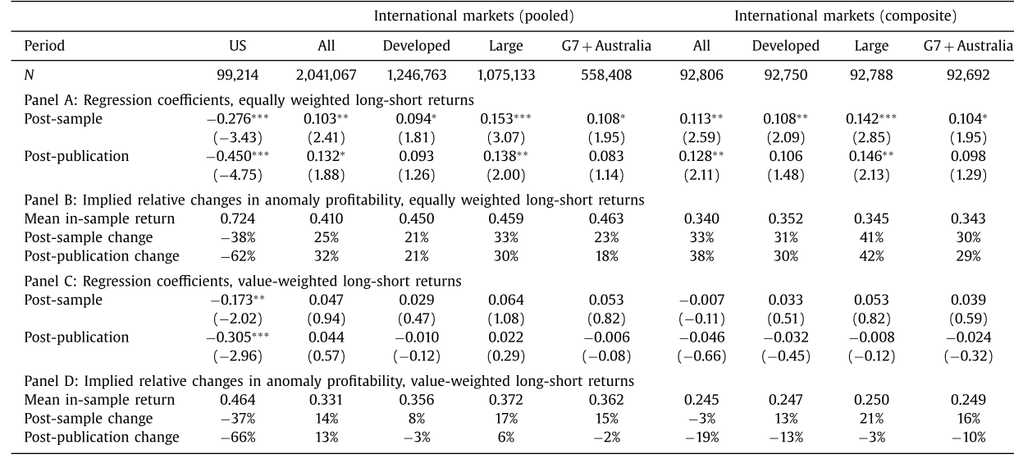
Empirical Result: Aggregate Market-Dummy Regression
Results are the same as results of portfolio returns.

Slide 17
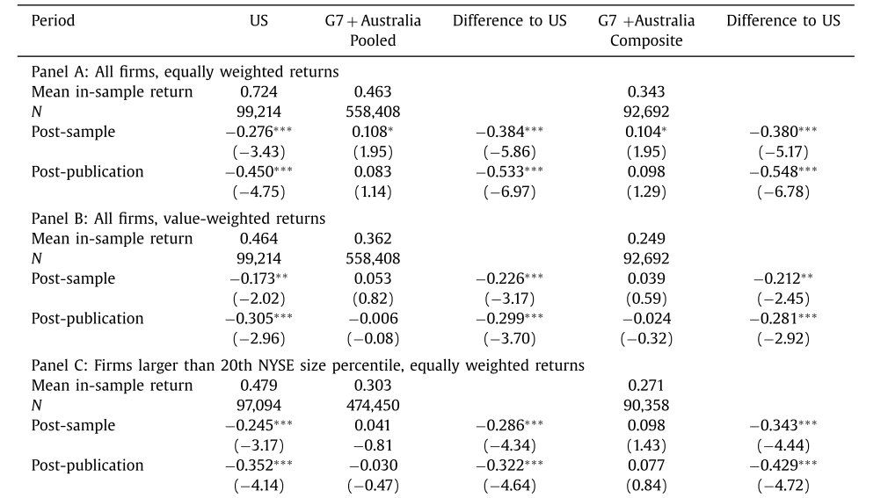
Empirical Result: Arbitrage Costs: Size
Size as the proxy of arbitrage cost: bigger size, less arbitrage costs.
The publication effect can be explained by arbitrage costs.

Slide 18
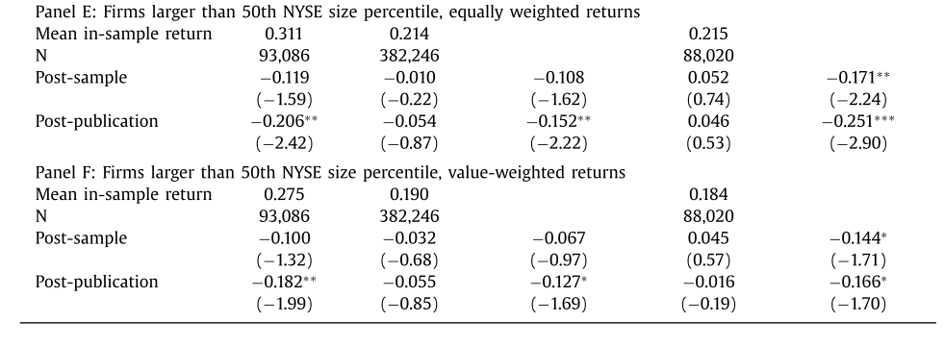
Empirical Result: Arbitrage Costs: Size
Size as the proxy of arbitrage cost: bigger size, less arbitrage costs.
The publication effect can be explained by arbitrage costs.

Slide 19
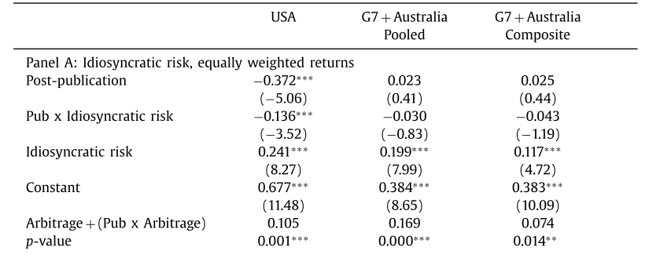
Empirical Result: Arbitrage Costs: 5 Control Variables Regression
Idiosyncratic risk, lagged firm size, illiquidity(Amihud , 2002) , dollar trading volume, bid-ask (Corwin and Schultz, 2012) .
Expect a positive (negative) coefficient for idiosyncratic risk, illiquidity, bid-ask spreads, and the composite index (firm size, dollar volume).

Slide 20
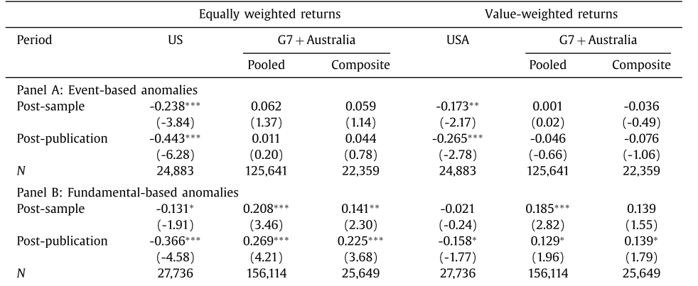
Robust Test: Data Base Problem
Test the publication effect of different type of anomalies
Results is the same(Only US market has publication effect)

Slide 21
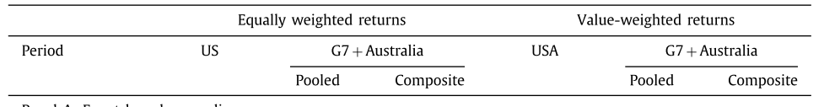
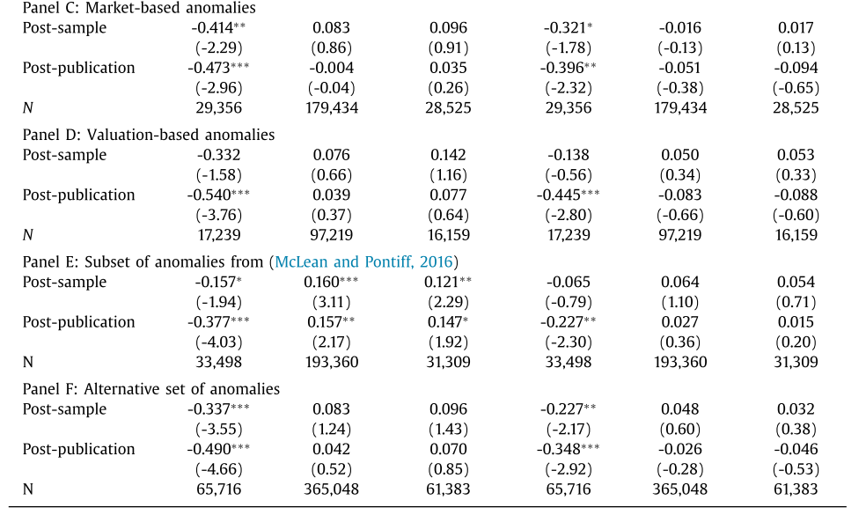
Robust Test: Data Base Problem
Test the publication effect of different type of anomalies
Results is the same(Only US market has publication effect)

Slide 22
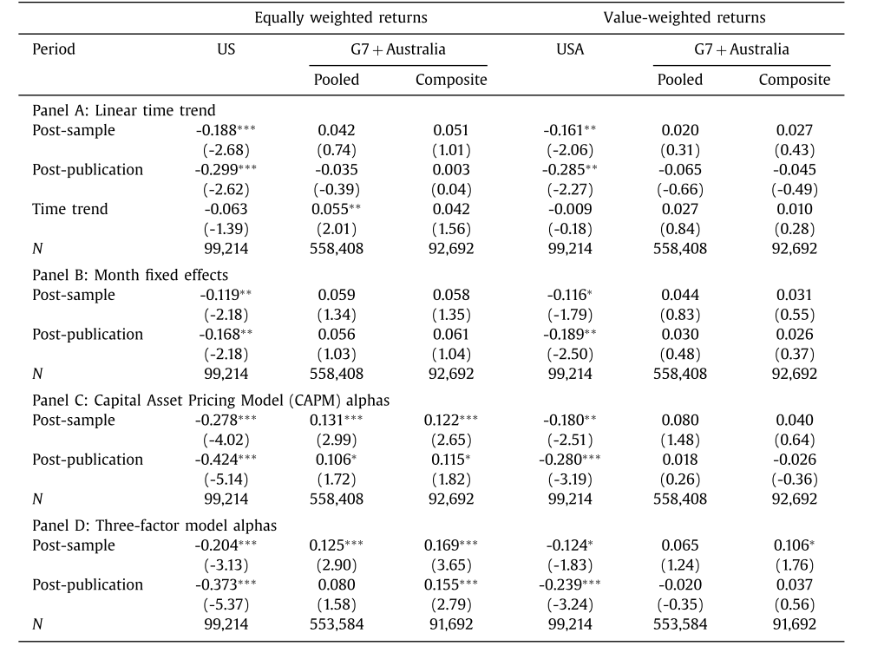
Robust Test: Time effect and after Adjusted returns.
Test the impact of time effects and asset pricing models
Results are the same.

