Slide 1
Do Mutual Funds Profit from the Accruals Anomaly?
A S H I Q A L I , X U A N J U A N C H E N , TONG YAO , AND TONG YU
March, 2008 JAR
讲解人：梅子萌

Slide 2
Outline
Introduction
Methodology
Data
Empirical Result

Slide 3
Introduction: Background
To date, academic literature has identified several market anomalies; however, whether sophisticated investors profit from these anomalies has not yet been adequately addressed.
There’s no adequate studies exploring the accrual anomaly with data of mutual funds.
Prior studies do not provide conclusive evidence on whether investors can profitably trade on the accruals anomaly.
Several studies explore this issue using hypothetical trading costs instead of actual trading costs.

Slide 4
Introduction: Related Researches
the raise of accruals anomaly ：
Sloan [1996], Xie [2001], Collins, Gong, and Hribar [2003], Thomas and Zhang [2002], Chan et al. [2006]
Researches that consider trading cost:
Bushee and Raedy’s [2006]
Researches on profitability of accruals anomaly:
Mashruwala, Rajgopal, and Shevlin [2006], Lev and Nissim [2006], Kraft, Leone, and Wasley [2006], Khan [2007]

Slide 5
Introduction: Related Researches
Whether sophisticated investors profit from accruals anomaly is debated by several researches. Some suggest that even though institutional investors may be aware of the accruals anomaly, they would not be able to implement a profitable trading strategy because of transaction costs, trading constraints, high idiosyncratic return volatility, and other unattractive firm characteristics of extreme-accruals stocks, and the possibility of no abnormal returns after proper risk adjustments.

Slide 6
Introduction: Motivation
To further research on the profitability of accruals anomaly for sophisticated investors
Using actual cost of trading instead of estimated cost in research

Slide 7
Introduction: Contribution
Combining data of mutual funds and information of stocks market, providing evidence that trading on the accruals anomaly can be profitable even after transaction costs
Using actual cost of mutual funds instead of estimating trading cost
Shed light on why the accruals anomaly has remained profitable

Slide 8
Accruals
△CA is the change in current assets from the previous fiscal year
△ Cash is the change in cash/cash equivalents
△CL is the change in current liabilities
△STD is the change in debt included in current liabilities
△TP is the change in income taxes payable
DEP is depreciation and amortization expense
ATA is the average of the beginning and ending total assets of the reporting year.

Slide 9

AIM Calculation
We construct an accruals investing measure (AIM) to quantify how actively a fund follows the accruals anomaly.
AccRank j,t is the ranking of stock j in all sample of stocks based on accruals in year t, rank from 1 to 10

Slide 10
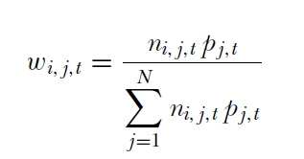
AIM Calculation
Wi,j,t is the value of stock j owned by fund i as a percentage of total value of stocks the fund holds at the end of June of year t:
ni,j,t is the number of shares of stock j held by the fund at the end of June of year t and pj,t is the market price of stock j at the end of June of year t

Slide 11
Data
Data base : CRSP(Survivorship Bias Free Mutual Fund Database), Thomson Financial CDA/Spectrum Database
Data sample: consists of actively managed U.S. domestic equity funds with aggressive growth, growth, and growth and income investment objectives (classified by CDA database), from 1984 to 2003, 99,871 firm-year observations

Slide 12
Data
Specific processing:
Remove funds with apparently misreported investment objectives
Exclude fund-quarter observations if the total market value of reported holdings is less than 50% or more than 150% of the reported total net assets of the fund, or the total net assets is less than one million dollars

Slide 13
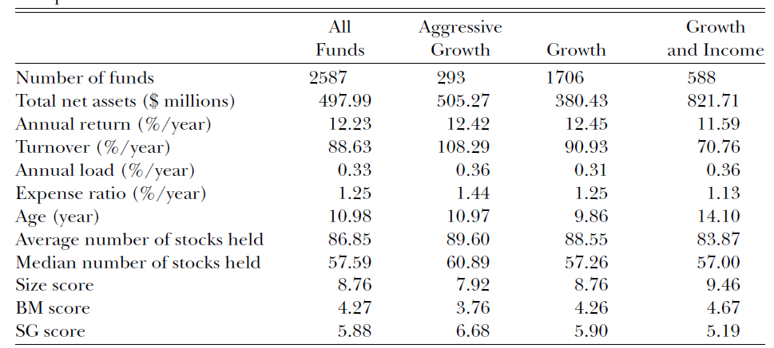
Data

Slide 14
Empirical Result
Does accruals anomaly exist?
Do mutual funds trade on the accruals anomaly?
What are the characteristics of stocks held by low AIM funds?
Do low AIM funds profit from the accruals anomaly?
What are the characteristics of low AIM funds?

Slide 15
Empirical Result: the accruals anomoly
First conduct portfolios on accruals with all stocks available, than with stocks chosen by fund
For each year t, sort the sample stocks into 10 equal-weighted portfolios based on their accruals for the fiscal year that ends in the calendar year t−1 then compute buy-and-hold portfolio returns from July of year t to June of year
For delisted stocks, use CRSP delisting returns if they are available; otherwise, follow Shumway[1997] and use −30% to replace missing delisting returns if the delisting is performance related, and zero otherwise.

Slide 16
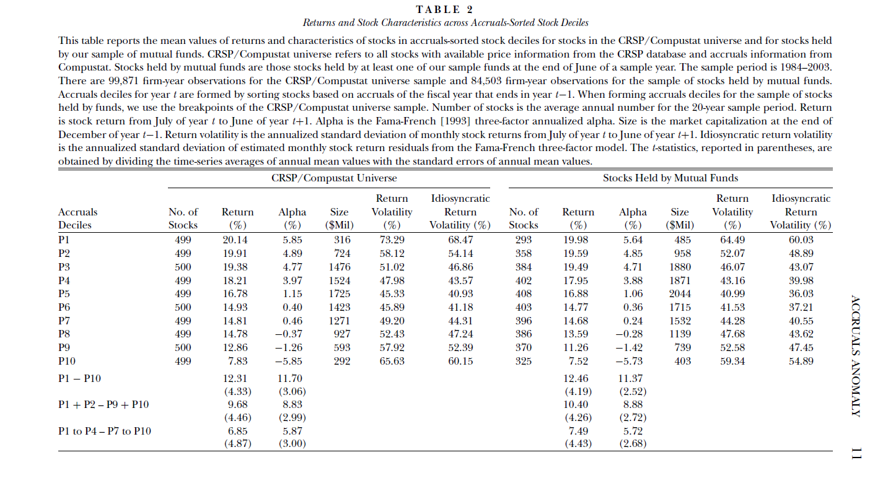
Empirical Result: the accruals anomoly

Slide 17
Empirical Result:Do mutual funds trade on the accruals anomaly?
The average AIM for our sample funds is 5.55, so the hypothesis that mutual funds as a whole do not tilt their portfolios toward low-accruals stocks can’t be rejected, but a subset of funds may possible to trade on accruals anomaly
To facilitate comparison, we also identify 10% of the funds whose stockholdings are neutral to accruals, this benchmark group is referred as INACTIVE funds

Slide 18
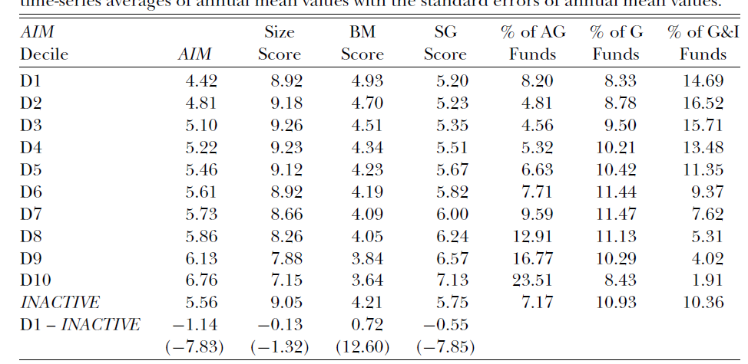
Empirical Result:Do mutual funds trade on the accruals anomaly?

Slide 19
Empirical Result:Do mutual funds trade on the accruals anomaly?
A fund may fall into the D1 decile by chance and not due to the intentional pursuit of the low-accruals stocks, so examine of the persistence of AIM across fund deciles is essential
Passive AIM of year t+1 is calculated with the stock holdings in June of year t and the accruals ranking of year t+1

Slide 20
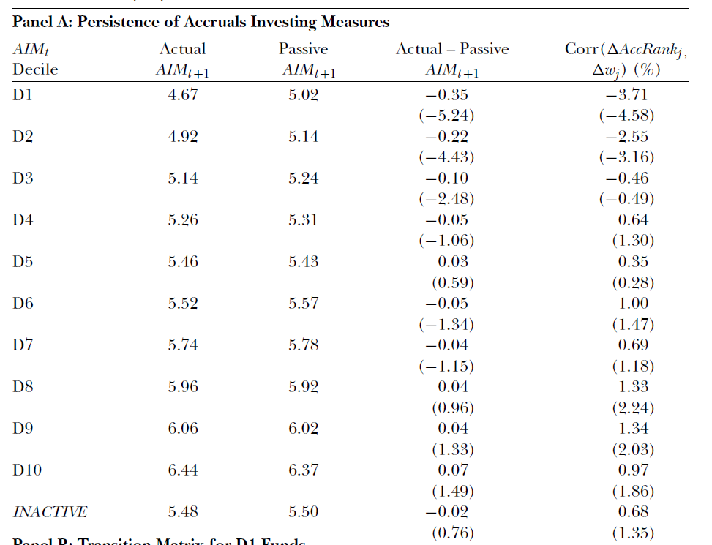
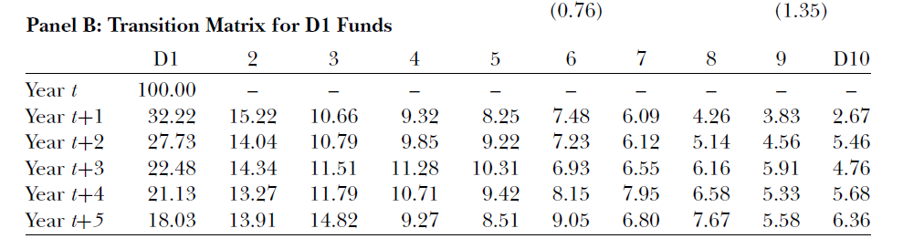

Slide 21
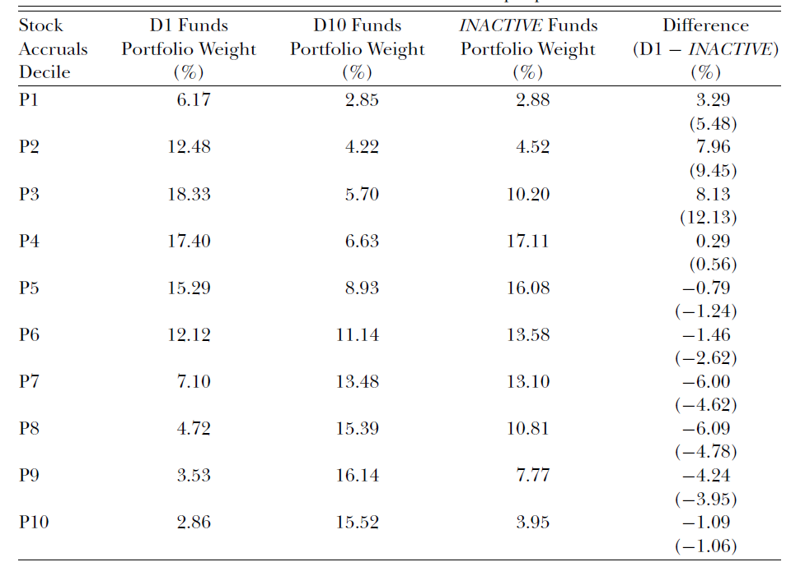
Empirical Result: Characteristics of stocks held by D1 funds

Slide 22
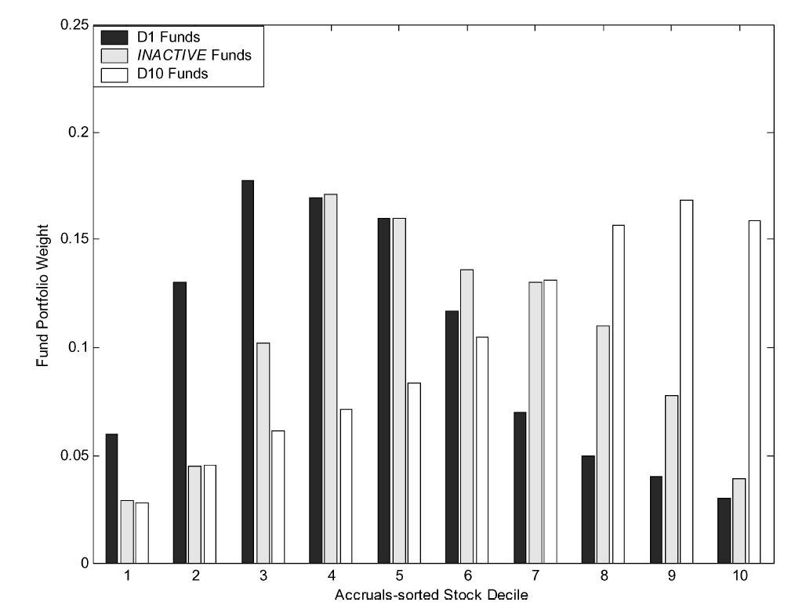

Slide 23
Empirical Result: Characteristics of stocks held by D1 funds
P1 stocks that D1 funds buy have a significantly larger market capitalization, significantly higher book-to-market ratio, and significantly higher Fama-French three-factor alpha.
P10 stocks owned by D1 funds have significantly lower accruals for the prior year, suggesting that some of the P10 stocks that D1 funds own are previously low accruals stocks that the funds hold in the prior period but do not get rid of in time, possibly due to trading frictions

Slide 24
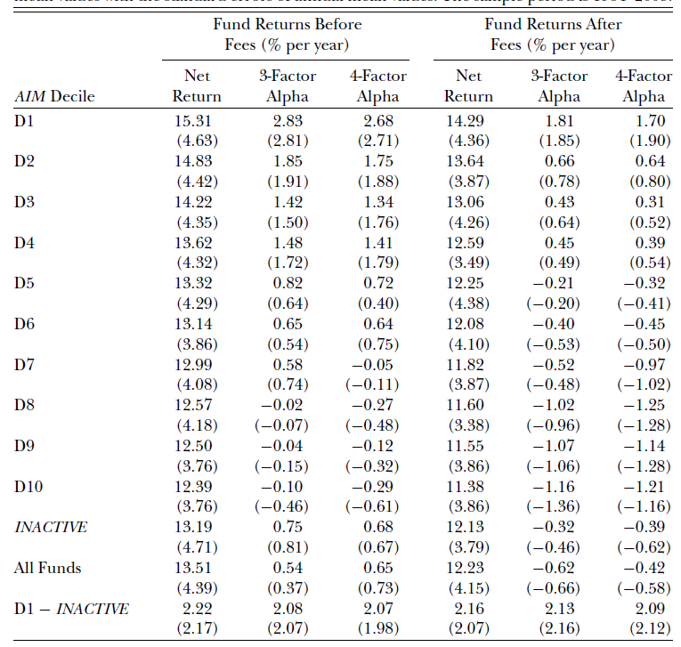
Empirical Result: Do D1 funds profit from the accruals anomaly?

Slide 25
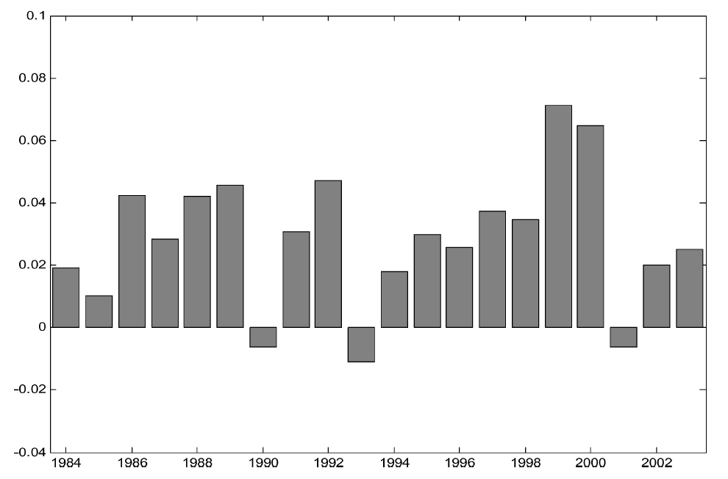
Empirical Result: Do D1 funds profit from the accruals anomaly?

Slide 26
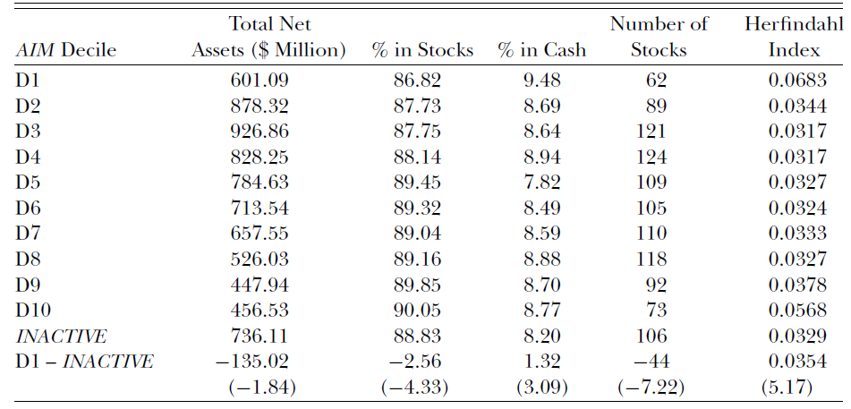
Empirical Result: Characteristics of D1 funds
The Herfindahl index is calculated as the sum of the squared portfolio weights of stocks held by a fund

Slide 27
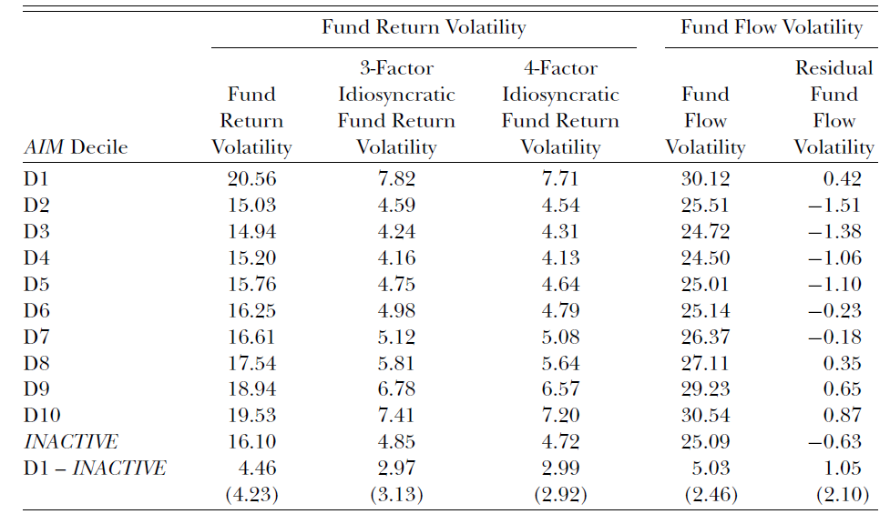

Slide 28
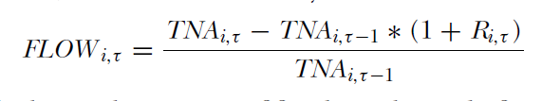
Empirical Result: Characteristics of D1 funds
The idiosyncratic return volatility of stocks held by D1 funds is not significantly different from that of stocks held by INACTIVE funds, so a likely reason for D1 funds having higher volatility is that D1 funds hold less diversified portfolios
TNAi,τ is the total net assets of fund i at the end of month τ
Ri,τ is the fund monthly return

Slide 29
Empirical Result: Characteristics of D1 funds
Residual fund flow volatility is the estimated residual from the annual cross-sectional regression of fund flow volatility on the net return of the fund for the previous year, the logarithm of fund size, expense ratio, load dummy, and fund age.
The load dummy takes the value of one if the fund is a load fund, and zero otherwise.

