Slide 1
Sparse Signals in the Cross-Section of Returns
Alex Chinco, Adam D. Clark-Joseph, and Mao Ye
The Journal of Finance, 2019.
解读者：屠雪永
2020.9.19

Slide 2
Outline
Introduction
Research design
The LASSO
Empirical result
Out-of-Sample Performance
Predictor Analysis
Economic Origins
Conclusion

Slide 3
1.Introduction
1.1. Motivation
In the past, researchers typically use their intuition to identify predictors and statistics to estimate quality.
Modern financial markets are big, fast, and complex. Predictability now exists at scales that are not easy for a researcher to intuit.
We apply the Least Absolute Shrinkage and Selection Operator (LASSO) rather than intuition to identify unexpected short-lived predictors.

Slide 4
1.Introduction
1.2. Questions
How the LASSO works and why we use it?
Regularization and Sparsity.
Will LASSO increase the out-of-sample fit?
Using the LASSO and a benchmark model increases out-of-sample fit.
What is the economic magnitude of this gain?
An annualized Sharpe ratio of 1.791.
What do the predictors selected by the LASSO look like?
Unexpected, short-lived, and sparse.
Does the LASSO’s success have its economic origins?
Predictors stocks with news about fundamentals.

Slide 5
1.Introduction
1.3. Contributions
Firstly, the LASSO increases both out-of-sample fit and forecast-implied Sharpe ratios.
Secondly, LASSO uses a statistical rule rather than economic intuition to identify predictors, which are associated with news about fundamentals.

Slide 6


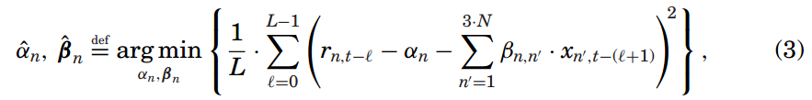

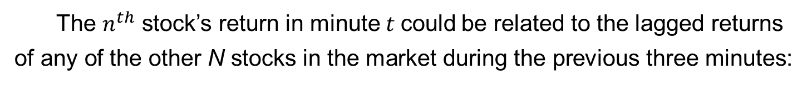
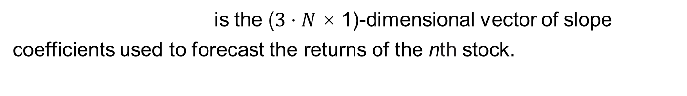
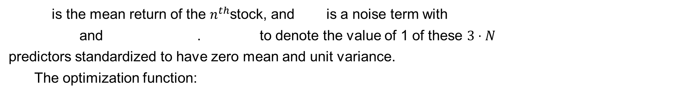
2. Research design--The LASSO
The $n^{th}$ stock’s return in minute$t$could be related to the lagged returns of any of the other N stocks in the market during the previous three minutes:
is the mean return of the $n^{th}$stock, and is a noise term with
and . to denote the value of 1 of these $3⋅N$ predictors standardized to have zero mean and unit variance.
The optimization function:
is the ($3⋅N$ × 1)-dimensional vector of slope coefficients used to forecast the returns of the nth stock.

Slide 7
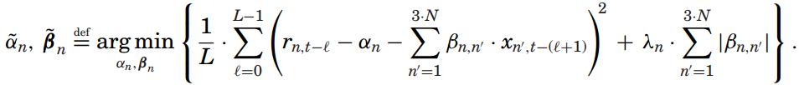
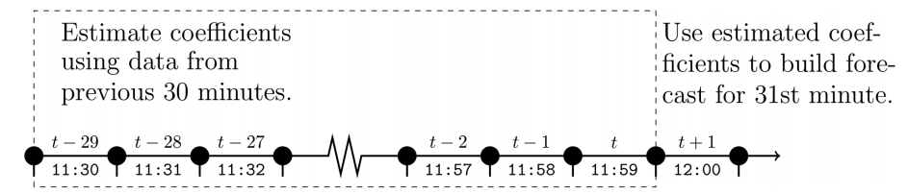
2. Research design--The LASSO
The LASSO:
（7）
LASSO Forecasts :
Figure 1. Estimation and forecast timing

Slide 8
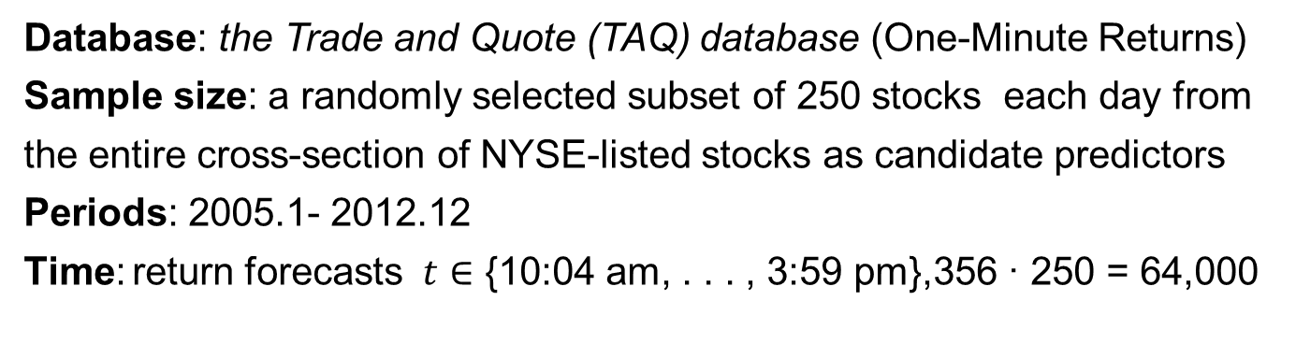
3.1. Empirical result--Out-of-Sample Performance
Data Description
Database: the Trade and Quote (TAQ) database (One-Minute Returns)
Sample size: a randomly selected subset of 250 stocks each day from the entire cross-section of NYSE-listed stocks as candidate predictors
Periods: 2005.1- 2012.12
Time: return forecasts $t∈$ {10:04 am, . . . , 3:59 pm},356 · 250 = 64,000
Benchmark Predictors: market return--the iShares market ETF.
Size and Value return--the iShares Russell 1000 and 2000 value and growth ETFs(steady long-lived predictors)
Control Variables: Market capitalization, Trading volume, Return volatility, The bid-ask spread
Daily Factors: Kenneth French’s Web site(the abnormal returns)

Slide 9
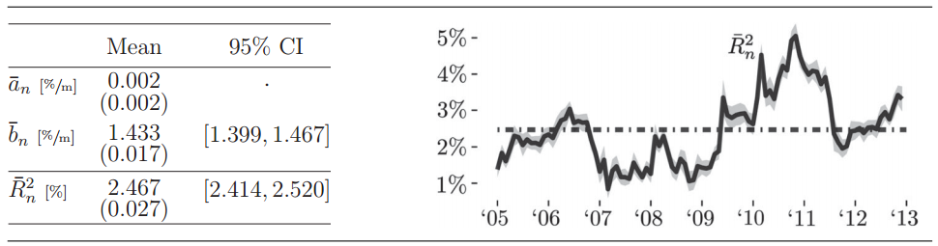
3.1. Empirical result--Out-of-Sample Performance
Out-of-Sample Fit
How much return variation can the LASSO explain?
Table I Out-of-Sample Fit, The LASSO
On average, the LASSO’s one-minute-ahead return forecast explains 2.467% of the variation in a stock’s returns on a given day.
The LASSO explains at least 1% of the variation.

Slide 10

3.1. Empirical result--Out-of-Sample Performance
Increase in Out-of-Sample Fit
To justify using the LASSO:

Slide 11
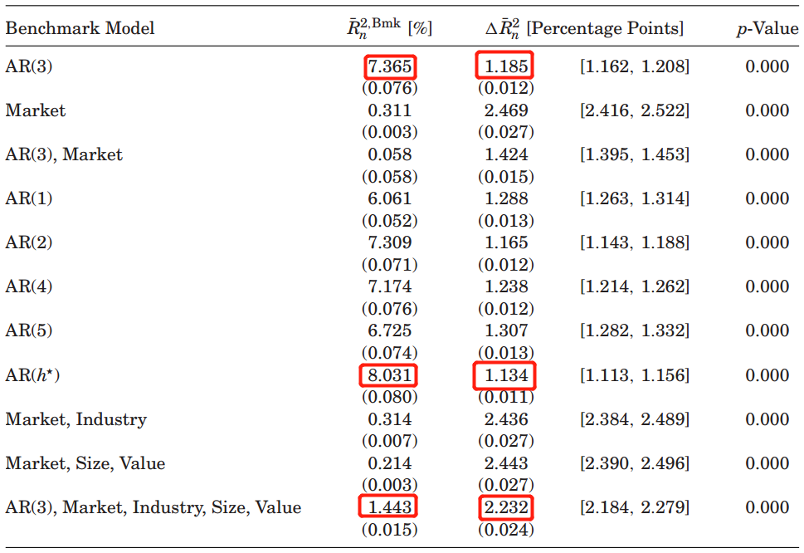

3.1. Empirical result--Out-of-Sample Performance
Increase in Out-of-Sample Fit
An additional percentage points of the variation in returns by using both the LASSO and an AR(3) model.

Slide 12
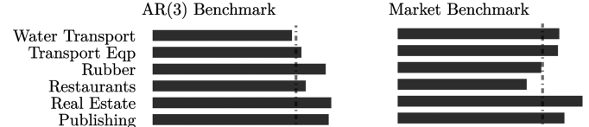
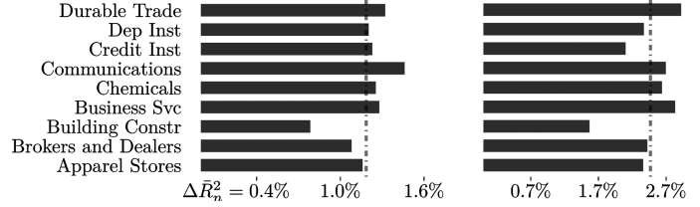
3.1. Empirical result--Out-of-Sample Performance
Increase in Out-of-Sample Fit
1.185%
2.469%
Figure 2. Increase in out-of-sample fit, by industry.
The results indicate that the LASSO increases out-of-sample fit for all industries.

Slide 13
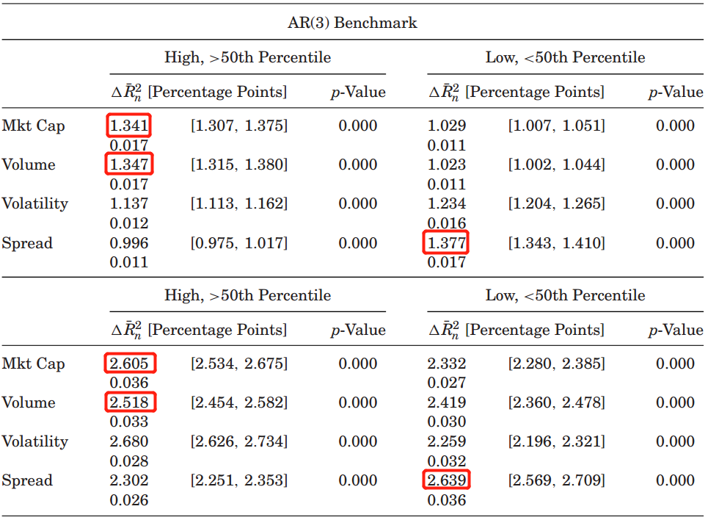
3.1. Empirical result--Out-of-Sample Performance
Table III Increase in Out-of-Sample Fit, by Characteristics
Increase in Out-of-Sample Fit
The LASSO increases out-of-sample fit slightly more for large, liquid, and frequently traded stocks

Slide 14
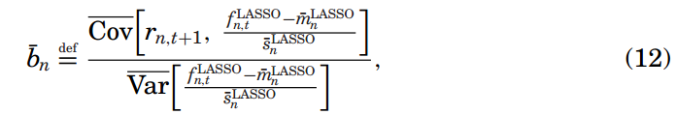
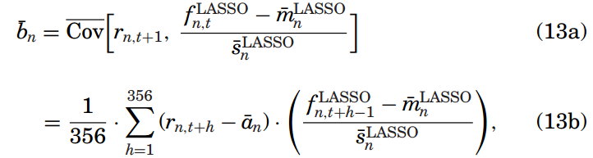
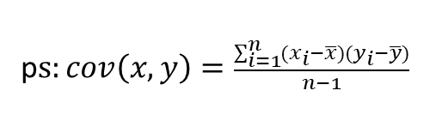
3.1. Empirical result--Out-of-Sample Performance
Sharpe Ratios
A LASSO-implied trading strategy:
p$s:cov\left(x,y\right)=\frac{\sum_{i=1}^{n}{(x_{i}−\overline{x})(y_{i}−\overline{y})}}{n−1}$

Slide 15





3.1. Empirical result--Out-of-Sample Performance
Sharpe Ratios
Three problems with implementing this strategy:
1.Trading Costs :
Execute an order when
Compute the strategy’s realized returns net of this bid-ask spread
2.Look-Ahead Bias: = (previous 30 minutes of trading)
3. Portfolio Construction:

Slide 16
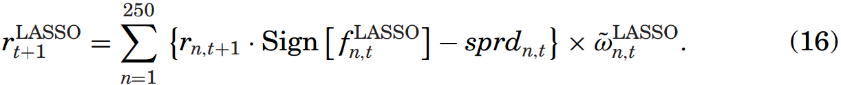
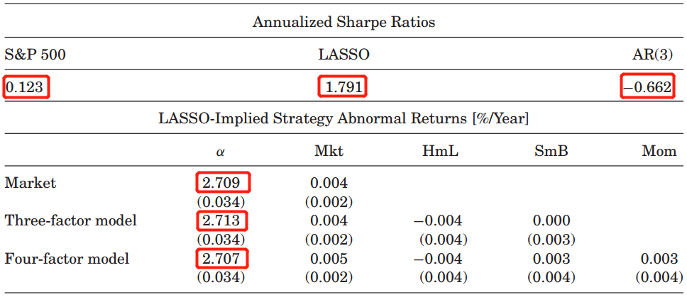
3.1. Empirical result--Out-of-Sample Performance
Sharpe Ratios
LASSO-implied strategy:
Table IV Forecast-Implied Performance Net of Trading Costs
An annualized Sharpe ratio of 1.791, and these excess returns are not explained by the strategy’s exposures to standard risk factors.

Slide 17
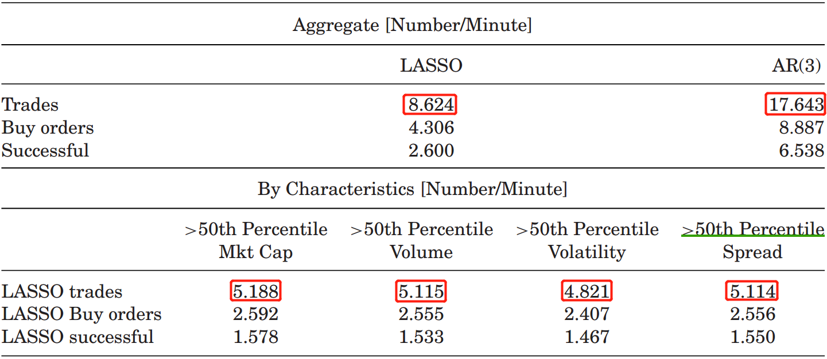
3.1. Empirical result--Out-of-Sample Performance
Sharpe Ratios
Table V Trading Frequency of Forecast-Implied Strategies
The AR(3)-implied strategy trades roughly twice as often as the LASSO-implied strategy, and the LASSO-implied strategy is more active in large, liquid, and frequently traded stocks .

Slide 18
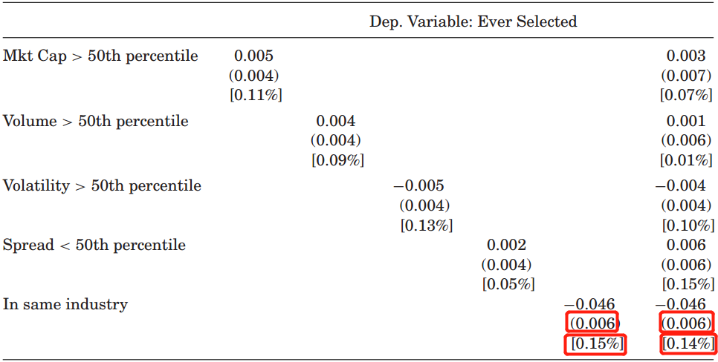
3.2. Empirical result--Predictor Analysis
Unexpected
Table VI Characteristics of LASSO Predictors
There is little correlation between the LASSO’s choice of predictors and firm size, trading volume, return volatility, and the bid-ask spread.
The LASSO is less likely to select a stock from the same industry as a predictor.

Slide 19
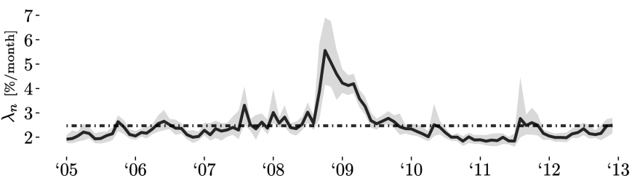
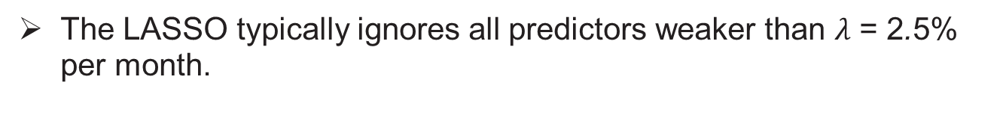
3.2. Empirical result--Predictor Analysis
Unexpected
Figure 4. The LASSO’s penalty parameter
2.5%
The LASSO typically ignores all predictors weaker than $λ$ = 2.5% per month.

Slide 20
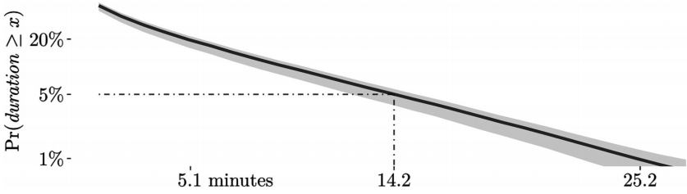
3.2. Empirical result--Predictor Analysis
Short-Lived
Figure 5. Predictor duration.
Less than 5% of predictors selected by the LASSO are used for more than 14.2 consecutive minutes.

Slide 21
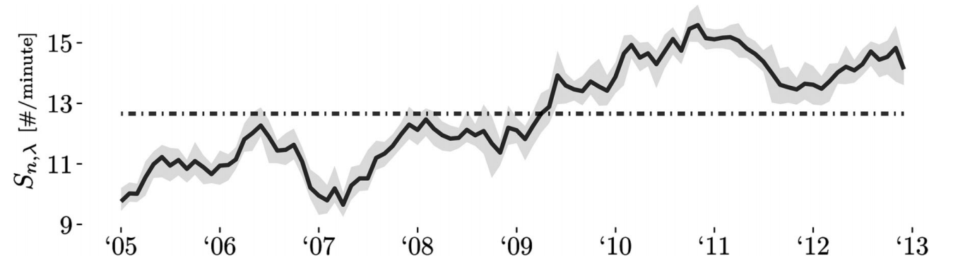
3.2. Empirical result--Predictor Analysis
Sparse
Figure 6. Predictor sparsity
12.7
On average, the LASSO uses only 12.7 predictors (out of a possible 3 · N ≈ 6,000) when making its one-minute-ahead return forecasts for each stock.

Slide 22
3.3. Empirical result--Economic Origins
Ravenpack Data
Ravenpack data: consist of all Dow Jones Newswire and Wall Street Journal articles.
Time: time-stamped to the millisecond, occur from 10:04 am to 3:59 pm.
Processing: only consider articles that Ravenpack labels as “news flashes”, remove any news articles about companies that had another revenue-related news flash during the previous five days.

Slide 23
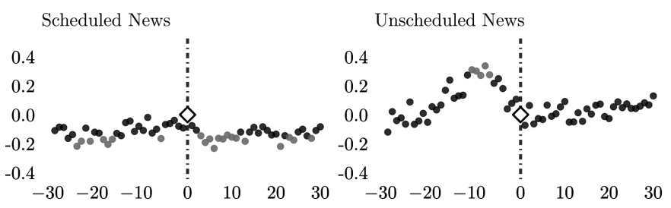
3.3. Empirical result--Economic Origins
Event Study
Figure 7. The LASSO’s selection rate around news.
When there is a scheduled news flash, the LASSO selects stock n as a predictor slightly more often for h = 0.
But if the news flash is unscheduled, then the LASSO selects stock n as a predictor much more often when making its one-minute-ahead return forecasts in the 10 minutes prior to minute t.

Slide 24
4. Conclusion
Firstly, We find that using the LASSO increases both out-of-sample fit and forecast implied Sharpe ratios.
Secondly, Identified predictors are unexpected, short-lived, and sparse.
Finally, we document that these predictors are often the lagged returns of stocks with recent news about firm fundamentals.

