Slide 1
Bond Return Predictability: Economic Value and Links to the Macroeconomy
Presented by: Long Zhen
Antonio Gargano, Davide Pettenuzzo, Allan Timmermann
Management Science

Slide 2
Contents
Introduction
Background
Motivation
Research problem
Research Design
Data
Method
Empirical Results
Conclusion

Slide 3
Introduction – Backgrounds
Understanding the risk and return dynamics for treasury bonds is of central economic importance.
There’s a contradiction between treasury bonds’ strong out-of-sample predictability and weak portfolio performance. (Thornton and Valente, 2012)

Slide 4
Introduction – Motivation
→ How to deal with this contradiction?
Improve prediction accuracy:
Macroeconomic data
Time-varying models
Explain the economic drivers:
Bond return predictability
Portfolio performance

Slide 5
Introduction – Research Problem
Whether the inclusion of time-varying parameters and volatility and macroeconomic data can improve bond excess return predictability?
Can we translate gains in predictive accuracy into better investment performance?
What’s the economic drivers of bond return predictability and portfolio performance?
√
√

Slide 6
Research Design – Data
Monthly bond excess returns 1962.1~2015.12
2,3,4 and 5-year maturities, in excess of the 1-month T-bill rate
Based on daily yields, constructed by Gurkaynak et al. (2007)
Non-overlapping → avoid serial correlation
Catch dramatic swings over short periods

Slide 7


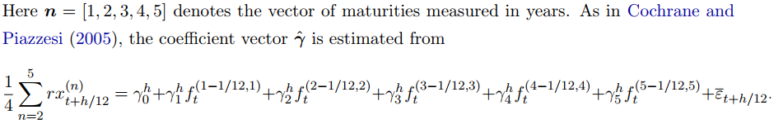
Research Design – Data
Predictor variables:
Forward spread (FB)
A linear combination of forward rates (CP)

Slide 8


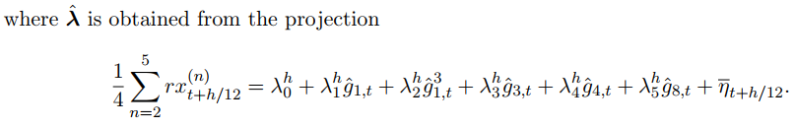
Research Design – Data
Predictor variables:
A linear combination of macro factors
FRED-MD dataset: principal components analysis → first 8 factors

Slide 9
Research Design
NEW models:
Bonds are sensitive to monetary policies→ time-varying parameters
Uncertainty changes over time→ time-varying volatility
Investors are concerned not only with the most likely outcome but also with the degree of uncertainty → probability distribution of bond returns

Slide 10


Research Design
4 classes of models:
(i) constant coefficient models with constant volatility
(ii) constant coefficient models with stochastic volatility;

Slide 11
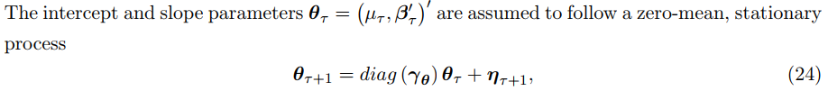

Research Design
(iii) time varying parameter models with constant volatility
(iv) time varying parameter models with stochastic volatility

Slide 12
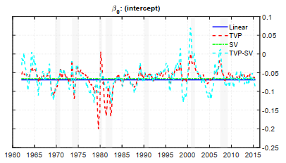

Slide 13

Research Design
Univariate + Multivariate model
FB/CP/LN/ FB+CP+LN
Benchmark
Expectation Hypothesis
Estimate method: Bayesian approach
Evaluate the effect of estimation error on the result
Allow for time-varying parameters and volatility
Multivariate asset allocation requires stochastic volatility
Address model uncertainty through combination(BMA)

Slide 14
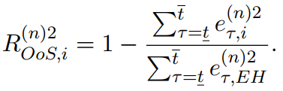
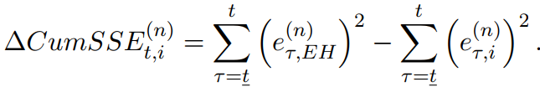
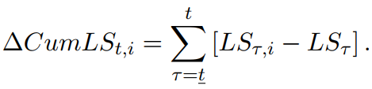
Research Design
Forecasting performance
Predictive likelihood score (accuracy of the density forecast)
Natural log of the predictive densities evaluated at the observed bond excess return for the EH and alternative models

Slide 15
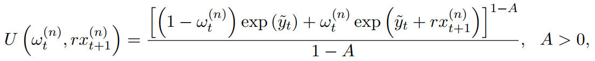
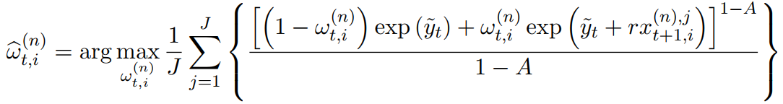

Research Design
Economic value of return forecasts
Multivariate asset allocation
Jointly model bond excess returns across the 4 maturities.

Slide 16
Research Design
Economic drivers of bond return predictability and portfolio performance
Economic cycle
Risk premia
Sharpe ratio in recessions;
Return forecast & GDP growth;
Return forecast & expected consumption growth risk/expected inflation risk
ICAPM
Economy uncertainty and agents’ subjective belief bias
macro risk factors

Slide 17
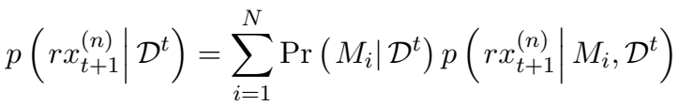
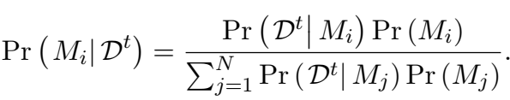
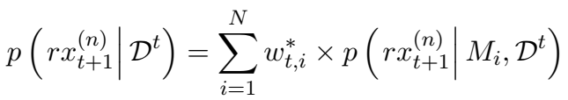
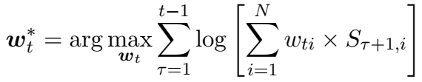
Research Design
Model combination (model uncertainty)
Equal-weighted
Bayesian model averaging (BMA)
Optimal predictive pool (OW)

Slide 18
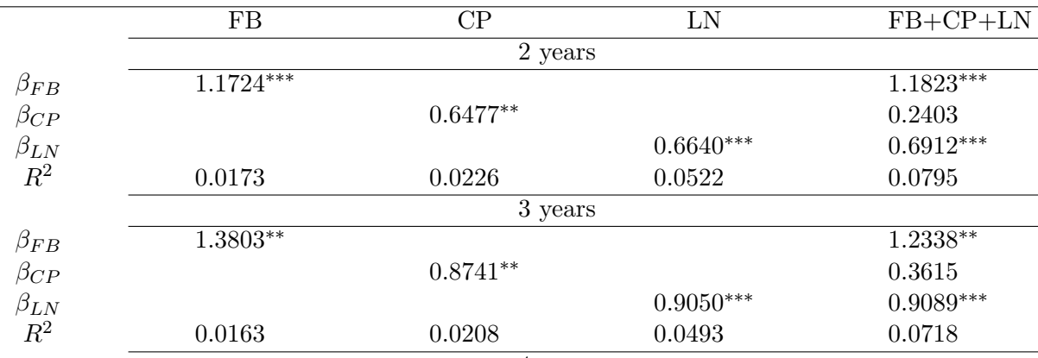
Empirical Results
1、Full-sample estimation:
Table 1: Full-sample OLS estimates
LN factor contains more information than FB and CP
R²s for non-overlapping data are notably smaller than those conventionally reported overlapping data

Slide 19
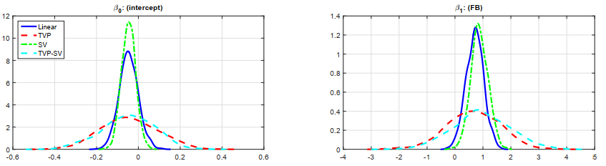
Figure 1: full-sample posterior densities of coefficients
Parameter uncertainty is greatest for the TVP and TVP-SV models
The SV model generates more precise estimates than the constant volatility benchmark

Slide 20
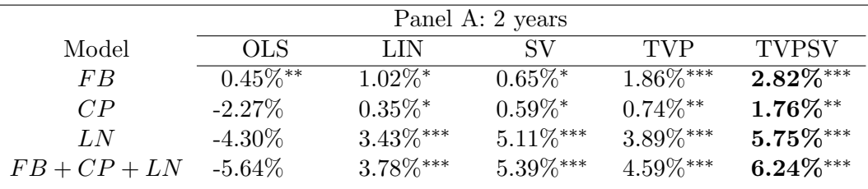
Out-of-sample forecast:
Table 2: Out-of-sample forecasting performance: R2 values
Almost all models estimated using our Bayesian approach generate significantly more accurate forecasts
The FB and, in particular, the LN predictor, add considerable improvements in out-of-sample predictive performance.

Slide 21
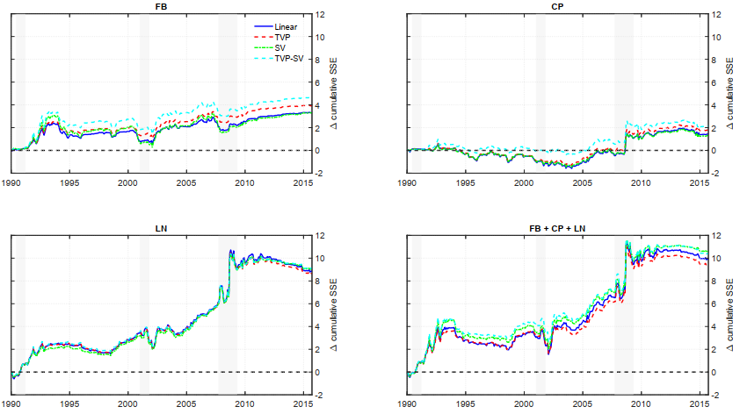
Out-of-sample forecast:
Figure 2: Cumulative sum of squared forecast error differentials

Slide 22
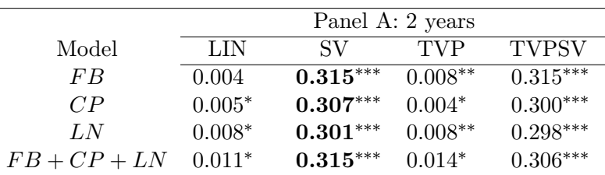
Out-of-sample forecast:
Table 3: Out-of-sample forecasting performance: predictive likelihood
The results show that the SV and TVPSV models perform significantly better than the EH benchmark across all predictors and maturities

Slide 23
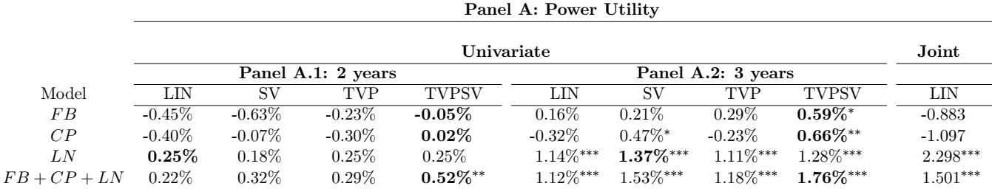
2、Economic value:
Table 4: Out-of-sample economic performance of bond portfolios
The CER values generally increase with the bond maturity.
In most cases, the highest CER values are found for the TVP-SV models. Stochastic volatility matters.
The inclusion of the LN macro factor as a predictor makes an important difference.

Slide 24
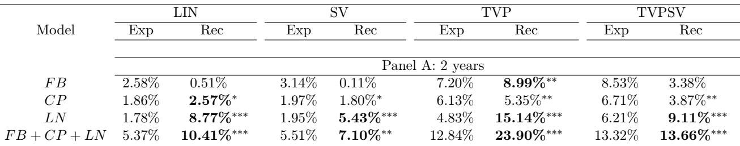
3、Economic driver——cyclical variation:
Table 5: Bond return predictability in expansions and recessions
The R2 values are generally higher during recessions than in expansions.

Slide 25
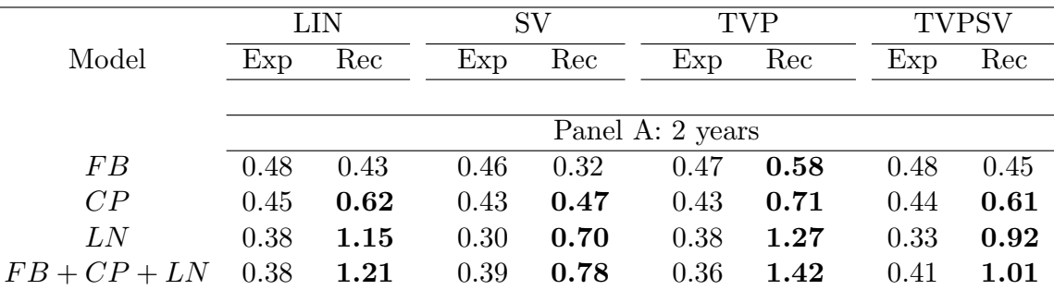
Economic driver——risk premia variation:
Table 6: Sharpe ratios in expansions and recessions
The Sharpe ratios are higher during recessions than in expansions.

Slide 26
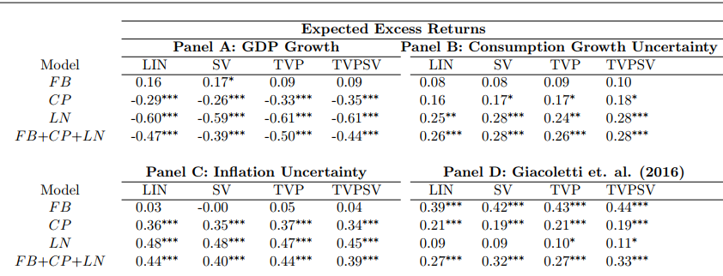
Economic driver——risk premia variation:
Table 7: Correlations between expected bond excess returns and economic variables
Time-varying variation at least partly drives the predictability

Slide 27
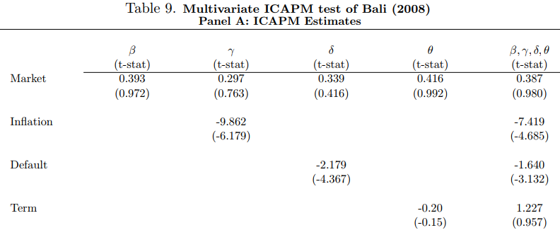
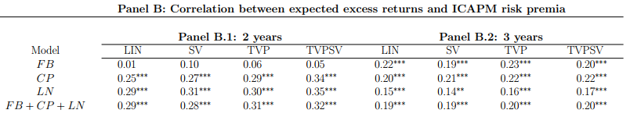
Economic driver——Multivariate ICAPM test:
Time-variation in the conditional covariance between bond excess returns and economic innovations account, at least in part, for our results.

Slide 28
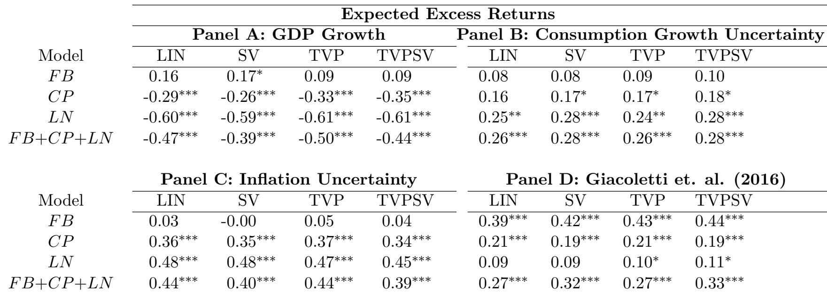
Economic driver——Portfolio Performance:
Table 10: Correlations between expected bond excess returns, realized utilities, and economic variables
The bond portfolios perform better in economic utility terms during times where macroeconomic uncertainty is high.

Slide 29
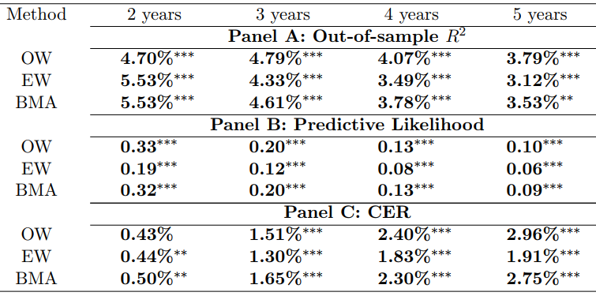
Combination performance
Table 11. Economic and statistical performance of forecast combinations

Slide 30
Conclusion
Bond excess returns are significantly predictable both statistically and economically.
This predictability can be attributed to the information in macro factors along with modeling stochastic volatility and time-varying parameters

Slide 31
My thoughts:
We can apply similar methodologies to different subjects.
But a different subject has its own features and needs another perspective.
Bayesian estimation and time-varying models
Special attention to the economic drivers

