Slide 1
Resiliency and Stock Returns
Jian Hua, Lin Peng，Robert A. Schwartz，Nazli Sila Alan
The Review of Financial Studies
2020 2
王念硕

Slide 2
Outline
Introduction
Research design
Empirical result
Conclusion

Slide 3
1. Introduction
Background
It has been established in the literature that liquidity is a key determinant of asset prices and investors demand a premium for less liquid stocks.
Hou, Xue, and Zhang ( 2015, 2017) argues that many related to frictions associated with illiquidity, are not robust.

Slide 4
1. Introduction
Motivation
The failure to find a robust illiquidity premium in previous literature can be attributed to a misspecification of how liquidity is defined and measured.

Slide 5
1. Introduction
Research question
1. We present an expanded definition of liquidity, can we prove that liquidity has a real relationship with expected returns？

Slide 6
1. Introduction
Related researches
Amihud and Mendelson (1986) first argued that investors demand a premium for less liquid stocks.
It has been established in the literature that illiquidity is positively priced in the cross-section of expected stock returns (Easley and O’Hara 2004; Amihud, Mendelson, and Pedersen 2005).
If a stock is not perfectly liquid, a liquidity shock will generate a transitory price movement that takes time to reverse. (Grossman (1988), Campbell (1993), Llorente (2002), and Bao (2011) )
Hou, Xue, and Zhang (2015, 2017) points out that the earlier analyses have been based mostly on equal-weighted returns that cause the anomaly findings to be excessively influenced by micro-cap stocks.

Slide 7
1. Introduction
Research Contents
This paper presents an expanded definition of liquidity. We refer to it as resiliency (RES): an asset is more resilient if a shock is less apt to drive a wedge between its price and its equilibrium value and, when a deviation does occur, if it is repaired swiftly.
RES has a strong negative relationship with returns and the relationship is indeed stronger in high volume month, which is consistent with the previous paper on liquidity.

Slide 8
1. Introduction
Contribution
We proposed resiliency as a more comprehensive liquidity measure, and suggest that liquidity is indeed a crucial factor for asset pricing across the broad spectrum of stocks.

Slide 9
2. Research design
Measure RES
Whether RES can obtain significant excess return?
Is it still significant after the adjustment of the methods of Hou (2015, 2017) ?
Comparison with other liquidity measures.
How does RES perform in the month with large volume?

Slide 10
2. Research design
Definition of RES
An asset is more resilient if a shock is less apt to drive a wedge between its price and its equilibrium value and, when a deviation does occur, if it is repaired swiftly.
If investors are averse to nonresiliency, we should observe a nonresiliency premium that is negatively related to RES.

Slide 11
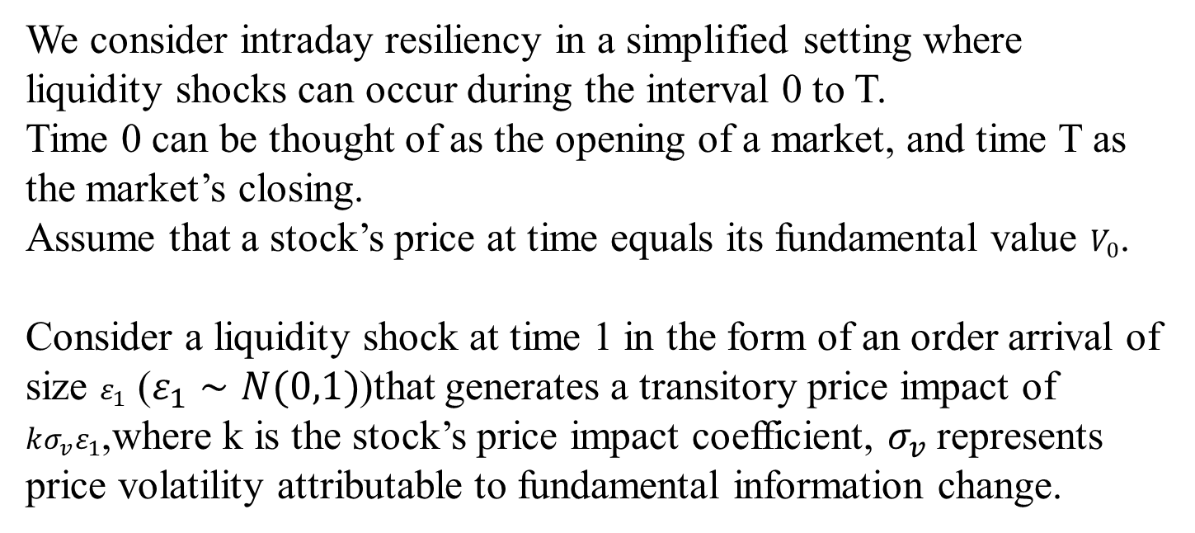
2. Research design
A simple illustration
We consider intraday resiliency in a simplified setting where liquidity shocks can occur during the interval 0 to T.
Time 0 can be thought of as the opening of a market, and time T as the market’s closing.
Assume that a stock’s price at time equals its fundamental value $V_{0}$.
Consider a liquidity shock at time 1 in the form of an order arrival of size $ε_{1}$ ($ε_{1}∼N(0,1)$)that generates a transitory price impact of $kσ_{v}ε_{1}$,where k is the stock’s price impact coefficient, $σ_{v}$represents price volatility attributable to fundamental information change.

Slide 12
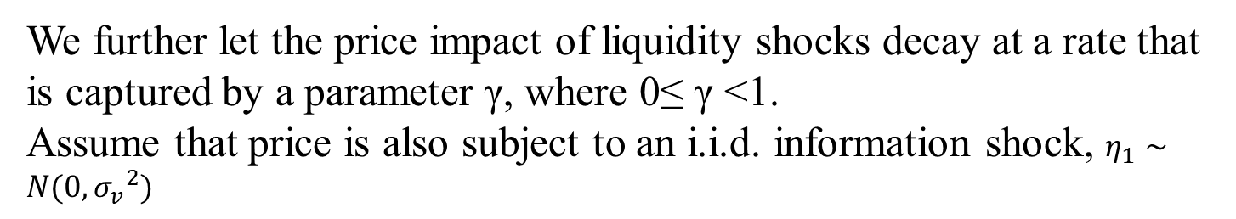
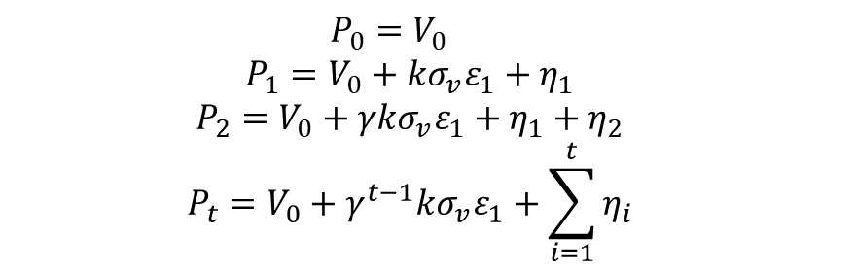
2. Research design
A simple illustration
We further let the price impact of liquidity shocks decay at a rate that is captured by a parameter γ, where 0≤ γ <1.
Assume that price is also subject to an i.i.d. information shock, $η_{1}∼N(0,{σ_{v}}^{2})$
$$P_{0}=V_{0}$$
$$P_{1}=V_{0}+kσ_{v}ε_{1}+η_{1}$$
$$P_{2}=V_{0}+γkσ_{v}ε_{1}+η_{1}+η_{2}$$
$$P_{t}=V_{0}+γ^{t−1}kσ_{v}ε_{1}+\sum_{i=1}^{t}{η_{i}}$$

Slide 13
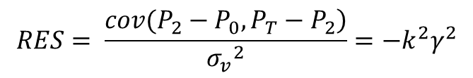
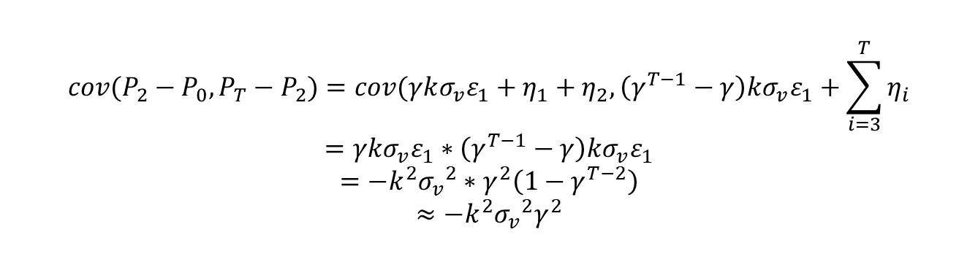
2. Research design
Measure RES
$$cov({P_{2}−P_{0}, P}_{T}−P_{2})=cov(γkσ_{v}ε_{1}+η_{1}+η_{2}, \left(γ^{T−1}−γ\right)kσ_{v}ε_{1}+\sum_{i=3}^{T}{η_{i}}$$
$$=γkσ_{v}ε_{1}∗\left(γ^{T−1}−γ\right)kσ_{v}ε_{1}$$
$$=−k^{2}{σ_{v}}^{2}∗γ^{2}\left(1−γ^{T−2}\right)$$
$$≈−k^{2}{σ_{v}}^{2}γ^{2}$$
$$RES= \frac{\left.cov({P_{2}−P_{0}, P}_{T}−P_{2}\right)}{{σ_{v}}^{2}}=−k^{2}γ^{2}$$
For a stock that is less resilient (everything else equal), a shock
creates a larger price impact (higher κ), and it endures longer (larger γ).
Notes:
冲击的影响越大，持续时间越久，弹性越小

Slide 14
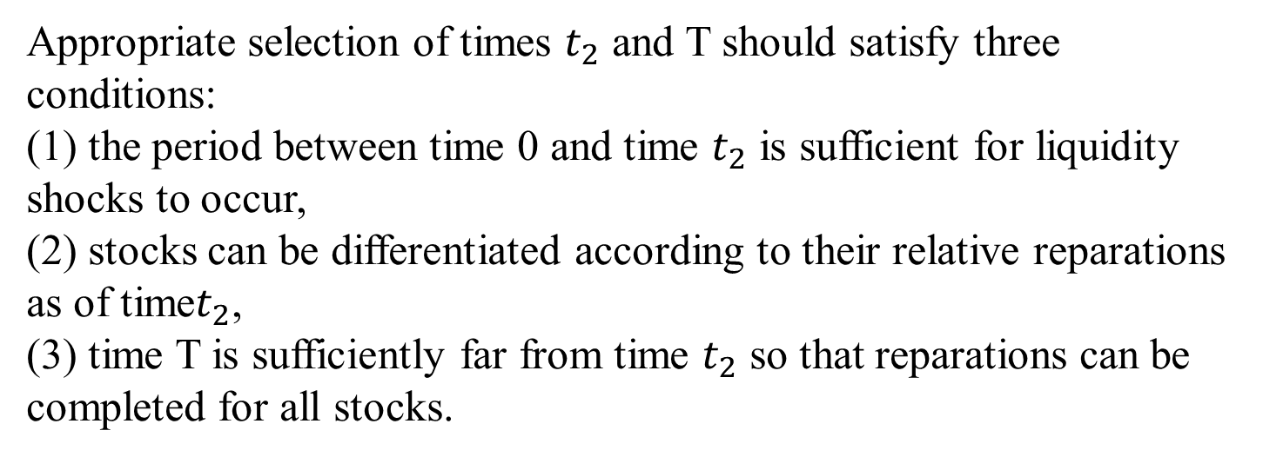
2. Research design
Measure RES
Appropriate selection of times $t_{2}$ and T should satisfy three conditions:
(1) the period between time 0 and time $t_{2}$ is sufficient for liquidity shocks to occur,
(2) stocks can be differentiated according to their relative reparations as of time$t_{2}$,
(3) time T is sufficiently far from time $t_{2}$ so that reparations can be completed for all stocks.

Slide 15
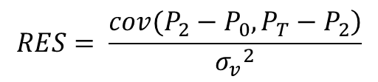
2. Research design
Measure RES
We define the first interval (time 0 to time 2) to be 9:30 to 10:00, and the second interval (time 2 to time T) to be 10:00 to 16:00.
The first interval is more likely to capture liquidity shocks(a crucial time for trading and price formation), whereas the second allows for the reparation of the shocks.
We assess a stock’s monthly resiliency (RES) based on the covariance of two intraday returns: an opening return (9:30 to 10:00), and a rest of the day return (10:00 to 16:00), where the covariance is divided by the variance of daily returns. We use daily return volatility as our measure of fundamental volatility.
$$RES= \frac{\left.cov({P_{2}−P_{0}, P}_{T}−P_{2}\right)}{{σ_{v}}^{2}}$$

Slide 16
2. Research design : Other Variable
Variable | Calculation method
ILLIQ | monthly average ratio of a stock’s absolute daily return to its daily dollar trading volume
VRSPR | the monthly average of the intraday volume-weighted effective spreads
HLSPR | spread estimates based on daily high and low prices
ROLL | Roll’s (1984) spread estimator
PS | stock’s liquidity exposure
OI | the opening half-hour share difference between buy and sell initiated orders, divided by the total number of shares
DTURN | the log of the stock’s detrended turnover per month
BETA | covariance of market return and stock return over the prior 60 months

Slide 17
2. Research design : Other Variable
Variable | Calculation method
LNME | the natural logarithm of a stock’s market capitalization
LNBM | the book value of shareholders’ equity scaled by the market value
MOM | the cumulative compounded stock returns over a period of 11 months
REV | the stock’s prior month return
COSKEW | the stock’s and the market’s prior 60 month returns
IVOL | the standard deviation of the market model’s residual errors estimated using daily returns
MAX | the maximum daily return in the prior month
TURN | the number of shares traded, divided by the number of shares outstanding
RET5VOL | the standard deviation of monthly returns over the prior 60 months
ES | the difference between the median analysts’ earnings forecasts and actual announced earnings
DISP | the standard deviation of earnings-per-share forecasts scaled by the absolute value of the average forecast

Slide 18
2. Research design : Data
Company financial data：CRSP、Compustat、the I/B/E/S data set、 Trade and Quote (TAQ) data
Period：1993 - 2014 daily data.
Sample: The study includes all common stocks traded on the NYSE, Amex, and NASDAQ

Slide 19
2. Research design : method
Univariate portfolio analysis
Bivariate portfolio analysis
Fama-MacBeth regressions

Slide 20
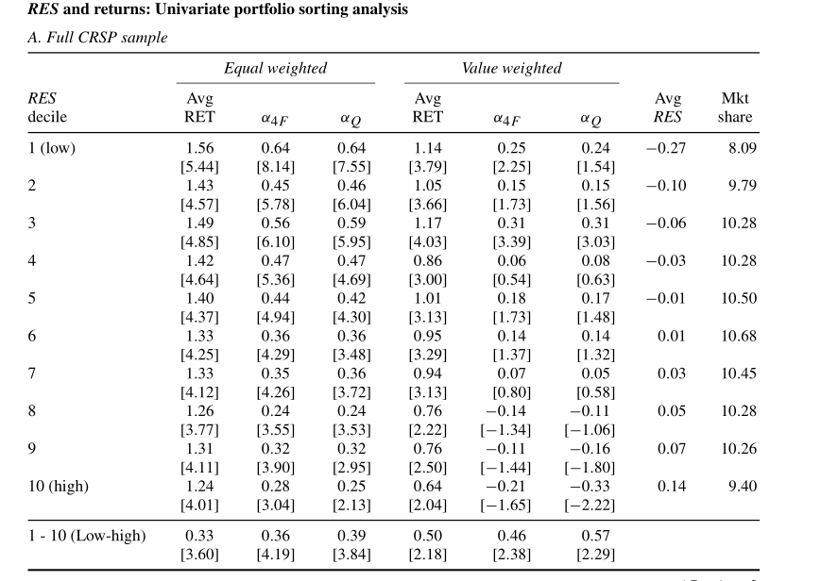
3. Empirical result: Univariate portfolio analysis
RES decile monthly average portfolio raw returns by 33bps for equal-weighted returns, and by 50 bps for value-weighted returns. The returns adjusted by (1) Carhart four factors and (2) Hou, Xue, and Zhang Q factors is still significant.
Firm size appears to be reasonably evenly distributed across the deciles, so the results are not likely to be driven by differences in firm size.

Slide 21
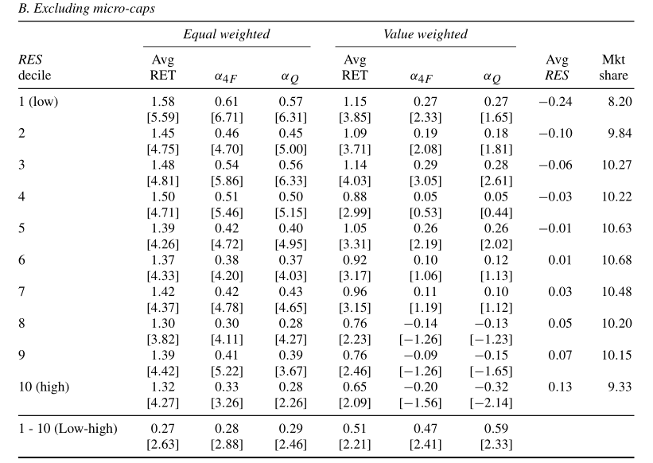
3. Empirical result: Univariate portfolio analysis
Hou, Xue, and Zhang (2015, 2017) find that liquidity anomalies disappear when micro-cap stocks are excluded.
We omit stocks with market caps below the twentieth percentile. The results remain statistically significant.

Slide 22
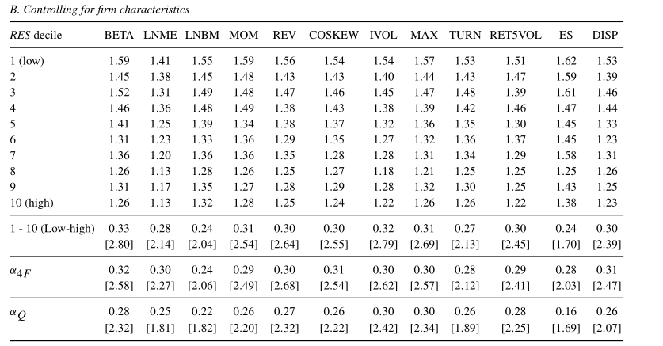
3. Empirical result: Bivariate portfolio analysis
Firstly forming tercile portfolios according to each control variable, then within each control variable tercile, forming RES deciles, the portfolio return is then obtained by averaging across the control variable’s tercile groups.
The double-sorted portfolio results confirm that the aforementioned control variables do not account for the RES return relationship.

Slide 23
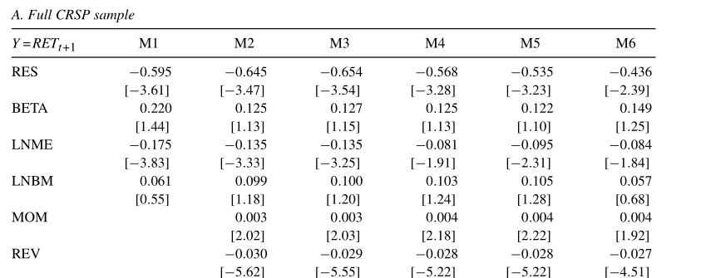
3. Empirical result: Fama-MacBeth regressions
RES has a significantly negative slope coefficient that ranges from -0.436 to -0.654. This confirms our sorting results that stocks with lower resiliency do indeed yield higher expected returns.

Slide 24
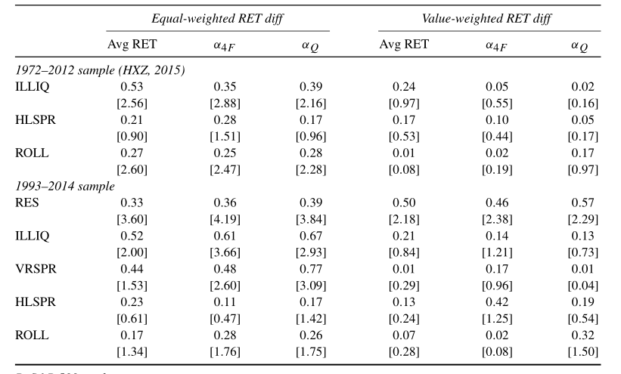
3. Empirical result: comparison with other liquidity
We directly compare the ability of various liquidity measures to explain cross-sectional differences in expected returns.
We confirm their finding that the existing liquidity measures give no evidence of significant value-weighted abnormal returns. In contrast, RES is robustly priced.

Slide 25
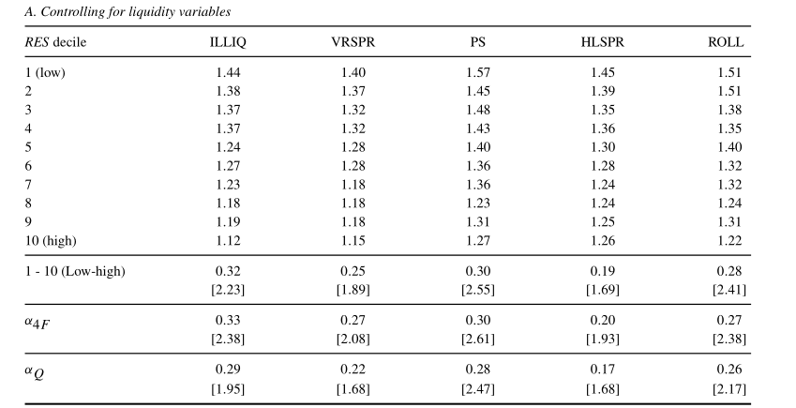
3. Empirical result: comparison with other liquidity
RES’s explanatory power regarding future returns remains in the bivariate sorts

Slide 26
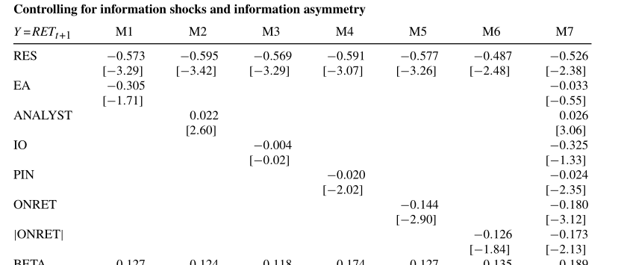
3. Empirical result
RES also can be affected by information shocks. We deal with this by controlling for information asymmetry and for the occurrence of information shocks. To control for information asymmetry, we include information related variables. Across all specifications, the coefficients on RES remain statistically significant.

Slide 27
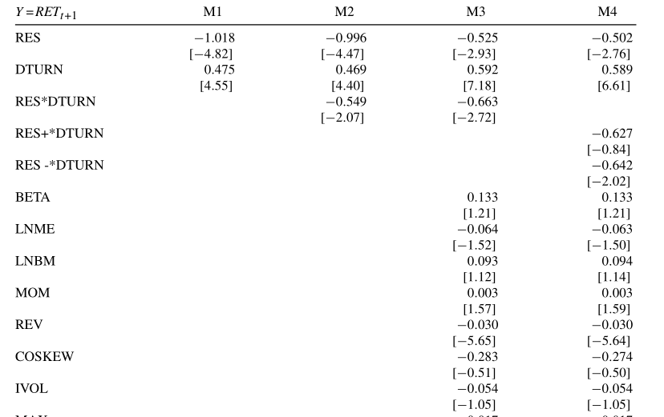
3. Empirical result
We include trading volume in our analysis to better focus on the liquidity driven component of RES.
The interaction between DTURN and RES is also negative and significant, which suggests that the RES expected return relationship is indeed stronger when trading volume is heavier.

Slide 28
4. Conclusion
RES is negatively correlated with expected returns for a broad cross-section of stocks.
The premium persists when other liquidity measures and standard return determinants are controlled for. These results remain after controlling for information and when micro-cap stocks are excluded. Further, the RES return relationship is stronger on month with high trading volume.
Hou, Xue, and Zhang (2015, 2017) cast doubt on the existence of an illiquidity premium. We suggest that liquidity is indeed a crucial factor for asset pricing across the broad spectrum of stocks.

