Slide 1
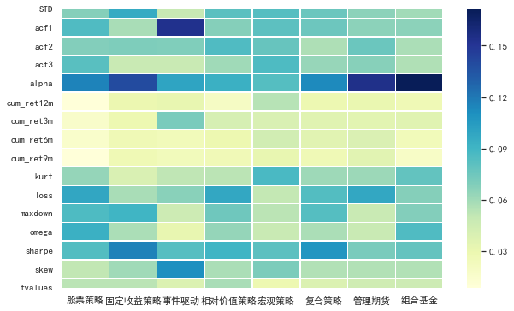
Feature importance

Slide 2
私募预测
Fung Hsieh 7 factor alpha
国内没有相关的研究，国债收益/违约利差/市场收益/smb 可以获得，但是根据债券期货/商品期货和外汇期货构成期权portfolio，国内没有外汇期货。指标无法获取
指数回溯
上证指数中有一些没有权重（自由流通股数计算）
中证指数：沪深300先根据交易金额排序删掉后50%再根据市值排序，但是1998到2000初沪深只有700只股票，如果根据条件继续筛选，并保持10%的比例变动，成份股无法满足300只

Slide 3
Portfolio concentration and mutual fund performance
Fulkerson J. A , Riley T.B
Journal of Empirical Finance, 2019.

Slide 4
Outline
Introduction
Research design
Empirical result
Robust Test
Conclusion

Slide 5
Outline
Increase the portfolio concentration to take advantage of valuable information.
Receive the quality information signals
①
Excess return
②
Cross sectional difference: fund characteristics
③
Time series difference:
market condition

Slide 6
Introduction: Literature
Information Advantages
Treynor and Black (1973) find that a manager with strong beliefs about particular securities should give those securities disproportionate weight by increasing portfolio concentration.
Cohen et al. (2010) find that the largest positions in a fund’s portfolio (i.e., the manager’s ‘‘best ideas’’) significantly outperform.
Van Nieuwerburgh and Veldkamp (2010) consider the cost of information acquisition and find that a manager unwilling to undertake extensive search costs could also rationally hold a concentrated portfolio.

Slide 7
Introduction: Literature
Idiosyncratic Volatility
Brown et al. (1996) show that fund managers with poor performance during the first half of the year will increase their volatility during the second half of the year, presumably as a gamble to rapidly improve their performance relative to other funds.
Chevalier and Ellison (1997) and Sirri and Tufano (1998), find convexity in the relation between fund performance and flows. In this environment, idiosyncratic volatility can benefit the fund manager by increasing the likelihood of being one of the best performing funds.
Kacperczyk et al. (2005) that the increase in idiosyncratic volatility that can be expected from increased concentration could actually benefit the fund manager if the costs of poor performance are small relative to the benefits of good performance.

Slide 8
Introduction: Literature
In our analysis, we focus on information-based explanations for increasing concentration.
Kim (2013) finds the apparent convexity of the relation has diminished during the previous two decades.
Clifford et al. (2014) show that the convex relation is driven by a large number of very small funds and that the majority of assets in the industry are held by funds subject to a linear relation.
Among corporate bond funds, Chen and Qin (2017) find no evidence of a convex flow-performance relation, and Goldstein et al. (2017) contend the relation is concave.

Slide 9
Introduction: Literature
A mutual fund manager must still balance the expected benefits from increasing concentration against the expected costs.
Keim and Madhavan (1997) show that transaction costs for institutional traders increase with trade size.
Sapp and Yan (2008) find evidence that relatively concentrated funds do suffer liquidity problems.
Fulkerson and Riley (2017) show that higher concentration funds experience per-dollar liquidity-motivated trading costs more than twice the magnitude of that experienced by lower concentration funds.

Slide 10
Research Design: Data
Mutual fund sample
(CRSP) Survivor-Bias-Free U.S. Mutual Fund database
Holding data
Thomson Reuters Mutual Fund Holdings Database
Fund Filter
Only use funds which Lipper identifies as following a traditional long-only U.S. equity strategy.
Require funds invest at least 80 percent of their assets in common equity.
Include funds at least two years old and until it has reached at least $20 million in assets.

Slide 11
Research Design: Data
Fund Filter
Fund holdings are available starting in the 1980s, but our analysis begins in 1999 because that is the first full year in which CRSP has daily fund returns available, which allows us to effectively measure quarterly risk-adjusted fund returns
Our final sample has 45,912 fund-quarter observations across 1875 unique funds covering the period 1999 to 2014.

Slide 12
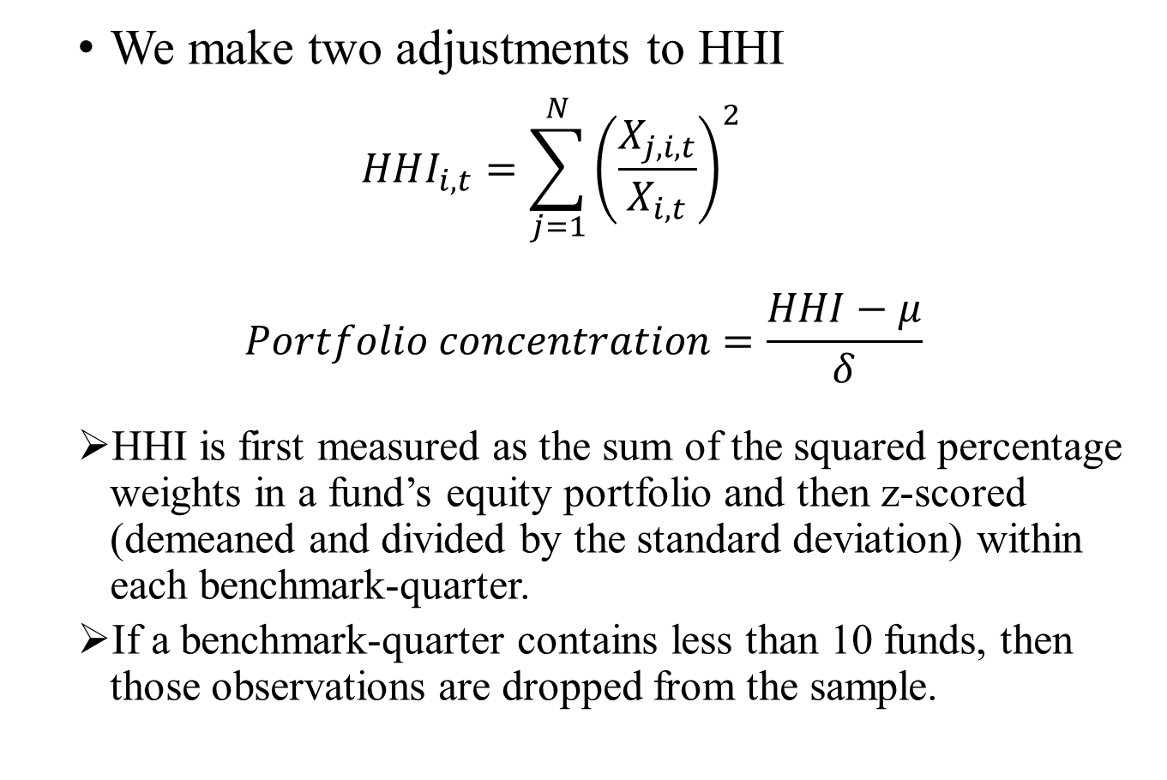
Measuring concentration
We make two adjustments to HHI
$$HHI_{i,t}=\sum_{j=1}^{N}{{\left(\frac{X_{j,i,t}}{X_{i,t}}\right)}^{2}}$$
$$Portfolio concentration=\frac{HHI−μ}{δ}$$
HHI is first measured as the sum of the squared percentage weights in a fund’s equity portfolio and then z-scored (demeaned and divided by the standard deviation) within each benchmark-quarter.
If a benchmark-quarter contains less than 10 funds, then those observations are dropped from the sample.

Slide 13
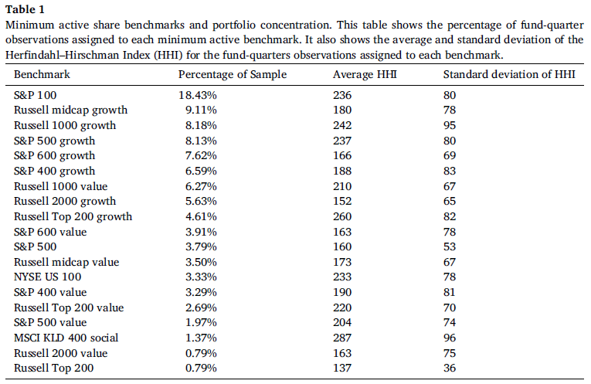
Mutual Fund Concentration
We control for differences in concentration over time and across benchmarks by z-scoring (i.e., de-meaning and dividing by the standard deviation) HHI within each benchmark-quarter.

Slide 14
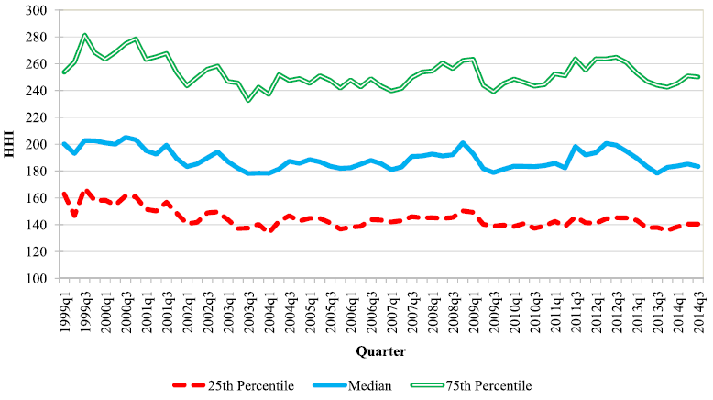
Mutual Fund Concentration

Slide 15
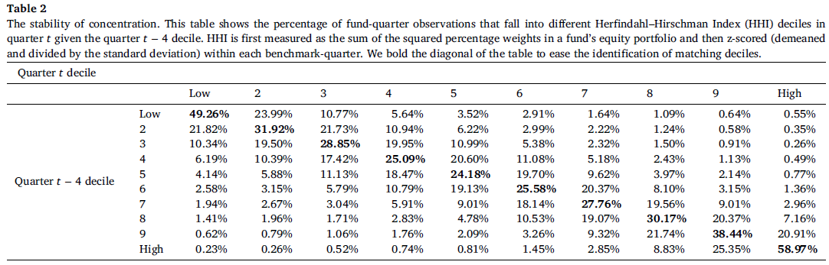
Mutual Fund Concentration
Funds appear to have a ‘‘concentration style’’ (i.e., they are low, medium, or high concentration), but they do vary their concentration while staying within their style.

Slide 16

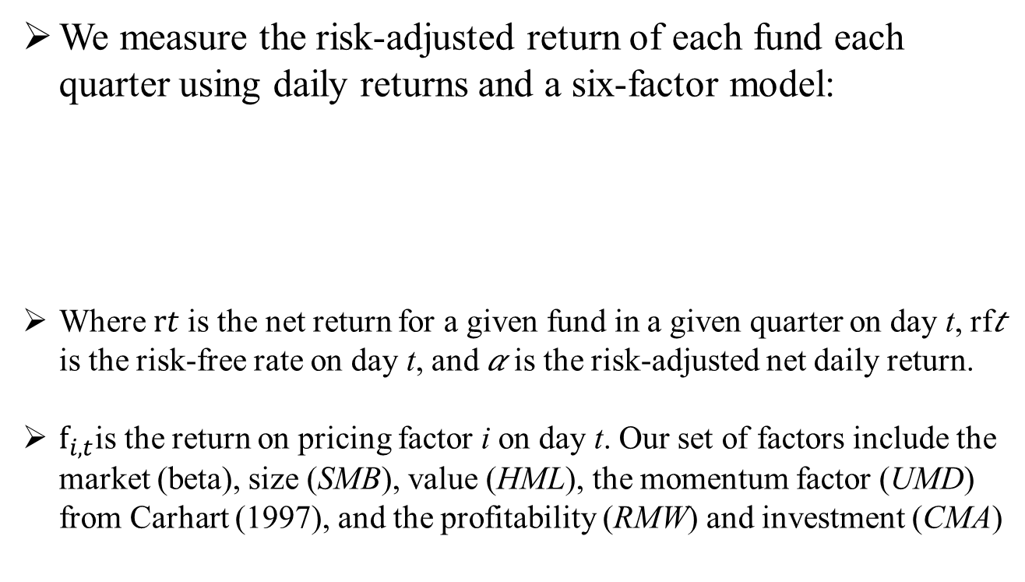
Measuring Performance
We measure the risk-adjusted return of each fund each quarter using daily returns and a six-factor model:
Where $rt$is the net return for a given fund in a given quarter on day t, rf𝑡 is the risk-free rate on day t, and 𝛼 is the risk-adjusted net daily return.
$f_{i,t}$is the return on pricing factor i on day t. Our set of factors include the market (beta), size (SMB), value (HML), the momentum factor (UMD) from Carhart (1997), and the profitability (RMW) and investment (CMA)

Slide 17
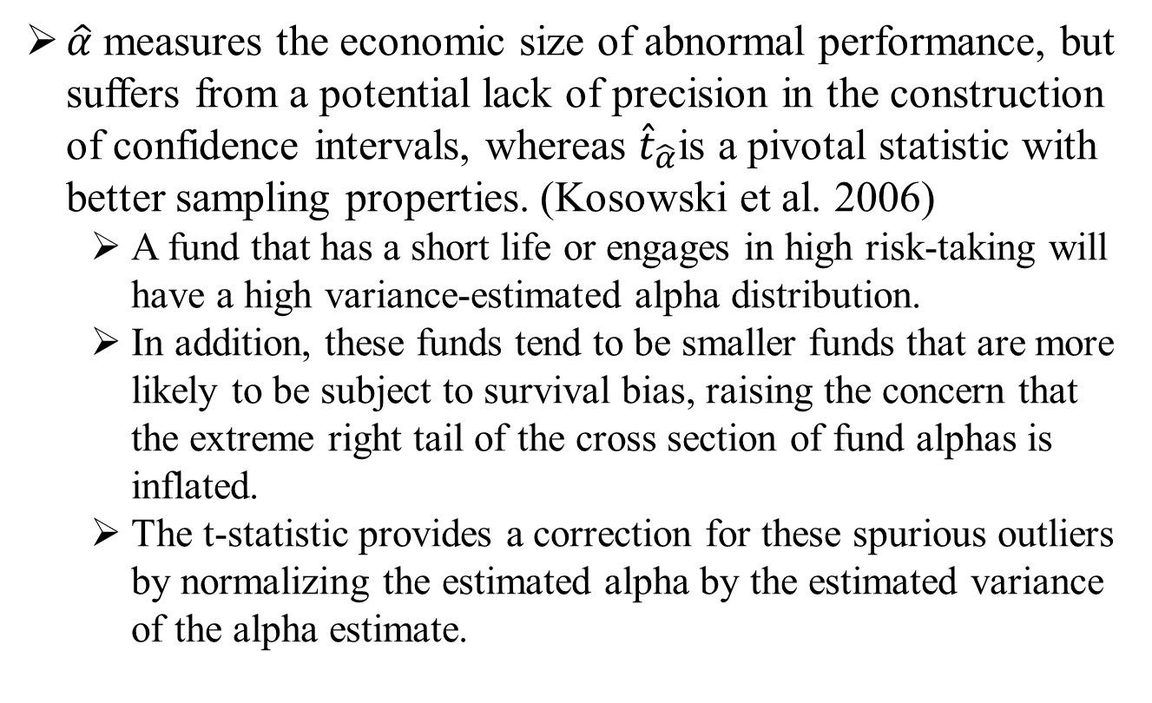
Why t-statistics?
$\hat{α}$ measures the economic size of abnormal performance, but suffers from a potential lack of precision in the construction of confidence intervals, whereas ${\hat{t}}_{\hat{α}}$is a pivotal statistic with better sampling properties. (Kosowski et al. 2006)
A fund that has a short life or engages in high risk-taking will have a high variance-estimated alpha distribution.
In addition, these funds tend to be smaller funds that are more likely to be subject to survival bias, raising the concern that the extreme right tail of the cross section of fund alphas is inflated.
The t-statistic provides a correction for these spurious outliers by normalizing the estimated alpha by the estimated variance of the alpha estimate.

Slide 18
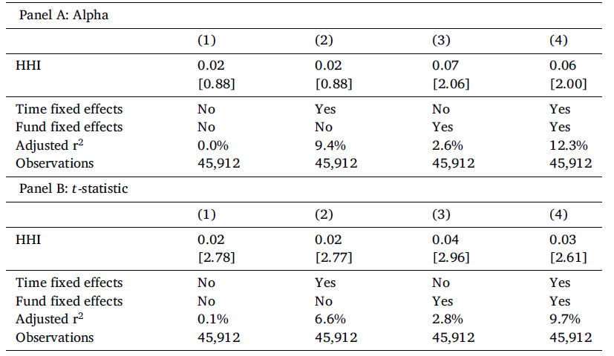
The relation between concentration and performance
Cross sectional
Time series

Slide 19
Variation in the relation between concentration and performance
We expect that the strength of the relation between concentration and performance will vary depending on the characteristics of the mutual funds and market conditions
We first consider how cross-sectional variation in fund characteristics affects the relation between concentration and performance.
We then consider how time-series variation in market conditions affects the same relation.

Slide 20


Cross-sectional variation
The first characteristic is the average liquidity of the equities held by the fund.
We measure liquidity for a fund as the asset-weighted average Amihud (2002) liquidity of the equities in a fund’s portfolio.
The second characteristic is how difficult it is to value the equities held by a mutual fund.
We measure valuation certainty as the sum of the asset weighted average profitability (RMW) and investment (CMA) exposures of a mutual fund’s equity holdings
The final characteristic is the proportion of the mutual fund held by institutional investors.
We measure the institutional investors by calculating the percentage of fund assets held in share classes which are designated by CRSP as for institutional investors only.
$$TV=\frac{FCF(1+g)}{WACC−g}$$

Slide 21
Cross-sectional variation
For institutional ownership, we divide the sample into low (< 10 %), medium (> 10 % & < 75 %), and high (>75 %) groups using manual cut-offs because a large number of mutual funds have almost no institutional ownership or almost complete institutional ownership.
For liquidity and value uncertainty, funds are sorted into terciles at the end of quarter t using the asset-weighted average Amihud (2002) liquidity of equity holdings and the sum of the asset-weighted average RMW and CMA exposures of equity holdings.

Slide 22
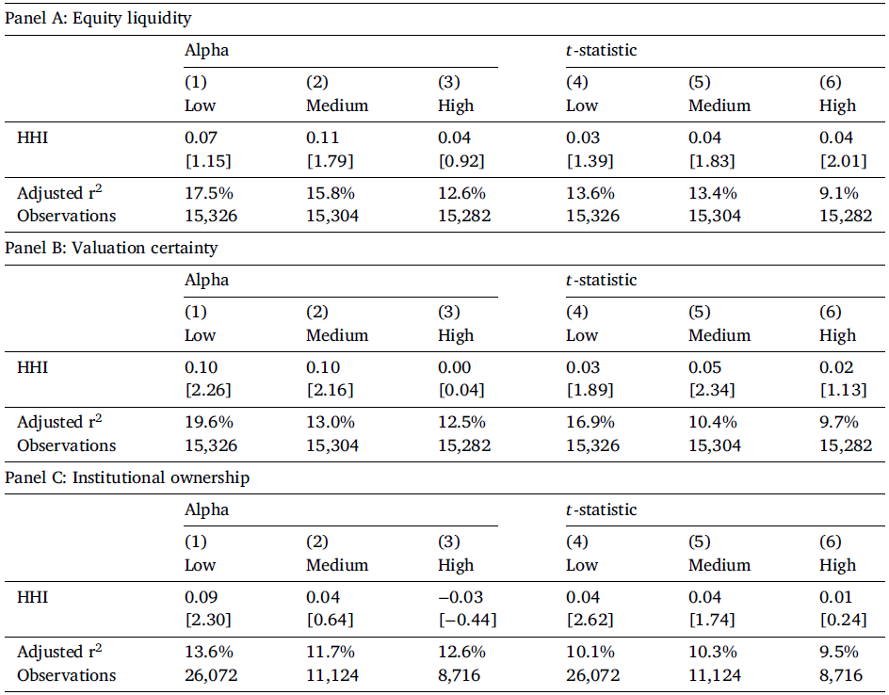
The relation between concentration and performance
<10%
>75%

Slide 23
Time-series variation
If market conditions make increased concentration costlier, mutual fund managers should require a more valuable information set before choosing to increase concentration.
The first is the expected market volatility
We measure expected volatility using the CBOE VIX
The second is the aggregate level of market liquidity
We measure the level of aggregate liquidity in the U.S. equity market following Pastor and Stambaugh (2003)
The final measure we consider is investor sentiment
We measure investor sentiment following Baker and Wurgler (2006)

Slide 24
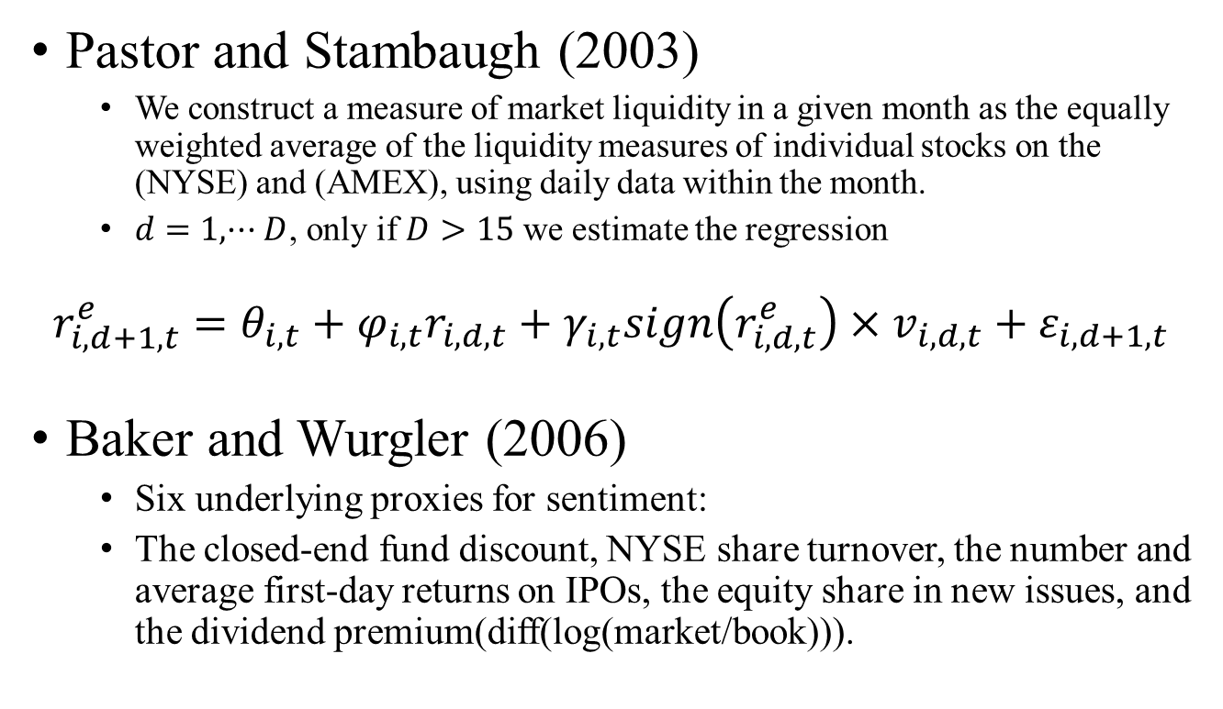
Time-series variation
Pastor and Stambaugh (2003)
We construct a measure of market liquidity in a given month as the equally weighted average of the liquidity measures of individual stocks on the (NYSE) and (AMEX), using daily data within the month.
$d=1,···D$, only if $D>15$ we estimate the regression
$$r_{i,d+1,t}^{e}=θ_{i,t}+φ_{i,t}r_{i,d,t}+γ_{i,t}sign\left(r_{i,d,t}^{e}\right)×v_{i,d,t}+ε_{i,d+1,t}$$
Baker and Wurgler (2006)
Six underlying proxies for sentiment:
The closed-end fund discount, NYSE share turnover, the number and average first-day returns on IPOs, the equity share in new issues, and the dividend premium(diff(log(market/book))).

Slide 25


Time-series variation
Baker and Wurgler (2006)
We define SENTIMENT as the first principal component of the correlation matrix of six variables
Specifically, we regress each of the six raw proxies on growth in the industrial production index, growth in consumer durables, nondurables, and services, and a dummy variable for NBER recessions

Slide 26
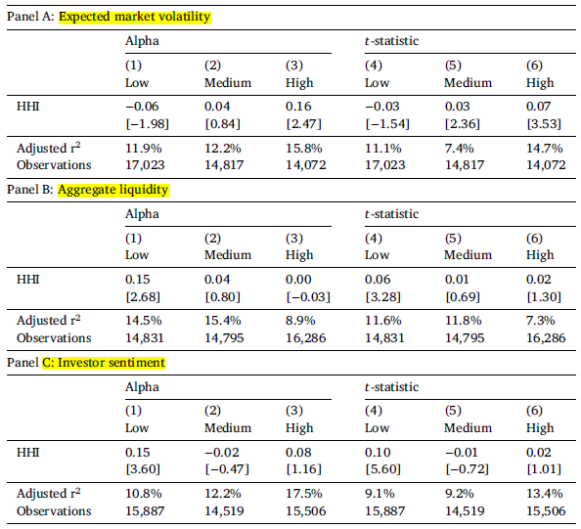
The relation between concentration and performance

Slide 27
Results
Cross sectional variation
We do not find the anticipated results with respect to equity liquidity.
Mutual funds that invest in more difficult to value equities have a stronger relation between HHI and performance.
Funds with less institutional ownership have a stronger relation between concentration and performance.
Time series variation
The impact of concentration on performance is large within the high tercile of expected market volatility.
The impact of concentration on performance is large within the low terciles of aggregate liquidity and investor sentiment.

Slide 28


Robustness
Alternative Measures of Concentration
Count of the number of fund holdings.
Security Concentration Index (SCI) from Sapp and Yan(2008)
Industry Concentration Index (ICI)
Alternative Fund Benchmarks
The benchmark a fund self-declares in its prospectus (SD);
The mode of a fund’s minimum active share benchmark (Mode);
The benchmark with the highest correlation with a fund’s daily returns over the full sample (FS Corr);
The benchmark with the highest correlation with a fund’s daily returns over the prior three months (3M Corr);
The benchmark with the highest correlation with a fund’s daily returns over the prior 12 months (12M Corr).

Slide 29
Robustness
Alternative Factor Models
Capital Asset Pricing Model (CAPM);
Fama–French three-factor model (FF3);
Fama–French four-factor model (FF4);
Fama–French four-factor model augmented with Stambaugh and Yuan (2017) mispricing factors (MP);
Hou et al. (2015) q-factor model (HXZ);
Cremers et al. (2012) seven-factor model (CPZ7).

Slide 30
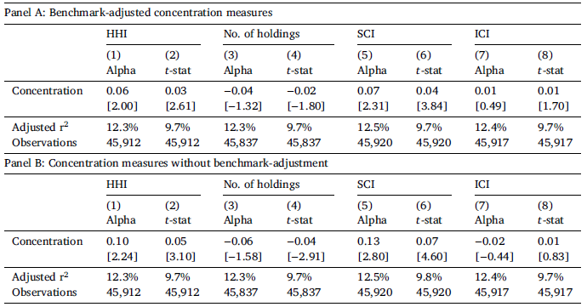
Robustness-A
Alternative Measures of Concentration
Notes:
proxy for the investor redemption risk,because Ω is sensitive to the investor’s utility function

Slide 31
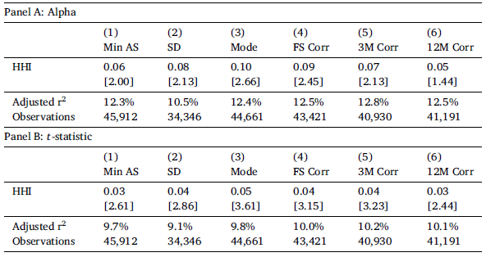
Robustness-B
Alternative Fund Benchmarks
Notes:
proxy for the investor redemption risk,because Ω is sensitive to the investor’s utility function

Slide 32
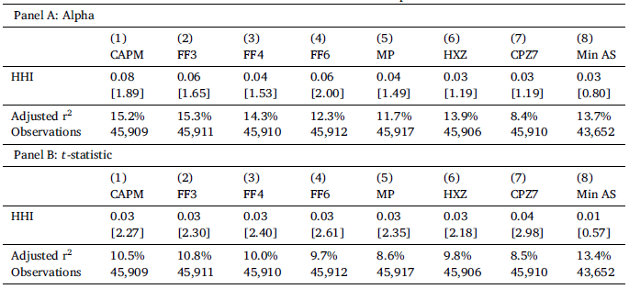
Robustness-C
Alternative Factor Models
Notes:
proxy for the investor redemption risk,because Ω is sensitive to the investor’s utility function

