Slide 1
Shrinking Factor Dimension: A Reduced-Rank Approach
Dashan Huang, Jiaen Li, Guofu Zhou
Working paper
Current version: February 2020
王念硕

Slide 2
Outline
Introduction
Research design
Empirical result
Conclusion

Slide 3
1. Introduction
Background
While theories usually identify a few parsimonious factors, there are more than 300 potential factors shown to affect stock returns one way or the other (Harvey, Liu, and Zhu (2016), Hou, Xue, and Zhang (2018)).
Anderson (1951) appears the first one to introduce RRA in statistics. In finance, Velu and Zhou (1999) apply a similar method to test multi-beta asset pricing models.

Slide 4
1. Introduction
Motivation
How to reduce a large number of observable time series factors to a few parsimonious ones, which has not been addressed elsewhere.
So far, no scholar has used RRA to shrink factor dimension.

Slide 5
1. Introduction
Research question
How many factors do we really need to explain cross-section stock returns?
Given a set of well-known factors, such as the prominent five factors of Fama and French (FF, 2015), are there other factors that can provide incremental information for explaining the cross section of stock returns?
Can RRA perform better than PCA and PLS?

Slide 6
1. Introduction
Related researches
Based on firm characteristics, Kelly, Pruitt, and Su (2019) find 10 factors that are significant using their instrumented PCA (IPCA).
Feng, Giglio, and Xiu (2019) find 14 factors out of 99 firm characteristics with LASSO.
Using Bayesian LASSO, Kozak, Nagel, and Santosh (2019) find that the best linear combinations of the factor proxies in the stochastic discount factor framework and estimate the parameters by numerically solving a dual-penalty problem.

Slide 7
1. Introduction
Research Contents
Out of 70 factor proxies that include the market factor, we are interested in finding a few out of them. Our overall evidence suggests that the 70 factor proxies do not sufficiently capture the cross section of stock returns, and new and better factors are needed.
This paper also extends the models by pre-specifying the FF five factors as part of the true factors. We find that the additional factors provide little extra explanatory power.
Empirically, the RRA performs better in our observable factor context than both the PCA and PLS.

Slide 8
1. Introduction
Contribution
We prove that including more factors based on existing factor proxies cannot significantly improve the pricing performance relative to the FF five factors.
We provide a simple reduced-rank approach (RRA) for shrinking factor dimension, a solution to dealing with the large number of observable factors discovered by the empirical finance literature.

Slide 9
2. Research design
Basic assets
48 industry portfolios
202 characteristic portfolios
70 factor proxies
Shrinking factor dimension
FF factor models as benchmarks
PCA、PLS、RRA
VS
Explanatory power to the return of basic assets
Pre-specifying the FF five factors as part of the true factors, whether the remaining proxies can help improve the explanation power ?

Slide 10
2. Research design : Variable
Basis assets
We explore two sets of basis assets to proxy for the cross section of stock returns.
The first set of basis assets consists of the FF (1997) 48 industry portfolios.
The second set consists of 202 characteristic portfolios used by Giglio and Xiu (2019): 25 portfolios sorted by size and book-to-market ratio,
17 industry portfolios,
25 portfolios sorted by operating profitability and investment,
25 portfolios sorted by size and variance,
35 portfolios sorted by size and net issuance,
25 portfolios sorted by size and accruals,
25 portfolios sorted by size and beta,
25 portfolios sorted by size and momentum.

Slide 11
2. Research design : Variable
Economically, Ross (1978) shows that basis assets, the set of assets that investors use in making portfolio decisions, can be reduced to a group of portfolios that dominate the opportunity set represented by individual assets, based on which an asset pricing model can be tested, rather than on a larger number of individual assets.
Empirically, portfolios can efficiently reduce idiosyncratic noises in individual stock returns.

Slide 12

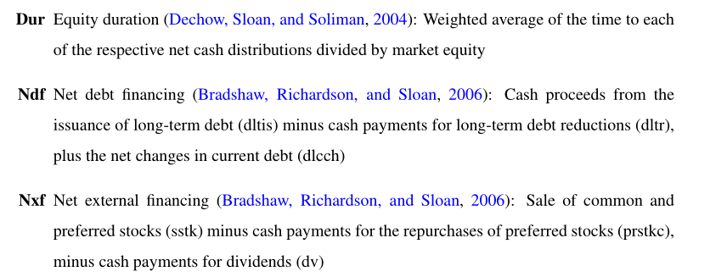
2. Research design : Variable
Factor proxies

Slide 13
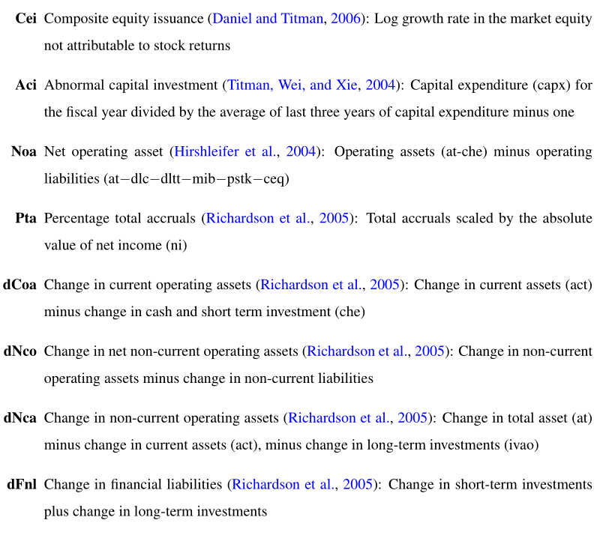
2. Research design : Variable

Slide 14
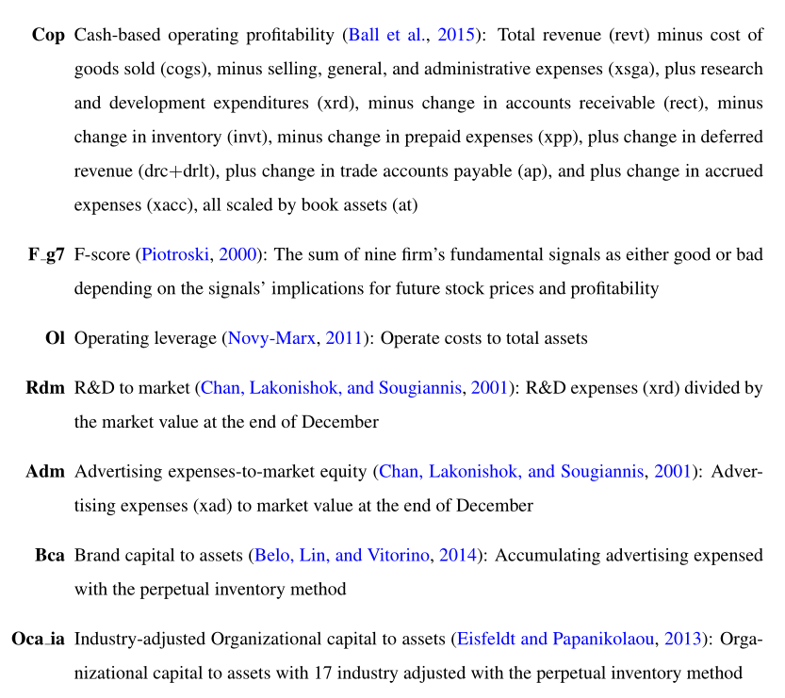
2. Research design : Variable

Slide 15
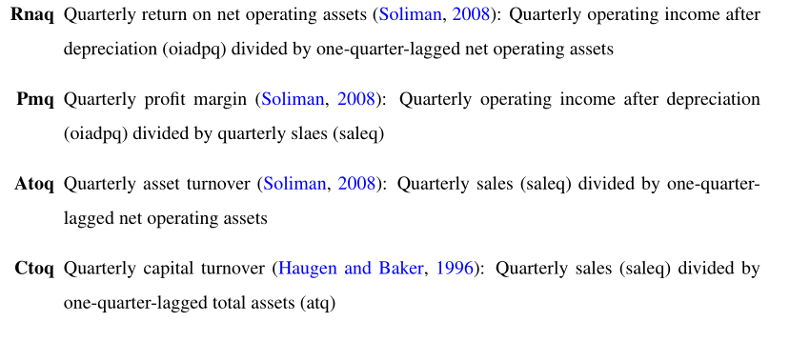
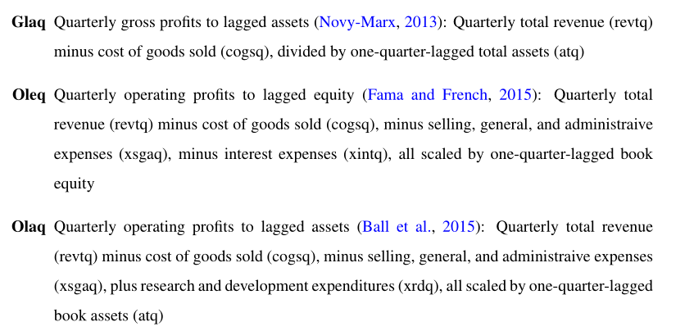
2. Research design : Variable

Slide 16
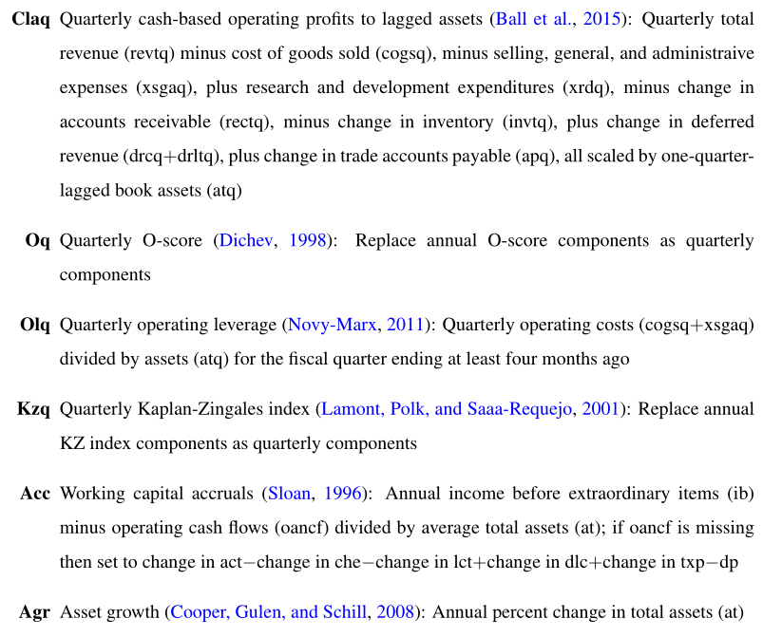
2. Research design : Variable

Slide 17
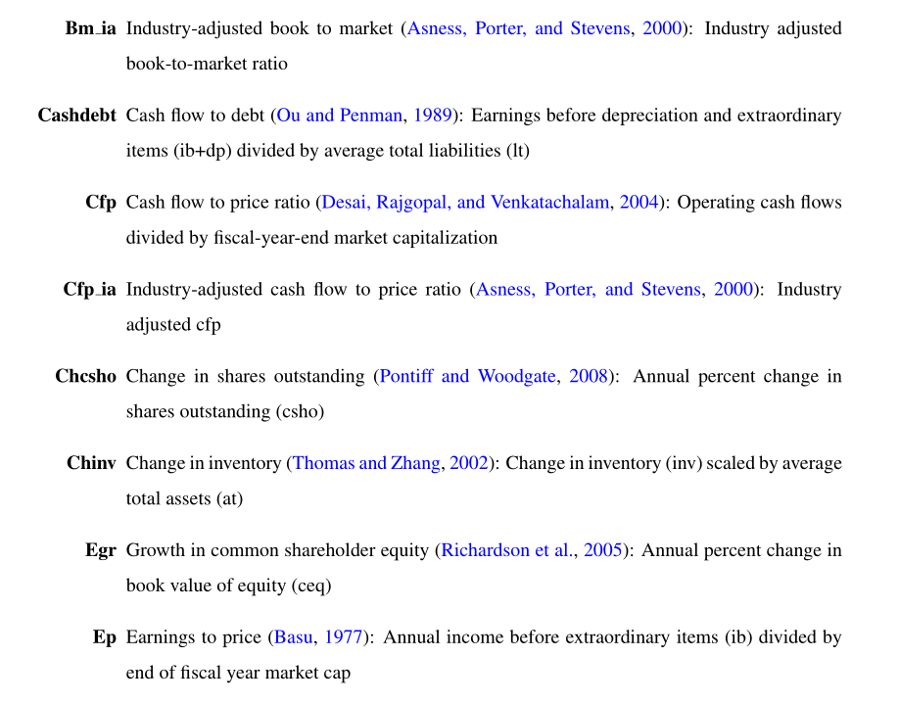
2. Research design : Variable

Slide 18
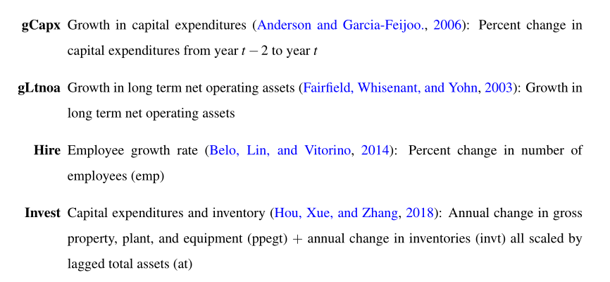
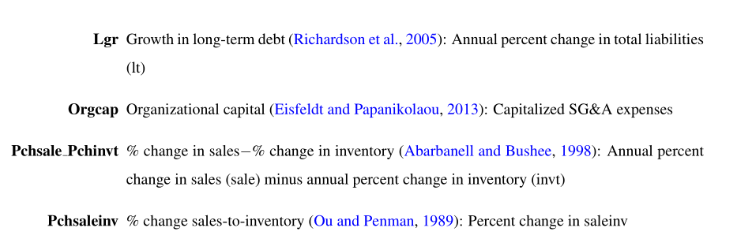
2. Research design : Variable

Slide 19
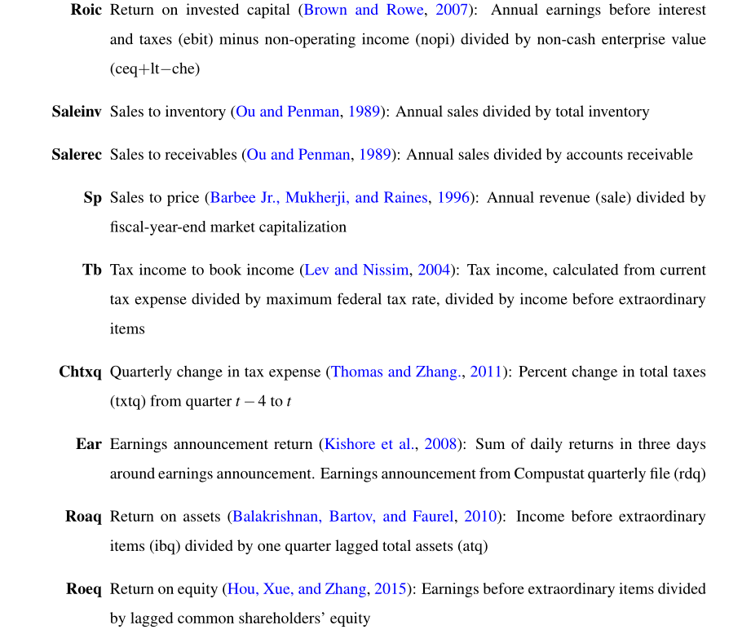
2. Research design : Variable

Slide 20
2. Research design : Data
Company financial data： CRSP、 Compustat
Period：1974 - 2016 month data.
Sample: our sample consists of all New York Stock Exchange (NYSE), American Stock Exchange (Amex), and Nasdaq. If a stock is included in the test if it has at least 24 month returns.

Slide 21
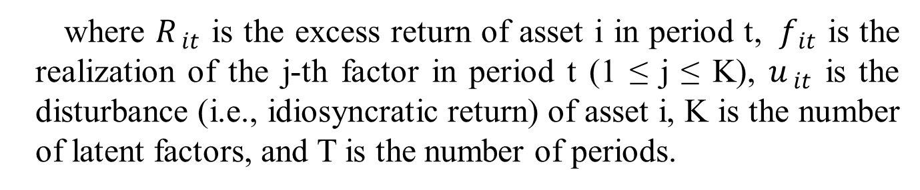
2. Research design : method
We assume that basis assets that represent the cross section of stock returns are governed by a latent multi-factor model:
where $R_{ it}$ is the excess return of asset i in period t, $f_{ it}$ is the realization of the j-th factor in period t (1 ≤ j ≤ K), $u_{ it}$ is the disturbance (i.e., idiosyncratic return) of asset i, K is the number of latent factors, and T is the number of periods.

Slide 22

2. Research design : method
The factors are assumed to be related to a number of factor proxies:
where $g_{ 1}$ ,··· $g_{ L}$are L observable variables that can be highly correlated with factor $f_{ k}$.

Slide 23



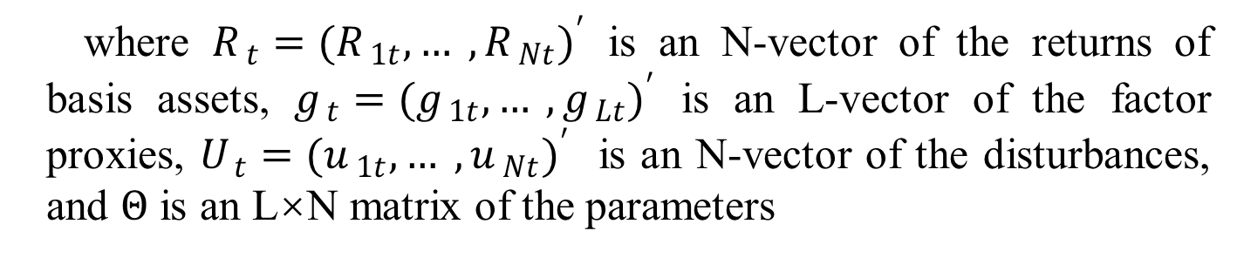
2. Research design : RRA
where $R_{ t}={(R_{ 1t},… , R_{ Nt})}^{′}$ is an N-vector of the returns of basis assets, $g_{ t}={(g_{ 1t},… , g_{ Lt})}^{′}$ is an L-vector of the factor proxies, $U_{ t}={(u_{ 1t},… , u_{ Nt})}^{′}$ is an N-vector of the disturbances, and $Θ$ is an L×N matrix of the parameters
where $Φ$ is an L×K matrix of $φ_{ kl}$ and is a K×N matrix of $β_{ ik}$.
Then it is clear that

Slide 24



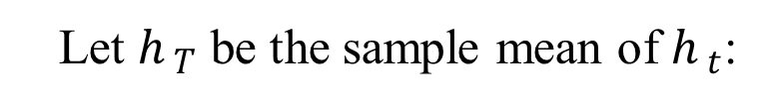
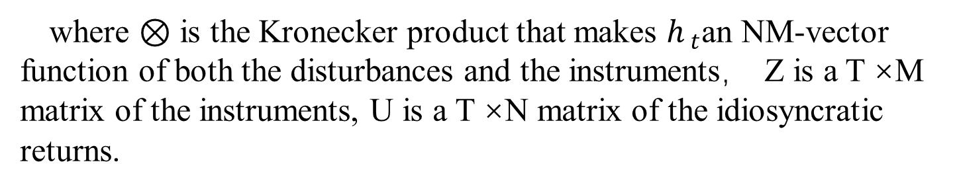
2. Research design : RRA
Let $Z_{ t}$ be an M-vector of the instruments available at time t. Then, the moment condition is
where $⊗$ is the Kronecker product that makes $h_{ t}$an NM-vector function of both the disturbances and the instruments， Z is a T ×M matrix of the instruments, U is a T ×N matrix of the idiosyncratic returns.
Let $h_{ T}$ be the sample mean of $h_{ t}$:

Slide 25


2. Research design : RRA
Then the GMM estimator solves the following minimization problem:
where $W_{ T}$ is an NM×NM weighting matrix that is positive definite.
In terms of the notation of this paper, M = L+1 and

Slide 26
2. Research design : RRA
if the weighting matrix is of the following form :
we can solve the problem analytically in two steps.

Slide 27

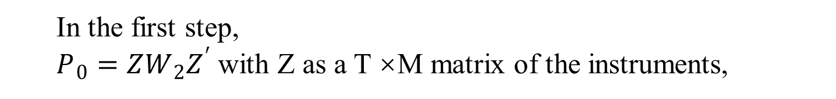
2. Research design : RRA
In the first step,
$P_{ 0}=ZW_{ 2}Z^{′}$ with Z as a T ×M matrix of the instruments,
$$P=P_{ 0}−P_{ 0}X{\left(X^{′}P_{ 0}X\right)}^{−1}X^{′}P_{ 0}$$
where X is a T-vector of ones
A=
R is a T ×N matrix of the returns, and G is a T ×L matrix of the factor proxies.
E is the L × K matrix that stacks the ‘standardized’ eigenvectors corresponding to the K largest eigenvalues of A

Slide 28



2. Research design : RRA
In the second step, to estimate
$Θ=Φβ$,
Under a suitable normalization such that the first K columns of β is an identity matrix, the estimates of Φ and β are uniquely given by
$G^{∗}=G\hat{Φ}$

Slide 29


2. Research design : RRA
Conditional on $Θ$, the estimate of α can be solved analytically as
The estimated factors will then be given by
Theoretically, the estimators are asymptotically consistent, but not necessarily optimal with the minimum covariance matrix.

Slide 30

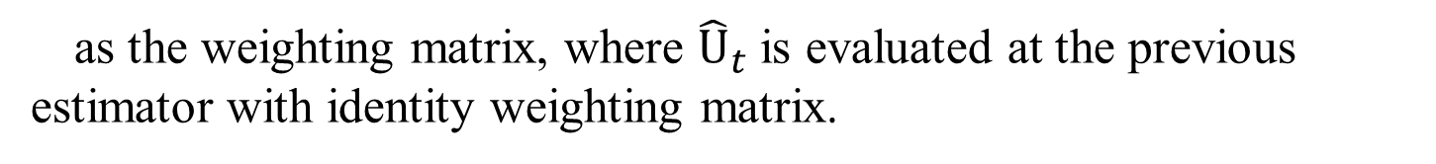
2. Research design : RRA
If one is interested in improving the accuracy, it is easy to have a new estimator by using the inverse of
as the weighting matrix, where ${\hat{U}}_{t}$ is evaluated at the previous estimator with identity weighting matrix.

Slide 31


2. Research design : PCA & PLS
the PCA solves
the PLS solves

Slide 32
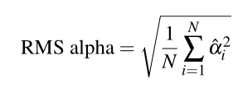
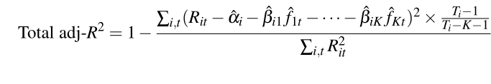
2. Research design : Performance measures
The first measure is
The second measure is

Slide 33
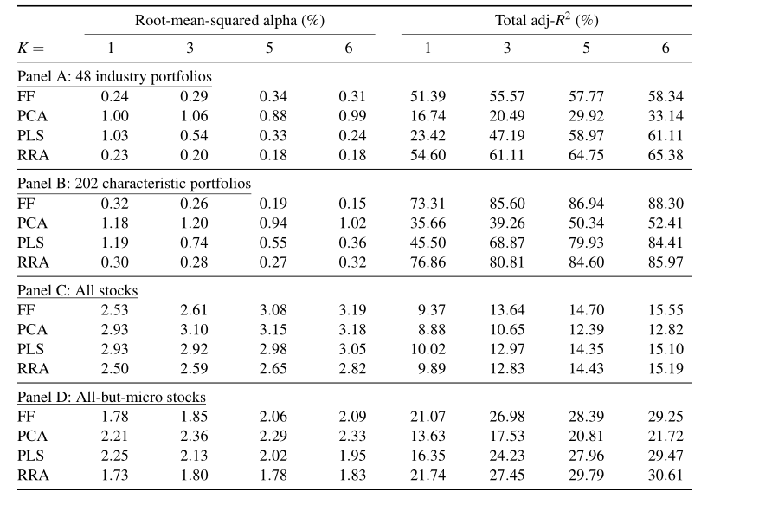
3. Empirical result: In-sample performance
Panel A shows that the RMS alphas of the FF one-, three-, five-, and six-factor models for explaining the 48 industry portfolios are 0.24%, 0.29%, 0.34%, and 0.31%.
When turning to the total adj-R2, these four FF models explain 51.39%, 55.57%, 57.77%, and 58.34% of cross-sectional variations in the 48 industry portfolios.
one may conclude that the market factor is the most important one and the momentum factor has little incremental power

Slide 34
3. Empirical result: In-sample performance
The second row of Panel A shows that the PCA factor models explain the 48 industry portfolios poorly. The one-, three-, five-, and six-factor RMS alphas are 1.00%, 1.06%, 0.88%, and 0.99%, and the corresponding total adj-R2s are 16.74%, 20.49%, 29.92%, and 33.14%, which are much worse than the results of the corresponding FF factor models.

Slide 35
3. Empirical result: In-sample performance
The third row of Panel A shows that the PLS factors outperform the PCA factors, and perform similarly as the FF factors when K ≥ 5.
It may be a good model for explaining the cross section of stock returns, especially when the number of factors is relatively large.

Slide 36
3. Empirical result: In-sample performance
The last row of Panel A shows that the RRA factor model performs the best in explaining the 48 industry portfolios. That is, its RMS alpha is the smallest and total adj-R2 is the largest, compared with the FF, PCA, and PLS factor models.

Slide 37
3. Empirical result: In-sample performance
Panel B considers the 202 characteristic portfolios in Giglio and Xiu (2019) as the test assets. Since most of the portfolios are finer sorts of the FF five factors, the pricing power should tilt toward the FF five-factor model. the RRA factor models perform much better than the PCA and PLS when K ≤ 5, and the performances are close to that of the FF models.

Slide 38
3. Empirical result: In-sample performance
When the test assets are all individual stocks, the FF, PLS, and RRA models perform similarly when they are restricted to have the same number of factors.
A model with more than five factors provides little incremental power in explaining the cross section of individual stock returns relative to a five-factor model.

Slide 39
3. Empirical result: In-sample performance
Since both the PLS and RRA use information in the basis assets in estimating the factors, one natural question is whether their pricing performance is sensitive to the choice of the basis assets.
To answer this question, we use the 202 characteristic portfolios in Giglio and Xiu (2019) as basis assets to estimate the factors.

Slide 40
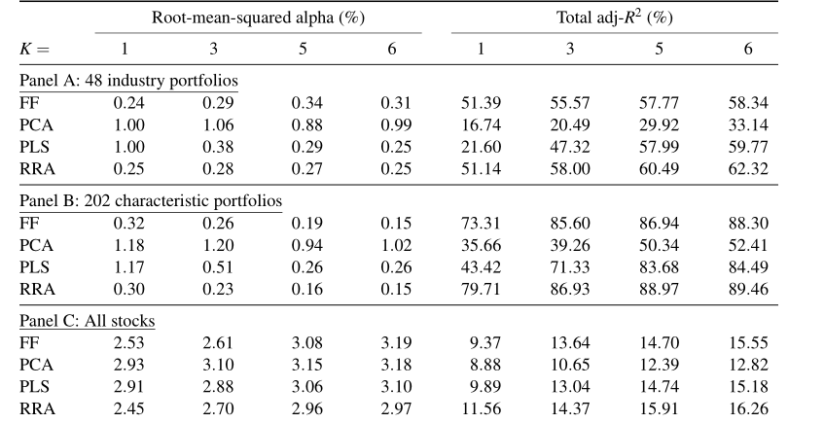
3. Empirical result: In-sample performance
when the test assets are portfolios, RRA may have greater pricing power than the other; but when the test assets are the universe of individual stocks, the FF, PCA, PLS, and RRA models perform similarly.

Slide 41
3. Empirical result: Out-of-sample performance
One natural question is how the performances change over time if the factor weights are constructed ex ante. To answer this question, we use the first 30-year data to estimate the weights, and assign the weights to the rest 13-year data to estimate the PCA, PLS, and RRA factors. For each individual asset, we employ a 60-month rolling window approach, requiring at least 24 observations, to calculate the out-of-sample RMS alphas and total adj-R2. As a result, the out-of-sample evaluation period is January 2006 to December 2016.

Slide 42
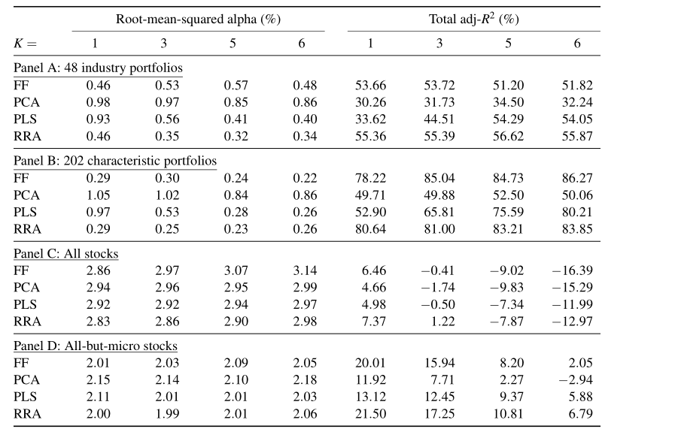
3. Empirical result: Out-of-sample performance
The reason for this poorer out-of-sample performance is twofold. First, as we use the 60-month rolling-window approach in calculating the out-of-sample performance, this small sample for estimating each asset’s risk exposures undoubtedly gives rise to more estimation errors. Second, since the in- and out-of-sample sample periods are different (1974–2016 vs. 2006–2016), the pricing power of the factor models over the 1974–2005and 2006–2016periods can be different.

Slide 43
3. Empirical result: Out-of-sample performance
First, to price the 48 industry portfolios, a five-factor model seems adequate.
Second, when the number of factors is suitably specified, the weights on the PCA, PLS, and RRA factors are relatively stable over time.
The RRA factors also perform very well and have performances close to that of the FF factors.

Slide 44
3. Empirical result: Out-of-sample performance
In summary, both show that the conclusion that the 70 factor proxies do not have enough new information relative to the FF factors continues to hold out-of-sample, when the test assets are individual stocks rather than portfolios.

Slide 45

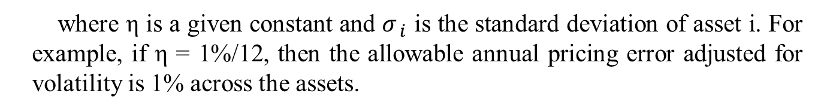
3. Empirical result: pricing error restrictions
This section shows that how the factors can be chosen conditional on a given degree of pricing error.
It is intuitive that the pricing error is likely greater for more volatile assets. Hence, it seems more sensible to consider a pricing error restriction as the following form
where η is a given constant and $σ_{ i}$ is the standard deviation of asset i. For example, if η = 1%/12, then the allowable annual pricing error adjusted for volatility is 1% across the assets.
Mathematically, we replace R by subtracting $α$ from each of its rows.

Slide 46
3. Empirical result: pricing error restrictions
This section explores how a pricing error restriction affects the pricing performance of the RRA factors.
Without loss of generality, we consider the pricing error constraint with four scenarios: η =0, 0.5/12, 1/12, and 1.5/12, suggesting that the pricing error ranges from zero to 1.5/12 times of the standard deviation.
Conceptually, if a K-factor model prices the basis assets well, a zero alpha restriction does not affect the pricing performance, and in contrast, a non-zero alpha restriction will reduce the pricing performance.

Slide 47
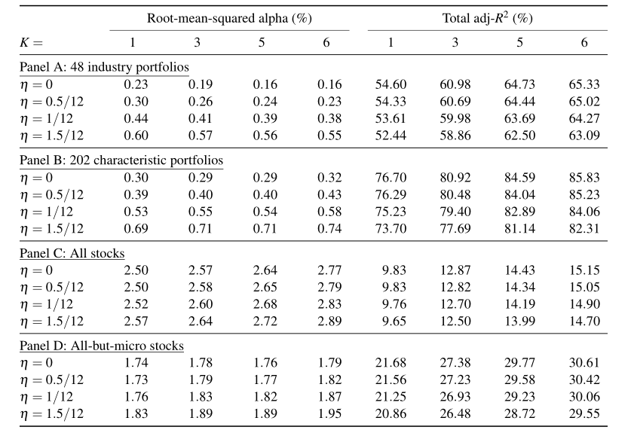
3. Empirical result: pricing error restrictions
First, imposing a zero alpha constraint does not dramatically affect the pricing performance of the RRA factors in this paper.
Second, a non-zero alpha restriction greatly and negatively affects the RMS alphas but has a negligible effect on the total adj-R2 when pricing portfolios.

Slide 48
3. Empirical result: pricing error restrictions
Third, a non-zero alpha restriction has a negligible effect on both the RMS alphas and total adj-R2 when pricing individual stocks.
Fourth, the RRA factors do a good job for describing the average returns of portfolio returns, with negligible effects on the RMS alphas. At the same time, the RRA factors fail to do a good job for describing the average returns of individual stocks.

Slide 49
3. Empirical result: pricing error restrictions
Finally, a five-factor model seems suitable for pricing all the four sets of testing assets. When the number of factors increases from five to six, the RMS alphas do not decrease but slightly increase in most of the cases, and the total adj-R2 do not change very much.

Slide 50
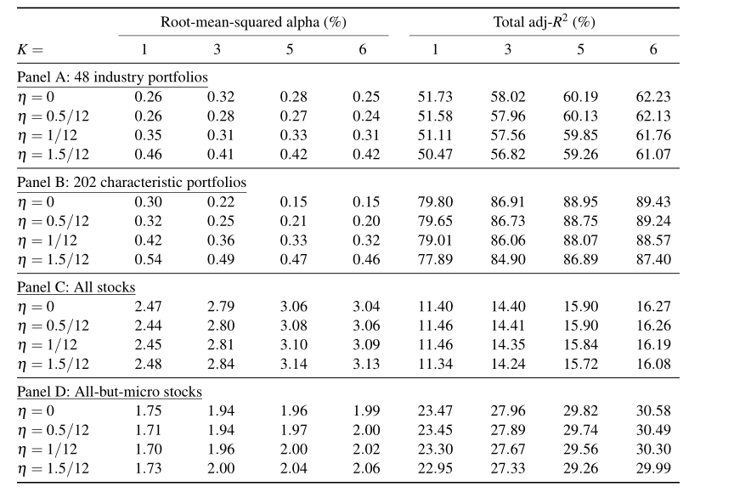
3. Empirical result: pricing error restrictions
This pattern continues to hold when η is not equal to zero. Table 7 confirms this finding when the basis assets are the 202 characteristic portfolios
In sum, a pricing error restriction may affect the RMS alpha for pricing portfolios in-sample in some cases, but has a negligible effect.

Slide 51
3. Empirical result: pre-specified factors
In this section, we answer the second question in this paper: given the prominent FF five factors, are there other factors that provide incremental information for explaining the cross section of stock returns?

Slide 52

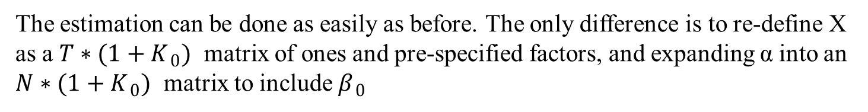
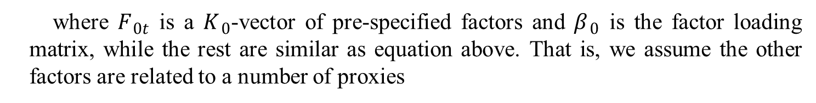
3. Empirical result: pre-specified factors
In this case, we have the following multi-factor model for the basis assets:
where $F_{ 0t}$ is a $K_{ 0}$-vector of pre-specified factors and $β_{ 0}$ is the factor loading matrix, while the rest are similar as equation above. That is, we assume the other factors are related to a number of proxies
where $g_{ 1t},… , g_{ Lt}$ are L factor proxies excluding $F_{ 0t}$
The estimation can be done as easily as before. The only difference is to re-define X as a $T∗(1+K_{ 0})$ matrix of ones and pre-specified factors, and expanding α into an $N∗(1+K_{ 0})$ matrix to include $β_{ 0}$

Slide 53
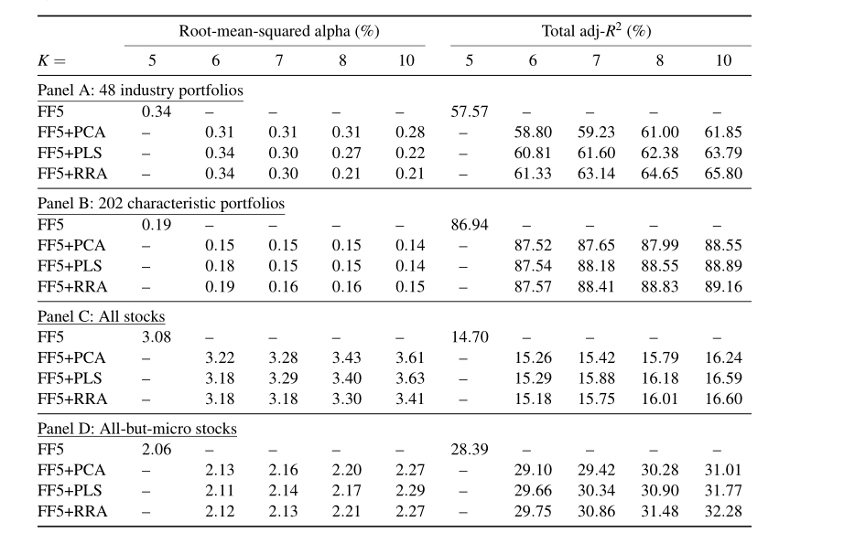
3. Empirical result: pre-specified factors
Apparently, the better performance with the RRA factors is expected as they are designed to describe the average returns of the 48 industry portfolios. Regarding the total adj-R2 , it does not increase very much relative to the FF five factors when we increase the number of factors even to 10.
When turning to the case where the test assets are not basis assets, the PCA, PLS, and RRA factors have no incremental power for describing the average returns of portfolios and individual assets

Slide 54
3. Empirical result: pre-specified factors
These results suggest that adding more factors to the FF five-factor model cannot substantially increase the pricing power, regardless how the additional factors are extracted.
We conclude this section that there are too few factors that are useful, and the future research is to identify new factors that contain incremental information relative to the FF five factors.

Slide 55
4. Conclusion
We provide a simple reduced-rank approach (RRA) for shrinking factor dimension, a solution to dealing with the large number of observable factors discovered by the empirical finance literature, which performs better than PCA and PLS to some extent.
We find that, while the 70 factor proxies improve the pricing performance at the portfolio level, they do not provide much new information at the stock level relative to the FF five factors.
In addition, we extend the RRA to include the FF five factors as pre-specified factors, and find that linear combinations of the remaining factor proxies do not improve much the performance.

