Slide 1
Forecasting Corporate Bond Returns with a Large Set of Predictors: An Iterated Combination Approach
Hai Lin, Chunchi Wu, Guofu Zhou
MANAGEMENT SCIENCE
September 2018
王念硕

Slide 2
Outline
Introduction
Research design
Empirical result
Conclusion

Slide 3
1. Introduction
Background
The vast studies have considerably improved our understanding for time variations in equity and bond risk premia and their roles in asset pricing, portfolio allocation, risk management, and performance evaluation of investment managers.
There is a large body of literature on whether stock returns are predictable, and there is also an equally impressive number of studies on government bond returns, but there is only a handful of research on the predictability of corporate bond returns

Slide 4
1. Introduction
Motivation
There are few studies on the risk premium of bonds.
Few studies predict bond yield by reducing dimension from high-dimensional variables.

Slide 5
1. Introduction
Research question
The first is what economic variables can have predictive power for corporate bond returns.
The second question is how to combine the information from a large set of predictors to obtain optimal bond return forecasts.
The third question is whether the predictability is of economic value.
The fourth question is what the economic sources are that drive the corporate bond return predictability.

Slide 6
1. Introduction
Related researches
Chordia et al. (2016) and Choi et al. (2016) study the cross-sectional predictability of corporate bond returns, investigating whether equity variables that capture stock return anomalies can explain the cross section of expected bond returns.
Greenwood et al. (2013) and Lin et al. (2014) further identify issuer quality and liquidity and forward rate factors, separately, as additional predictors for corporate bond returns.
Watson (2001) find that a simple mean combination (MC) method is the favored strategy rather than using dozens of individual predictive models.

Slide 7
1. Introduction
Research Contents
In this paper, we consider three types of predictors that are relevant in theory for corporate bond returns: stock market, Treasury market, and corporate bond market variables. Most of these variables can predict bond yields.
The pooling of information from the large set of predictors improves the predictability of corporate bond returns dramatically by using Iterated Combination Approach.
The average utility gains from the predictability based on the Iterated Combination Approach are 5.74% at the monthly horizon.
On source of predictability, we find that risk premia of bonds with different ratings contain important information about future macro-economic activities at short and long horizons.

Slide 8
1. Introduction
Contribution
This research helps understand the time-varying risk premia in the corporate bond market.
A methodological contribution of this paper is that we provide a simple method to improve the MC and WC further by combining them again with the historical sample mean forecast.

Slide 9
2. Research design
27 predictors
Iterated Combination Approach
Prediction power of single predictor
Combination Approach
Predictive power of aggregate information
PCA
The economic value of the predictability
FF Regression
Economic sources of predictive power

Slide 10
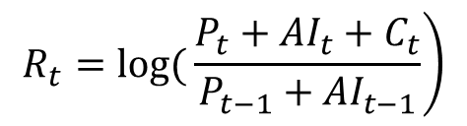
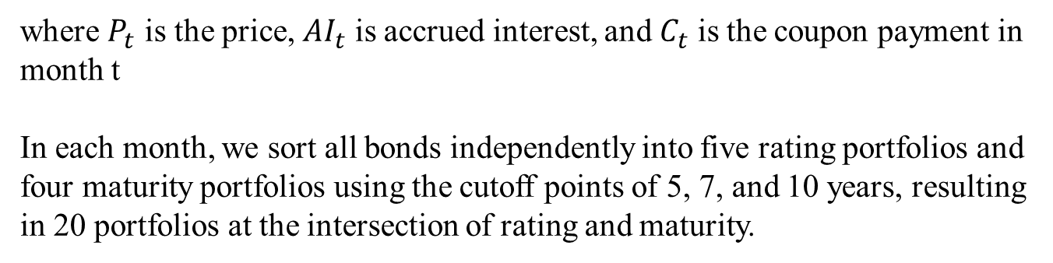
2. Research design : Variable
Monthly Returns
The monthly corporate bond log return as of time t is as follows:
$$\left.R_{t}=\log{(}\frac{P_{t}+{AI}_{t}+C_{t}}{P_{t−1}+{AI}_{t−1}}\right)$$
where $P_{t}$ is the price, ${AI}_{t}$ is accrued interest, and $C_{t}$ is the coupon payment in month t
In each month, we sort all bonds independently into five rating portfolios and four maturity portfolios using the cutoff points of 5, 7, and 10 years, resulting in 20 portfolios at the intersection of rating and maturity.

Slide 11
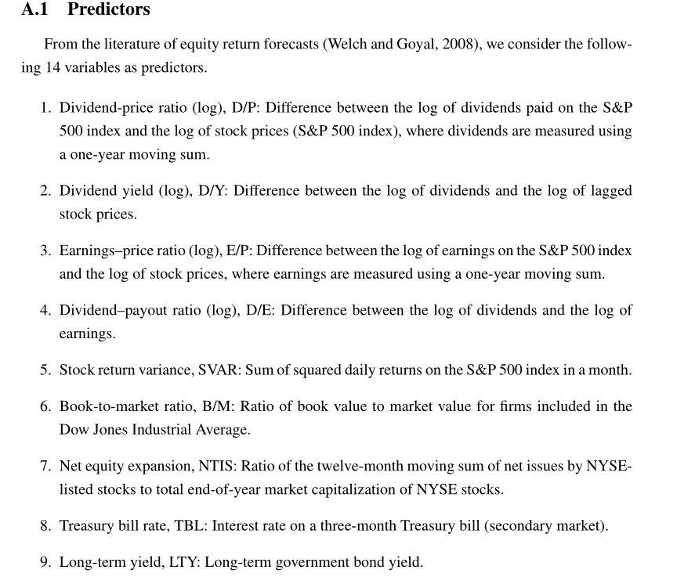
2. Research design : Variable
27 predictors

Slide 12
2. Research design : Data
Corporate bond data：the Lehman Brothers Fixed Income (LBFI) database, Datastream, the National Association of Insurance Commissioners (NAIC) database, the Trade Reporting and Compliance Engine (TRACE) database, and Mergent’s Fixed Investment Securities Database (FISD)
Period：January 1973 to June 2012 monthly data.
Sample: We exclude bonds with maturity less than two years and longer than 30 years.

Slide 13


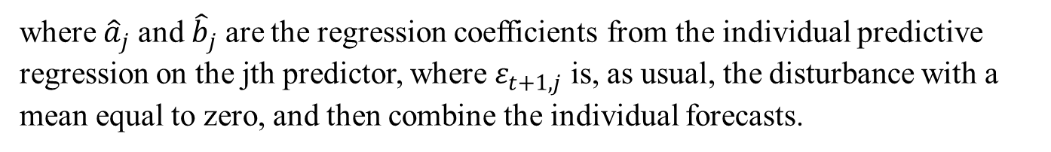
2. Research design : method
Forecast Combination Methods
where $r_{t+1}$ is the excess return of a corporate bond , $z_{jt}$ is the jth predictor at time t
where${\hat{a}}_{j}$ and ${\hat{b}}_{j}$ are the regression coefficients from the individual predictive regression on the jth predictor, where $ε_{t+1,j}$ is, as usual, the disturbance with a mean equal to zero, and then combine the individual forecasts.

Slide 14

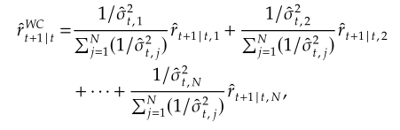
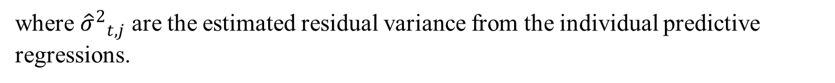
2. Research design : method
A mean combination forecast will be the average of the N individual forecasts that utilizes the information of all predictors:
The weighted-average forecast:
where ${{\hat{σ}}^{2}}_{t,j}$ are the estimated residual variance from the individual predictive regressions.

Slide 15
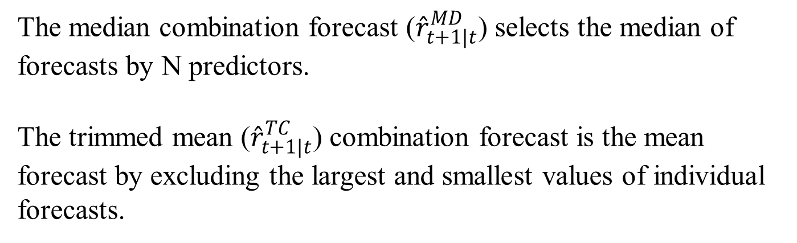
2. Research design : method
The median combination forecast (${\hat{r}}_{t+1|t}^{MD}$) selects the median of forecasts by N predictors.
The trimmed mean (${\hat{r}}_{t+1|t}^{TC}$) combination forecast is the mean forecast by excluding the largest and smallest values of individual forecasts.

Slide 16


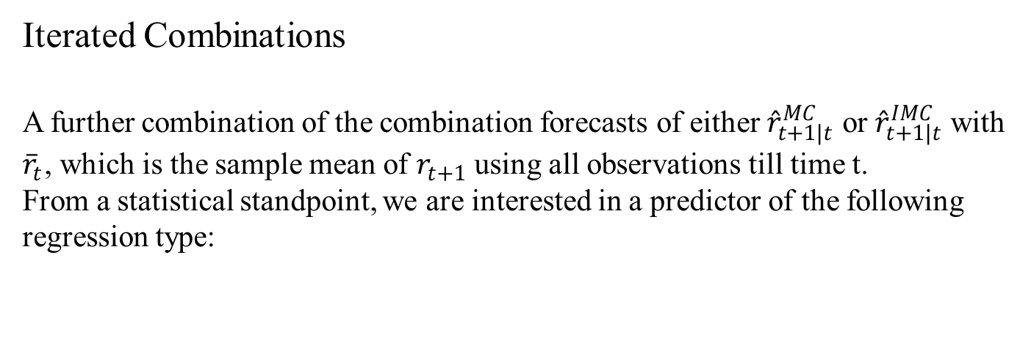
2. Research design : method
Iterated Combinations
A further combination of the combination forecasts of either ${\hat{r}}_{t+1|t}^{MC}$ or ${\hat{r}}_{t+1|t}^{IMC}$ with ${\overline{r}}_{t}$, which is the sample mean of $r_{t+1}$ using all observations till time t.
From a statistical standpoint, we are interested in a predictor of the following regression type:
where $u_{t+1}$ is the noise. Instead of using the bivariate regression, we use the constrained version:
because it has an interesting portfolio diversification interpretation.

Slide 17


2. Research design : method
Iterated Mean Combination (IMC) forecast
Iterated Weighted Combination (IWC) forecast

Slide 18
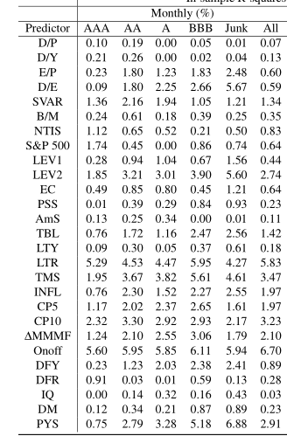
3. Empirical result: In-sample test
Individual predictors have varying predictive power and each of these predictors contains information in different dimensions for returns of bonds with distinct quality and premium components.
There is considerable room for combining individual forecasts to increase the predictive power of the model.

Slide 19
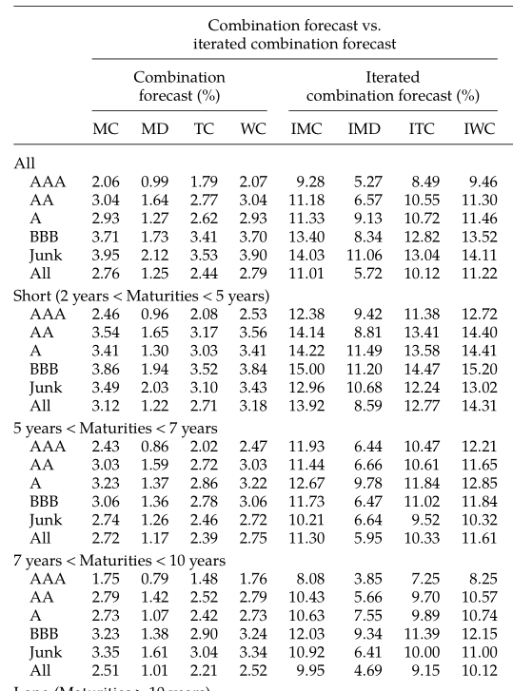
3. Empirical result: In-sample test
Consistent with the literature, combination forecasts are valuable in combining the information. Furthermore, the MC and WC appear to perform the best among the four combination methods.

Slide 20
3. Empirical result: In-sample test
As shown in the right panel of the table, each of the four iterated combination forecasts has a substantially higher R2 than its respective combination counterpart.

Slide 21
3. Empirical result: In-sample test
We now compare the IWC forecast with three major alternative forecasts in the literature.
The first is the PCA forecast that is based on the first principal component of all predictors.
The second is the FF model (Fama and French 1989) model that uses default spreads and term spreads as predictors.
The third is the Greenwood–Hanson (2013) model (hereafter referred to as GH) that uses the Treasury bill rates, lagged high-yield bond returns, and the issuer quality ratio as predictors.

Slide 22
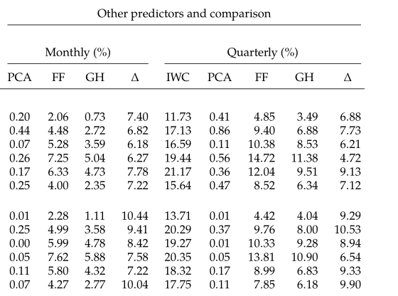
3. Empirical result: In-sample test
The FF model performs well with an average in-sample R2 of 4% for the monthly forecast and 8.52% for the quarterly forecast.
the GH model does not perform better than FF even in the in-sample forecast.
The principal component predictor PCA has poor performance too.

Slide 23
3. Empirical result: In-sample test
The last column for each forecast horizon in the right panel reports the difference in the R2 values between the prediction using the IWC predictor and that using the FF model, to further highlight the improvement of the IWC.
The superior performance of the IWC is robust across ratings and maturities

Slide 24
3. Empirical result: Out-of- sample test
Welch and Goyal (2008) argue forcefully that in-sample predictability can be due to overfitting, and out-of- sample forecasting is a more stringent test of return predictability. Henceforth, we shall focus on out-of-sample results in the remaining analysis.

Slide 25
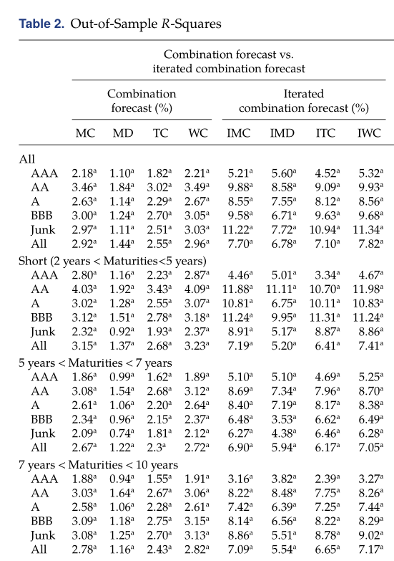
3. Empirical result: Out-of- sample test
First, all of the combination methods deliver positive and statistically significant R2 values, implying that they are indeed robust forecasting procedures that are able to predict returns both in-sample and out-of-sample.
Second, the MD (median combination forecast) seems to have the worst performance among the four combinations.

Slide 26
3. Empirical result: Out-of- sample test
Third, the iterated combinations improve their original combinations substantially.
Overall, results strongly suggest that iterated combination is a superior method to generate more efficient forecasts.

Slide 27
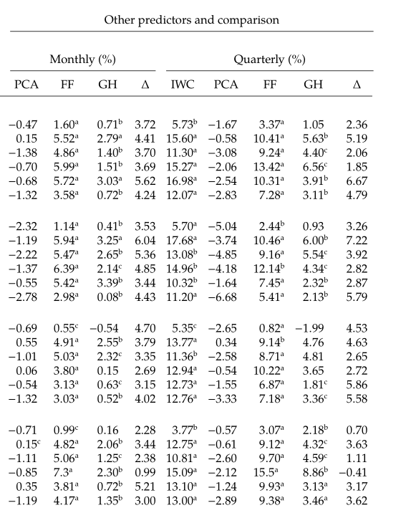
3. Empirical result: Out-of- sample test
The IWC has the best out-of-sample predictive performance among the four models
Interestingly, these out-of-sample R2 values are substantially higher than those for forecasting the stock risk premium. For example, Rapach et al. (2010) report an out-of-sample R2 of only about 1% for the quarterly forecast during 1975–2005. Thus, the results suggest that the corporate bond market is much more predictable than the stock market.

Slide 28
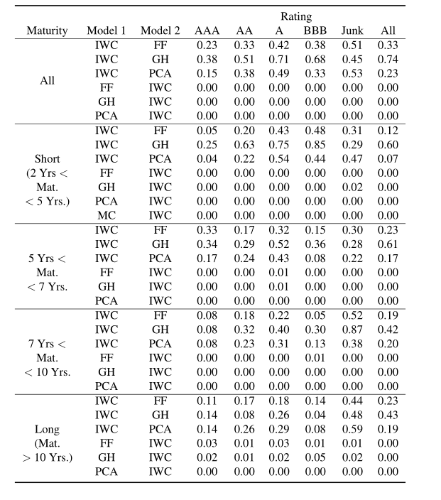
3. Empirical result: Forecast encompassing tests
We also conduct forecast encompassing tests using the HLN statistics of Harvey et al. (1998) to formally evaluate which model is better. The empirical results show that the IWC model encompasses other models strongly

Slide 29
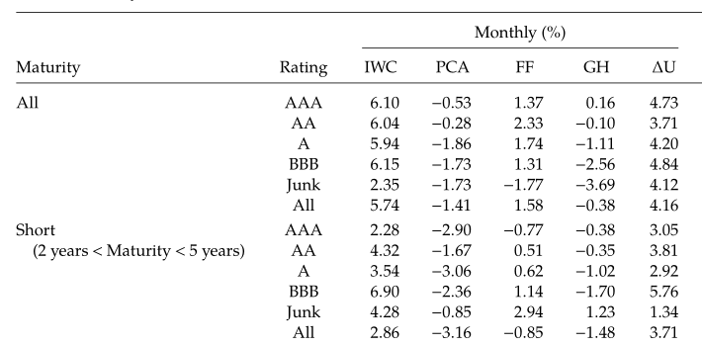
3. Empirical result: Certainty equivalent returns
Table 3 reports results of economic significance measured by utility gains or certainty equivalent returns (CER).
The risk aversion coefficient is set equal to 5, and the optimal weight is between 0 (short-sales constraint) and 5, similar to other studies such as Thornton and Valente (2012) and Goh et al. (2013).

Slide 30
3. Empirical result: Certainty equivalent returns
The utility gains of the IWC are much larger than those of the FF, which in turn are often much larger than those of the GH and PCA.
The last column in both panels of Table 3 reports the differences in utility gains between the IWC and FF models. These differences are overwhelmingly positive for both monthly and quarterly forecast horizons.

Slide 31
3. Empirical result: Certainty equivalent returns
For the monthly forecast, the utility gain is 5.74% for the sample that includes all bonds. there is substantial economic value of using a large set of predictors and the proposed methodology in bond return forecasts.

Slide 32
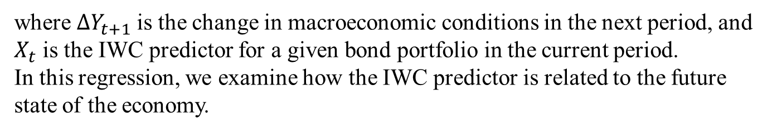

3. Empirical result: Source of predictability
In this section, we examine how the IWC predictor links to economic fundamentals to under-stand more about the source of its predictive power. Cochrane (2007) suggests that return forecasts are more plausibly related to macroeconomic risk if the return predictors also demonstrate an ability to forecast business cycle. The predictability can then be more credibly attributed to time-varying risk premia due to changing risks or risk aversion.
Consider the following predictive regression:
$$∆Y_{t+1}=α+βX_{t}+ε_{t+1}$$
where $∆Y_{t+1}$is the change in macroeconomic conditions in the next period, and $X_{t}$ is the IWC predictor for a given bond portfolio in the current period.
In this regression, we examine how the IWC predictor is related to the future state of the economy.

Slide 33
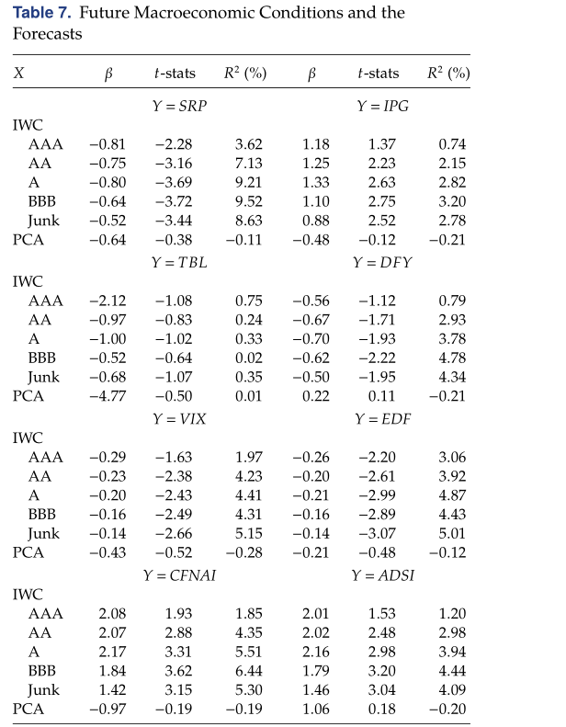
3. Empirical result: Source of predictability
The results strongly indicate that the IWC predictor has high predictive power for the future change in economic conditions.
An important finding is that the IWC predictor associated with lower-grade bonds has much higher predictive power than that associated with higher-grade bonds.

Slide 34
3. Empirical result: Source of predictability
Results show that the predicted premia by the IWC for BBB and junk bonds have consistently higher predictive power for future economic activity than those of higher-grade bonds. These findings suggest that the expected excess return or risk premium of lower-grade bonds contains substantially more information for future economic activity than that of higher-grade bonds.

Slide 35
3. Empirical result: Source of predictability
By contrast, none of the results using the PCA to predict future economic conditions is significant and the adjusted R-squares are extremely low.
In summary, our empirical results strongly suggest that the predictive power of the IWC forecast is derived from its ability to forecast future macroeconomic conditions.

Slide 36
4. Conclusion
We show that the proposed iterated combination method is capable of retaining the useful information and reducing noise in individual predictors to obtain much better forecasts.
The predictor based on the iterated combination method in in-sample and out-of-sample forecasts in terms of both statistical and economic significance.
On source of predictability, we find that risk premia of bonds with different ratings contain important information about future macro-economic activities at short and long horizons.

