Slide 1
Extrapolative Beliefs in the Cross-Section: What Can We Learn from the Crowds?
Zhi Da, Xing Huang, Lawrence J. Jin
Working Paper
March 2020
王念硕

Slide 2
Outline
Background
Motivation
Research question
Related researches
Research Contents
Contribution
Framework
Introduction
Research design
Empirical result
Conclusion & Comment
Variable
Data
Method
Forming expectations
Return predictability of expectations

Slide 3
1. Introduction
Background
A central question in finance is how investors form expectations about future asset returns. The available evidence suggests that the notion that investors’ expectations about an asset’s future return are a positive function of the asset’s recent past returns.
Recent models of Barberis, Greenwood, Jin, and Shleifer (2015) and Jin and Sui (2019) show that return extrapolation helps explain facts about the aggregate stock market such as excess volatility and predictability of stock market returns.

Slide 4
1. Introduction
Motivation
Despite intuitive theoretical appeal, extrapolation models have thus far been tested primarily with data on the aggregate stock market. There has been very little direct evidence on how investors form expectations about individual stock returns, whether these expectations are rational, and how they relate to subsequent returns.

Slide 5
1. Introduction
Research question
How do investors form the expected returns of individual stocks?
Whether these expectations are accurate or systematically biased?
Can these expectations obtain excess return?

Slide 6
1. Introduction
Related researches
Recent work, including Vissing-Jorgensen (2004), Bacchetta, Mertens, and van Wincoop (2009), Amromin and Sharpe (2013), Greenwood and Shleifer (2014), and Kuchler and Zafar (2019), provides convincing evidence of return extrapolation, the notion that investors' expectation of future stock returns is positively correlated with past returns.
Recent models of Barberis, Greenwood, Jin, and Shleifer (2015) and Jin and Sui (2019) show that return extrapolation helps explain facts about the aggregate stock market such as excess volatility and predictability of stock market returns.
Cassella and Gulen (2018) analyze the relation between investor expectations about aggregate stock market returns and the relative pricing of stocks in the cross-section.

Slide 7
1. Introduction
Research Contents
We first estimate, across stocks, tow regressions of investor expectations on past stock returns and find that individuals extrapolate from a stock’s recent past returns when forming expectations about its future return.
These expectations are negatively related to subsequent returns, indicating that they are not fully rational.
We evaluate the economic significance and generalizability of our return predictability results. A trading strategy generates a significant profit of 7 basis points per day.

Slide 8
1. Introduction
Contribution
In this paper, we provide some of the first direct evidence of investor expectations about individual stock returns and add to a literature that uses survey data to study investor beliefs.
Our cross-sectional analysis provides new empirical regularities that can inform future theoretical work on investor beliefs.

Slide 9
1. Introduction
Framework
Investor expectations——consensus Forcerank score
Drivers of investor expectations
Linear model、
Exponential decay model
Accuracy of investor expectations
Investment strategy based on investors' expectations

Slide 10
2. Research design: Variable
Forcerank score:
Forcerank is a crowdsourcing platform that organizes weekly competitions in which participants enter thematic games, and in each game, rank a list of ten stocks according to their perceived performance (percentage gain) of these stocks over the next week.
Among users who choose to participate on Forcerank, they are likely to truthfully reveal their relative return expectations across stocks in the game.

Slide 11
2. Research design: Data
Data Source： Forcerank、CRSP
Period：February 2016 to December 2017 daily data of Forcerank, April 2001 to December 2017 daily data of CRSP.
Sample: Our sample contains mostly industry contests (1,318 out of a total of 1,396 contests)

Slide 12
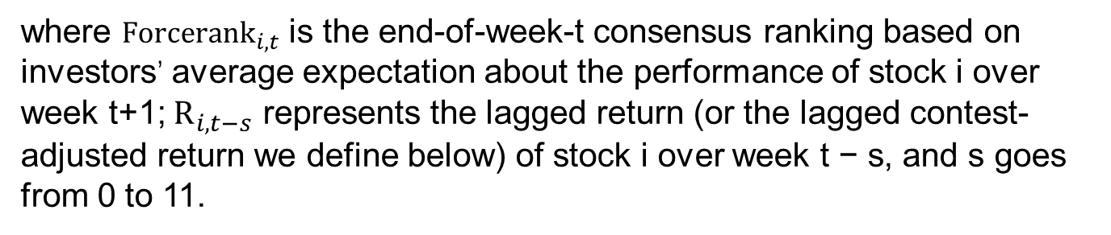
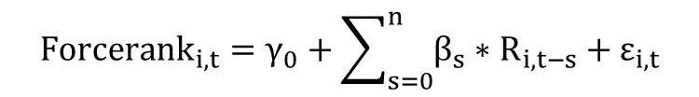
2. Research design: Method
Linear model
$${Forcerank}_{i,t}=γ_{0}+\sum_{s=0}^{n}{β_{s}∗R_{i,t−s}}+ε_{i,t}$$
where ${Forcerank}_{i,t}$ is the end-of-week-t consensus ranking based on investors’ average expectation about the performance of stock i over week t+1; $R_{i,t−s}$ represents the lagged return (or the lagged contest-adjusted return we define below) of stock i over week t − s, and s goes from 0 to 11.

Slide 13
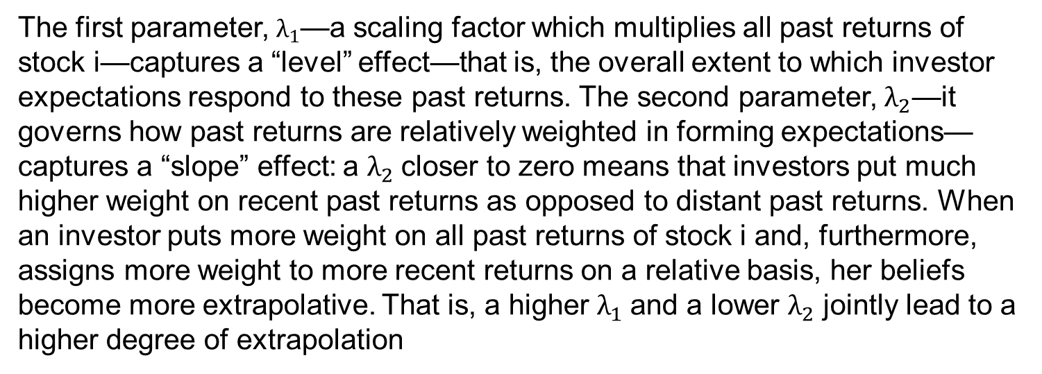

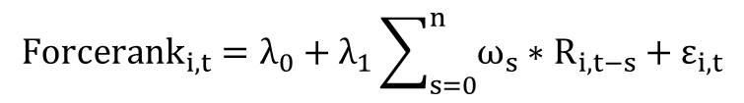
2. Research design: Method
Exponential decay model
$${Forcerank}_{i,t}=λ_{0}+λ_{1}\sum_{s=0}^{n}{ω_{s}∗R_{i,t−s}}+ε_{i,t}$$
$$ω_{s}=\frac{λ_{2}^{s}}{\sum_{j=0}^{n}{λ_{2}^{j}}}$$
The first parameter, $λ_{1}$—a scaling factor which multiplies all past returns of stock i—captures a “level” effect—that is, the overall extent to which investor expectations respond to these past returns. The second parameter, $λ_{2}$—it governs how past returns are relatively weighted in forming expectations— captures a “slope” effect: a $λ_{2}$closer to zero means that investors put much higher weight on recent past returns as opposed to distant past returns. When an investor puts more weight on all past returns of stock i and, furthermore, assigns more weight to more recent returns on a relative basis, her beliefs become more extrapolative. That is, a higher $λ_{1}$and a lower $λ_{2}$ jointly lead to a higher degree of extrapolation

Slide 14
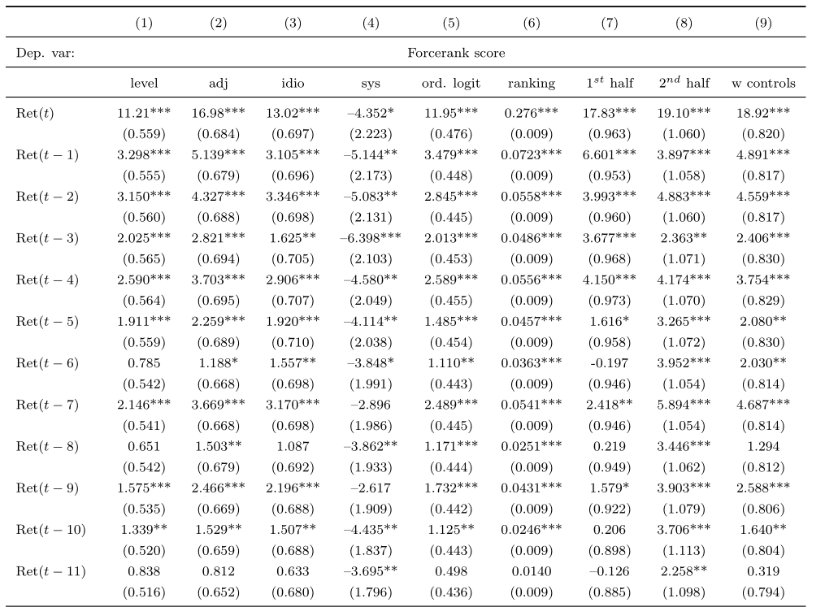
3. Empirical result: Linear model
The results show clear evidence that past returns drive Forcerank scores. The coefficients on recent past returns are in general higher than those on distant past returns.

Slide 15
3. Empirical result: Linear model
In Column (2), we adjust past returns by demeaning these return levels within each contest: we compute contest-adjusted returns by subtracting from raw returns the average return of the ten stocks in the contest.

Slide 16
3. Empirical result: Linear model
We further decompose past weekly returns into their systematic and idiosyncratic components using the CAPM.

Slide 17
3. Empirical result : Linear model
In Column (5), we estimate an ordered logit model that accounts for the ranking nature of our dependent variable.
In Column (6), we convert the explanatory variables from past weekly returns to the stocks’ actual past rankings.

Slide 18
3. Empirical result: External validation
As an external validation, we now examine the trading behavior of a large group of retail investors. Here we focus on the initial buys of these retail investors. Compared to other types of trade—for example, additional buys of the same stock or sales, which could be driven by factors other than investor beliefs such as investor preferences or liquidity needs—initial buys are more likely to reflect investors’ return expectations.
We measure initial buys using individual-level transaction records from a large discount broker-age firm over the period from January 1991 to December 1996.The dependent variable is an indicator that equals one for week t if, during that week, there is at least one retail investor who purchased the stock for the first time in the sample.

Slide 19
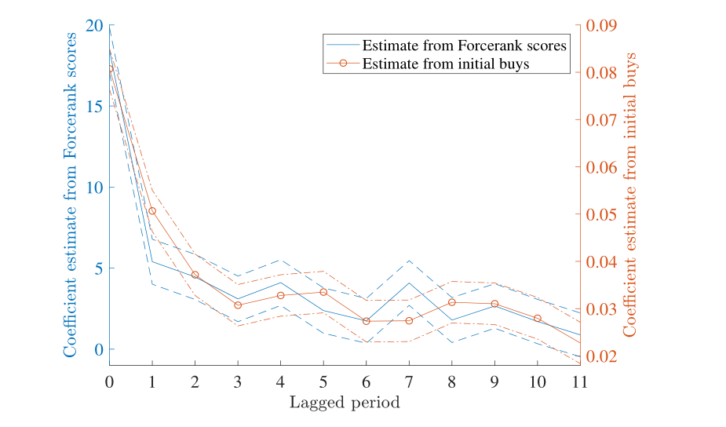
3. Empirical result: External validation
We find that the extrapolative patterns are very similar across these two settings: the changes in the two sets of coefficients are almost proportional to each other.

Slide 20
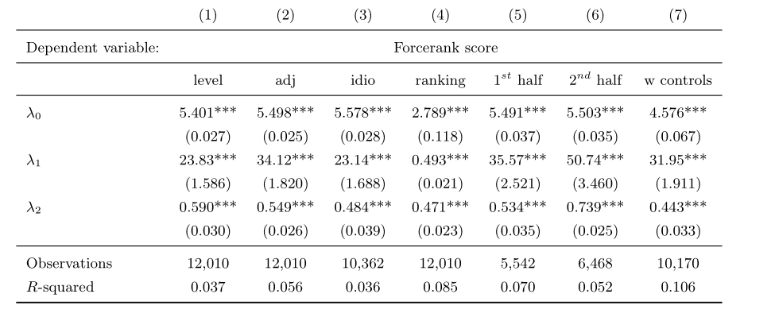
3. Empirical result: Exponential decay model
Table 4 confirms the presence of return extrapolation using the nonlinear regression in (2). Across all columns, we find λ1 to be significantly positive and λ2 to be positive and significantly smaller than one.

Slide 21
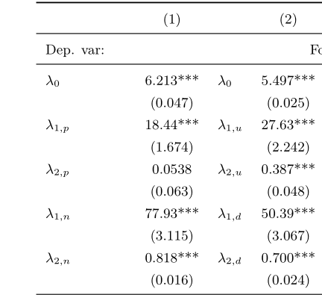
3. Empirical result: Past return characteristics
Column (1) of Table 5 show that return extrapolation is asymmetric, individuals seem to put more weight on negative past returns.
Column (2) show that negative—rather than positive— information at both the individual-stock level and the market level is more important in driving return expectations (a higher λ1 )

Slide 22
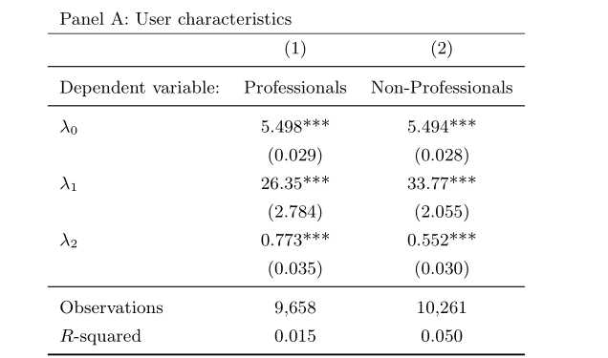
3. Empirical result: Past return characteristics
The result suggests that non-professionals display a stronger degree of extrapolation as they overweight recent past returns more strongly.

Slide 23
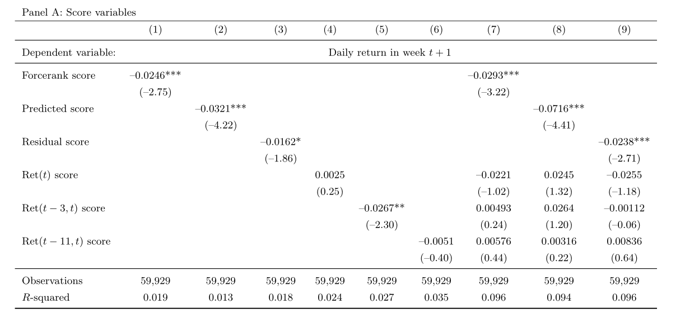
3. Empirical result: Return predictability
As Column (1) shows, the consensus Forcerank scores significantly predict the next week’s stock returns with a negative sign.
Column (2) shows that the predicted score also significantly predicts future stock returns with a negative sign.

Slide 24
3. Empirical result: Return predictability
Interestingly, Columns (3) that the residual score also negatively predicts the next week’s return. This finding suggests that the predictive power of the Forcerank score is not completely driven by its association with past returns. The Forcerank score contains additional information about investor “sentiment” above and beyond return extrapolation.
Altogether, our results show that the beliefs of Forcerank participants are systematically biased

Slide 25
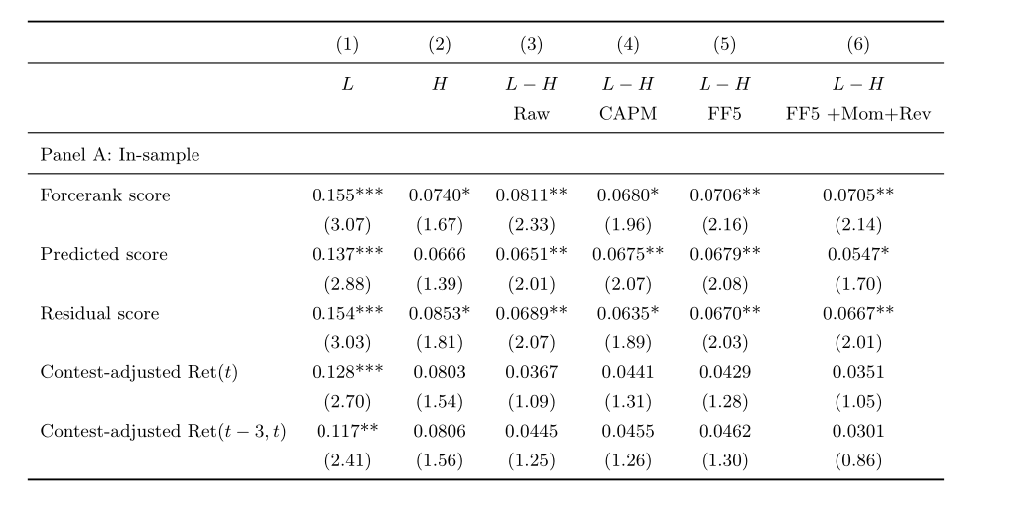
3. Empirical result: Return predictability
It shows that Forcerank scores negatively predict future stock returns: the low-score-minus-high-score return spread is 8.11 bps per day (t-value of 2.33).

Slide 26
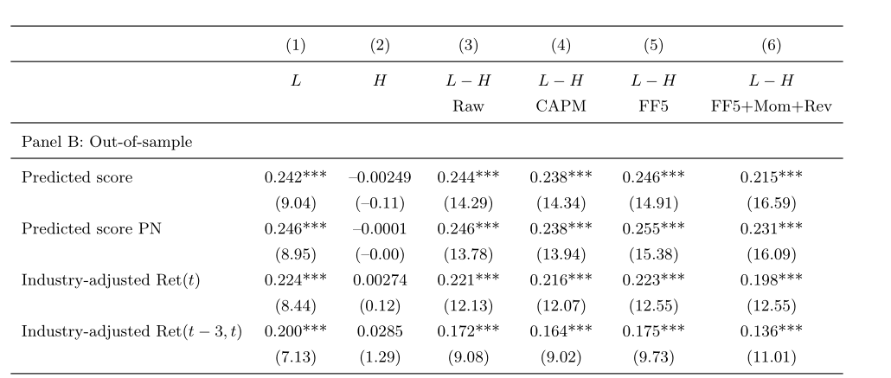
3. Empirical result: Return predictability
We examine the generalizability of our return predictability results. If the beliefs of Forcerank users represent the thinking process of a broader group of behavioral investors in the market, we would expect that the predicted scores for non-Forcerank stocks also have predictive power for the future returns of these stocks.
The low-score-minus-high-score return spread is 24.4 bps per day (t-value of 14.29). The spread remains highly significant after various risk adjustments.

Slide 27
4. Conclusion & Comment
Conclusion
We provide strong empirical evidence that investors extrapolate from recent past returns of individual stocks when forming expectations about future returns.
Beliefs of Forcerank users are systematically biased.
We form trading strategies to evaluate the economic magnitude of the return predictability of extrapolative beliefs, the risk-adjusted profits generated by our trading strategies are economically significant.

Slide 28
4. Conclusion & Comment
Comment
This article mainly considers the impact of past earnings on investors' expectations, and perhaps other factors, such as the attention of stocks and the reports of news media.
The parameters of the model are estimated only according to the short time interval, and there will be deviation out of the sample.

