Slide 1
Factors that Fit the Time Series and Cross-Section of Stock Returns
Martin Lettau, et.al, Review of Financial Studies, 2020.

Slide 2
Outline
Introduction
Research design
Empirical result
Robust Test
Some views

Slide 3
Introduction: Background
Finding the “right” factors which explains the cross-section of expected return has become the central question of asset pricing
“Factor zoo” (Cochrane, 2011)leads to the question of which risk factors are important and which factors are subsumed by others.

Slide 4
Introduction: Motivation
Statistical factor analysis based on PCA extracts factors that capture co-movement but does not incorporate any information contained in the means of the data
Many anomaly-based factors are more likely to be “weak” factors, which is hard for PCA to detect.

Slide 5
Introduction: Research Questions
Does risk premium PCA(RP-PCA) can extract the information from “weak” factors?
What’s the structure of SDF formed by RP-PCA.
Is there a constant factor structure for individual stocks?

Slide 6
Introduction: Related Researches
Using PCA methods:
Fan et al. (2016) introduced Projected-PCA which allows for time-varying factor loadings.
Kelly et al. (2017) introduced Instrumented-PCA (IPCA) to perform dimensionality reduction of the characteristic space.

Slide 7
Introduction: Related Researches
Using machine learning methods:
DeMiguel et al. (2017), Freyberger et al. (2019) and Feng et al. (2019) employ factor selection with Lasso-style L1-norm penalties. These papers have in common that they assume that the stochastic discount factor has a sparse exposure to the characteristics.

Slide 8
Introduction: Research Contents
Form RP-PCA and compare it with traditional PCA. Then find that PCA is not a reliable method to estimate latent asset pricing factors and is dominated by RP-PCA.
Show that a small number of factors is sufficient to fit the first and second moments of the 370 anomaly portfolios
Estimate RP-PCA and PCA models using a sample of 270 large individual stocks. Find that the out-of-sample fit is poor, suggesting that the assumption of a constant factor structure is not appropriate for individual stock data

Slide 9
Introduction: Innovation
Adding risk premium into traditional PCA model. The new model(Risk premium PCA, RP-PCA) can extract information from “weak” factors.

Slide 10
Introduction: Contribution
Draw RP-PCA model, which can extract information from both “strong” factors and “weak” factors.

Slide 11
Research Design:
Factor portfolios
or
Individual stocks
vs
PCA
FF-3
FF-5
RP-PCA
The structure of RP-PCA/PCA factors

Slide 12
Research Design: Data
1963.11-2017.12 monthly data.
Double sort 25 portfolios. (8 x 25)
size and book-to-market, accruals, investment, profitability, momentum, short-term reversal, volatility, and idiosyncratic volatility.
370(37 x 10) single sort portfolios used in Kozak et al. (2019)
270 individual stocks, which always in S&P500 from 1963-2017.
Rolling window: 20 years

Slide 13
Research Design: Theoretical Derivation
“Strong” and “weak” factors:
“Strong” factors affect a large number of assets and/or have large variances.
“Weak” factors only affect a small factor depends on the structure of the loading
That is, “weak ” factors affects more in return rather than variance.

Slide 14
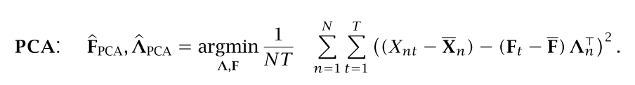
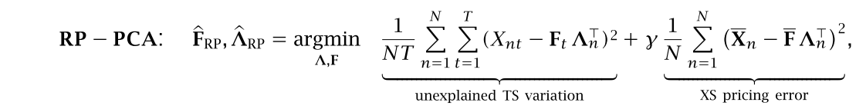
Research Design: Theoretical Derivation
RP-PCA design
Loss function of traditional PCA
Loss function of RP-PCA

Slide 15


Research Design: Theoretical Derivation
Form SDF:
After gain RP-PCA factors the SDF can be calculated by:

Slide 16


Research Design: Performance
Root mean square error(RMS):
Idiosyncratic variance:
Sharpe ratio

Slide 17
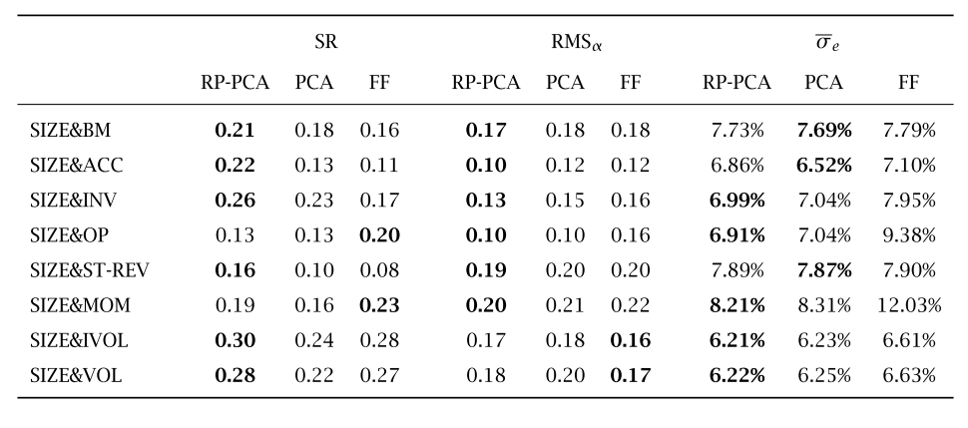
Empirical Result: Model Performance
RP-PCA behaves better than other model in most cases.

Slide 18
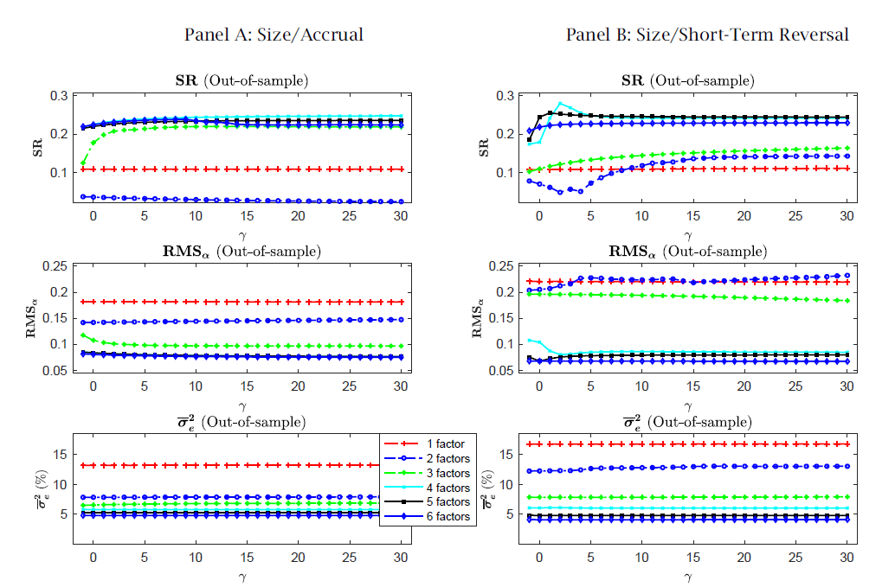
Empirical Result: Why RP-PCA behave better

Slide 19
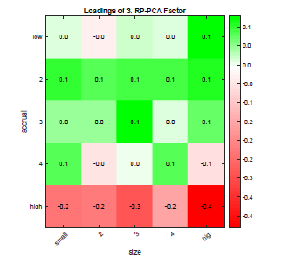
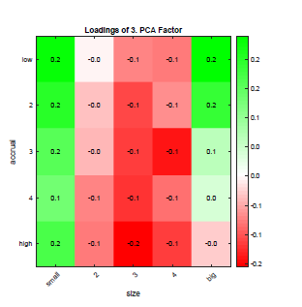
Empirical Result: The structure of the third factor
The loadings of RP-PCA shows long low accruals and short high accruals, while PCA factors has no obvious pattern.

Slide 20
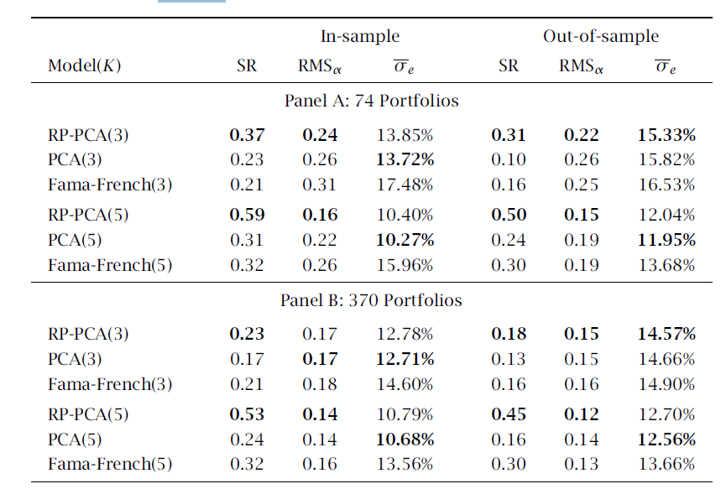
Empirical Result: Large Portfolio Set Performance

Slide 21
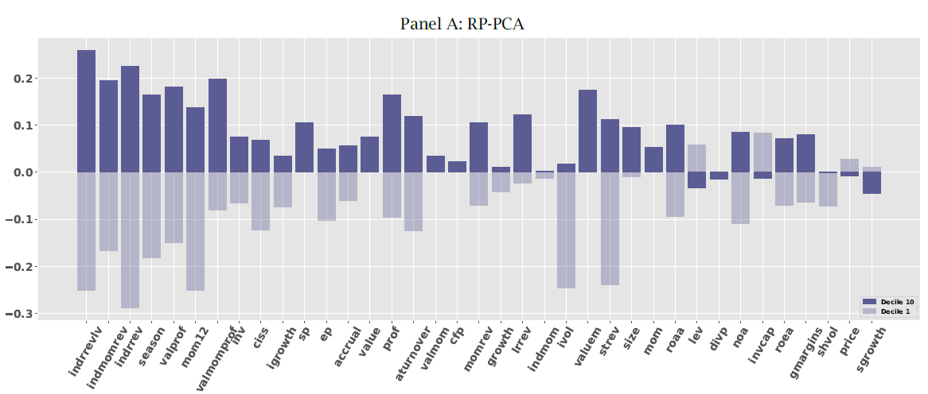
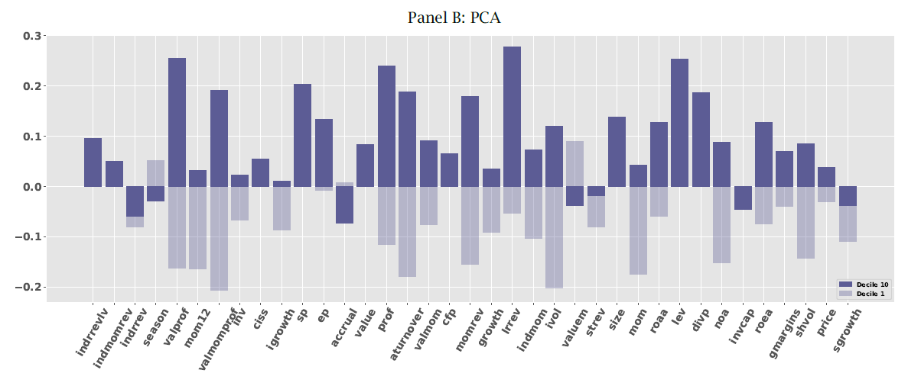
Empirical result: Structure of SDF

Slide 22
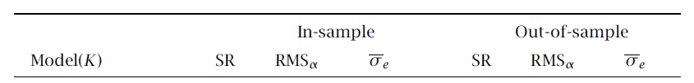
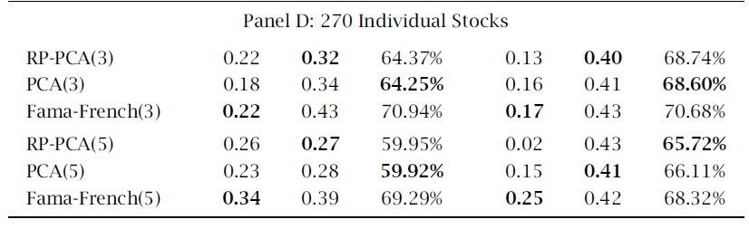
Empirical Result: Performance in Individual Stocks
There is no model behaves better than other models in most cases.

Slide 23
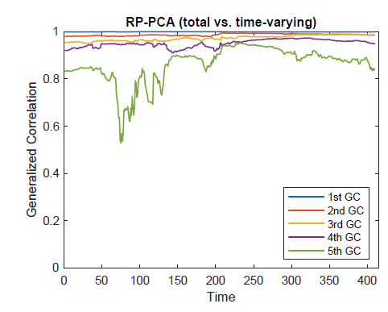
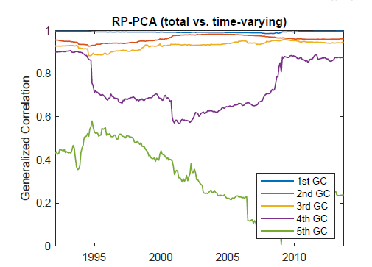
Empirical Result: Why it doesn’t work
The loading structure of stocks has higher volatility than structure of portfolios. (left is portfolio’s , right is stock’s)

Slide 24
Some views
Inspiration:
What if adding the same restriction into autoencoder?

Slide 25
本周工作
研究设计：
输入变量94个因子。
去掉了分析师指标数据（2个），原因：大部分存在因子数据是从2013年开始。
参考Chen, et.al(2020) 建立模型。
To do:
下周做出初步的GAN模型结果并与DFN模型或者Autoencoder(Gu, et. al, 2019)结果进行对比。

Slide 26
本周工作
模型构成：
DFN1
SDF
因子数据
GAN优化器
DFN2
整合后因子信息
收益率数据

