Slide 1
International Stock Return Predictability: What Is the Role of the United Stated? The Journal of Finance 2013 David E. Rapach, Jack K. Strauss, and Guofu Zhou
Can US Economic Variables Predict the Chinese Stock Market?
Pacific-Basin Finance Journal 2013
Jeremy C. Goh, Fuwei Jiang, Jun Tu , Yuchen Wang
Presented by: Zhen Long

Slide 2
Contents
Introduction
Background
Motivation
Research problem
Contribution
Research Design
Data
Method
Empirical Results
Conclusion

Slide 3
Introduction
Backgrounds:
Stock return predictability are established
US (Fama and Schwert (1977), Campbell (1987) ...)
Other countries (Cutler, Poterba, and Summers (1991), Harvey (1991)…)
GW(2008) doubt→ Rapach (2010) etc. confirmed the OOS predictability
Motivation:
Few researches focus on international prediction

Slide 4
Introduction
Research Problem:
What’s the stock return predictive relationship between US and other countries?
Contribution:
Uncovers a powerful new predictor of monthly stock returns in industrialized countries

Slide 5
International Stock Return Predictability:
11 industrialized countries
US
China
Similarities:
International stock return predictability
Focus on US
Differences:
Relation: US returns → 11 industrialized countries
US variables → China
Method: theory model + empirical test & empirical test
Story : a leading role of US, news-diffusion model
increased integration after China join WTO

Slide 6
Research Design – Data
US + Australia/ Canada/ France/ Germany/ Italy/ Japan/ Netherlands/ Sweden/ Switzerland/ UK
Global Financial Data/Morgan Stanley Capital International
1980.02~2010.12
Monthly & Daily (adjust closing time across markets)

Slide 7
Research Design
Benchmark: 11 conventional predictive regression
Lagged international return prediction
1、Pairwise Granger causality test
Account for differences in closing times across markets
if the close of the equity market in country i occurs prior to the market close in country j, then we exclude the last trading day of month t

Slide 8



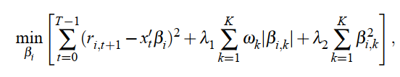


Research Design
Lagged international return prediction
2、General model specification
Too many regressors:
Pooled version:
Adaptive Elastic Net

Slide 9
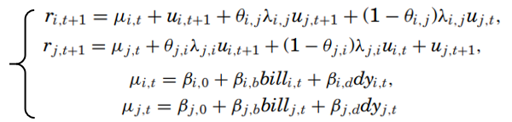


Research Design
News-Diffusion model
Return shock in country j affects returns in country i
International information friction

Slide 10



Research Design
News-Diffusion model
Assumption: non-US returns don’t affect US returns
Estimation: two-step GMM
Out-of-Sample predictive regression

Slide 11
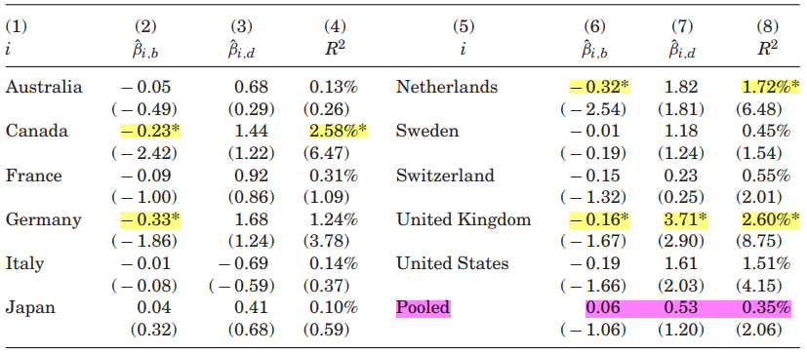

Empirical Results
Table 1 Benchmark Predictive Regression Model Estimation Results, 1980:02 to 2010:12
Empirical p-values: bootstrap
Pooled:
Allowing for country-specific constants

Slide 12
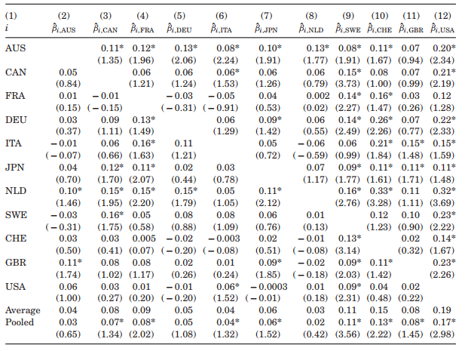
Table2 Pairwise Granger Causality Test Results, 1980:02 to 2010:12
Lagged US returns have the strongest predictive power
Lagged non-US returns don’t
Lagged Swedish and Swiss returns
Explanation:
Information friction
US/ Sweden Swiss

Slide 13
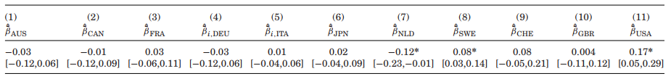
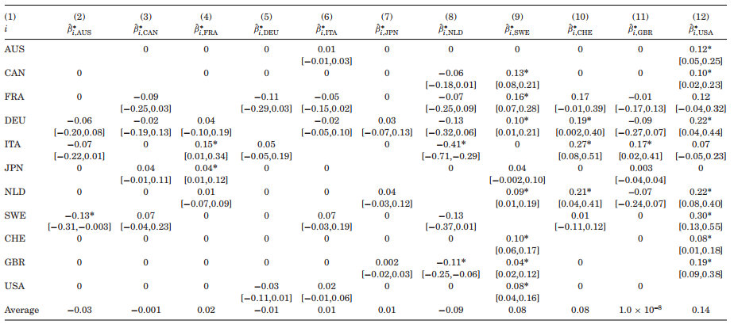
Table 3 Estimation Results for the Pooled General Model Specification, 1980:02 to 2010:12
Table 4 Adaptive Elastic Net Estimation Results for the General Model Specification, 1980:02 to 2010:12

Slide 14
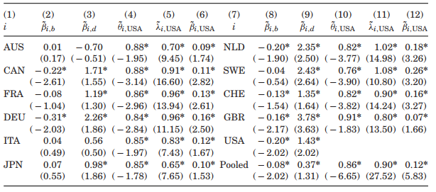
Table 5 News-Diffusion Model Parameter Estimates, 1980:02 to 2010:12
Θ≠1, λ>0 are significant
Θ<1 → Non-US returns underreact to US return shocks, which generates predictive power for lagged US returns
βi,US significantly larger than 0, but smaller than the parameter in Granger test→ info friction don’t account for all of the predictability of lagged US returns

Slide 15
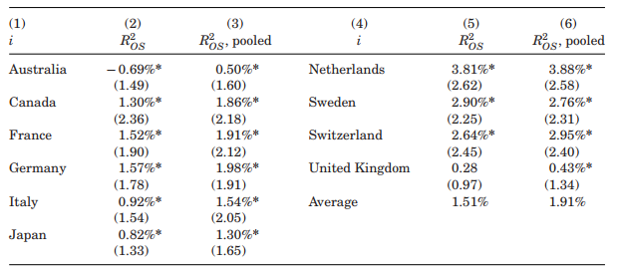
Table 6 Out-of-Sample Predictive Ability of Lagged U.S. Returns, 1985:01 to 2010:12

Slide 16
Conclusion
Lagged US returns have substantial predictive power for many non-US returns.
Lagged non-US returns can’t predict US returns
Information frictions provide a explanation

Slide 17
Research Design（China - US）
OOS regression
IS analysis —— PCA

Slide 18
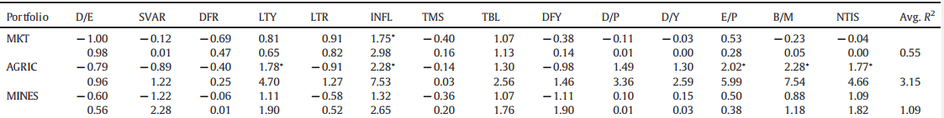
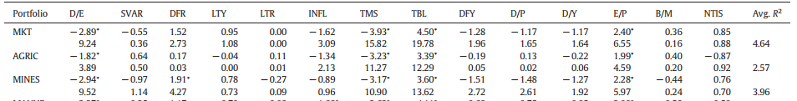
Table 1 Regression results based on fourteen US economic variables, 1993:07–2001:12
Table 2 Regression results based on fourteen US economic variables, 2002:01–2008:12.
China joining the WTO may result in the Chinese stock market may be significantly affected by the world economy and/or the US economy

Slide 19
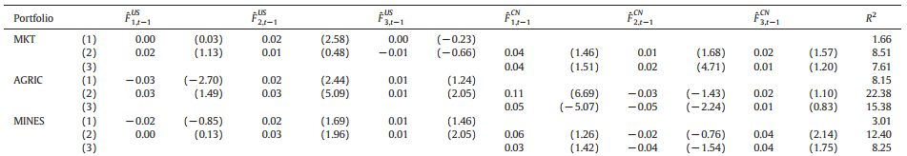
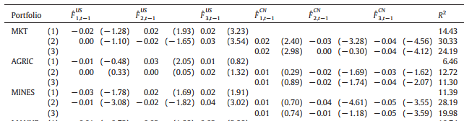
Table 3 Regression results based on principle component factors, 1993:07–2001:12
Table 4 Regression results based on principle component factors, 2002:01–2008:12
the US economic variables can be used in conjunction with the China economic variables to enhance return forecasts for the Chinese stock market.

Slide 20
Reflection:
Economic explanation matters
Similar perspective, different stories

