Slide 1
Maxing out: Stocks as lotteries and the cross-section of expected returns
Turan G. Bali, Nusret Cakici, Robert F. Whitelaw
Journal of Financial Economics
2010 08
王念硕

Slide 2
Outline
Introduction
Research design
Empirical result
Conclusion

Slide 3
1. Introduction
Background
There is evidence that investors have a preference for lottery-like assets, i.e., assets that have a relatively small probability of a large payoff.
Thaler and Ziemba (1988) find two prominent examples that are the favorite-longshot bias in horsetrack betting, and the popularity of lottery games despite the prevalence of negative expected returns.

Slide 4
1. Introduction
Motivation
The existing research have proved that investors have a preference for lottery stocks, which often have the characteristics of extreme positive returns. But there is no study on the relationship between extreme positive return and stock future return.

Slide 5
1. Introduction
Research question
Investors have a preference for lottery stocks, when we use the characteristics of lagged extreme positive returns to measure lottery stocks, whether there is significant ability to predict future returns?
Whether the anomalies of idiosyncratic volatility and idiosyncratic skewness can also be attributed to investors' preference for lottery stocks with lagged extreme positive returns ?

Slide 6
1. Introduction
Related researches: lottery-type stocks
Kumar (2009) defines lottery-type stocks as low-priced stocks with high idiosyncratic volatility and high idiosyncratic skewness and shows that certain groups of individual investors appear to exhibit a preference for lottery-type stocks.

Slide 7
1. Introduction
Related researches: Extreme positive returns (MAX)
According to the cumulative prospect theory (Tversky and Kahneman, 1992) , errors in the probability weighting of investors cause them to over-value stocks that have a small probability of a large positive return.
Investors tend to think that stocks with extreme positive returns in a given month should also be more likely to exhibit this phenomenon in the future.

Slide 8
1. Introduction
Related researches: Idiosyncratic volatility
Ang, Hodrick, Xing, and Zhang (2006, 2009) show that stocks with high idiosyncratic volatility have low subsequent returns.
Stocks with high maximum daily returns in a given month will also have high realized volatility in the same month, measured using squared daily returns.

Slide 9
1. Introduction
Related researches: Skewness
Harvey (1999, 2000) and Smith (2007) measure co-skewness and idiosyncratic skewness, finding that stocks with lower skewness outperform stocks with higher skewness and that this premium varies significantly over time.
There may be some relationship between idiosyncratic skewness and co-skewness

Slide 10
1. Introduction
Research Contents
We examine the role of extreme positive returns (MAX) in the cross-sectional pricing of stocks.
We then conduct empirical tests to explore the relationship between MAX and other relevant anomalous, such as idiosyncratic volatility and skewness.

Slide 11
1. Introduction
Contribution
The study proves that there are a strong connection between stock return and extreme positive returns (MAX).
There is no idiosyncratic volatility puzzle, which can be seen as proxy of MAX.

Slide 12
2. Research design
Whether there are a strong connection between stock return and extreme positive returns (MAX)?
Is the relationship still robust after controlling many related variables?
Whether the presence or absence of extreme positive returns is persistent?
Analyzing the relationship between MAX and idiosyncratic volatility.
Analyzing the relationship between MAX and skewness.

Slide 13
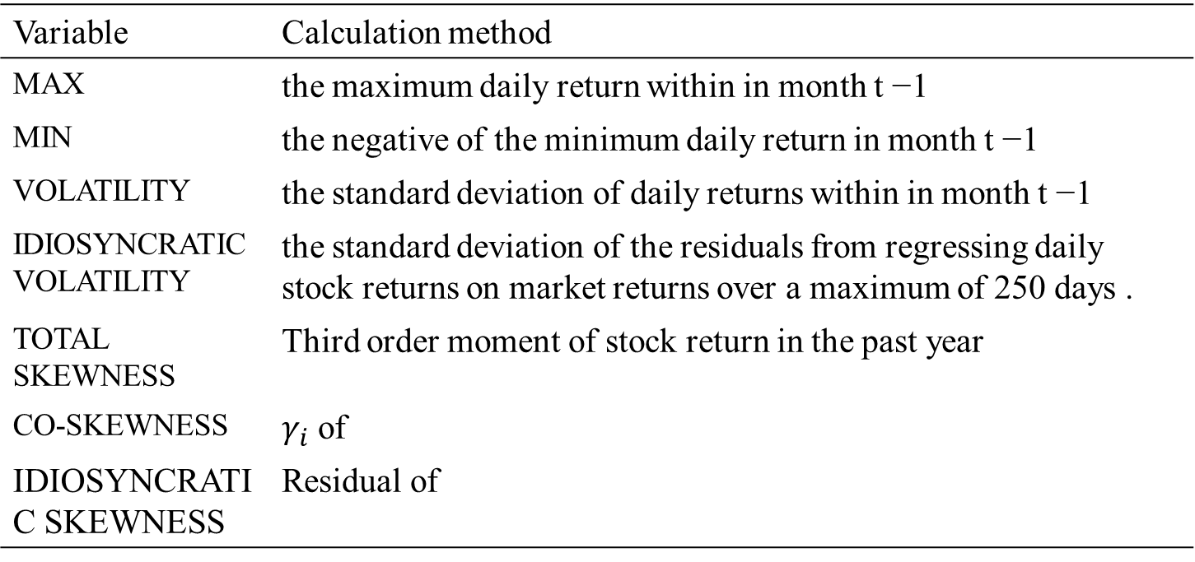
2. Research design : Variable
Variable | Calculation method
MAX | the maximum daily return within in month t −1
MIN | the negative of the minimum daily return in month t −1
VOLATILITY | the standard deviation of daily returns within in month t −1
IDIOSYNCRATIC VOLATILITY | the standard deviation of the residuals from regressing daily stock returns on market returns over a maximum of 250 days .
TOTAL SKEWNESS | Third order moment of stock return in the past year
CO-SKEWNESS | $γ_{i}$ of
IDIOSYNCRATIC SKEWNESS | Residual of

Slide 14
2. Research design : Variable
Variable | Calculation method
TURN | the average daily turnover (the number of shares traded divided by the number of shares out-standing) over the past 12 months.
ILLIQ | the average of absolute daily returns divided by the daily trading volume over the past 12 months
SIZE | The log of market value of equity
BM | Book-to-market equity ratio
MOM | the cumulative stock return from month t −1 to t −12
REVERSAL | the stock return in month t −1

Slide 15
2. Research design : Data
Company financial data： CRSP 、 Compustat
Period：1926 - 2005 daily data.
Sample: our sample consists of all New York Stock Exchange (NYSE), American Stock Exchange (Amex), and Nasdaq

Slide 16
2. Research design : method
Univariate portfolio analysis
Bivariate portfolio analysis
Fama-MacBeth regressions

Slide 17
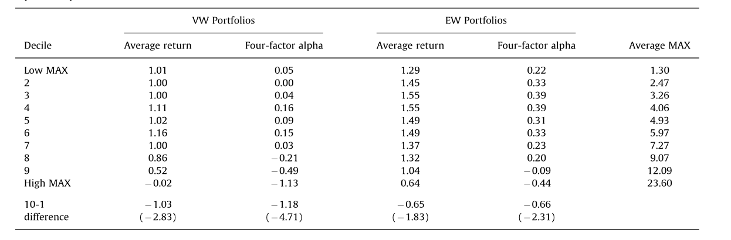
3. Empirical result: Univariate portfolio analysis
The difference between high and low portfolio is economically significant and statistically significant at all conventional levels.
It is clear that the pattern is not one of a uniform decline as MAX increases.
Investors view these stocks as valuable lottery-like assets, with a small chance of a large gain.

Slide 18
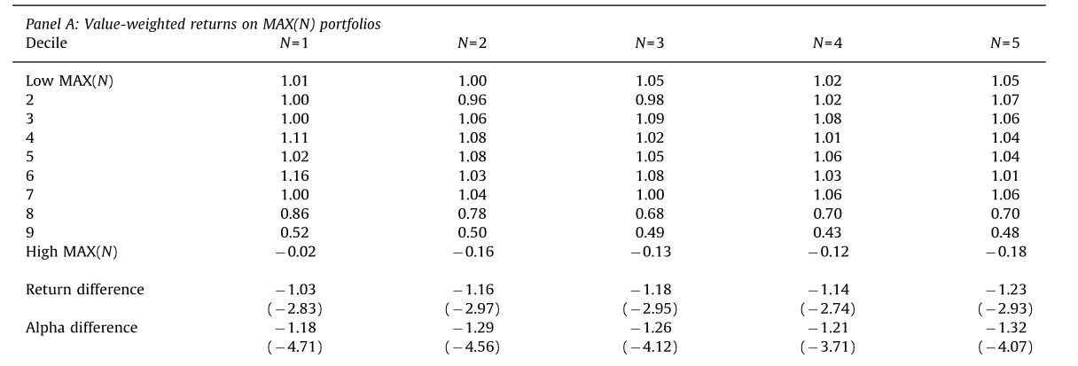
3. Empirical result: Univariate portfolio analysis
We also rank stocks by the average of the N (N=1, 2, …, 5) highest daily returns within the month.
We report the difference between the returns and alphas on the deciles of firms with the highest and lowest average daily returns over the prior month.
The difference between high and low portfolio is statistically significant.

Slide 19
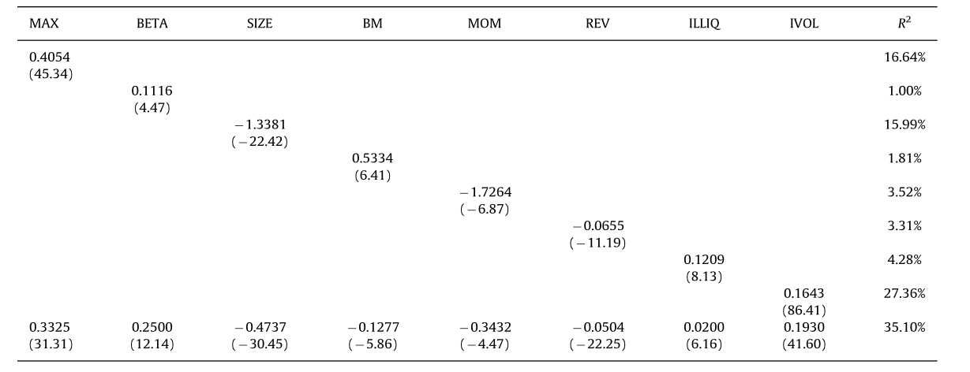
3. Empirical result: Fama-MacBeth regressions
In the regression of MAX on lagged MAX, the coefficient is positive, quite large, and extremely statistically significant, and the R-squared of over 16% indicates substantial cross-sectional explanatory power. Swith extreme positive daily returns in one month also tend to exhibit similar features in the following month.

Slide 20
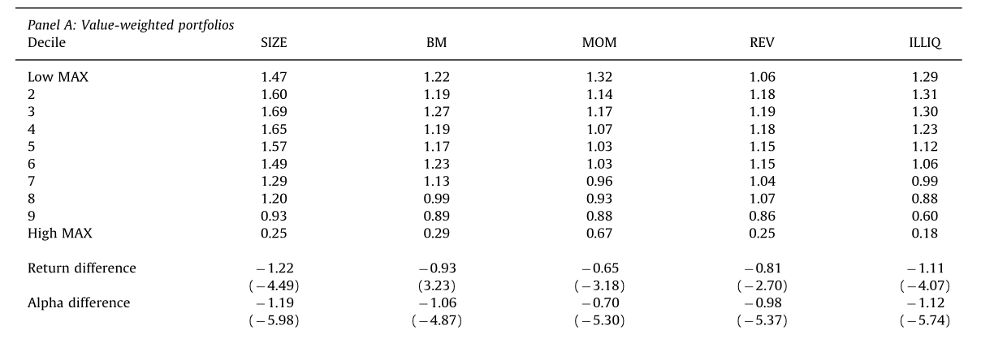
3. Empirical result: Bivariate portfolio analysis
After controlling these variables, these average raw return differences are both economically and statistically significant

Slide 21
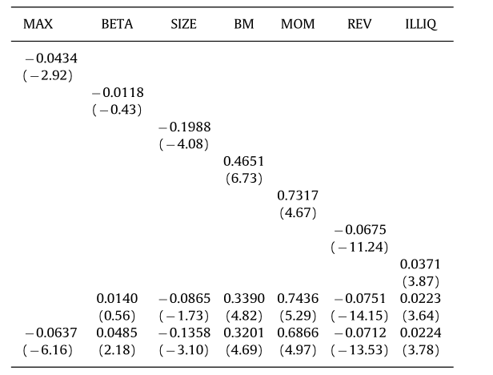
3. Empirical result: Fama-MacBeth regressions
The clear conclusion is that cross-sectional regressions provide strong corroborating evidence for an economically and statistically significant negative relation between extreme positive returns and future returns.

Slide 22
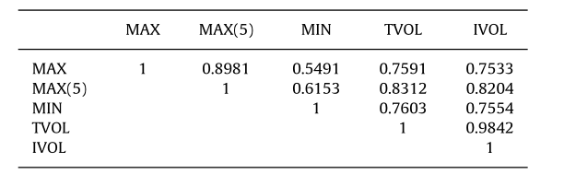
3. Empirical result: MAX and Idiosyncratic volatility
MAX and MAX(5) are highly correlated. Of greater interest, the average, cross-sectional correlations between IVOL and both MAX and MIN are approximately 0.75, which is very high given that all three variables are calculated at the individual stock level.

Slide 23
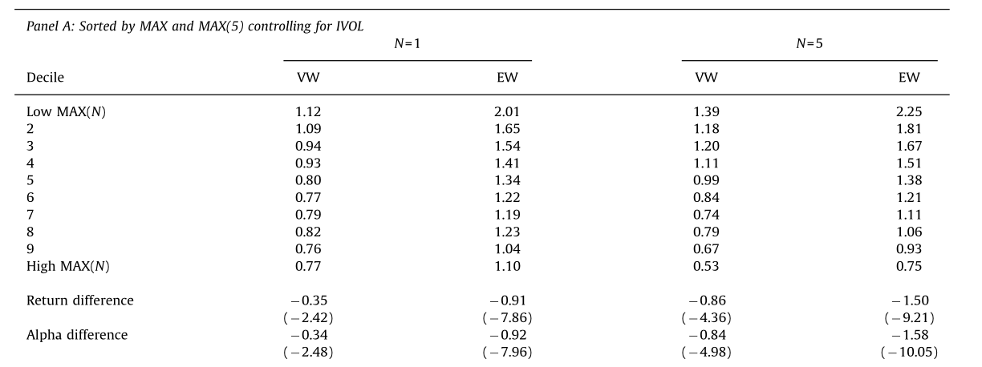
3. Empirical result: MAX and Idiosyncratic volatility
Idiosyncratic volatility does not completely explain the high (low) returns to low (high) MAX stocks.

Slide 24
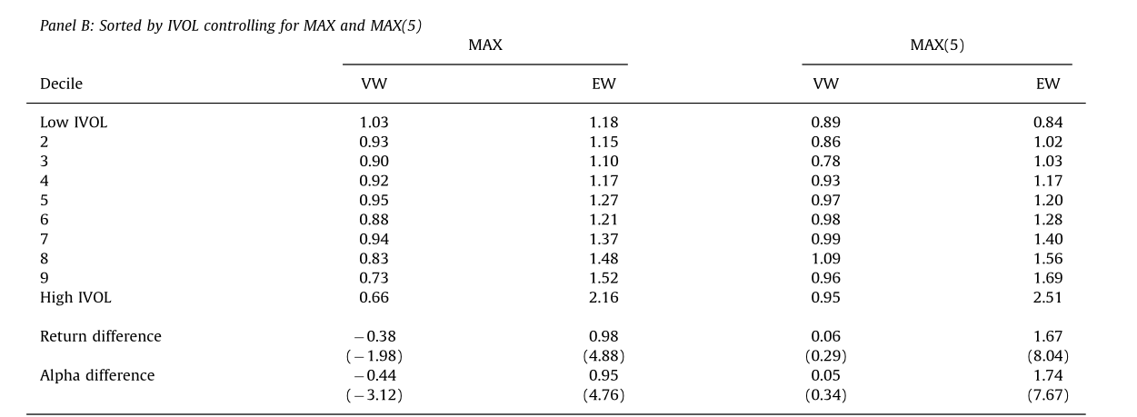
3. Empirical result: MAX and Idiosyncratic volatility
This is the reverse of the counter-intuitive negative relation shown by Ang, Hodrick, Xing, and Zhang (2006, 2009)

Slide 25
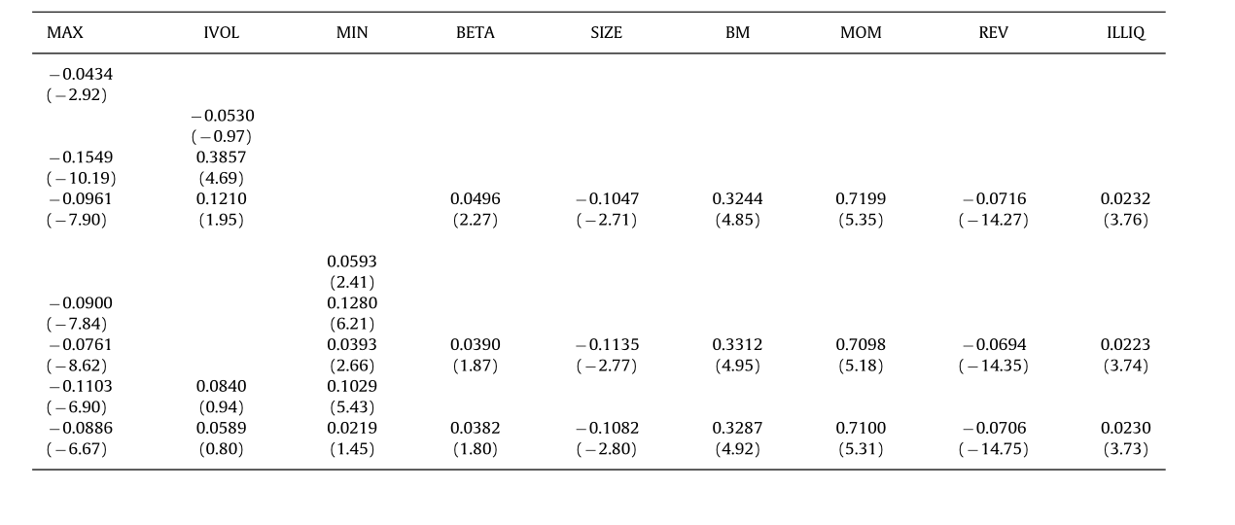
3. Empirical result: MAX and Idiosyncratic volatility
This positive relation between IVOL and expected returns remains significant even after augmenting the regression with the six control variables.

Slide 26
3. Empirical result: MAX and Idiosyncratic volatility
These regressions provide further evidence that there is no idiosyncratic volatility puzzle.
Our conclusion is that there is no idiosyncratic volatility puzzle as recently reported in Ang, Hodrick, Xing, and Zhang (2006, 2009) the reason for the presence of a negative relation between IVOL and expected returns shown by Ang et al. is that IVOL is a proxy for MAX.

Slide 27
3. Empirical result: MAX and Idiosyncratic volatility
We interpret our results in the context of a market with poorly diversified yet risk-averse investors who have a preference for lottery-like assets.
In fact, it may be the preference for lottery-like payoffs that causes under diversification.
Thus, the expected returns on stocks that exhibit extreme positive returns are low but, controlling for this effect, the expected returns on stocks with high idiosyncratic risk are high.

Slide 28
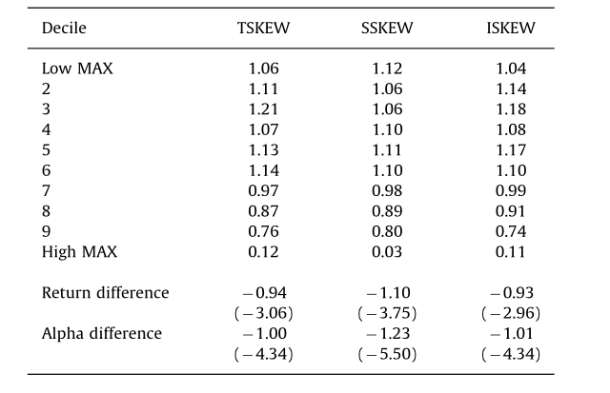
3. Empirical result: Skewness and MAX
These results indicate that systematic and idiosyncratic skewness cannot explain the significantly negative relation between MAX and expected stock returns

Slide 29
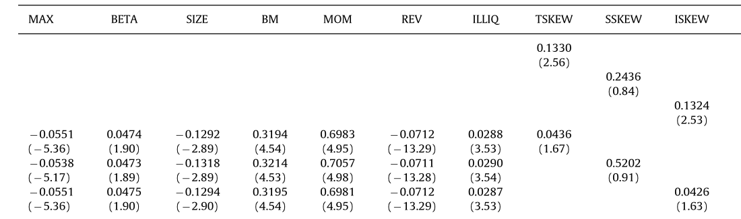
3. Empirical result: Skewness and MAX
In the full specifications these average coefficients of skewness are statistically insignificant.

Slide 30
4. Conclusion
We find a statistically and economically significant relation between lagged extreme positive returns, as measured by the maximum daily return over the prior month or the average of the highest daily returns within the month, and future returns.
Idiosyncratic volatility can be regarded as the proxy index of MAX.
We interpret our results in the context of a market with poorly diversified yet risk-averse investors who have a preference for lottery-like assets
We also present some evidence that stocks with extreme negative returns exhibit the reverse effect, i.e., investors find them undesirable and hence, they offer higher future returns.

Slide 31
价值性投资还是博彩性投机？
—— 中国Ａ股市场的MAX异象研究
朱红兵 张兵
金融研究
2020 02
王念硕

Slide 32
1.引言
研究动机
中国Ａ股市场中散户规模更大，择时和择股能力欠佳，博彩性投机者更加偏好市场风险，他们认为市场波动越大，个股出现极端收益率的概率越大。尽管郑振龙和孙清泉(2013)发现中国市场上存在MAX异象，但没有对MAX异象的成因加以理论解释。

Slide 33
1. 引言
研究问题
中国市场上MAX异象是否稳健存在?
MAX是否存在惯性传递特征？
在彩票类股票和价值类股票中，MAX异象是否会有所区别？

Slide 34
1.引言
研究内容
本文通过实证研究检验中国Ａ股市场的MAX异象。
在检验MAX惯性传递特征的基础上，利用非线性概率模型估计出不同等级MAX由ｔ月传递到ｔ＋１月，ｔ＋３月，ｔ＋６月以及ｔ＋１２月的概率转移矩阵，证实了投资者的非理性追涨行为.
从行为金融的角度剖析了MAX异象的形成机制，证实了MAX异象会随着个股博彩特征强化而得到增强。而股票的价值特征对MAX异象具有弱化作用。

Slide 35
1.引言
研究贡献
创新性地通过非线性概率模型证明了极端收益率的转移传递具有时变衰减特征。
价值投资可以弱化MAX异象。

Slide 36
2. 研究设计
股票收益率和极端正收益率（MAX）之间是否有很强的联系?
极端收益率具有转移传递以及时变衰减特征
比较彩票类股票与非彩票类股票中的MAX异象的区别
比较价值高的股票与价值低的股票中的MAX异象的区别
套利限制对MAX异象的影响
2020/4/25
36

Slide 37
2. 研究设计
数据来源： WIND、RESSET
时期：1995 - 2017 年日度数据.
股票样本: 全部A股，剔除金融股与ST股票

Slide 38
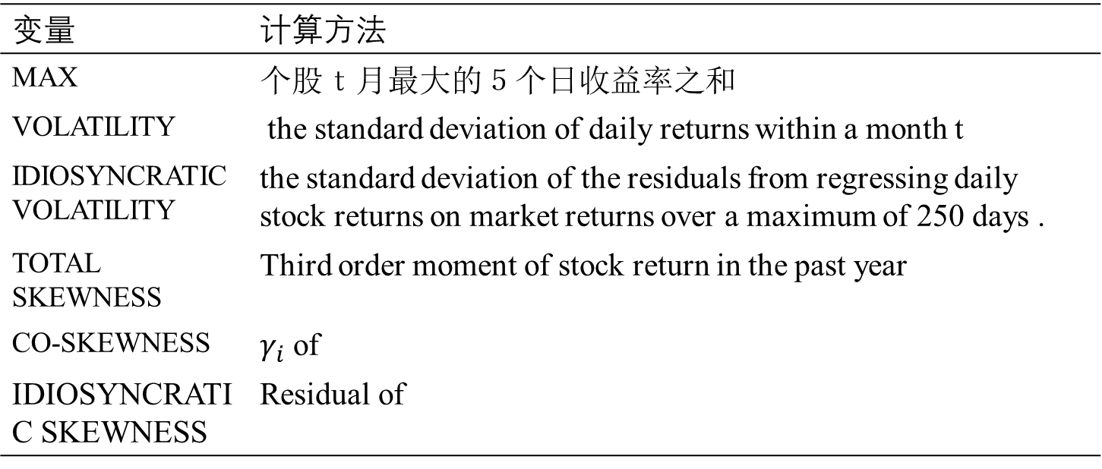
2. 研究设计: 变量
变量 | 计算方法
MAX | 个股ｔ月最大的５个日收益率之和
VOLATILITY | the standard deviation of daily returns within a month t
IDIOSYNCRATIC VOLATILITY | the standard deviation of the residuals from regressing daily stock returns on market returns over a maximum of 250 days .
TOTAL SKEWNESS | Third order moment of stock return in the past year
CO-SKEWNESS | $γ_{i}$ of
IDIOSYNCRATIC SKEWNESS | Residual of

Slide 39
2.研究设计: 变量
变量 | 计算方法
TURN | the average daily turnover (the number of shares traded divided by the number of shares out-standing) over the past 12 months.
ILLIQ | the average of absolute daily returns divided by the daily RMB trading volume over the past 12 months
SIZE | The log of market value of equity
BM | Book-to-market equity ratio
MOM | the cumulative stock return from month t −1 to t −12
REVERSAL | the stock return in month t −1

Slide 40
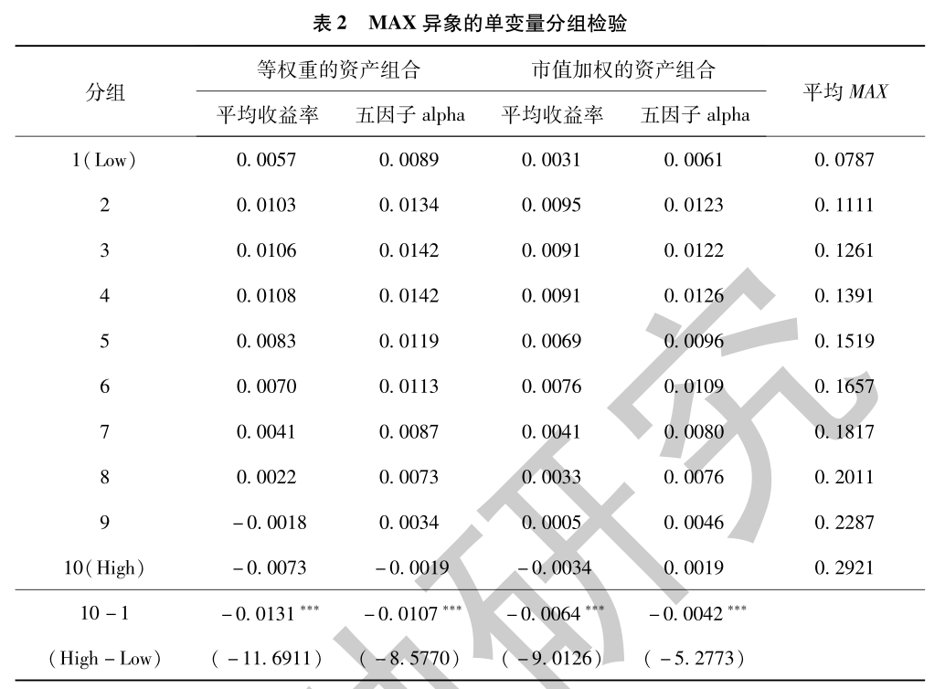
3. 实证结果
随着MAX增大，组合的平均收益呈现出明显的下降趋势，当月的MAX与下月收益率之间存在负向关系。通过多空策略组合——买入组合MAX（1）并卖出MAX（10），可实现月均1.31％（等权重）和0.64％（市值加权）的收益。

Slide 41
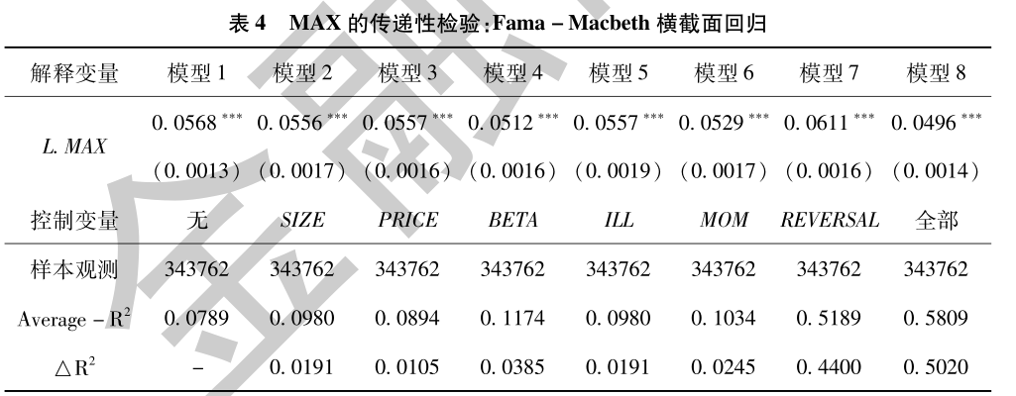
3. 实证结果
模型１至模型８均显示出ｔ-１月的MAX与ｔ月的MAX有着显著的正向相关关系，平均强度0.0548左右，反映出个股历史极端收益率具有一定的传递性

Slide 42
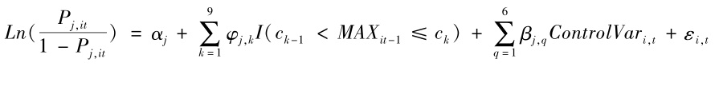
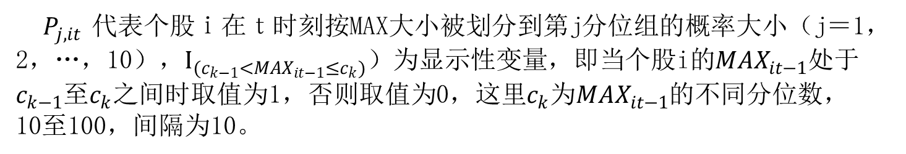
3. 实证结果: 转移概率估计
$P_{j,it}$代表个股ｉ在ｔ时刻按MAX大小被划分到第j分位组的概率大小（j＝1，2，…，10），$I_{(c_{k−1}<{MAX}_{it−1}≤c_{k})}$）为显示性变量，即当个股i的${MAX}_{it−1}$处于$c_{k−1}$至$c_{k}$之间时取值为1，否则取值为0，这里$c_{k}$为${MAX}_{it−1}$的不同分位数，10至100，间隔为10。

Slide 43
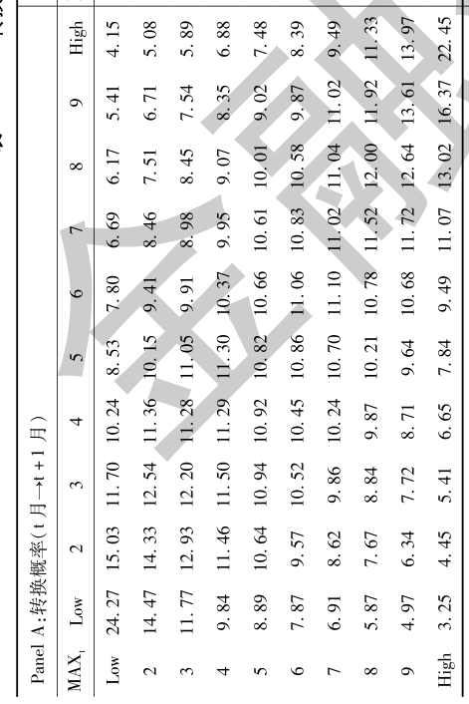
3. 实证结果
ｔ月的MAX（10）在ｔ＋１月仍然为MAX（10）的概率为22.45％，ｔ月的MAX（10）在ｔ＋１月转换为MAX（8），MAX（9），MAX（10）的联合概率为51.84％，远大于转换为其他MAX级别水平的概率值上述数值特征表现出MAX在短期具有大概率正向传递特征，会刷新个股的极端收益率，造成更高MAX的产生，加剧其博彩特征进而吸引更多"博彩者"入场

Slide 44
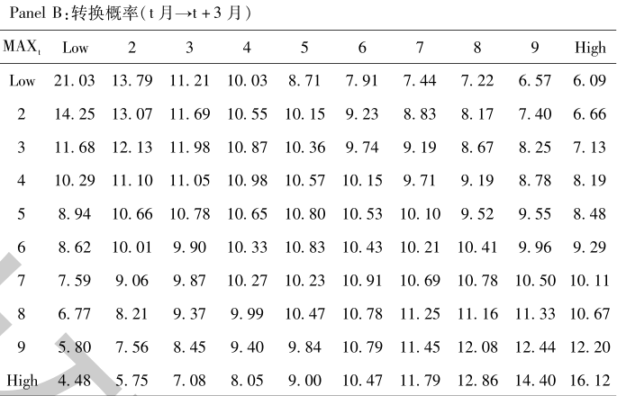
3. 实证结果
PANEL Ｂ、Ｃ和Ｄ中的概率转移矩阵也表现出了相似的结果，但随时间推移MAX的正向传递性逐渐减弱，ｔ月的MAX（10）在ｔ＋３月仍然为MAX（10）的概率为16.12％。延续时间越长，各组别相互之间的概率差异逐渐缩小。

Slide 45
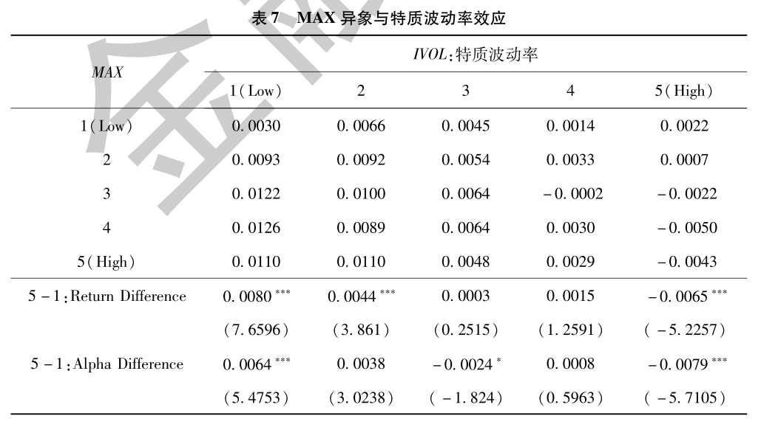
3. 实证结果
在特质波动率的１至４组别中，MAX异象无法被观测到，而在最高特质波动率的第５组中异象则非常显著，通过多空策略组合可实现月均0.65％（已实现收益率）的收益，说明：高博彩特征股票的异象更显著

Slide 46
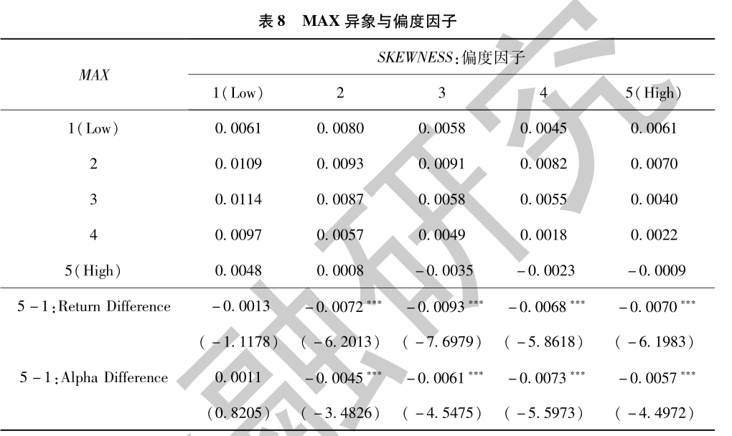
3. 实证结果
从博彩型股票的第二个特征（偏度）出发，再次证明了博彩特征越突出的组合中MAX异象越强烈

Slide 47
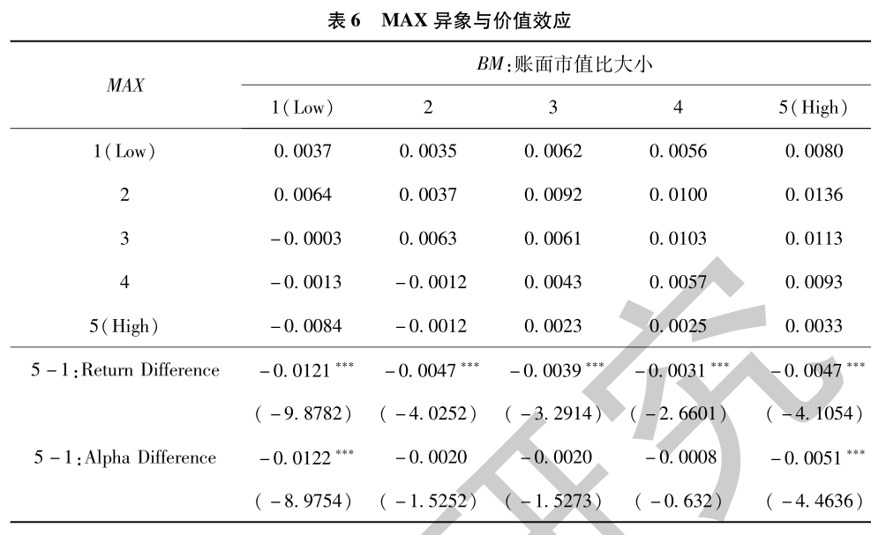
3. 实证结果
内在价值最高组的收益率相对于内在价值最低组的收益率有明显下降，两组收益率的差异表明：内在价值越高的组合中，MAX对收益率的负向影响越小

Slide 48
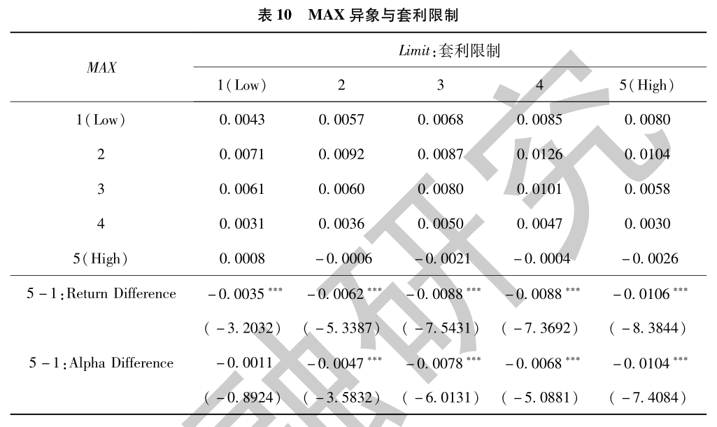
3. 实证结果
随着套利限制程度的加强，多空策略组合的月均收益呈上升趋势。套利限制增加了投资者的套利成本，使得非理性投机行为而产生的价格偏离无法在中短期内恢复至均衡水平，从而强化了市场异象。

Slide 49
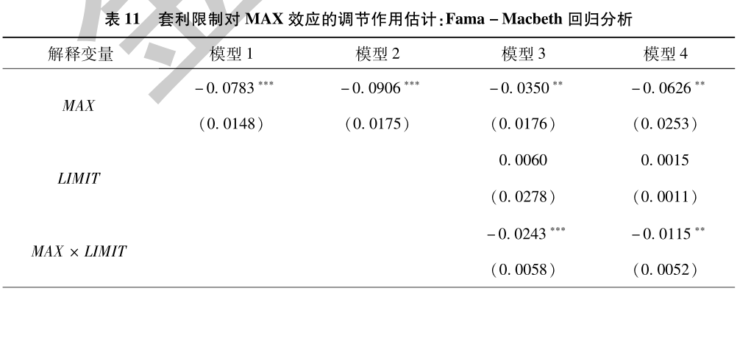
3. 实证结果
套利限制与MAX的交互项系数在５％的水平下达到了-0,0115，即MAX对收益率的负向影响随套利限制的上升而增强，套利限制强化了MAX异象。

Slide 50
4. 结论
中国Ａ股市场存在显著的MAX异象。
受投资者博彩性投机心理作用，短期内MAX具有惯性传递特征。
低价值、高博彩特征股票的MAX异象要显著强于高价值、低博彩特征的股票。
由于套利约束，投资者非理性投机行为导致的证券价格偏离在中短期内无法恢复至均衡水平，强化了MAX异象。

