Slide 1
Q-theory, mispricing, and profitability premium: Evidence from China
Fuwei Jiang , Xinlin Qi, Guohao Tang
Journal of Banking and Finance
2017 10
王念硕

Slide 2
Outline
Introduction
Research design
Empirical result
Conclusion

Slide 3
1. Introduction
Background
Legendary investors such as Benjamin Graham, Warren Buffett and Joel Greenblatt pay great attention to profitability when judging the quality of firms and making investment decisions ( Greenblatt, 2010; Frazzini et al., 2013; Lee, 2014 ).
Recent literature has shown decidedly that profitability is associated with higher future returns in America (Piotroski, 2000; Cohen et al., 2002; Hou et al., 2015 ; Fama and French, 2015 ).

Slide 4
1. Introduction
Motivation
The existing research on profit premium mainly focuses on the United States stock market, no scholar have proved whether there is a significant profit premium in Chinese stock market.
The Chinese stock market has long been criticized as speculative, lacking a strong link between equity valuation and economic fundamentals such as profitability.

Slide 5
1. Introduction
Research question
Whether there is profit premium in the Chinese stock market?
Can the profit premium be explained by mispricing theory or q-theory with investment frictions?

Slide 6
1. Introduction
Related researches
Hou et al. (2015, 2016 ) as well as Fama and French (2015) have included the factor of profitability in new multifactor asset pricing models to explore asset pricing anomalies.
Shleifer (1997), Wang et al.(2013) argue that the investors fail to fully reflect the valuation information embedded in a firm's profitability due to behavioral biases and profitable firms tend to be relatively underpriced leading to return predictability.
Q-theory with investment frictions provides a potentially rational explanation for the profitability effect ( Li et al., 2009; Hou et al., 2015).

Slide 7
1. Introduction
Research Contents
We examine the profitability effect in the Chinese stock market by using a variety of empirical profitability measures.
We then conduct empirical tests to explore the behavioral mispricing and q-theory explanations, concluding that the results appear more consistent with q-theory and reject the behavioral explanations.

Slide 8
1. Introduction
Contribution
The study proves that there are a strong connection between stock valuation and economic fundamentals such as profitability in the Chinese stock market and provides positive evidence for the profitability effect beyond the US market.

Slide 9
2. Research design
Whether profitability can obtain significant excess return in the Chinese stock market ?
The comparison of profit premium between Chinese and American Stock Markets.
Analyzing what kind of stocks the profit premium of Chinese market mainly comes from.
Explaining profit premium based on mispricing and q-theory.

Slide 10
2. Research design
Q-theory and profitability premium
The q-theory of investment with investment frictions implies that expected return or cost of capital is equal to the marginal profitability of investments divided by the marginal cost of investments.
Therefore, with the same level of marginal cost of investment, stocks with high profitability should earn higher expected returns than stocks with low profitability.
Moreover, after controlling for the positive investment rate, expected returns vary positively with profitability and low investment frictions will strengthen the profitability effect.

Slide 11


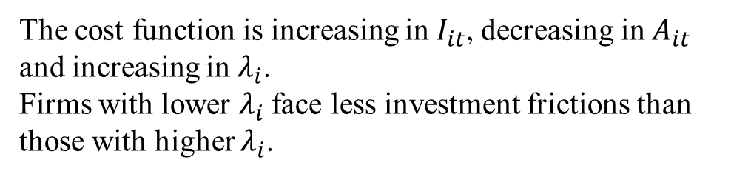
2. Research design
Q-theory and profitability premium
$Π_{it}(A_{it}）$is firm i ’s operating profit function, which is constant returns to scale.
$A_{it}$ is firm i ’s assets in period t.
δ is the rate of asset depreciation
The cost function is increasing in $I_{it}$, decreasing in $A_{it}$ and increasing in $λ_{i}$.
Firms with lower $λ_{i}$face less investment frictions than those with higher $λ_{i}$.

Slide 12

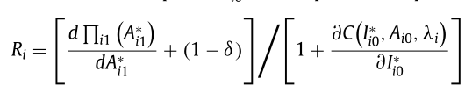
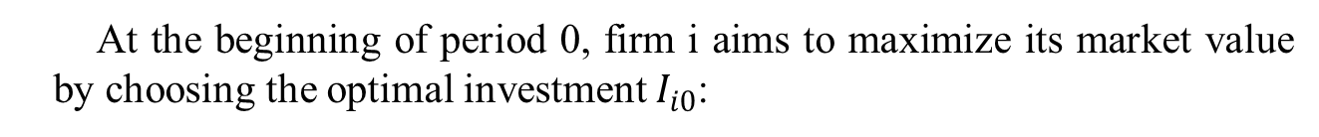
2. Research design
Q-theory and profitability premium
At the beginning of period 0, firm i aims to maximize its market value by choosing the optimal investment $I_{i0}$:
The first-order condition with respect to $I_{i0}$:
R is equal to the marginal profitability of investment divided by the marginal cost of investment

Slide 13



2. Research design
Q-theory and profitability premium
Assume:
$$Π_{it}\left(A_{it}\right)=π_{it}A_{it}$$
Differentiating the first-order condition equation with respect to expected profitability $Π_{it}$:
which indicates that expected return increases with expected profitability.

Slide 14

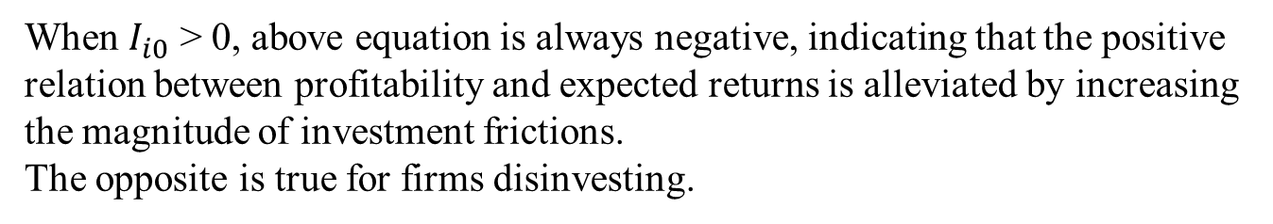
2. Research design
Q-theory and profitability premium
Differentiating the above equation with respect to expected profitability $λ_{i}$:
When $I_{i0}$ > 0, above equation is always negative, indicating that the positive relation between profitability and expected returns is alleviated by increasing the magnitude of investment frictions.
The opposite is true for firms disinvesting.

Slide 15
2. Research design
Misvalue and profitability
Daniel (2001) , Barberis(2003) show that behavioral bias and limits to arbitrage cause investors to fail to fully reflect the information contained about a firm’s profitability and lead to behavioral mispricing.
Hirshleifer (2001), Daniel et al. (2001) have shown that investor behavioral biases are stronger among firms with higher valuation uncertainty.
Therefore, we expect that the profitability premiums would be stronger for stocks with higher valuation uncertainty and with greater limits to arbitrage if it is captured by behavioral mispricing.

Slide 16
2. Research design : Variable
Variable | Calculation method
GP | the operating revenue minus the cost of goods sold divided by the average of total assets
ROA | Operating profit divided by the average of total assets
ROE | net income divided by the average of total shareholders’ equity
SIZE | The log of market value of equity
BM | Book-to-market equity ratio
MOM | the cumulative stock return from month t −1 to t −12
I/A | the annual change in a firms’ quarterly total asset divided by the 1-year-lagged total assets.

Slide 17
2. Research design : Variable
Investment frictions Variable | Calculation method
DIV | the pretax dividend per share in the fiscal year ending in calendar year t
AT | Total assets
KZ | KZ = -1 . 002 *Cashflow + 0 . 283 *Tobin ’ s Q +3.139 * Debt/Total Capital -39 . 368*Dividends - 1 . 315*Cash
SA | SA = -0 . 737 *AT + 0 . 043*AT^2 -0.040*Age
In short, firms with higher dividend, higher total assets, lower KZ index and lower SZ index are considered as lower investment frictions.

Slide 18
2. Research design : Variable
Mispricing Variable | Calculation method
IVOL | the standard deviation of the residuals from regressing daily stock returns on market returns over a maximum of 250 days .
TURN | the average daily turnover (the number of shares traded divided by the number of shares out-standing) over the past 12 months.
ILLIQ | the average of absolute daily returns divided by the daily RMB trading volume over the past 12 months
PRC | Monthly closing stock price
RVOL | the sum of daily share trading volume multiplied by the daily closing price over the past 12 months
In short, firms with higher idiosyncratic volatility, higher turnover , illiquidity measure, lower share price, and lower RMB trading volume are considered as possessing higher limits to arbitrage and thus higher mispricing.

Slide 19
2. Research design : Data
Company financial data：CSMAR、 RESSET Financial Research Database
Period：2001 - 2014 daily data.
Sample: our sample consists of all Chinese A-share stocks, excluding firm with “ST” or “PT”, financial industry, negative book value of equity, and we require firms to be listed on the CSMAR database for at least one year.

Slide 20
2. Research design : method
Univariate portfolio analysis
Bivariate portfolio analysis
Triple portfolio analysis
Fama-MacBeth regressions

Slide 21
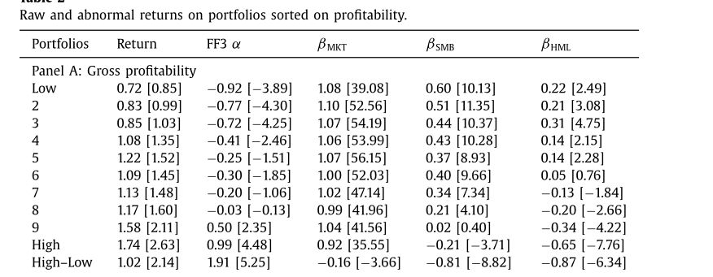
3. Empirical result: Univariate portfolio analysis
The average return of the GP spread portfolio, computed as the difference between the returns of the highest and lowest deciles, is 1.02% per month.
ROA and ROE have similar results.

Slide 22
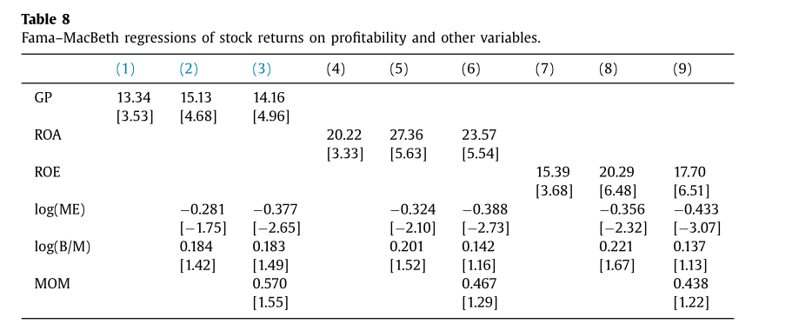
3. Empirical result: Fama-MacBeth regressions
Therefore, the profitable firms significantly outperform the unprofitable ones, confirming the strong positive profitability–return relationship demonstrated in the earlier portfolio analysis.

Slide 23
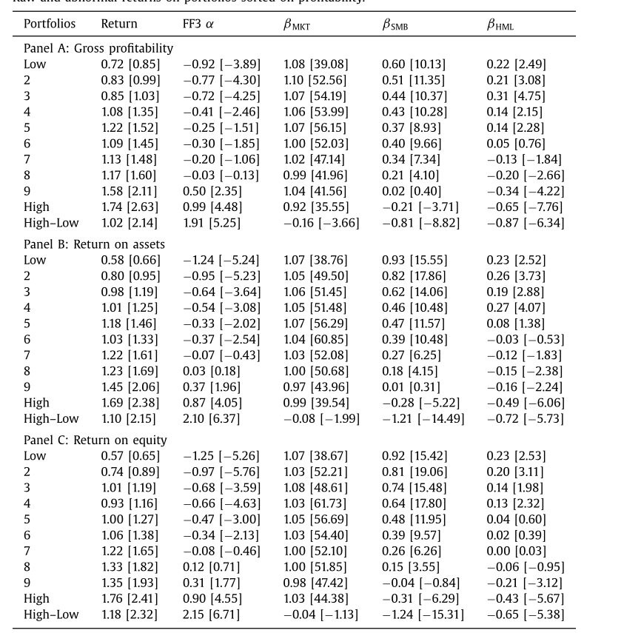
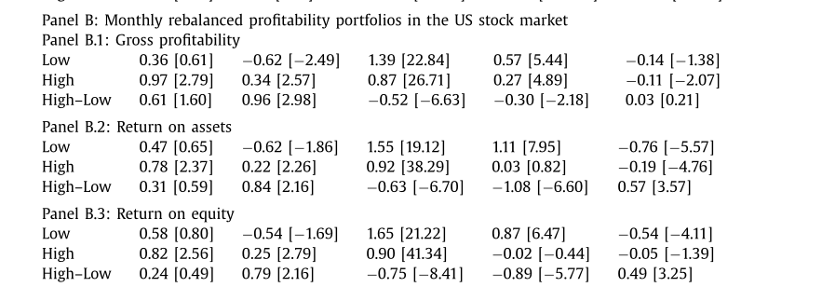
3. Empirical result: Chinese & US stock market
the Chinese stock market
Whereas the US stock market also delivers a large positive profitability premium over the same sample period, its economic value is smaller compared to the Chinese stock market.
In addition, we find that the Chinese profitability premium largely comes from the long legs, which are also sharply different from the US stock market.

Slide 24
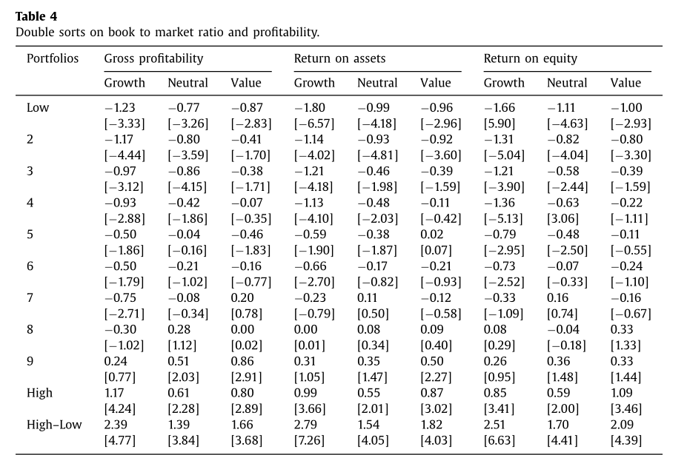
3. Empirical result: Bivariate portfolio analysis
The profitability premium is prevalent across firms with all valuation levels, and it is especially strong among the growth firms.

Slide 25
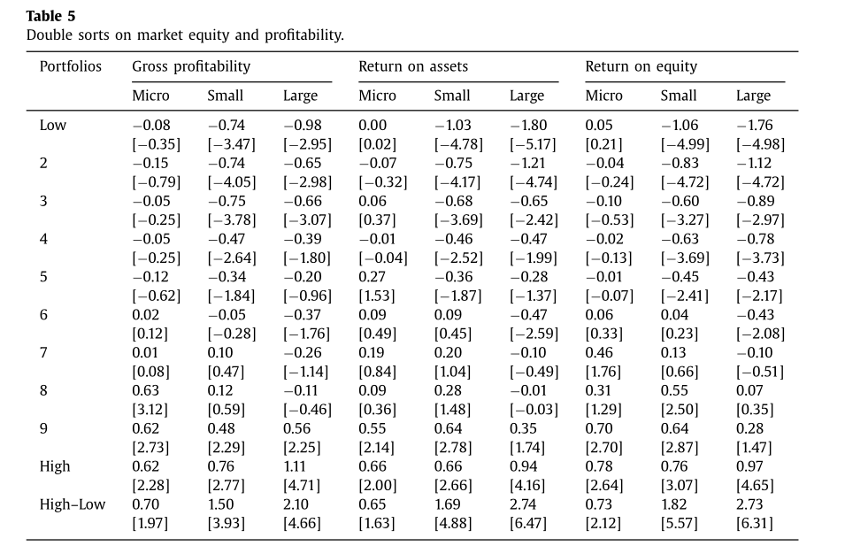
3. Empirical result: Bivariate portfolio analysis
The positive profitability premium is significant and large for firms with large market capitalization but much weaker for micro-cap firms. This finding indicates that the profitability strategy tends to be a large cap strategy.

Slide 26
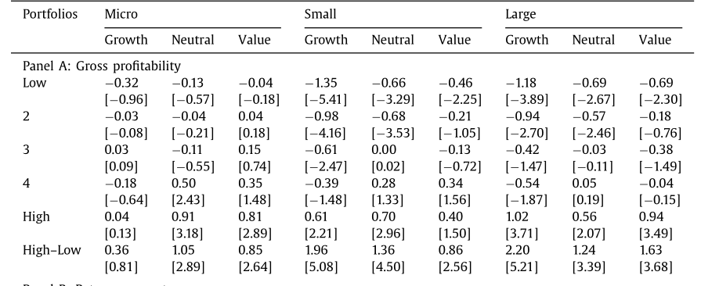
3. Empirical result: Triple portfolio analysis
The positive profitability premium is particularly strong among large and growth firms.

Slide 27
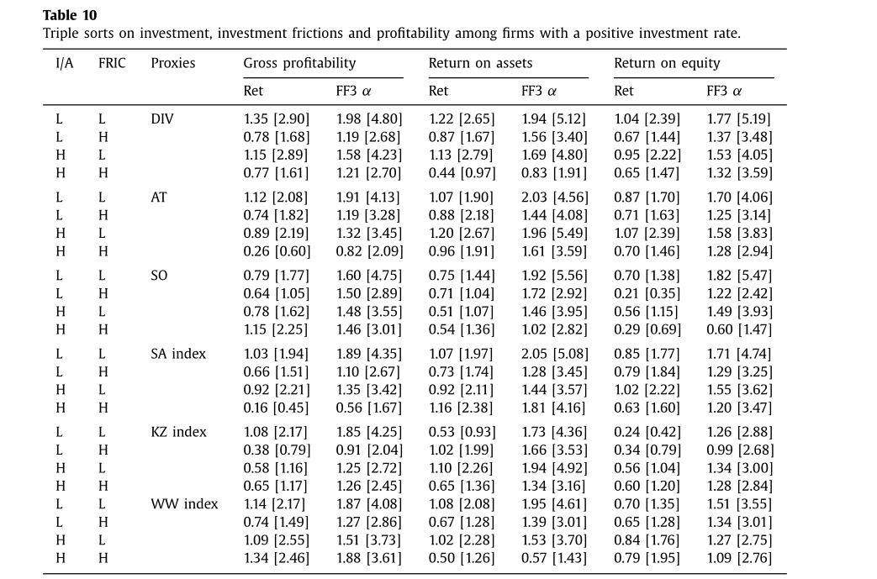
3. Empirical result: Q-theory-based explanations
When controlling for positive investment rate, the profitability premium is much higher among firms with lower investment frictions.
The negative effect of investment frictions on profitability premium also exists in the group of firms with high positive investment rates.

Slide 28
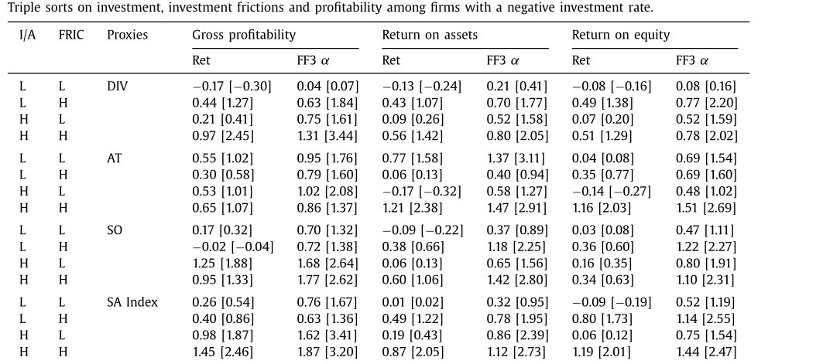
3. Empirical result: Q-theory-based explanations
When we control for the negative investment rate in the sample of disinvesting firms, the profitability premium is higher among firms with higher investment frictions.
In summary, our findings are consistent with q -theory with investment frictions.

Slide 29
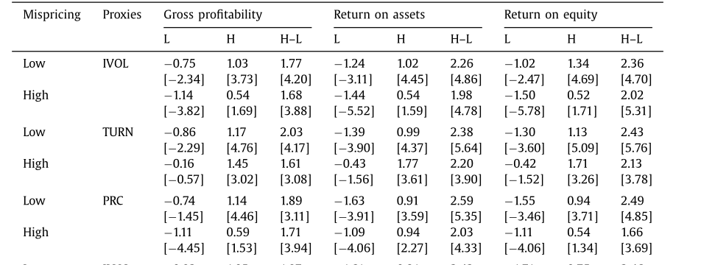
3. Empirical result: Behavioral mispricing
Indeed, the premium is stronger among stocks with low valuation uncertainty, low limits to arbitrage and thus low mispricing.
In summary, we find that the profitability premium is stronger among stocks with a lower likelihood of mispricing, suggesting that behavioral bias and mispricing have little power in explaining the profitability premium in the Chinese stock market.

Slide 30
4. Conclusion
In this paper, we show that the positive profitability premium exists in the Chinese stock market, which indicates that there are a strong connection between stock valuation and economic fundamentals such as profitability in the Chinese stock market.
Profitability premium is particularly strong among firms with large capitalization and high growth.
We further provide evidence that the profitability premium is more likely attributed to the q-theory of investment than behavioral mispricing.

