Slide 1
Model-based earnings forecasts vs. financial analysts’ earnings forecasts
Richard D.F. Harris, Pengguo Wang
2019
讲解人：梅子萌

Slide 2
Outline
Introduction
Research Question 1
Methodology
Data
Empirical Result
Research Question 2
Methodology
Empirical Result
Research Question 3
Hypotheses
Empirical Result

Slide 3
Introduction: Background
Forecasting earnings is of paramount importance in fundamental equity valuation and decision making in capital budgeting.
Many existing accounting-based forecasting models of earnings do not fully consider information that is contained in stock prices or do not based on rigorous valuation.
Pope and Wang (2005, PW) raised a cross-sectional model

Slide 4
Introduction: Research Question
Can forecasts model that contains stock price outperform those from financial analysts and purely accounting based models at both shorter and longer horizons?
Do analysts' consensus forecasts contain unique information in explaining future earnings besides model based forecasts?
Does earnings forecast accuracy depend on firm characteristics such as industry membership?

Slide 5
Introduction: Rrealated Research
Analysts' forecasts are systematically biased
O'Brien, 1988; Mendenhall,1991; Brown, 1993; Das, Levine, & Sivarmakrishnan, 1998; Bradshaw, Drake, Myers, & Myers, 2012; Lee & So, 2017
Cross-sectional model
Pope & Wang, 2005; Hou, van Dijk, and Zhang ,2012; Ashton and Wang,2013; Li and Mohanram,2014
Other forecast model
Gerakos and Gramacy ,2013

Slide 6
Introduction: Research Question
Can forecasts model that contains stock price outperform those from financial analysts and purely accounting based models at both shorter and longer horizons?
Do analysts' consensus forecasts contain unique information in explaining future earnings besides model based forecasts?*
Does earnings forecast accuracy depend on firm characteristics such as industry membership?

Slide 7

Ashton and Wang(2013) raised price-related model,
earnings (et), book value of equity (bt ), stock price (Pt)
HDV(2012) model:
aj,t , dj,t and accj,t are assets, common dividends and operating accruals on a per share basis, NegEj,t is a dummy variable that equals 1 if the firm has negative earnings at time t and 0 otherwise
Combine price and earnings components together we get a new model (PW):

Slide 8




Follow Pope and Wang(2005) ,Ashton and Wang (2013):
price of equity (Pt) is written in terms of book value (bt), abnormal earnings ( ) and earnings component (x2t)
R-1 is cost of capital. Then, we have:

Slide 9
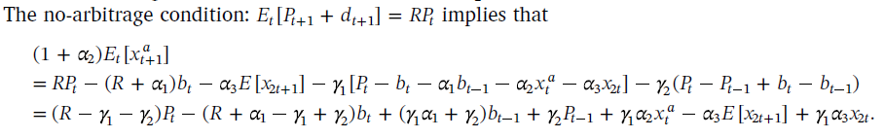
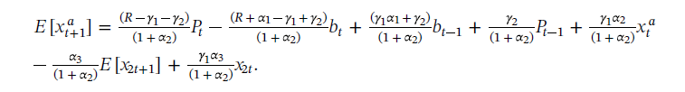
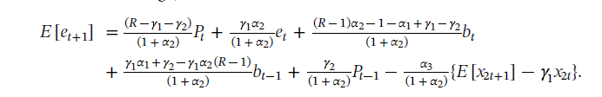
That is:
For

Slide 10

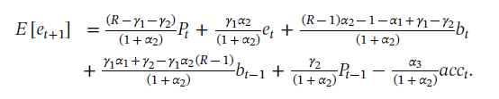
Let x2t be operating cash flows at time t. Then
can be viewed as accruals(acct+1)
So we have:

Slide 11

Benchmark
HDV model
Random walk model
IBES analyst forecast
AR model

Slide 12
Data
Forecast from July 1976 to June 2015, ten-year rolling window forecast (pool regression) , 1,2 and 5 year ahead forecast are calculated(k=1,2,5)
149750 sample, firm with negative book values are removed, firms in the extreme percentile of earnings, book values, assets, prices, and one period ahead earnings forecasts are removed
Database: CRSP, Compustat, IBES

Slide 13
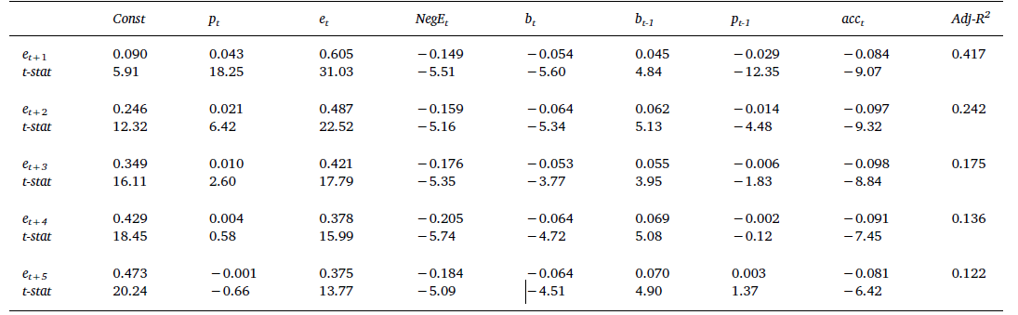
Empirical Result

Slide 14
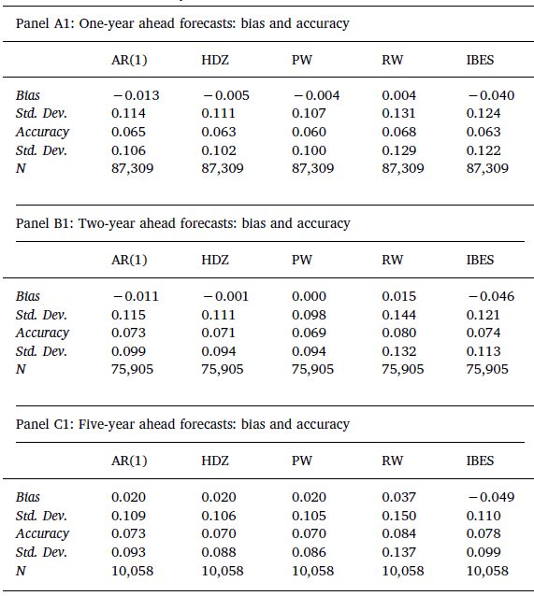

Slide 15
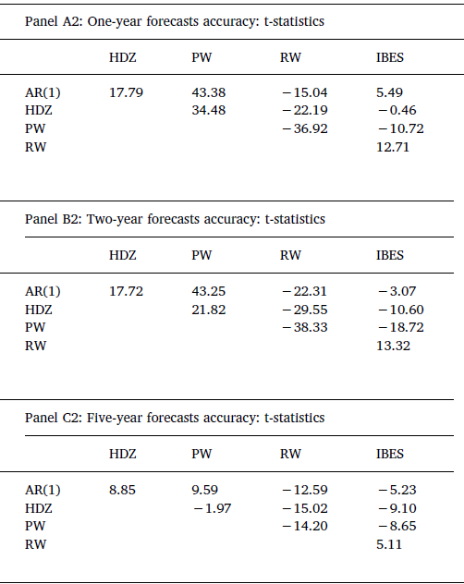

Slide 16
Introduction: Research Question
Can forecasts model that contains stock price outperform those from financial analysts and purely accounting based models at both shorter and longer horizons?
Do analysts' consensus forecasts contain unique information in explaining future earnings besides model based forecasts?*
Does earnings forecast accuracy depend on firm characteristics such as industry membership?

Slide 17



Weak efficiency is tested by estimating the following Mincer and Zarnowitz (1969) regression:
is the forecast made at time t of the earnings and is the actual earnings of firm j at time t+1
If the earnings forecasts are weakly efficient, the slope coefficient should be close to one.
The R-squared statistic from the Mincer-Zarnowitz regression measures the information content of the forecasts

Slide 18
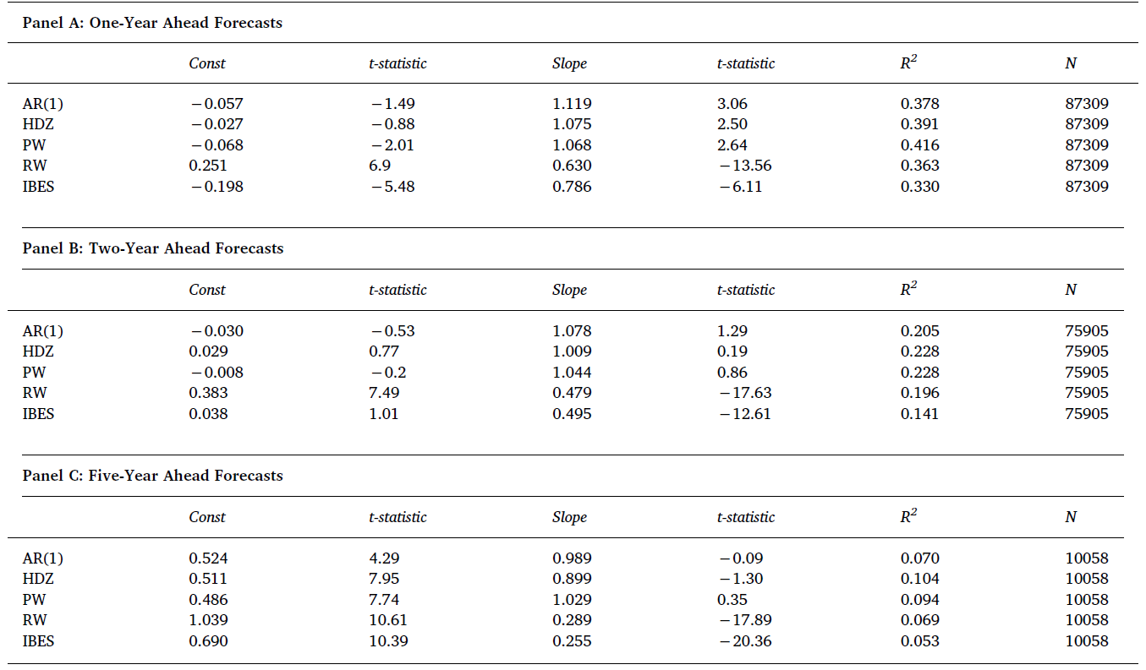

Slide 19

Another regression to measure the incremental information of forecasts :
If βk=0 then the forecasts from model k do not contain any information about realized earnings beyond that contained in the other models
Model | 1 | 2 | 3 | 4 | 5 | 6 | 7 | 8 | 9 | 10
AR(1) | √ | √ | √ |  |  |  | √ | √ |  | √
HDZ | √ |  |  | √ | √ |  | √ | √ | √ | √
PW |  | √ |  | √ |  | √ | √ |  | √ | √
IBES |  |  | √ |  | √ | √ |  | √ | √ | √

Slide 20
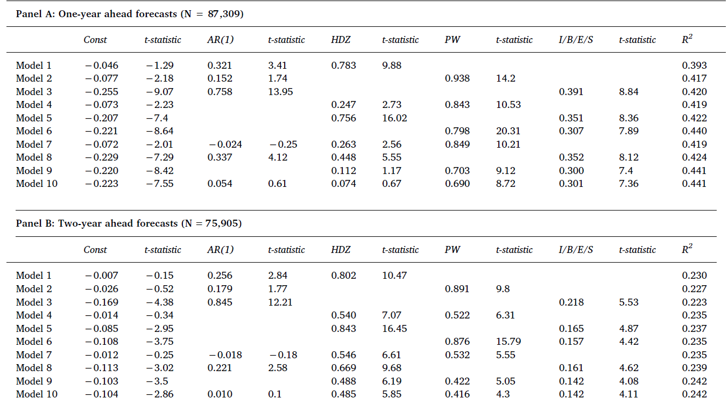
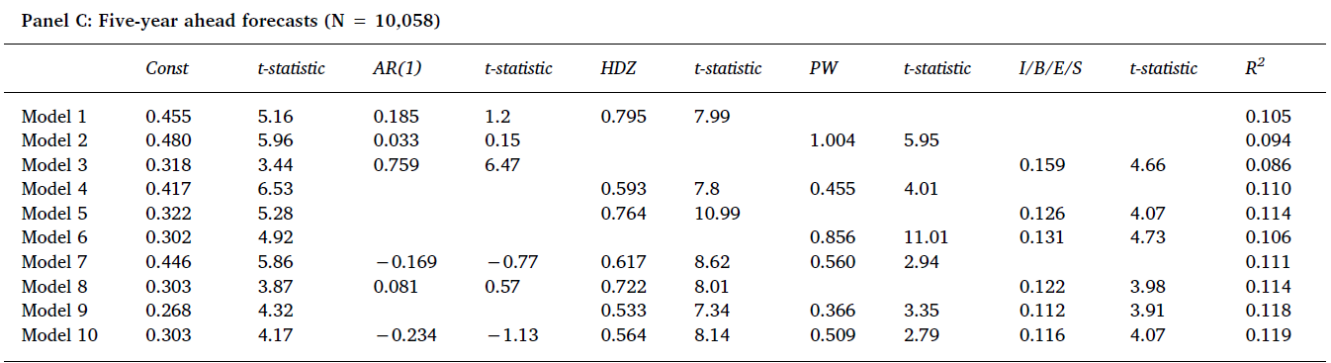

Slide 21
Introduction: Research Question
Can forecasts model that contains stock price outperform those from financial analysts and purely accounting based models at both shorter and longer horizons?
Do analysts' consensus forecasts contain unique information in explaining future earnings besides model based forecasts?*
Does earnings forecast accuracy depend on firm characteristics such as industry membership?

Slide 22
Three Hypotheses
Financial analysts' consensus forecasts are more accurate than model-based forecasts for industries with distinct characteristics in their financial statements.
Financial analysts' consensus forecasts are more accurate than model-based forecasts for large firms.
Financial analysts' consensus forecasts are more accurate than model-based forecasts for high E/P firms.

Slide 23
Empirical Result
We divide the full sample into 12 industries using the classification from Ken French's website
Firm size is measured by market capitalization

Slide 24
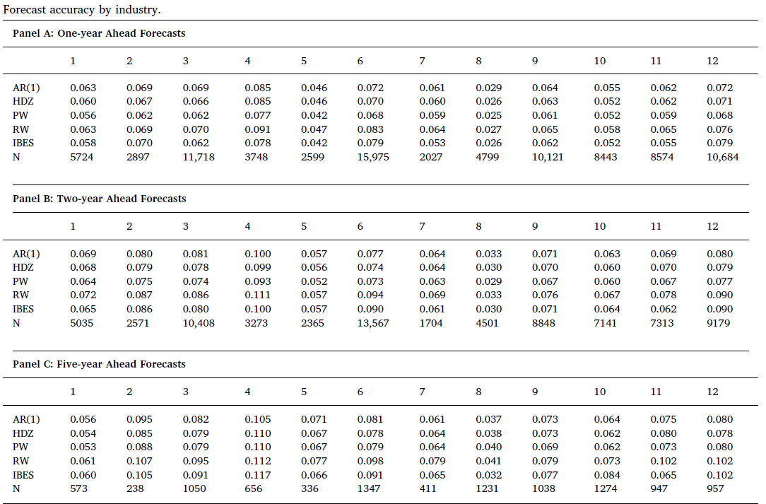

Slide 25
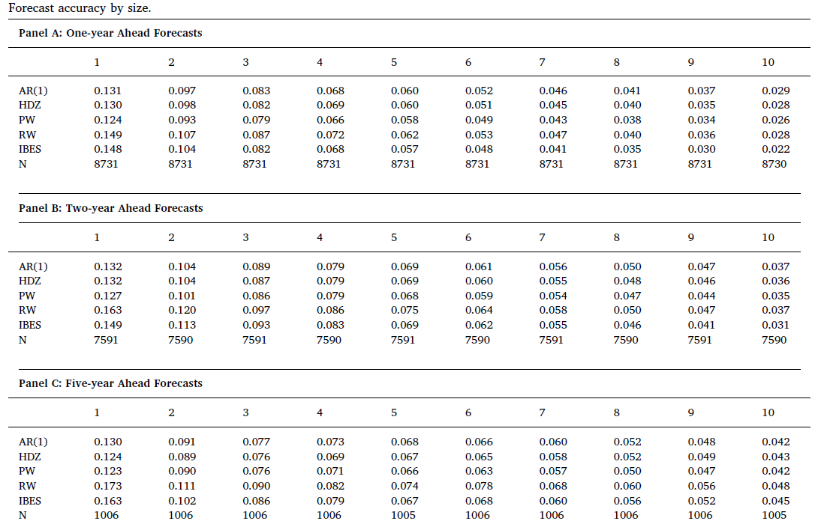

Slide 26
