Slide 1
Forest Through the Trees: Building Cross-Sections of Stock Returns
Pelger Markus, et.al, working paper, 2020.

Slide 2
Outline
Introduction
Research design
Empirical result

Slide 3
Introduction: Background
Portfolio sorting is a reliable way for empirical assets pricing.
More anomalies are detected which leads to that portfolio sorting is harder to catch all important information.
Many researchers used machine learning method solving economic problems, but most of them did not combine economic and new method.

Slide 4
Introduction: Motivation
Portfolio sorting always pays more attention to 2/3 factors. When adding factors, portfolio sorting is face with “curse of dimensionality”
Tree method can be seen as a kind of portfolio sorting with characteristic selection.
Pruning improve tree behavior by cutting redundant nodes.

Slide 5
Introduction: Research Questions
Does the Assets Pricing Tree method provide a better way to generate portfolios which represent cross-section returns?
How many portfolios which can represents cross-section return well?

Slide 6
Introduction: Related Researches
Using machine learning method to form SDF:
Lettau and Pelger (2019) extend principal component analysis to include a cross-sectional pricing restriction that helps to identify weak factors, and our paper is based on a similar intuition, relying on a no-arbitrage criterion to select the optimal tree portfolios.
Kelly, Pruitt, and Su (2019) and Fan, Liao, and Wang (2016) explicitly model stock loadings on the SDF as a function of its characteristics, and as a result apply PCA to managed portfolios that represent linear projections of asset returns on characteristics.

Slide 7
Introduction: Related Researches
Using Tree methods:
Moritz and Zimmerman (2016), Gu, Kelly, and Xiu (2019),and Rossi (2018) rely on decision trees in estimating conditional moments of stock returns.

Slide 8
Introduction: Research Contents
Form AP-Tree model which splits stocks better than traditional double/triple sorts.
Reduce the base portfolios formed by AP-Trees and find less base portfolios can represent the cross section returns.

Slide 9
Introduction: Contribution
Draw a new pruning method and use it to form AP-Tree model.
Find 10 portfolios from AP-Tree can represent 100 firm characteristic portfolios well.

Slide 10
Research Design:
36 Anomalies
Stock returns
vs
Triple sorts
AP-Tree
Portfolios from Decision Tree
Final
portfolios
AP-Pruning

Slide 11
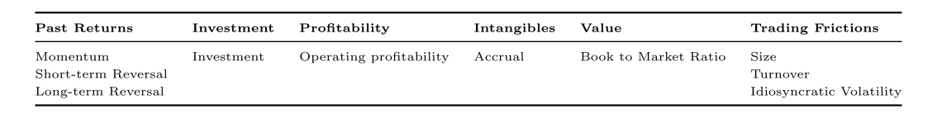
Research Design: Data
1964.01-2016.12 monthly data. All stocks from CRSP
10 anomalies from Kenneth French Data Library
1964-1983 for train; 1984-1993 for validation; 1994-2016 for test.

Slide 12
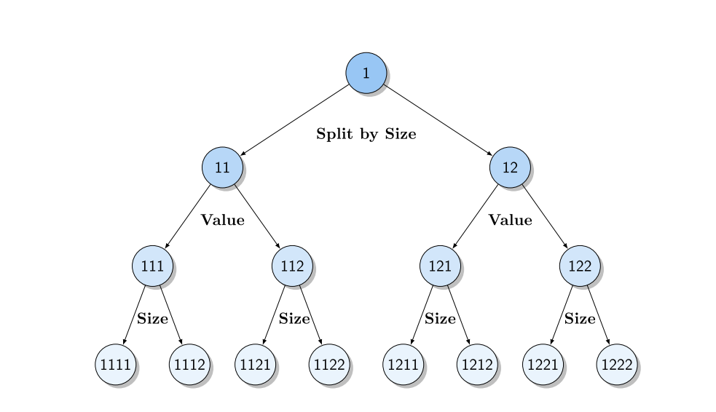
Research Design: Portfolios from Tree
Using returns and firm characteristics to train trees.
Each node of Decision Tree is a portfolio.
Example:

Slide 13
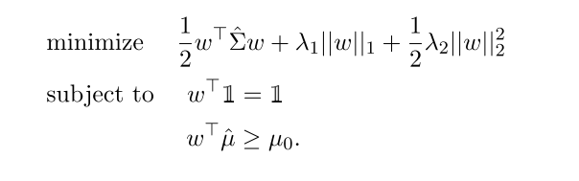
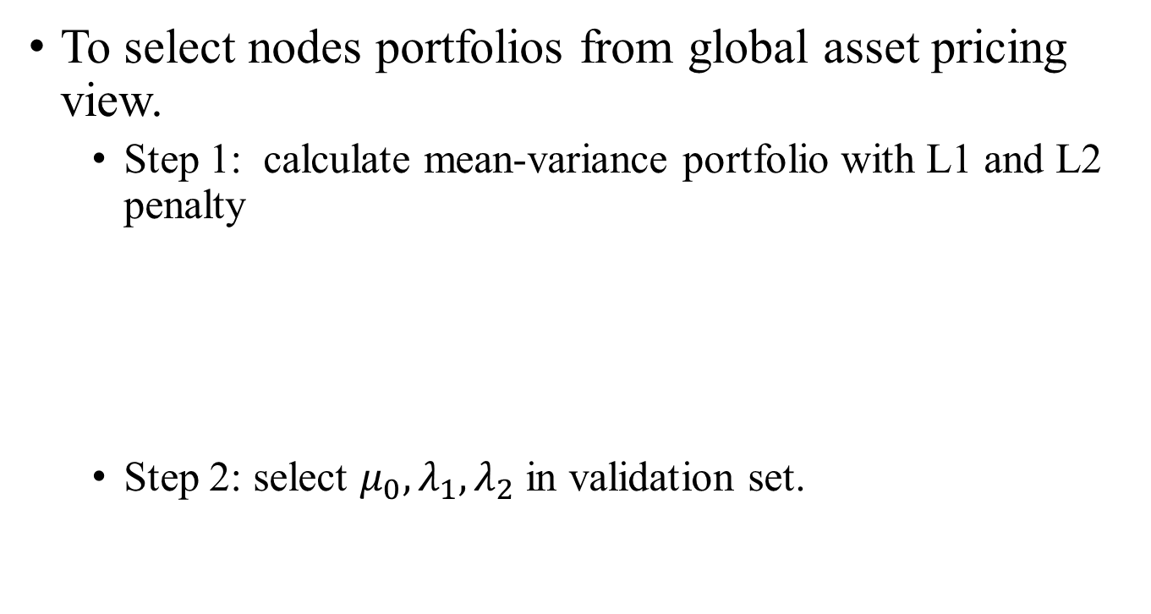
Research Design: Pruning
To select nodes portfolios from global asset pricing view.
Step 1: calculate mean-variance portfolio with L1 and L2 penalty
Step 2: select $μ_{0}, λ_{1},λ_{2}$ in validation set.

Slide 14
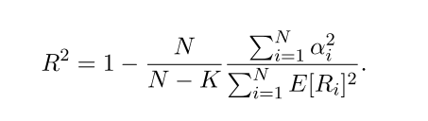
Research Design: Performance
Alpha after FF model adjusted
FF-3
FF-5
XSF: market + HML + momentum + any other one.
FF11: market + firm characteristics’ long-short portfolios
Sharpe ratio of mean-variance portfolios.
Cross-section R2:

Slide 15
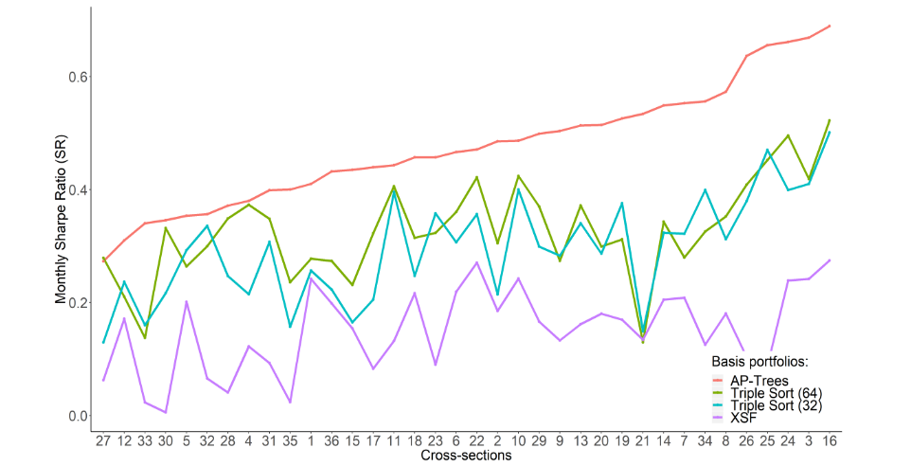
Empirical Result: Model Performance-Sharpe Ratio

Slide 16
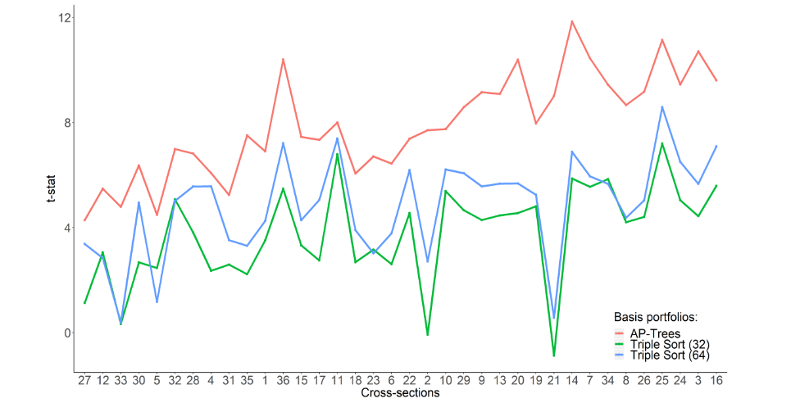
Empirical Result: Alpha

Slide 17
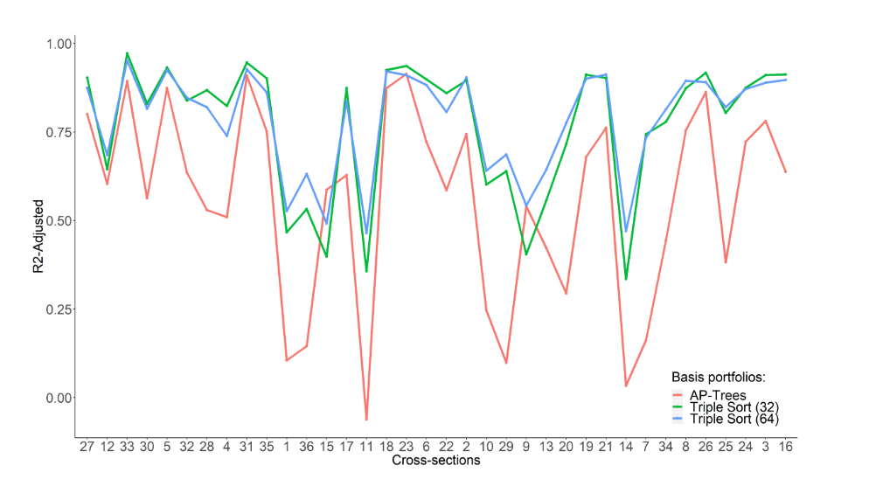
Empirical Result: Cross section R2

Slide 18
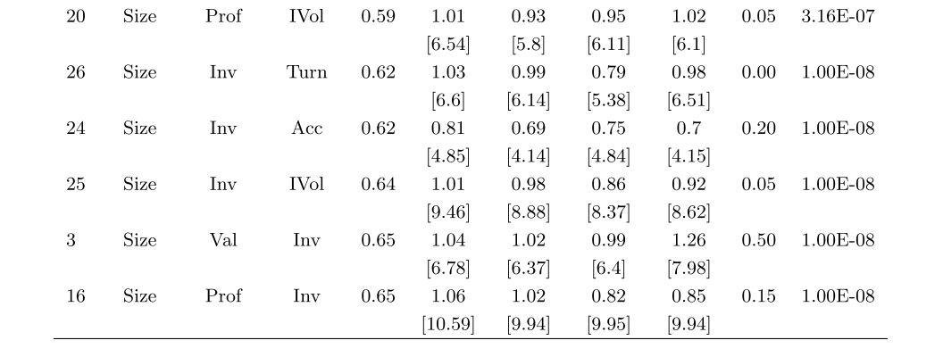
Empirical Result: The Combination of Firm Characteristics

Slide 19
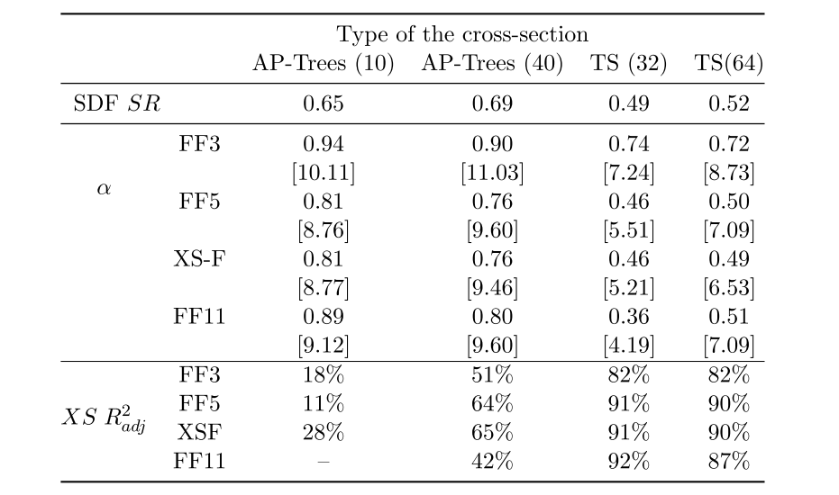
Empirical Result: When reduces the number of base portfolios

Slide 20
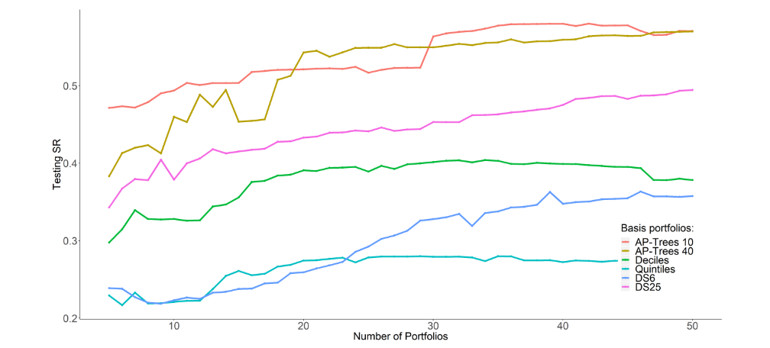
Empirical Result: All Firm characteristics

Slide 21
本周工作
检查因子
重跑因子筛选结果，但结果不好，查找问题。展示在Excel中。
To do:
查找问题，调整结果
构建中国市场三因子做调整。

