Slide 1
Comparing Cross-Section and Time-Series Factor Models
E. Fama and K. French, The Review of Financial Studies, 2020.

Slide 2
Outline
Introduction
Research design
Empirical result
Robust Test
Some views

Slide 3
Introduction: Background
Several models like CAPM, FF3, FF5 are drawn to explain assets’ returns.
Cross-section models have fixed factor loadings, which is argued by many researchers.
Test which model behaves better becomes an important problem.

Slide 4
Introduction: Motivation
Models can be divided into cross-section model and time-series model, but no evidence shows which kind of models behaves better.
When allowing loadings change, cross-section model like FF5 becomes time-series model, which may gain better behavior.

Slide 5
Introduction: Research Questions
Which model behaves better in explaining stock returns?
Does the performance become better when cross-section model has time-varying loading ?

Slide 6
Introduction: Related Researches
Factor models are often motivated by evidence from Fama and MacBeth(FM 1973) :
The five-factor model of Fama and French (FF 2015) follows evidence from FM cross-section regressions that profitability and investment capture differences in average returns missed by the three-factor model.
But FM cross-section regressions are, however, a type of factor model.
Two papers by Back, Kapadia, and Ostdiek (2013, 2015) use FM cross-section regression slopes as factors in time-series regressions

Slide 7
Introduction: Related Researches
Many papers argue that factor loadings are likely to vary through time (like, Shanken 1990; Ferson and Harvey 1991)
Procedures to capture the variation are often somewhat arbitrary (for example, periodically re-estimate the loadings or allow them to change as functions of arbitrary variables, like interest rates).

Slide 8
Introduction: Research Contents
Check 4 type assets pricing models and find cross section model with time-varying loadings behaves better.
Changing target portfolios to 100 5x5 portfolios and 110 anomaly portfolios, find the result is stable.

Slide 9
Research Design:
185 portfolios,
100 5x5 portfolios,
110 Anomaly portfolios
Cross-section Model
vs
Time-series Model

Slide 10
Research Design: Data
1963.06-2016.08 monthly data of stocks with CRSP share codes of 10 or 11 from CRSP and Compustat.
9 Firm Characteristics: MC(market cap), BM(book-to-market), OP(Operating profitability), INV(Investment), mom(Momentum-11), NI(Net stock issues), AC(Accruals), Beta(Market beta), Var(Variance of daily total returns.)

Slide 11
Research Design: Time Series Models
Model 1:
From Fama and Macbeth(1973), the first time-series model can be set as:
Model 2:
Take characteristic as loadings, the model changed as :

Slide 12
Research Design: Cross Section Models
Model 3:
FF5 model represents the cross-section model in this paper.
Model 4:
The calculation way of FF5 factors is fixed which may not explain time trend of stock returns.
Change factor to cross-section factor from model 2, model 3 becomes:

Slide 13
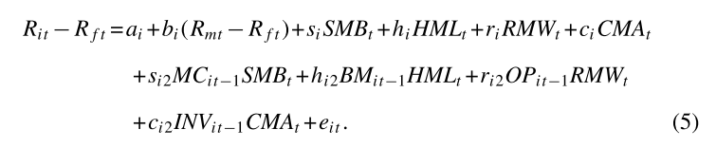
Research Design: Models
Model 5:
To test whether adding time-varying loadings into cross-section model benefits pricing returns or not.
When adding time-varying loading, model 3 becomes:

Slide 14



Research Design: Performance
Average Alpha, t value, R2, The square of sharpe ratio
GRS statistics(Hotellings T value), for the square of t value
for adjusted square of t value, in which

Slide 15
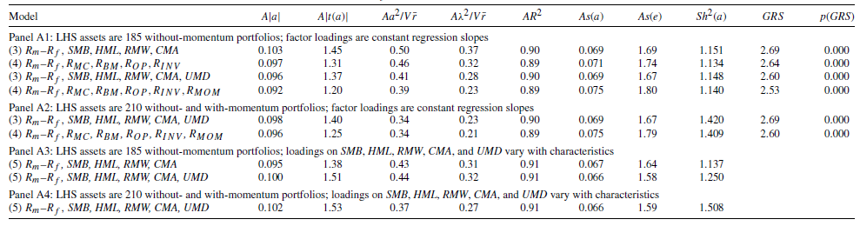
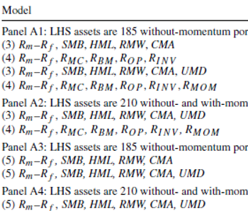
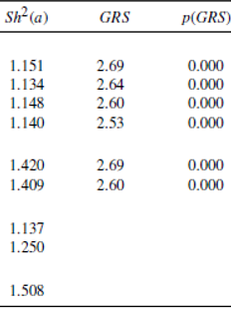

Empirical Result: All Portfolio Results
After allowing factor loadings change, the cross section model becomes the best model.
There is no evidence to replace SMB by $R_{MC}$
s
s
s

Slide 16
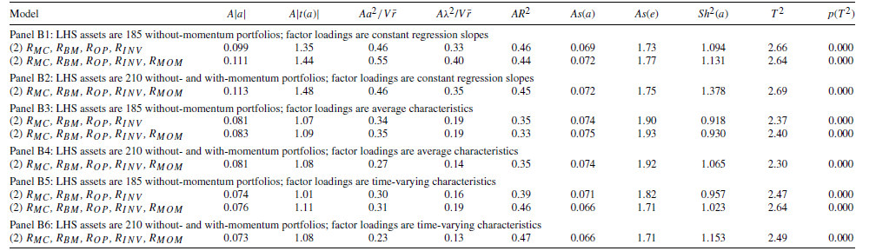
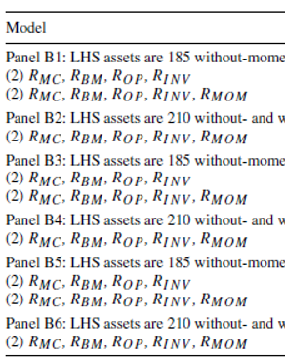
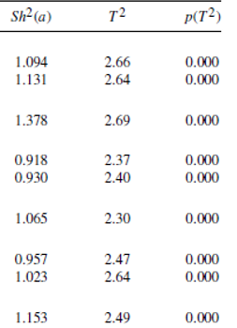
Empirical Result: All Portfolio Results

Slide 17
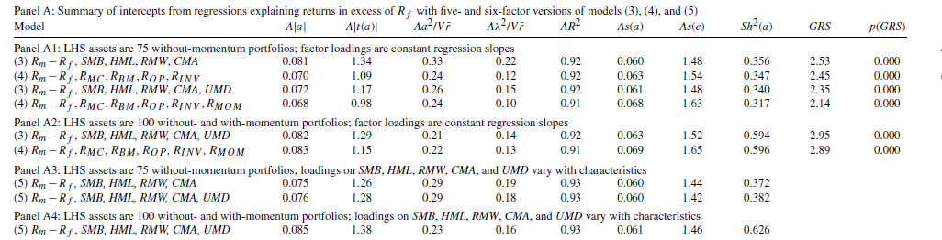
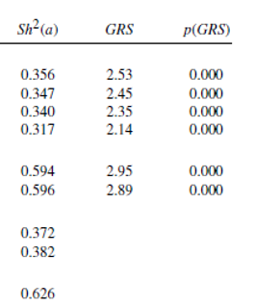
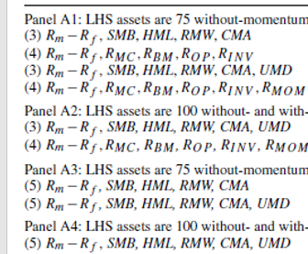
Robust Result: 100 Portfolio Results
Change left hand portfolios to 5x5 MC-BM, MC-OP, MC-INV, MC-MOM

Slide 18
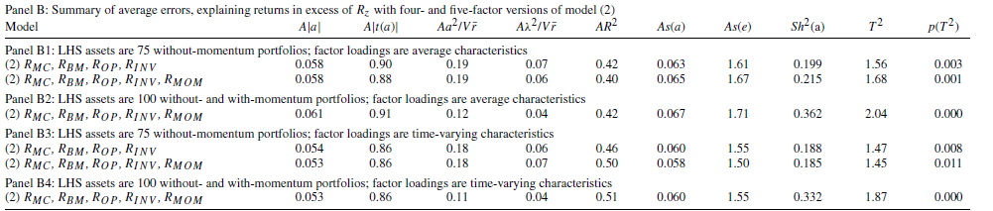
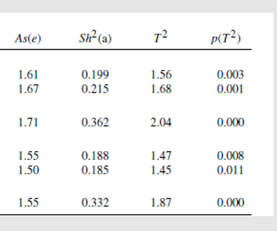
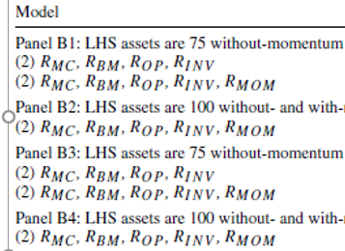
Robust Result: 100 Portfolio Results

Slide 19
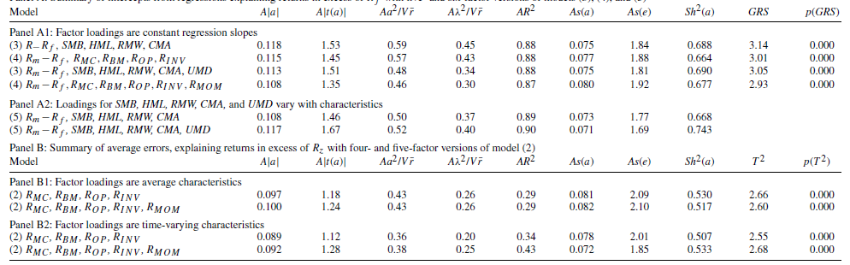
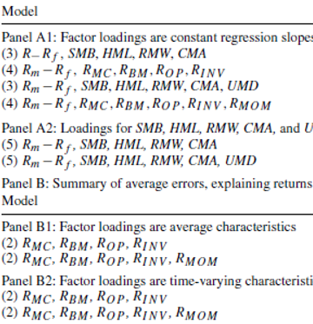
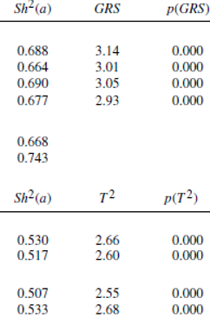
Robust Result: 110 Portfolio Results
Change left hand portfolios to 110 MC-beta, MC-AC, MC-NI, MC-VAR

Slide 20
Some Views
They just test the explanation power of portfolios. But the portfolio they chose may not represent the whole stock market.

