Slide 1
Forecasting the Equity Premium: Mind the News! Philipp Adämmer, Rainer A Schüssler Review of Finance, 13 May 2020
Long Zhen

Slide 2
Contents
Introduction
Motivation
Research problem
Contribution
Research Design
Data
Method
Empirical Results
Conclusion

Slide 3
Introduction – Motivation
Economic predictors’ predictability is limited
Investors’ decisions are driven by a plethora of information → mind the news
Price data → Fundamental data → Textual data
Textual data is high-dimensional → why machine learning

Slide 4
Introduction – Motivation
The application of text mining techniques for econometric and financial research
Sentiment: Dictionary-based methods
Jiang et al. (2019) manager sentiment and stock returns
Engelberg, Reed, and Ringgenberg (2012), Garcia (2013) and Glasserman and Mamaysky (2019). Turner, Ye, and Walker (2018)
Contents: Probabilistic topic
Calomiris and Mamaysky (2019) use Louvain method to disentangle the various effects of news on risk and returns in 51 developed and emerging equity markets.

Slide 5
Introduction – Research Problem
Can textual data predict equity premium?
Which topics is the most important?

Slide 6
Introduction – Contribution
Method: Investigate the benefits of topic modeling to predict the equity premium
Data: Investigate newspaper information’s performance in asset pricing

Slide 7
Research Design – Data
New York Times and Washington Post article beginning in June 1980 that either contains the character string econom in its text or a proportion of economic relevance greater than zero (732,354)
S&P 500 index
Training sample: 1980.6~1995.12
Test sample: 1996.1~2018.12

Slide 8
Research Design
Articles
①Correlated topic model(CTM)
② 100 variables（topic proportions）
③Data-adaptive forecast aggregation method
Equity Premium
Topic analysis

Slide 9
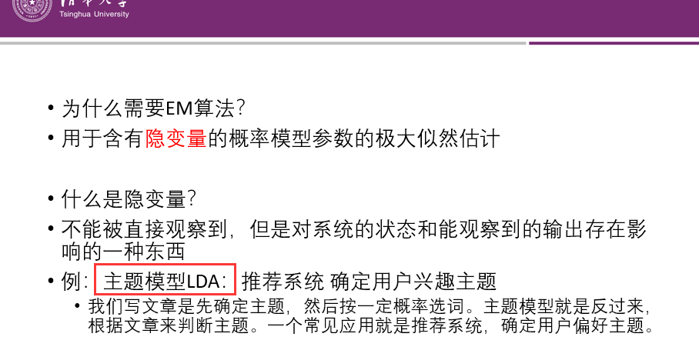
①Correlated Topic Model (CTM)
目的：识别主题
问题：文档-主题分布和主题-词汇分布耦合(隐变量)
Remember EM(Expectation Maximum) method?

Slide 10
硬币模型
已知：n个抛硬币结果（正反反正……）
生成：抛哪个硬币→ 正反结果
未知：骰子-硬币的概率、硬币-正反的概率
主题模型：
已知：n个词（无顺序）
生成：什么主题→ 选用词
未知：文章-主题的分布、主题-词的分布
区别：
伯努利分布 → 逻辑正态分布
主题独立分布 → 引入主题相关性矩阵

Slide 11
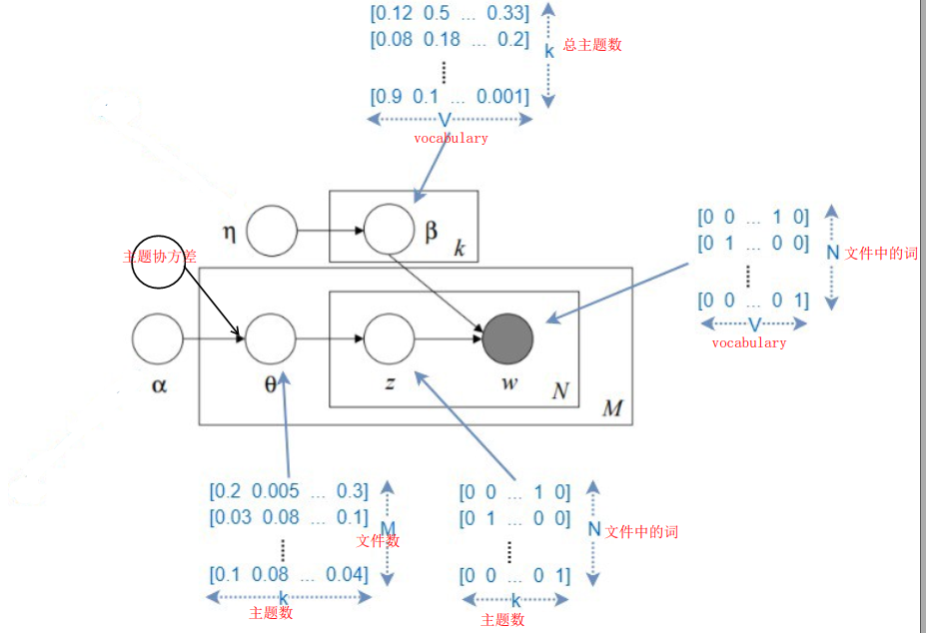
相关主题模型示意图

Slide 12
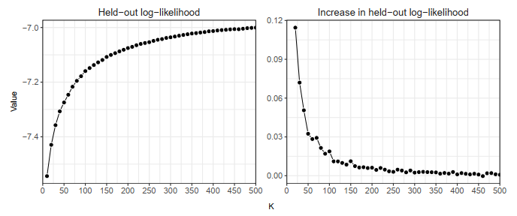
② Construct variables
Choose the number of topics:
Document-completion held-out likelihood method: compare predictive performance by estimating the probability of the 2nd half of a document, given the 1st

Slide 13
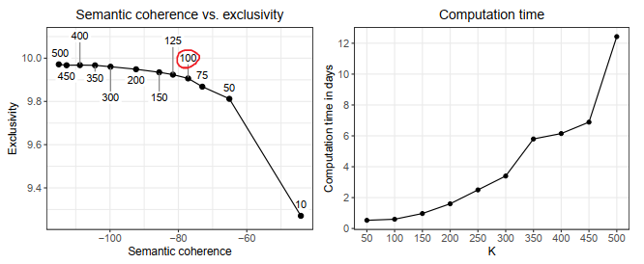
Choose the number of topics:
Semantic coherence & exclusivity
Computation time
一个主题的高概率词在其他主题下概率低
一个主题中概率最大的词同时出现
→ choose 100 as the number of topics

Slide 14
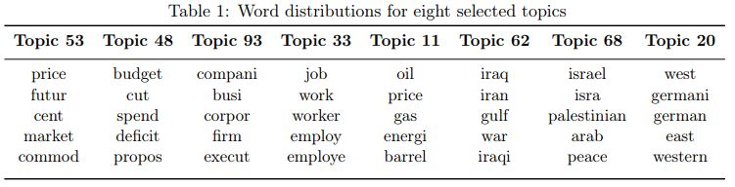
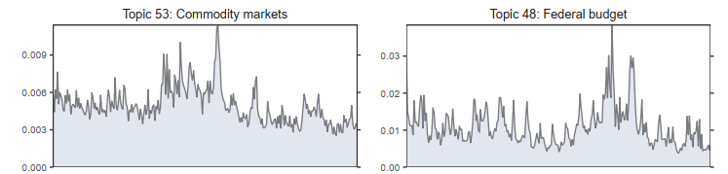
Train the CTM based on 1980.6~1995.12
Compute monthly averages of topic proportions, beginning with OOS documents in 1996.1
Monthly averages of topic proportions

Slide 15


③Forecast with 100 Topic Proportions
Switch method
Many of the 100 predictors are irrelevant
Strong predictors should be given higher weight
Predictors’ power vary over time
1- run 100 univariate predictive regressions
→compute 100 predictions
2- forecast aggregation
Model averaging
Model selection: lowest OOS mean squared prediction error (MSPE)

Slide 16



Model switching
Choose optimal δ
pick δ that would have generated the lowest OOS MSPE until the given point in time t:
where 0 < δ ≤ 1 denotes an exponential discount factor.

Slide 17
Timeline:
100 topic proportions
CTM_sel & CTM_avg
CTM_Sw
1980.6
1995.12
1997.6
1998.12
2018.12
Train CTM
In-sample
Initialize δ

Slide 18

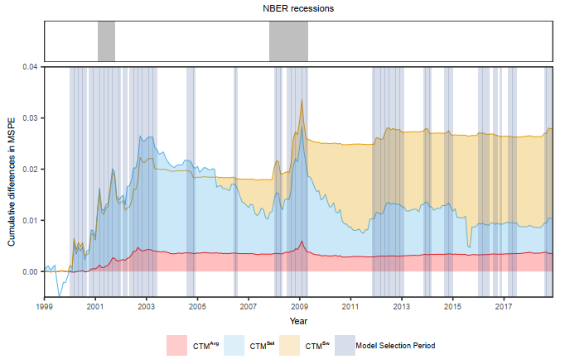
Empirical result: OOS predictability
=6.52%
1、增长来自sel部分
2、衰退时期效果更好
3、在sel优于历史均值时作为sw，否则选择了稳定的avg

Slide 19

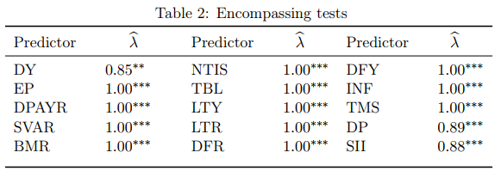
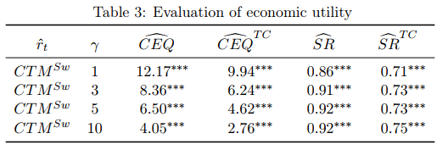
Compare to economic predictors
Goyal and Welch(2008) 14 + Rapach(2016) 1 short interest rate
Encompassing test:
Economic gain

Slide 20
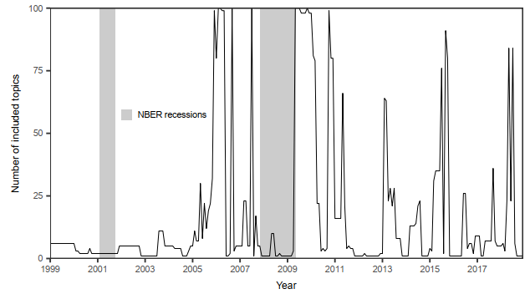
Generalized forecast aggregation
Rather than the extremes of using only one forecast or averaging over all models, we allow for any average
Figure 7: This figure depicts how many topics were included in the aggregate forecast at each point in time

Slide 21
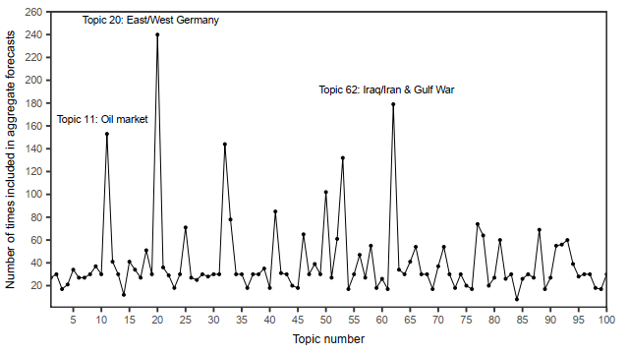
=5.08%
annualized certainty equivalent return = 10.01% annualized Sharpe ratio = 1.07
Figure 8: This figure shows how often each topic (proportion) was included in the aggregate forecast.

Slide 22
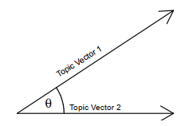
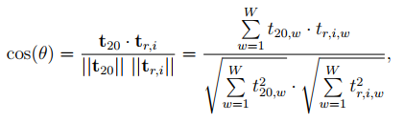
Empirical result: topic analysis
Topic 20 is always included when switch to selection
West/german/east → about Germany
Q1:Which events, apart from Germany, are captured by topic20?
Train two CTM(K=40) based on NBER recessions
Use 100 most probable words of each topic to form matrix
Calculate similarity
vectors
40 topics
All words

Slide 23
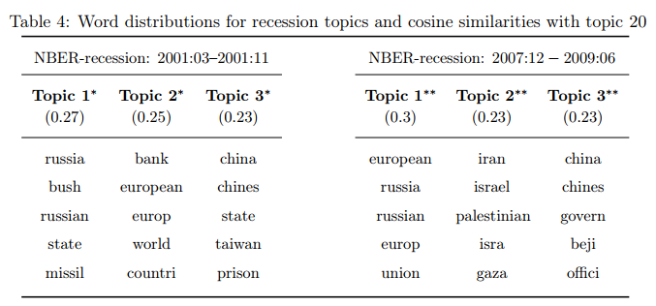
Geopolitical events have an impact on aggregate equity returns
→ Manela and Moreira (2017): decompose news-based implied volatility index(NVIX)
the majority of the index’ variance is driven by word categories related to
(i) Government (Tax Policy)
(ii) Financial Intermediation
(iii) Stock Market
(iv) War
(v) Remaining

Slide 24

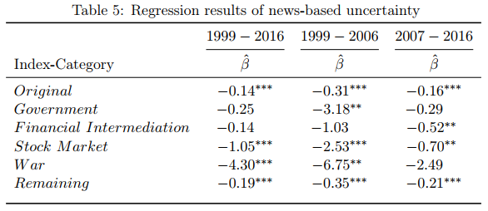
Q2: Whether CTM_sw tends to pick CTM_sel in periods of high(news-based) uncertainty?
Run a logit regression
Xt is a binary variable, 0 if CTMSw picks model selection in period t and 1 in case model averaging is selected
CTM_sw tends to choose CTM_sel when uncertainty is high
1999-2006: government、war (Kosovo war/ 911/ Afghanistan war/Iraq war)
2007-2016: financial intermediation、stock market

Slide 25
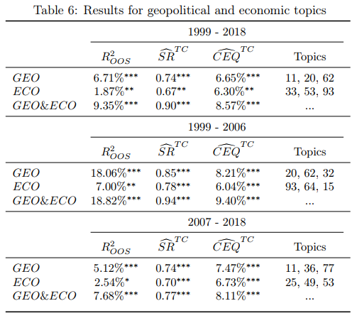
Q3: Geopolitical vs. Economic News ?
Compare 3 geopolitical and 3 economic topics that were picked most frequently by CTM_gen
conduct the analysis for subsamples 1999:01–2006:12 and 2007:01–2018:12
GEO exhibit stronger predictive power
A combination leads to a boost in performance
the predictive power of GEO is strongest between 1999–2006

Slide 26
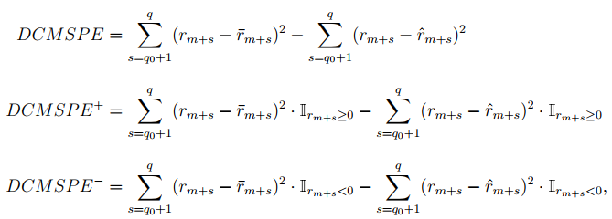
Empirical result: Countercyclical Predictability
Researchers all find much stronger predictability during economic downturns.

Slide 27
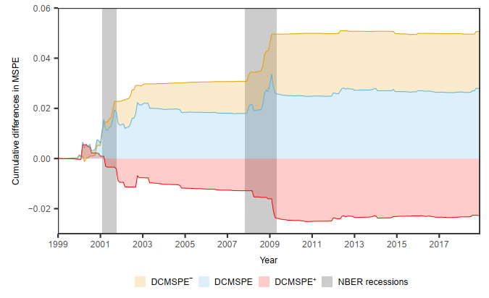
Why ?
Cujean and Hasler (2017): Disagreement spikes in bad times, which causes returns to react to past news and thus induces predictability

Slide 28
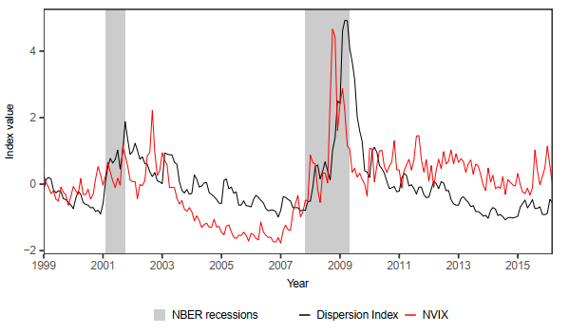
Q4:Whether Cujean’s explanation makes sense?
Disagreement proxy: the ratio of the standard deviation and the mean analyst forecasts
The estimated slope coefficient is positive (0.0382) with a t-statistic of 3:06

Slide 29
Conclusion
The news-based aggregate forecast has strong predictive power
Geopolitical news rather than economic news are at times more important for predicting the equity premium

Slide 30
Inspirations
Geopolitics matters for us
Text analysis can apply to many other studies, but…
Why China’s premium predictability exhibits in expansion periods?

