Slide 1
When Anomalies Are Publicized Broadly, Do Institutions Trade Accordingly?
Calluzzo. P., Moneta. F., Topaloglua.S.
Management Science, 2020.
雷印如 2020/09/26

Slide 2
Outline
Introduction
Research design
Empirical result
Robust Test
Conclusion

Slide 3
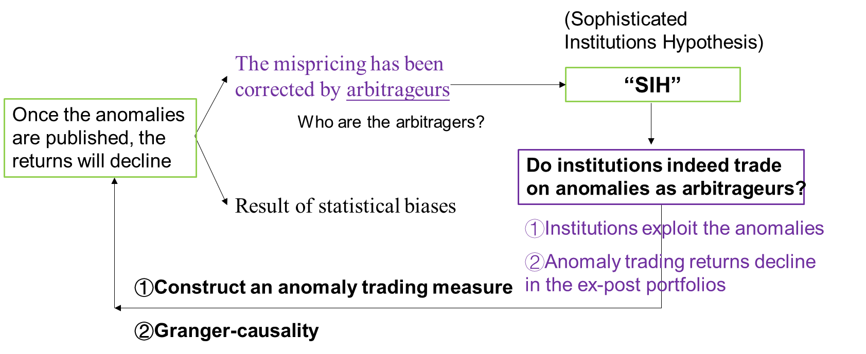
Outline
Publication/ Information/ Heterogeneity

Slide 4
Motivation
Do institutional investors act as an arbitrager and correct anomaly mispricing?
Once the anomalies are published, the returns will decline.
(1) Anomalies are the result of statistical biases that will not persist out-of-sample
(2) They are due to mispricing that is corrected by arbitrageurs.
Institutional investors are prime candidates for the role of arbitrageurs as they are generally perceived to be sophisticated.

Slide 5
Contribution
Institutions trade on the anomalies only when they have the necessary accounting data.
We ﬁnd that a group of investors trade against anomalies even after academic publication, and may be a source of the contrarian trading documented by EIK.
Our paper adds to the strand of research that investigates institutional trading and market eﬃciency. Our ﬁndings suggest a positive role for some institutions in contributing to more eﬃcient markets.

Slide 6
Research Design: Data
(CRSP MF) database to obtain the accounting and ﬁnancial data needed to replicate the anomalies from 1982 to 2013
U.S. common stocks traded on the NYSE, AMEX, and NASDAQ
Exclude utilities, ﬁnancial ﬁrms, and stocks priced under $5
Thomson Reuters (TR) 13F database to measure institutional trading.
Identify hedge funds from Griﬃn et al. (2011) and update by Cella et al. (2013)
identify mutual funds and transient institutions by Brian Bushee’s website
Transient institutions are characterized as having high portfolio turnover.

Slide 7
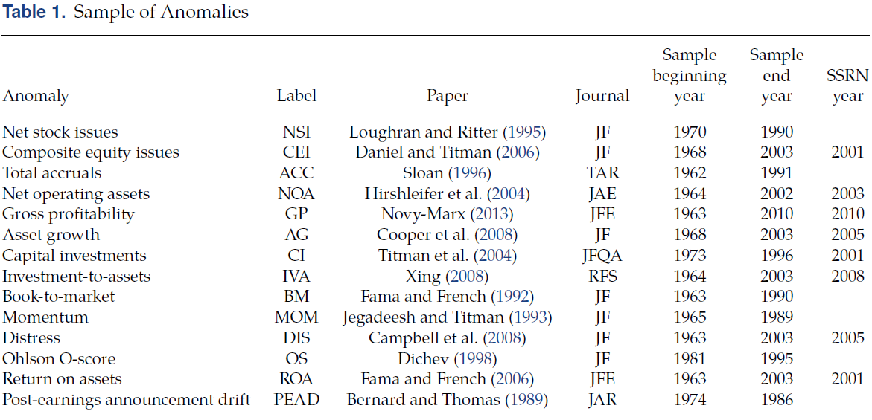
Anomaly Publication
For simplicity, we assume that the papers were already public at the beginning of the year
Stambaugh et al. (2012)
Chen et al. (2011)

Slide 8
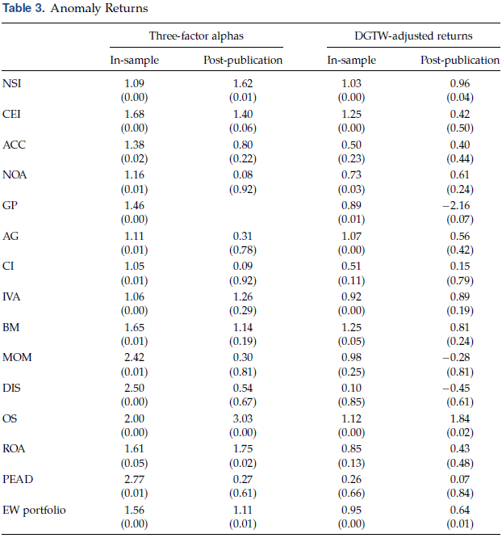
Anomaly Returns Decay

Slide 9
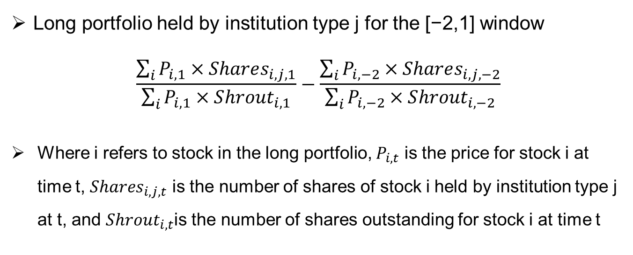
Measure anomaly trading
t=-2 12.31
t=-1 3.31
t=0 6.30
t=1 9.30
End of ﬁscal year
Release its accounting information
Construct long and short portfolios
Mandate release date within 60 (90) days
Long portfolio held by institution type j for the [−2,1] window
$$\frac{\sum_{i}{P_{i,1}×Shares_{i,j,1}}}{\sum_{i}{P_{i,1}×S{hrout}_{i,1}}}−\frac{\sum_{i}{P_{i,−2}×Shares_{i,j,−2}}}{\sum_{i}{P_{i,−2}×S{hrout}_{i,−2}}}$$
Where i refers to stock in the long portfolio, $P_{i,t}$ is the price for stock i at time t, $Shares_{i, j,t}$ is the number of shares of stock i held by institution type j at t, and $Shrout_{i,t}$is the number of shares outstanding for stock i at time t

Slide 10
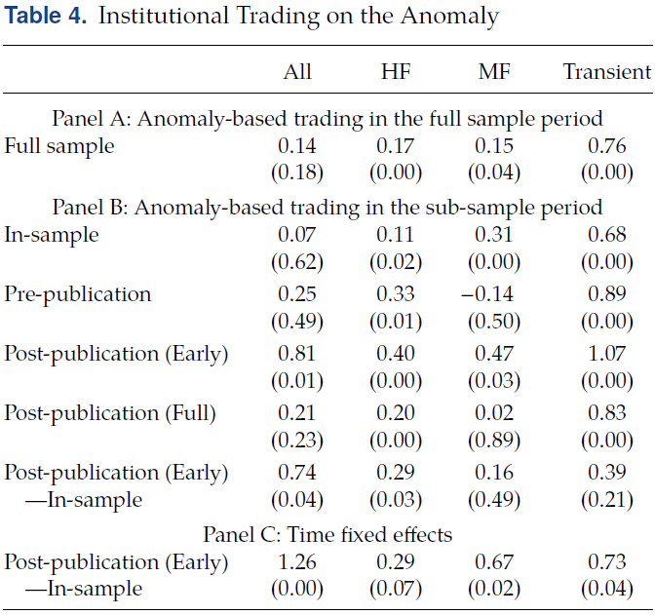
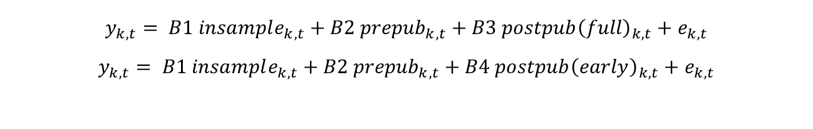
Anomaly Trading
$$y_{k,t}= B1 insample_{k,t}+B2 {prepub}_{k,t}+B3 postpub{\left(full\right)}_{k,t}+e_{k,t}$$
$$y_{k,t}= B1 insample_{k,t}+B2 {prepub}_{k,t}+B4 postpub{\left(early\right)}_{k,t}+e_{k,t}$$
The ﬁnding that institutions trade on the anomalies in the post-publication (early) period, but not in the full post-publication period
We also ﬁnd evidence of heterogeneity among institutional investors, with hedge funds and transient institutions most actively exploiting anomalies

Slide 11
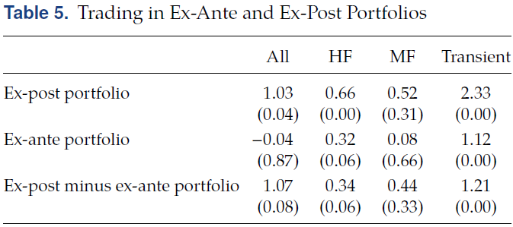
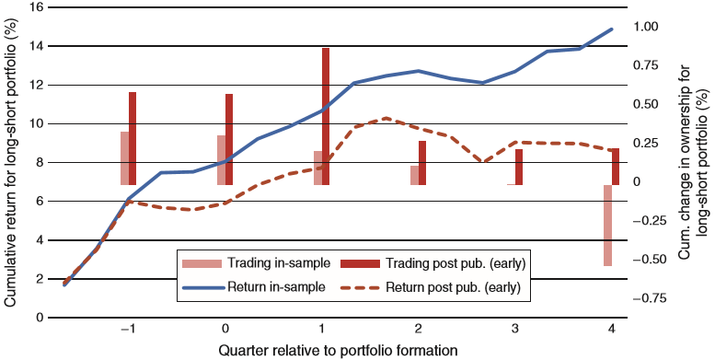
Anomaly Trading and Returns
We construct an ex-ante and an ex-post portfolio. The ex-ante portfolio is based on the anomalies that are yet to be published, while the ex-post portfolio is constructed using the anomalies that are already published.
We assign a percentile rank to each stock, based on each anomaly, and compute the equal-weighted average rank for ex-ante and ex-post anomalies

Slide 12
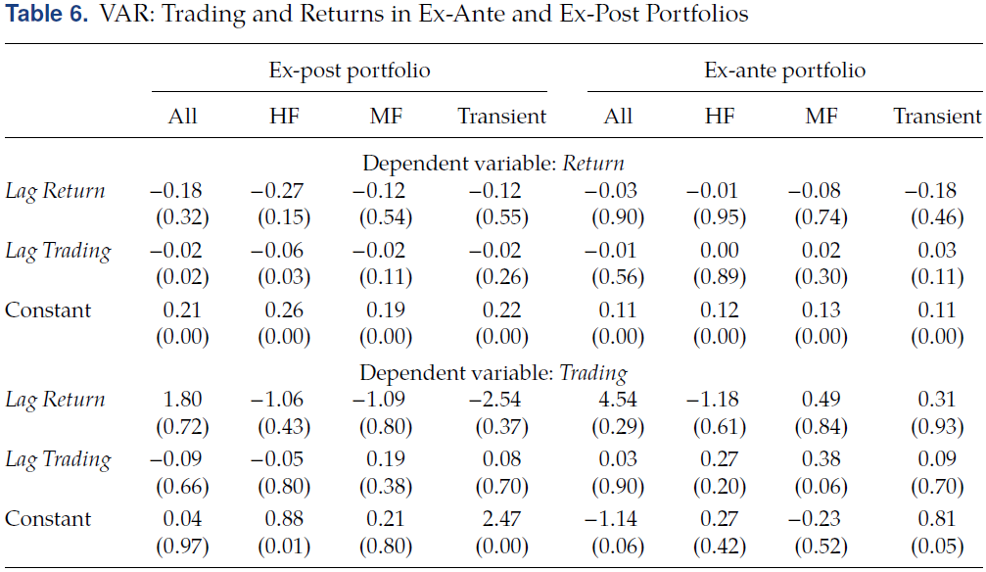
Anomaly Trading and Returns
We estimate a VAR model that examines trading and anomaly returns for the long-short portfolio.
$$y_{t}=c+Ay_{t−1}+e_{t}$$

Slide 13
Comparison with EIK
EIK report that institutions trade in the opposite direction of anomalies
Diﬀer in how to measure anomaly-based trading
They use the change in the number of institutions holding a stock (whereas we use change in holdings with a value weighted approach)
Differ in trading window
EIK measure institutional trading over a window that begins one year before the start of our trading window (t=-6)
Consider diﬀerent types of institutions

Slide 14
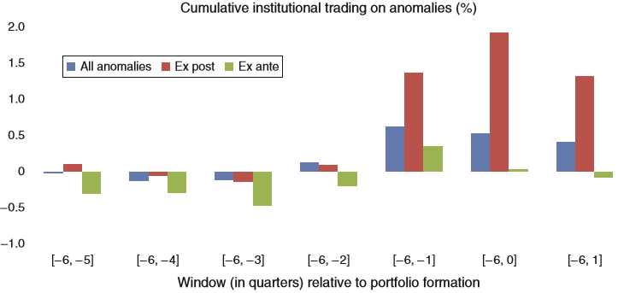
Comparison with EIK
Diﬀer in in trading window

Slide 15
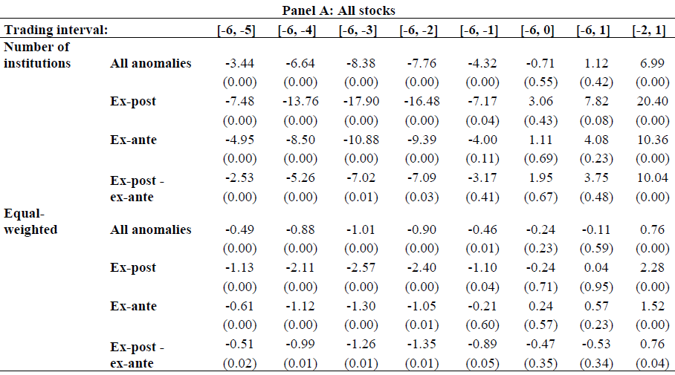
Comparison with EIK
Diﬀer in how to measure anomaly-based trading

Slide 16
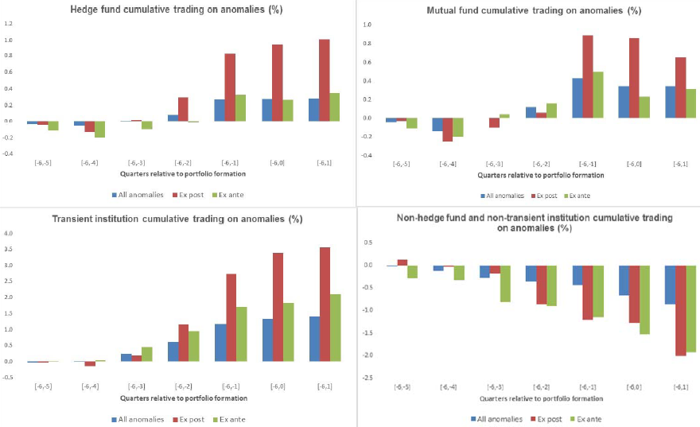
Comparison with EIK
Consider diﬀerent types of institutions

Slide 17
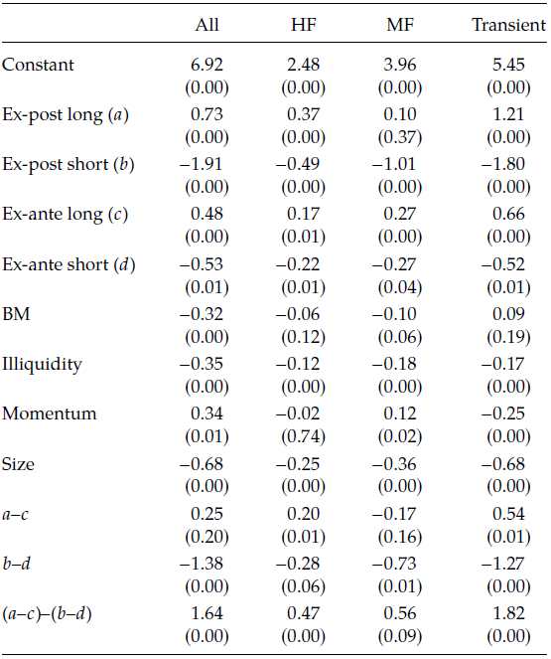
Fama-MacBeth
We use Fama-MacBeth regressions to test our hypothesis, that anomaly trading increases after publication, at the individual stock level.

Slide 18
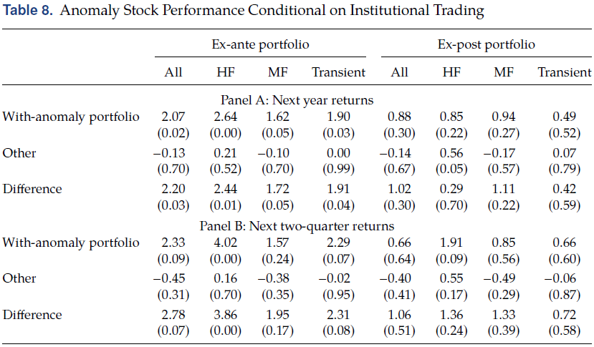
Anomaly Performance
The “with-anomaly” portfolio, which is long in the long-leg stocks institutions buy and short in the short-leg stocks institutions sell

Slide 19
Robustness Checks
Long and Short Leg Results
Anomaly Selection
Trading in Quarterly Ranked Anomalies
Additional Concerns

Slide 20
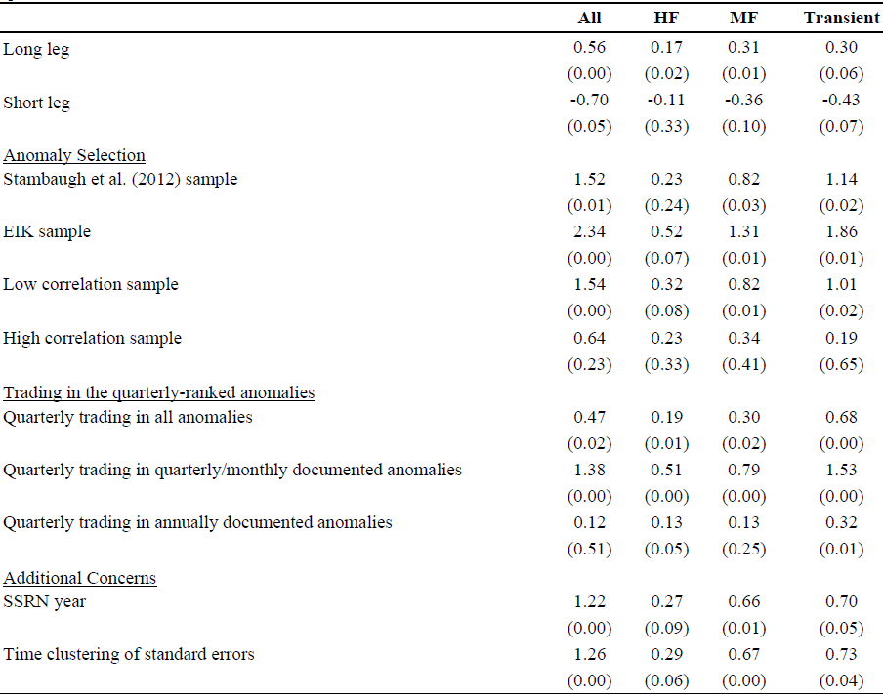
Robustness Checks

Slide 21
Conclusion
We observe an increase in anomaly-based trading among institutional investors, especially hedge funds and transient institutions, when information about the anomalies is available.
Using a VAR model, we ﬁnd a negative relation between lagged institutional trading and anomaly returns following academic publication.
Our paper has implications for the extent to which academics engage with practitioners and suggest that both parties may gain from more connections

Slide 22
Conclusion
We observe an increase in anomaly-based trading among institutional investors, especially hedge funds and transient institutions, when information about the anomalies is available.
Using a VAR model, we ﬁnd a negative relation between lagged institutional trading and anomaly returns following academic publication.
Our paper has implications for the extent to which academics engage with practitioners and suggest that both parties may gain from more connections

Slide 23
Conclusion
由于中国市场数据的原因无法复制（文献发表的时间和机构投资者数据）
其实可以增加一部分data snooping的研究在前面，排除这种情况之后在对套利学习进行检验，Jones and Mo(2020)同时考虑了套利活动和市场竞争的影响，市场竞争也可能会影响发表失效，但本身文章的逻辑已经比较完整

