Slide 1

Clean code

Slide 2
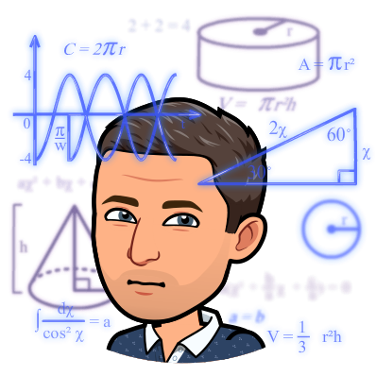
Your definition of clean code
Imagine you open the most beautiful code on earth. It is perfect !!!
What do you see in this code ? Why is it so perfect ?
https://miro.com/welcomeonboard/EhZaQPO9XwTHCd7RGyP17SmoTCrN60QrAlngV6tGmoNo6BsWmCNTF4joUEID3rOI

Slide 3
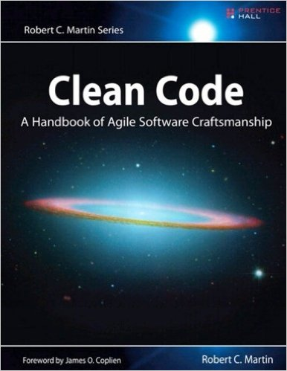
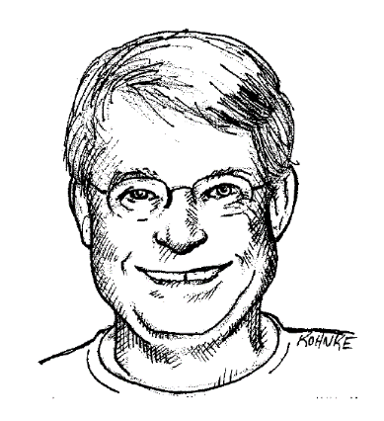
A word on the book
Robert C. Martin a.k.a Uncle bob
Prentice Hall, 2009

Slide 4
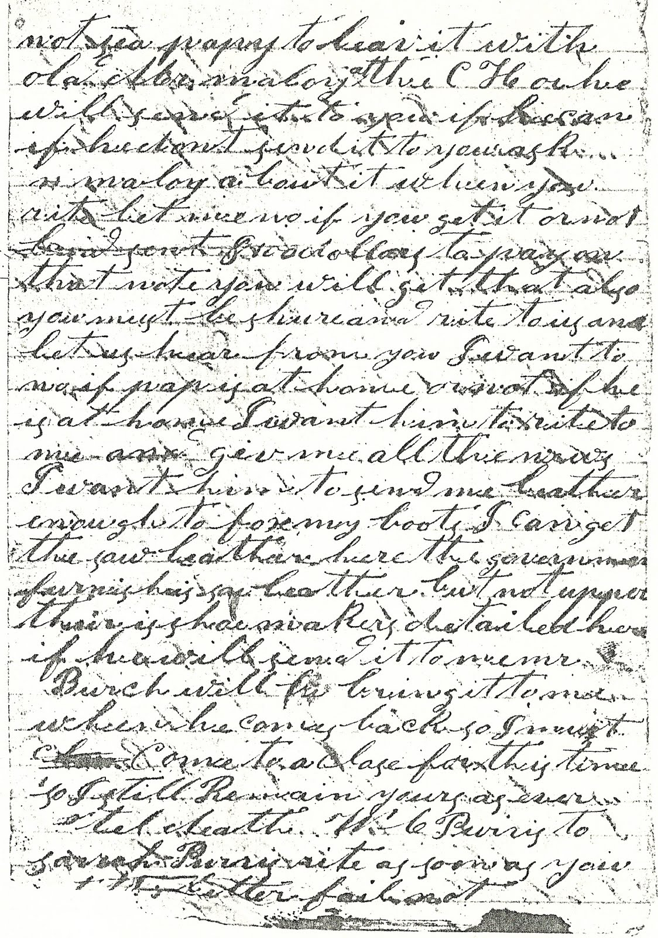
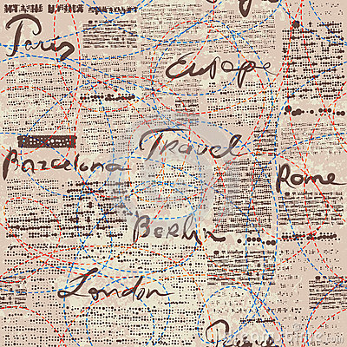
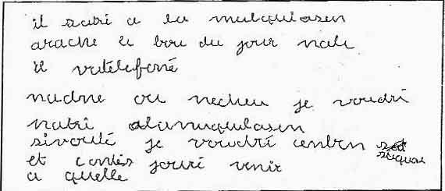
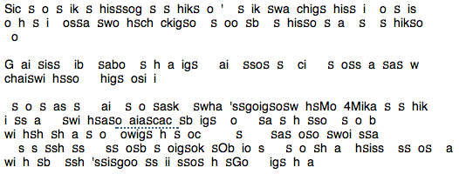
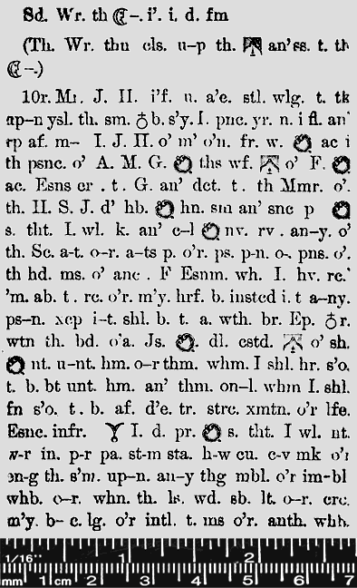
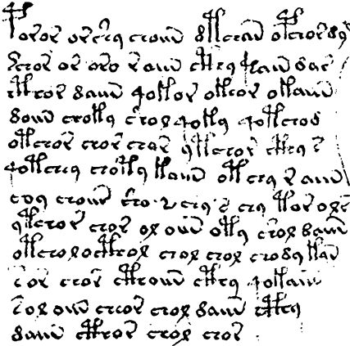

Slide 5

Time spent by programmers at work
Programmers = authors
Our Audience = other programmers
Notes:
Book of quality = Human readable
Code of quality = Human readable

Slide 6
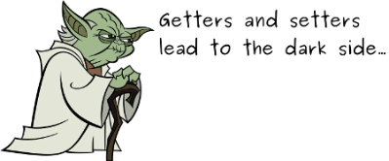
What is bad code ?
Not easy to understand
Classes are tightly coupled
Not easy to change
Does not communicate the intent
Shows too much of the internals (bad encapsulation)

Slide 7
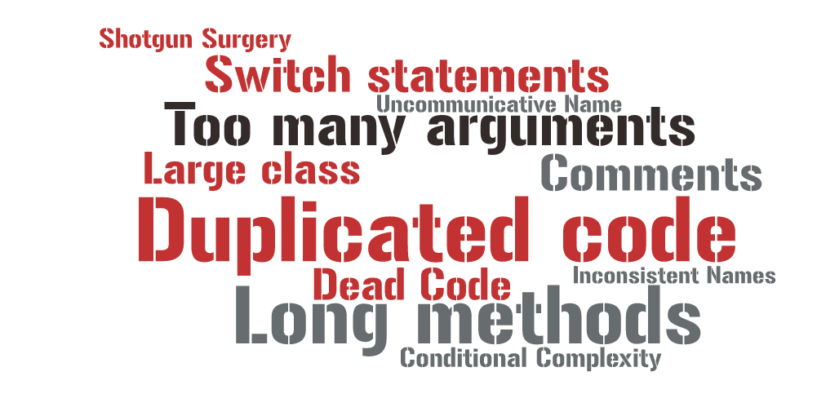
Code smells are warning signs in the code
Notes:
https://tagul.com/create
CODE SMELLS

Slide 8
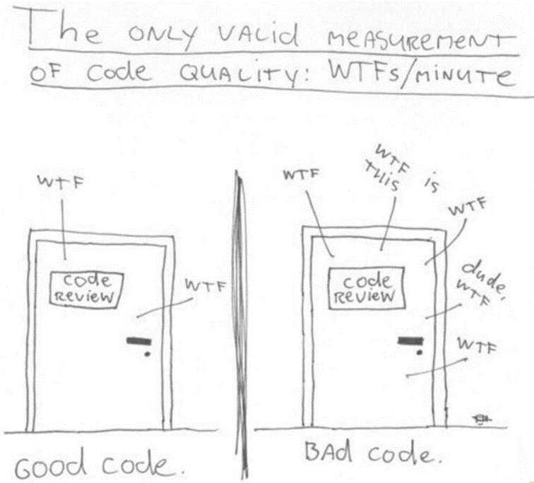
“The only valid measurement of code quality is the number of WTFs per minute” – Robert C. Martin

Slide 9

4 big topics
Naming
Comments
Formatting
functions
developer
good identifier names
I can read code and
understand code

Slide 10
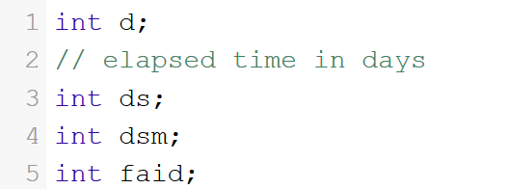

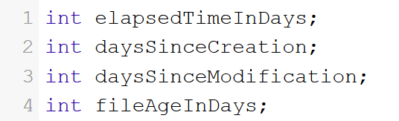
Names must reveal your intentions
Notes:
Choosing good names takes time but saves more than it takes.
Take care with your names and change them when you find better ones.
The name of a variable, function or class should answer the big questions such as why it exists, what it does, how it is used.
If a name requires a comment, then the name does not reveal its intent.

Slide 11



Avoid Disinformation
Notes:
You must avoid leaving false clues that obscure the meaning of code.
Spelling similar concepts in similar ways is good – it is informative. Using inconsistent spelling, however, is disinformation.
Photo => Aaaron Spelling

Slide 12
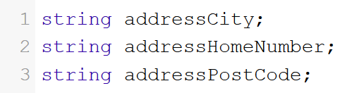
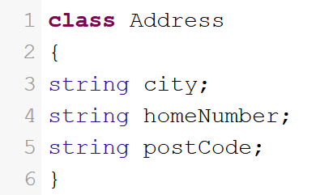
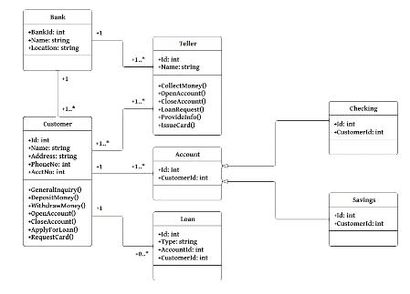
Use meaningful names in their self context
Notes:
All the information that is connected with a variable is contained in:
a variable name
a class that includes this variable
a namespace that includes the class
In object-oriented programming, do not use prefixes, instead design a class!

Slide 13


Good names length
Notes:
A good name contains as many words as are needed to express a concept but nothing more
Any unnecessary words make the name longer and harder to understand.
Short names are good only when they describe the whole concept in the current context (it is better to say “customersInOrder” than “list” in a context of making an order).

Slide 14
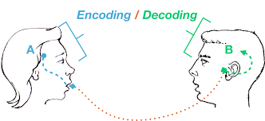
Avoid Encodings
Notes:
Encoding type or scope information into names simply adds to the burden of deciphering.
Hungarian Notation (HN) adds nothing :
objects are strongly typed
your IDEs will help you
your compiler too (in case of type changes)
Member prefixes are not needed any more : your IDE should distinguish member variables by their colours.

Slide 15

Class Names
Classes and objects should have noun or noun-phrase names
A class name should not be a verb.
Java class names from Spring Framework :
SimpleBeanFactoryAwareAspectInstanceFactory
AbstractInterceptorDrivenBeanDefinitionDecorator
AbstractSingletonProxyFactoryBean

Slide 16
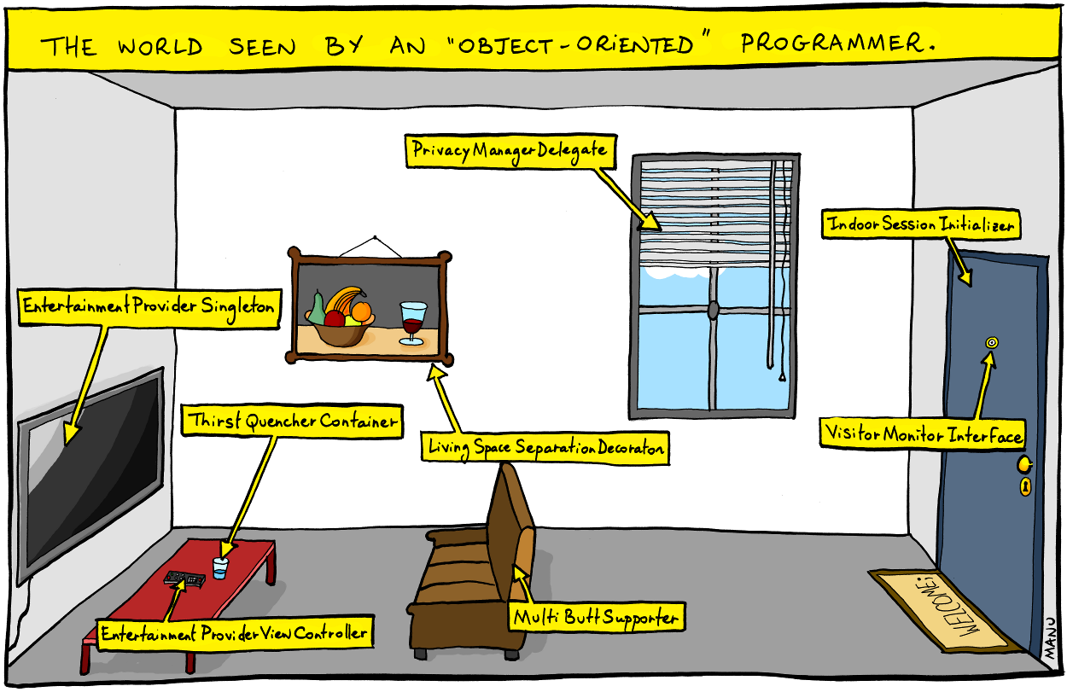

Slide 17
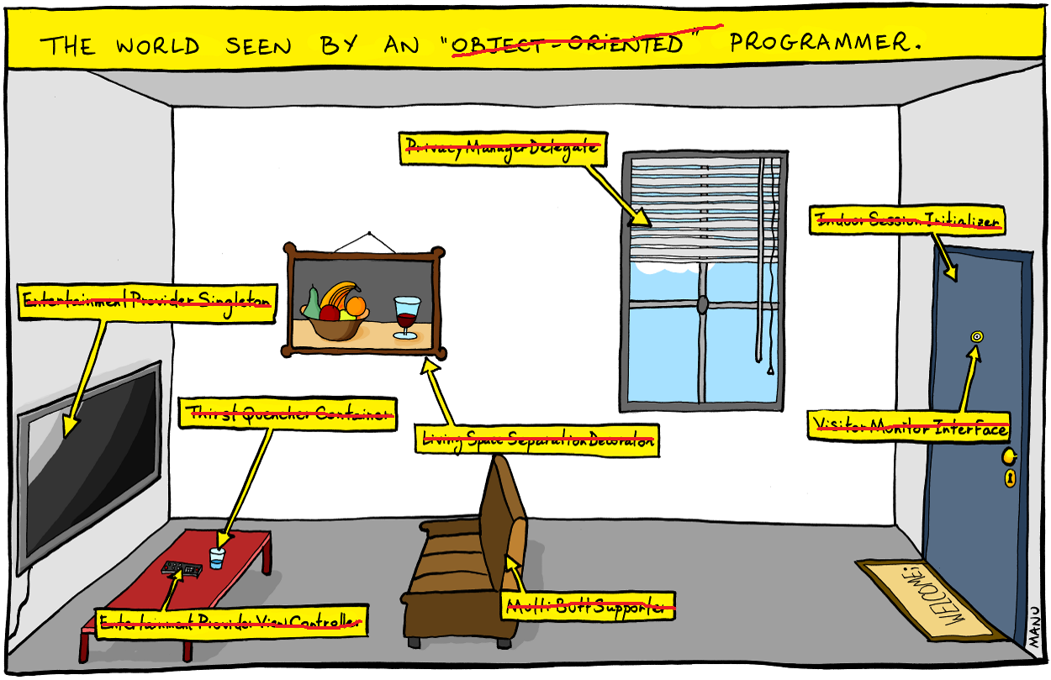
VenetianBlind
Door
Television
Glass
Picture
Peephole
TelevisionRemoteControl
Sofa

Slide 18
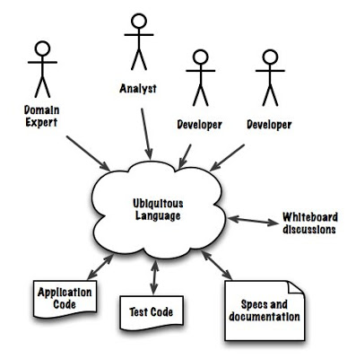
Use an ubiquitous language
Language used :
By all team members
By all business experts
In the source code as well
Notes:
Programmers should speak the language of domain experts to :
avoid miscommunication, delays, and errors ⬄ avoid ambiguity
avoid mental translation between domain language and code
reflect in code how users of the software think and speak about their work
design your software to use the language of the domain

Slide 19

What about comments ?
“A common fallacy is to assume authors of incomprehensible code will somehow be able to express themselves lucidly and clearly in comments.”
—Kevlin Henney
Notes:
We probably either writing too many comments or none at all
Too many generally means
Too many to maintain
Becoming dangerously inaccurate comments
Likely to mean that they’re badly written and unimproved
Hard to write “lucidly and clearly.”
None at all means relying on
Perfect naming
Code structure
Tests
Harder than it sounds
Comments are a problem when you’re maintaining 100,000 lines of code that other people wrote and are still adding to
That code isn’t all going to be perfect, and needs some explanation
Hard question is how much explanation: how many comments?

Slide 20

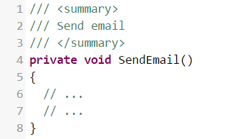
Redundant comments

Slide 21
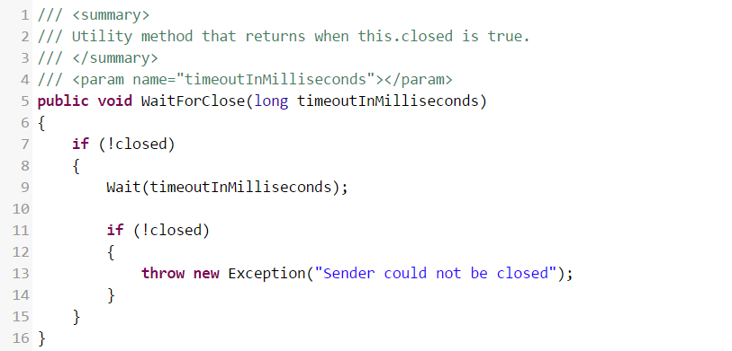
Misleading comments can contain lies
Notes:
The method does not return when this.closed becomes true.
It returns if this.closed Is true; otherwise, it waits for a time-out and then throws an exception if this.closed is still not true.
Misleading ⬄ could cause another programmer to call this function in the expectation that it will return as soon as this.closed becomes true

Slide 22
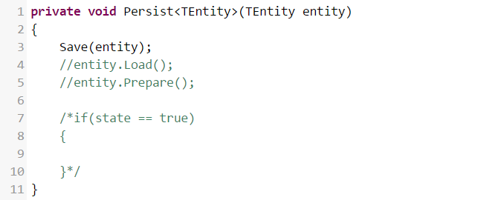
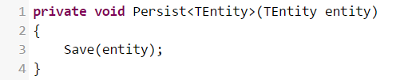
Don't leave commented out code in your codebase
Notes:
Use your source control instead

Slide 23
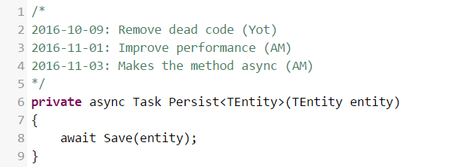



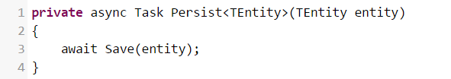
Don't have journal comments Use your source control instead

Slide 24
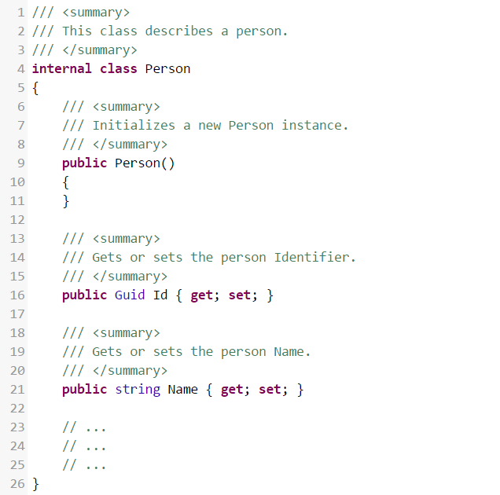
Comments are noise

Slide 25

Valid use of comments
Notes:
Qui fait de la code review ?

Slide 26
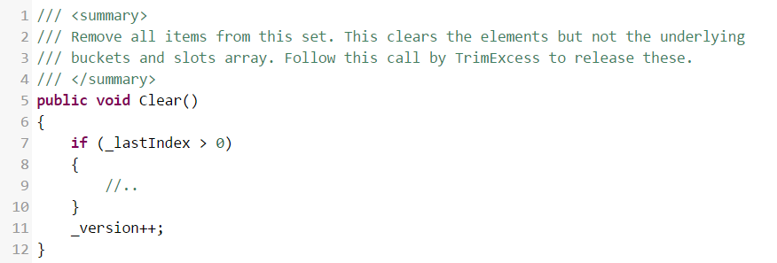
Public API comments

Slide 27

Legal comments

Slide 28
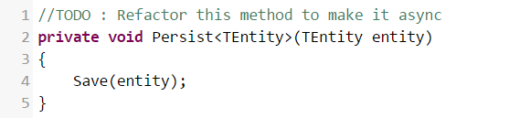
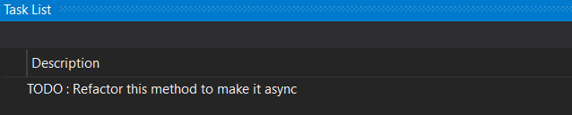
TODO comments

Slide 29
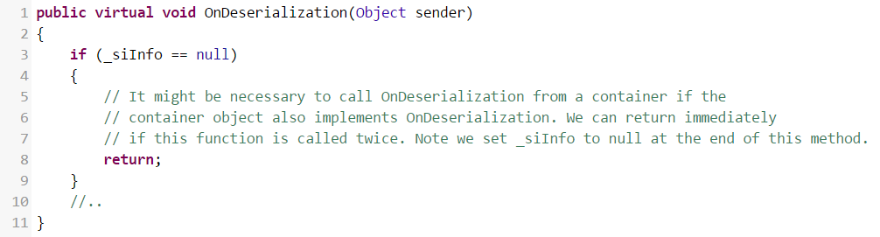
Explanation of intent

Slide 30
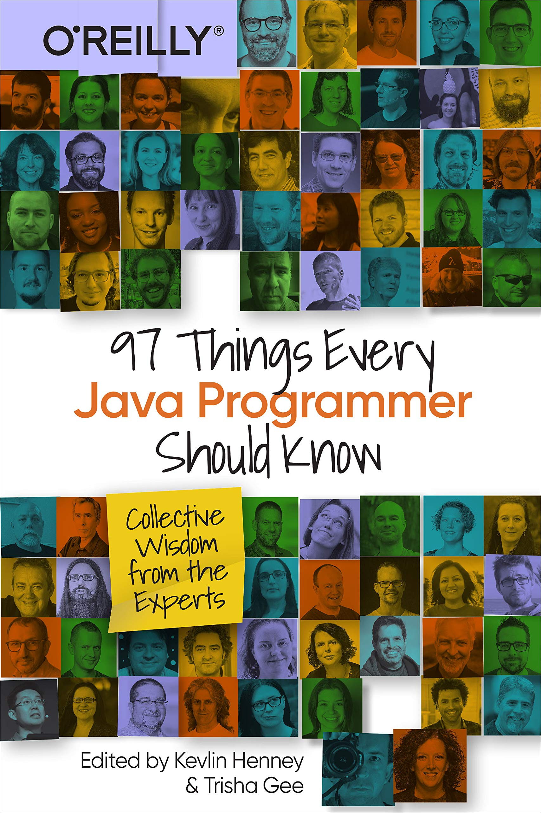
One-sentence documentation comments – peter hilton
Write the best code you can.
Write a one-sentence documentation comment for every public class and method/function.
Refactor the code.
Delete unnecessary comments.
Rewrite bad comments (because all good writing requires rewriting).
Only add detail where necessary.
Comments are Answering the why questions that you can’t answer in code
Notes:
This approach helps
Discover which comments are necessary
Either because the code cannot explain things like why it exists or because you haven’t had time to refactor it yet
You find out when you write the one-sentence comment:
if a good comment takes several minutes to write, it’s necessary and will save you and other readers time in the future.
If you wrote a good comment as fast as you can type
You identified “obvious” code that doesn’t need the comment
Must immediately delete
Always need a minimum number of comments
That comment only what the code cannot say
Answering the why questions that you can’t answer in code

Slide 31

What about formatting ?
Notes:
Qui fait de la code review ?

Slide 32
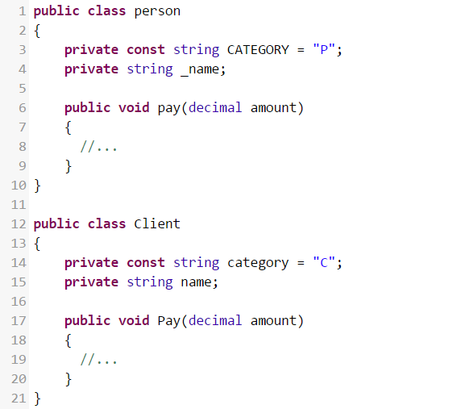
Use consistent capitalization

Slide 33
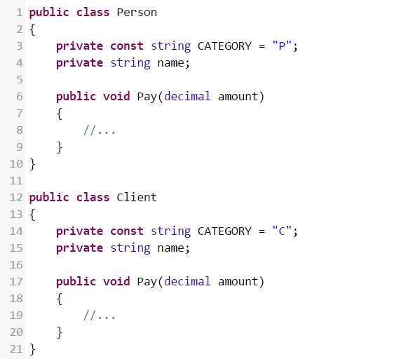
Use consistent capitalization

Slide 34
Unsustainable Spacing
We are uncovering better ways of developing software by
doing it and helping others do it. Through this work we have come to value:
Individuals and interactions over processes and tools Working software over comprehensive documentation Customer collaboration over contract negotiation Responding to change over following a plan

Slide 35
How many programmers lay out their code
Column 80
Notes:
Horizontal vs vertical

Slide 36
How people read

Slide 37
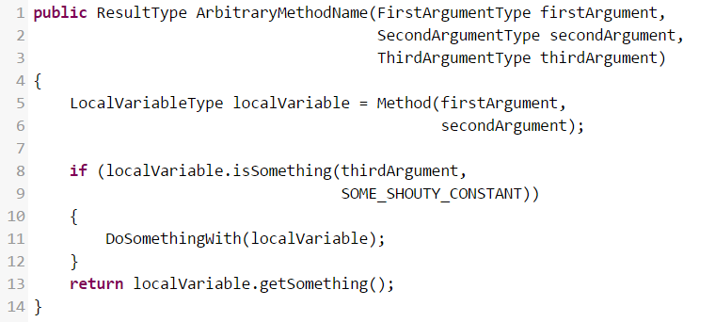

Slide 38
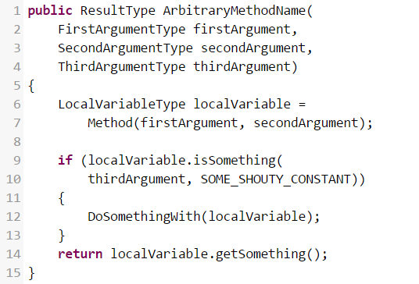

Slide 39
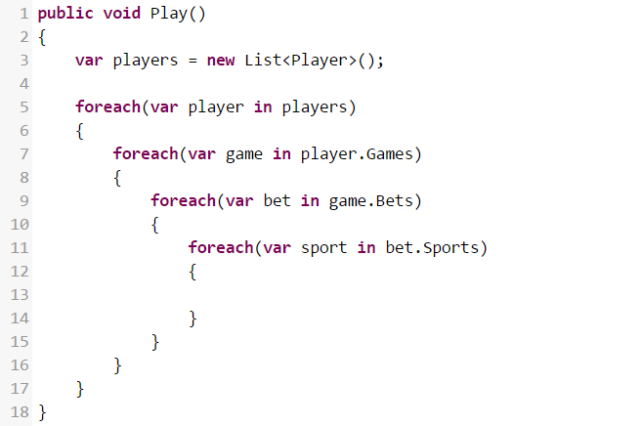
Indentation can reveal things
Cyclomatic complexity :
Metric to indicate the complexity of a piece of code
Measure the number of independent paths through our code
Notes:
La complexité cyclomatique est une métrique permettant d’évaluer la complexité d’un programme (ou d’une méthode) en mesurant le nombre de « chemins » possibles (des if, foreach, switch case,…). Plus vous aurez de chemins possibles, plus votre programme est jugé complexe donc difficile à maintenir et à faire évoluer.
https://www.codeproject.com/articles/13212/code-metrics-code-smells-and-refactoring-in-practi
CC=2+1=3 (one if + one else + 1).
CC Value
Risk
1-10
Low risk program
11-20
Moderate risk
21-50
High risk
>50
Most complex and highly unstable method

Slide 40
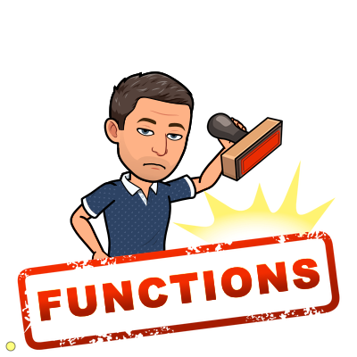
Functions
Notes:
Qui fait de la code review ?

Slide 41
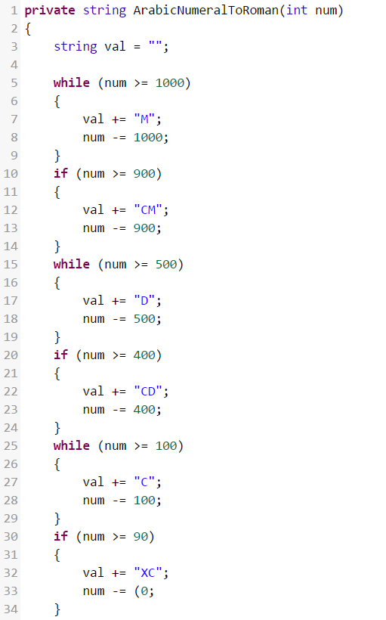

Functions Should be Small (no longer than about 6 or so lines long)
Notes:
That means that:
blocks within if statements, else statements, while statements, etc., should be only one line long — and that line should probably be a function call, and it should have a nicely descriptive name
the function should not be large enough to hold nested structures — so the indent level should not be more than one or two

Slide 42
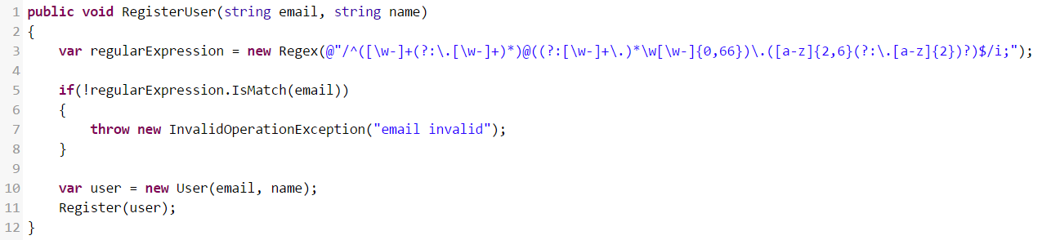
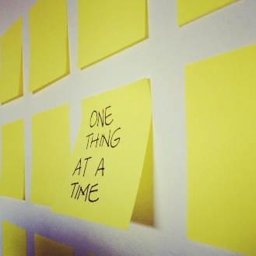
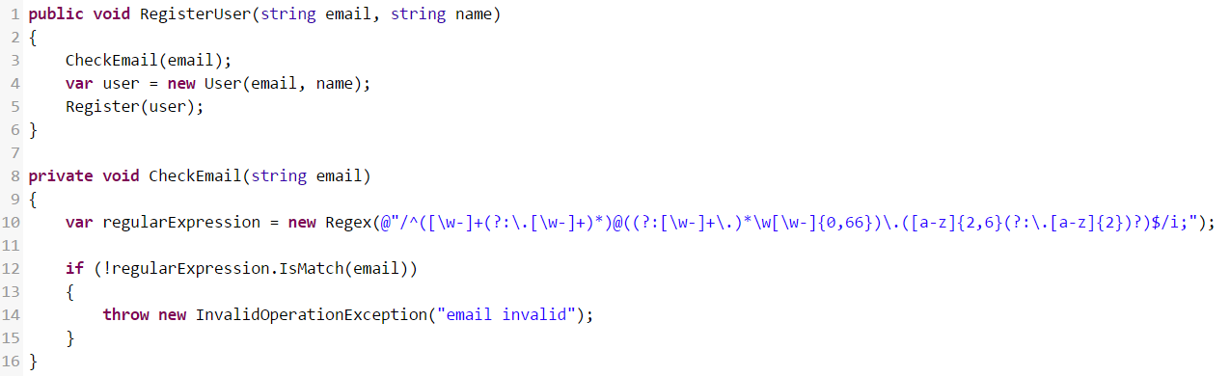
Functions Should Do Only One Thing
Notes:
A way to know that a function is “doing more than one thing” is if you can extract another function from it with a name that is not merely a restatement of its implementation.
You've extracted too much when your code itself is more clear than the method name.
Single responsibility.

Slide 43
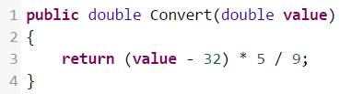


Use Descriptive Names
Notes:
Don’t be afraid to make a name long.
A long descriptive name is better than a short enigmatic one.
Experiment with names to find the ones that clarify the design of your module.
It is not uncommon that hunting for a good name results in a favourable restructuring of the code.
Be consistent in your naming. It will enhance the telling of the story.

Slide 44
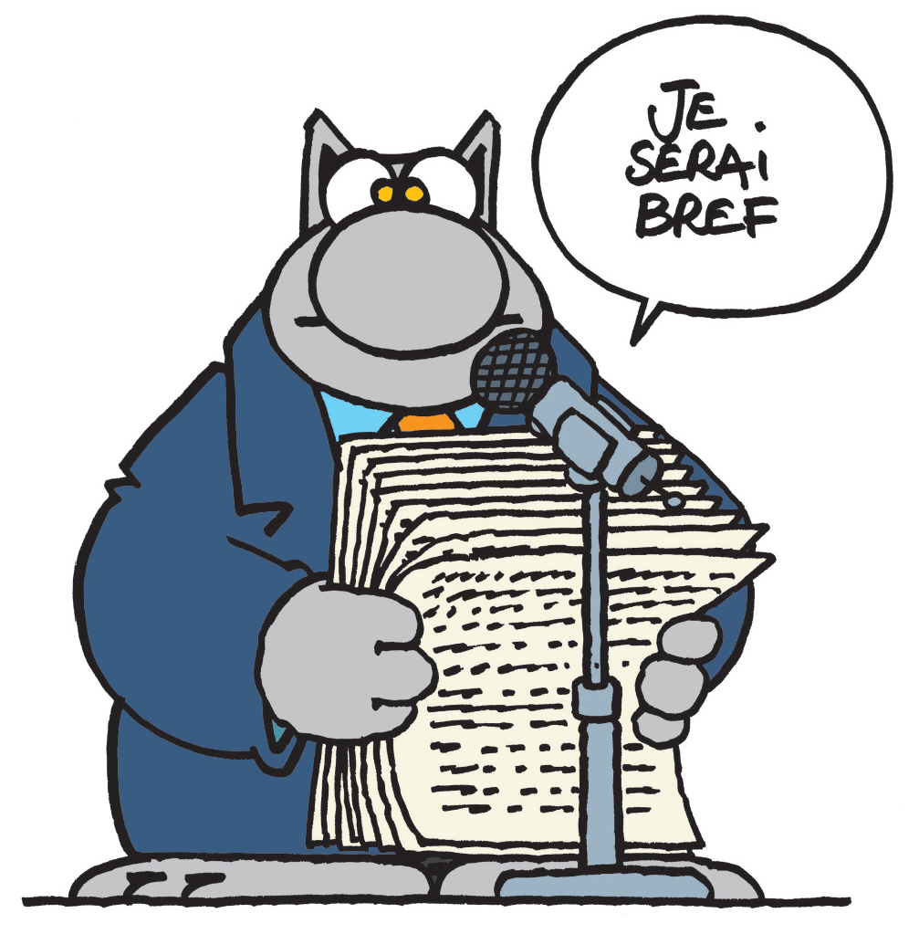
Function Arguments
A function should have preferably no arguments (niladic).
Otherwise, preferably one (monadic),
two is okay (dyadic),
three (triadic) should be avoided where possible,
and you should never have four or more (polyadic).
Notes:
A function should have preferably no arguments (niladic).
Otherwise, preferably one (monadic),
two is okay (dyadic),
three (triadic) should be avoided where possible,
and you should never have four or more (polyadic).
Arguments are hard:
They take a lot of conceptual power.
They may mix levels of abstraction.
You have to write tests that handle every permutation and combination of all arguments for the function that has them.

Slide 45
Monadic Functions
3valid forms :
boolean FileExists("MyFile")
InputStream FileOpen("MyFile")
void onPasswordAttemptsFailed(int attempts)
Those taking “flag” arguments, such as
void Render(true/false)
should be split in 2 functions that take no argument
Notes:
There are three valid forms of the monadic function:
asking a question : boolean FileExists("MyFile")
“transforming” argument : InputStream FileOpen("MyFile")
no output argument ⬄ change the state of the system in some way void onPasswordAttemptsFailed(int attempts)

Slide 46
Diadic Functions
There are times when two arguments are conceptually important, such as AddNewPoint(int x, int y)
> 2 arguments : your function is trying to do too much ?
Notes:
Otherwise, see if you can turn arguments into instance variables of the class or extract out a new class.

Slide 47
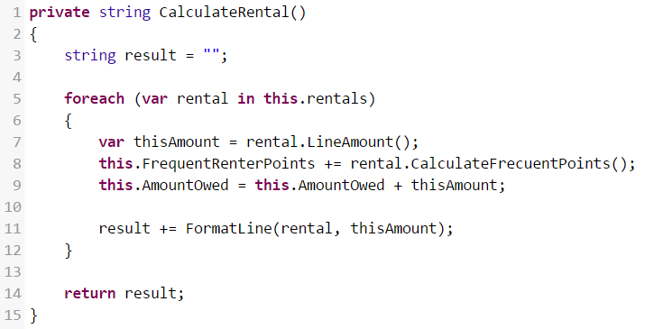
Command/Query Separation

Slide 48
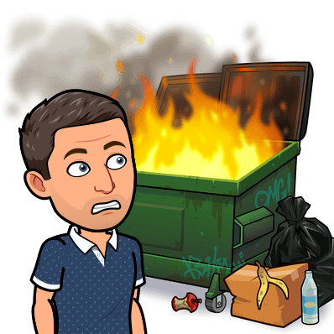
Command/Query Separation
A function should either :
do something : change the state of an object — a command
return something : return some information about that object — a query
not do both
Notes:
The solution is to separate the command from the query, by creating two functions from the one that did two things.
Asking a question should not change the answer - Bertrand Meyer, 1988
Side effects are lies.
Your function promises to do one thing, but it also does other hidden things that the name of the function does not imply.

Slide 49
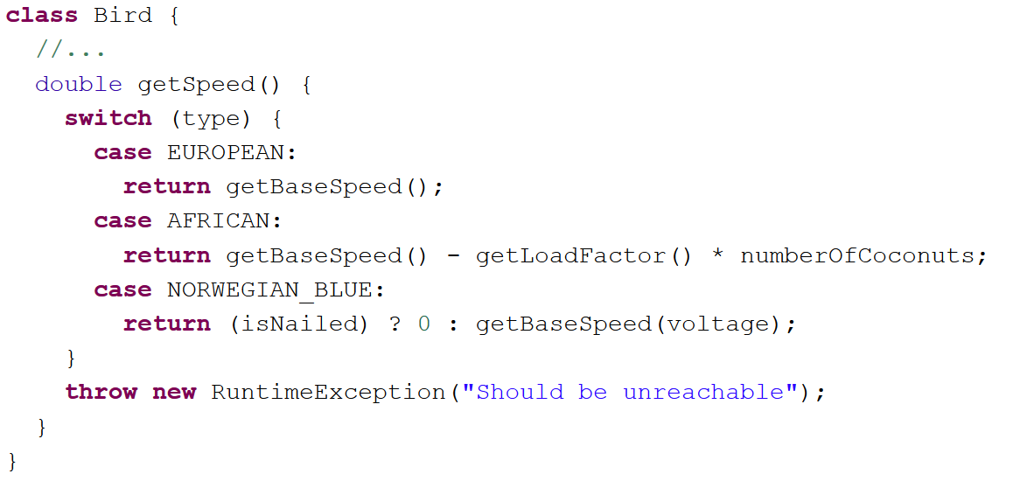
conditional that performs various actions depending on object type or properties.
Notes:
It looks like a bird :
https://vimeo.com/51523127 (24s)

Slide 50
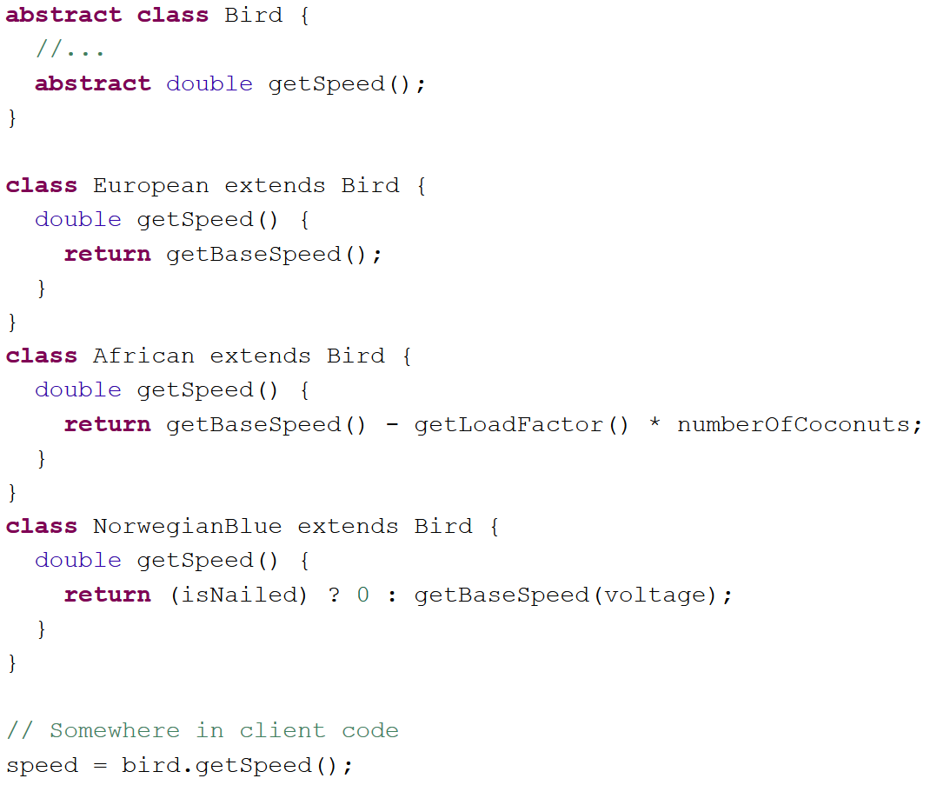

Tell-Don't-Ask principle Replace Conditional with Polymorphism
Notes:
Tell-Don't-Ask principle:
Instead of asking an object about its state and then performing actions ⬄ much easier to simply tell the object what it needs to do and let it decide for itself how to do that.
Most if’s can be replaced by polymorphism.
Why ?
Functions without if’s are easier to read
Functions without if’s are easier to test
Polymorphic systems are easier to maintain
Use polymorphism
If an object should behave differently based on its state
If you have to check the same condition in multiple places
Switch almost always means you should use polymorphism
Use conditionals mainly to do comparisons of primitive objects (>,<,==, !=)

Slide 51
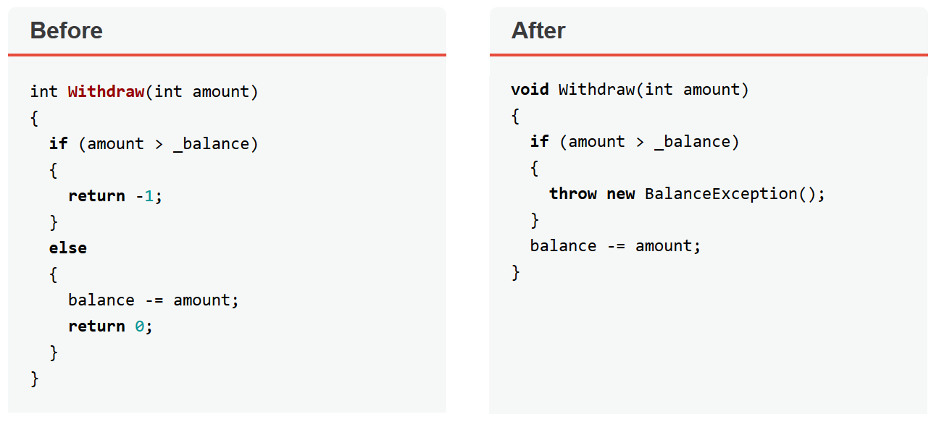
Prefer Exceptions to Returning Error Codes
Notes:
When you return an error code, the calling code must deal with the error IMMEDIATELY.
Return Codes means you can't chain expressions Add(a, Multiply(b, c)).
Frees code from a large number of conditionals for checking various error codes.
Lets talk about “Introduce Null Object” -> Dozens of checks for null make your code longer and uglier.

Slide 52

streams
Favor streams when having a collection or an object that has streams already

Slide 53
List<String> list = Arrays.asList("", null, ""); List<String> result = list.stream().filter(Objects::nonNull).collect(Collectors.toList()); String zero = result.get(0); if (zero != null) { log.info(zero); }
Make use of findAny, findFirst, findAll terminal operations
list.stream() .filter(Objects::nonNull)
.findFirst() .ifPresent(log::info);

Slide 54
list.stream() .map(s -> { String result = s; if (s != null) { result = s.toUpperCase(); result = result.concat("PREFIX_"); } return result; }) .collect(Collectors.toList());
Use short lambdas or use method references in streams
list.stream()
.filter(Objects::nonNull)
.map(s -> s.concat("PREFIX_"))
.collect(Collectors.toList());
OR method ref
list.stream() .map(this::applyPrefix) .collect(Collectors.toList());

Slide 55
list.stream() .filter(s -> { if(s != null && s.contains("PREFIX_") && s.length() > 30) { return true; } return false; }) .map(this::applyPrefix) .collect(Collectors.toList());
multiple filters are better than one long lambda with all conditions
list.stream() .filter(Objects::nonNull) .filter(s -> s.contains("PREFIX_")) .filter(s -> s.length() > 30) .map(this::applyPrefix) .collect(Collectors.toList());

Slide 56
list.stream().filter(Objects::nonNull).filter(s -> s.contains("PREFIX_")).filter(s -> s.length() > 30).map( this::applyPrefix).collect(Collectors.toList());
When chaining prefer to put every stream operation on a new line
list.stream() .filter(Objects::nonNull) .filter(s -> s.contains("PREFIX_")) .filter(s -> s.length() > 30) .map(this::applyPrefix) .collect(Collectors.toList());

Slide 57

Rule number 1
“Leave the campground cleaner than you found it.” - Boy scout rule
“Leave your code better than you found it.” - Clean coder
Notes:
Always leave the checked in code cleaner than the code that is checked out

Slide 58

CODE SMELLS

Slide 59

exercises
Practice clean code principles on code examples
Clone the repository at : https://github.com/ythirion/clean-code

Slide 60


Exercise 1
Notes:
Add lombok
Refactoring technics : extract methods

Slide 61


https://refactoring.guru/
Notes:
Naviguer sur le site Code smells puis Refactorings technics

Slide 62


Exercise 2
Notes:
Reformat
Use StringBuilder
Rename -> FN – Shift – F6

Slide 63


Exercise 3
Identify the code smells
Define your refactoring strategy (steps)
https://yoan-thirion.gitbook.io/knowledge-base/software-craftsmanship/code-katas/mikado-method

Slide 64

Exercise 3
Comments are useless
Naming
Remove magic numbers (const+enum)
Switch case
What else ?
Notes:
public class DiscountManager
{
public decimal ApplyDiscount(decimal price, AccountStatus accountStatus, int timeOfHavingAccountInYears)
{
decimal priceAfterDiscount = 0;
decimal discountForLoyaltyInPercentage = (timeOfHavingAccountInYears > Constants.MAXIMUM_DISCOUNT_FOR_LOYALTY) ? (decimal)Constants.MAXIMUM_DISCOUNT_FOR_LOYALTY / 100 : (decimal)timeOfHavingAccountInYears / 100;
switch (accountStatus)
{
case AccountStatus.NotRegistered:
priceAfterDiscount = price;
break;
case AccountStatus.SimpleCustomer:
priceAfterDiscount = (price - (Constants.DISCOUNT_FOR_SIMPLE_CUSTOMERS * price));
priceAfterDiscount = priceAfterDiscount - (discountForLoyaltyInPercentage * priceAfterDiscount);
break;
case AccountStatus.ValuableCustomer:
priceAfterDiscount = (price - (Constants.DISCOUNT_FOR_VALUABLE_CUSTOMERS * price));
priceAfterDiscount = priceAfterDiscount - (discountForLoyaltyInPercentage * priceAfterDiscount);
break;
case AccountStatus.MostValuableCustomer:
priceAfterDiscount = (price - (Constants.DISCOUNT_FOR_MOST_VALUABLE_CUSTOMERS * price));
priceAfterDiscount = priceAfterDiscount - (discountForLoyaltyInPercentage * priceAfterDiscount);
break;
default:
throw new NotImplementedException();
}
return priceAfterDiscount;
}
}
public enum AccountStatus
{
NotRegistered = 1,
SimpleCustomer = 2,
ValuableCustomer = 3,
MostValuableCustomer = 4
}
public static class Constants
{
public const int MAXIMUM_DISCOUNT_FOR_LOYALTY = 5;
public const decimal DISCOUNT_FOR_SIMPLE_CUSTOMERS = 0.1m;
public const decimal DISCOUNT_FOR_VALUABLE_CUSTOMERS = 0.3m;
public const decimal DISCOUNT_FOR_MOST_VALUABLE_CUSTOMERS = 0.5m;
}

Slide 65

Exercise 3
SRP (Loyalty and Account Status Calculator)
Polymorphism
Notes:
https://www.codeproject.com/articles/1083348/csharp-bad-practices-learn-how-to-make-a-good-code
public class DiscountManager
{
private readonly IAccountDiscountCalculatorFactory _factory;
private readonly ILoyaltyDiscountCalculator _loyaltyDiscountCalculator;
public DiscountManager(IAccountDiscountCalculatorFactory factory, ILoyaltyDiscountCalculator loyaltyDiscountCalculator)
{
_factory = factory;
_loyaltyDiscountCalculator = loyaltyDiscountCalculator;
}
public decimal ApplyDiscount(decimal price, AccountStatus accountStatus, int timeOfHavingAccountInYears)
{
decimal priceAfterDiscount = 0;
priceAfterDiscount = _factory.GetAccountDiscountCalculator(accountStatus).ApplyDiscount(price);
priceAfterDiscount = _loyaltyDiscountCalculator.ApplyDiscount(priceAfterDiscount, timeOfHavingAccountInYears);
return priceAfterDiscount;
}
}
public interface ILoyaltyDiscountCalculator
{
decimal ApplyDiscount(decimal price, int timeOfHavingAccountInYears);
}
public interface IAccountDiscountCalculatorFactory
{
IAccountDiscountCalculator GetAccountDiscountCalculator(AccountStatus accountStatus);
}
public interface IAccountDiscountCalculator
{
decimal ApplyDiscount(decimal price);
}
public class LoyaltyDiscountCalculator : ILoyaltyDiscountCalculator
{
public decimal ApplyDiscount(decimal price, int timeOfHavingAccountInYears)
{
decimal discountForLoyaltyInPercentage = (timeOfHavingAccountInYears > Constants.MAXIMUM_DISCOUNT_FOR_LOYALTY) ? (decimal)Constants.MAXIMUM_DISCOUNT_FOR_LOYALTY / 100 : (decimal)timeOfHavingAccountInYears / 100;
return price - (discountForLoyaltyInPercentage * price);
}
}
public class AccountDiscountCalculatorFactory : IAccountDiscountCalculatorFactory
{
public IAccountDiscountCalculator GetAccountDiscountCalculator(AccountStatus accountStatus)
{
IAccountDiscountCalculator calculator;
switch (accountStatus)
{
case AccountStatus.NotRegistered:
calculator = new NotRegisteredDiscountCalculator();
break;
case AccountStatus.SimpleCustomer:
calculator = new SimpleCustomerDiscountCalculator();
break;
case AccountStatus.ValuableCustomer:
calculator = new ValuableCustomerDiscountCalculator();
break;
case AccountStatus.MostValuableCustomer:
calculator = new MostValuableCustomerDiscountCalculator();
break;
default:
throw new NotImplementedException();
}
return calculator;
}
}
public class NotRegisteredDiscountCalculator : IAccountDiscountCalculator
{
public decimal ApplyDiscount(decimal price)
{
return price;
}
}
public class SimpleCustomerDiscountCalculator : IAccountDiscountCalculator
{
public decimal ApplyDiscount(decimal price)
{
return price - (Constants.DISCOUNT_FOR_SIMPLE_CUSTOMERS * price);
}
}
public class ValuableCustomerDiscountCalculator : IAccountDiscountCalculator
{
public decimal ApplyDiscount(decimal price)
{
return price - (Constants.DISCOUNT_FOR_VALUABLE_CUSTOMERS * price);
}
}
public class MostValuableCustomerDiscountCalculator : IAccountDiscountCalculator
{
public decimal ApplyDiscount(decimal price)
{
return price - (Constants.DISCOUNT_FOR_MOST_VALUABLE_CUSTOMERS * price);
}
}

Slide 66

Exercise 4
Notes:
public class UglyPoker {
public String card1;
public String card2;
public String card3;
public String card4;
public String card5;
public UglyPoker(String p1, String p2, String p3, String p4, String p5) {
this.card1 = p1;
this.card2 = p2;
this.card3 = p3;
this.card4 = p4;
this.card5 = p5;
}
public boolean doCompareHC(String p1, String p2, String p3, String p4, String p5) {
String hc = "s02";
List<String> o = new ArrayList<String>();
List<String> m = new ArrayList<String>();
o.add(p1);
o.add(p2);
o.add(p3);
o.add(p4);
o.add(p5);
m.add(card1);
m.add(card2);
m.add(card3);
m.add(card4);
m.add(card5);
for (int i = 0; i < o.size(); i++) {
String mc = m.get(i);
for (int j = 0; j < o.size(); j++) {
String oc = m.get(j);
if (Integer.valueOf(oc.substring(1)) > Integer.valueOf(mc.substring(1))) {
if (Integer.valueOf(oc.substring(1)) > Integer.valueOf(hc.substring(1))) {
hc = oc;
}
} else {
if (Integer.valueOf(mc.substring(1)) > Integer.valueOf(hc.substring(1))) {
hc = mc;
}
}
}
}
return m.contains(hc);
}
}

Slide 67

Acronyms please

Slide 68

Clean code acronyms cheat sheet
kiss
Keep it simple AND stupid
Simplicity should be a key goal in design, and that unnecessary complexity should be avoided
You ain't gonna need it
Programmers should not add functionality until it is necessary
Always implement things when you need them, never when you just foresee that you need them
yagni
DRY
Don't repeat yourself
Reducing repetition of information of all kinds
dry
die
Duplication is evil
Every piece of knowledge must have a single, unambiguous, representation within a system

Slide 69
“Always code as if the guy who ends up maintaining your code will be a violent psychopath who knows where you live” - Martin Golding

Slide 70


Slide 71


Slide 72



4 square feedback
Connections : my feeling about what I have learned are…
learned : the most important concepts I learned are…
Concrete practice : what I plan to do with what I learned…
Conclusions : a final comment, suggestion, or question I still have is

