Slide 1
Constellation Classification
Alex Knowlton

Slide 2
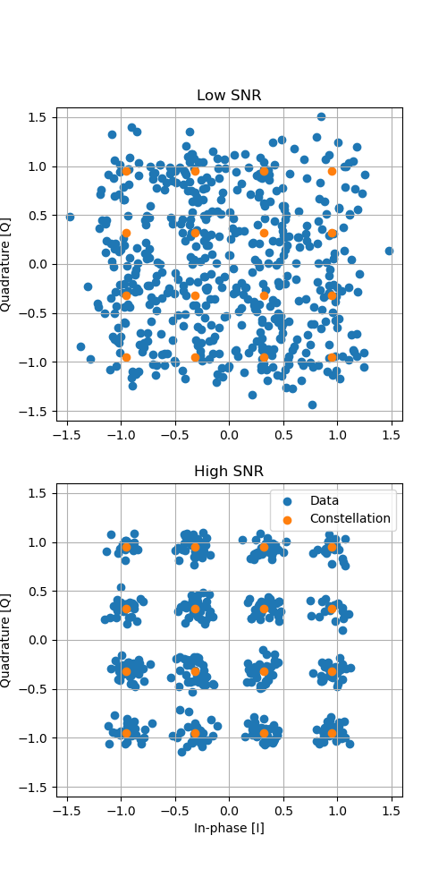
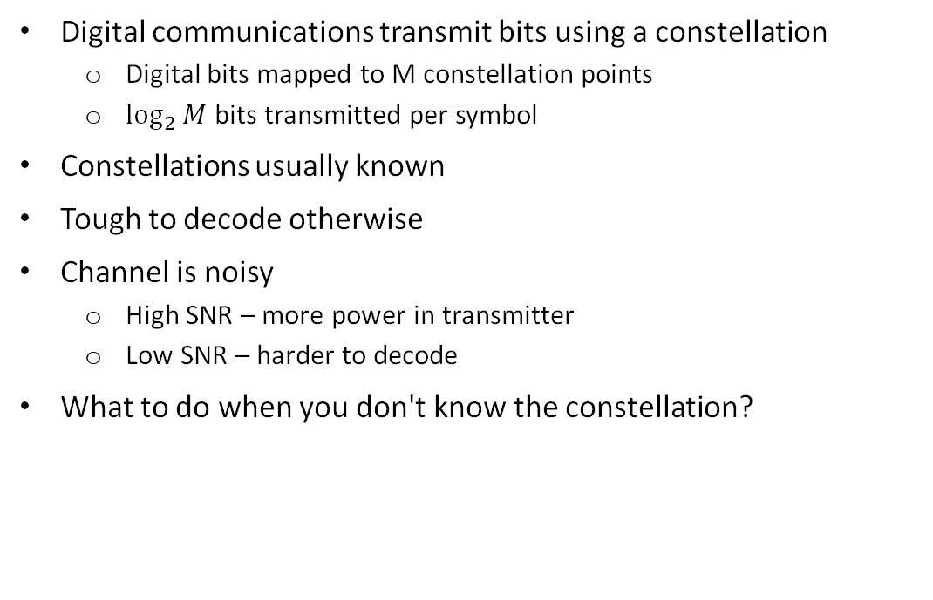
Problem Statement
Digital communications transmit bits using a constellation
Digital bits mapped to M constellation points
$\log_{2}{M}$bits transmitted per symbol
Constellations usually known
Tough to decode otherwise
Channel is noisy
High SNR – more power in transmitter
Low SNR – harder to decode
What to do when you don't know the constellation?

Slide 3
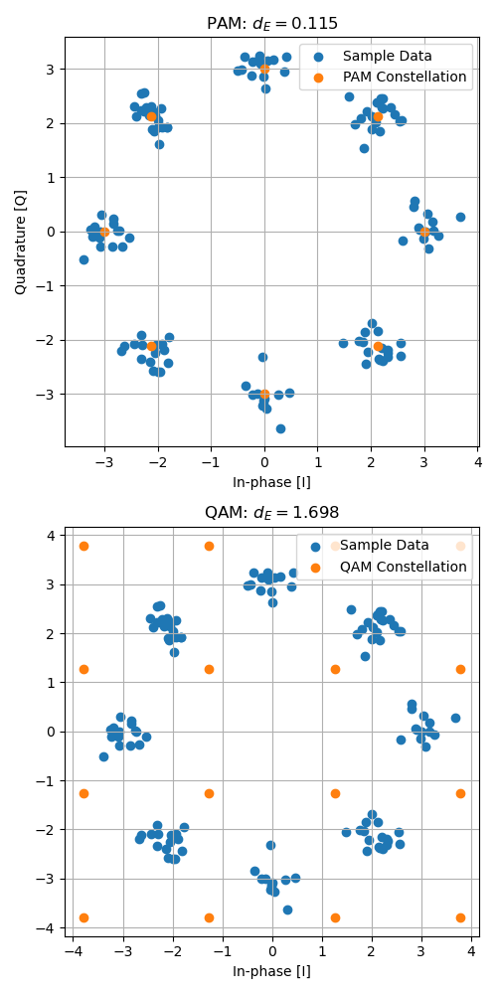
Problem Statement, cont'd
Analytical solution is very intense
Calculate Euclidean distance of received signal to each constellation point
Find minimum Euclidean distance
Lowest average Euclidean distance is most likely constellation
Goal: approximate using a neural network
PAM more likely

Slide 4
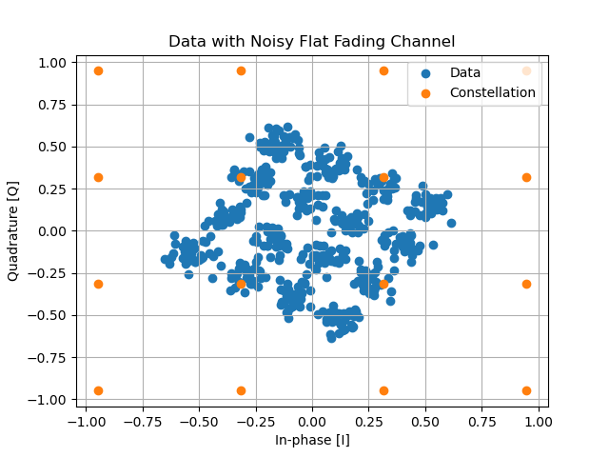

Problem Statement, cont'd
Further problem: fading channels
Channels are both noisy and lossy
At a given frequency:
$h\left(f\right)=A(f)e^{−jπθ(f)}$
$r\left(x\right)=tx(t)∗h\left(f\right)+n(t)$
Received data attenuated, rotated, and noisy

Slide 5
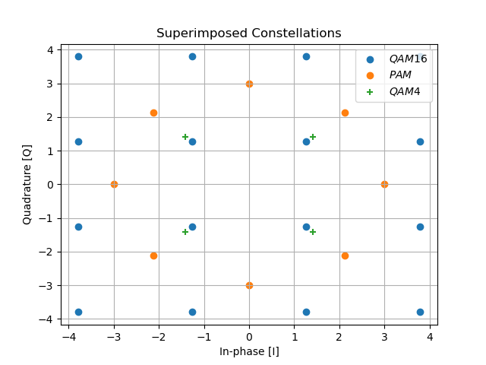
Methodology
Data is a vector of randomly sampled values from constellation
Real and complex values, so shape of (512, 2)
Convolution with a kernel of size (1, 2)
Output is correlation of convolution with signal
High correlation means signal likely
Contiguous data points unrelated
Most likely points = feature selection
Convolution to calculate similarity
Output gives correlation with a point in all constellations
Output most likely kernels to fully-connected network

Slide 6
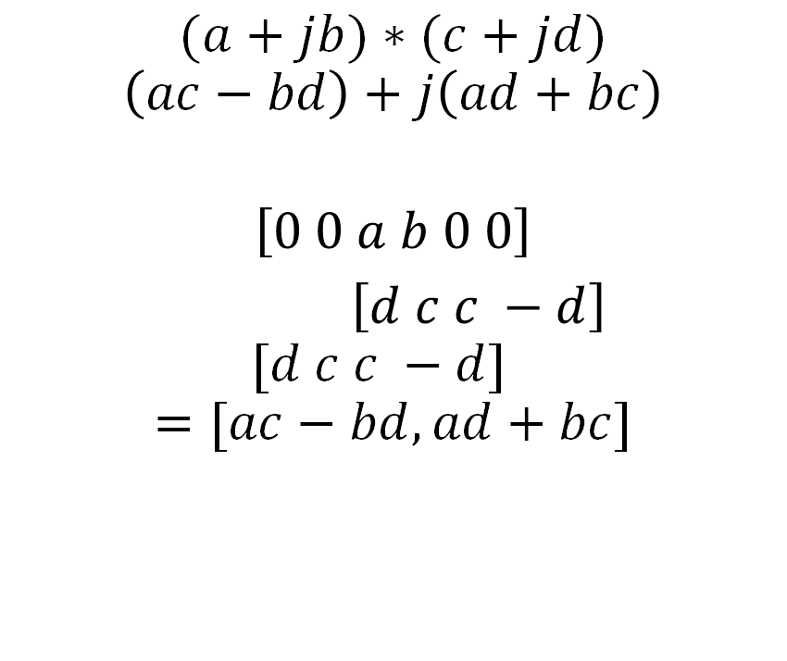
Methodology, Channel Modeling
Channel modeled as complex values
Amplitude and phase shift
Equivalent to convolution
Padding with 2 zeros and stride=2
Equivalent to complex multiplication
$$(a+jb)∗(c+jd)$$
$$\left(ac−bd\right)+j\left(ad+bc\right)$$
$$\left[0 0 a b 0 0\right]$$
$\left[d c c −d\right]$
$$[d c c −d]$$
$$=[ac−bd,ad+bc]$$

Slide 7

Methodology, activity score
If activity score known, it becomes a feature
Use softmax to calculate kernel activity
Differentiable, backpropagation possible
Most active convolutions lead to most likely constellation points, allows prediction
Features passed through fully-connected network to predict constellation
$$a_{k}=Σ\left(softmax\left(conv\left(x\right)\right)∗conv\left(x\right)\right)$$

Slide 8
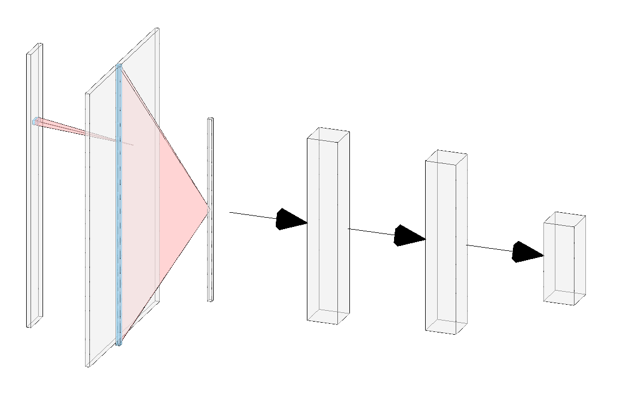
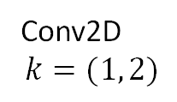
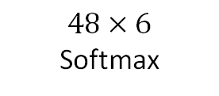
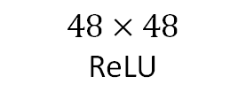
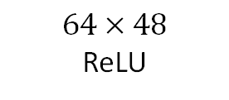
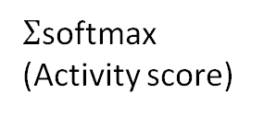
Implementation
Softmax
Conv2D
$$k=(1, 2)$$
$Σ$softmax
(Activity score)
$$64×48$$
ReLU
$$48×48$$
ReLU
$$48×6$$
Softmax

Slide 9
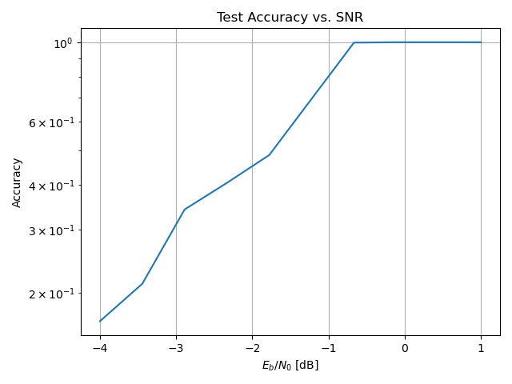
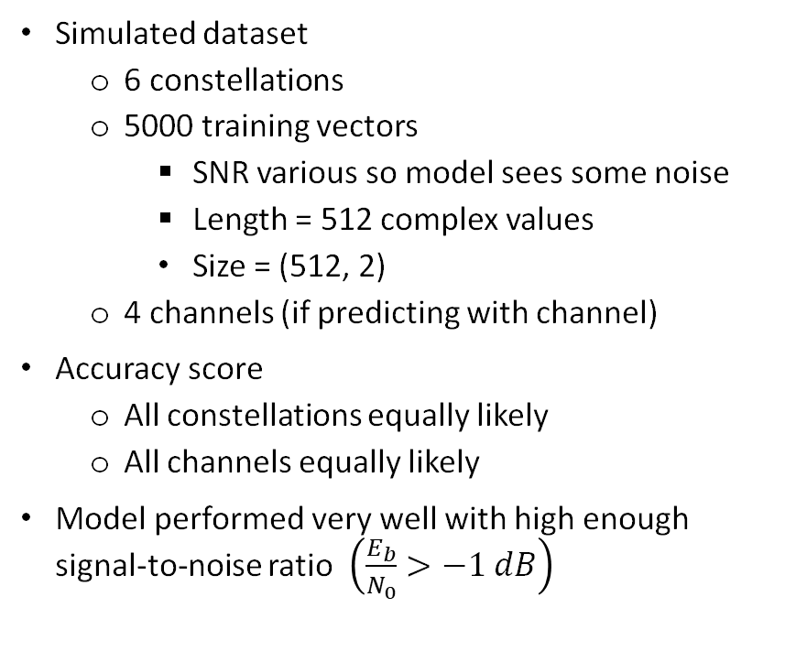
Evaluation
Simulated dataset
6 constellations
5000 training vectors
SNR various so model sees some noise
Length = 512 complex values
Size = (512, 2)
4 channels (if predicting with channel)
Accuracy score
All constellations equally likely
All channels equally likely
Model performed very well with high enough signal-to-noise ratio $\left(\frac{E_{b}}{N_{0}}>−1 dB\right)$

Slide 10
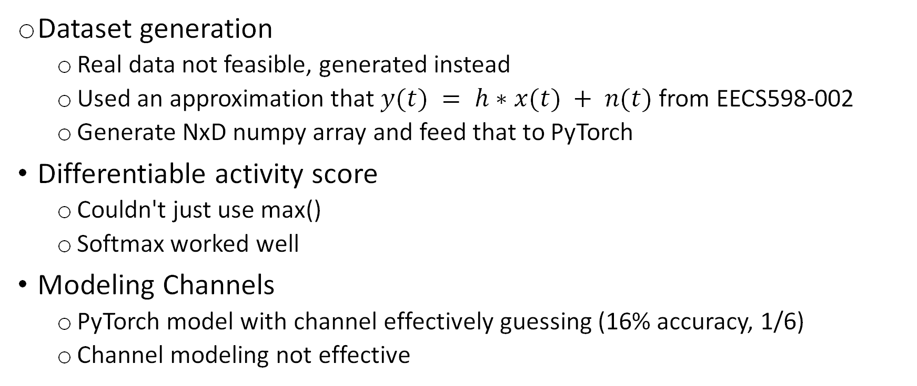
Challenges
Dataset generation
Real data not feasible, generated instead
Used an approximation that $y(t) = h∗x(t) + n(t)$ from EECS598-002
Generate NxD numpy array and feed that to PyTorch
Differentiable activity score
Couldn't just use max()
Softmax worked well
Modeling Channels
PyTorch model with channel effectively guessing (16% accuracy, 1/6)
Channel modeling not effective

Slide 11
Future work
Potential for work in distress signals or surveillance
Channel modeling needs work
Currently supervised learning
Must know roughly how many constellation points are being used
Might have application in unsupervised learning
Teach itself constellations
K-means might be effective here

Slide 12
References
[1] Stark, Wayne. Introduction to Digital Communications. 1st ed., Cambridge University Press, 2023.
[2] Shannon, Claude Elwood, and Warren Weaver. The Mathematical Theory of Communication. University of Illinois Press, 1949.
[3] R. R. Selvaraju, M. Cogswell, A. Das, R. Vedantam, D. Parikh and D. Batra, "Grad-CAM: Visual Explanations from Deep Networks via Gradient-Based Localization," 2017 IEEE International Conference on Computer Vision (ICCV), Venice, Italy, 2017, pp. 618-626, doi: 10.1109/ICCV.2017.74.

Slide 13
Recording Link
https://youtu.be/glsg7tVp5_4

