Slide 1
Intelligent Parking Lot WSN Lab Final Demo Group 2
Zhihao Deng, Chi Xia, Kaikang Huang
Chair of Communication Networks
School of Computation, Information and Technology
Technical University of Munich
Munich, July 15 2025

Slide 2

Smart Parking System: Motivation
Motivation
Inefficient underground parking leads to time waste and congestion
A wireless sensor network detects space availability in real-time
The system adapts to topology changes and saves power automatically
Drivers receive parking information before turning in
Project Objectives
Build a multi-hop smart parking network using at least 7 sensor nodes
GUI for drivers to check available spaces
GUI for developers to monitor topology and node status (failures, updates)
Integrate two sensor types for reliable detection and fault tolerance

Slide 3
Hardware and Software
Hardware
Light Sensor Detects ambient light drop caused by vehicle presence (e.g. shadow under car)
Distance Sensor Measures how close car front is to the wall
LED indicators Visually mark space as occupied or free
nRF52840 boards
7 boards with sensors (each installed in one parking spot)
1 board runs GUI and manages network (gateway)
Software
Contiki-NG (written in C)
Runs on each node
Collects and processes sensor data
Performs wireless communication using multi-hop
QT GUI / Python (host-side)
Visual interface for drivers or developers
Displays available parking spots in real time

Slide 4
Network description and routing technique

Slide 5
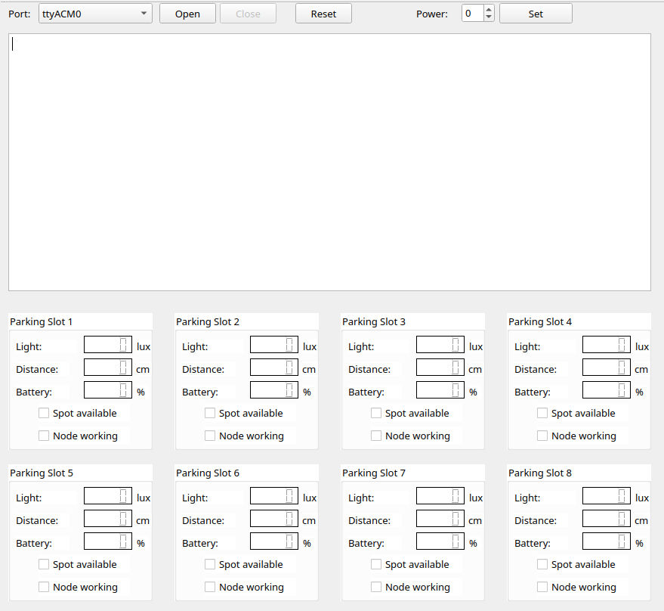
Graphical user interface (GUI)

Slide 6
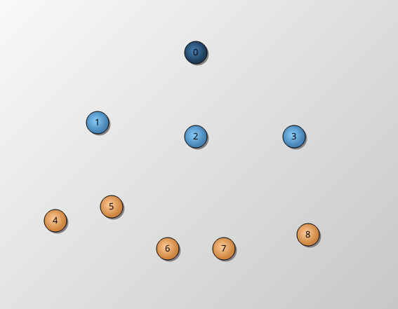
Graphical user interface (GUI)
Right-hand-side of the GUI:
displays topology + network changes
Use different color to mark different nodes (4 types in total)

Slide 7
Application-specific features
Routing Protocol
Value filter system in network and GUI

Slide 8
Demonstration cases

Slide 9
Case 1: Initialization and network establishment
Turn on all 7 boards -> topology establishment
Sensor value readout and display
Evaluation of parking slot status (green -> parking slot available,
Red -> parking slot possessed)

Slide 10
Case 2: Dynamic routing
New node discovery: turn on a new board -> listens to channel 12 for 5 times -> if no flooding message is received -> send discovery signal to neighbor nodes -> master initialize network reset
Existing node failure: turn off a working node -> master does not receive its heartbeat signal -> master initialize network reset

Slide 11
Case 3: Reactive network (application specific)
Sensor value will only be transmitted and displayed when it changes dramatically (change of light > 50 lux or distance > 10cm)

Slide 12
Case 4: Low-energy awareness routing

Slide 13
Thanks for Listening
Any questions or feedback?

