Slide 1
Intelligent Parking Lot WSN Lab Kick-Off Presentation Group 2
Chi Xia
chi.xia@tum.de
Zhihao Deng
zhihao.deng@tum.de
Kaikang Huang
go49jan@mytum.de
TUM School of Computation, Information and Technology
Technical University of Munich
Munich, 03. Juni 2025

Slide 2

Provide a user-friendly GUI for drivers to view open spots
Smart Parking System: Motivation and Objectives
Motivation
Inefficient underground parking leads to time waste and congestion
A wireless sensor network detects space availability in real-time
The system adapts to topology changes and saves power automatically
Drivers receive parking information before turning in
Project Objectives
Build a multi-hop smart parking network using at least 7 sensor nodes
GUI for drivers to check available spaces
GUI for developers to monitor topology and node status (failures, updates)
Integrate multiple sensor types for reliable detection and fault tolerance
Normal Operation
Node Failure Scenario
three slots available
Only two nodes work properly
→Topology change

Slide 3
Hardware and Software
Hardware
Light Sensor Detects ambient light drop caused by vehicle presence (e.g. shadow under car)
Distance Sensor Measures how close an object (car bumper) is above the spot
PIR Motion Sensor (optional) Used to detect car entry/exit motion for higher confidence
LED indicators Visually mark space as occupied or free
nRF52840 boards
6 boards with sensors (each installed in one parking spot)
1 board runs GUI and manages network (gateway)
Software
Contiki-NG (written in C)
Runs on each node
Collects and processes sensor data
Performs wireless communication using multi-hop
QT GUI / Python (host-side)
Visual interface for drivers or developers
Displays available parking spots in real time
Alerts on failed nodes or topology changes

Slide 4
MAC protocol and Routing protocol
Routing protocol, TEEN [1]
Clustering hierarchy
Reactive network
Threshold of data determines transmission
Depends on battery to choose head
Head sends heartbeat info
Inside a Cluster
Node directly connects to head
OR
Apply some algorithm to save energy， i.e. Radio-Duty-Cycle (RDC)
Carrier-Sense Multiple Access (CSMA)
Not a time-sensitive application
ACK
Join a node
Broadcast and get feedback
Decide Cluster
[1] A. Manjeshwar and D. P. Agrawal, "TEEN: a routing protocol for enhanced efficiency in wireless sensor networks," Proceedings 15th International Parallel and Distributed Processing Symposium. IPDPS 2001, San Francisco, CA, USA, 2001, pp. 2009-2015, doi: 10.1109/IPDPS.2001.925197. keywords: {Routing protocols; Intelligent networks; Wireless sensor networks; Temperature sensors; Sensor phenomena and characterization; Energy efficiency; Condition monitoring; Fault tolerance; Costs; Mobile computing},

Slide 5
MAC protocol and Routing protocol
1. Determine cluster (human or auto)
2. Node transmits reactively
Heads are randomly chosen based on battery conditions; broadcast to its nodes
some event occurs
3. Head transmits info
4. re-choose head after a period
Step 1

Slide 6
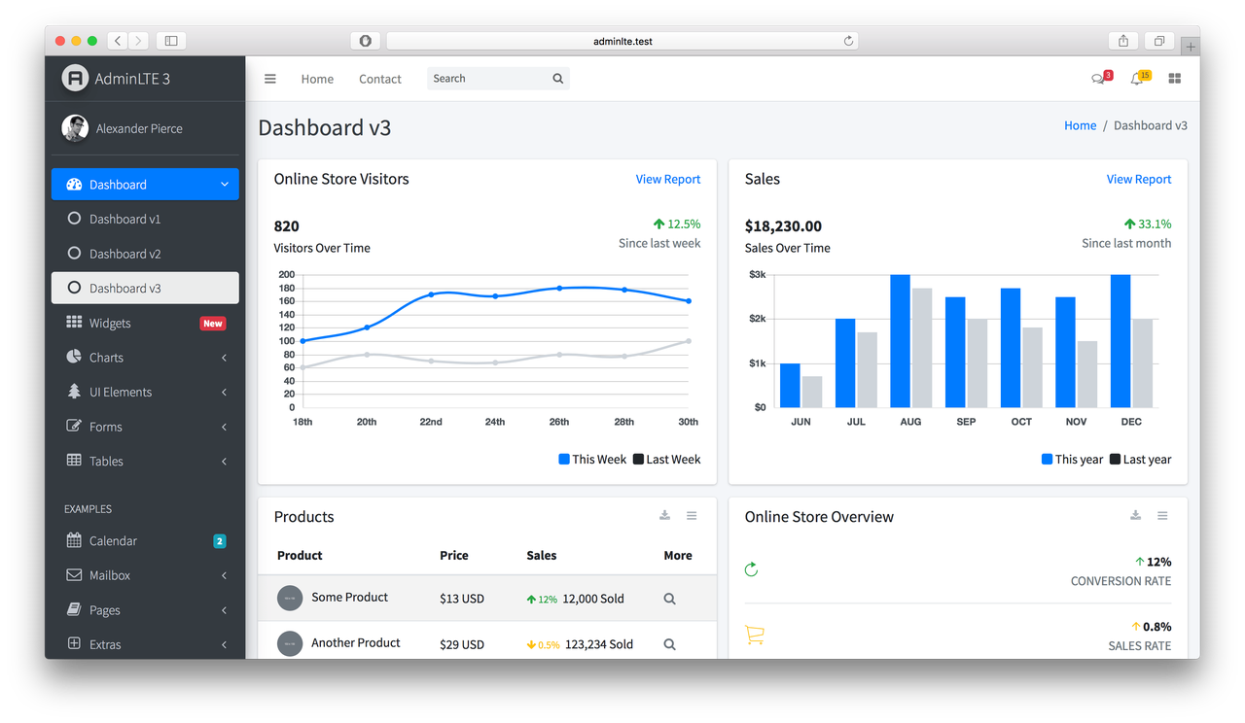
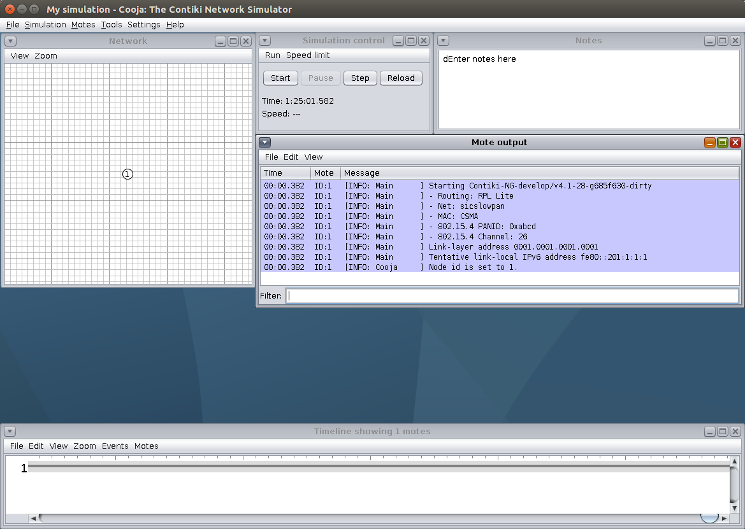
GUI Design -- What should GUI do?
Figure 3.1 GUI Sample of WSN
a) Dashboard of IoT b) GUI of Contiki Simulator Cooja

Slide 7
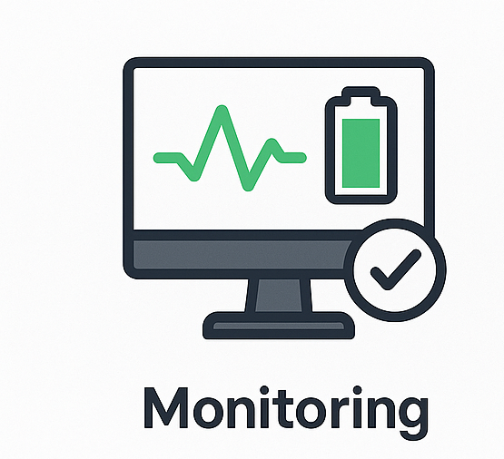
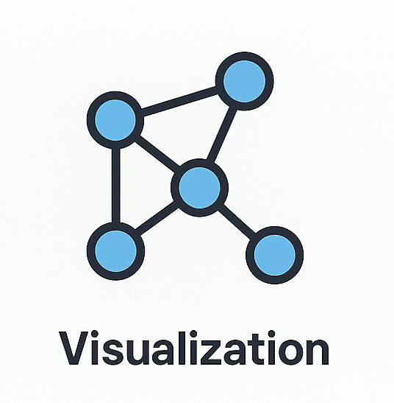

GUI Design -- What should GUI do?
Monitoring
monitoring sensor nodes statuts
sending warning when nodes fail
Visualization
Topology graph (nodes + links)
Geographic map (if sensor locations are known)
Heatmaps for sensed data (like temperature spread)
Time-series charts (for values over time)
Interaction
Select individual nodes
Change sampling frequency or reporting interval
Reset or restart nodes
Trigger event-based actions (like turn off node, change routing)

Slide 8
GUI Design -- Where would GUI be placed?
Whole Structure of the GUI
Connection to Master Node
via serial connection
Master Node is fixed
Data Flow
Sensor nodes → Master node → GUI display
GUI → Master node → Sensor nodes
GUI
PC
Serial
Master Node
Working Node
WSN

Slide 9
GUI Design
Network Topology
Logging Terminal
Warning Erorr Info
Node ID
Control Panel
Sensors
Sensor Data
Power Control
Battery Volatage
....

Slide 10
Timeline
3.6 🔹Kickoff Presentation
10.6 🔧Realization of single node functionality
17.6 🌐Realization of single cluster communication
24.6 ✅Realization of full system integration
1.7 🖥 Implementation of GUI
10.7 🧪Debugging & Finalization

Slide 11
Questions and Suggestions

Slide 12
Thanks for Listening

