Slide 1
Intelligent Parking Lot WSN Lab Final Demo Group 2
Zhihao Deng, Chi Xia, Kaikang Huang
Chair of Communication Networks
School of Computation, Information and Technology
Technical University of Munich
Munich, July 15 2025

Slide 2

Smart Parking System: Motivation
Motivation
Inefficient underground parking leads to time waste and congestion
A wireless sensor network detects space availability in real-time
The system adapts to topology changes and saves power automatically
Drivers receive parking information before turning in
Project Objectives
Build a multi-hop smart parking network using at least 7 sensor nodes
GUI for drivers to check available spaces
GUI for developers to monitor topology and node status (failures, updates)
Integrate multiple sensor types for reliable detection and fault tolerance

Slide 3
Hardware and Software
Hardware
Light Sensor Detects ambient light drop caused by vehicle presence (e.g. shadow under car)
Distance Sensor Measures how close car front is to the wall
LED indicators Visually mark space as occupied or free
nRF52840 boards
7 boards with sensors (each installed in one parking spot)
1 board runs GUI and manages network (gateway)
Software
Contiki-NG (written in C)
Runs on each node
Collects and processes sensor data
Performs wireless communication using multi-hop
QT GUI / Python (host-side)
Visual interface for drivers or developers
Displays available parking spots in real time

Slide 4
Demonstration

Slide 5
Case 1: Build up network

Slide 6
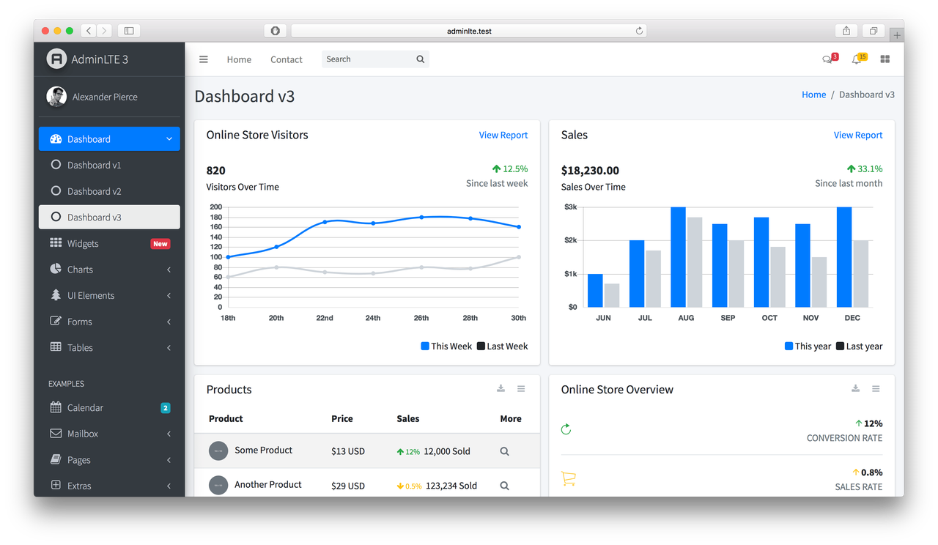
GUI Design

Slide 7
Thanks for Listening
Any questions or feedback?

