Slide 1
Intelligent Parking Lot WSN Lab Final Group 2
Zhihao Deng, Chi Xia, Kaikang Huang
Chair of Communication Networks
School of Computation, Information and Technology
Technical University of Munich
Munich, July 15 2025

Slide 2

Project overview
Motivation
Inefficient underground parking leads to time waste and congestion
A wireless sensor network detects space availability in real-time
The system adapts to topology changes and saves power automatically
Drivers receive parking information before turning in
Project Objectives
Build a multi-hop network using 7 sensor nodes
GUI for drivers to check available spaces
GUI for developers to monitor topology and node status (failures, updates)
Integrate two types of sensor for reliable detection and fault tolerance

Slide 3
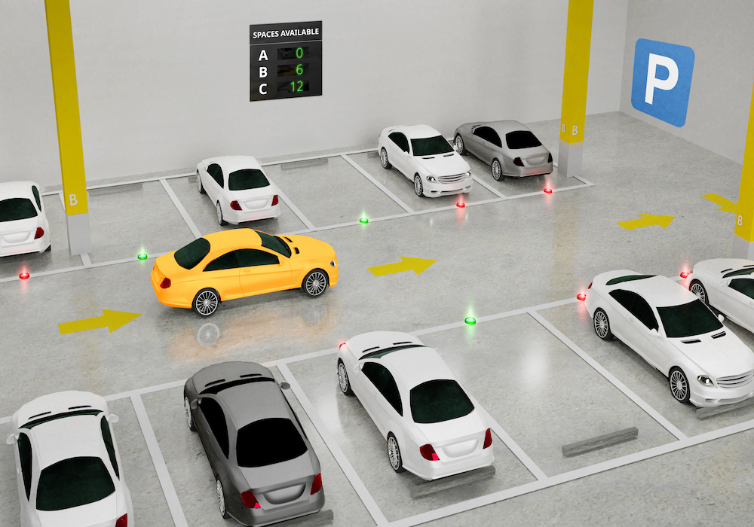

Slide 4
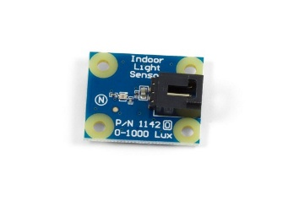

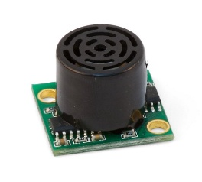
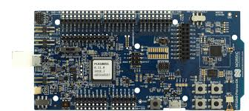

Hardware and Software
Hardware
Light Sensor Detects ambient light drop caused by vehicle presence (e.g. shadow under car)
Distance Sensor Measures how close car front is to the wall
nRF52840 boards
7 boards with sensors (each installed in one parking spot)
1 board runs GUI and manages network (gateway)
Software
Contiki-NG
Runs on each node
Collects and processes sensor data
Performs wireless communication using multi-hop
QT GUI
Visual interface for drivers and developers
Displays available parking spots in real time

Slide 5
Network description and routing technique
Custom RIP-based multi-hop protocol with self-organizing topology
Cluster heads selected based on hop count, RSSI, and battery level
Topology discovery via DIO/DAO exchange; routing tables updated dynamically
Master node maintains global view and broadcasts cluster assignments
Hierarchical data forwarding through cluster heads
Dynamic node joining supported via DIO broadcast and topology re-initiation

Slide 6
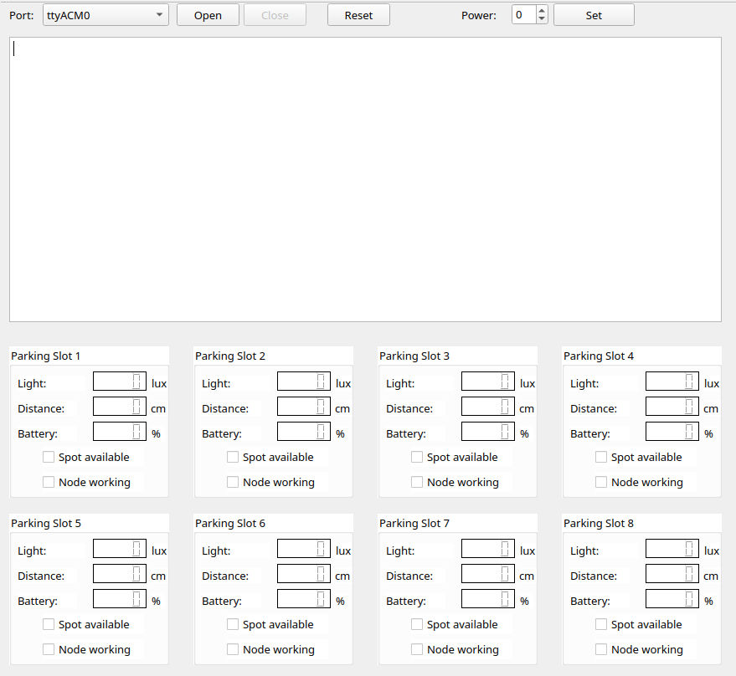
Graphical user interface (GUI)
Left panel of the GUI:
Open/close serial port, set transmit power
Show parsed messages from master
Display light, distance, battery per node
Indicate parking slot status
Indicate node status

Slide 7
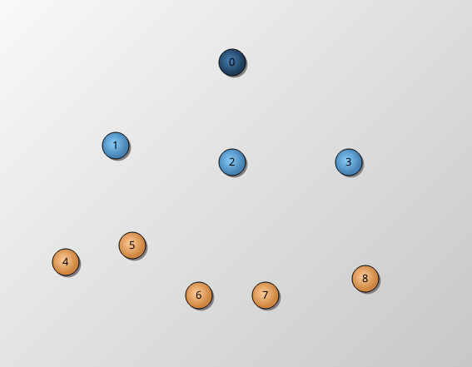
Graphical user interface (GUI)
Right panel of the GUI:
Visualizes real-time network topology and routing updates
Node types are color-coded:
🔴 Red: Offline
🟠 Orange: Normal node
🔵 Light blue: Cluster head
🔷 Dark blue: Master node

Slide 8
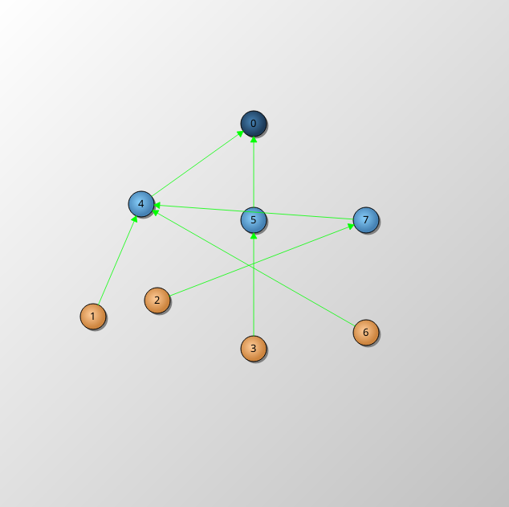
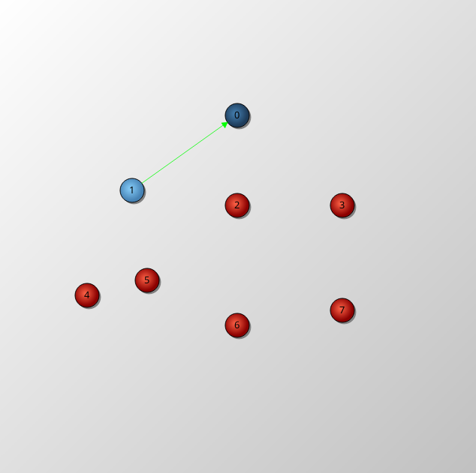
Network in different states
Stable state: all nodes working
Init state: only one node is working -> selected as cluster head

Slide 9
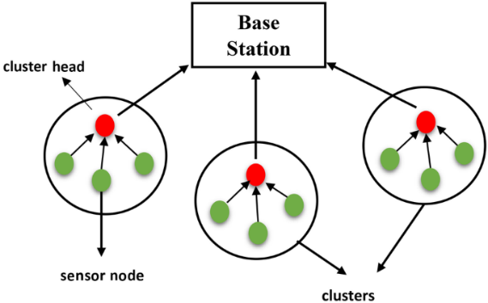
Application-specific features
Customized cluster-based routing with head selection logic
Cluster head selection considers hop count, RSSI, and battery level
Sensor data transmission triggered only on significant changes appear
-> energy saving
4. GUI filters short-term value fluctuations to improve display stability and avoid wrong detection

Slide 10


Thanks for your Attention
Any questions?

Slide 11

Demonstration cases

Slide 12
Case 1: Initialization and network establishment
Turn on all 7 boards -> topology establishment
Sensor value readout and display
Evaluation of parking slot status (green -> parking slot available,
red -> parking slot possessed)

Slide 13
Case 2: Dynamic routing
New node discovery:
1. turn on a new board (e.g. node 6)
2. Node listens to channel 12 for 5 times
3. if no flooding message is received
4. send discovery signal to neighbor nodes
5. master initialize network reset

Slide 14
Case 2: Dynamic routing
Existing node failure:
turn off a working node (simulate node failure)
master does not receive its heartbeat signal
master initialize network reset

Slide 15
Case 3: Reactive network
Sensor value will only be transmitted and displayed when it changes dramatically (change of light > 50 lux or distance > 10cm)

Slide 16
Case 4: Low-energy awareness routing

